Slide 1



Amazon Prime OTT Media Dashboard
MENTOR
Ms.N.Renuka ,
Assistant Professor
Jayadhanush.R(22ADR040)
Jesinth Wilson.A(22ADR044)
Dileep.T(22ADR022)
SUBMITTED BY

Slide 2
PROBLEM STATEMENT
Developing an interactive dashboard using Power BI for an OTT media platform requires addressing the complexity of analyzing diverse viewership patterns, adapting to dynamic content trends, and integrating multiple data sources.

Slide 3

OBJECTIVE:
To analyze and monitor key performance indicators (KPIs) related to user engagement, content consumption, and subscription trends on an OTT media platform.
This involves leveraging diverse data sources to create an interactive dashboard that provides insights, enabling the platform to optimize content strategies, and enhance overall viewer experience.

Slide 4
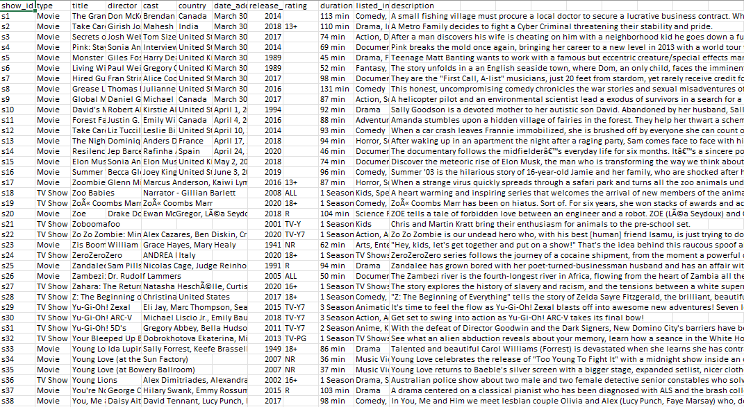
Dataset Link
Link https://www.kaggle.com/datasets/shivamb/amazon-prime-movies-and-tv-shows

Slide 5
Preprocessing Steps
Splitting Date Column into Day,Month and Year
The Date is present in the format (Month/Day/Year)
Using Split By Delimiter splitting the columns into three columns Day,Month and Year
Here we used the delimiter as “/”

Slide 6
Questions
How does the number of available shows vary across different countries on popular streaming platforms such as prime ?
Visualize whether movies or TV shows have a higher number of shows in amazon prime?
Visualize the total number of shows released each year on Amazon Prime?
Visualize the total shows in amazon prime based on ratings
Visualize the total shows based on genres
Who are the top 10 directors with the highest number of shows directed?
Analyze and Visualize the movie titles and their durations
Visualize the count of movies based on genres
Visualize the count of genres on movies and TV shows
Visualize the type of shows across each countries
Visualize the count of movies based on ratings
How many titles are available by type (Movies vs TV Shows)?
Which cast members appear in the most content?
What is the release year trend for Amazon Prime content?
What are the top 10 longest-duration titles by genre?
Visualize the number of movies containing titles as Nursery Rhymes

Slide 7
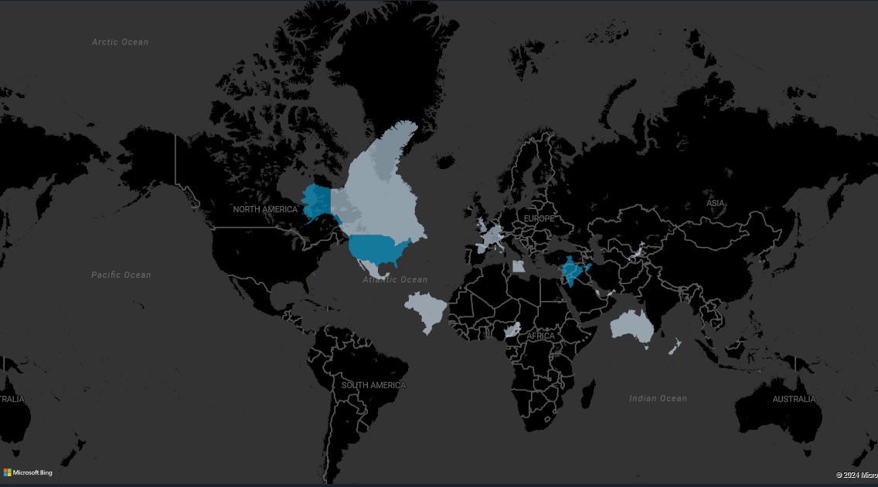
1. How does the number of available shows vary across different countries on popular streaming platforms such as amazon prime ?
DAX QUERY:
Shows_By_Country =
SUMMARIZE(
'amazon_prime_titles',
'amazon_prime_titles'[country],
"Number of Shows", COUNT('amazon_prime_titles'[show_id]))
Inference:The map depicts the number of Amazon devices per country. North America and Europe have the highest number of Amazon devices, followed by Asia and South America. Africa and Australia have the fewest Amazon devices.

Slide 8
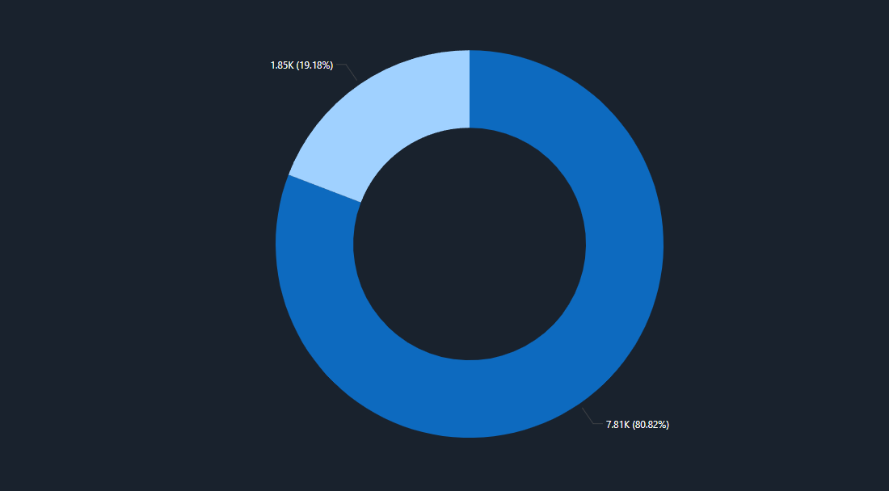
2. Visualize whether movies or TV shows have a higher number of shows in amazon prime?
DAX QUERY:
Shows_By_Type = SUMMARIZE( 'amazon_prime_titles', 'amazon_prime_titles'[type], "Number of Shows", COUNT('amazon_prime_titles'[show_id]) )
Inference:The pie chart indicates that Amazon primarily offers TV shows , with a significant majority (80.82%) of its content dedicated to movies. Movies constitute a smaller portion (19.18%) of the content library.

Slide 9
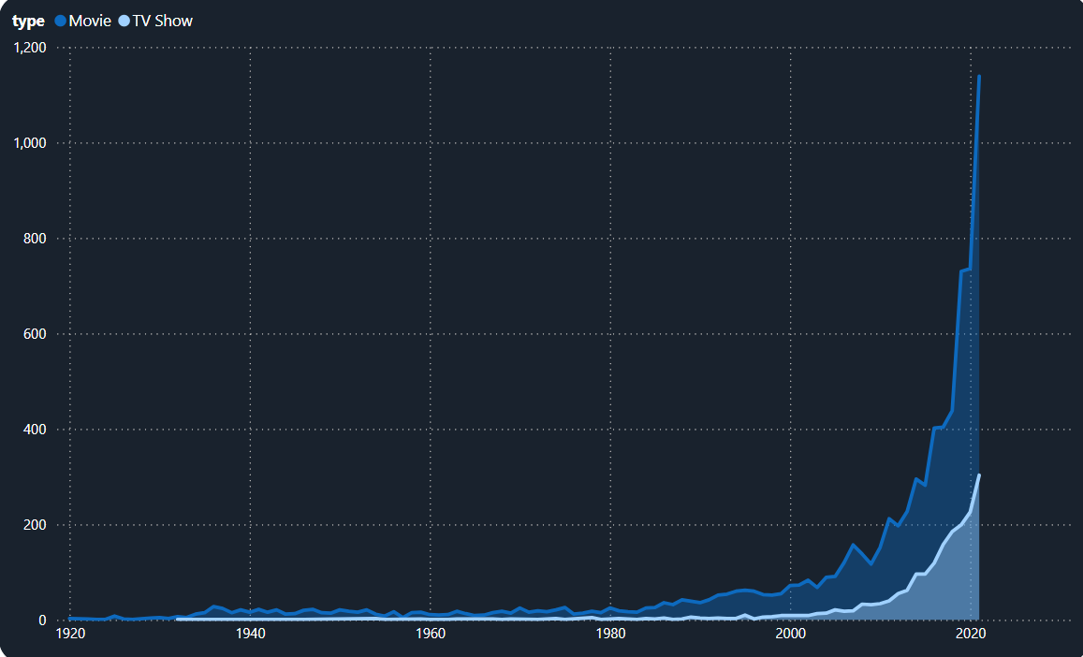
3. Visualize the total number of shows released each year on Amazon Prime?
DAX QUERY:
Number_of_Shows_By_Year = CALCULATE( COUNT('amazon_prime_titles'[show_id]), ALLEXCEPT('amazon_prime_titles', 'amazon_prime_titles'[release_year]) )
Inference:The area chart indicates that the total number of releases for both movies and TV shows has increased each year, showing a consistent rise in the number of shows released annually.

Slide 10
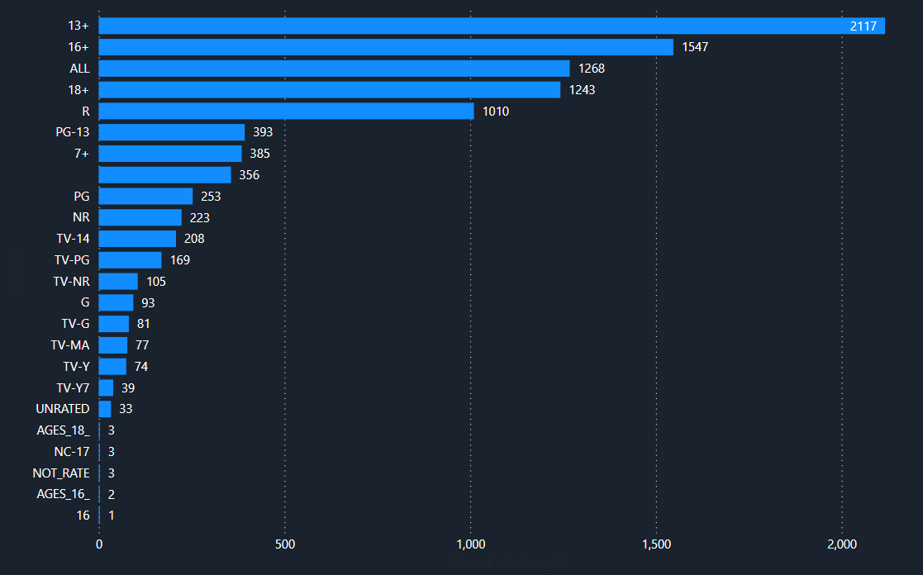
4. Visualize the total shows in amazon prime based on ratings.
DAX QUERY:
Shows_By_Rating =
SUMMARIZE(
'amazon_prime_titles',
'amazon_prime_titles'[rating],
"Number of Shows", COUNT('amazon_prime_titles'[show_id])
)
Inference:The stacked bar chart indicates that shows with a 13+ rating have the highest number, totaling 2,117 shows, making it the only rating category with over 2,000 shows. In contrast, there is only one show with a 16 rating, placing it at the bottom of the chart.

Slide 11
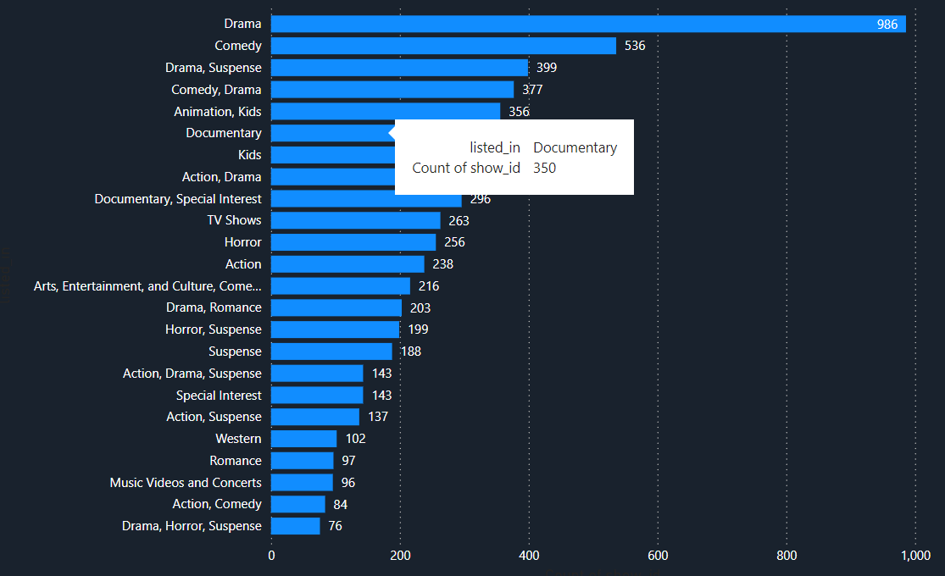
5. Visualize the total shows based on genres .
DAX Query:
Shows_By_Genre =
SUMMARIZE(
'amazon_prime_titles',
'amazon_prime_titles'[listed_in],
"Number of Shows", COUNT('amazon_prime_titles'[show_id])
)
Inference: The clustered bar chart indicates that the drama genre has the highest number of shows, with a total of 980, whereas the drama-horror-suspense combination ranks last with only 76 shows.

Slide 12
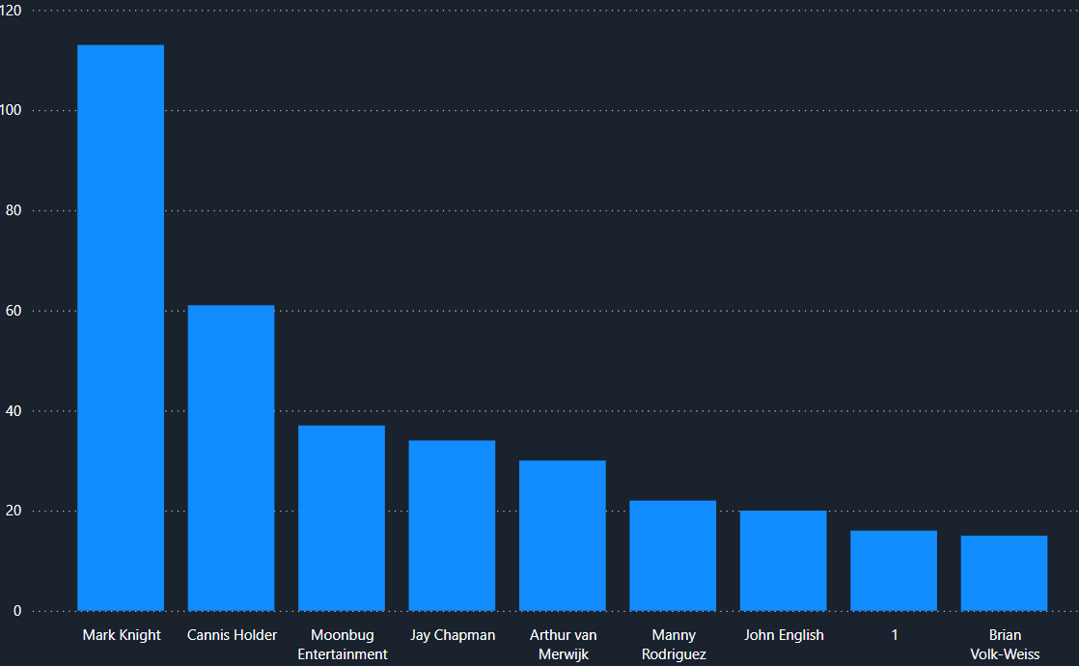
6. Who are the top 10 directors with the highest number of shows directed?
DAX QUERY: Top_10_Directors =
TOPN(
10,
SUMMARIZE(
'amazon_prime_titles',
'amazon_prime_titles'[director],
"Number of Shows", COUNT('amazon_prime_titles'[show_id])
),
[Number of Shows],
DESC
)
Inference:The stacked column chart shows that director Mark Knight leads with 113 films directed, while director Brian Volk-Weiss has directed the fewest, with only 6 films.

Slide 13
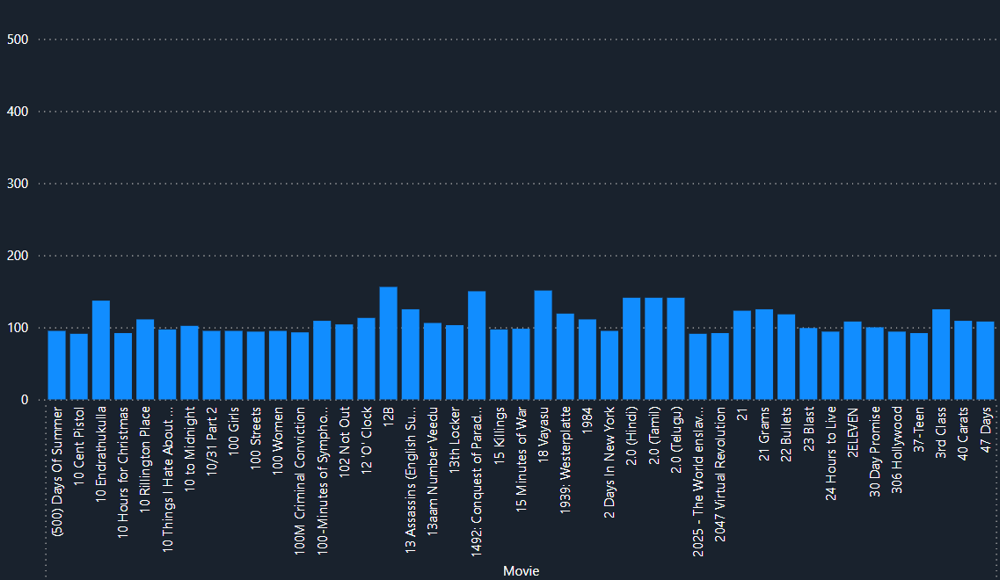
7. Analyze and Visualize the movie titles and their durations.
DAX QUERY:
Movies_With_Duration =
FILTER(
'amazon_prime_titles',
'amazon_prime_titles'[type] = "Movie"
)
Inference: The stacked column chart shows movies released on Amazon along with the duration of each. The movie titled Himalayan Singing Bowls has the longest duration, totaling 550 minutes.

Slide 14
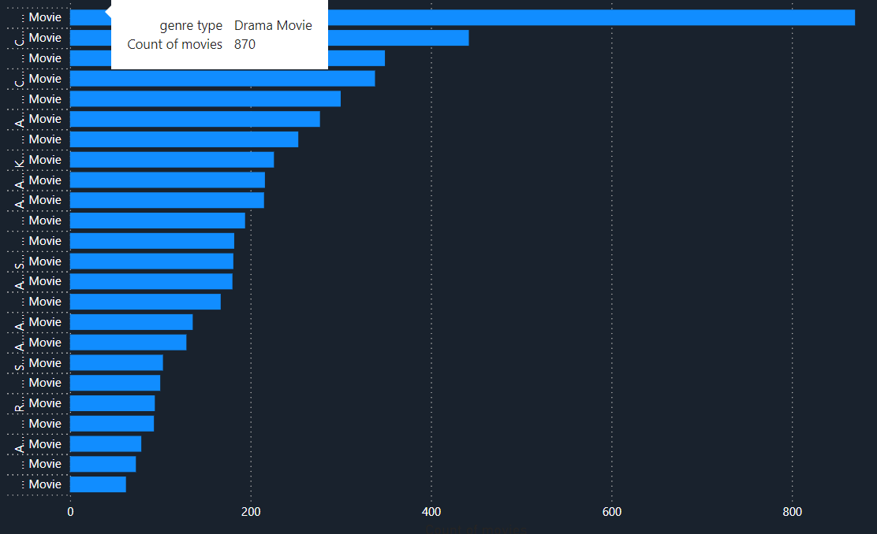
8. Visualize the count of movies based on genres
DAX Query:
Movies_By_Genre =
SUMMARIZE(
FILTER(
'amazon_prime_titles',
'amazon_prime_titles'[type] = "Movie"
),
'amazon_prime_titles'[listed_in],
"Number of Movies", COUNT('amazon_prime_titles'[show_id])
)
Inference: The stacked bar chart shows the number of movies released in each genre, with the drama genre leading at 870 movies

Slide 15
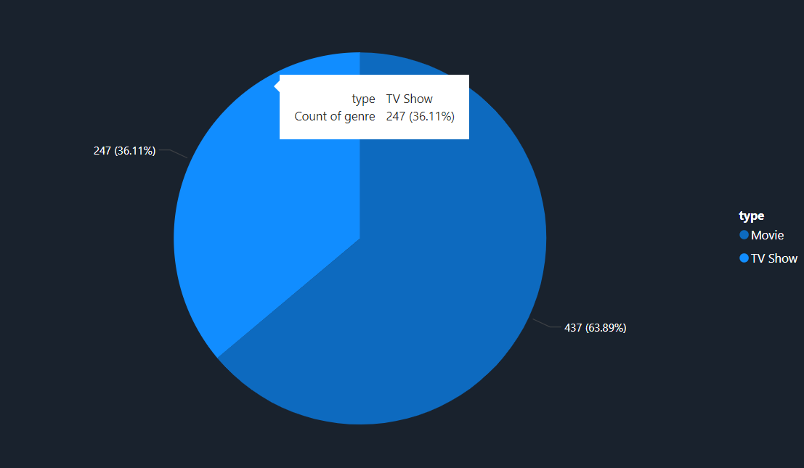
9. Visualize the count of genres on movies and TV shows
DAX Query:
Movies_By_Genre =
SUMMARIZE(
FILTER(
'amazon_prime_titles',
'amazon_prime_titles'[type] = "Movie"
),
'amazon_prime_titles'[listed_in],
"Number of Movies", COUNT('amazon_prime_titles'[show_id])
)
Inference:The pie chart indicates that Amazon primarily offers Movies, with a significant majority (63.89%) based on count of genre. TV shows constitute a smaller portion (36.11%).

Slide 16
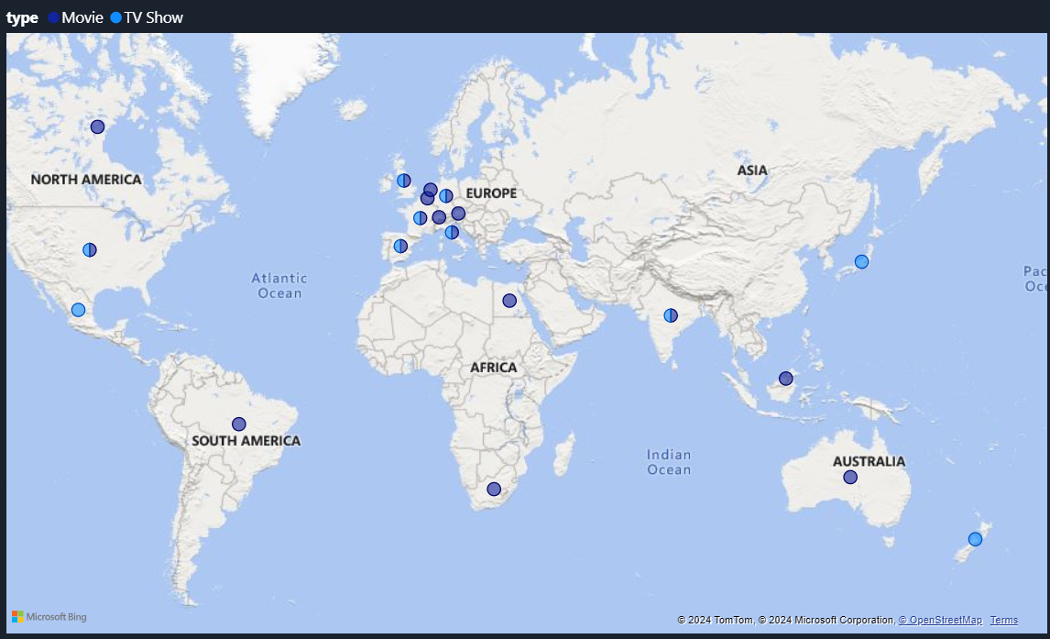
10. Visualize the type of shows across each countries.
DAX Query:
Shows_By_Country_And_Type =
CALCULATE(
COUNT('amazon_prime_titles'[show_id]),
VALUES('amazon_prime_titles'[country]),
VALUES('amazon_prime_titles'[type])
)
Inference : This map shows the distribution of movies and TV shows across different countries, with Europe having the highest concentration of shows, particularly in Western Europe. North America, Australia, and scattered regions in Africa and Asia-Pacific have fewer shows represented. The data visualizes where content is geographically focused in the entertainment industry.

Slide 17
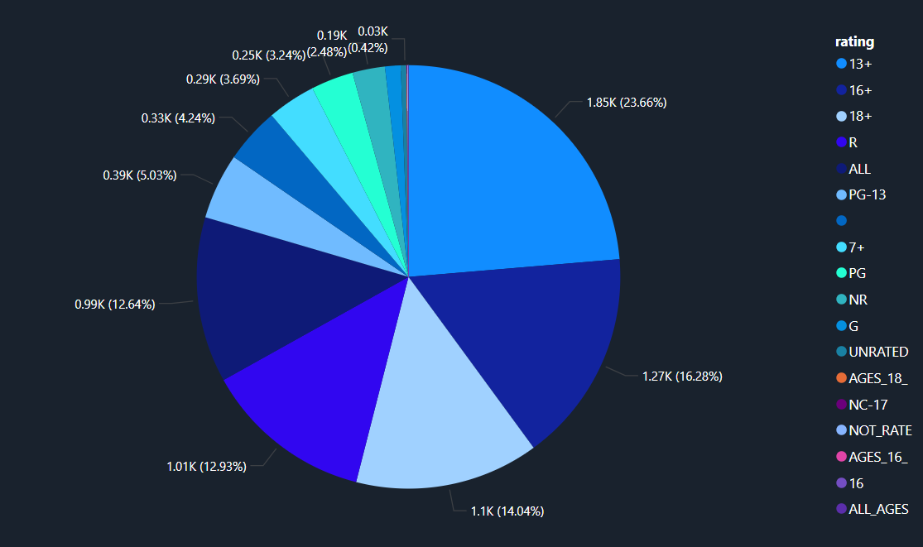
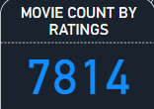
11. Visualize the count of movies based on ratings
DAX QUERY:
Movies_By_Rating =
SUMMARIZE(
FILTER(
'amazon_prime_titles',
'amazon_prime_titles'[type] = "Movie"
),
'amazon_prime_titles'[rating],
"Number of Movies", COUNT('amazon_prime_titles'[show_id])
)
Inference : This pie chart visualizes the count of movies based on their ratings. The largest category is for movies rated 13+ (23.66%), followed by 16+ (16.28%) and 18+ (14.04%). Movies rated R (12.93%) and PG-13 (12.64%) also represent significant portions. The chart indicates that most movies are targeted at teens and adults, with smaller percentages for general audiences and other ratings.Total movie count by ratings 7814

Slide 18
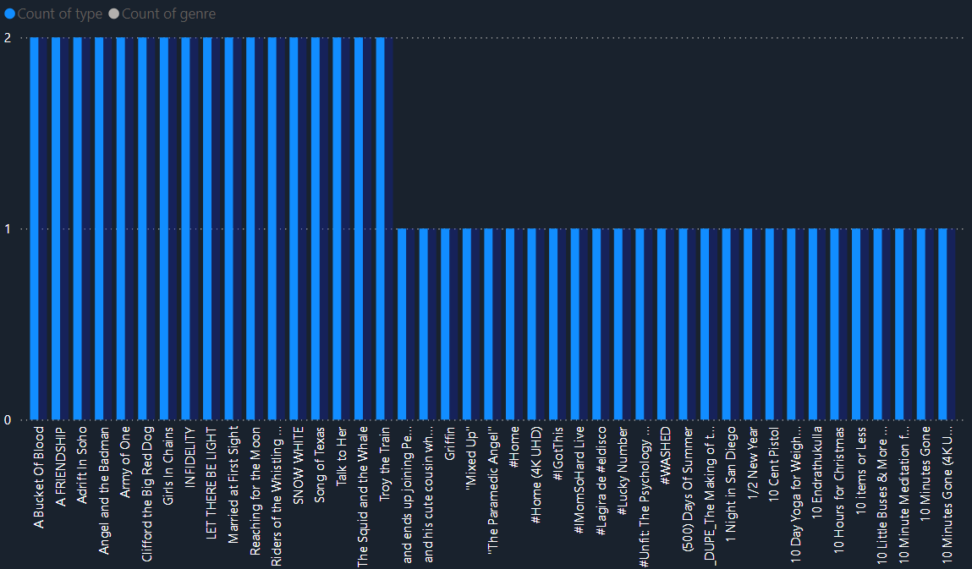
12. How many titles are available by type (Movies vs TV Shows)?
DAX QUERY:
Titles_By_Type =
SUMMARIZE(
'amazon_prime_titles',
'amazon_prime_titles'[type],
"Number of Titles", COUNT('amazon_prime_titles'[show_id])
)
Inference:The chart shows that each title has a count of "type" represented by a bar, mostly at the same height. This suggests that there are likely equal numbers or similar counts of each type (Movies and TV Shows), without a strong skew toward either category.

Slide 19

13. Find the number of distinct directors using DAX Query
DAX QUERY:
Unique_Directors_Count =
CALCULATE(
DISTINCTCOUNT('amazon_prime_titles'[director])
)
Inference:The chart shows that the number of distinct directors in the amazon ott platform is 5769.

Slide 20
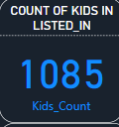
14. Find the number of kids genre in listed_in using DAX Query
DAX QUERY:
Kids_Count =
CALCULATE(
COUNTROWS('amazon_prime_titles'),
FILTER(
'amazon_prime_titles',
CONTAINSSTRING('amazon_prime_titles'[listed_in], "Kids")
)
)
Inference:The chart shows that the number of distinct kids genre in the Listed_in column is 1085.

Slide 21
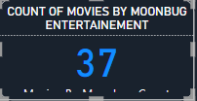
15.Number of movies directed by MoonBug Entertainment using Dax Query
DAX QUERY:
Movies_By_Moonbug_Count =
CALCULATE(
COUNTROWS('amazon_prime_titles'),
'amazon_prime_titles'[director] = "Moonbug Entertainment",
'amazon_prime_titles'[type] = "Movie"
)
Inference:The chart shows that the number of movies directed by MoonBug entertainments is 37.

Slide 22
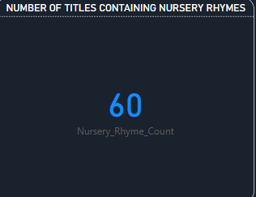
16. Number of movies containing titles as Nursery Rhymes
DAX QUERY:
Nursery_Rhyme_Count =
CALCULATE(
COUNTROWS('amazon_prime_titles'),
CONTAINSSTRING('amazon_prime_titles'[title], "Nursery Rhyme")
)
Inference:The chart shows that the number of entries containing titles as nursery rhymes is 60.

Slide 23
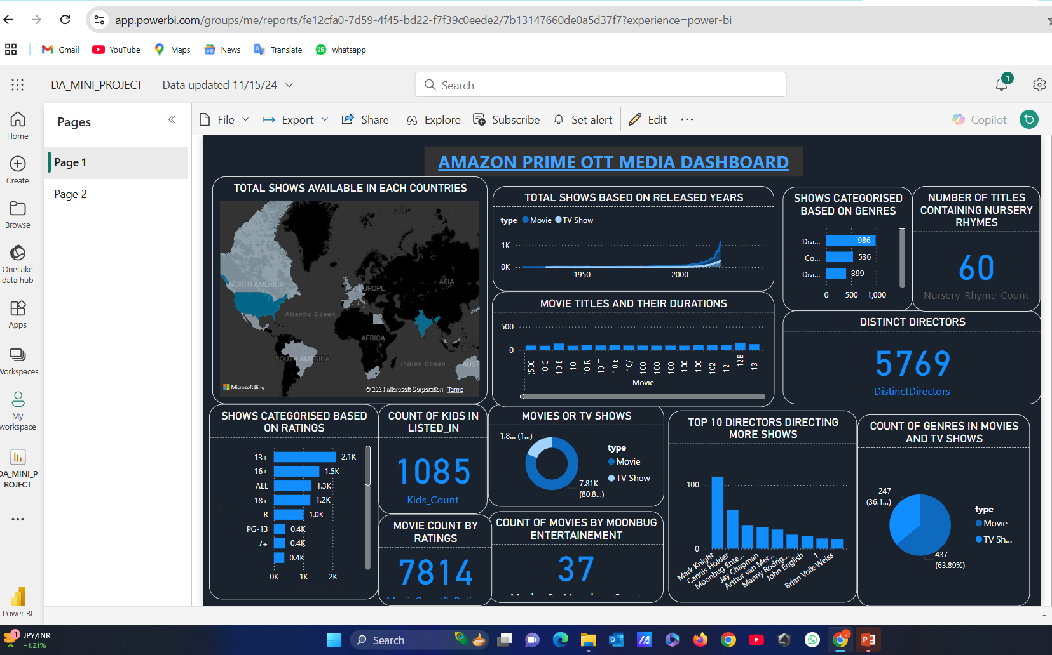
PUBLISHED DASHBOARD
POWER BI SERVICE
Link: https://app.powerbi.com/groups/me/reports/fe12cfa0-7d59-4f45-bd22-f7f39c0eede2/7b13147660de0a5d37f7?experience=power-bi

Slide 24

GITHUB REPO
GITHUB
Link: https://github.com/jayadhanush/amazon-prime-dashboard

Slide 25
THANK YOU

