Slide 1
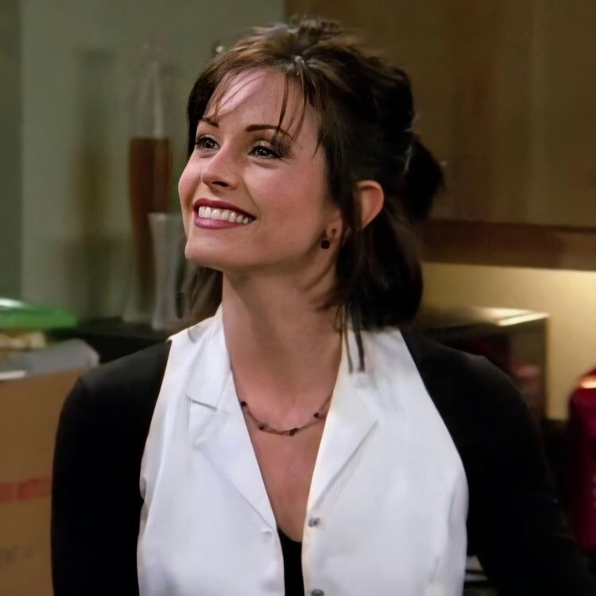
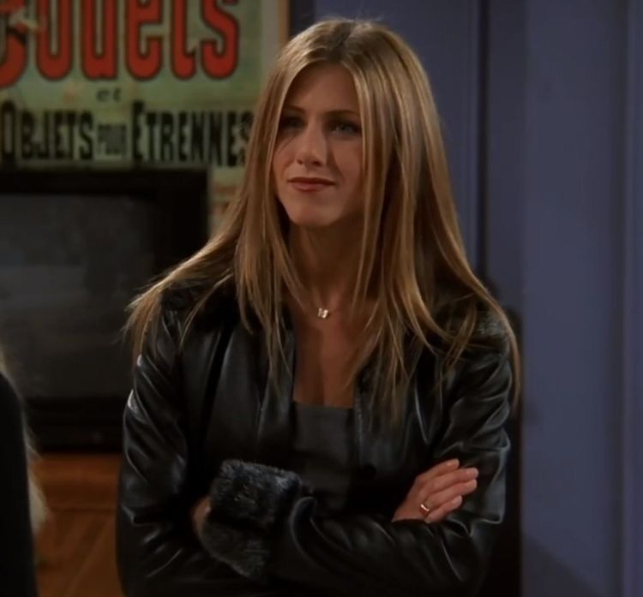
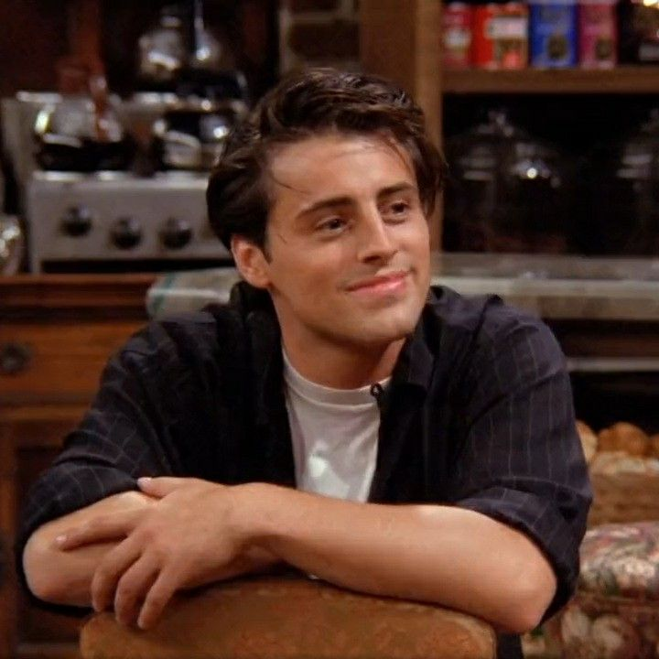
Friends
CP
Your seat at Central Perk
Central Perk Fan Experience
A cozy React fan website with character profiles, quotes, and a five-question quiz.
10-minute IHK frontend presentation
IHK frontend project · 1/9
Notes:
Hello, my name is Dilek, and this is my Friends Central Perk fan experience.
The idea is simple: I took an existing fan website and turned it into a warmer React project with character profiles, quotes, and a short quiz.
The design is inspired by Central Perk, so the page should feel cozy and familiar, not like a generic template.

Slide 2
FRIENDS CENTRAL PERK
Problem and audience
The redesign turns a static fan page into a clearer, more interactive cafe visit.
Problem
Audience
The old page had useful content, but the experience felt flat and less exam-ready as a React project.
Friends fans, mobile visitors, and IHK examiners who need to see structure, interaction, and accessibility.
IHK frontend project · 2/9
Notes:
The problem was that the old site had useful content, but it worked more like a static page.
For the exam, I wanted to show a clearer frontend project: a page with structure, interaction, responsive design, and accessibility.
The target audience is Friends fans on mobile or desktop, and also the examiner, who needs to see how the project is built.

Slide 3
FRIENDS CENTRAL PERK
Objectives and scope
A focused frontend project with no backend, no login, and no video playback.
Cozy cafe atmosphere
Warm cream, espresso brown, muted orange, and restrained purple accents.
Scope stays small: frontend only, local data, responsive layout
Useful interactions
Profiles, quote generator, and quiz support a simple visitor journey.
Explainable React code
Reusable components, props, state, events, and local JSON loading.
IHK frontend project · 3/9
Notes:
The scope is intentionally focused. There is no backend, no login, and no video playback.
My objectives were to keep the useful content, improve the visual identity, and add interactions that are easy to explain.
The main features are character profiles, a random quote generator, and a five-question quiz.

Slide 4
FRIENDS CENTRAL PERK
Technical architecture
Vite serves a React app that loads local JSON at runtime.
Browser
App.jsx
Components
public/data
HTML root and bundled React
Fetches JSON and handles status
Render sections and interactions
Characters, quotes, quiz
Loading, empty, error, and Retry states keep the data flow visible.
IHK frontend project · 4/9
Notes:
Technically, the project uses Vite and React.
The page starts from the browser and the React root. App.jsx loads the local JSON files from public/data with fetch.
The data is passed into components, and the app also handles loading, empty, error, and retry states. This is local JSON data, not a real API.

Slide 5
FRIENDS CENTRAL PERK
React implementation
The components stay small enough to understand and explain.
State
Props
Events
Menu open, profile expanded, current quote, quiz answer, score, loading status.
Character and quote data move from parent components into reusable child components.
Buttons open profiles, choose quotes, answer quiz questions, and restart the quiz.
Core components: Header, Hero, CharacterGrid, CharacterCard, QuoteGenerator, Quiz
IHK frontend project · 5/9
Notes:
The React structure is split into small components.
For example, CharacterGrid receives the character data and renders CharacterCard components with props. Each card has its own expanded state.
The quiz uses state for the current question, selected answer, score, and completion. Button clicks are handled with normal event handlers.

Slide 6
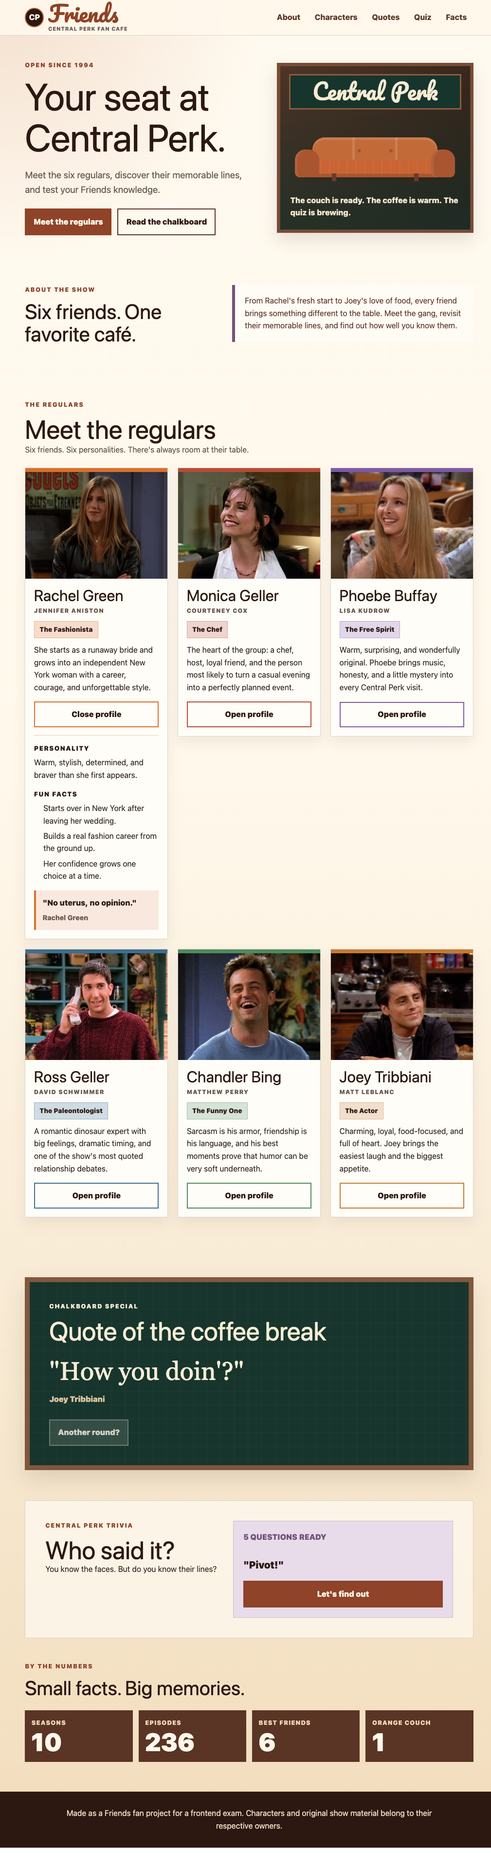
FRIENDS CENTRAL PERK
Live demo flow
The demo follows the visitor journey from cafe entry to quiz result.
Start at the cafe
Show header, hero, and Central Perk visual.
Open one profile
Finish by resizing the page to show mobile-first responsiveness.
Explain reusable character card state.
Use quote and quiz
Show event handling, feedback, score, and restart.
IHK frontend project · 6/9
Notes:
Now I switch to the live website.
I will start at the hero and show the Central Perk look. Then I open one character profile to show the expandable content.
Next, I go to the quote section and click Another round. After that, I run through part of the quiz and show feedback, Next, score, and Restart.
Small demo sentence: This is the moment where the site feels less like a poster and more like a little cafe visit.

Slide 7
FRIENDS CENTRAL PERK
Challenge and solution
The hardest part was making interactions work across screen sizes and input methods.
Challenge
Solution
The quiz and expandable cards had to work with mouse, touch, and keyboard while the layout stayed stable.
Native buttons, explicit focus handling, responsive grids, and checked breakpoints made the flow more reliable.
Tested widths: 320, 390, 768, 1024, 1440 px
IHK frontend project · 7/9
Notes:
One challenge was keeping the interactions reliable across screen sizes and input methods.
For example, the quiz needs to work with mouse, touch, and keyboard. After an answer, the next step must stay reachable.
The solution was to use native buttons, visible focus styles, careful focus handling in the quiz, and responsive grid rules for the cards.

Slide 8
FRIENDS CENTRAL PERK
Accessibility, responsiveness, and AI ethics
The project documents what was built, what was tested, and how AI helped.
Accessibility
Responsiveness
AI assistance
Semantic sections, visible focus, native controls, aria states, and live feedback.
No horizontal overflow in the checked widths. Cards stack cleanly on small screens.
AI helped with planning, code review, accessibility checks, and documentation. The work stays transparent.
IHK frontend project · 8/9
Notes:
Accessibility was part of the project, not something added at the end.
The site uses semantic sections, native controls, aria-expanded for profiles, live feedback for quotes and quiz messages, and visible focus styles.
Responsive checks were done at 320, 390, 768, 1024, and 1440 pixels.
AI assistance was used transparently for planning, design refinement, accessibility checks, and documentation. I still need to understand and explain the final code myself.

Slide 9
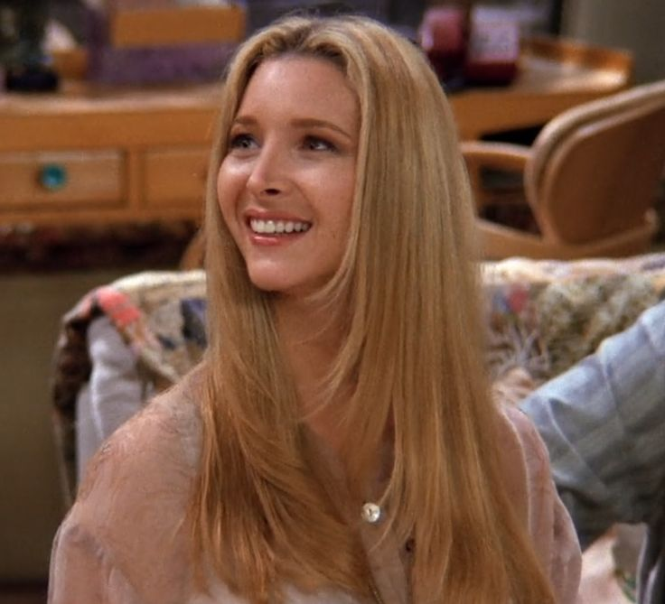

FRIENDS CENTRAL PERK
Reflection and future outlook
The finished version gives me a project I can explain from design to code.
What I learned
React state, component boundaries, JSON loading, and responsive CSS need to work together.
What I would improve
Favorite character storage, filters, a season timeline, and more quiz questions.
Final message
Ready for demo and examiner questions
A small fan site can still show real frontend decisions clearly.
IHK frontend project · 9/9
Notes:
To close, this project taught me how design decisions and React structure work together.
I can explain the component structure, the JSON data flow, state, props, and event handling without going line by line through the code.
Future improvements would be a favorite character saved in localStorage, filters, more quiz questions, and maybe a season timeline.
Final closing sentence: The finished version is small, but it shows real frontend decisions clearly, and it is ready for the live demo and questions.

