Slide 1
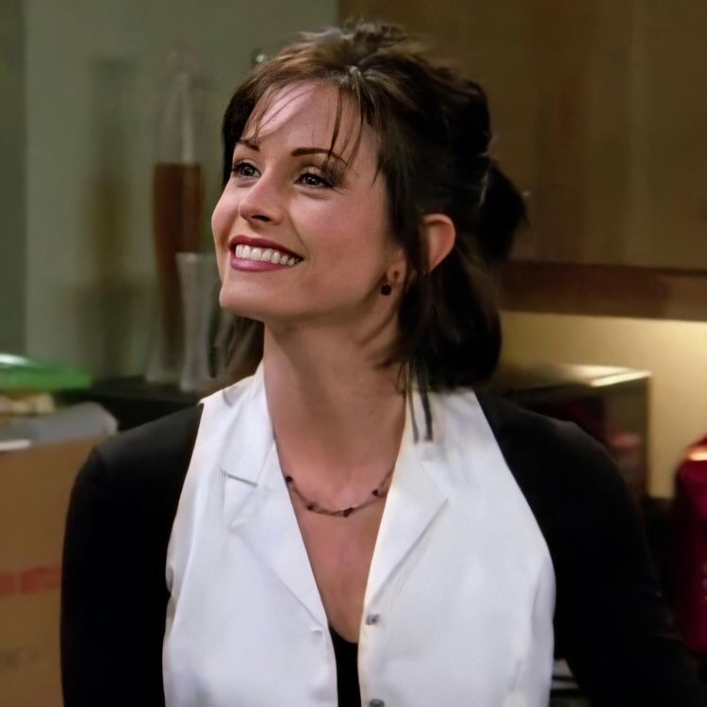
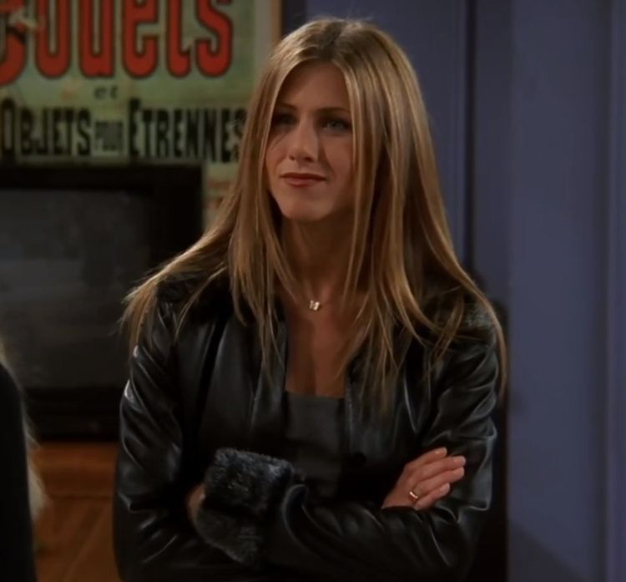
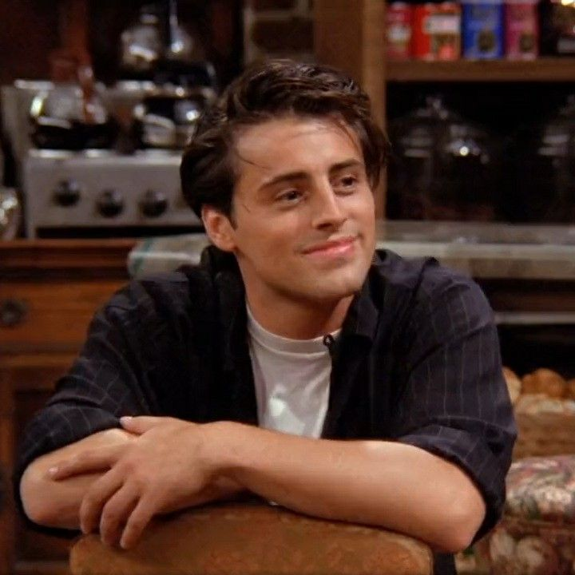
Friends
CP
Your seat at Central Perk
Central Perk Fan Experience
A cozy React fan website with character profiles, quotes, and a five-question quiz.
10-minute IHK frontend presentation
IHK frontend project · 1/9

Slide 2
FRIENDS CENTRAL PERK
Problem and audience
The redesign turns a static fan page into a clearer, more interactive cafe visit.
Problem
Audience
The old page had useful content, but the experience felt flat and less exam-ready as a React project.
Friends fans, mobile visitors, and IHK examiners who need to see structure, interaction, and accessibility.
IHK frontend project · 2/9

Slide 3
FRIENDS CENTRAL PERK
Objectives and scope
A focused frontend project with no backend, no login, and no video playback.
Cozy cafe atmosphere
Warm cream, espresso brown, muted orange, and restrained purple accents.
Scope stays small: frontend only, local data, responsive layout
Useful interactions
Profiles, quote generator, and quiz support a simple visitor journey.
Explainable React code
Reusable components, props, state, events, and local JSON loading.
IHK frontend project · 3/9

Slide 4
FRIENDS CENTRAL PERK
Technical architecture
Vite serves a React app that loads local JSON at runtime.
Browser
App.jsx
Components
public/data
HTML root and bundled React
Fetches JSON and handles status
Render sections and interactions
Characters, quotes, quiz
Loading, empty, error, and Retry states keep the data flow visible.
IHK frontend project · 4/9

Slide 5
FRIENDS CENTRAL PERK
React implementation
The components stay small enough to understand and explain.
State
Props
Events
Menu open, profile expanded, current quote, quiz answer, score, loading status.
Character and quote data move from parent components into reusable child components.
Buttons open profiles, choose quotes, answer quiz questions, and restart the quiz.
Core components: Header, Hero, CharacterGrid, CharacterCard, QuoteGenerator, Quiz
IHK frontend project · 5/9

Slide 6
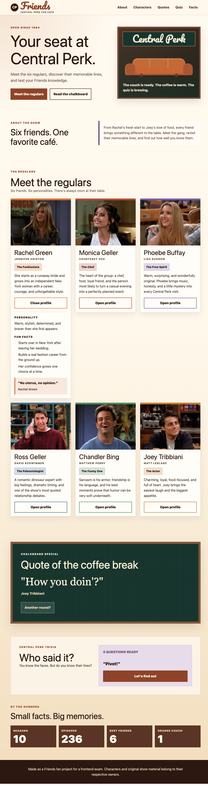
FRIENDS CENTRAL PERK
Live demo flow
The demo follows the visitor journey from cafe entry to quiz result.
Start at the cafe
Show header, hero, and Central Perk visual.
Open one profile
Finish by resizing the page to show mobile-first responsiveness.
Explain reusable character card state.
Use quote and quiz
Show event handling, feedback, score, and restart.
IHK frontend project · 6/9

Slide 7
FRIENDS CENTRAL PERK
Challenge and solution
The hardest part was making interactions work across screen sizes and input methods.
Challenge
Solution
The quiz and expandable cards had to work with mouse, touch, and keyboard while the layout stayed stable.
Native buttons, explicit focus handling, responsive grids, and checked breakpoints made the flow more reliable.
Tested widths: 320, 390, 768, 1024, 1440 px
IHK frontend project · 7/9

Slide 8
FRIENDS CENTRAL PERK
Accessibility, responsiveness, and AI ethics
The project documents what was built, what was tested, and how AI helped.
Accessibility
Responsiveness
AI assistance
Semantic sections, visible focus, native controls, aria states, and live feedback.
No horizontal overflow in the checked widths. Cards stack cleanly on small screens.
AI helped with planning, code review, accessibility checks, and documentation. The work stays transparent.
IHK frontend project · 8/9

Slide 9
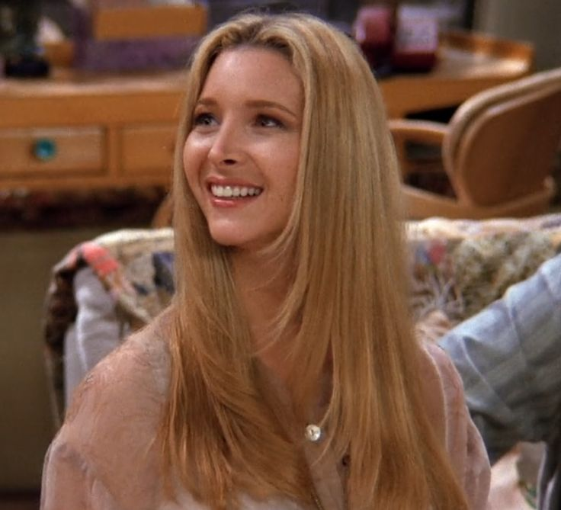

FRIENDS CENTRAL PERK
Reflection and future outlook
The finished version gives me a project I can explain from design to code.
What I learned
React state, component boundaries, JSON loading, and responsive CSS need to work together.
What I would improve
Favorite character storage, filters, a season timeline, and more quiz questions.
Final message
Ready for demo and examiner questions
A small fan site can still show real frontend decisions clearly.
IHK frontend project · 9/9

