Slide 1
Introduction to Machine Learning (Google course)
COMP 468 Machine Learning in Python
Instructor: Zafer Aydın

Slide 2
Google Course Link
https://developers.google.com/machine-learning/intro-to-ml

Slide 3
Learning Objectives
Understand the different types of machine learning
Understand the key concepts of supervised machine learning
Learn how solving problems with ML is different from traditional approaches

Slide 4
What is Machine Learning?
The process of training a model, to make useful predictions from data
An ML model represents the mathematical relationship between the elements of data that an ML system uses to make predictions

Slide 5
Example
An app to predict rainfall
Traditional approach
A physics-based representation of the Earth’s atmosphere and surface
Computing massive amounts of fluid dynamics equations
Difficult
ML approach
Give ML model a lot of weather data
ML model will eventually learn the mathematical relationship between weather patterns that produce differing amounts of rain
Give the model current weather data and it would predict the amount of rain

Slide 6
Watch Video: What is ML

Slide 7
Types of ML Systems
Supervised learning
Unsupervised learning
Semi-supervised learning
Reinforcement learning

Slide 8
Supervised Learning
True outputs (correct answers) are available during model training
Model discovers the connections between the elements in the data that produce the correct answers
Types of supervised learning
Regression
Classification

Slide 9
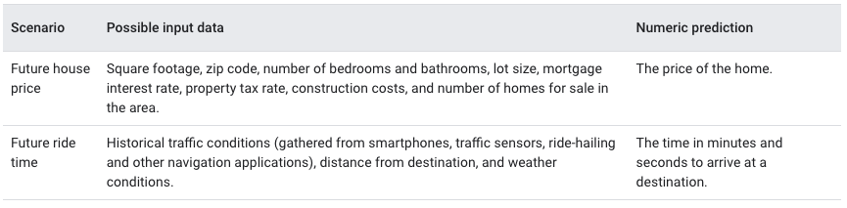
Regression
Output is continuous valued (i.e. numeric)
Example
A model that predicts the amount of rain in inches or milimeters
More examples

Slide 10
Classification
Output is discrete-valued
A value that states which category the input belongs to
Examples
Predict if an e-mail is spam
Predict if a photo contains a cat
Types of classification
Binary classification (output can take two different values)
Rain or no rain
Multi-class classification (output can take more than two values)
Rain, hail, snow, or sleet

Slide 11
Watch Video: Supervised Machine Learning

Slide 12
Unsupervised Learning
There is no true output (correct answer) in training set
The goal is to identify meaningful patterns among the data
The model has no hints on how to categorize each piece of data, but instead it must infer its own rules

Slide 13
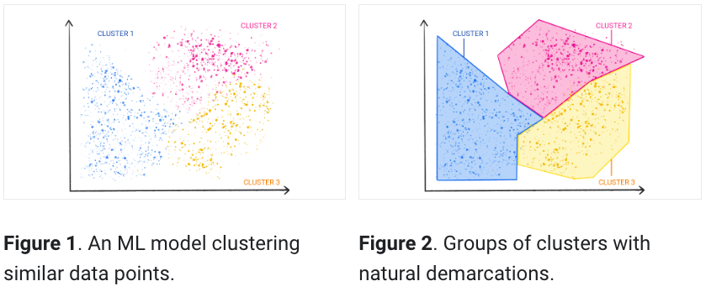
Unsupervised Learning
A commonly used unsupervised learning technique is called clustering
The model finds data points that demarcate natural groupings

Slide 14
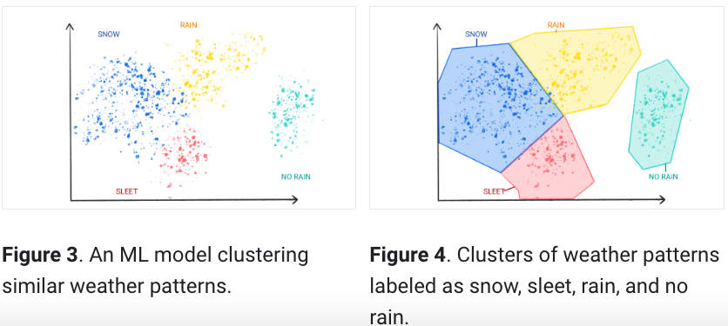

Slide 15
Unsupervised Learning
Clustering differs from classification because the categories aren't defined by you
For example, an unsupervised model might cluster a weather dataset based on temperature, revealing segmentations that define the seasons
You might then attempt to name those clusters based on your understanding of the dataset
Check your understanding

Slide 16
Reinforcement Learning
Models make predictions by getting rewards or penalties based on actions performed within an environment
A reinforcement learning system generates a policy that defines the best strategy for getting the most rewards
Examples
Train robots to perform tasks, like walking around a room
Train software programs like AlphaGo to play the game of Go

Slide 17
Supervised Learning
More use cases than unsupervised learning
Utilizes historical data better than reinforcement learning
Core concepts of supervised learning
Data
Model
Training
Evaluating
Inference

Slide 18
Data
Words and numbers stored in tables
Values of pixels in images
Values of waveforms in audio files
Example datasets
Images of cats
Housing prices
Weather information

Slide 19
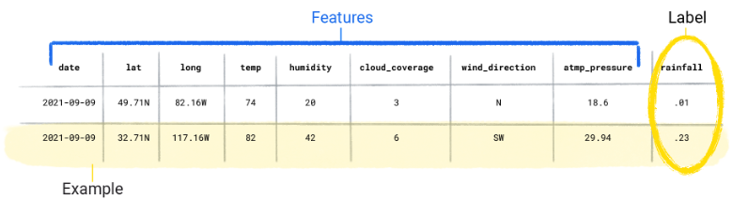
Data
Datasets are made up of individual examples (samples) that contain features (input) and a label (output)
For tabular data, an example is a single row in a spreadsheet or data table
The label is the "answer," or the value we want the model to predict
Examples that contain both features and labels are called labeled examples

Slide 20
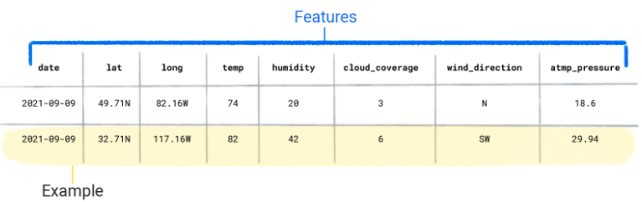
Data
Unlabeled examples contain features but no label

Slide 21
Dataset Characteristics
A dataset is characterized by its size and diversity
Size indicates the number of examples
Diversity indicates the range those examples cover
Good datasets are both large and highly diverse
Datasets may have
Large size, large diversity
Low size, large diversity
Large size, low diversity
Low size, low diversity

Slide 22
Dataset Characteristics
Example
A dataset might contain 100 years worth of data, but only for the month of July (large size, low diversity)
Using this dataset to predict rainfall in January would produce poor predictions
A dataset might cover only a few years but contain every month (low size, large diversity)
This dataset might produce poor predictions because it doesn't contain enough years to account for variability
Check your understanding

Slide 23
Dataset Characteristics
A dataset can also be characterized by the number of its features
Datasets with more features can help a model discover additional patterns and make better predictions
Datasets with more features don't always produce models that make better predictions because
Some features might have no causal relationship to the label
Curse of dimensionality

Slide 24
Model
In supervised learning, a model is the complex collection of numbers that define the mathematical relationship from specific input feature patterns to specific output label values
y=f(x)
The model discovers these patterns through training

Slide 25
Training
Before a supervised model can make predictions, it must be trained
To train a model, we give the model a dataset with labeled examples
The model's goal is to work out the best solution for predicting the labels from the features
The model finds the best solution by comparing its predicted value to the label's actual value
Based on the difference (or distance) between the predicted and actual values—defined as the loss—the model gradually updates its solution
As a result, the model learns the mathematical relationship between the features and the label so that it can make the best predictions on unseen data

Slide 26
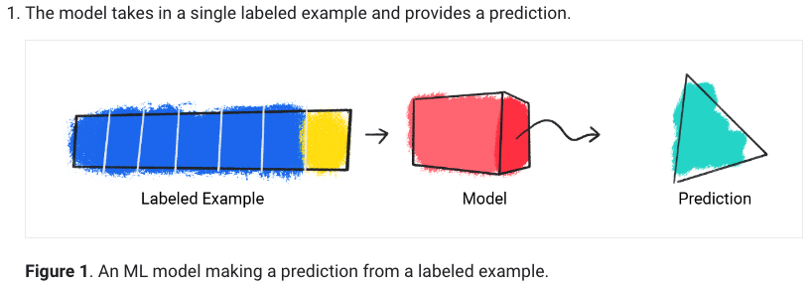
Training

Slide 27
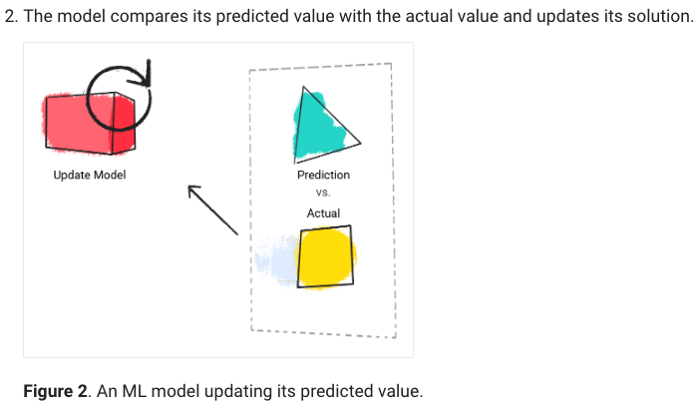
Training

Slide 28
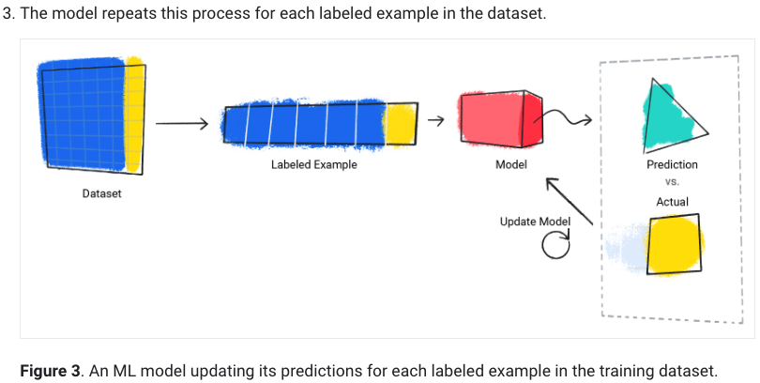
Training

Slide 29
Training
The model gradually learns the correct relationship between the features and the label
This gradual understanding is also why large and diverse datasets produce a better model

Slide 30
Training
Certain features have more predictive power than others
We can consider including or removing a feature to see if the model makes better predictions with or without it

Slide 31
Evaluating
We evaluate a trained model to determine how well it learned
When we evaluate a model, we use a labeled dataset called test set, but we only give the model the dataset's features as input
We then compare the model's predictions to the label's true values
Depending on the model's predictions, we might do more training and evaluating before deploying the model in a real-world application

Slide 32
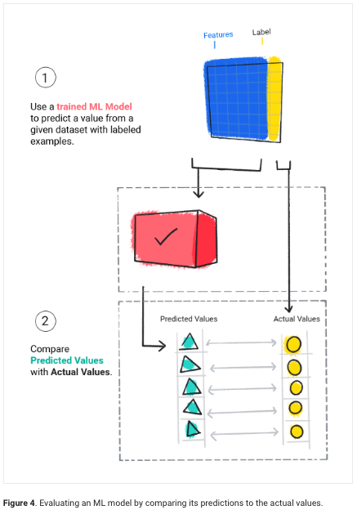

Slide 33
Evaluating
Check your understanding

Slide 34
Inference
After evaluation, if we are satisfied about the model’s performance, we can use the model to make predictions, called inferences, on unlabeled examples
In the weather app example, we would give the model the current weather conditions—like temperature, atmospheric pressure, and relative humidity—and it would predict the amount of rainfall

