Slide 1
Introduction to Machine Learning (from Textbook)
COMP 468 Machine Learning in Python
Instructor: Zafer Aydın

Slide 2
20
45
58
73
84
91

Slide 3
What is Machine Learning?
Machine Learning is the science (and art) of programming computers so they can learn from data
[Machine Learning is the] field of study that gives computers the ability to learn without being explicitly programmed
A computer program is said to learn from experience E with respect to some task T and some performance measure P, if its performance on T, as measured by P, improves with experience E

Slide 4
Example: Spam Filter
Machine Learning program that can learn to flag spam given examples of spam emails (e.g., flagged by users) and examples of regular (nonspam, also called “ham”) emails
The examples that the system uses to learn are called the training set
Each training example is called a training instance (or sample)
The task T is to flag spam for new emails
The experience E is the training data
The performance measure P needs to be defined
Ratio of correctly classified emails (i.e. accuracy)

Slide 5
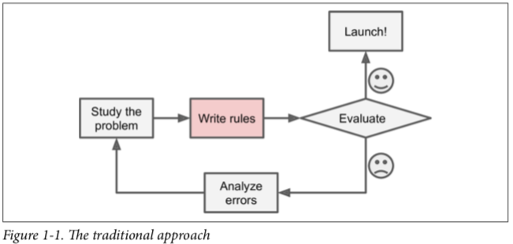
Why Use Machine Learning?
Implementing spam filter using traditional programming techniques
Look at what spam typically looks like (common words as 4U, credit card, free, amazing)
Write a detection algorithm for each of the patterns that you noticed
Flag emails as spam if a number of these patterns are detected
Test your program and repeat the above steps until it is good enough
You may end up with a long list of rules

Slide 6
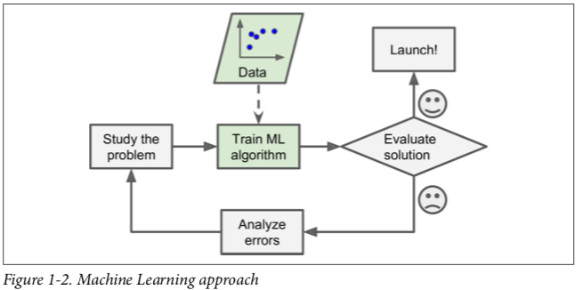
Why Use Machine Learning?
A spam filter based on Machine Learning techniques
Automatically learns which words and phrases are good predictors of spam by detecting unusually frequent patterns of words in the spam examples compared to the ham examples
The program is much shorter, easier to maintain, and most likely more accurate

Slide 7
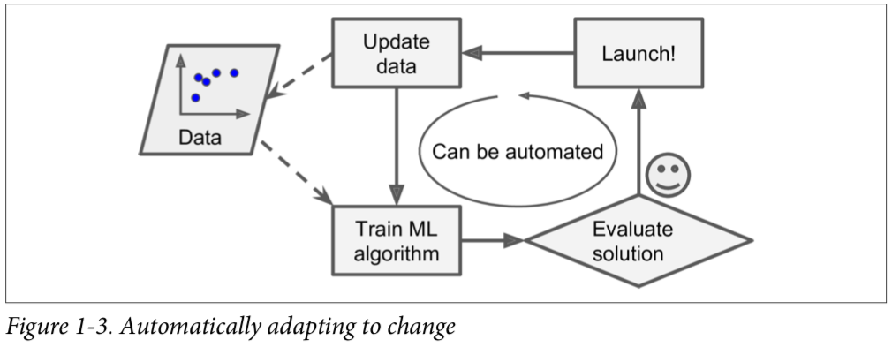
Why Use Machine Learning?
Spammers may notice that their e-mails containing 4U are blocked
They may start writing “For U” instead
A spam filter using traditional programming techniques would need to be updated to flag “For U” emails
Spammers may keep changing their e-mail content based on the updates made in spam filter
In traditional approach, we may need to write new rules forever
If we use machine learning, the spam filter will automatically recognize that “For U” has become unusually frequent in spam flagged by users
It will start flagging them without our intervention

Slide 8
Why Use Machine Learning?
For problems that are too complex for traditional approaches or have no known algorithm
Example: speech recognition
Write a program to distinguish words one and two
Word two starts with a high pitch sound T
Write an algorithm that measures high pitch sound intensity and use it to distinguish ones and twos
Will not scale to thousands of words spoken by millions of very different people in noisy environments and in dozens of languages
The best solution is to write an algorithm that learns by itself given many example recordings for each word

Slide 9
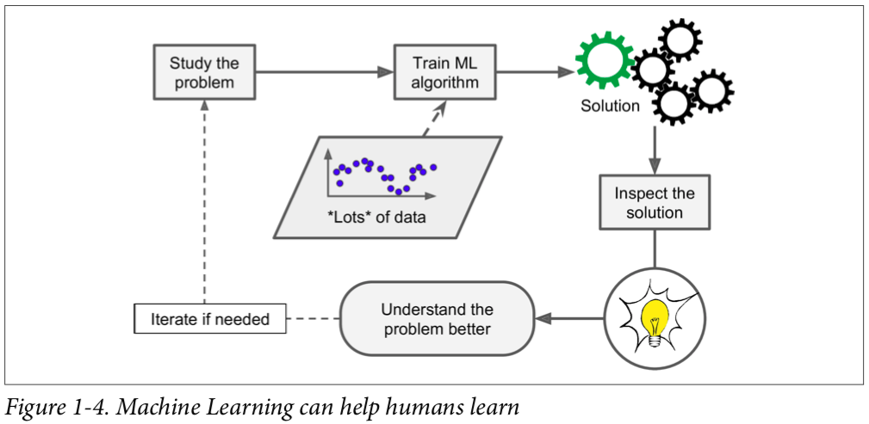
Why Use Machine Learning?
Machine learning can help humans to learn
ML algorithms can be inspected to see what they have learned
Once the spam filter has been trained on enough spam, it can easily be inspected to reveal the list of words and combinations of words that it believes are the best predictors of spam
Sometimes this will reveal unsuspected correlations or new trends, and thereby lead to a better understanding of the problem

Slide 10
Why Use Machine Learning?
Applying ML techniques to dig into large amounts of data can help discover patterns that were not immediately apparent. This is called data mining.

Slide 11
Why Use Machine Learning?
To summarize, Machine Learning is great for:
Problems for which existing solutions require a lot of hand-tuning or long lists of rules: one Machine Learning algorithm can often simplify code and perform better.
Complex problems for which there is no good solution at all using a traditional approach: the best Machine Learning techniques can find a solution.
Fluctuating environments: a Machine Learning system can adapt to new data.
Getting insights about complex problems and large amounts of data.

Slide 12
Types of Machine Learning Systems
Classify ML systems
Trained with human supervision or not
supervised, unsupervised, semisupervised, and Reinforcement Learning
Learn incrementally on the fly or not
online versus batch learning
Compare new data points to known data points, or detect patterns in the training data and build a predictive model
instance-based versus model-based learning
A spam filter may learn on the fly using a deep neural network
Online, model-based, supervised learning system

Slide 13
ML Systems Based on Supervision
Supervised learning
Unsupervised learning
Semi-supervised learning
Reinforcement learning

Slide 14
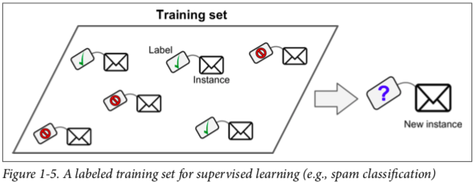
Supervised Learning
Training data includes desired solutions called labels

Slide 15
Supervised Learning
Classification
Regression

Slide 16
Supervised Learning
Classification
Output is discrete-valued
Example: spam filter, handwritten digit recognition

Slide 17
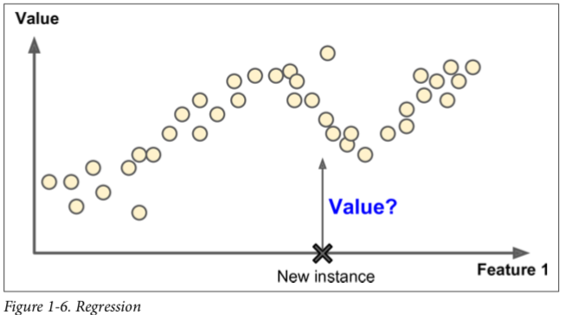
Supervised Learning
Regression
Output is numeric
Features are called predictors
Example: predict the price of a car

Slide 18
Supervised Learning
Some regression algorithms can be used for classification
Logistic regression is commonly used for classification
It can output a value that corresponds to the probability of belonging to a given class (e.g., 20% chance of being spam)

Slide 19
Supervised Learning Algorithms
k-Nearest Neighbors
Linear Regression
Logistic Regression
Support Vector Machines (SVMs)
Decision Trees and Random Forests
Neural networks
can also be unsupervised or semi-supervised

Slide 20
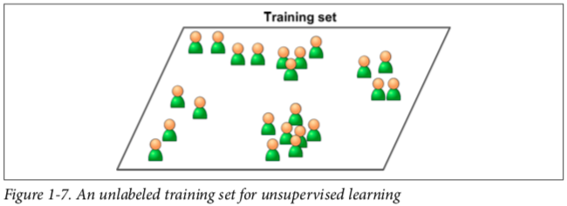
Unsupervised Learning
Training data is unlabeled
The system tries to learn without a teacher

Slide 21
Unsupervised Learning Algorithms
Clustering
K-means
DBSCAN
Hierachical Cluster Analysis
Anomaly detection and novelty detection
One-class SVM
Isolation forest
Visualization and dimensionality reduction
Principal Component Analysis (PCA)
Kernel PCA
Locally-Linear Embedding (LLE)
t-distributed Stochastic Neighbor Embedding (t-SNE)
Association rule learning
Apriori
Eclat

Slide 22
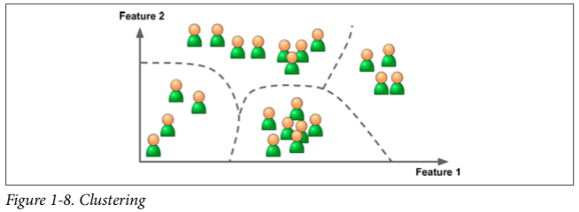
Unsupervised Learning
Example
Data about blog’s visitors
Clustering algorithm to try to detect groups of similar visitors
40% of your visitors are males who love comic books and generally read your blog in the evening
20% are young sci-fi lovers who visit during the weekends
Hierarchical clustering algorithm may also subdivide each group into smaller groups. This may help you target your posts for each group

Slide 23
Unsupervised Learning
Visualization
Feed unlabeled data as input
Outputs a 2D or 3D representation of your data that can easily be plotted
These algorithms try to preserve as much structure as they can
e.g., trying to keep separate clusters in the input space from overlapping in the visualization
This way you can understand how the data is organized and perhaps identify unsuspected patterns

Slide 24
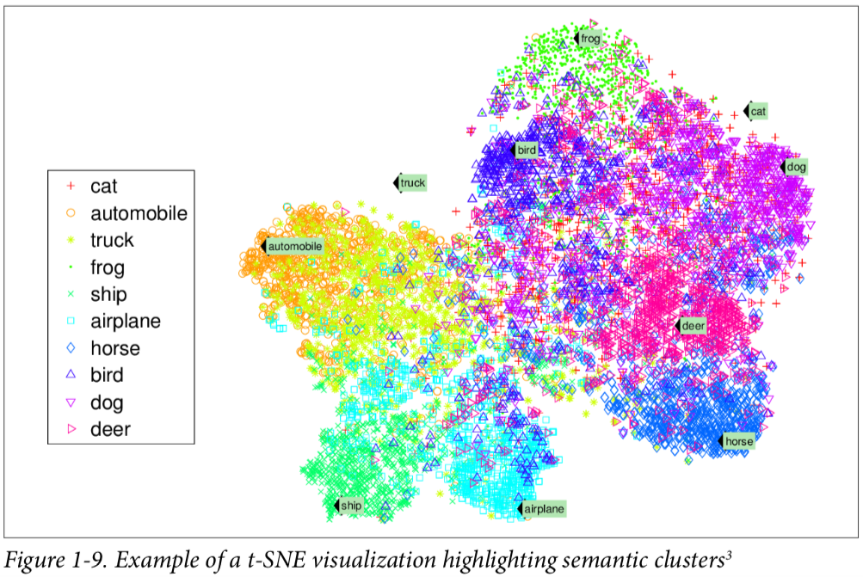

Slide 25
Unsupervised Learning
Dimensionality reduction
Simplify the data without losing too much information
One way to do this is to merge several correlated features into one
For example, a car’s mileage may be very correlated with its age
Merge them into one feature that represents the car’s wear and tear
This is called feature extraction
Transform features to a new space with lower dimension
PCA, kernel-PCA

Slide 26
Unsupervised Learning
Anomaly detection
Examples
Detecting unusual credit card transactions to prevent fraud
Catching manufacturing defects
Removing outliers from a dataset before feeding it to another learning algorithm
The system is shown mostly normal instances during training
It learns to recognize normal instances
When it sees a new instance it can tell whether it looks like a normal one or whether it is likely an anomaly

Slide 27
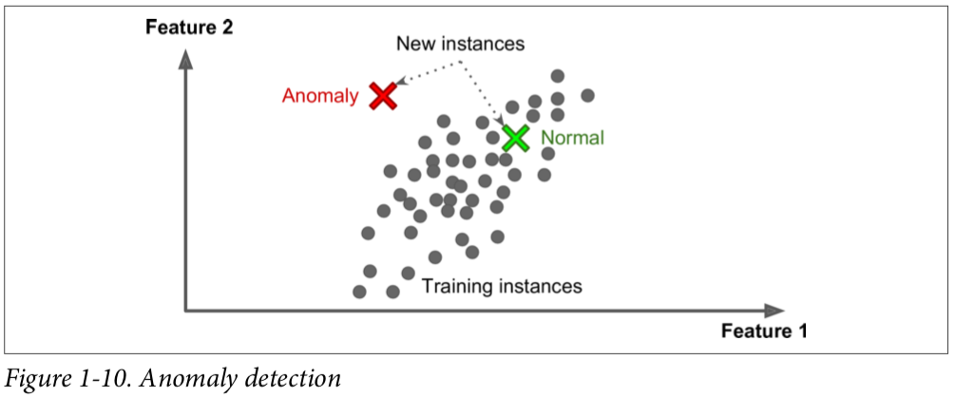

Slide 28
Unsupervised Learning
Novelty detection
Similar to anomaly detection
Difference is that novelty detection algorithms expect to see only normal data during training, which is not polluted by outliers (i.e. novelties)
Anomaly detection algorithms are usually more tolerant, they can often perform well even with a small percentage of outliers in the training set
Try to fit the regions where the training data is the most concentrated, ignoring the deviant observations

Slide 29
Semi-supervised Learning
Can deal with partially labeled training data
Usually a lot of unlabeled data and a little bit of labeled data
Example: Google photos
Unsupervised part of the algorithm (clustering)
Once you upload all your family photos to the service, it automatically recognizes that the same person A shows up in photos 1, 5, and 11, while another person B shows up in photos 2, 5, and 7
All the system needs is for you to tell it who these people are
Just one label per person, and it is able to name everyone in every photo, which is useful for searching photos

Slide 30
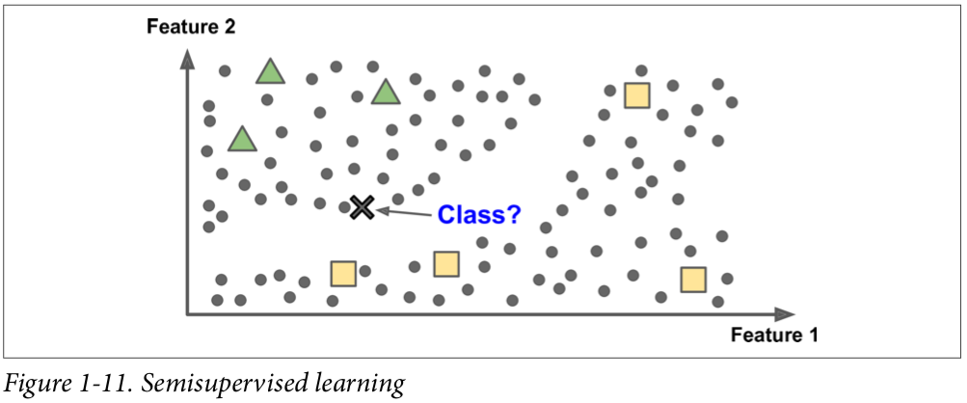

Slide 31
Semi-supervised Learning
Most of them are combinations of unsupervised and supervised algorithms
Deep belief networks (DBNs) are based on unsupervised components called restricted Boltzmann machines (RBMs) stacked on top of one another
RBMs are trained sequentially in an unsupervised manner
The whole system is fine-tuned using supervised learning techniques

Slide 32
Reinforcement Learning
The learning system, called an agent
Can observe the environment
Select and perform actions
Get rewards in return (or penalties in the form of negative rewards)
It must then learn by itself what is the best strategy, called a policy, to get the most reward over time
A policy defines what action the agent should choose when it is in a given situation

Slide 33
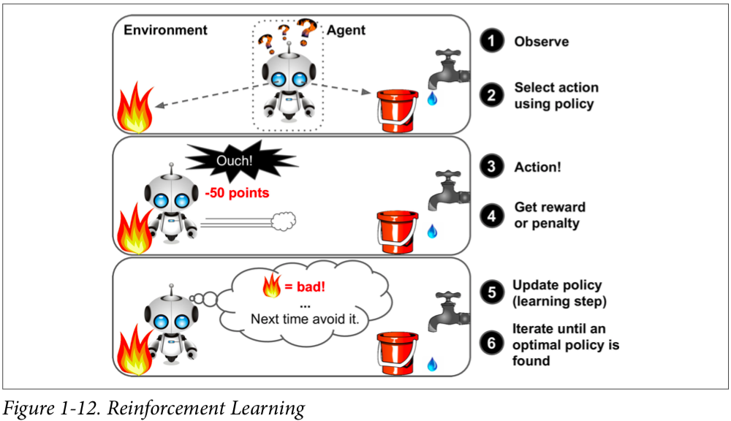

Slide 34
Reinforcement Learning
Example
Many robots implement Reinforcement Learning algorithms to learn how to walk
DeepMind’s AlphaGo program is also a good example of Reinforcement Learning
It learned its winning policy by analyzing millions of games, and then playing many games against itself
Learning was turned off during the games against the champion; AlphaGo was just applying the policy it had learned

Slide 35
Batch and Online Learning
Whether or not the system can learn incrementally from a stream of incoming data

Slide 36
Batch Learning
The system is incapable of learning incrementally
It must be trained using all the available data
This will generally take a lot of time and computing resources, so it is typically done offline
First the system is trained
Then it is launched into production
Runs without learning anymore, it just applies what it has learned
This is called offline learning

Slide 37
Batch Learning
Suppose new training data becomes available
e.g. a new type of spam
You need to train a new version of the system from scratch on the full dataset
The new data plus the old data
Then stop the old system and replace it with the new one

Slide 38
Batch Learning
Training using the full set of data
Can take many hours
Requires a lot of computing resources (CPU, memory space, disk space, disk I/O, network I/O, etc.)
It may cost money
If the amount of data is huge, it may even be impossible to use a batch learning algorithm

Slide 39
Online Learning
Train the system incrementally by feeding it data instances sequentially
Either individually or by small groups called mini-batches
Each learning step is fast and cheap, so the system can learn about new data on the fly, as it arrives

Slide 40
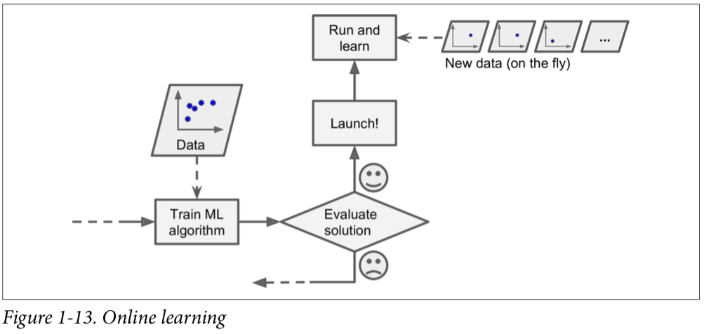

Slide 41
Online Learning
Great for systems that
Receive data as a continuous flow
e.g., stock prices
Need to adapt to change rapidly or autonomously
Have limited computing resources
Once an online learning system has learned about new data instances, you can discard them
Saves disk space

Slide 42
Online Learning
Can also be used to train systems on huge datasets that cannot fit in machine’s main memory
This is called out-of-core learning
Loads part of the data
Runs a training step on that data
Repeats the process until it has run on all of the data
Out-of-core learning is usually done offline (i.e., not on the live system)
Online learning can be a confusing name
Think of it as incremental learning

Slide 43
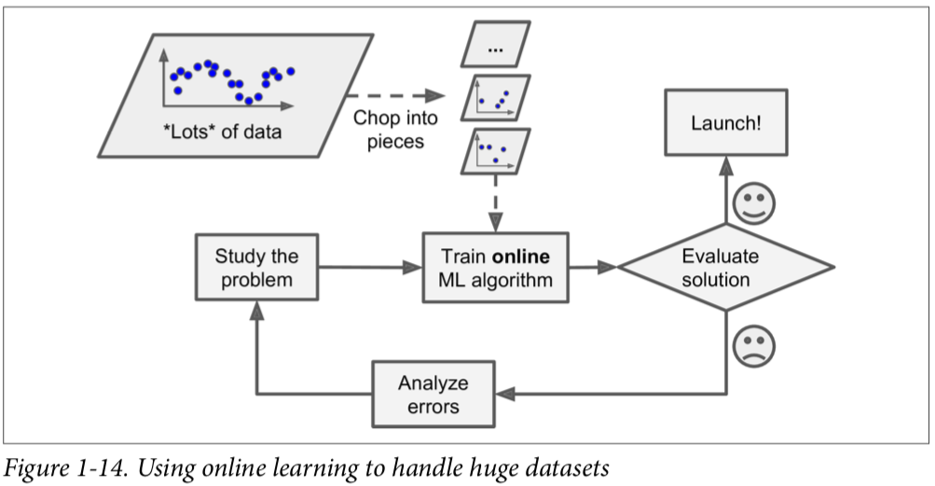

Slide 44
Online Learning
A parameter of online learning systems controls how fast they should adapt to changing data
Learning rate
If the system has a high learning rate
Your system will rapidly adapt to new data
It will also tend to quickly forget the old data
E.g. you don’t want a spam filter to flag only the latest kinds of spam it was shown
If the system has a low learning rate
The system will have more inertia and learn more slowly
It will also be less sensitive to noise in the new data or to sequences of nonrepresentative data points (outliers)

Slide 45
Online Learning
If bad data is fed to the system, the system’s performance will gradually decline
For example, bad data could come from
A malfunctioning sensor on a robot
Someone spamming a search engine to try to rank high in search results
To reduce this risk
You need to monitor your system closely
Promptly switch learning off (and possibly revert to a previously working state) if you detect a drop in performance
You may also want to monitor the input data and react to abnormal data (e.g., using an anomaly detection algorithm)

Slide 46
Instance-Based Versus Model-Based Learning
Categorize ML systems based on how they generalize
Most Machine Learning tasks are about making predictions
This means that given a number of training examples, the system needs to be able to generalize to examples it has never seen before
Having a good performance measure on the training data is good, but insufficient; the true goal is to perform well on new instances

Slide 47
Instance-Based Learning
Spam filter example
Flag all emails that are identical to emails that have already been flagged by users
Flag emails that are very similar to known spam emails
Measure of similarity between two emails
The number of words they have in common
Flag an email as spam if it has many words in common with a known spam email

Slide 48
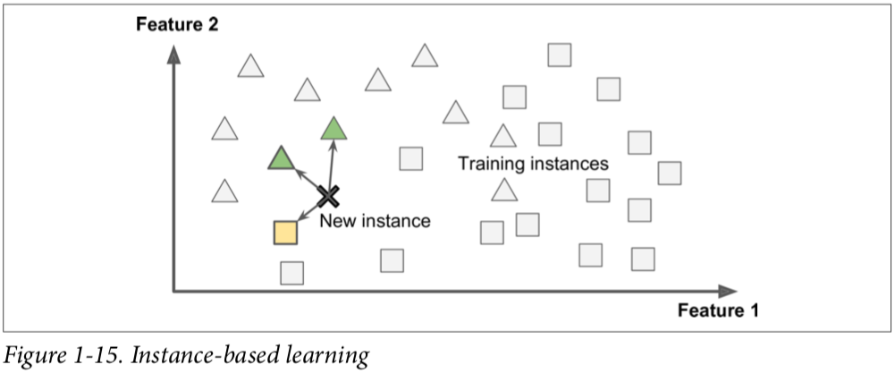
Instance-Based Learning
Learns the examples by heart
Generalizes to new cases by comparing them to the learned examples (or a subset of them) using a similarity measure

Slide 49
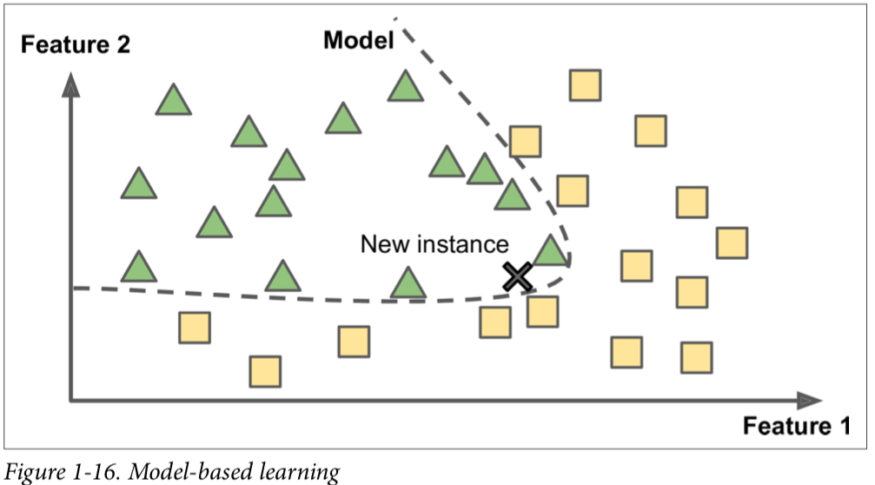
Model-Based Learning
Build a model using training examples
Use this model to make predictions

Slide 50
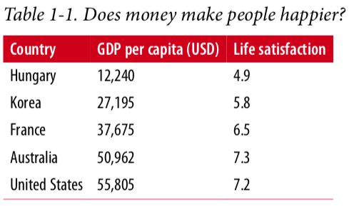
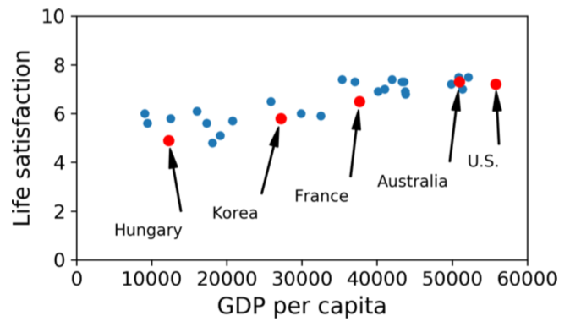
Model-Based Learning
Example: Want to know if money makes people happy

Slide 51

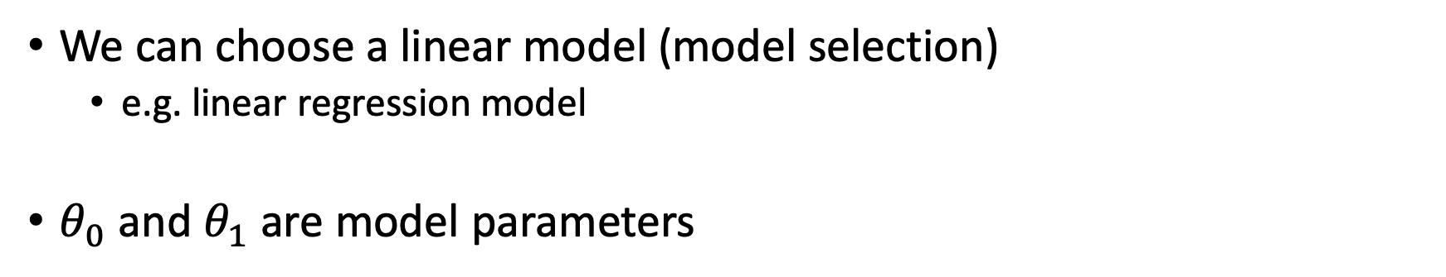
Model-Based Learning
We can choose a linear model (model selection)
e.g. linear regression model
$θ_{0}$ and $θ_{1}$ are model parameters

Slide 52
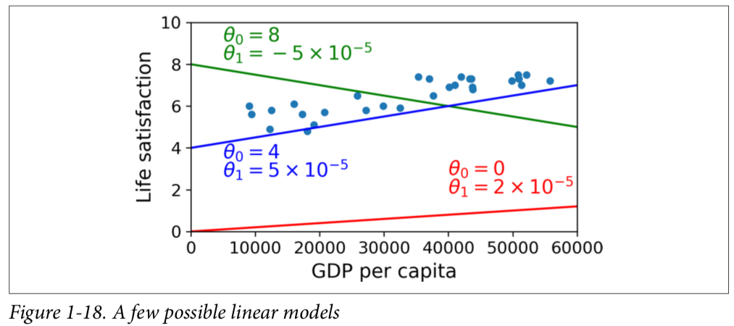

Slide 53
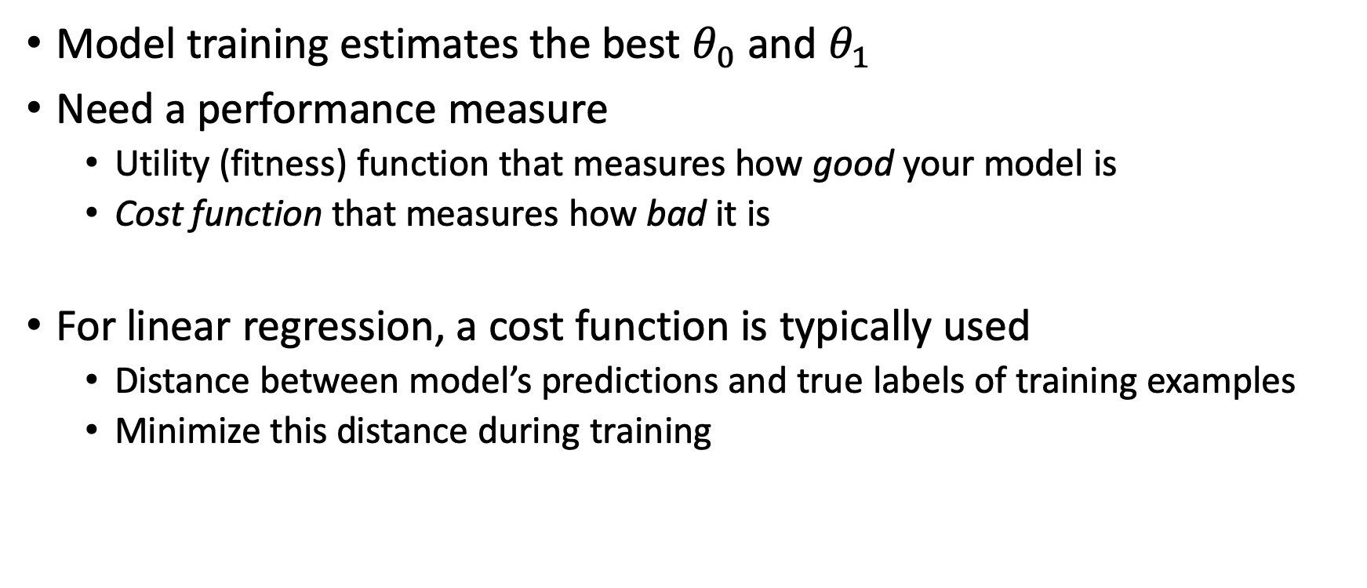
Model-Based Learning
Model training estimates the best $θ_{0}$ and $θ_{1}$
Need a performance measure
Utility (fitness) function that measures how good your model is
Cost function that measures how bad it is
For linear regression, a cost function is typically used
Distance between model’s predictions and true labels of training examples
Minimize this distance during training

Slide 54
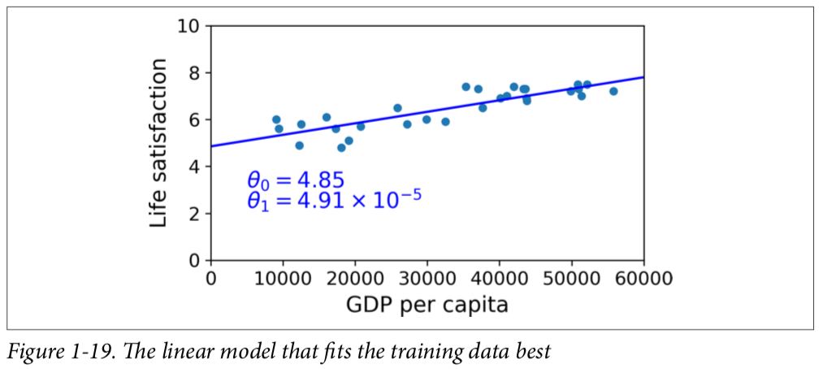

Slide 55
Model-Based Learning
Run the model to make predictions for new data
Want to know how happy Cypriots are and it is not available in our dataset
Cyprus’s GDP per capita = $22,587
Compute life satisfaction using linear regression model
4.85 + 22,587 × 4.91 × 10-5 = 5.96

Slide 56
Instance-Based Learning for Example Problem
Three countries with closest GDP per capita to that of Cyprus
Slovenia, Portugal, Spain
Life satisfactions: 5.7, 5.1, 6.5
Average of life satisfactions: 5.77
K-nearest-neighbor regression (k=3 for this example)

Slide 57
Ways to Improve
If these approaches do not perform well
Use more attributes (employment rate, health, air pollution, etc.)
Get more or better quality training data
Select a more powerful model (e.g., a Polynomial Regression model)

Slide 58
Main Steps of an ML Project
Study the data
Select a model
Train the model on training data
Apply the model and make predictions on new data hoping that the model will generalize well
Inference

Slide 59
Main Challenges of Machine Learning
Two things can go wrong: bad data and bad algorithm
Challenges related to bad data will be covered next

Slide 60
Insufficient Quantity of Training Data
For simple problems one may need thousands of examples
For complex problems such as image or speech recognition one may need millions of examples (unless you can reuse parts of an existing model)

Slide 61
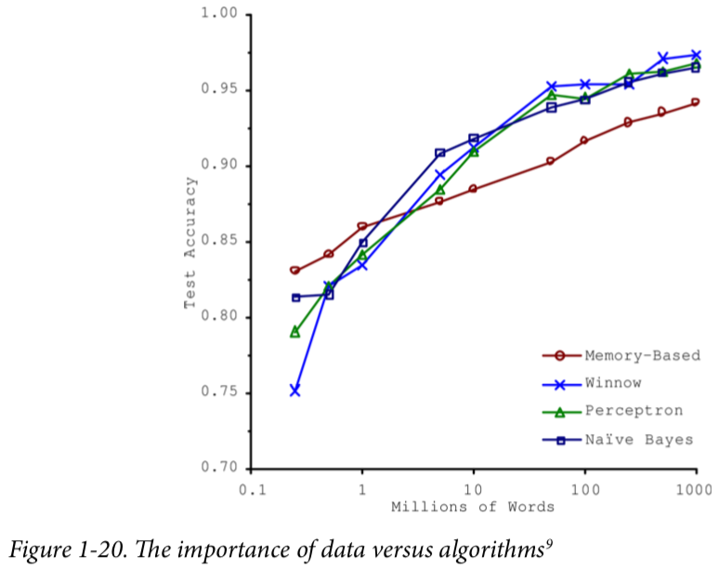
Natural language disambiguation

Slide 62
Nonrepresentative Training Data
In order to generalize well, it is crucial that your training data be representative of the new cases you want to generalize to
True whether you use instance-based learning or model-based learning
For example, the set of countries we used earlier for training the linear model was not perfectly representative; a few countries were missing

Slide 63
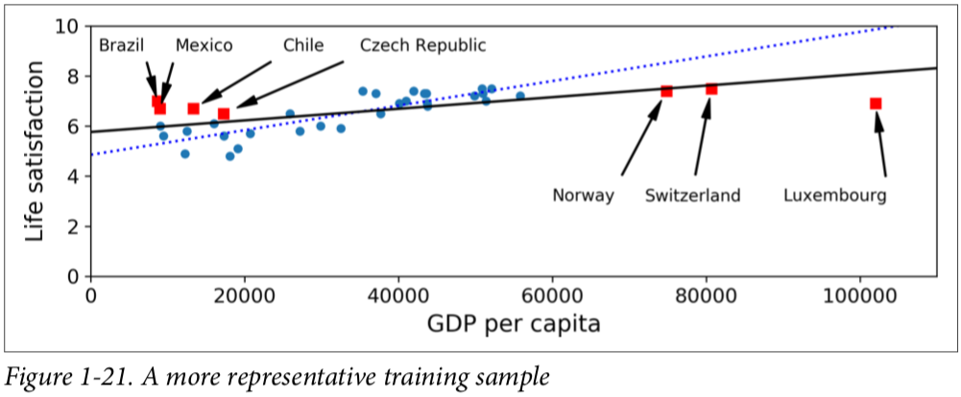

Slide 64
Nonrepresentative Training Data
If you train a linear model on this new data, you get the solid line, while the old model is represented by the dotted line
Adding a few missing contries significantly changed the model
Linear model may not be the best model for this data
Very rich countries are not happier than moderately rich countries
By using a nonrepresentative training set, we trained a model that is unlikely to make accurate predictions, especially for very poor and very rich countries

Slide 65
Nonrepresentative Training Data
If the sample size is too small, you will have sampling noise (i.e., nonrepresentative data as a result of chance)
But even very large number of samples can also be nonrepresentative if the sampling method is flawed. This is called sampling bias

Slide 66
Nonrepresentative Training Data
An example to sampling bias
US presidential election in 1936
Literary Digest conducted a very large poll, sending mail to about 10 million people
It got 2.4 million answers, and predicted with high confidence that Landon would get 57% of the votes
Instead, Roosevelt won with 62% of the votes

Slide 67
Nonrepresentative Training Data
The flaw in sampling method of Literary Digest
Literary Digest used telephone directories, lists of magazine subscribers, club membership lists, and the like
All of these lists tend to favor wealthier people, who are more likely to vote Republican (hence Landon)
Less than 25% of the people who received the poll answered
This introduces a sampling bias, by ruling out people who don’t care much about politics, people who don’t like the Literary Digest, and other key groups
This is a special type of sampling bias called nonresponse bias

Slide 68
Poor-Quality Data
If training data contains errors, outliers, and noise (e.g., due to poor- quality measurements) it will make it harder for the system to detect the underlying patterns, and the system is less likely to perform well
Training data can be cleaned before model training
Outliers can be removed or the errors can be fixed manually
If some features contain missing data
Ignore features with missing data
Ignore instances with missing data
Fill the missing values
Train one model with the feature that has missing data and another model without it

Slide 69
Irrelevant Features
Your system will only be capable of learning if the training data contains enough relevant features and not too many irrelevant ones
A critical part of the success of a Machine Learning project is coming up with a good set of features to train on. This process, called feature engineering, involves
Feature selection: selecting the most useful features to train on among existing features
Feature extraction: combining existing features to produce a more useful one
Generating new features by gathering new data

Slide 70
Main Challenges of Machine Learning
Two things can go wrong: bad data and bad algorithm
Challenges related to bad algorithm will be covered next

Slide 71
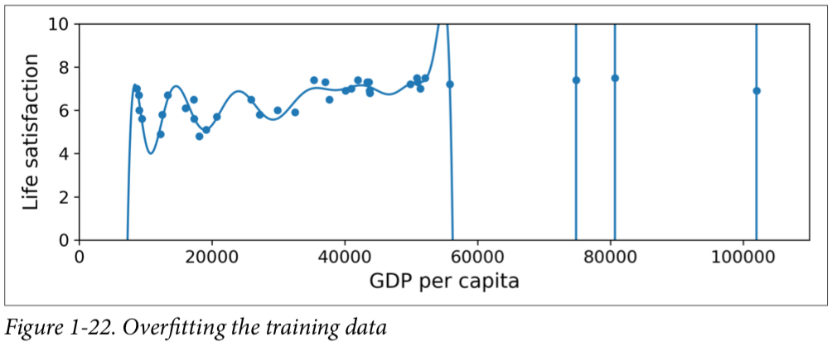
Overfitting the Training Data
Model performs well on training data but it does not perform well on test data and does not generalize well to new unseen data
A high-degree polynomial life satisfaction model that strongly overfits the training data

Slide 72
Overfitting the Training Data
Complex models such as deep neural networks can detect subtle patterns in the data
If the training set is noisy, or if it is too small (which introduces sampling noise), then the model is likely to detect patterns in the noise itself
These patterns will not generalize to new instances

Slide 73
Overfitting the Training Data
Example: add country name to life satisfaction model
A complex model may detect patterns like the fact that all countries in the training data with a w in their name have a life satisfaction greater than 7: New Zealand (7.3), Norway (7.4), Sweden (7.2), and Switzerland (7.5)
This w rule will not generalize to new data such as Rwanda or Zimbabwe
This pattern occurred by chance and the model has no way to tell whether a pattern is real or simply the result of noise in the data

Slide 74
Overfitting the Training Data
Overfitting happens when the model is too complex relative to the amount and noisiness of the training data
The possible solutions are:
To simplify the model by
selecting one with fewer parameters (e.g., a linear model rather than a high-degree polynomial model),
reducing the number of attributes in the training data
constraining the model (e.g. regularization)
To gather more training data
To reduce the noise in the training data (e.g., fix data errors and remove outliers)

Slide 75

Overfitting the Training Data
Constraining a model to make it simpler and reduce the risk of overfitting is called regularization
Consider the linear model for predicting life satisfaction
$θ_{0}$ and $θ_{1}$ are model parameters

Slide 76
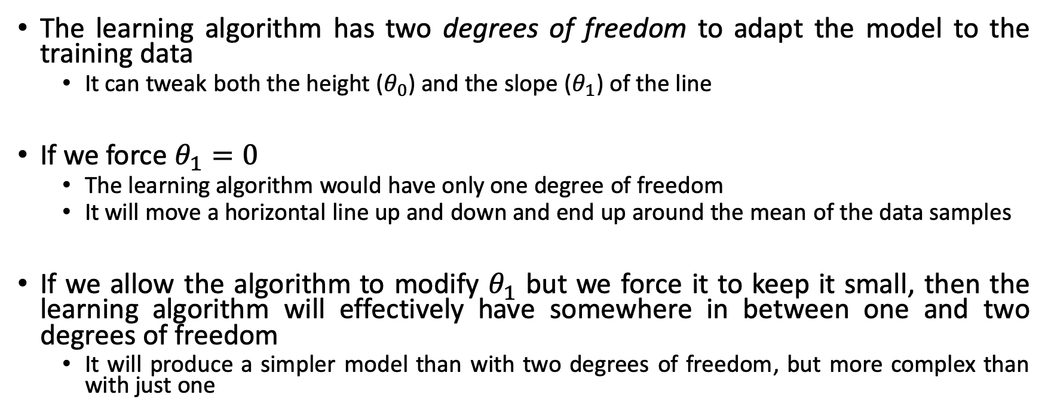
Overfitting the Training Data
The learning algorithm has two degrees of freedom to adapt the model to the training data
It can tweak both the height ($θ_{0}$) and the slope ($θ_{1}$) of the line
If we force $θ_{1}=0$
The learning algorithm would have only one degree of freedom
It will move a horizontal line up and down and end up around the mean of the data samples
If we allow the algorithm to modify $θ_{1}$ but we force it to keep it small, then the learning algorithm will effectively have somewhere in between one and two degrees of freedom
It will produce a simpler model than with two degrees of freedom, but more complex than with just one

Slide 77
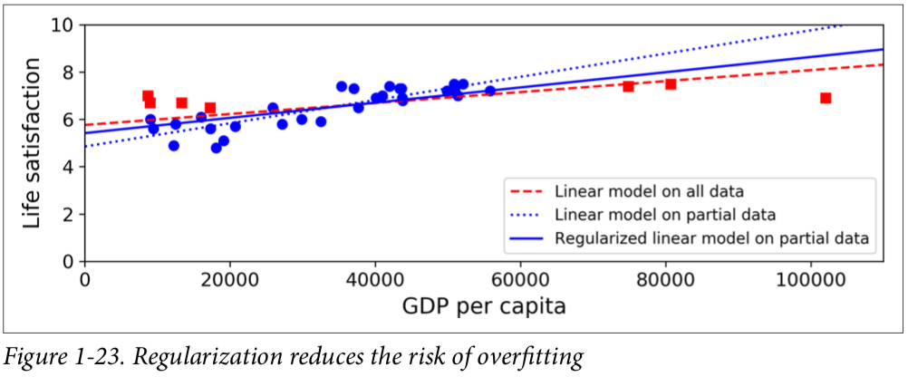
Overfitting the Training Data
You want to find the right balance between fitting the training data perfectly and keeping the model simple enough to ensure that it will generalize well
In the life satisfaction example, regularization forced the model to have a smaller slope, which fits a bit less the training data that the model was trained on, but actually allows it to generalize better to new examples

Slide 78
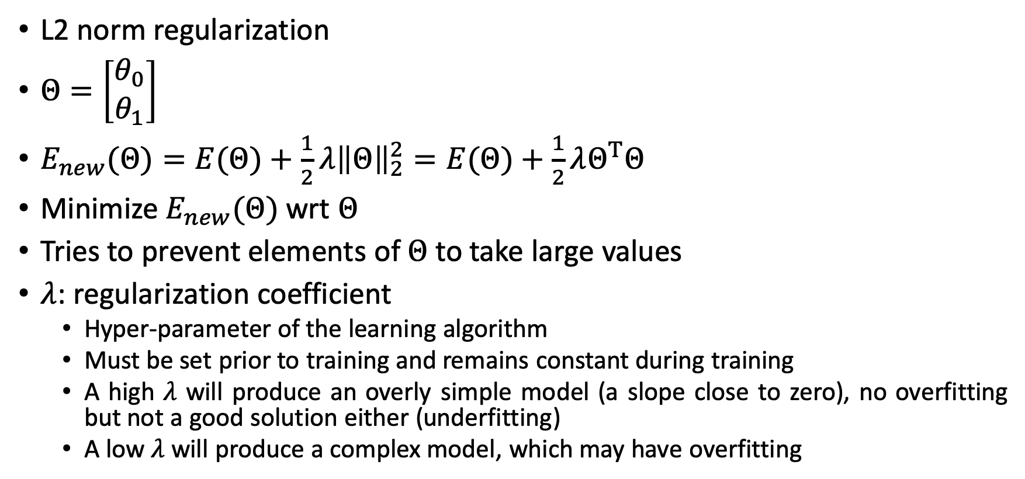
Overfitting the Training Data
L2 norm regularization
$Θ=\left[\begin{aligned}θ_{0} \\ θ_{1}\end{aligned}\right]$
$E_{new}(Θ)=E(Θ)+\frac{1}{2}λ{\left\|Θ\right\|}_{2}^{2}=E(Θ)+\frac{1}{2}λΘ^{T}Θ$
Minimize $E_{new}(Θ)$ wrt $Θ$
Tries to prevent elements of $Θ$ to take large values
$λ$: regularization coefficient
Hyper-parameter of the learning algorithm
Must be set prior to training and remains constant during training
A high $λ$ will produce an overly simple model (a slope close to zero), no overfitting but not a good solution either (underfitting)
A low $λ$ will produce a complex model, which may have overfitting

Slide 79
Underfitting the Training Data
Opposite of overfitting
Occurs when your model is too simple to learn the underlying structure of the data
For example,
A linear model of life satisfaction is prone to underfit
Reality is just more complex than the model
Its predictions are bound to be inaccurate, even on the training examples
Low performance both on training and test set

Slide 80
Underfitting the Training Data
The main options to fix this problem are:
Selecting a more powerful model, with more parameters
Feeding better features to the learning algorithm (feature engineering)
Reducing the constraints on the model (e.g., reducing the regularization hyper‐parameter)

Slide 81
Stepping Back
Machine Learning is about making machines get better at some task by learning from data, instead of having to explicitly code rules
There are many different types of ML systems: supervised or not, batch or online, instance-based or model-based, and so on
In an ML project you gather data in a training set, and you feed the training set to a learning algorithm
If the algorithm is model-based it tunes some parameters to fit the model to the training set (i.e., to make good predictions on the training set itself), and then hopefully it will be able to make good predictions on new cases
If the algorithm is instance-based, it just learns the examples by heart and generalizes to new instances by comparing them to the learned instances using a similarity measure

Slide 82
Stepping Back
The system will not perform well if
Your training set is too small
If the data is not representative
If the data is noisy
If the data is polluted with irrelevant features (garbage in, garbage out)
Your model needs to be neither too simple (in which case it will underfit) nor too complex (in which case it will overfit)

Slide 83
Testing and Validating
Split your data into two sets: the training set and the test set
Train your model using the training set and test it using the test set
The error rate on new cases is called the generalization error (or out-of- sample error)
By evaluating your model on the test set, you get an estimate of this error
This value tells you how well your model will perform on instances it has never seen before
It is common to use 80% of the data for training and hold out 20% for testing
This also depends on the size of the dataset: if it contains 10 million instances, then holding out 1% means your test set will contain 100,000 instances: that’s probably more than enough to get a good estimate of the generalization error

Slide 84
Testing and Validating
If the training error is low (i.e., your model makes few mistakes on the training set) but the generalization error is high, it means that your model is overfitting the training data

Slide 85
Hyperparameter Tuning and Model Selection
Suppose we have a regression problem and we use regression models
Linear regression, polynomial regression
We want to apply regularization to avoid overfitting
How to select (i.e. optimize) the regularization coefficient (a hyper-parameter)?

Slide 86
Hyperparameter Tuning and Model Selection
Do not optimize it on test set because on new and unseen data the model may perform worse
One technique is called holdout validation
Select a subset of training set randomly as validation set (also called development set or dev set)
The rest becomes the training set for optimizing hyper-parameters
Try different values for the hyper-parameter(s), train the model on training set and evaluate its performance on validation set
Choose the particular hyper-parameter value combination that gives the best performance on validation set
Train the model on the full training set (combination of reduced training set and validation set)
Evaluate the final performance of the model on test set (estimate of generalization error) using the optimum values of hyper-parameters found on validation set

Slide 87
Dataset
Training set
Test set
Training set
Validation set
Test set

Slide 88
Hyperparameter Tuning and Model Selection
If validation set is small, model evaluations will be imprecise
If we increase the size of the validation set then the number of samples that will go to reduced training set will be small
For this case, one can perform cross-validation on training set to optimize hyper-parameters
Cross-validation gives more accurate measure of the model’s performance as compared to using a single validation set (if validation set is small)
Computational cost of cross-validation is higher as compared to using a single validation set

Slide 89
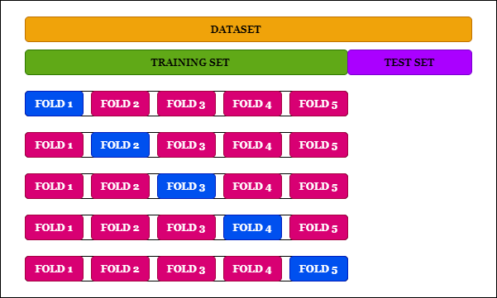
Cross-validation

Slide 90
Hyperparameter Tuning and Model Selection
Training set, validation set, test set
Training set (cross-validation), test set

Slide 91
Data Mismatch
Data that goes to training, validation and test set should be representative
Example: you want to create a mobile app to take pictures of flowers and automatically determine their species
Suppose validation set performance is low
Overfitting
Mismatch between web and mobile app pictures
Training set
(millions of pictures from web)
Validation set
(5000 pictures from mobile app)
Test set
(5000 pictures from mobile app)

Slide 92
Data Mismatch
Select a subset of training set as train-dev set
Train on training set and evaluat on train-dev set
If performance on train-dev set is low then there is overfitting
Simplify or regularize the model, get more training data, clean up training data
If performance on train-dev set is high then the problem is caused by data mismatch
Preprocess web images to make them look like images taken by mobile app
Training set
(millions of pictures from web)
Train-dev set
(pictures from web)
Validation set
(5000 pictures from mobile app)
Test set
(5000 pictures from mobile app)

Slide 93
No Free Lunch Theorem
If we make no assumptions about the data there is no reason to prefer one model over any other
For some datasets the best model can be a linear model and for others it may be a neural network
There is no model that is a priori guaranteed to work better
The only way to know for sure which model is best is to evaluate them all (not practical)
In practice you make some reasonable assumptions about the data and you evaluate only a few reasonable models
For example, for simple tasks you may evaluate linear models with various levels of regularization
For a complex problem you may evaluate various neural networks

