Slide 1
Week 10-Public Key Infrastructure – aka PKI and Session Key Exchange
Source:https://cseweb.ucsd.edu/classes/sp22/cse107-a/

Slide 2
Plan
Public Key Infrastructure (PKI)
Session key exchange

Slide 3


The public key setting
Bob’s secret key is sk[B] and its associated public key is pk[B]. The public key setting assumes Alice is in possession of pk[B].
_{A}pk[B]
B
C ←$ E_{pk[B]}(M)
V_{pk[B]}(M, σ)
C
M ← D_{sk[B]}(C )
M,σ
$
σ ← S (M)
sk[B]
Now Alice can encrypt a message M under pk[B] to get a ciphertext C
that B can decrypt using sk[B].
Bob can sign a message M using sk[B] to get signature σ that Alice can verify using pk[B].
But how does Alice get pk[B]?
1/38

Slide 4
But who exactly are Alice and Bob?
Typically, as in most uses of TLS, Bob is a server. Its identity B is an associated domain name or IP address, for example B = google.com.
Alice is a client, also with an associated ip address.
2/38

Slide 5
How does A get B’s public key?
How about: B runs a prescribed key-generation algorithm K to generate (pk[B], sk[B]). It sends (B, pk[B]) to A.
B,pk[B]
(pk[B], sk[B]) ←$ K
3/38

Slide 6

Entity-in-the-middle attack
A
Adversary E
B,pk[E ]
(pk[E ], sk[E ]) ←$ K
4/38

Slide 7
Entity-in-the-middle attack
A
Adversary E
B,pk[E ]
(pk[E ], sk[E ]) ←$ K
So:
C ←$ E_{pk[E ]}(M)
V_{pk[E ]}(M, σ)
C
M ← D_{sk[E ]}(C )
M,σ
$
σ ← S (M)
sk[E ]
Adversary E can decrypt ciphertexts intended for B and can forge B’s signatures. Adversary effectively becomes B.
4/38

Slide 8
PKI, CAs and certificates
Goal: A gets an authentic copy of B’s public key, meaning if pk claims to come from B, then A has a proof to be sure it is real B.
Popular Solution: The PKI (Public Key Infrastructure).
Certificate authority: Trusted entity that provides the above proof. Certificate: The proof
Note: There are other ways to reach the goal: B could post its public key on its Facebook; post it on its personal or corporate webpage; include it as an attachment in its emails; put it on a keyserver like openpgp SKS; hand it to A in person; ... (what do you think of these methods?)

Slide 9
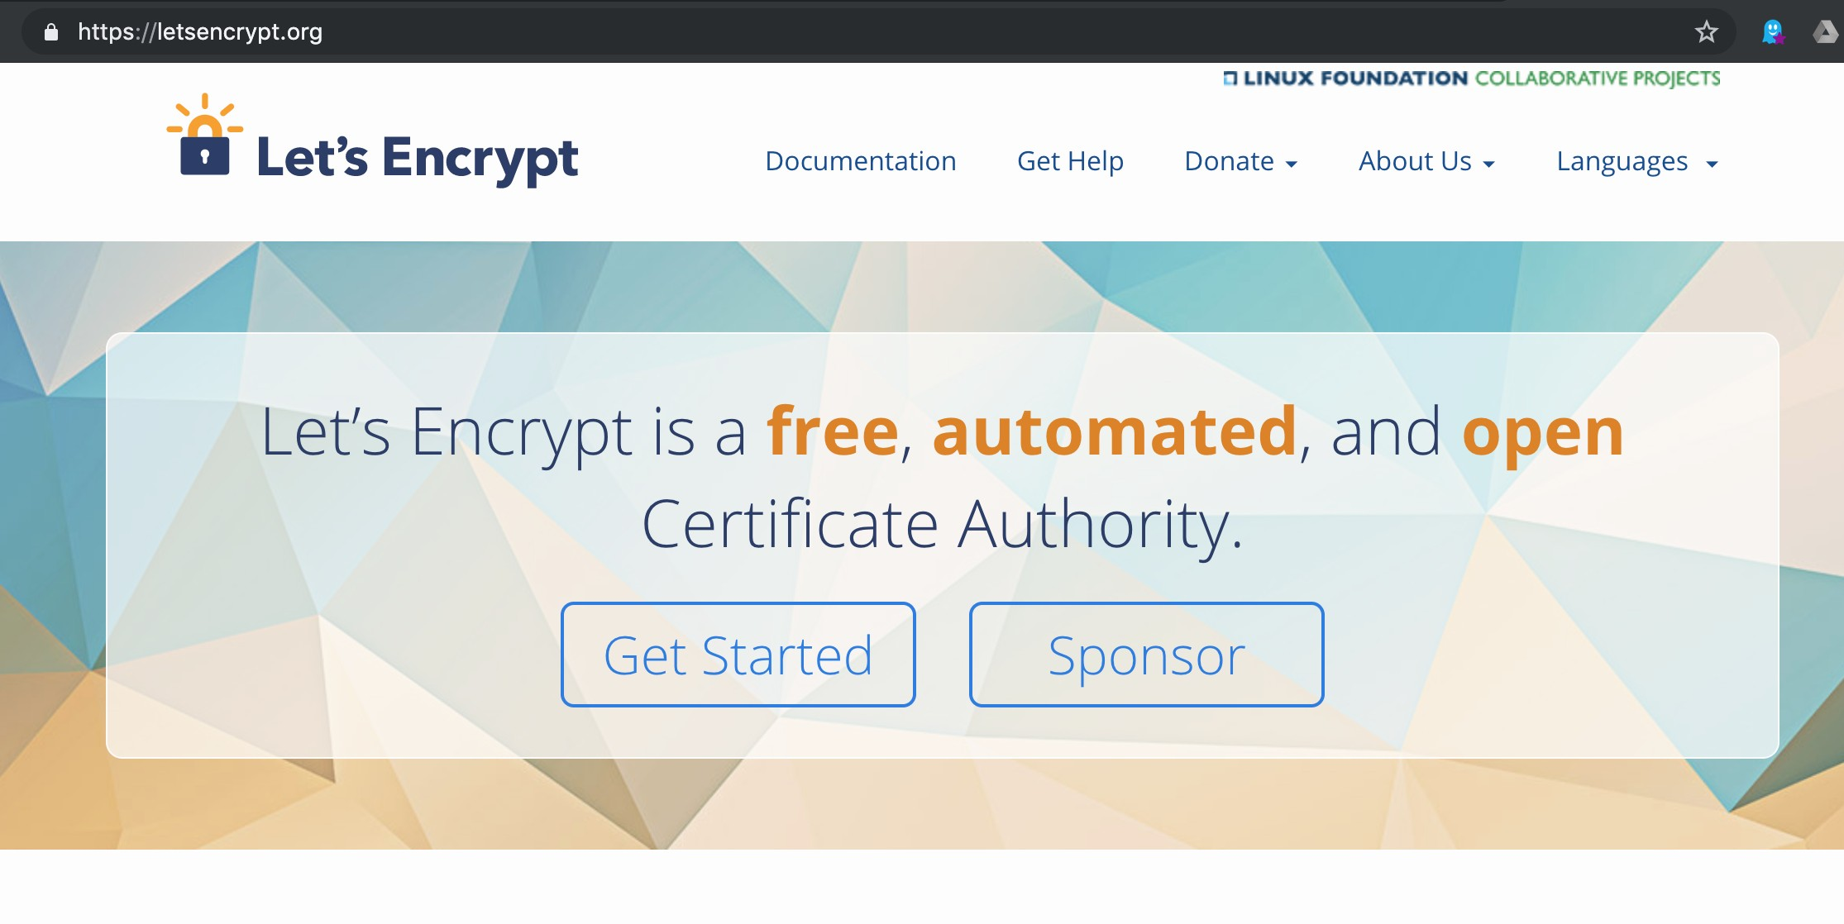
Let’s Encrypt

Slide 10
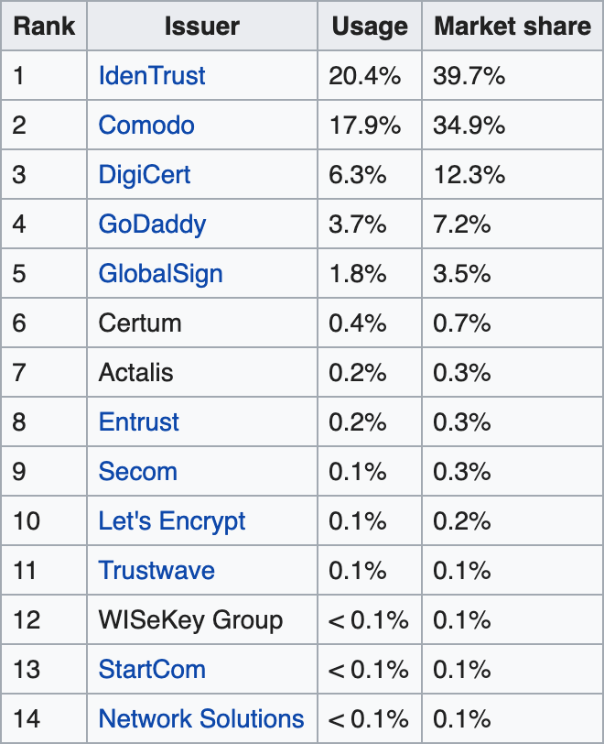
Some other certificate authorities

Slide 11
Certificate process
B generates (pk, sk) ←$ K by running a key-generation algorithm K
B sends its identity B, and pk, to CA
CA does identity check to ensure pk is B’s B proves knowledge of sk to CA
CA issues certificate to B B sends certificate to A
A verifies certificate and extracts B’s public key pk

Slide 12
OPENSSL
OpenSSL is a software library for applications that provide secure communications over computer networks against eavesdropping, and identify the party at the other end. It is widely used by Internet servers, including the majority of HTTPS websites.
OpenSSL contains an open-source implementation of the SSL and TLS protocols. The core library, written in the C programming language, implements basic cryptographic functions and provides various utility functions.

Slide 13
RSA Key generation with openssl
Generate a 3072-bit RSA key, output it to key.pem:
$ openssl genrsa -out key.pem 3072
Generating RSA private key, 3072 bit long modulus (2 primes)
........................++++
.................................++++ e is 65537 (0x010001)
Extract the public key from the key pair, which can be used in a certificate
$ openssl rsa -in key.pem -outform PEM -pubout -out public.pem writing RSA key

Slide 14
EC Key generation with openssl
Generate an EC (256-bit) private key with the elliptic curve prime256v1, output it to key.pem:
$ openssl ecparam -name prime256v1 -genkey -noout -out key.pem
Extract the public key from the key pair, which can be used in a certificate
$ openssl ec -in key.pem -pubout -out public.pem read EC key
writing EC key

Slide 15
Checks
B sends its identity B (domain name, ip address, email address, ...) and its public key pk to the certificate authority (CA).
Upon receiving (B, pk) the CA performs some checks to ensure pk is really
B’s key.
Example: If B is a domain name, then the CA sends B a challenge and checks that it can put it on the webpage of the domain name.
Example: If B is an email address, then the CA sends an email to that address with a link for B to click to verify that it owns the address.
Example: If B is a passport or driver’s license, the CA may be able to verify it physically, or from official government system.
Proof of knowledge of secret key: The CA might have B sign or decrypt something under sk to ensure that B knows sk. This ensures B has not copied someone else’s public key.

Slide 16
In openssl: certificate requests
$ openssl req -newkey rsa:3072 Generating a RSA private key
..............++++
...++++
writing new private key to ’privkey.pem’ Enter PEM pass phrase:
Verifying - Enter PEM pass phrase:
[...]
Country Name (2 letter code) [AU]:
State or Province Name (full name) [Some-State]: [...]
-----BEGIN CERTIFICATE REQUEST-----
MIIDijCCAfICAQAwRTELMAkGA1UEBhMCQVUxEzARBgNVBAgMClNvbWUtU3RhdGUx
ITAfBgNVBAoMGEludGVybmV0IFdpZGdpdHMgUHR5IEx0ZDCCAaIwDQYJKoZIhvcN AQEBBQADggGPADCCAYoCggGBAMJxl8Y0INj9UwmMoFqj4/azaEOwG4DSmDlOWp8u uc0ox9QQ20d7LI7cSZOMiXF7U5OAQl6VwbdPdU14BCSlfG9vP23kgirz6T4TuOcG 7Yj82LwqucOmhbhhdcPYooLbmxk6xu1/QQhz+9eLYZmLfE+n7MzdmRxrsLeIwPFs IQHQo1StyDO2A2JbyA1VVB8GpXe2Jj+vRTT5pWc1Qq5DBTvHb4I0ydekswb3hP6j GoavlHATPlPostesQCuCGFxjAn1npxdePaNe11IMCqPQ2UiTlssg3KfbueAWOdzS dl9cly0DclDh3Emriv2mtRS+SBYN6VptTqc1Uu7DwzEOhbVQkFa1OfPaNwafJTL0 j+4LBbcywEoHD9baA1ZRUr80Dn3SXsY4fTqXqSR2S5mEK1K7GoEmp917kg2mITRO o8eoUbERDEWC1h6IHAw9C4u2M7fPbln46AtbbRAOpkbCBTi9IqtsPQvE67XiH3uX 1hvCPsUfrD9sYMMjTxg/fsKCUwIDAQABoAAwDQYJKoZIhvcNAQELBQADggGBAEbL OBbMJQ6gxG5MGA7UwDs7J4I2uZEo9YMzgRClqxzi9Xuh7BU8JNkL4hD5XgtHAn6A ZAEgWKp0TUbqcLZBVRmiAU+nNH+ZgTIcJ7ZJySSQnI+XCi3UsGTus6cpCudikuf9 HoTuil6CI7geUFr5U57olCvbWFNPm+eOfZcVt3iUixwUrMrNLipraMsJwQx703oR 9AohE13QtvJLJysk+XI6X4B9bmm+CJ/YyoMxG+BGNP/0i5WgGyQMgOiKp4nhozC2 WzqxOE5ECmVzSGuInF7hnIJT1UDUsEgwpjgMMZfA9L/NaZj7f4+KD3O9CjUbZzGw 9zVqjbCuMOweyMNzGTBLuuXvNQVpXPr5jRs8iVwFW+eQaaWAXQH4Ox75/DYMo3HH NFm8drk+lhBzERwdHIHg7127x9epzfxkPwz1h1QMBooQKAqNLQO6c3DqvfRyda7z q/IBpoZpM35PeqsYS8IUCceIjwYAM5GmpQZ4Fsb9VgW1bmK/fUBlUf9TGJhUwQ==
-----END CERTIFICATE REQUEST-----
key + identity
=
certificate request

Slide 17
In openssl: certificate requests
$ openssl req -newkey ec:<(openssl ecparam -name prime256v1)
Generating an EC private key
writing new private key to ’privkey.pem’ Enter PEM pass phrase:
Verifying - Enter PEM pass phrase:
[...]
Country Name (2 letter code) [AU]:
State or Province Name (full name) [Some-State]: [...]
-----BEGIN CERTIFICATE REQUEST-----
MIH/MIGnAgEAMEUxCzAJBgNVBAYTAkFVMRMwEQYDVQQIDApTb21lLVN0YXRlMSEw
HwYDVQQKDBhJbnRlcm5ldCBXaWRnaXRzIFB0eSBMdGQwWTATBgcqhkjOPQIBBggq hkjOPQMBBwNCAAStLsJ/rKbthNWCo01RF3O0ZvCVZK0yS60TmJ0o0lHl/PXWqLlD fLNPTGEmuEVdD8IkcH7INzfkz3VEO0AYsbHZoAAwCgYIKoZIzj0EAwIDRwAwRAIg ZzQRe1h42I6Olazt+qN2ymx20qe81kJraCEtAkBmp4ICIA6kAIL9wBnBlpk2+v73 L1cN0E9k+eFszl89yVJSaazG
-----END CERTIFICATE REQUEST-----
key + identity
=
certificate request
Elliptic curve keys and certificate requests are shorter than for RSA, because the DLog problem is very hard on elliptic curves, and 256-bit keys are safe enough.

Slide 18
Certificate Issuance
Once CA is convinced that pk belongs to B, it forms a certificate
CERT[B] = (CERTDATA, σ),
where σ is the CA’s signature on CERTDATA, computed under the CA’s secret key sk[CA], and CERTDATA contains:
B’s public key pk, and its type (RSA, EC, ...) Identity B of B
Name of CA
Expiry date of certificate
...
The certificate CERT[B] is returned to B.

Slide 19
Certificate usage
B can send CERT[B] to A, who is assumed to have the CA’s public key
pk[CA], and now will:
Parse CERT[B] as (CERTDATA, σ) ← CERT[B]
Check that V_{pk[CA]}(CERTDATA, σ) = 1 Extract (pk, B, expiry, . . .) ← CERTDATA Check certificate has not expired
Check that B is the desired identity
. . .
If all is well, A accepts the certificate and is ready to use the public key pk
therein.
How does A get pk[CA]? CA public keys are embedded in software such as your browser, or, on Apple, in the keychain.

Slide 20
Certificate hierarchies
CERT[Alice]
CERT[CA(USA) : CA(Calif)]
CERT[CA(Calif) : CA(SD)]
CERT[CA(SD) : CA(UCSD)] CERT[CA(UCSD) : Alice]
CA(USA)
CA(Calif) CA(Mass) CA(SD)
CA(UCSD)
Alice
CERT[X : Y ] = ( (pk[Y ], Y , . . .), S_{sk[X ]}((pk[Y ], Y , . . .)) )
To verify CERT[Alice] you need only pk[CA[USA]].

Slide 21
Why certificate hierarchies?
It is easier for CA(UCSD) to check Alice’s identity (and issue a certificate) than for CA(USA) since Alice is on UCSD’s payroll and UCSD already has a lot of information about her.
Spreads the identity-check and certification job to reduce work for individual CAs
Browsers need to have fewer embedded public keys. (Only root CA public keys needed.)

Slide 22
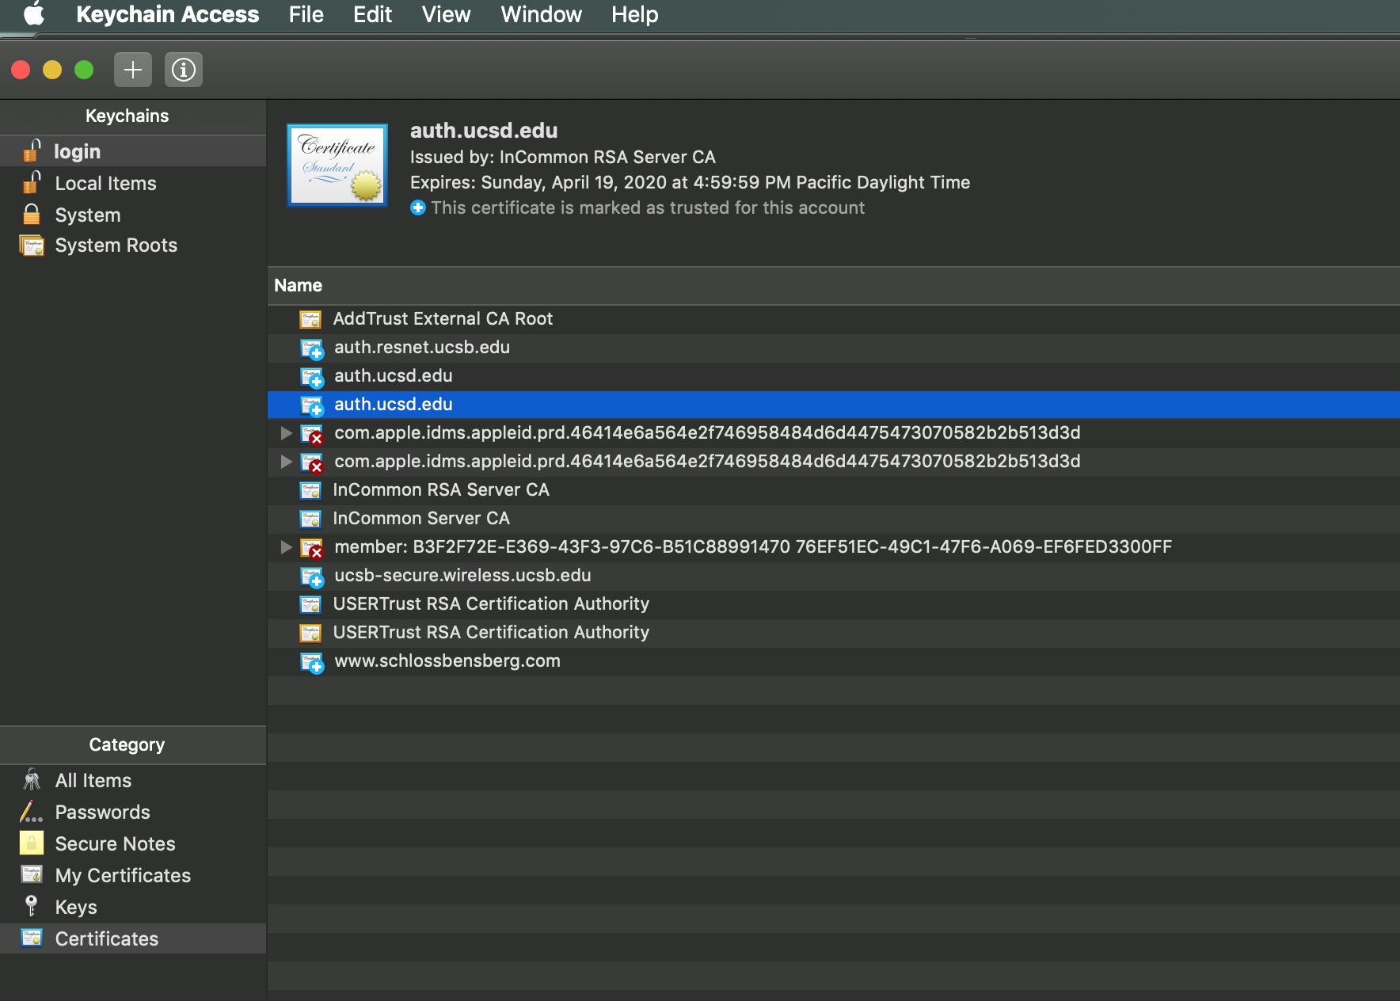
Certificates on Mac: keychain

Slide 23
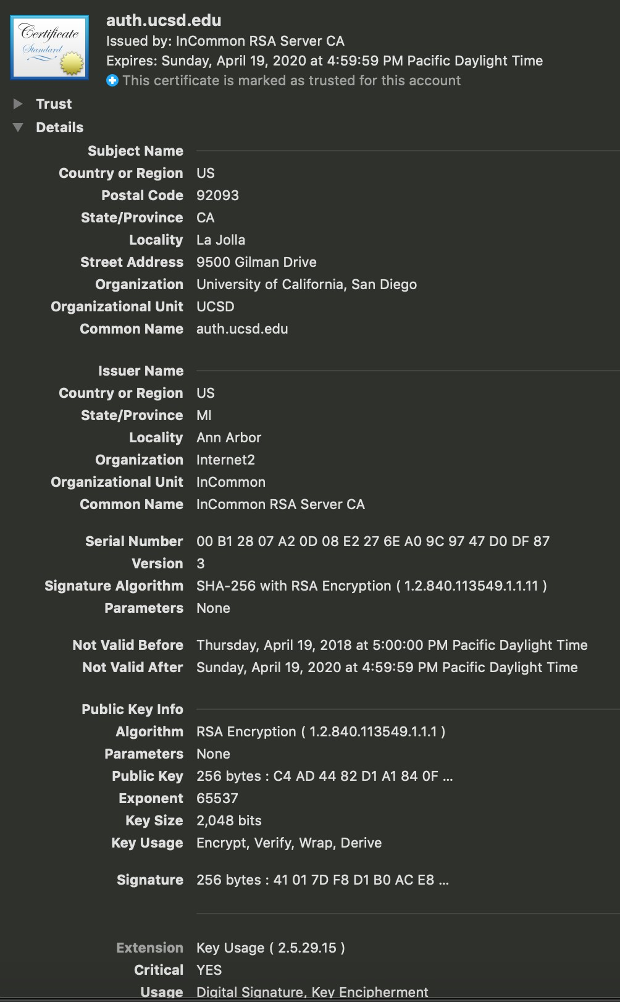
A particular certificate

Slide 24
Revocation
Suppose B wishes to revoke its certificate CERT[B] = (CERTDATA, σ), perhaps because its secret key sk, corresponding to the pk in CERTDATA, was compromised. Then:
B sends CERT[B] and revocation request to CA, signed under sk
CA verifies the signature under pk
CA puts (CERT[B], RevocationDate) on its Certificate Revocation List (CRL)
This list is disseminated.
Before A accepts B’s certificate, A should check that it is not on the CRL. The OCSP (Online Certificate Status Protocol) is one way to do this.

Slide 25
Revocation Issues
May 13: B’s secret key compromised May 16: B’s CERT[B] revoked
May 17: A sees CRL
CERT[B] might be used in the May 13-16 range, compromising security. In practice, CRLs are large and revocation is a problem.

Slide 26
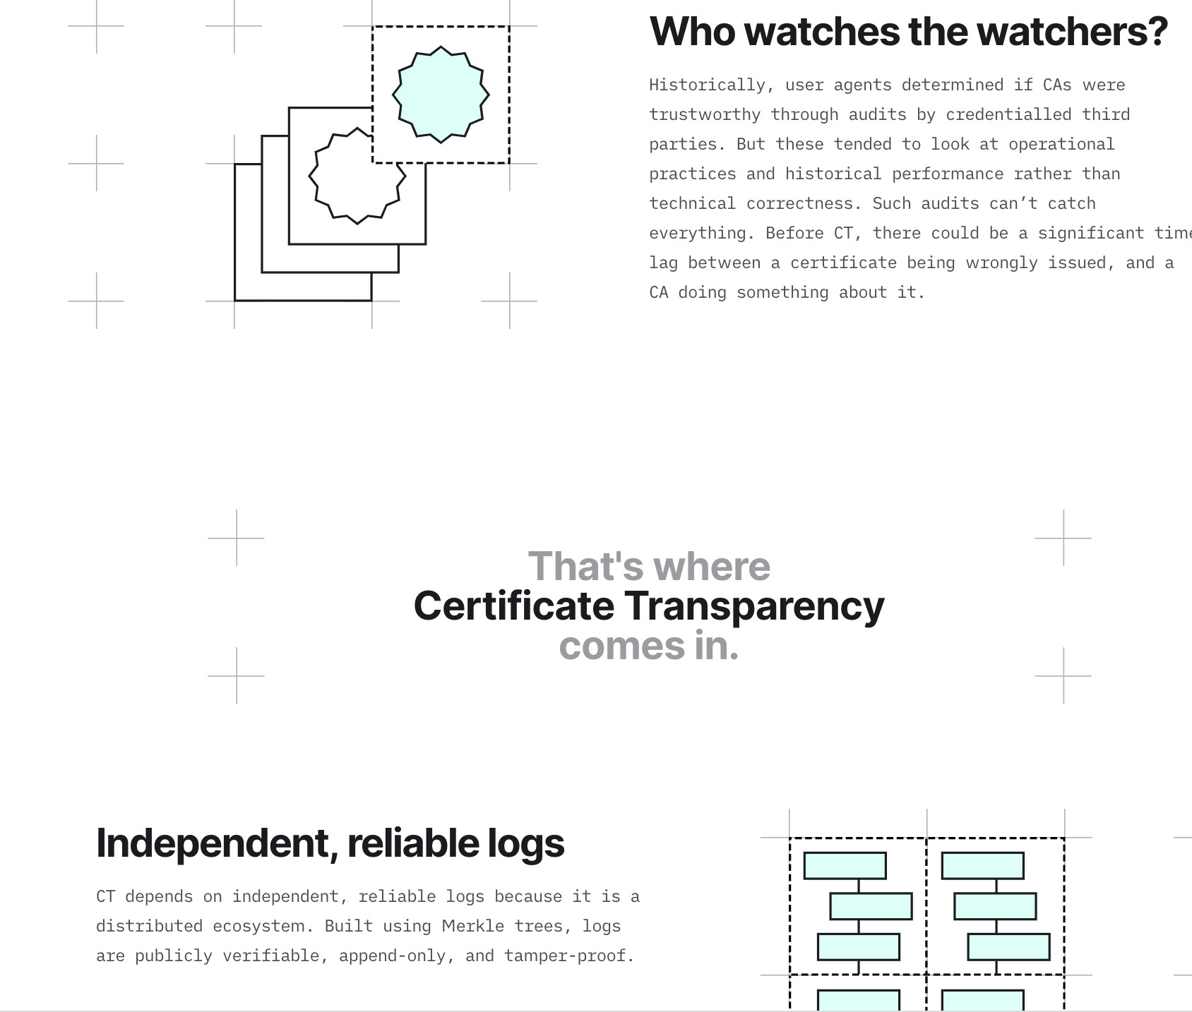
Certificate transparency (link)

Slide 27
OpenPGP
Pretty Good Privacy (PGP) is an encryption program that provides cryptographic privacy and authentication for data communication.
PGP is used for signing, encrypting, and decrypting texts, e-mails, files, directories, and whole disk partitions and to increase the security of e-mail communications. Phil Zimmermann developed PGP in 1991.
PGP encryption uses a serial combination of hashing, data compression, symmetric-key cryptography, and finally public-key cryptography; each step uses one of several supported algorithms.
Each public key is bound to a username or an e-mail address.

Slide 28
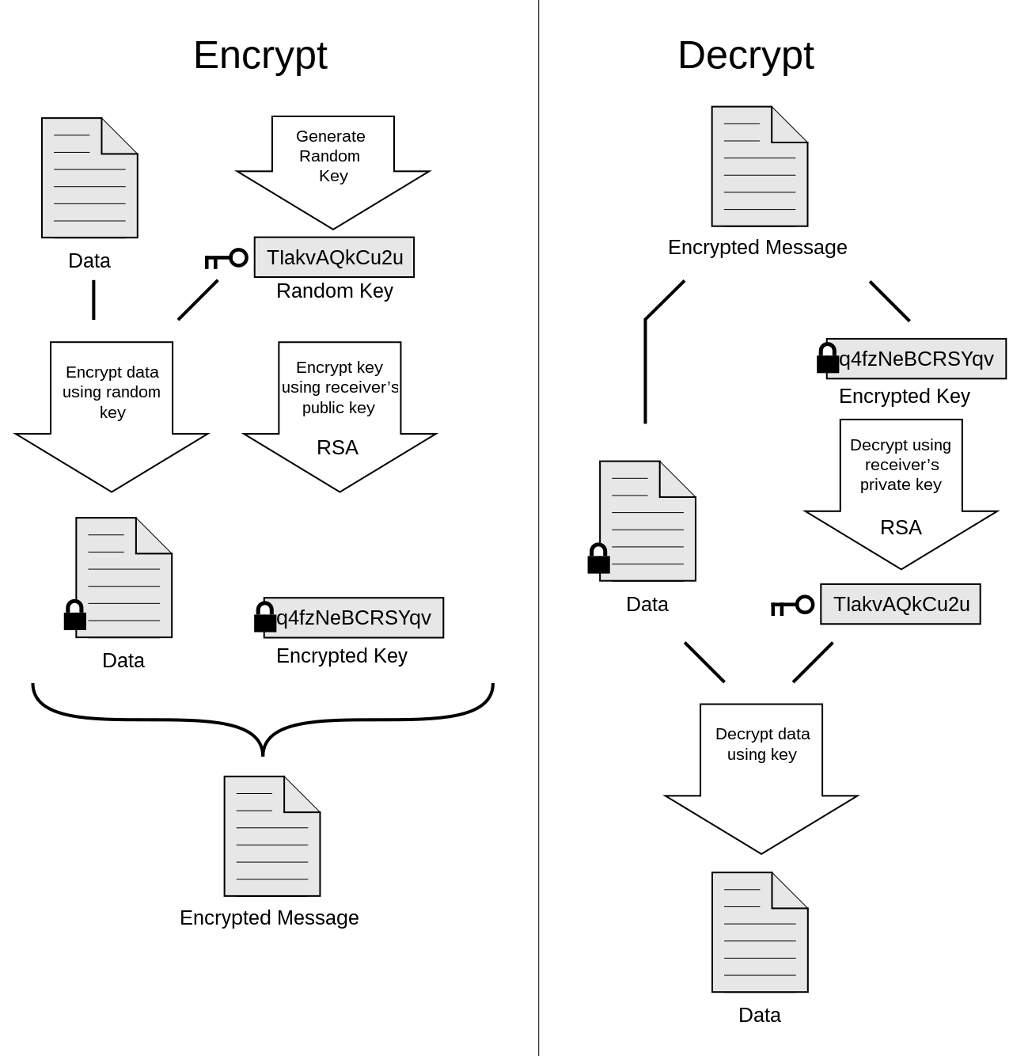
Notes:
https://en.wikipedia.org/wiki/Pretty_Good_Privacy

Slide 29
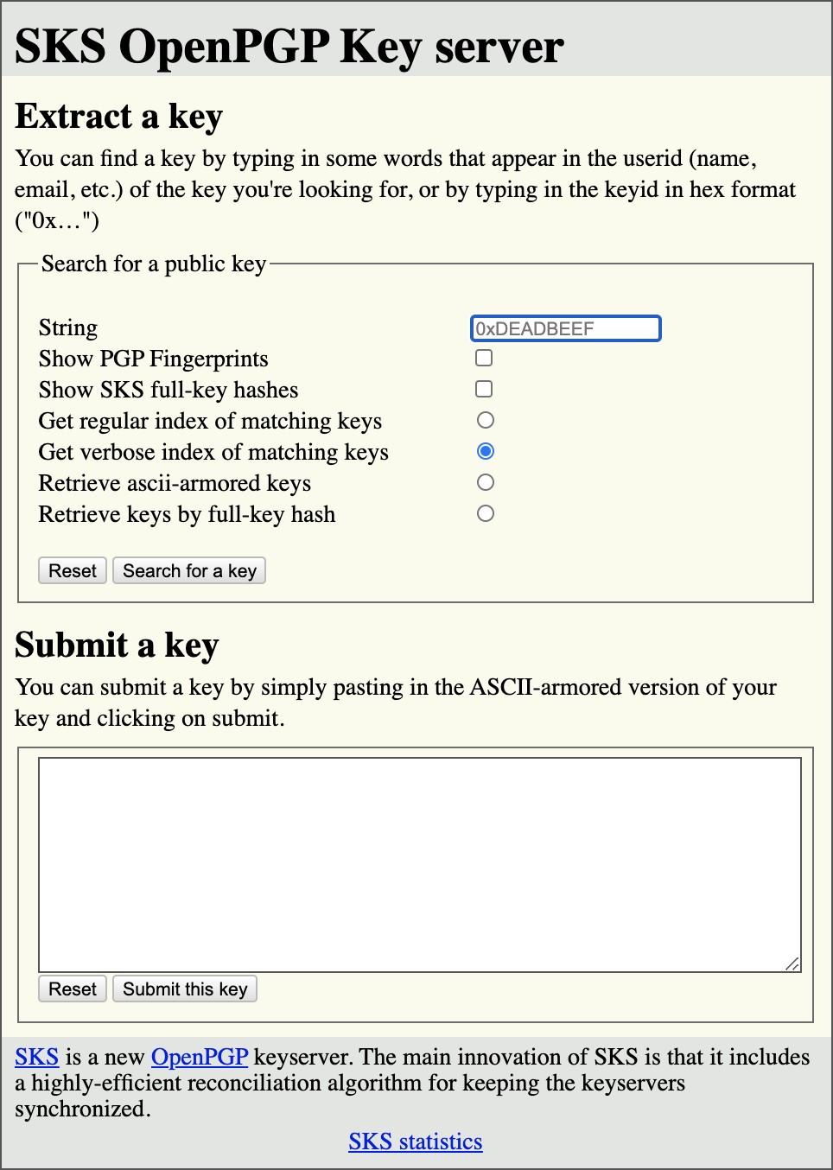
PGP SKS keyservers

Slide 30
Plan
Public Key Infrastructure (PKI)
Session key exchange

Slide 31
Session key exchange
A large part of secure communication over the Internet is through protocols like TLS (https).
Here, public-key cryptography is not used to directly secure data.
Rather, public-key cryptography is used in a session-key exchange that provides (client) A and (server) B with a shared (symmetric) session key K .
Data is then secured under K using an authenticated encryption scheme
AE = (K, E , D):
_{A}K _{B}K
M ← D_{K} (C )
C
C ←$ E_{K} (M)

Slide 32
Session key exchange
Why session keys, as opposed to directly securing data with public-key cryptography?
One reason is performance: symmetric cryptography is more efficient than asymmetric Cryptography in general.
We mentioned that as one of the arguments in favor of hybrid encryption.
More fundamentally, it reflects the Internet architecture in which A and B will engage in multiple, sometimes concurrent communication sessions.
The session key exchange paradigm gives each such session a fresh
session key, making its security independent of that of other sessions.

Slide 33
Recall Diffie-Hellman Key Exchange
Let G = ⟨g ⟩ be a cyclic group of order m in which the Dlog problem is hard. Let H: {0, 1}∗ → {0, 1}^{k} be a hash function.
A
B
x ←$ Z_{m}; X ← g^{x}
L ← Y ^{x}
A,X
B,Y
y ←$ Z_{m}; Y ← g^{y}
L ← X^{y}
Y ^{x} = (g^{y} )^{x} = g ^{xy} = (g^{x} )^{y} = X^{y}
`˛¸x
L
This enables A and B to agree on the common k-bit key K = H(L) =
H(g ^{xy} ).
So is this a suitable session key exchange protocol? Are we done?

Slide 34
DH Key Exchange is secure under Passive Attack
A
B
x ←$ Z_{m}; X ← g^{x}
L ← Y ^{x}
A,X
B,Y
y ←$ Z_{m}; Y ← g^{y}
L ← X^{y}
A passive adversary is one that observes the communication, acquiring X = g^{x} and Y = g^{y} , and wants to compute K = H(g ^{xy} ). But to do so requires solving the Dlog problem, which is here assumed hard.
27/38

Slide 35
DH Key Exchange is secure under Passive Attack
A
B
x ←$ Z_{m}; X ← g^{x}
L ← Y ^{x}
A,X
B,Y
y ←$ Z_{m}; Y ← g^{y}
L ← X^{y}
A passive adversary is one that observes the communication, acquiring X = g^{x} and Y = g^{y} , and wants to compute K = H(g ^{xy} ). But to do so requires solving the Dlog problem, which is here assumed hard.
However, the problem of authenticity remains!!
27/38

Slide 36
DH Key Exchange is insecure under Active Attack
Entity-in-the-middle attack:
A
E
x ←$ Z_{m}; X ← g^{x}
L ← Y ^{x}
A,X
B,Y
y ←$ Z_{m}; Y ← g^{y}
L ← X^{y}
Adversary E impersonates B.
A thinks it shares K = H(L) with B, but in fact A shares K with E .
If A now encrypts, under K , a message intended for B, then E can decrypt the ciphertext and recover the message.
DH in itself does not solve the session key exchange problem.
28/38

Slide 37
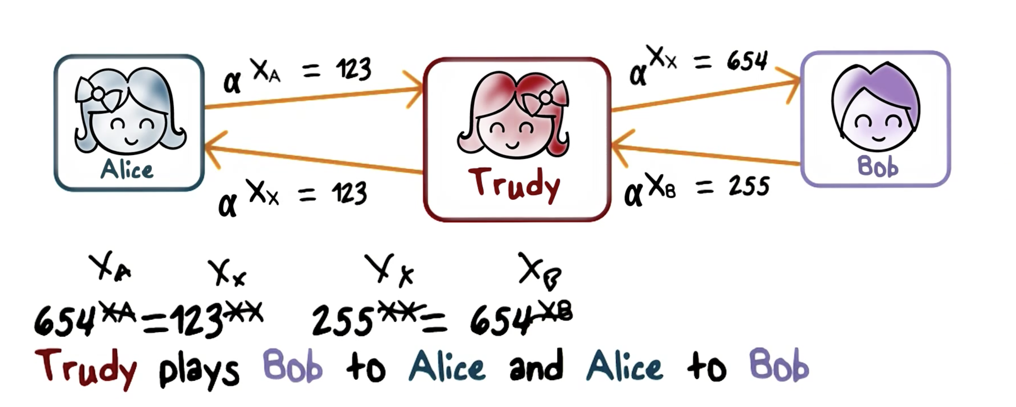
Remember: Man-in-the-Middle(MIM)
Notes:
In general, when Alice and Bob use Diffie-Hellman on the Internet, there is threat of man-in-the-middle. That is Trudy, can intercept the message, or the public key, sent from Alice to Bob, and send her own to Bob; likewise, she can intercept the message sent from Bob to Alice and instead send her own to Alice. The result is that the shared key that Alice computes is actually the key she shares with Trudy; likewise, the shared key that Bob computes is the actually the shared key that he shares with Trudy. In other words, Trudy plays Alice to Bob and Bob to Alice.
The man-in-the-middle attack is possible because the Diffie-Hellman protocol does not authenticate Alice or Bob, for example, there is no way for Alice to know the message that she receives is really from Bob. There are number of ways to fix this. For example, everyone can publish his or her public key, that is, instead of having to send it and risk interception and forgery, just publish it at a public, trusted site. Or, if Alice has already published her RSA public key, she can sign the Diffie-Hellman key when she sends it to Bob.

Slide 38
Session key exchange requirements
We consider the unilateral, public-key setting. Here B has a certificate CERT[B] and corresponding public and secret keys pk[B], sk[B]. A is not assumed to have a certificate or corresponding keys.
This is the most common setting for TLS, where B is a server like
google.com and A is a client.
The session key exchange should result in a session key K , known to both
A and B, and satisfying:
Authenticity: A really shares K with B, not some other entity Secrecy: The adversary does not know K .
This must hold even if the adversary knows session keys of other sessions and is active, meaning in complete control of the communication.
These basic requirements are supplemented by various others including forward secrecy, anonymity, ...
29/38

Slide 39
Session key exchange secrecy
Secrecy: The adversary E cannot distinguish the true session key K from a random string of the same length.
Suppose the protocol terminates and a party X outputs a session key K . Now we let
K₁ ← K ; K₀ ←$ {0, 1}^{|K |}; game returns K₀ or K₁. Adversary must tell which.
Then the adversary’s advantage should be small.
This must hold even if the adversary has obtained the session key of all other instances except the one partnered with X , and when the adversary is active, in charge of all communication.
Warning: This is not a formal definition, just a glimpse of it. The IND-CCA notion for KEMs comes closer.
Notes:
KEM: Key Encapsulation Mechanism

Slide 40
Session key exchange landscape
Session-key exchange is a subtle problem.
Easy to specify protocols, hard to get them right. One very hard aspect is that an active adversary may have multiple concurrent sessions.
Many security requirements, many proposed protocols, many attacks.
Definitions and provable security treatment started in the mid 1990s and continued well into the 2000s.
Today, standards look for proof-based support.
The TLS 1.3 session key exchange protocol is based on the Sigma (sign-and-mac) protocol of [Kr03].

Slide 41
Plan
Session key exchange
Key exchange protocols

Slide 42
Protocol KE1
A
B
A,R_{A}
B,R_{B},CERT[B],Sig_{B} (R_{A}∥R_{B} )
C ←$ Enc_{B} (L)
C,MAC_{M} (R_{A}∥R_{B} ∥C )
R_{A}, R_{B} , called nonces, are randomly chosen by the parties.
Sig_{B} (X ) is B’s signature on X , computed under sk[B] and verifiable under the pk[B] that is in CERT[B].
L is randomly chosen by A. Session key is K = H₁(L) and MAC key is
M = H₂(L) where H₁, H₂ are public hash functions.
Enc_{B} (L) is encryption of L under B’s public key pk[B]. Decryption uses
sk[B].

Slide 43
Identity mis-binding attack on KE1
A
E
B
A,R_{A}
E,R_{A}
B,R_{B},CERT[B],Sig_{B} (R_{A} ∥R_{B} )
B,R_{B},CERT[B],Sig_{B} (R_{A} ∥R_{B} )
C,MAC_{M} (R_{A} ∥R_{B} ∥C )
C,MAC_{M} (R_{A} ∥R_{B} ∥C )
A accepts B and thinks it shares K with B.
But B accepts E and thinks it shares K with E .
This is viewed as a problem, even though E does not know K , because there is a mis-binding of identities.
A good definition would view this as a successful attack.
A good protocol should ensure that if A accepts B with K , then B either accepts A with K , or accepts nobody with K or a key related to K .

Slide 44
Protocol KE2
Identity mis-binding is circumvented by inclusion of identities in the signature and the MAC, and addition of a MAC from the server:
A B
A,R_{A}
B,R_{B},CERT[B],Sig_{B} (A∥B∥R_{A}∥R_{B} )
C ←$ Enc_{B} (L)
C,MAC_{M} (0∥A∥B∥R_{A}∥R_{B} ∥C )
MAC_{M} (1∥A∥B∥R_{A}∥R_{B} )
Session key is K = H₁(A∥B∥R_{A}∥R_{B} ∥L) and MAC key is
M = H₂(A∥B∥R_{A}∥R_{B} ∥L).

Slide 45
KE2 is not forward secure
A,R_{A}
B,R_{B},CERT[B],Sig_{B} (A∥B∥R_{A}∥R_{B} )
C ←$ Enc_{B} (L)
C,MAC_{M} (0∥A∥B∥R_{A}∥R_{B} ∥C )
MAC_{M} (1∥A∥B∥R_{A}∥R_{B} )
C_{B}
C_{B} ←$ Enc_{K} (X )
Apr. 17: Adversary E records above flows.
May. 13: E compromises B’s system and obtains sk[B] May. 17: B revokes CERT[B], and thus pk[B]
However, at any time after May. 13, E can obtain session key K and decrypt C_{B} to obtain X via: K ← Dec_{sk[B]}(C ) ; X ← Dec_{K} (C_{B} ).
This is a violation of what’s called forward secrecy.

Slide 46
Forward secrecy
Definition (Forward Secrecy)
Forward secrecy asks that exposure of sk[B] does not allow recovery of session keys K exchanged prior to the time of exposure.
FS is achieved using the DH key exchange inside the session key exchange protocol.
Forward secrecy is considered necessary in modern session key exchange, and is present in the TLS 1.3 protocol.
Session-key exchange protocols using DH for forward secrecy are often called authenticated DH key exchange protocols.

Slide 47
Protocol KE3
Let G = ⟨g ⟩ be a cyclic group of order m in which the Dlog problem is hard.
A,gª
B,g^{b},CERT[B],Sig_{B} (A∥B∥gª ∥g^{b} ),MAC_{M} (1∥A∥B∥gª ∥g^{b} )
MAC_{M} (0∥A∥B∥gª ∥g^{b} )
Here a, b ←$ Z_{m} are chosen by A, B, respectively, and gª, g^{b} play the role of nonces.
Sig_{B} (X ) is B’s signature on X , computed under sk[B] and verifiable under the pk[B] that is in CERT[B].
Let L = g^{ab} be the DH key. Then session key is K = H₁(A∥B∥gª∥g^{b} ∥L) and MAC key is M = H₂(A∥B∥gª∥g^{b} ∥L) where H₁, H₂ are as before.

Slide 48
Protocol KE3
A,gª
B,g^{b},CERT[B],Sig_{B} (A∥B∥gª ∥g^{b} ),MAC_{M} (1∥A∥B∥gª ∥g^{b} )
MAC_{M} (0∥A∥B∥gª ∥g^{b} )
There is no public-key encryption used here, only signatures.
Compromise of sk[B] only gives E the ability to forge signatures. Even given sk[B], it cannot recover the DH key L = g^{ab} from a prior exchange, and thus cannot distinguish from random the session key
K = H₁(A∥B∥gª∥g^{b} ∥L).
Accordingly this provides forward secrecy.
This is roughly the core of the unilateral session-key exchange in the TLS
1.3 handshake.

