Slide 1

What is a block cipher?
Week 3-Block ciphers
Source: Some slides are taken from Dan Boneh’s course on cryptography.

Slide 2
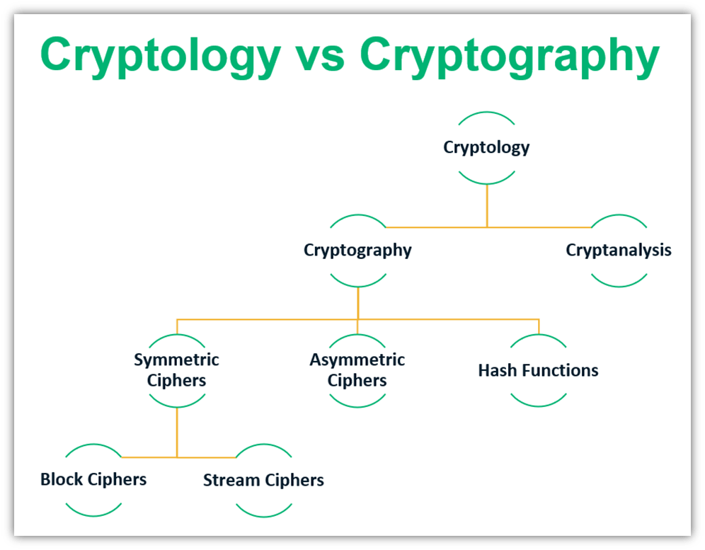


Block ciphers

Slide 3
Block ciphers
A block cipher is a type of symmetric-key encryption algorithm that operates on fixed-size blocks of data, rather than individual bits or bytes. In other words, it divides the input data into blocks of a specified size, typically 64 or 128 bits, and encrypts each block separately. Key characteristics of block ciphers include:
Fixed Block Size: Block ciphers work on data blocks of a fixed size, such as 64 bits (as in DES) or 128 bits (as in AES). The input data is divided into these fixed-size blocks for processing.
Symmetric-Key Encryption: Block ciphers use the same secret key for both encryption and decryption, making them symmetric-key encryption algorithms. The security of the cipher relies on the secrecy of the key.
Block Modes: Block ciphers are typically used in combination with block cipher modes of operation, which specify how to handle data that is larger than a single block. Common modes include ECB (Electronic Codebook), CBC (Cipher Block Chaining), CFB (Cipher Feedback), and others.
Iterative Process: A block cipher operates on a single block of plaintext at a time, often repeating a set of cryptographic operations (such as substitutions, permutations, and permutations) multiple times in rounds to produce ciphertext.
Standardized Algorithms: Many block ciphers are standardized and widely accepted for security purposes. For example, the Advanced Encryption Standard (AES) is a widely used block cipher that supports various key lengths and block sizes.
Block ciphers are essential for a wide range of applications, including file encryption, disk encryption, secure communication protocols, and more. However, they are not suitable for encrypting streams of data, such as real-time communication, where stream ciphers are typically used. To encrypt continuous streams of data, stream ciphers, as opposed to block ciphers, are the more appropriate choice.

Slide 4

Block Cipher Primitives
Confusion:
An encryption operation where the relationship between the key and ciphertext is obscured
Achieved with substitution
Notes:
The goal of encryption is to transform a plaintext into an unintelligible form.
We always assume that the attacker can see the ciphertext, for example, because it is transmitted on the network and the attacker can capture the packet.
But we don’t want the attacker to be able to learn about the plaintext given the ciphertext.
In order to accomplish this, we apply two principles.
Confusion – think about the generalized substitution ciphers where each letter can be mapped to any other.

Slide 5
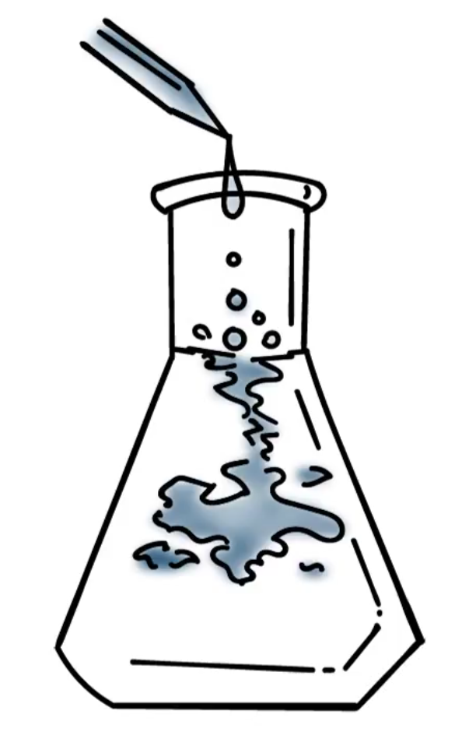
Block Cipher Primitives
Diffusion:
An encryption operation where the influence of one plaintext bit is spread over many ciphertext bits with the goal of hiding statistical properties of the plaintext
Achieved with permutation
Notes:
But that is not enough, e.g., statistical analysis of letters, so we also need diffusion, e.g., a letter is not just mapped to another letter in the English alphabet, it is mapped to “parts” of many 8-bit letters. So applying statistical distribution of English letters won’t work.

Slide 6
Block cipher applications
Can be used to build:
Encryption of arbitrary length messages
Message authentication codes
Authenticated encryption
Hash functions
(Cryptographically secure) pseudorandom generators
Key derivation functions

Slide 7
Block ciphers: crypto work horse
n bits
n bits
E,D
PT Block
CT Block
Key
k bits
n=block size
k=key size
Canonical examples:
DES: n= 64 bits, k = 56 bits
AES: n=128 bits, k = 128, 192, 256 bits

Slide 8
Block Ciphers Built by Iteration
key k
key expansion
k₁
k₂
k₃
k_{r}
m
R(k₁, ⋅)
R(k₂, ⋅)
R(k₃, ⋅)
R(k_{r}, ⋅)
c
R(k,m) is called a round function
for DES (r=16), for AES-128 (r=10)
r=number of rounds

Slide 9
Performance: Crypto++ 5.6.0 [ Wei Dai ]
AMD Opteron, 2.2 GHz ( Linux)
Cipher Block/key size Speed (MB/sec)
RC4 126
Salsa20/12 643
Sosemanuk 727
3DES 64/168 13
AES-128 128/128 109
stream
block

Slide 10
Abstractly: PRPs and PRFs
Pseudo Random Function (PRF) defined over (K,X,Y):
F: K × X → Y
such that exists “efficient” algorithm to evaluate F(k,x)
Pseudo Random Permutation (PRP) defined over (K,X):
E: K × X → X
such that: 1. Exists “efficient” deterministic algorithm to evaluate E(k,x)
2. The function E( k, ⋅ ) is one-to-one
3. Exists “efficient” inversion algorithm D(k,y)

Slide 11
Running example
Example PRPs: 3DES, AES, …
AES: K × X → X where K = X = {0,1}¹²⁸
3DES: K × X → X where X = {0,1}⁶⁴ , K = {0,1}¹⁶⁸
Functionally, any PRP is also a PRF.
A PRP is a PRF where X=Y and is efficiently invertible.

Slide 12
Secure PRFs
Let F: K × X → Y be a PRF
Funs[X,Y]: the set of all functions from X to Y
S_{F} = { F(k,⋅) s.t. k ∈ K } ⊆ Funs[X,Y]
Intuition: a PRF is secure if a random function in Funs[X,Y] is indistinguishable from a random function in S_{F}
Funs[X,Y]
S_{F}
Size |Y|^{|X|}
Size |K|

Slide 13
Secure PRFs
Let F: K × X → Y be a PRF
Funs[X,Y]: the set of all functions from X to Y
S_{F} = { F(k,⋅) s.t. k ∈ K } ⊆ Funs[X,Y]
Intuition: a PRF is secure if a random function in Funs[X,Y] is indistinguishable from a random function in S_{F}
f ← Funs[X,Y]
x ∈ X
???
k ← K
f(x) or F(k,x) ?

Slide 14
Secure PRPs (secure block cipher)
Let E: K × X → Y be a PRP
Perms[X]: the set of all one-to-one functions from X to Y
S_{F} = { E(k,⋅) s.t. k ∈ K } ⊆ Perms[X,Y]
Intuition: a PRP is secure if a random function in Perms[X] is indistinguishable from a random function in S_{F}
π ← Perms[X]
x ∈ X
???
k ← K
π(x) or E(k,x) ?

Slide 15
Let F: K × X → {0,1}¹²⁸ be a secure PRF.
Is the following G a secure PRF?
G(k, x) =
0 ¹²⁸ if x=0
F(k,x) otherwise
No, it is easy to distinguish G from a random function
Yes, an attack on G would also break F
It depends on F

Slide 16
An easy application: PRF ⇒ PRG
Let F: K × {0,1}^{n} → {0,1}^{n} be a secure PRF.
Then the following G: K → {0,1}^{nt} is a secure PRG:
G(k) = F(k,0) ll F(k,1) ll ⋯ ll F(k,t-1)
Key property: parallelizable
Security from PRF property: F(k, ⋅) indist. from random function f(⋅)

Slide 17
End of Segment

Slide 18
The data encryption standard (DES)
Online Cryptography Course Dan Boneh
Block ciphers

Slide 19
Block ciphers: crypto work horse
n bits
n bits
E, D
PT Block
CT Block
Key
k Bits
Canonical examples:
DES: n= 64 bits, k = 56 bits Key: 64 bit quantity=8-bit parity+56-bit key
AES: n=128 bits, k = 128, 192, 256 bits

Slide 20
Block Ciphers Built by Iteration
key k
key expansion
k₁
k₂
k₃
k_{r}
m
R(k₁, ⋅)
R(k₂, ⋅)
R(k₃, ⋅)
R(k_{r}, ⋅)
c
R(k,m) is called a round function
for 3DES (r=48), for AES-128 (r=10)
r=number of rounds

Slide 21
The Data Encryption Standard (DES)
Early 1970s: Horst Feistel designs Lucifer at IBM
key-len = 128 bits ; block-len = 128 bits
1973: NBS asks for block cipher proposals. IBM submits variant of Lucifer.
1976: NBS adopts DES as a federal standard
key-len = 56 bits ; block-len = 64 bits
1997: DES broken by exhaustive search
2000: NIST adopts Rijndael as AES to replace DES
Widely deployed in banking (ACH) and commerce

Slide 22
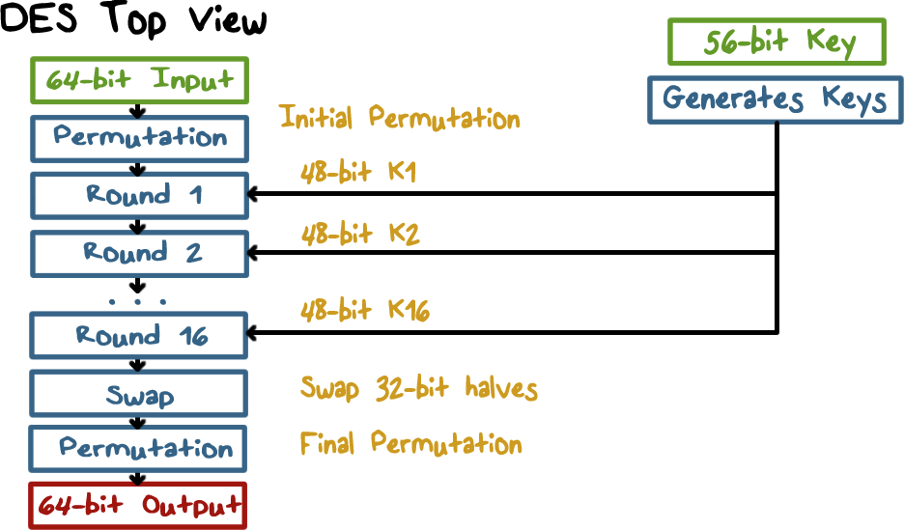
Data Encryption Standard
Notes:
There are 16 rounds of processing. From the original 56-bit key, 16 subkeys are generated, one of which is used for each round.
The process of decryption with DES is essentially the same as the encryption process. The rule is as follows: Use the ciphertext as input to the DES algorithm, but use the subkeys K _{i} in reverse order. That is, use K ₁₆ on the first iteration, K ₁₅ on the second iteration, and so on until K 1 is used on the sixteenth and last iteration.

Slide 23
DES: core idea – Feistel Network
Given functions f₁, …, f_{d}: {0,1}^{n} ⟶ {0,1}^{n}
Goal: build invertible function F: {0,1}^{2n} ⟶ {0,1}^{2n}
R₀
R₁
R₂
R_{d-1}
R_{d}
n-bits
f₁
f₂
⋯
f_{d}
L₀
L₁
L₂
L_{d-1}
L_{d}
n-bits
⊕
⊕
⊕
input
output
In symbols:

Slide 24
R₀
R₁
R₂
R_{d-1}
R_{d}
n-bits
f₁
f₂
⋯
f_{d}
L₀
L₁
L₂
L_{d-1}
L_{d}
n-bits
⊕
⊕
⊕
input
output
Claim: for all f₁, …, f_{d}: {0,1}^{n} ⟶ {0,1}^{n}
Feistel network F: {0,1}^{2n} ⟶ {0,1}^{2n} is invertible
Proof: construct inverse
R_{i-1}
R_{i}
R_{i-1} = L_{i}
L_{i-1} = f_{i}(L_{i}) ⨁ R_{i}
inverse
f_{i}
L_{i-1}
L_{i}
⊕

Slide 25
R₀
R₁
R₂
R_{d-1}
R_{d}
n-bits
f₁
f₂
⋯
f_{d}
L₀
L₁
L₂
L_{d-1}
L_{d}
n-bits
⊕
⊕
⊕
input
output
Claim: for all f₁, …, f_{d}: {0,1}^{n} ⟶ {0,1}^{n}
Feistel network F: {0,1}^{2n} ⟶ {0,1}^{2n} is invertible
Proof: construct inverse
R_{i-1}
R_{i}
R_{i}
⊕
R_{i-1}
inverse
f_{i}
L_{i}
f_{i}
L_{i-1}
L_{i-1}
L_{i}
⊕

Slide 26
Decryption circuit
R_{d}
⊕
⊕
⊕
n-bits
R_{d-1}
R_{d-2}
R₁
R₀
⋯
f_{d}
f_{d-1}
f₁
L_{d}
L_{d-1}
L_{d-2}
L₁
L₀
n-bits
Inversion is basically the same circuit, with f₁, …, f_{d} applied in reverse order
General method for building invertible functions (block ciphers) from arbitrary functions.
Used in many block ciphers … but not AES

Slide 27
“Thm:” (Luby-Rackoff ‘85):
f: K × {0,1}^{n} ⟶ {0,1}^{n} a secure PRF
⇒ 3-round Feistel F: K³ × {0,1}^{2n} ⟶ {0,1}^{2n} a secure PRP
R₀
R₁
R₂
R₃
f
f
f
L₀
L₁
L₂
L₃
⊕
⊕
⊕
input
output

Slide 28
Data Encryption Standard
Notes:
There are 16 rounds of processing. From the original 56-bit key, 16 subkeys are generated, one of which is used for each round.
The process of decryption with DES is essentially the same as the encryption process. The rule is as follows: Use the ciphertext as input to the DES algorithm, but use the subkeys K _{i} in reverse order. That is, use K ₁₆ on the first iteration, K ₁₅ on the second iteration, and so on until K 1 is used on the sixteenth and last iteration.

Slide 29
DES: 16 round Feistel network
f₁, …, f₁₆: {0,1}³² ⟶ {0,1}³² , f_{i}(x) = F( k_{i}, x )
k
key expansion
⋯
k₁
k₂
k₁₆
16 round Feistel network
IP
IP⁻¹
64 bits
64 bits
input
output
To invert, use keys in reverse order

Slide 30
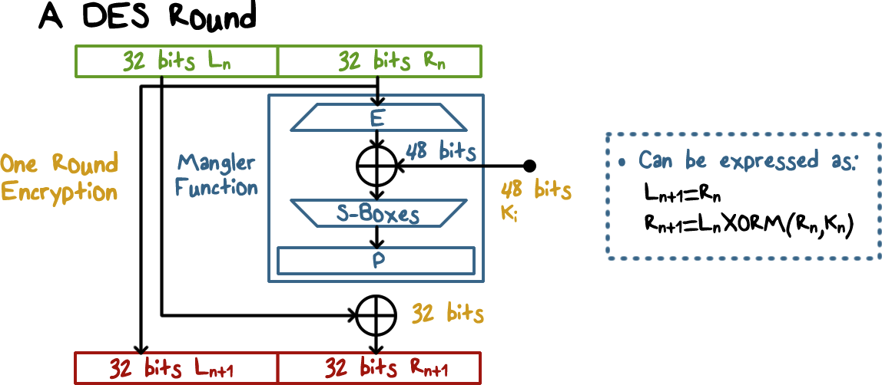
Data Encryption Standard
Notes:
Here is an illustration of the operations in a DES round.
Each takes as input the ciphertext thus far and the per round key and outputs ciphertext for the next round.
The input is divided into left and right halves.
The output left half is just the input right half.
The output right half is the result of XORing the input left half with the output of the Mangler process, which takes as input the input right half, expands it to 48 bit, and XORes it with the per-round key, and then uses S boxes to substitute the 48-bit data with another 32-bit data.
---
We can also simply use algebra to represent the processing in a DES round.

Slide 31
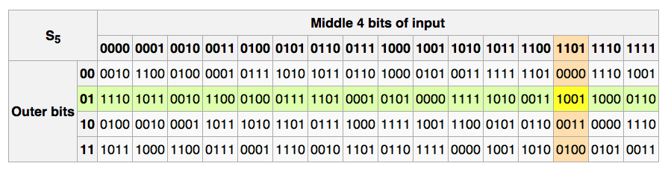
The S-boxes
S_{i}: {0,1}⁶ ⟶ {0,1}⁴
011011 -> 1001

Slide 32
Choosing the S-boxes and P-box
Choosing the S-boxes and P-box at random would result in an insecure block cipher (key recovery after ≈2²⁴ outputs) [BS’89]
Several rules used in choice of S and P boxes:
No output bit should be close to a linear func. of the input bits
S-boxes are 4-to-1 maps
⋮

Slide 33
End of Segment

Slide 34
Exhaustive Search Attacks
Online Cryptography Course Dan Boneh
Block ciphers

Slide 35
Exhaustive Search for block cipher key
Goal: given a few input output pairs (m_{i}, c_{i} = E(k, m_{i})) i=1,..,3 find key k.
Lemma: Suppose DES is an ideal cipher
( 2⁵⁶ random invertible functions )
Then ∀ m, c there is at most one key k s.t. c = DES(k, m)
Proof:
with prob. ≥ 1 – 1/256 ≈ 99.5%

Slide 36
Exhaustive Search for block cipher key
For two DES pairs (m₁, c₁=DES(k, m₁)), (m₂, c₂=DES(k, m₂))
unicity prob. ≈ 1 - 1/2⁷¹
For AES-128: given two inp/out pairs, unicity prob. ≈ 1 - 1/2¹²⁸
⇒ two input/output pairs are enough for exhaustive key search.
Notes:
Unicity: quality of the unique

Slide 37
DES challenge
msg = “The unknown messages is: XXXX … “
CT = c₁ c₂ c₃ c₄
Goal: find k ∈ {0,1}⁵⁶ s.t. DES(k, m_{i}) = c_{i} for i=1,2,3
1997: Internet search -- 3 months
1998: EFF machine (deep crack) -- 3 days (250K $)
1999: combined search -- 22 hours
2006: COPACOBANA (120 FPGAs) -- 7 days (10K $)
⇒ 56-bit ciphers should not be used !! (128-bit key ⇒ 2⁷² days)

Slide 38
Strengthening DES against ex. search
Method 1: Triple-DES
Let E : K × M ⟶ M be a block cipher
Define 3E: K³ × M ⟶ M as
For 3DES: key-size = 3×56 = 168 bits. 3×slower than DES.
(simple attack in time ≈2¹¹⁸ )
3E( (k₁,k₂,k₃), m) =

Slide 39
Why not double DES?
Define 2E( (k₁,k₂), m) = E(k₁ , E(k₂ , m) )
Attack: M = (m₁,…, m₁₀) , C = (c₁,…,c₁₀).
step 1: build table.
sort on 2nd column
key-len = 112 bits for DES
E(k₂,⋅)
E(k₁,⋅)
m
c
k⁰ = 00…00
k¹ = 00…01
k² = 00…10
⋮
k^{N} = 11…11
E(k⁰ , M)
E(k¹ , M)
E(k² , M)
⋮
E(k^{N} , M)
2⁵⁶
entries

Slide 40
Meet in the middle attack
E(k₂,⋅)
E(k₁,⋅)
m
c
k⁰ = 00…00
k¹ = 00…01
k² = 00…10
⋮
k^{N} = 11…11
E(k⁰ , M)
E(k¹ , M)
E(k² , M)
⋮
E(k^{N} , M)
Attack: M = (m₁,…, m₁₀) , C = (c₁,…,c₁₀)
step 1: build table.
Step 2: for all k∈{0,1}⁵⁶ do:
test if D(k, C) is in 2nd column.
if so then E(k^{i},M) = D(k,C) ⇒ (k^{i},k) = (k₂,k₁)

Slide 41
Meet in the middle attack
E(k₂,⋅)
E(k₁,⋅)
m
c
Time = 2⁵⁶log(2⁵⁶) + 2⁵⁶log(2⁵⁶) < 2⁶³ << 2¹¹² , space ≈ 2⁵⁶
Same attack on 3DES: Time = 2¹¹⁸ , space ≈ 2⁵⁶
E(k₃,⋅)
E(k₂,⋅)
E(k₁,⋅)
m
c

Slide 42
Method 2: DESX
E : K × {0,1}^{n} ⟶ {0,1}^{n} a block cipher
Define EX as EX( (k₁,k₂,k₃), m) = k₁ ⨁ E(k₂, m⨁k₃ )
For DESX: key-len = 64+56+64 = 184 bits
… but easy attack in time 2⁶⁴⁺⁵⁶ = 2¹²⁰ (homework)
Note: k₁ ⨁ E(k₂, m) and E(k₂, m⨁k₁) does nothing !!

Slide 43
End of Segment

Slide 44
More attacks on block ciphers
Online Cryptography Course Dan Boneh
Block ciphers

Slide 45
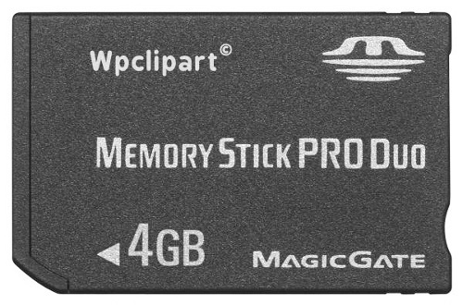
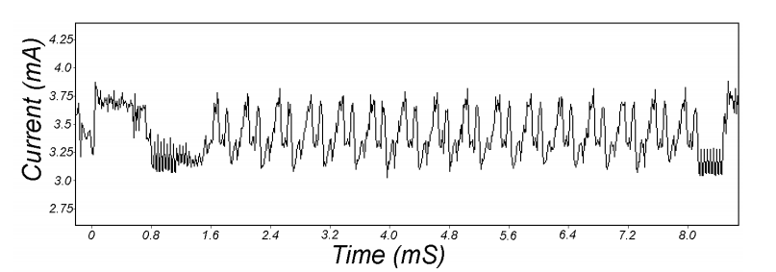
Attacks on the implementation
1. Side channel attacks:
Measure time to do enc/dec, measure power for enc/dec
2. Fault attacks:
Computing errors in the last round expose the secret key k
⇒ do not even implement crypto primitives yourself …
Another Example:
https://eprint.iacr.org/2009/127.pdf
smartcard
[Kocher, Jaffe, Jun, 1998] access here
https://link.springer.com/chapter/10.1007/3-540-48405-1_25
Notes:
Many timing attacks: cache timing, multi-core attacks, smartcard attacks
A fault attack is an attack on a physicial electronic device (e.g., smartcard, HSM, USB token) which consists in stressing the device by an external mean (e.g., voltage, light) in order to generates errors in such a way that these errors leads to a security failure of the system (key recovery, ePurse balance increase, false signature acceptation, PIN code recovery…)

Slide 46
Quantum attacks
Generic search problem:
Let f: X ⟶ {0,1} be a function.
Goal: find x∈X s.t. f(x)=1.
Classical computer: best generic algorithm time = O( |X| )
Quantum computer [Grover ’96] : time = O( |X|^{1/2} )
Can quantum computers be built: unknown but we are hopeful

Slide 47
Quantum exhaustive search
Given m, c=E(k,m) define
Grover ⇒ quantum computer can find k in time O( |K|^{1/2} )
DES: time ≈2²⁸ , AES-128: time ≈2⁶⁴
quantum computer ⇒ 256-bits key ciphers (e.g. AES-256)
Read this: https://medium.com/bootdotdev/is-aes-256-quantum-resistant-4dc3447e7b82
if E(k,m) = c
0 otherwise
f(k) =

Slide 48
End of Segment

Slide 49
The AES block cipher
Online Cryptography Course Dan Boneh
Block ciphers

Slide 50
The AES process
1997: NIST publishes request for proposal
1998: 15 submissions. Five claimed attacks.
1999: NIST chooses 5 finalists
2000: NIST chooses Rijndael as AES (designed in Belgium)
Key sizes: 128, 192, 256 bits. Block size: 128 bits
Notes:
AES is a variant of the Rijndael block cipher[5] developed by two Belgian cryptographers, Joan Daemen and Vincent Rijmen, who submitted a proposal[7] to NIST during the AES selection process. https://en.wikipedia.org/wiki/Advanced_Encryption_Standard

Slide 51
AES is a Subs-Perm network (not Feistel)
k_{n}
k₁
k₂
S₁
S₁
S₁
S₂
S₂
S₂
S₃
S₃
S₃
⋯
⨁
input
⨁
output
⨁
⋯
⋯
⋯
S₈
S₈
S₈
subs.
layer
perm.
layer
inversion
Notes:
Substitution and permutation network

Slide 52
AES-128 schematic
10 rounds
4
ByteSub
ShiftRow
MixColumn
ByteSub
ShiftRow
MixColumn
ByteSub
ShiftRow
input
⋯
4
⨁
⨁
⨁
⨁
invertible
k₀
k₁
k₂
k₉
⨁
k₁₀
key
output
4
key expansion:
16 bytes
16 bytes ⟶176 bytes
4

Slide 53
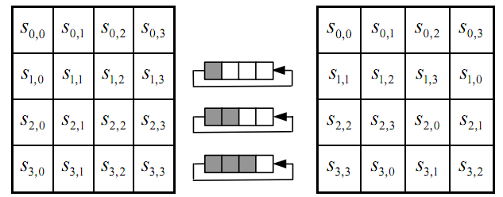
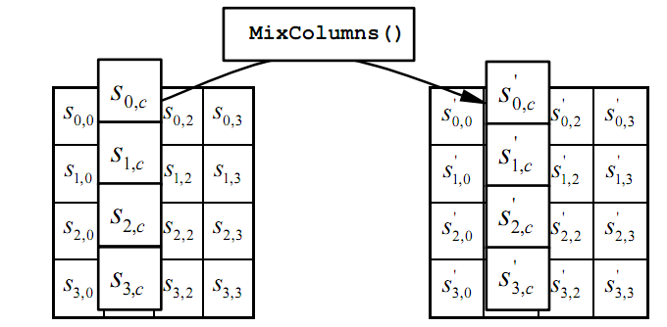
The round function
Provides Confusion
ByteSub: a 1 byte S-box. 256 byte table (easily computable)
ShiftRows:
MixColumns:
Provides Diffusion
Provides Diffusion
Notes:
S-box is easily computable with little code. All three steps can be combined and accelerated with pre-computed tables.
In the MixColumns step, the four bytes of each column of the state are combined using an invertible linear transformation. The MixColumns function takes four bytes as input and outputs four bytes, where each input byte affects all four output bytes. Together with ShiftRows, MixColumns provides diffusion in the cipher.

Slide 54
Code size/performance tradeoff
 | Code size | Performance
Pre-compute round functions (24KB or 4KB) | largest | fastest: table lookups and xors
Pre-compute S-box only (256 bytes) | smaller | slower
No pre-computation | smallest | slowest

Slide 55


Example: Javascript AES
AES in the browser:
AES library (6.4KB)
no pre-computed tables
Prior to encryption: pre-compute tables
Then encrypt using tables
http://crypto.stanford.edu/sjcl/
Whitepaper: https://crypto.stanford.edu/sjcl/acsac.pdf
Notes:
http://crypto.stanford.edu/sjcl/

Slide 56
AES in hardware
AES instructions in Intel Westmere:
aesenc, aesenclast: do one round of AES
128-bit registers: xmm1=state, xmm2=round key
aesenc xmm1, xmm2 ; puts result in xmm1
aeskeygenassist: performs AES key expansion
Claim 14 x speed-up over OpenSSL on same hardware
Similar instructions on AMD Bulldozer
Notes:
To implement AES called aesenc 9 times and then call aesenclast.

Slide 57
Attacks
Best key recovery attack: four times better than ex. search [BKR’11]
Related key attack on AES-256: [BK’09]
Given 2⁹⁹ inp/out pairs from four related keys in AES-256
can recover keys in time ≈2⁹⁹

Slide 58
End of Segment

Slide 59
Block ciphers from PRGs
Online Cryptography Course Dan Boneh
Block ciphers

Slide 60
Can we build a PRF from a PRG?
Let G: K ⟶ K² be a secure PRG
Define 1-bit PRF F: K × {0,1} ⟶ K as
F(k, x∈{0,1} ) = G(k)[x]
Thm: If G is a secure PRG then F is a secure PRF
Can we build a PRF with a larger domain?
k
G
G(k)[0]
G(k)[1]

Slide 61
Extending a PRG
Let G: K ⟶ K² .
define G₁: K ⟶ K⁴ as G₁(k) = G(G(k)[0]) ll G(G(k)[1])
k
G
We get a 2-bit PRF:
F(k, x∈{0,1}² ) = G₁(k)[x]
G(k)[0]
G(k)[1]
G
G
00
01
10
11
G₁(k)

Slide 62
G₁ is a secure PRG
k
G
G(k)[0]
G(k)[1]
r₀
r₁
G
G
G
G
≈_{p}
00
01
10
11
≈_{p}
G₁(k)
r₁
G
≈_{p}
random in K⁴
r₀₁
r₀₀

Slide 63
Extending more
Let G: K ⟶ K² .
define G₂: K ⟶ K⁸ as G₂(k) =
k
G
G(k)[0]
G(k)[1]
We get a 3-bit PRF
G
G
G
G
G
G
000
001
010
011
100
101
110
111
G₂(k)
Notes:
Show to evaluate for x=101

Slide 64
Extending even more: the GGM PRF
Let G: K ⟶ K² . define PRF F: K × {0,1}^{n} ⟶ K as
For input x = x₀ x₁ … x_{n-1} ∈ {0,1}^{n} do:
k
k₁
k₂
k₃
k_{n}
G(k)[x₀]
G(k₁)[x₁]
G(k₂)[x₂]
⋯
G(k_{n-1})[x_{n-1}]
Security: G a secure PRG ⇒ F is a secure PRF on {0,1}^{n} .
Not used in practice due to slow performance.
Check here https://crypto.stanford.edu/pbc/notes/crypto/ggm.html

Slide 65
PRG
Clarification on PRG: a deterministic algorithm, and it is public (known to any adversary). It takes a random seed as input, and presumably it will introduce extra bits deterministically (it has to be expanding) and scramble them with the random seed in some sophisticated way. The output should look random (we’ve given two equivalent formulations of “randomlooking”). Basically any efficient distinguisher taking either an output from PRG or a truly random string can not tell a difference.

Slide 66
PRF
Pseudorandom functions (PRFs), which are meant to be “randomlooking” functions. Roughly, it means that it behaves the same as a truly random function, at least as far as an efficient observer is concerned.

Slide 67
PRP
A pseudorandom permutation is a theoretical concept used in the analysis and design of block ciphers. A PRP is a permutation of a fixed set of values (e.g., all possible block inputs) that appears random, even though it is generated by a deterministic algorithm. In essence, a PRP acts like a random permutation, providing a one-to-one mapping from plaintext blocks to ciphertext blocks. Block ciphers are designed to emulate the properties of PRPs, and this property is crucial for their security.

Slide 68
End of Segment

