Slide 1

Week 9 - Digital Signatures
Source: Raj Jain Washington University in Saint Louis https://www.cse.wustl.edu/~jain/cse571-11/ftp/l_13ds.pdf

Slide 2

Overview
Digital Signatures
ElGamal Digital Signature Scheme
Schnorr Digital Signature Scheme
Digital Signature Standard (DSS)
These slides are based partly on Lawrie Brown’s slides supplied with William Stallings’s book “Cryptography and Network Security: Principles and Practice,” 5th Ed, 2011.

Slide 3
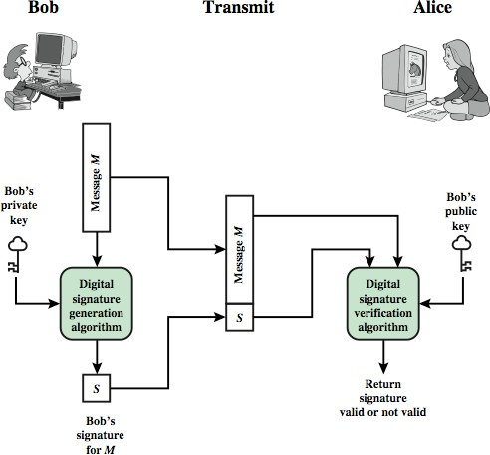
Digital Signatures
Verify author, date & time of signature
Authenticate message contents
Can be verified by third parties to resolve disputes

Slide 4
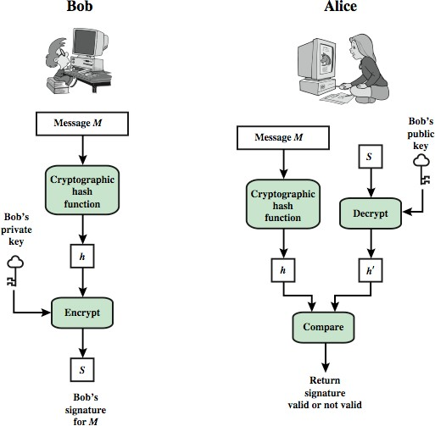
Digital Signature Model

Slide 5
Attacks
In the order of Increasing severity.
A=Attacker, C=Victim
Key-only attack: A only knows C’s public key
Known message attack: A has a set of messages, signatures
Generic chosen message attack: A obtains C’s signatures on messages selected without knowledge of C’s public key
Directed chosen message attack: A obtains C’s signatures on messages selected after knowing C’s public key
Adaptive chosen message attack: A may request signatures on messages depending upon previous message-signature pairs

Slide 6
Forgeries
Total break: A knows C’s private key
Universal forgery: A can generated C’s signatures on any message
Selective forgery: A can generate C’s signature for a particular message chosen by A
Existential forgery: A can generate C’s signature for a message not chosen by A

Slide 7
Digital Signature Requirements
Must depend on the message signed
Must use information unique to sender
To prevent both forgery and denial
Must be relatively easy to produce
Must be relatively easy to recognize & verify Directed ⇒ Recipient can verify
Arbitrated ⇒ Anyone can verify
Be computationally infeasible to forge
With new message for existing digital signature
With fraudulent digital signature for given message

Slide 8
ElGamal Digital Signatures
Signature variant of ElGamal, related to D-H
Uses exponentiation in a finite (Galois)
Based on difficulty of computing discrete logarithms, as in D-H
Each user (e.g., A) generates his/her key
Given a large prime q and its primitive root a
A chooses a private key: 1 < x_{A} < q-1
A computes his public key: y = a^{xA} mod q
A

Slide 9
ElGamal Digital Signature
Alice signs a message M to Bob by computing
Hash m = H(M), 0 <= m <= (q-1)
Choose random integer K with 1 <= K <= (q-1) and
gcd(K,q-1)=1 (K is the per message key)
K
Compute S₁ = a mod q
Compute K⁻¹ the inverse of K mod (q-1)
Compute the value: S₂ = K⁻¹(m-x_{A}S₁) mod (q-1)
If S₂ is zero, start with a new k
Signature is:(S₁,S₂)
Any user B can verify the signature by computing
V₁ = a mod q
m
V₂ = y ^{S1}
_{S} S2
mod q
A 1
Signature is valid if V₂ = V₁
(a^{xA} )^{S1 ¡}a^{K ¢S2}
_{= a}x_{A} S₁+KS_{2 = a}x_{A}S₁+m−x_{A} S₁
= a^{m}

Slide 10
ElGamal Signature Example
GF(19) q=19 and a=10
Alice computes her key:
16
A chooses x_{A}=16 & computes y_{A}=10 mod 19 = 4
Alice signs message with hash m=14 as (3,4):
Choosing random K=5 which has gcd(18,5)=1
Computing S₁ = 10 mod 19 = 3
5
Finding K⁻¹ mod (q-1) = 5⁻¹ mod 18 = 11
Computing S₂ = 11(14-16.3) mod 18 = 4
Any user B can verify the signature by computing
14
V₁ = 10 mod 19 = 16
V₂ = 4³🞨3⁴ = 5184 = 16 mod 19
Since 16 = 16 signature is valid

Slide 11
Schnorr Digital Signatures
Also uses exponentiation in a finite (Galois)
Minimizes message dependent computation
Main work can be done in idle time
Using a prime modulus p
p–1 has a prime factor q of appropriate size
typically p 1024-bit and q 160-bit (SHA-1 hash size)
Schnorr Key Setup: Choose suitable primes p , q
Choose a such that a^{q} = 1 mod p
(a,p,q) are global parameters for all
Each user (e.g., A) generates a key
Chooses a secret key (number): 0 < s < q
Computes his public key: v = a^{-s} mod q

Slide 12
Schnorr Signature
User signs message by
Choosing random r with 0<r<q and computing x = a^{r} mod p
Concatenating message with x and hashing:
e = H(M || x)
Computing: y = (r + se) mod q
Signature is pair (e, y)
Any other user can verify the signature as follows:
Computing: x' = a^{y}v^{e} mod p
Verifying that: e = H(M || x’)
x’= a^{y}v^{e} = a^{y}a^{-se} = a^{y-se} = a^{r} = x mod p

Slide 13
Digital Signature Standard (DSS)
US Govt approved signature scheme
Designed by NIST & NSA in early 90's
Published as FIPS-186 in 1991
Revised in 1993, 1996 & then 2000
Uses the SHA hash algorithm
DSS is the standard, DSA is the algorithm
FIPS 186-2 (2000) includes alternative RSA & elliptic curve signature variants
DSA is digital signature only

Slide 14
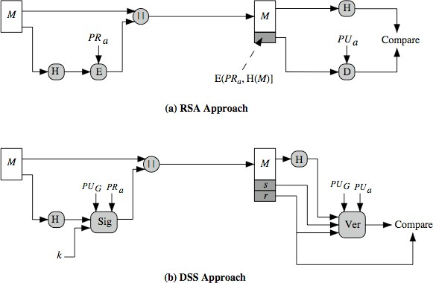
DSS vs. RSA Signatures
PU_{G} = Global Public Key k = Per message secret key

Slide 15
Digital Signature Algorithm (DSA)
Creates a 320 bit signature
With 512-1024 bit security
Smaller and faster than RSA
A digital signature scheme only
Security depends on difficulty of computing discrete logarithms
Variant of ElGamal & Schnorr schemes

Slide 16
DSA Key Generation
Shared global public key values (p, q, g):
Choose 160-bit prime number q
Choose a large prime p with 2^{L-1} < p < 2^{L}
Where L= 512 to 1024 bits and is a multiple of 64
Such that q is a 160 bit prime divisor of (p-1)
Choose g = h^{(p-1)/q}
Where 1<h<p-1 and h^{(p-1)/q} mod p > 1
Users choose private & compute public key:
Choose random private key: x<q
Compute public key: y = g^{x} mod p

Slide 17
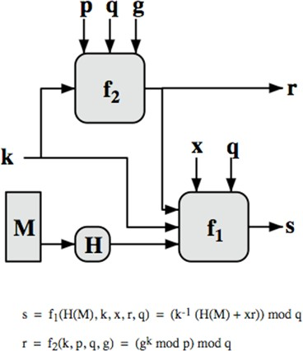
DSA Signature Creation
To sign a message M the sender:
Generates a random signature key k, k<q
Note: k must be random, be destroyed after use, and never be reused
Then computes signature pair: r = (g^{k} mod p)mod q s = [k⁻¹(H(M)+ xr)]
mod q
Sends signature (r,s) with message M

Slide 18
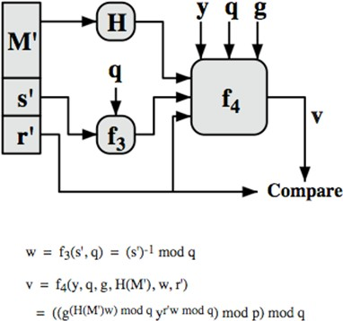
DSA Signature Verification
To verify a signature, recipient computes:
w = s⁻¹ mod q
u1= [H(M)w ]mod q u2= (rw)mod q
v = [(g^{u1} y^{u2})mod p
]mod q
If v=r then signature is verified

Slide 19

Summary
Digital signature depends upon the message and some information unique to the signer to prevent forgery and denial. Anyone should be able to verify.
ElGamal/Schnorr/DSA signatures use a per-message secret key and are based on exponentiation
DSA produces a 320 bit signature

