Slide 1

Exploratory Data Analysis
G2M insight for Cab Investment
02.08.2021

Slide 2

Agenda
Executive Summary
Problem Statement
Approach
EDA
EDA Summary
Recommendations

Slide 3
Summary & Problem Statement
XYZ is a private equity firm in US. Due to remarkable growth in the Cab Industry in last few years and multiple key players in the market, it is planning for an investment in Cab industry.
Path of the analyzes made in order to make the right decision for making investment and the conditions of the companies will be conveyed :
Understanding & evaluating data
Finding the most profitable Cab company by analyzing data
Recommendations for investment

Slide 4
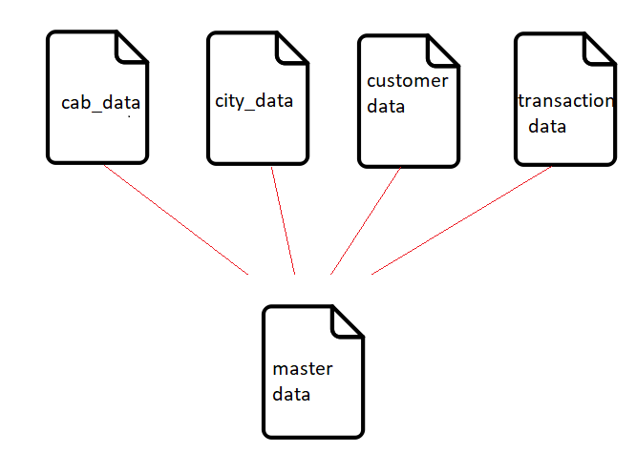
Approach
Understanding & evaluating data
There are four data sets.
16 Features( including 3 derived features)
Price_Charged and Cost_of_Trip features are used to calculate profit.
Time frame is 31/01/2016 to 31/12/2018.

Slide 5
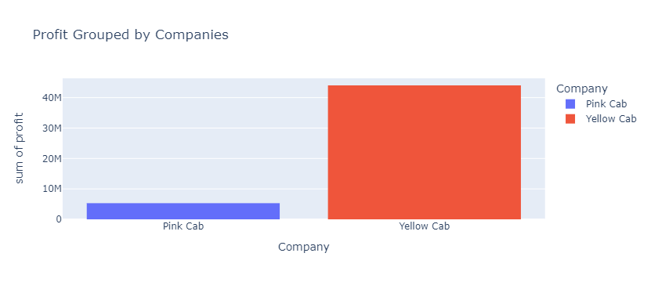
Profit
Sum of profit of yellow cab is way more than pink cab for given time frame. Yellow cab is close to 39M while pink cab is close to 5.3 M.

Slide 6
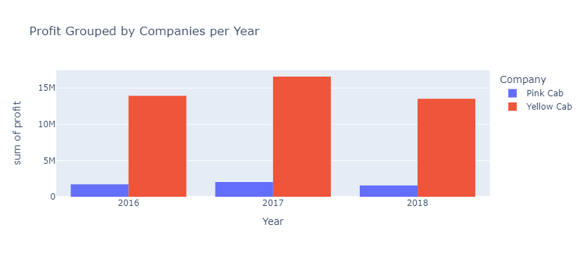
Yellow cab's profit is always higher than pink. Both pink and yellow had increase in their profits in 2017.
Yellow cab lost nearly 3M and pink cab lost nearly half a million in 2018.

Slide 7
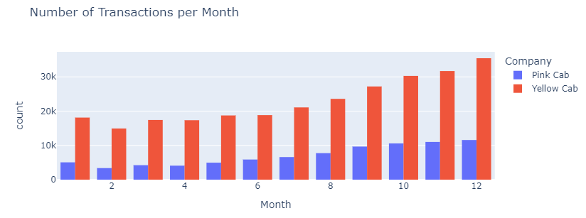
Transactions
Yellow cab has more transactions every month of the year, especially during month of December which is a holiday month for USA.

Slide 8
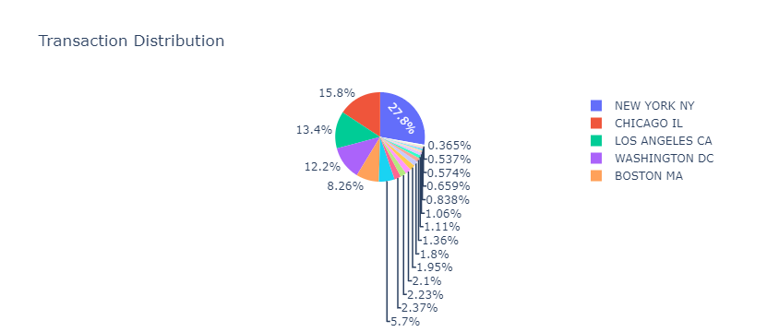
Transactions-2
About a quarter of all transactions are in New York.

Slide 9
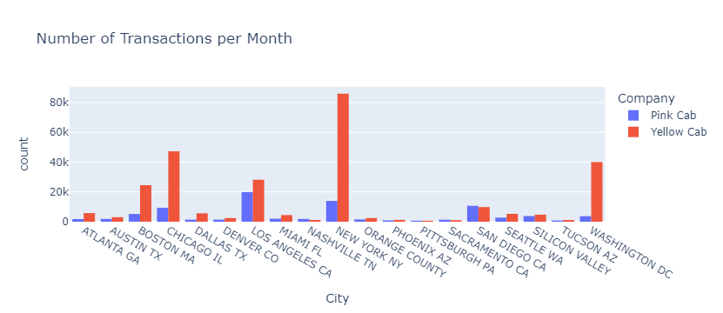
Transactions-3
This graph shows us transaction counts for each city grouped by company.
In Nashville,Sacramento and San Diego CA there are more transactions in Pink Cab.

Slide 10
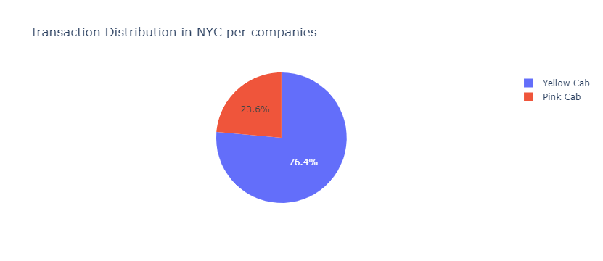
Transactions-4
Yellow cab has %76.4 of transactions in NYC.

Slide 11
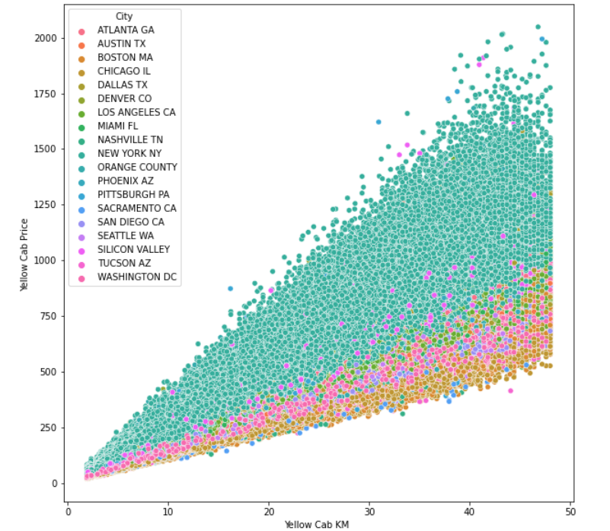
Since Yellow Cab has most of transactions in NYC, we checked if the reason is that it is cheaper to use Yellow Cab than Pink Cab in NYC ?
Yellow Cab’s prices.

Slide 12
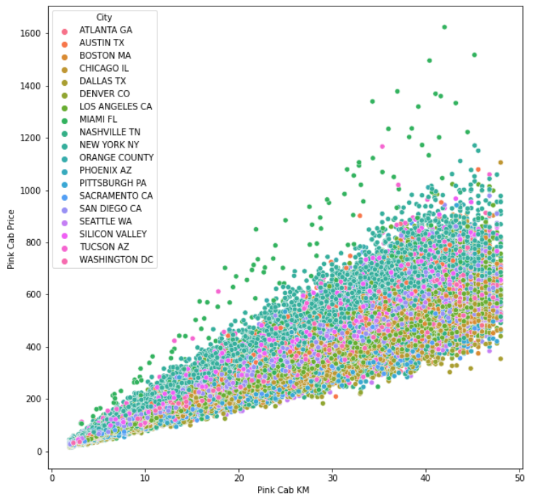
Pink Cab’s prices.
From the graphs, we can say that Yellow Cab costs more than Pink cab in NYC.
Also, we can see for Yellow Cab that they charge more than any other city in NYC.

Slide 13
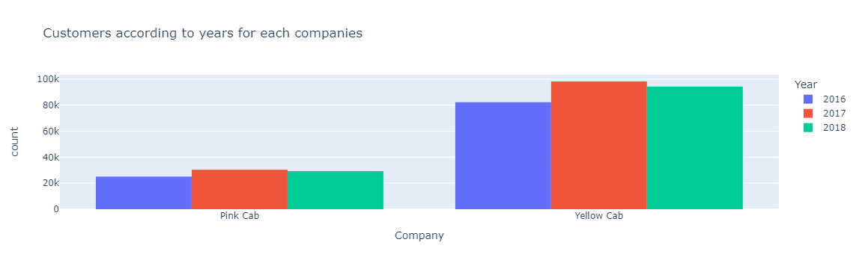
Customers
Did one of the companies had decrease in customers?
As shown,there is no decrease in customers in any cab firm.

Slide 14
Growth rate
Since both gained customers, we needed to look at which gained more profit. Time frame is 2016-2018 for calculating year-over-year growth in terms of customer number for each company.
Yellow cab’s growth rate : -0.0180814
Pink cab’s growth rate : -0.0028353
Yellow cab’s growth rate is better. Both of the companies are in negative values.

Slide 15
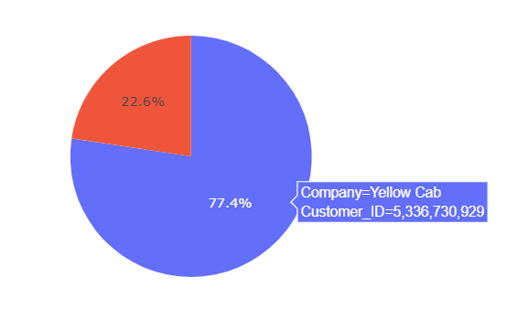
Customer share
Yellow cab has more share in customers.

Slide 16
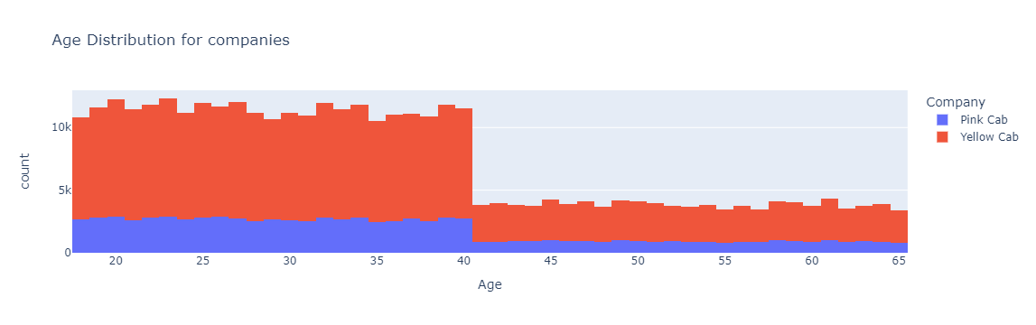
Age range
As shown, there is no significant difference of choice within age ranges.
We can say that no matter the age,Yellow cab is preffered more than Pink.

Slide 17
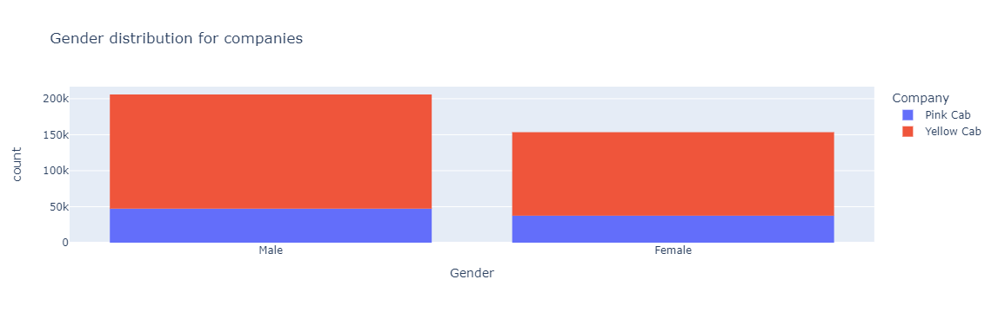
Gender
Yellow cab is preffered more no matter the gender.

Slide 18


Social class
Lower Income
High Income
People with lower income prefers Yellow Cab even though it is more expensive in some cities.(Like NYC).
People with higher income prefers Yellow Cab.

Slide 19
Recommendations
1.Yellow cab is preffered more than pink cab no matter age,income or gender by customers.
2.Yearly profit of yellow cab is always more than pink cab.
3.Growth rate of yellow cab is higher than pink cab.
4.Out of 19 cities, only in three cities there are more transactions done by Pink Cab than Yellow Cab.
5.Yellow cab has more customers every month of the year,especially during month of December which is a holiday month for USA. 6.Yellow cab usually costs more to customers.
On the basis of above point , we will recommend Yellow cab for investment.

Slide 20
Thank You

