Slide 2

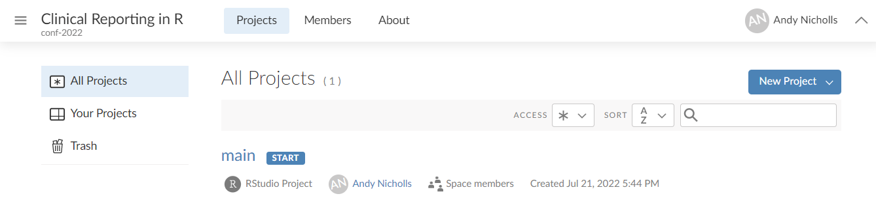
Our environment
For consistency, we’ll be working in RStudio Cloud
We’ve installed and configured everything for you
Following the course GitHub* will the environment installation script, examples and exercises
* https://github.com/rstudio-conf-2022/clinical-reporting-r

Slide 3





Plan for this workshop
Day 1
Day 2
Create Analysis for:
Demography
AE Table
Analysis
Plan
ADaMs
Outputs
Create ADaMs for:
ADSL
ADAE
Create displays for:
AE Table
PFTs Summary
Stats Analysis
Import metadata into R

Slide 4
Study Information
Phase 2B
Respiratory study, with change in FEV1 as the primary endpoint
Visits at:
Screening
Baseline
Week 4
Week 8
Week 12
200 subjects
100 per arm
Dataset specification can be found at:
specs/specs.xls

Slide 5






Building ADaMs process flow
Import metadata
Combine predecessor variables
Do any calculations
Drop unused variables
Import data
Export dataset
Notes:
Can be done, just using the tidyverse, but it requires a bit more work

Slide 6

{metacore}
General Purpose:
Holds the metadata used to build SDTM and ADaM datasets
Lifecycle:
It is on CRAN and has been around for ~1.5 years. Fairly stable, but will change with CDISC standards
Common Functions:
spec_to_metacore()
Reads a P21 spec into metacore
select_dataset()
Select a single dataset of metadata
get_control_term()
Pulls out the control terms for a variable
https://atorus-research.github.io/metacore/

Slide 7

{metatools}
General Purpose:
Automating dataset creation based on the {metacore}
Lifecycle:
It is on CRAN and has been around for ~1 year. Fairly stable, but new features are still being added
Common Functions:
build_from_derived()
Builds a dataset based on all predecessors
combine_supp()
Combines supps and domains
create_var_from_codelist()
Creates a new variable based on code/decode
create_cat_var()
Creates a categorial variable from continues based on codelist
order_cols()
Orders the columns per metadata definitions
set_variable_labels()
Adds labels to all columns per metadata definitions
check_ct_data()
Checks all values fall within control terms
pharmaverse.github.io/metatools/

Slide 8
{admiral}
General Purpose:
Functions to do common ADaM calculations
Lifecycle:
It is on CRAN and has been around for ~1.5 years. Some functions are still being sorted out
Common Functions:
derive_vars_merged_dtm()
Merge and impute datetime variables
derive_var_merged_exist_flag()
Merge an existing flag
compute_bmi()
Computes BMI
derive_var_base()
Creates a baseline column from flag
https://pharmaverse.github.io/admiral/

Slide 9
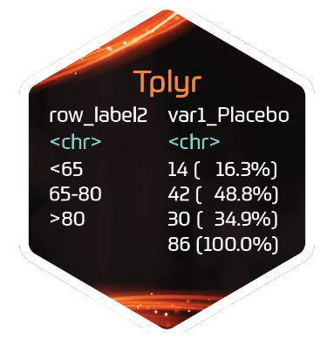



Descriptive statistics
{Tplyr} works by layering groups of descriptive statistics
Each layer has two basic flavours:
group_count()
group_desc()
Within the layer function add additional specifications such as:
Statistics to calculate
Distinct counts
 |  | Placebo | Treatment | Total
Age (y) | n | 15 | 13 | 28
 | Mean (sd) | 73.6(9.35) | 74.2(7.23) | 71.8(8.29)
Sex | n | 14 | 13 | 27
 | Male | 8 (57.1%) | 7 (53.8%) | 15 (55.6%)
 | Female | 6 (48.2%) | 6 (46.1%) | 12 (44.4%)

Slide 10
{Tplyr}
General Purpose:
Create standard descriptive statistics from ADAMs
Lifecycle:
It is on CRAN and has been around for ~2 years. Fairly stable, but new features are still being added
Common Functions:
tplyr_table()
Setup a table
add_layer()
Adds a layer to build descriptive stats on
group_count()
Calculates count based descriptive stats
group_desc()
Calculates continuous descriptive stats
add_total_group()
Adds totals column
get_numeric_data()
Pulls out an ARD from a Tplyr table
set_distinct_by()
Sets how to count distinct subjects
https://atorus-research.github.io/Tplyr/

Slide 11
Day 2

Slide 12
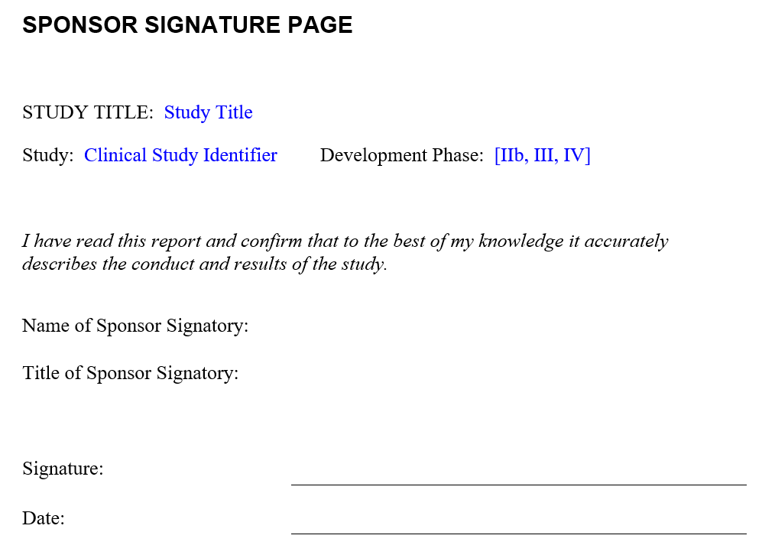


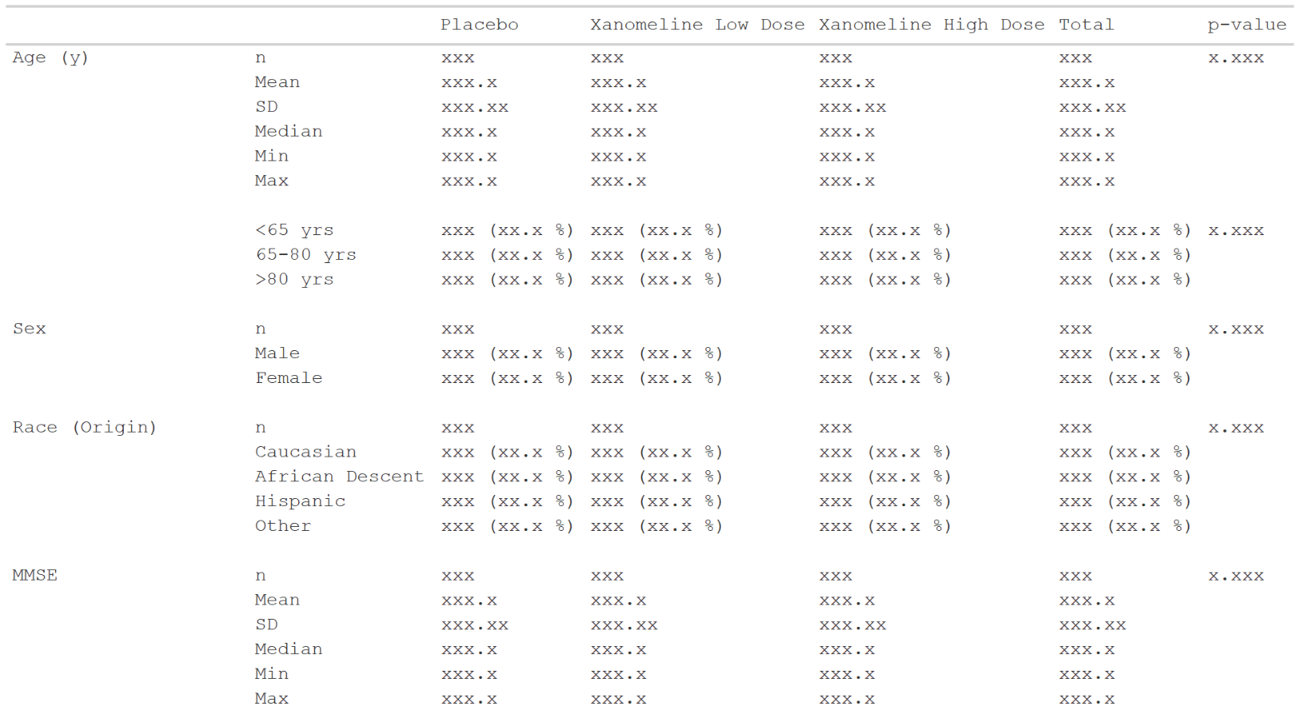

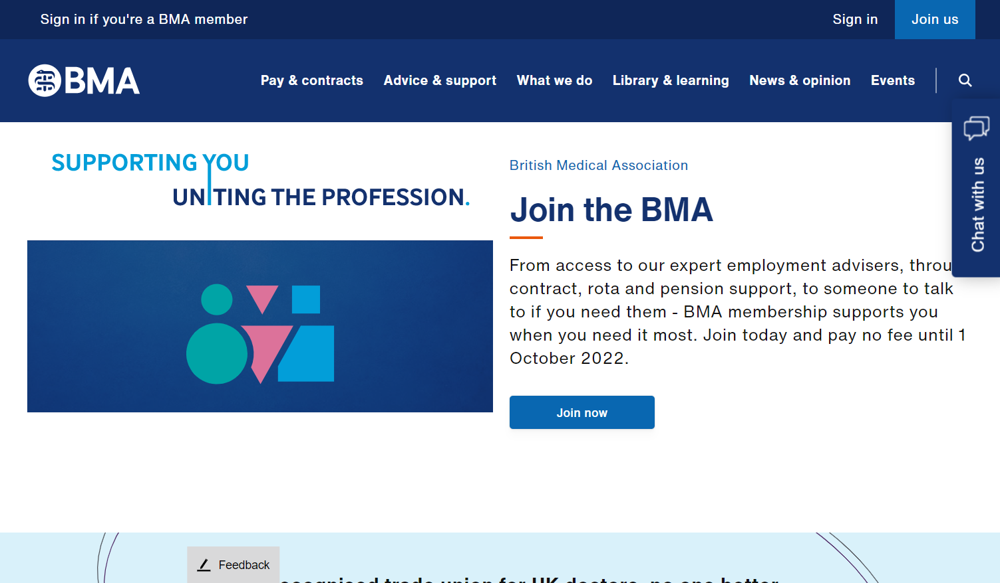

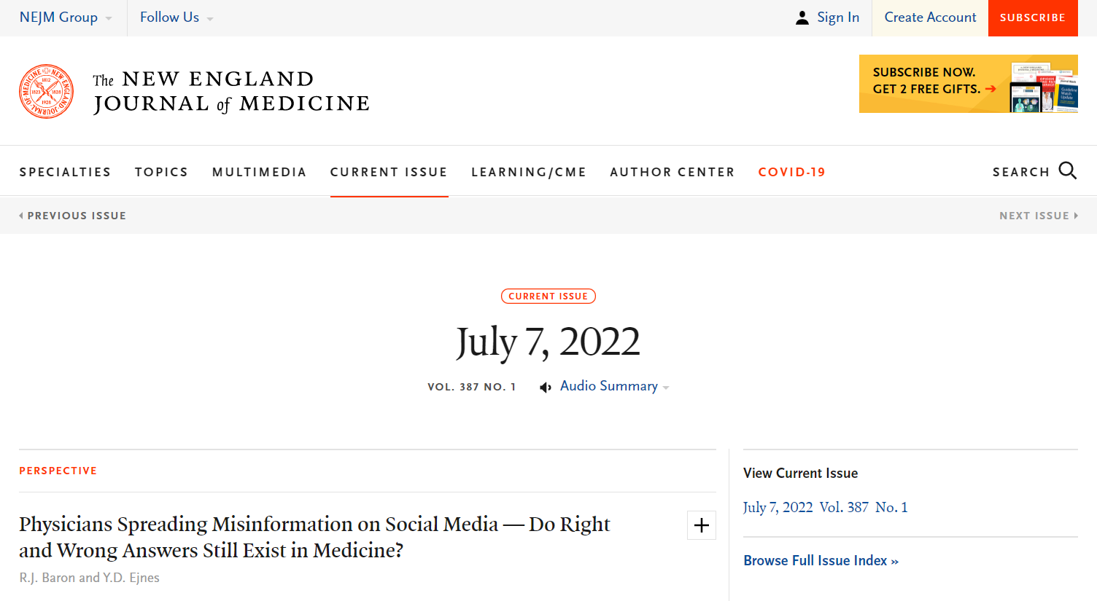
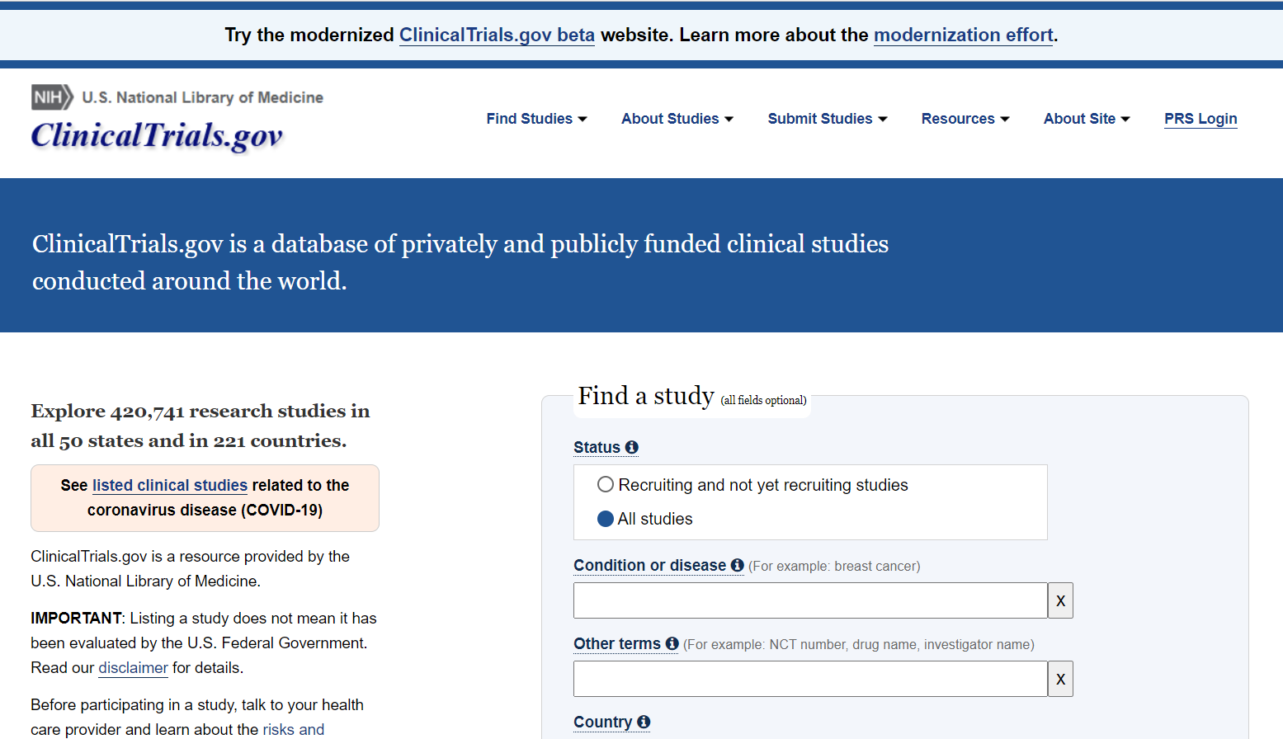
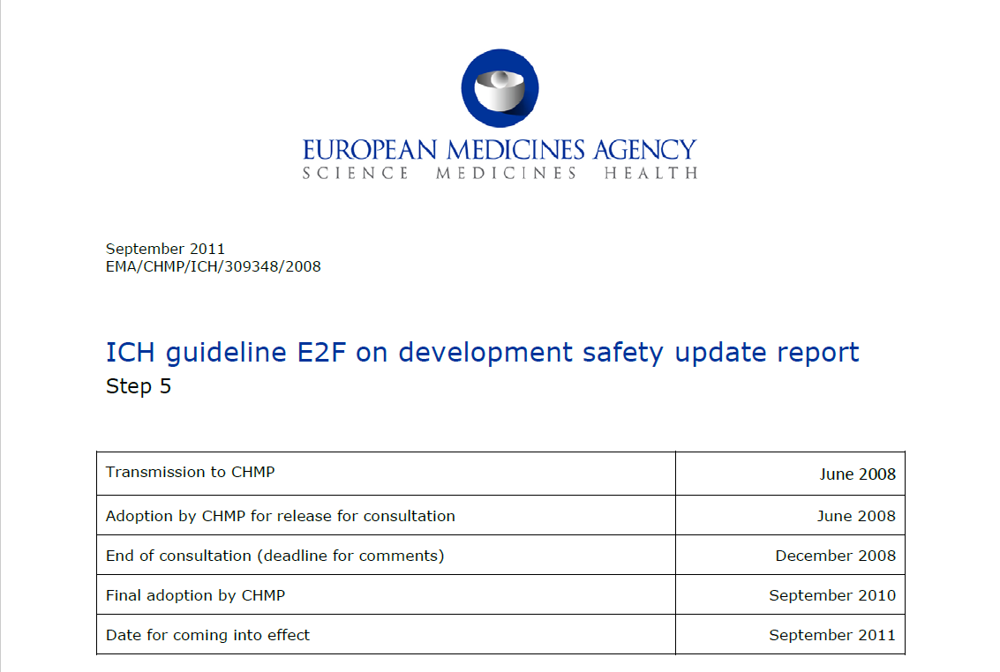
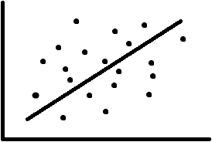
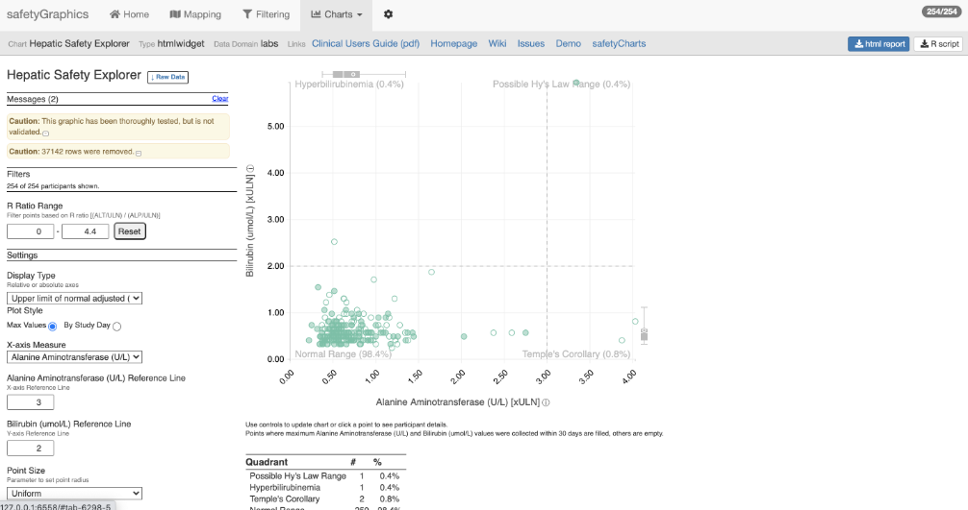
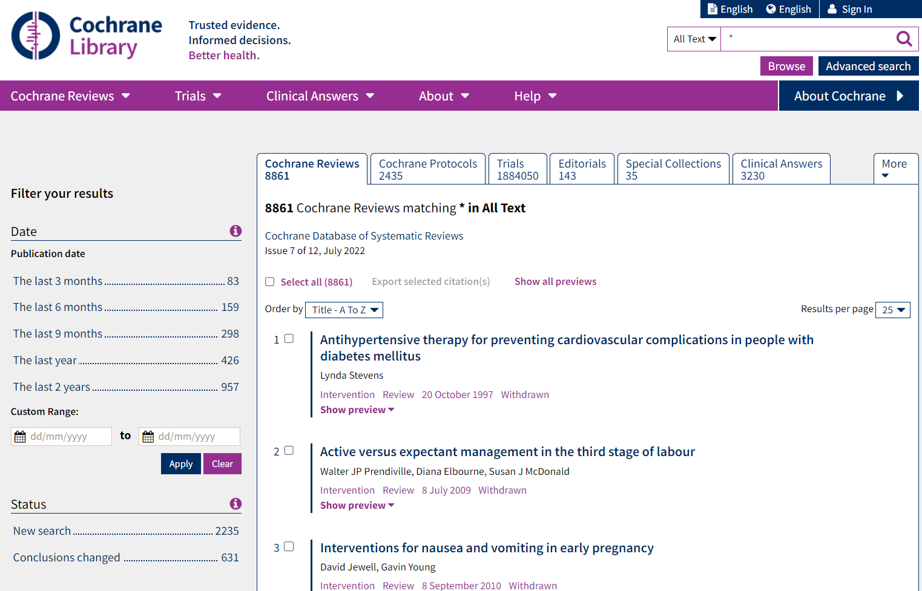
Analysis Results Data
The Possibilities
In-text CSR
Presentations
Submissions
Publications
Data Analysis
ADaM
Analysis Results Data
clinicaltrials.gov
In future, graphics?
Integrated safety reporting
Dynamic apps
Meta-analyses
Analysis
Formatting

Slide 13
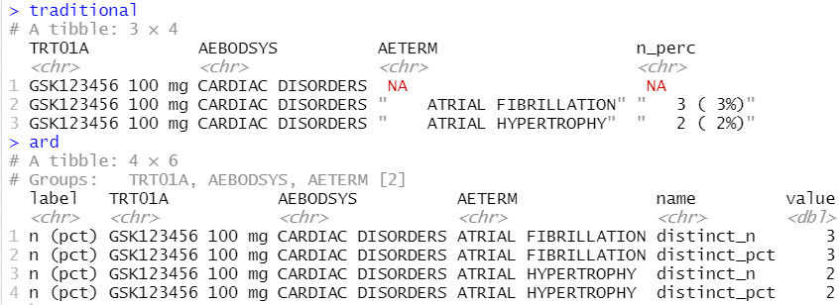
Analysis Results Data
Key features
Unformatted values
1 value per row
Distinct columns for each grouping variable
Include everything you want to display (particularly labels)
Interested in reading more, see:
Why we should respect analysis results as data
Why we should respect analysis results as data
Joana M Barros, Lukas A Widmer, Mark Baillie, Simon Wandel, (Analytics, Novartis Pharma AG, Basel, Switzerland)
https://doi.org/10.48550/arXiv.2204.09959

Slide 14

{tfrmt}
General Purpose:
Building tables from ARDs based on metadata
Lifecycle:
Alpha release is out. Will likely go to CRAN by the end of the year once additional functionality is added
Common Functions:
tfrmt()
Setup a table
body_plan()
Defines the body of the table
frmt_structure()
Defines which rows to apply formatting to
frmt_combine()/frmt_when()/frmt()
Defines the formatting
col_plan()
Sets column appearance
row_grp_plan()
Defines the style for each group
print_mock_gt()
Prints to gt without data to produce a mock
print_to_gt()
Prints to gt with data to make final table
https://gsk-biostatistics.github.io/tfrmt/

Slide 15


tfrmt process flow
Create a mock based on metadata
Define table metadata
Format values in accordance with metadata
ARD
Notes:
Why gt:
From Rstudio so a reputable source
Good functionality to go out to where we need to
Ect.

Slide 16
Tables parts
 |  | Placebo (N = XX) | Treatment (N = XX) | Total (N = XX)
Age (y) | n | XX | XX | XX
 | Mean (sd) | XX.X(XX.XX) | XX.X(XX.XX) | XX.X(XX.XX)
 | Median | XX.X | XX.X | XX.X
 | Min, Max | XX,XX | XX,XX | XX,XX
 | <65 yrs | XX (XX.X%) | XX (XX.X%) | XX (XX.X%)
 | 65-80 yrs | XX (XX.X%) | XX (XX.X%) | XX (XX.X%)
 | >80 yrs | XX (XX.X%) | XX (XX.X%) | XX (XX.X%)
Sex | n | XX | XX | XX
 | Male | XX (XX.X%) | XX (XX.X%) | XX (XX.X%)
 | Female | XX (XX.X%) | XX (XX.X%) | XX (XX.X%)
Columns
Row groups
Labels and groups
Table body
Notes:
How can we break a table down into component parts

Slide 17
Tables parts
 |  | Placebo (N = XX) | Treatment (N = XX) | Total (N = XX)
Age (y) | n | XX | XX | XX
 | Mean (sd) | XX.X(XX.XX) | XX.X(XX.XX) | XX.X(XX.XX)
 | Median | XX.X | XX.X | XX.X
 | Min, Max | XX,XX | XX,XX | XX,XX
 | <65 yrs | XX (XX.X%) | XX (XX.X%) | XX (XX.X%)
 | 65-80 yrs | XX (XX.X%) | XX (XX.X%) | XX (XX.X%)
 | >80 yrs | XX (XX.X%) | XX (XX.X%) | XX (XX.X%)
Sex | n | XX | XX | XX
 | Male | XX (XX.X%) | XX (XX.X%) | XX (XX.X%)
 | Female | XX (XX.X%) | XX (XX.X%) | XX (XX.X%)
tfrmt(…,
group = “var1”,
label = “var2”,
body_plan = body_plan(),
col_plan = col_plan(),
row_grp_plan = row_grp_plan()
)
Notes:
Tfrmt works by letting you set the styling of each component part

Slide 18
tfrmt with Analysis Results Data
Group | Label | Column | Param | Value
Age (y) | n | Placebo | n | 15.00
Age (y) | n | Treatment | n | 13.00
Age (y) | n | Total | n | 28.00
Sex | n | Placebo | n | 14.00
Sex | n | Treatment | n | 13.00
Sex | n | Total | n | 27.00
Age (y) | Mean (sd) | Placebo | mean | 73.56
Age (y) | Mean (sd) | Treatment | mean | 74.231
Age (y) | Mean (sd) | Total | mean | 71.84
Age (y) | Mean (sd) | Placebo | SD | 9.347
Age (y) | Mean (sd) | Treatment | SD | 7.234
Age (y) | Mean (sd) | Total | SD | 8.293
tfrmt(
group = Group,
label = Label,
column = Column,
values = Value,
param = Param,
…
)
 |  | Placebo | Treatment | Total
Age (y) | n | 15 | 13 | 28
 | Mean (sd) | 73.6(9.35) | 74.2(7.23) | 71.8(8.29)
Sex | n | 14 | 13 | 27
 | Male | 8 (57.1%) | 7 (53.8%) | 15 (55.6%)
 | Female | 6 (48.2%) | 6 (46.1%) | 12 (44.4%)
Notes:
Parameters allow you to combine elements and create conditional formatting for values with the same label

Slide 19
Value formatting
body_plan(
frmt_structure(
group_val = ".default",
label_val = ".default",
frmt_combine("{n} ({pct}%)",
n = frmt("X"),
pct = frmt("xx.x")
)
),
frmt_structure(
group_val = ".default",
label_val = "n",
frmt("XX")),
frmt_structure(
group_val = "Age (y)",
label_val = "Mean (sd)",
frmt_combine("{mean}({SD})",
mean = frmt("XX.X"),
SD = frmt("x.xx")
)
)
)
Group | Label | Column | Param | Value
Age (y) | n | Placebo | n | 15.00
Age (y) | n | Treatment | n | 13.00
Age (y) | n | Total | n | 28.00
Sex | n | Placebo | n | 14.00
Sex | n | Treatment | n | 13.00
Sex | n | Total | n | 27.00
Age (y) | Mean (sd) | Placebo | mean | 73.56
Age (y) | Mean (sd) | Treatment | mean | 74.231
Age (y) | Mean (sd) | Total | mean | 71.84
Age (y) | Mean (sd) | Placebo | SD | 9.347
Age (y) | Mean (sd) | Treatment | SD | 7.234
Age (y) | Mean (sd) | Total | SD | 8.293
 |  | Placebo | Treatment | Total
Age (y) | n | 15 | 13 | 28
 | Mean (sd) | 73.6(9.35) | 74.2(7.23) | 71.8(8.29)
Sex | n | 14 | 13 | 27
 | Male | 8 (57.1%) | 7 (53.8%) | 15 (55.6%)
 | Female | 6 (48.2%) | 6 (46.1%) | 12 (44.4%)

Slide 20
{tfrmt}
General Purpose:
Building tables from ARDs based on metadata
Lifecycle:
Alpha release is out. Will likely go to CRAN by the end of the year once additional functionality is added
Common Functions:
tfrmt()
Setup a table
body_plan()
Defines the body of the table
frmt_structure()
Defines which rows to apply formatting to
frmt_combine()/frmt_when()/frmt()
Defines the formatting
col_plan()
Sets column appearance
row_grp_plan()
Defines the style for each group
print_mock_gt()
Prints to gt without data to produce a mock
print_to_gt()
Prints to gt with data to make final table
https://gsk-biostatistics.github.io/tfrmt/

Slide 21

Map
Mocks
ARDs
Plan/Specs
ADaMs
Outputs

