Slide 2

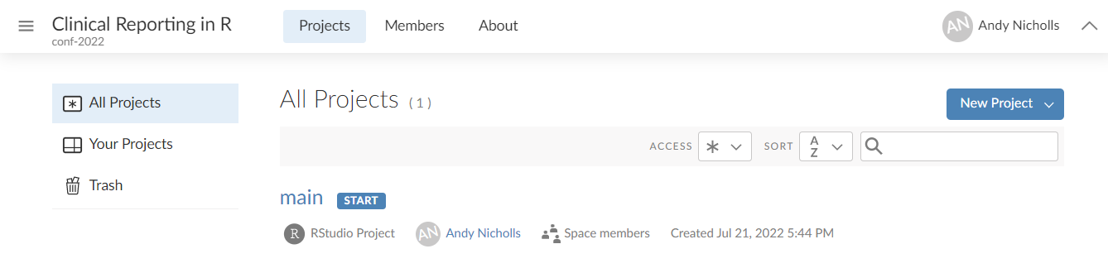
Our environment
For consistency, we’ll be working in RStudio Cloud
We’ve installed and configured everything for you
Following the course please visit GitHub for the environment installation script, examples and exercises

Slide 3





Plan for this workshop
Day 1
Day 2
Create Analysis for:
AE Table
PFTs Summary
Analysis
Plan
ADaMs
Outputs
Create ADaMs for:
ADSL
ADAE
Create displays for:
AE Table
PFTs Summary
Stats Analysis
Import metadata into R

Slide 4
Study Information
Phase 2B
Respiratory study, with change in FEV1 as the primary endpoint
Visits at:
Screening
Baseline
Week 4
Week 8
Week 12
200 subjects
100 per arm
Dataset specification can be found at:
specs/specs.xls

Slide 5






Building ADaMs process flow
Import metadata
Combine predecessor variables
Do any calculations
Drop unused variables
Import data
Export dataset
Notes:
Can be done, just using the tidyverse, but it requires a bit more work

Slide 6

{metacore}
General Purpose:
Holds the metadata used to build SDTM and ADaM datasets
Lifecycle:
It is on CRAN and has been around for ~1.5 years. Fairly stable, but will change with CDISC standards
Common Functions:
spec_to_metacore()
Reads a P21 spec into metacore
select_dataset()
Select a single dataset of metadata
get_control_term()
Pulls out the control terms for a variable
https://atorus-research.github.io/metacore/

Slide 7

{metatools}
General Purpose:
Automating dataset creation based on the {metacore}
Lifecycle:
It is on CRAN and has been around for ~1 year. Fairly stable, but new features are still being added
Common Functions:
build_from_derived()
Builds a dataset based on all predecessors
combine_supp()
Combines supps and domains
create_var_from_codelist()
Creates a new variable based on code/decode
create_cat_var()
Creates a categorial variable from continues based on codelist
order_cols()
Orders the columns per metadata definitions
set_variable_labels()
Adds labels to all columns per metadata definitions
check_ct_data()
Checks all values fall within control terms
pharmaverse.github.io/metatools/

Slide 8
{admiral}
General Purpose:
Functions to do common ADaM calculations
Lifecycle:
It is on CRAN and has been around for ~1.5 years. Some functions are still being sorted out
Common Functions:
derive_vars_merged_dtm()
Merge and impute datetime variables
derive_var_merged_exist_flag()
Merge an existing flag
compute_bmi()
Computes BMI
derive_var_base()
Creates a baseline column from flag
https://pharmaverse.github.io/admiral/

Slide 9
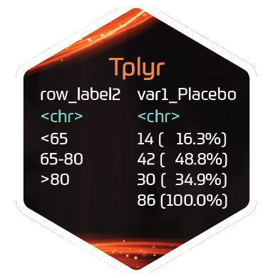



Descriptive statistics
{Tplyr} works by layering groups of descriptive statistics
Each layer has two basic flavours:
group_count()
group_desc()
Within the layer function add additional specifications such as:
Statistics to calculate
Distinct counts
 |  | Placebo | Treatment | Total
Age (y) | n | 15 | 13 | 28
 | Mean (sd) | 73.6(9.35) | 74.2(7.23) | 71.8(8.29)
Sex | n | 14 | 13 | 27
 | Male | 8 (57.1%) | 7 (53.8%) | 15 (55.6%)
 | Female | 6 (48.2%) | 6 (46.1%) | 12 (44.4%)

Slide 10
{Tplyr}
General Purpose:
Building an ARD from an ADAM for standard descriptive statistics
Lifecycle:
It is on CRAN and has been around for ~2 years. Fairly stable, but new features are still being added
Common Functions:
tplyr_table()
Setup a table
add_layer()
Adds a layer to build descriptive stats on
group_count()
Calculates count based descriptive stats
group_desc()
Calculates continuous descriptive stats
add_total_group()
Adds totals column
get_numeric_data()
Pulls out an ARD from a Tplyr table
set_distinct_by()
Sets how to count distinct subjects
https://atorus-research.github.io/Tplyr/

Slide 11
Day 2

Slide 12
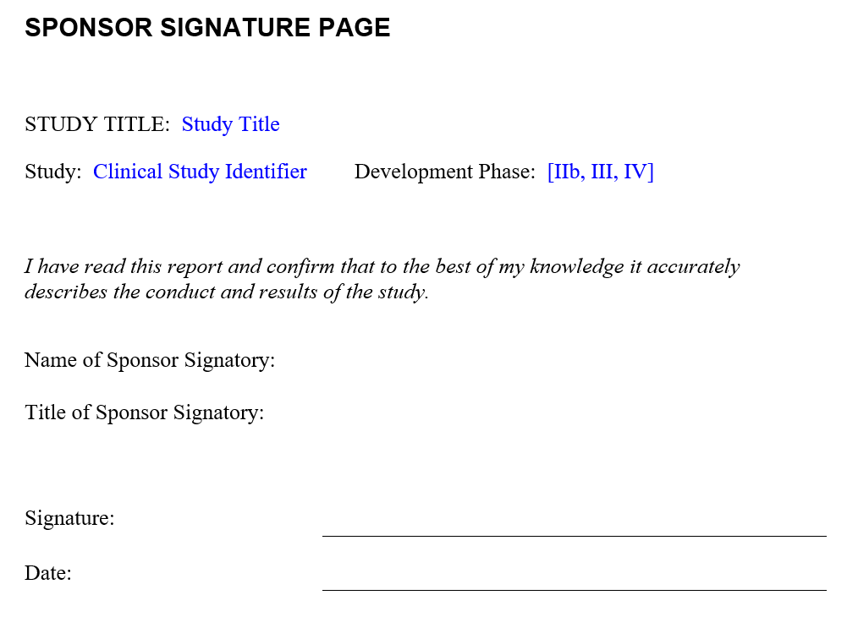


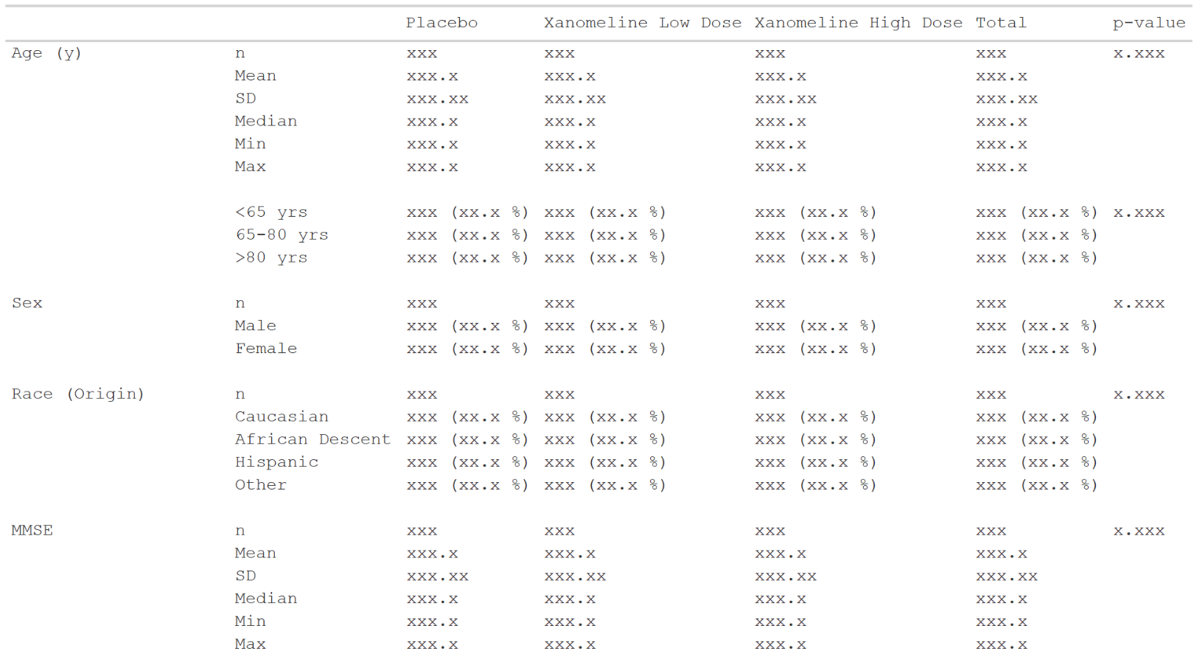

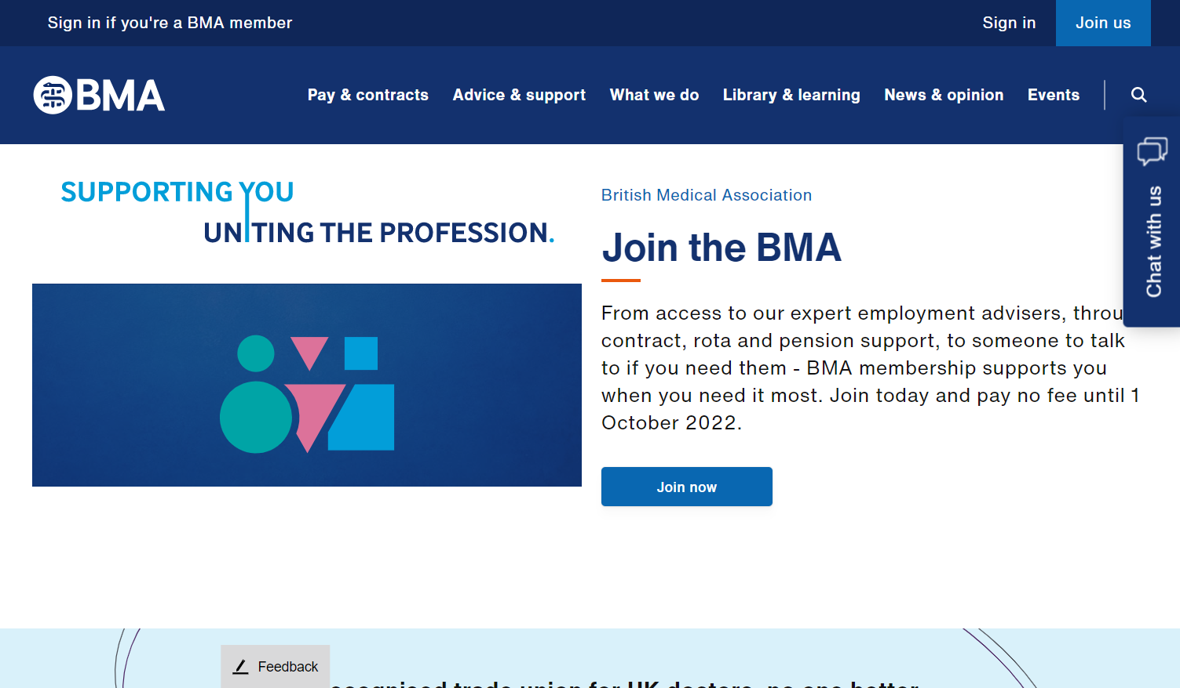

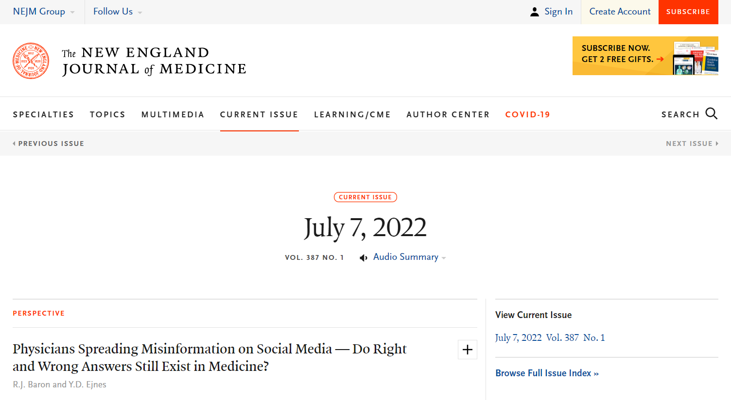
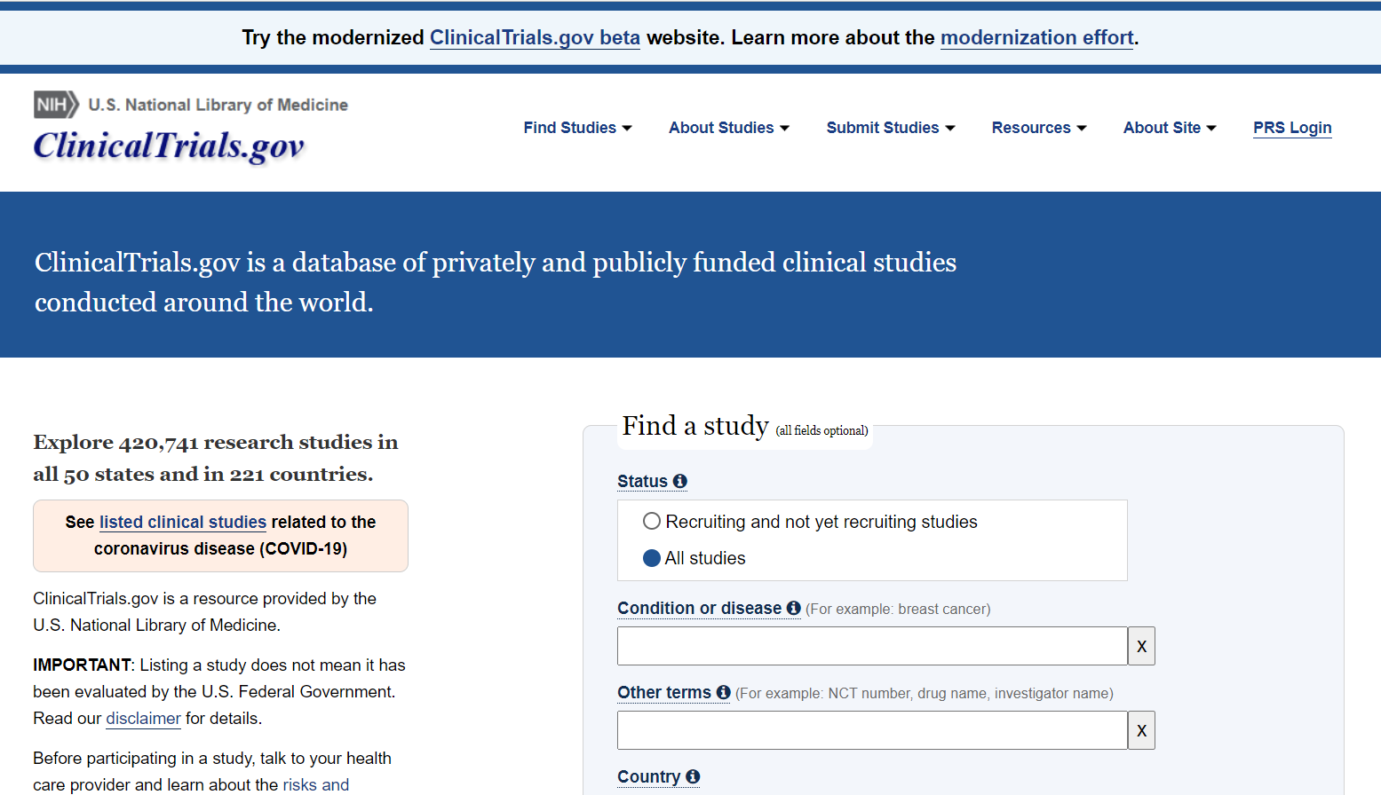
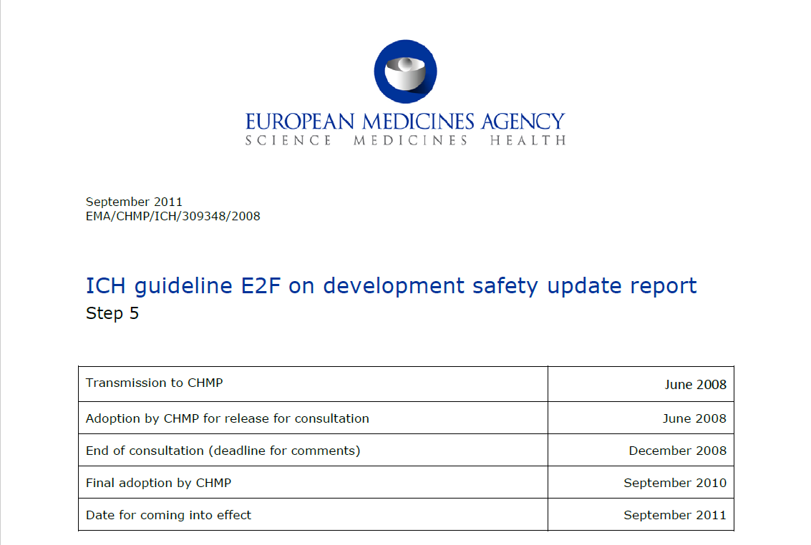
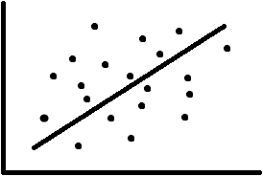
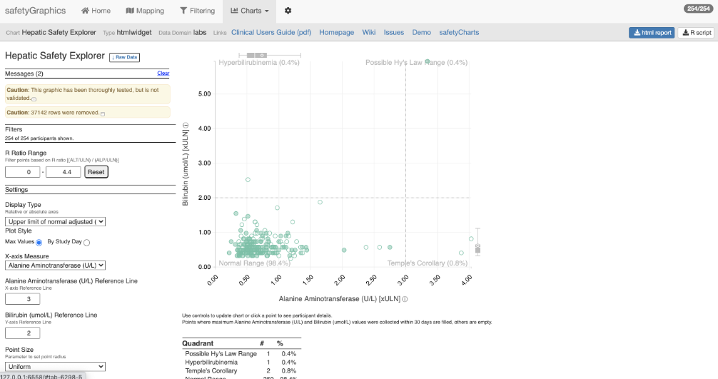
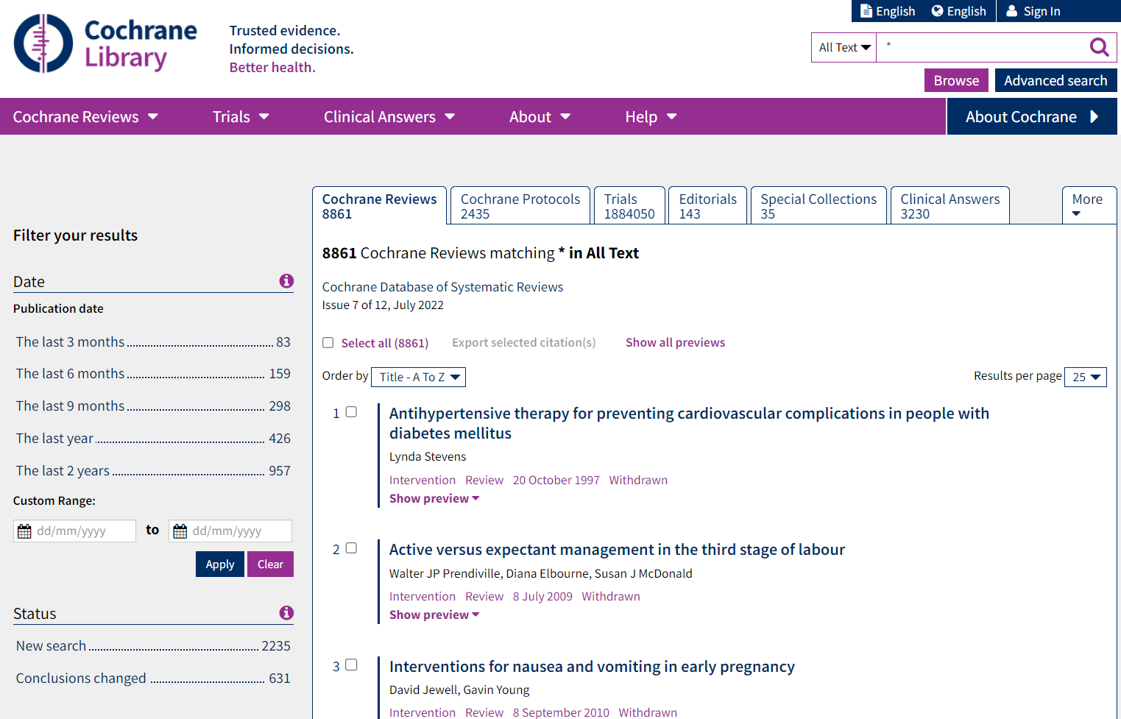
Analysis Results Data
The Possibilities
In-text CSR
Presentations
Submissions
Publications
Data Analysis
ADaM
Analysis Results Data
clinicaltrials.gov
In future, graphics?
Integrated safety reporting
Dynamic apps
Meta-analyses
Analysis
Formatting

Slide 13
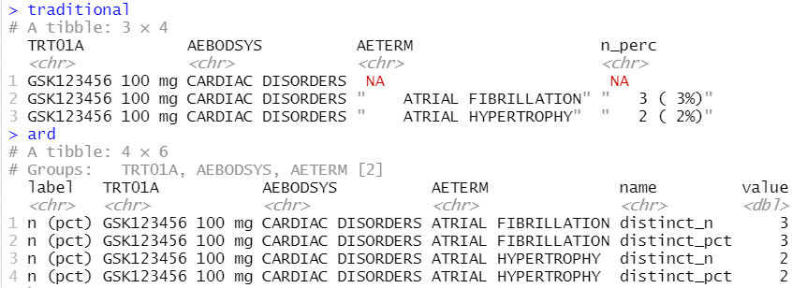
Analysis Results Data
Key features
Unformatted values
1 value per row
Distinct columns for each grouping variable
Include everything you want to display (particularly labels)
Interested in reading more, see:
Why we should respect analysis results as data
Why we should respect analysis results as data
Joana M Barros, Lukas A Widmer, Mark Baillie, Simon Wandel, (Analytics, Novartis Pharma AG, Basel, Switzerland)
https://doi.org/10.48550/arXiv.2204.09959

Slide 14

{tfrmt}
General Purpose:
Building tables from ARDs based on metadata
Lifecycle:
Alpha release is out. Will likely go to CRAN by the end of the year once additional functionality is added
Common Functions:
tfrmt()
Setup a table
body_plan()
Defines the body of the table
frmt_structure()
Defines which rows to apply formatting to
frmt_combine()/frmt_when()/frmt()
Defines the formatting
col_plan()
Sets column appearance
row_grp_plan()
Defines the style for each group
print_mock_gt()
Prints to gt without data to produce a mock
print_to_gt()
Prints to gt with data to make final table
https://gsk-biostatistics.github.io/tfrmt/

Slide 15


tfrmt process flow
Create a mock based on metadata
Define table metadata
Format values in accordance with metadata
ARD
Notes:
Why gt:
From Rstudio so a reputable source
Good functionality to go out to where we need to
Ect.

Slide 16
Tables parts
 |  | Placebo (N = XX) | Treatment (N = XX) | Total (N = XX)
Age (y) | n | XX | XX | XX
 | Mean (sd) | XX.X(XX.XX) | XX.X(XX.XX) | XX.X(XX.XX)
 | Median | XX.X | XX.X | XX.X
 | Min, Max | XX,XX | XX,XX | XX,XX
 | <65 yrs | XX (XX.X%) | XX (XX.X%) | XX (XX.X%)
 | 65-80 yrs | XX (XX.X%) | XX (XX.X%) | XX (XX.X%)
 | >80 yrs | XX (XX.X%) | XX (XX.X%) | XX (XX.X%)
Sex | n | XX | XX | XX
 | Male | XX (XX.X%) | XX (XX.X%) | XX (XX.X%)
 | Female | XX (XX.X%) | XX (XX.X%) | XX (XX.X%)
Columns
Row groups
Labels and groups
Table body
Notes:
How can we break a table down into component parts

Slide 17
Tables parts
 |  | Placebo (N = XX) | Treatment (N = XX) | Total (N = XX)
Age (y) | n | XX | XX | XX
 | Mean (sd) | XX.X(XX.XX) | XX.X(XX.XX) | XX.X(XX.XX)
 | Median | XX.X | XX.X | XX.X
 | Min, Max | XX,XX | XX,XX | XX,XX
 | <65 yrs | XX (XX.X%) | XX (XX.X%) | XX (XX.X%)
 | 65-80 yrs | XX (XX.X%) | XX (XX.X%) | XX (XX.X%)
 | >80 yrs | XX (XX.X%) | XX (XX.X%) | XX (XX.X%)
Sex | n | XX | XX | XX
 | Male | XX (XX.X%) | XX (XX.X%) | XX (XX.X%)
 | Female | XX (XX.X%) | XX (XX.X%) | XX (XX.X%)
tfrmt(…,
group = “var1”,
label = “var2”,
body_plan = body_plan(),
col_plan = col_plan(),
row_grp_plan = row_grp_plan()
)
Notes:
Tfrmt works by letting you set the styling of each component part

Slide 18
tfrmt with Analysis Results Data
Group | Label | Column | Param | Value
Age (y) | n | Placebo | n | 15.00
Age (y) | n | Treatment | n | 13.00
Age (y) | n | Total | n | 28.00
Sex | n | Placebo | n | 14.00
Sex | n | Treatment | n | 13.00
Sex | n | Total | n | 27.00
Age (y) | Mean (sd) | Placebo | mean | 73.56
Age (y) | Mean (sd) | Treatment | mean | 74.231
Age (y) | Mean (sd) | Total | mean | 71.84
Age (y) | Mean (sd) | Placebo | SD | 9.347
Age (y) | Mean (sd) | Treatment | SD | 7.234
Age (y) | Mean (sd) | Total | SD | 8.293
tfrmt(
group = Group,
label = Label,
column = Column,
values = Value,
param = Param,
…
)
 |  | Placebo | Treatment | Total
Age (y) | n | 15 | 13 | 28
 | Mean (sd) | 73.6(9.35) | 74.2(7.23) | 71.8(8.29)
Sex | n | 14 | 13 | 27
 | Male | 8 (57.1%) | 7 (53.8%) | 15 (55.6%)
 | Female | 6 (48.2%) | 6 (46.1%) | 12 (44.4%)
Notes:
Parameters allow you to combine elements and create conditional formatting for values with the same label

Slide 19
Value formatting
body_plan(
frmt_structure(
group_val = ".default",
label_val = ".default",
frmt_combine("{n} ({pct}%)",
n = frmt("X"),
pct = frmt("xx.x")
)
),
frmt_structure(
group_val = ".default",
label_val = "n",
frmt("XX")),
frmt_structure(
group_val = "Age (y)",
label_val = "Mean (sd)",
frmt_combine("{mean}({SD})",
mean = frmt("XX.X"),
SD = frmt("x.xx")
)
)
)
Group | Label | Column | Param | Value
Age (y) | n | Placebo | n | 15.00
Age (y) | n | Treatment | n | 13.00
Age (y) | n | Total | n | 28.00
Sex | n | Placebo | n | 14.00
Sex | n | Treatment | n | 13.00
Sex | n | Total | n | 27.00
Age (y) | Mean (sd) | Placebo | mean | 73.56
Age (y) | Mean (sd) | Treatment | mean | 74.231
Age (y) | Mean (sd) | Total | mean | 71.84
Age (y) | Mean (sd) | Placebo | SD | 9.347
Age (y) | Mean (sd) | Treatment | SD | 7.234
Age (y) | Mean (sd) | Total | SD | 8.293
 |  | Placebo | Treatment | Total
Age (y) | n | 15 | 13 | 28
 | Mean (sd) | 73.6(9.35) | 74.2(7.23) | 71.8(8.29)
Sex | n | 14 | 13 | 27
 | Male | 8 (57.1%) | 7 (53.8%) | 15 (55.6%)
 | Female | 6 (48.2%) | 6 (46.1%) | 12 (44.4%)

Slide 20
{tfrmt}
General Purpose:
Building tables from ARDs based on metadata
Lifecycle:
Alpha release is out. Will likely go to CRAN by the end of the year once additional functionality is added
Common Functions:
tfrmt()
Setup a table
body_plan()
Defines the body of the table
frmt_structure()
Defines which rows to apply formatting to
frmt_combine()/frmt_when()/frmt()
Defines the formatting
col_plan()
Sets column appearance
row_grp_plan()
Defines the style for each group
print_mock_gt()
Prints to gt without data to produce a mock
print_to_gt()
Prints to gt with data to make final table
https://gsk-biostatistics.github.io/tfrmt/

Slide 21

Map
Mocks
ARDs
Plan/Specs
ADaMs
Outputs

