Slide 1


Regularized Target Encoding
Authors
Vali Florinel Craciun | 667543 | v.craciun@studenti.unipi.it
Diletta Ferri | 667208 | d.ferri@studenti.unipi.it
Valeria Picchianti | 562913 | v.picchianti@studenti.unipi.it
Statistics for Data Science | Academic year 2022/23

Slide 2

Introduction
Encodings
Target based
Target agnostic
Control conditions
General settings
Model
Pipeline
Results
OUTLINE

Slide 3
Introduction
The following is an attempt to reproduce part of the work done in the paper «Regularized target encoding outperforms traditional methods in supervised machine learning with high cardinality features» (Pargent et al, 2021).
The challenge is about how to handle high cardinality features, intended as categorical predictor variables with a high number of different levels but without any natural ordering.
Although domain knowledge can sometimes be used to reduce the number of theoretically relevant levels, finding strategies that work well on a large variety of problems is highly important for many applications.
We replicate part of the work done in the paper, implementing the same encoding techniques and testing them on a single model (a neural network) since this was excluded in the original work. We also tried to stick as much as possible to the original pipeline carried out in the paper.

Slide 4
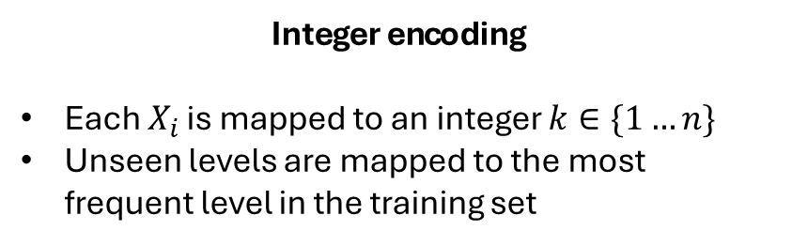
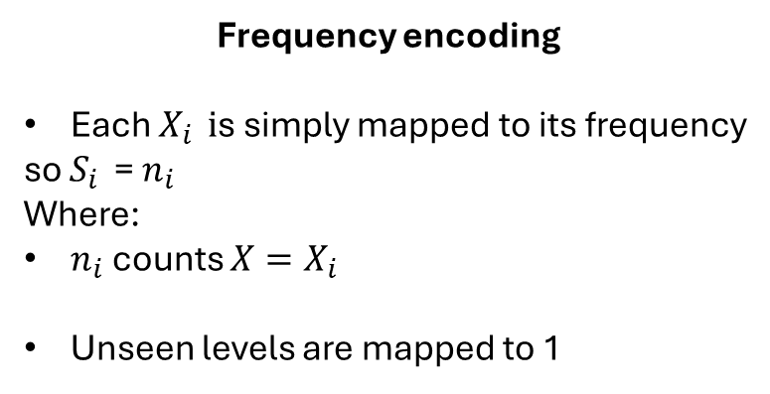
Target agnostic - frequency and integer encoding
Given a categorical attribute $X$ with $i=\left\{1…n\right\}$ being a level, so $n$ levels, the encoding will be defined as follow:
Frequency encoding
Each $X_{i } i$s simply mapped to its frequency
so $S_{i }$= $n_{i}$
Where:
$n_{i}$ counts ${X=X}_{i}$
Unseen levels are mapped to 1
Integer encoding
Each $X_{i }$is mapped to an integer $k∈\{1…n\}$
Unseen levels are mapped to the most frequent level in the training set

Slide 5
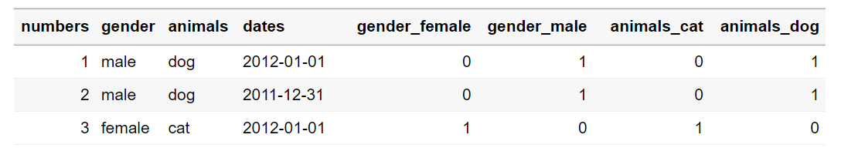
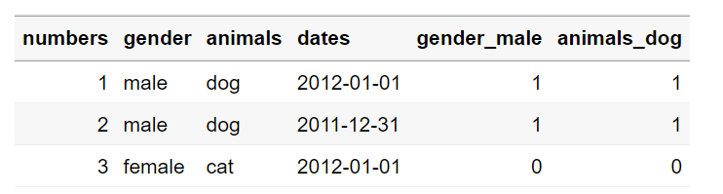
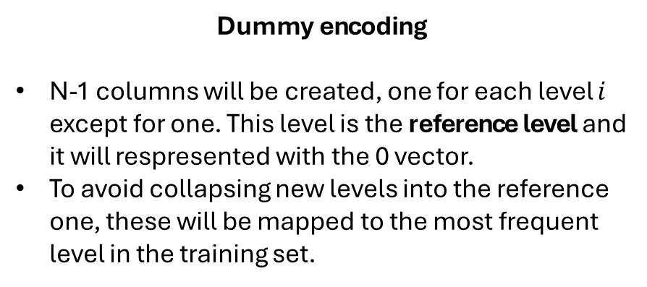
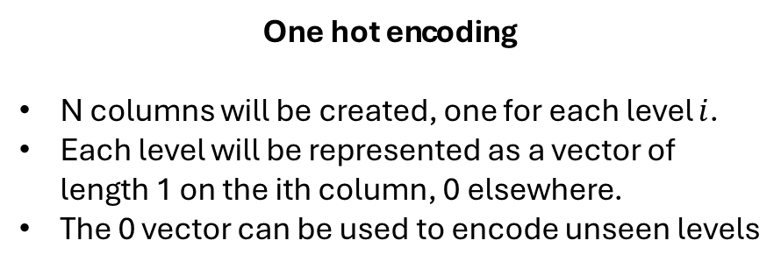
Target agnostic - indicator encoding
Indicator encoding is a broad term that comprehends both one hot encoding and dummy encoding.
Given a categorical attribute $X$ with $i=\left\{1…n\right\}$ being a level, so $n$ levels, the encoding will be defined as follow:
One hot encoding
N columns will be created, one for each level $i$.
Each level will be represented as a vector of length 1 on the ith column, 0 elsewhere.
The 0 vector can be used to encode unseen levels
Dummy encoding
N-1 columns will be created, one for each level $i$ except for one. This level is the reference level and it will respresented with the 0 vector.
To avoid collapsing new levels into the reference one, these will be mapped to the most frequent level in the training set.

Slide 6

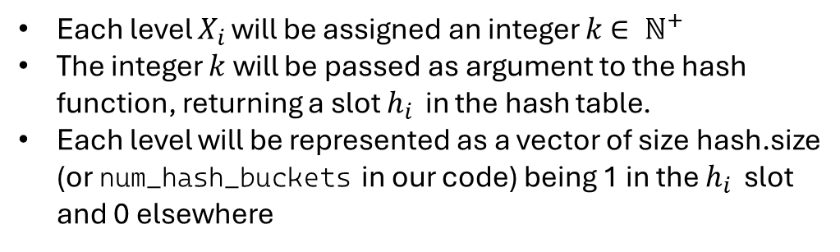
Target agnostic - hash encoding
Hash encoding can be seen as another way to compute indicator variables, based on a certain hash function.
Given a categorical attribute $X$ with $i=\left\{1…n\right\}$ being a level, so $n$ levels, the encoding will be defined as follow:
Each level $X_{i }$will be assigned an integer $k$ $∈ {\text{ℕ}}^{+}$
The integer $k$ will be passed as argument to the hash function, returning a slot $h_{i }$ in the hash table.
Each level will be represented as a vector of size hash.size (or num_hash_buckets in our code) being 1 in the $h_{i }$ slot and 0 elsewhere
Figure: R code of our hash function
Hash.size is completely arbitrary, however, due to the randomicity of the hash function, some collision may happen. An issue of this type of encoding is managing the «complexity-collision» trade off, i.e. the higher the Hash.size the higher is the number of available slots (fewer collisions) but this leads to an higher space complexity.

Slide 7
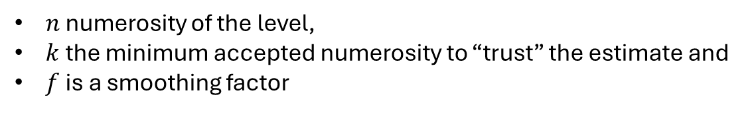
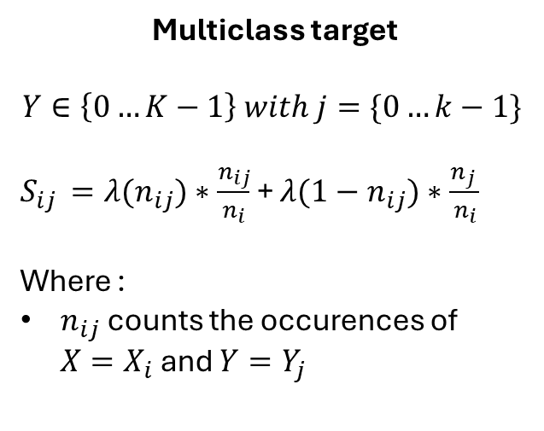
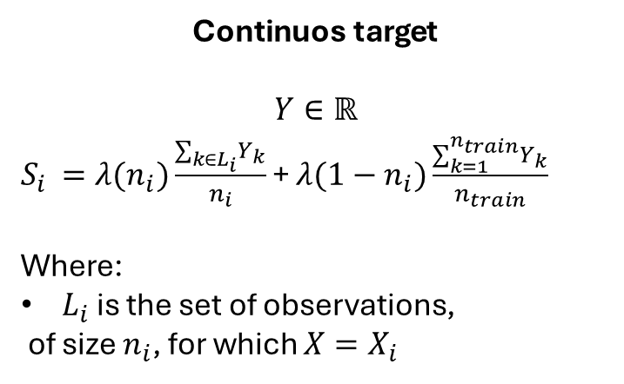
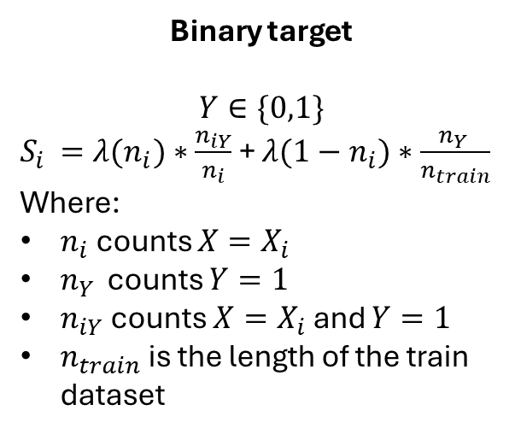
Target based- Regularized Impact encoding
The basic principle motivating the proposed preprocessing scheme is to map individual values of a high-cardinality categorical attribute to an estimate of the probability of the dependent attribute.
Given a categorical attribute $X$ with $i=\left\{1…n\right\}$ being a level, so $n$ levels, the encoding $S$ will be defined as follow:
Binary target
$$Y∈\{0,1\}$$
$S_{i }={λ(n}_{i})∗\frac{n_{iY}}{n_{i}}$ + ${λ(1−n}_{i})∗\frac{n_{Y }}{n_{train}}$
Where:
$n_{i}$ counts ${X=X}_{i}$
$n_{Y }$ counts ${Y=1}_{}$
$n_{iY}$counts ${X=X}_{i}$ and ${Y=1}_{}$
$n_{train}$ is the length of the train dataset
Continuos target
$$Y∈ℝ$$
$S_{i }={λ(n}_{i})\frac{∑_{k∈L_{i}}^{}Y_{k}}{n_{i}}$ + ${λ(1−n}_{i})\frac{∑_{k=1}^{n_{train}}Y_{k}}{n_{train}}$
Where:
$L_{i}$ is the set of observations,
of size $n_{i}$, for which ${X=X}_{i}$
Multiclass target
$$Y∈\left\{0…K−1\right\} with j=\{0…k−1\}$$
$S_{ij }={λ(n}_{ij})∗\frac{n_{ij}}{n_{i}}$ + ${λ(1−n}_{ij})∗\frac{n_{j }}{n_{i}}$
Where :
$n_{ij}$ counts the occurences of ${X=X}_{i}$ and ${Y=Y}_{j}$
$λ(n)$is a monotonically increasing function on n bounded between 0 and 1. In our case:
$λ(n)$ = $\frac{1}{1+e^{−(\frac{n−k}{f})}}$ where:
$n$ numerosity of the level,
$k$the minimum accepted numerosity to “trust” the estimate and
$f$is a smoothing factor

Slide 8
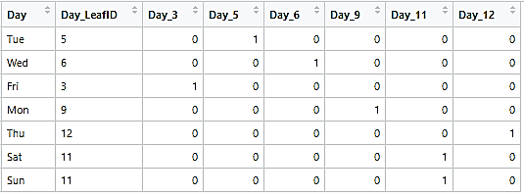
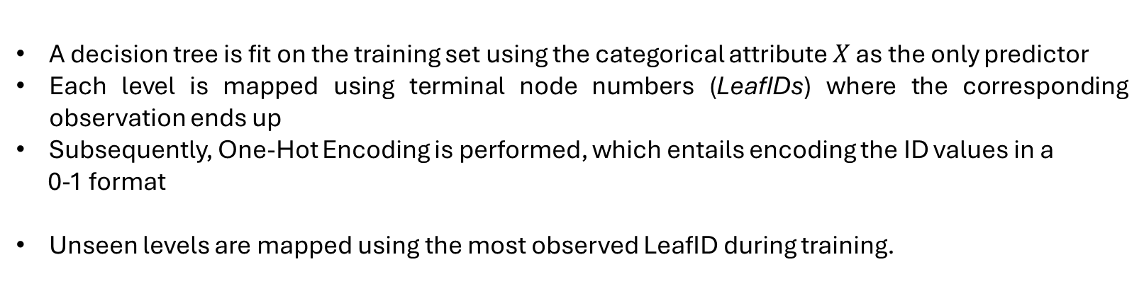
Target-based - Leaf encoding
Given a categorical attribute $X$ with $i=\left\{1…n\right\}$ being a level, so $n$ levels, the encoding will be defined as follow:
A decision tree is fit on the training set using the categorical attribute $X$ as the only predictor
Each level is mapped using terminal node numbers (LeafIDs) where the corresponding observation ends up
Subsequently, One-Hot Encoding is performed, which entails encoding the ID values in a
0-1 format
Unseen levels are mapped using the most observed LeafID during training.
Feature levels leading to the same terminal node are mapped to the same value, aiming to combine levels with similar targets.

Slide 9
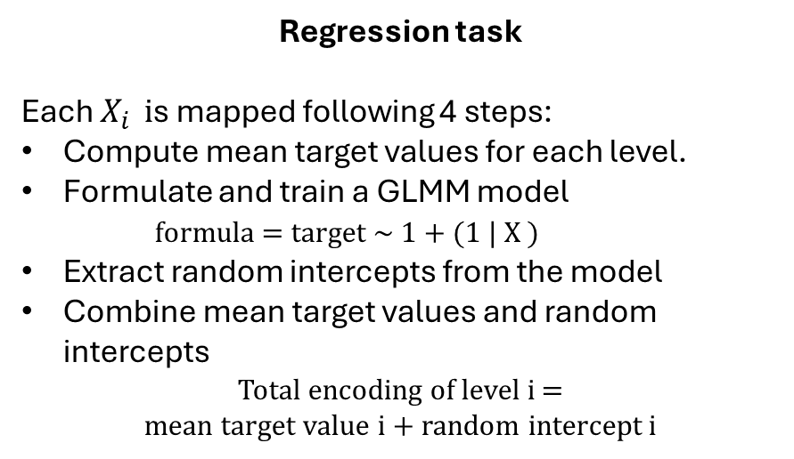
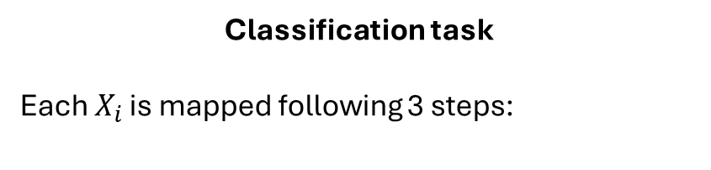
Target-based - GLMM encoding
Given a categorical attribute $X$ with $i=\left\{1…n\right\}$ being a level, so $n$ levels, the encoding can be interpreted as a simple generalized linear mixed model (GLMM), in which the target is predicted by a random intercept for each feature level in addition to a fixed global intercept
Regression task
Each $X_{i } i$s mapped following 4 steps:
Compute mean target values for each level.
Formulate and train a GLMM model
formula = target ~ 1 + (1 | X )
Extract random intercepts from the model
Combine mean target values and random intercepts
Total encoding of level i =
mean target value i + random intercept i
Classification task
Each $X_{i }$is mapped following 3 steps:
Train a GLMM model for each level of X and for each level of the target (C one vs. rest GLMMs)
Retrieve fixed coefficients and random effects from the model
Calculate the overall encoding value by combining the extracted coefficients and random effects, considering both the categorical level and the corresponding target level.
This involves generating encoded values for each level of X and for each level of the target, resulting in at most C * n encodings
Unseen levels are mapped to the fixed intercept of the model

Slide 10
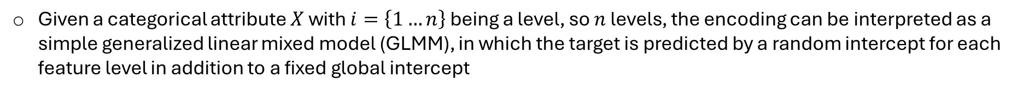
Target-based - the role of Random and Fixed components in GLMM encoding
Given a categorical attribute $X$ with $i=\left\{1…n\right\}$ being a level, so $n$ levels, the encoding can be interpreted as a simple generalized linear mixed model (GLMM), in which the target is predicted by a random intercept for each feature level in addition to a fixed global intercept
Random Effects
Fixed Intercepts
Role in Encoding: within GLMM-based encoding, random intercepts capture latent variability specific to different categorical feature levels. They account for variations in the impact of these levels on the target variable that can't be explained by fixed predictors.
Effect: Each categorical feature level is assigned its own random intercept. This addresses the diverse influence of feature levels on the target within the mixed-effects modeling framework.
Role in Encoding: The fixed intercept establishes a baseline prediction shared across all combinations of categorical feature levels and target variable classes.
Effect: It captures the common impact that all possible combinations of categorical feature and target variable have on the prediction process

Slide 11
Control conditions
Two different control conditions are introduced, aimed at enhancing the understanding of the effectiveness of the investigated encoding techniques
Remove high cardinality features control condition
Features with levels exceeding a threshold are omitted, and remaining features undergo one-hot encoding without collapsing rare levels.
The condition evaluates whether the inclusion of high cardinality features enhances predictive performance, investigating if encoding high cardinality features improves results beyond their exclusion.
A High Cardinality Threshold (HCT) parameter is also introduced, which aims to highlight the relationship between the complexity of encoding methods and the cardinality of categorical variables
HCT parameter takes values of 10, 25, and 125, representing different levels of cardinality
Indicator encoding: the HCT − 1 most frequent levels are encoded together with a single collapsed category for the remaining levels.
Other encoders (Integer, Frequency, Hash, Leaf, Impact, and GLMM): variables whose number of levels exceeds the HCT value are subjected to the encoding. The remaining categorical features are one-hot encoded.

Slide 12
Pseudocode for encoding and results pipeline
Pipeline
codes = {dataset_i = id_i} \\ set with all datasets with corresponding IDs
encodings = {«impact», «glmm»… «hash»} \\ set with all encodings
thresholds = {10,25, 125} \\ set with all thresholds
*all_results = data.frame() \\ empty dataframe to store the results
for all codes do :
get data from MLOpen \\ API call to MLOpen, dataset ID is required
prepare data \\ done with a custom function
split data
for all encodings do :
if encoding is «onehot» or «dummy»: \\ no need for threshold for these encoders
get encoded data \\ call the corresponding encoding
call NN model \\ call the model, again done with a custom function comprehending ad hoc normalization, fit and predict
get results \\ get the results from the model → AUC, AUNU or RMSE
append results to all_results \\ merge with main results collector
next \\ go to next encoder
else:
for all thresholds do:
get encoded data
call NN model
get results \\ of an encoder with a certain threshold
append results to all_results
return all_results * the results should be differentiated by the target type

Slide 13
Neural Network (NN) Model
The Neural Network model was created and trained using the neuralnet library. The fine-tuning of the parameters was kept to a minimum: they were set in the beginning and were kept constant with every dataset.
The parameters were set as follow:
Only one hidden layer, with 10 nodes
Threshold as a stopping criteria for the partial derivatives of the error function of 0.1
Linear Output = TRUE when dealing with regression problems; FALSE when dealing with classification problems.
The formula describing the model ensures that all the features present in the dataset are used to infer the value of the target variable.
All other parameters were kept as their default value.
Before training the NN model, the values of each dataset were standardized, using the training set to calculate the scaling factors. We did not standardize features obtained from one hot encoding.
After the training of the NN model, the function predict was used to apply the model to the test set.

Slide 14
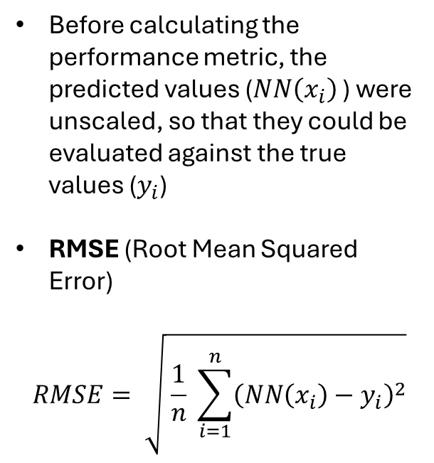
Evaluation of the NN Model
Depending on the target variable, different metrics were calculated to evaluate the performance of the classifier:
Regression
Binary classification
Multiclass classification
Before calculating the performance metric, the predicted values ($NN\left(x_{i}\right)$ ) were unscaled, so that they could be evaluated against the true values ($y_{i}$)
RMSE (Root Mean Squared Error)
$$RMSE= \sqrt{ \frac{1}{n} \sum_{i=1}^{n}{{\left(NN\left(x_{i}\right)−y_{i}\right)}^{2}}}$$
For classification problems, the predict function outputs the probability of each class of the target variable
The class with higher probability was selected as the predicted value
AUC (Area Under the ROC Curve)
The AUC was calculated using the library pROC
AUNU (AUC of each class against the rest)
AUNU computes the AUC considering a classifier with c possible classes
The AUNU was calculated using the library mlr3measures

Slide 15
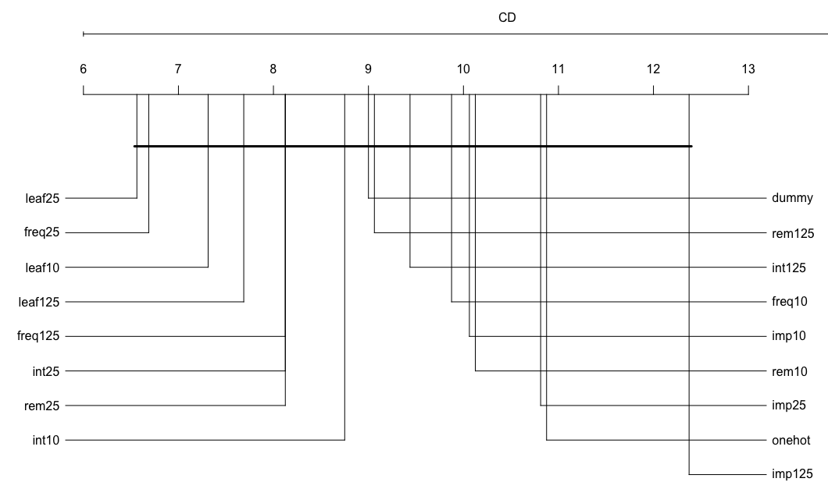
Results
After the evaluation of each NN model, the dataframe containing all the results was analyzed, in order to get some insights on which encoder and threshold would generally work best with this type of model.
This dataframe was prepared as follows:
We considered only datasets with a classification task, either binary or multiclass, since the training and fitting of the NN model was not time-efficient on regression problems.
Additionally, we decided to exclude datasets that, due to their size, would not converge or took too long to do so, making it impossible to train the model for every encoder and threshold.
For the same reason, we removed the columns corresponding to the hash and glmm encoders.
We performed the Nemenyi Test on the results dataframe.
the test did not find any significant difference between the mean rankings, so we can’t say that there is one encoding that performs better than the others.
Figure: Critical Differences plot

Slide 16
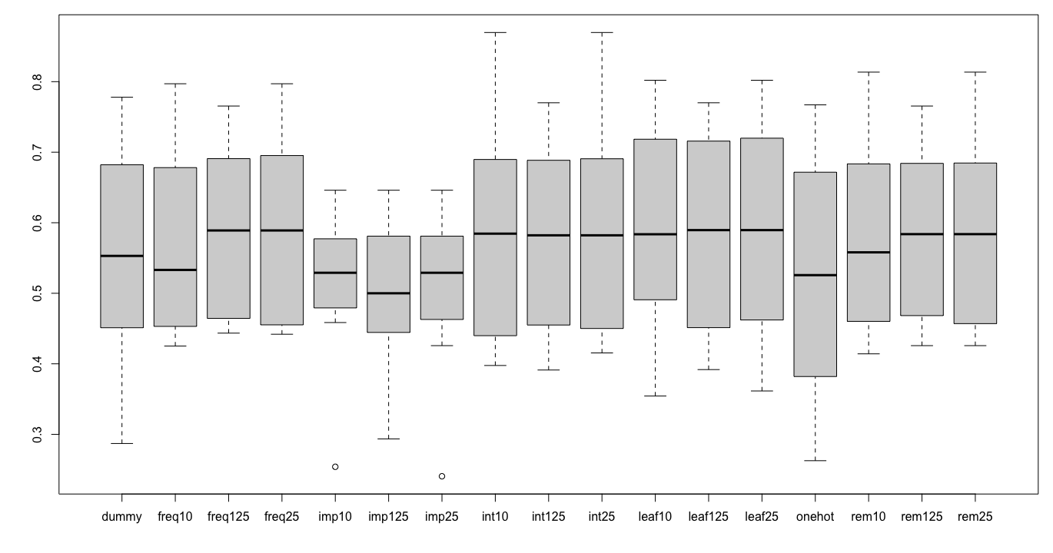
Conclusions
We report here also the boxplots plotted from the results dataframe, which are consistent with the results of the Nemenyi test: the median of all the encoders is similar, and the slight differences might be attributed to randomness.
Considering the overall results, we can say that the type of encoding doesn’t majorly influence the performance of the NN model, but there may be a few reasons for this unexpected result:
The training of NN is computationally complex, so in order to be able to run all the code we had to set the parameters in a way that could have negatively impacted the performance.
We had to drop the columns corresponding to the glmm results, since we couldn’t compute them for all datasets, but when present, it provided better results.
Figure: boxplot for each encoder on each dataset

