Slide 1
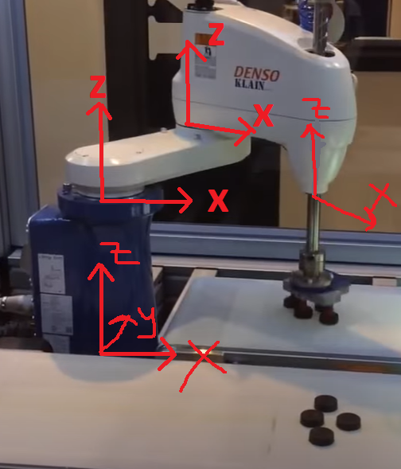
Configuration
First part of the code is deriving the forward kinematics of the Scara (I used the datasheet for the parameters).

Slide 2
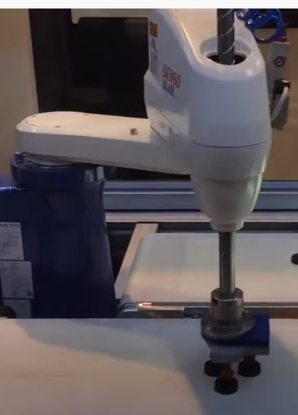
First the location to be picked up is spotted
However, the belt is moving. Therefore, the arm keeps moving until ist end effector aligns with the parts. ( I assumed a constant timeframe for this, but normally it would be a while loop that is active until the alignment is performed). During this time, task space is done with a constant sampling time.

Slide 3
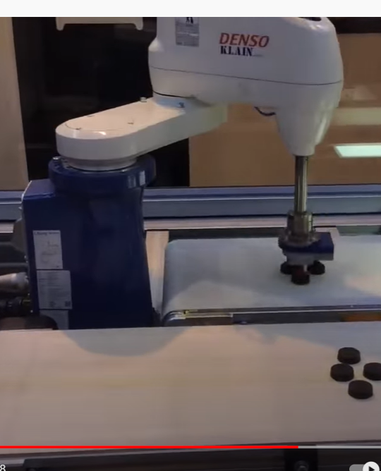
Then, the parts are dropped in a certain position
I assumed this is constant for every operation. Then joint space is performed since there is no collision danger or anything that needs to be taken into account.

Slide 4
I did not include the picking up and dropping movements, since only the last translational joint moves in this case and it is only a stroke.
Also, there is no stroke movement when the end effector is aligning its orientation with the parts.

