Slide 1
Drug-target interaction prediction using Multi-target methods

Slide 2
Multi-target prediction (MTP)
MTP is concerned with the simultaneous prediction of multiple target variables of diverse type.
Combines several subfields of machine learning, including:
Multi-label classification
Multivariate regression
Multi-task learning
Dyadic prediction
Zero-shot learning
Matrix completion
A general framework has been introduced that manages to cover the above aforementioned subfields as special cases.

Slide 3
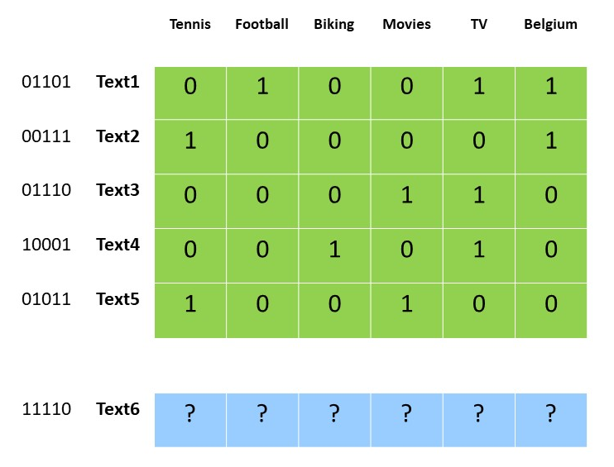
Multi-label classification
Simultaneous prediction of multiple binary targets.
Classic example: Automated document categorization (tagging). More that one tag can might be relevant for a particular document.
Bag-of-words representations common feature representation of the documents.
All targets are observed during training.
No side-information is available for targets.
The label matrix has no missing values.

Slide 4
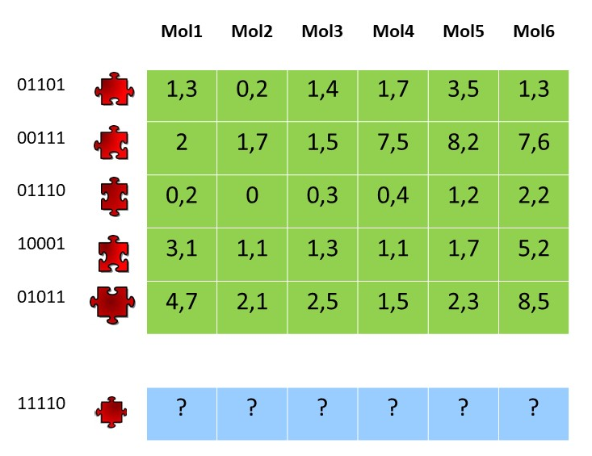
Multivariate regression
Binding affinity
Simultaneous prediction of multiple real-valued targets.
Classic example: Protein-ligand interaction prediction. More that one ligands might show high binding affinity with a protein.
All ligands-targets are observed during training.
No side-information is available for targets.
The label matrix has no missing values.

Slide 5
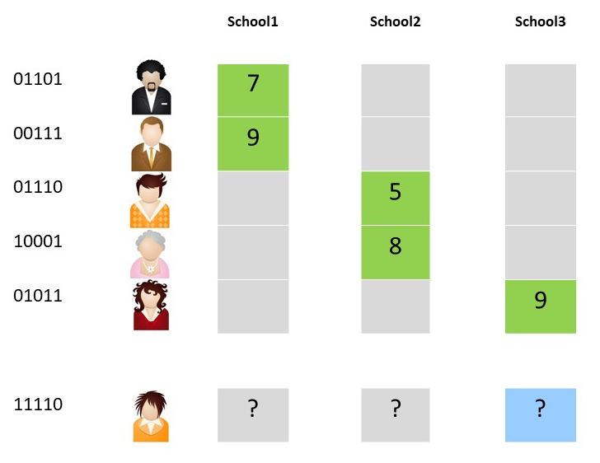
Multi-task learning
Multi-task learning unifies the subfields mentioned in the two previous slides, and further extends them to problems where not all targets are relevant for all instances.
Example: Student marks prediction. Here, each student usually attends one school. As a result, only one label per student is observed.
All schools-targets are observed during training.
No side-information is available for targets.
The label matrix has no missing values.

Slide 6
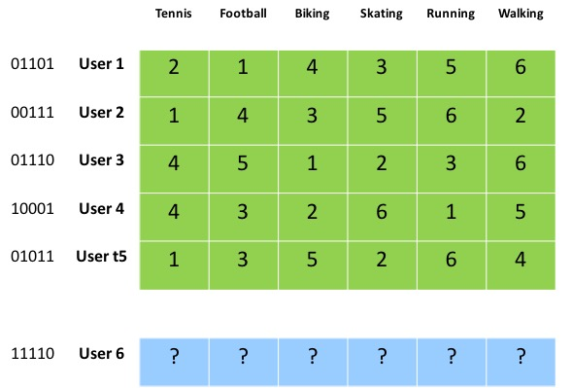
Label ranking
Label ranking can be seen as another instantiation of the general MTP framework.
Here, each instance is associated with a ranking (total order) of the targets.
Example: Student marks prediction. Here, each student usually attends one school. As a result, only one label per student is observed.
All schools-targets are observed during training.
No side-information is available for targets.
The label matrix has no missing values.

Slide 7
Integration of side-info for the targets
The conventional MTP settings like multi-label classification, multivariate regression, and multi-task learning can be extended by using additional side information about the target.
Multivariate regression
Dyadic prediction
Multi-label classification
+
Side-information
Hierarchical Multi-label classification
Multi-task learning
Transfer or Zero-shot learning

Slide 8
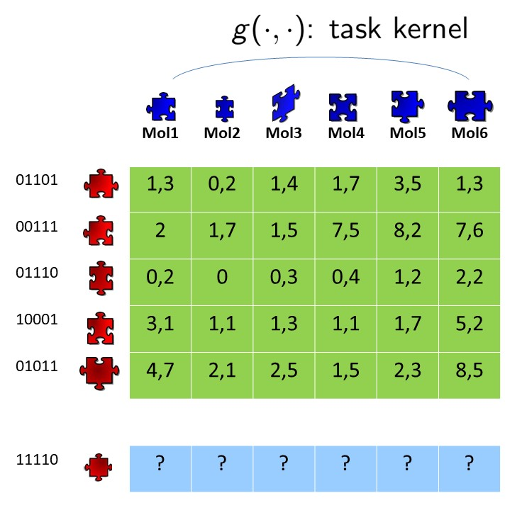
Dyadic prediction
In addition to the graph-based representation for the proteins (the instances in this example), a representation for the molecules is also available (the targets in this example).
Common situation in research on protein-ligand prediction where the target representation is either graph-based or feature-based (ECFP features).
One might say that:
Dyadic prediction = Multi-task learning + task features

Slide 9
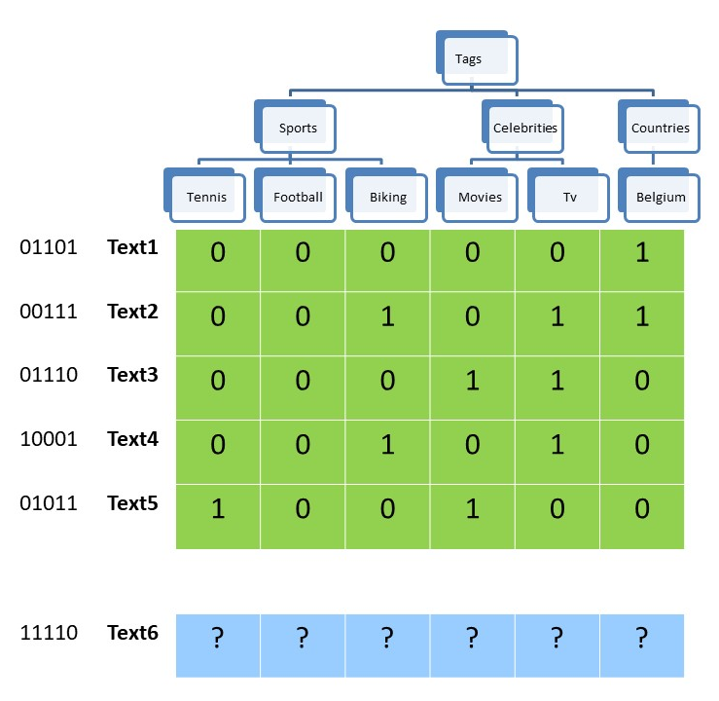
Hierarchical multi-label classification
In the document categorization application, the categories are usually organized in hierarchies.
The goal is for the proposed method to exploit the available hierarchy.

Slide 10

Transfer & zero-shot learning
One might be able to collect all sorts of variables about schools and courses like:
Geographical location
Teacher’s qualifications
School’s reputation
…
This side information is a key element for tackling transfer learning and zero-shot learning.

