Slide 1
LEVERAGING LOCAL LLM’s TO BENEFIT PC USERS AND FINE-TUNE PCs FOR PROFFESSIONAL WORKERS
TEAM MEMBERS
  Dilip Kumar. G [ 313522205010]
  Kishore. B [ 313522205030]
  Mohan. M [ 313522205036]
  Muthu Karthickeyan. D [ 313522205038]

Slide 2
PROBLEM STATEMENT
Modern organizations rely heavily on digital systems to manage departments, projects, tasks, and documents. However, many existing project management systems lack structured Role-Based Access Control (RBAC) and intelligent assistance, resulting in:
Unauthorized access to sensitive data
Inefficient task tracking and manual coordination
Lack of clarity in user responsibilities
Absence of intelligent support for decision-making
Although Artificial Intelligence (AI) can improve productivity, its uncontrolled integration may violate organizational security and hierarchy.
Hence, there is a need to design a secure project management system that integrates AI assistance while strictly enforcing role-based access control to improve productivity, security, and workflow efficiency.

Slide 3
ABSTRACT
Modern organizations require secure and efficient systems to manage departments, projects, tasks, and documents while maintaining strict access control. Traditional project management solutions often lack structured role-based access and intelligent support, leading to inefficient workflows and security risks.This project presents a role-based project management system integrated with Artificial Intelligence (AI) assistance to enhance organizational productivity and workflow efficiency. The system defines four hierarchical roles—CEO, Manager, Project Lead, and Employee—each with clearly enforced Role-Based Access Control (RBAC). The CEO manages departments and users, Managers oversee projects and teams, Project Leads assign tasks and manage documents, and Employees update task progress and access assigned resources. An integrated local AI assistant provides intelligent support such as query handling, information summarization, and task-related assistance, while strictly adhering to access control policies and organizational hierarchy. The system follows a modular and scalable architecture, ensuring security, maintainability, and future extensibility.The proposed solution demonstrates how combining RBAC with controlled AI assistance improves collaboration, accountability, and operational efficiency in modern enterprise environments.

Slide 4
INTRODUCTION
With the increasing complexity of organizational workflows, efficient project and task management has become essential. Traditional systems often rely on manual coordination, spreadsheets, or standalone tools, leading to poor collaboration and security risks. The advancement of Artificial Intelligence (AI) enables intelligent systems that can assist users by answering queries, summarizing information, and improving productivity. However, AI integration must be regulated to ensure security and access control.
This project proposes a role-based project management system integrated with AI assistance. The system supports four hierarchical roles:
CEO
Manager
Project Lead
Employee
Each role has clearly defined permissions enforced using Role-Based Access Control (RBAC). The integrated AI assistant provides intelligent support without violating access policies, ensuring secure and efficient organizational operations.

Slide 5
TOOLS AND TECHNOLOGIES
Frontend Technologies
1. React – Single Page Application (User Interface)
2. Tailwind CSS – Responsive design and layout styling
3. shadcn/ui – Reusable and professional UI components
Axios – API communication between frontend and backend.
Backend Technologies
1. Node.js – Server-side runtime environment
2. Express.js – RESTful API development and routing
3. MongoDB – NoSQL database for data storage
4. Mongoose – Schema modeling and data validation

Slide 6
TOOLS AND TECHNOLOGIES
Security & Authentication
1. JSON Web Token (JWT) – Stateless user authentication
2. bcrypt – Secure password encryption
AI Integration
Ollama – Local Large Language Model (LLM) engine for AI assistance
Development & Deployment Tools
1. Visual Studio Code – Code editor
2. Git – Version control system
3. GitHub – Source code hosting and collaboration
4. Postman – API testing and validation
5. PlantUML – System and UML diagram creation
6. npm – Package and dependency management

Slide 7
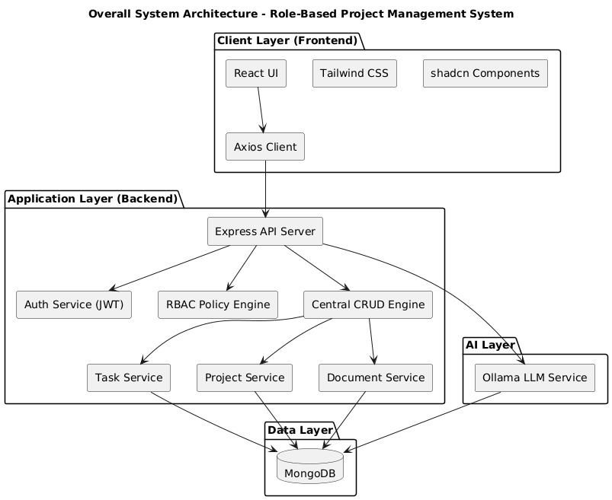
ARCHITECTURE DIAGRAM​

Slide 8
CONCLUSION
This project successfully demonstrates the design and implementation of a secure, role-based project management system integrated with AI assistance.
Key outcomes include:
Effective enforcement of Role-Based Access Control
Improved productivity through AI-assisted query handling and task support
Secure management of projects, tasks, and documents
Scalable and modular architecture suitable for enterprise environments
The system enhances collaboration, accountability, and operational efficiency while ensuring that AI assistance does not violate organizational security or hierarchy.

Slide 9
REFERENCES
1. A. Nikolakopoulos et al., Exploring the Potential of Offline LLMs in Data Science, IEEE Access, 2025.
2. C. Ebert & P. Louridas, Generative AI for Software Practitioners, IEEE Software, 2023.
3. A. Fan et al., Large Language Models for Software Engineering, IEEE/ACM ICSE, 2023.
4. M.-F. Wong et al., AI-Assisted Programming Using Large Language Models, Entropy, 2023.
5. P. Sahoo et al., Survey on Prompt Engineering in Large Language Models, arXiv, 2024.
6. S. I. Ross et al., Conversational AI Assistants for Software Development, ACM IUI, 2023.
7. NIST, Role-Based Access Control (RBAC) Standard, USA.

