Slide 1

DESIGN AND ANALYSIS OF ALGORITHMS
AN APPLICATION FOR
OPENING COFFEE SHOPS
Team Members :
G . Dilip Reddy – 2010030041
K . Vamshi – 2010030326
M . Ruchitha – 2010030480
P . Venkata Sai Aditya – 2010030434
Under the guidance of
P. Sree Lakshmi Mam
Notes:
2. Algorithm used- its description
3. Flow chart of the proposed solution
4. Numeric example of the algorithm (Sample input - expected output)
5. Coding status and testing
6. Work division
7. GitHub commits

Slide 2
ABSTRACT
Our project is implementation of the greedy approach to set cover.
The set cover problem is exciting simple to describe: given a collection F of sets, each containing a subset of a universe U of objects, find a smallest sub collection A of F such that every object in U is included in at least one of the sets in A.
However, like many such combinatorial problems, set cover is NP-hard, meaning that it is unlikely that an efficient algorithm will be found, and that approximation algorithms must be preferred for non-trivial problem instances.
One well-known approximation approach for set cover is to repeatedly add the set with the most uncovered items to the solution, continuing until every element in the universe is covered. this greedy approach has a provable logarithmic approximation ratio, essentially the best feasible ratio.

Slide 3
INTRODUCTION
Given a set system (U, F), where U contains n elements and F is a family of m subsets of U such that every element of U belongs to at least one subset in F, here each subset in F has a positive weight, a set cover C of U is a subfamily of F such that every element in U is in at least one of the subsets in C.
The set cover problem is to find a set cover with the minimal total weight of subsets in the set cover. For this famous NP-hard problem the set cover problem has many applications in practice.

Slide 4
INTRODUCTION
The complexity of the connected set cover problem for some special graphs. We shall see that the difficulty in solving the connected set cover problem not only lies in the structure of (U, F) system but also related to the property of give graph G.
Graph G is called a line graph if two vertices in V (G) have degree one and all others have degree two. Graph G is called a ring graph if it is connected and every vertex in V (G) has degree two.
Graph G is called a spider graph if G is a tree and only one vertex has degree greater than two, a spider graph is particularly called a star graph if one vertex has degree greater than one while all others have degree one.

Slide 5
LITERATURE SURVEY
S. No | Authors | Title | Published year | Pros
1 | Haiyun Sheng, Donglei Du, Yuefang Sun, Jian Sun & Xiaoyan Zhang | Approximation Algorithm for Stochastic Set Cover Problem | 2020 | The goal is to minimize the sum of the first stage cost, the expected second stage cost and the expected penalty cost.
2 | Wenbin Chen, Fufang Li, Ke Qi, Miao Liu & Maobin Tang | A Primal-Dual Randomized Algorithm for the Online Weighted Set Multi-Cover Problem | 2020 | It gives a randomized algorithm with competitive ratio for the problem based on the primal-dual method, which improve previous competitive ratio.
3 | Mitrović, Slobodan; Rubinfeld, Ronitt | Improved local computation algorithm for set cover via sparsification | 2020 | A parallel set cover algorithm that admits an efficient simulation in the LCA model by using a sparsification technique

Slide 6
METHODOLOGY
Greedy Approximation Algorithm is being used in the project to solve an optimal selection problem because the greedy algorithm is known as the best possible polynomial time algorithm for maximum coverage problem and works by iteratively selecting a set that contains the largest number of elements and then removing selected elements from all the remaining sets in the collection.

Slide 7
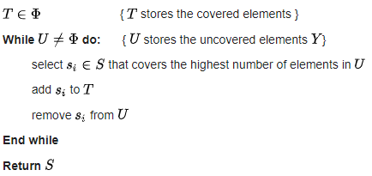
PROPOSED SYSTEM

Slide 8
PROPOSED SYSTEM
→Initially, T is a null/empty set used to store the covered elements while U is a set to store the uncovered elements.
→S contains all the possible subsets(s1,s2,…sn) which has different elements in it.
→From the available list of subsets, the set with maximum number of elements will be selected and the elements in that set are now considered as covered.

Slide 9
PROPOSED SYSTEM
So, we’ll add these elements to the set T.
→And as U stores the uncovered elements, we have to remove previously covered elements from the set U.
→This process keeps on iterating till all the sets become covered which means that U become null/empty set.
→In the end, we’ll return the elements which is considered to be the optimal solution.

Slide 10

EXAMPLE
We have a set U (University areas) that needs to be covered with C (camera locations).
U={1,2,3,4,5,6,7,8,9,10,11,12,13,14,15}
C = {C1,C2,C3,C4,C5,C6,C7,C8}
C1={1,3,4,6,7} C2={4,7,8,12}
C3={2,5,9,11,13} C4={1,2,14,15}
C5={3,6,10,12,14} C6={8,14,15}
C7={1,2,6,11} C8={1,2,4,6,8,12}
The cost of each Camera Location is the same in this case, we just hope to minimize the total number of cameras used, so we can assume the cost of each C to be 1.
Let I represents set of elements included so far. Initialize I to be empty.

Slide 11

First Iteration:
The new element cost for C1=1/5,for C2=1/4,for C3=1/5,for C4=1/4,for C5=1/5,for C6=1/3,for C7=1/4,for C8=1/6
Since,C8 has minimum value,C8 is added, and I becomes {1,2,4,6,8,12}
Second Iteration:
I = {1,2,4,6,8,12}
The new element cost for C1=1/2,for C2=1/1,for C3=1/4,for C4=1/2,for C5=1/3,for C6=1/2,for C7=1/1
Since,C3 has minimum value,C3 is added, and I becomes {1,2,4,5,6,8,9,11,12,13}
Third Iteration:
I = {1,2,4,5,6,8,9,11,12,13}
The new element cost for C1=1/2,for C2 = 1/1,for C4=1/2,for C5=1/3,for C6=1/2,for C7=1/1
Since C5 as minimum value,C5 is added, and I becomes {1,2,3,4,5,6,8,9,10,11,12,13,14}

Slide 12
Fourth iteration:
I = {1,2,3,4,5,6,8,9,10,11,12,13,14}
The new element cost for C1=1/1,for C2=1/1,for C4=1/0,for C6=1/1,for C7=1/0
Since C1,C2,C6 all have meaningful and same values, we can choose either both C1 and C6 or both C2 and C6.As C1 or C2 add 7 to I, and C6 add 15 to I.
I becomes {1,2,4,5,6,7,8,9,10,11,12,13,14,15}
Now,
The solution obtained is:
Option 1: C8 + C3 + C5 + C6 + C1
Option 2: C8 + C3 + C5 + C6 + C2
The greedy algorithm does not provide the optimal solution in this case.
The usual elimination algorithm would give us the minimum number of cameras that we need to install to be4, but the greedy algorithm gives us the minimum number of cameras that we need to install is 5.

Slide 13
HARDWARE & SOFTWARE REQUIREMENTS
HARDWARE REQUIREMENTS:
The hardware requirements that map towards the software are as follows:
RAM : 4.00 GB
Processor : Intel(R) Core(TM) i5-4210U CPU @ 1.70GHz 1.70 GHz
SOFTWARE REQUIREMENTS:
The major software requirements of the project are as follows:
Language : HTML, CSS, JAVASCRIPT and SQL
Operating system : Windows
Tools : PyCharm

Slide 14

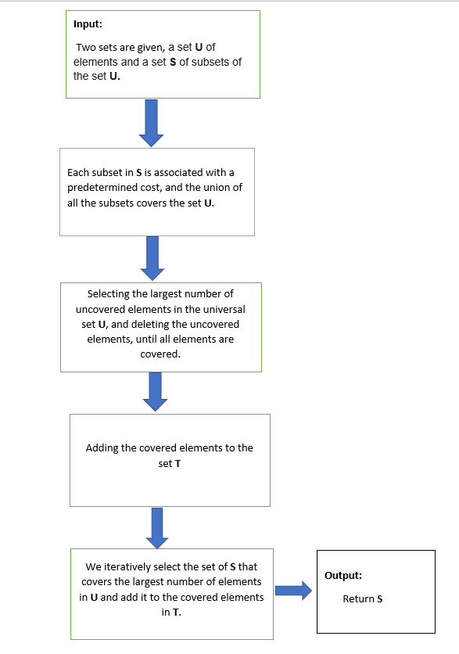
FLOW CHART OF THE PROPOSED SOLUTION

Slide 15
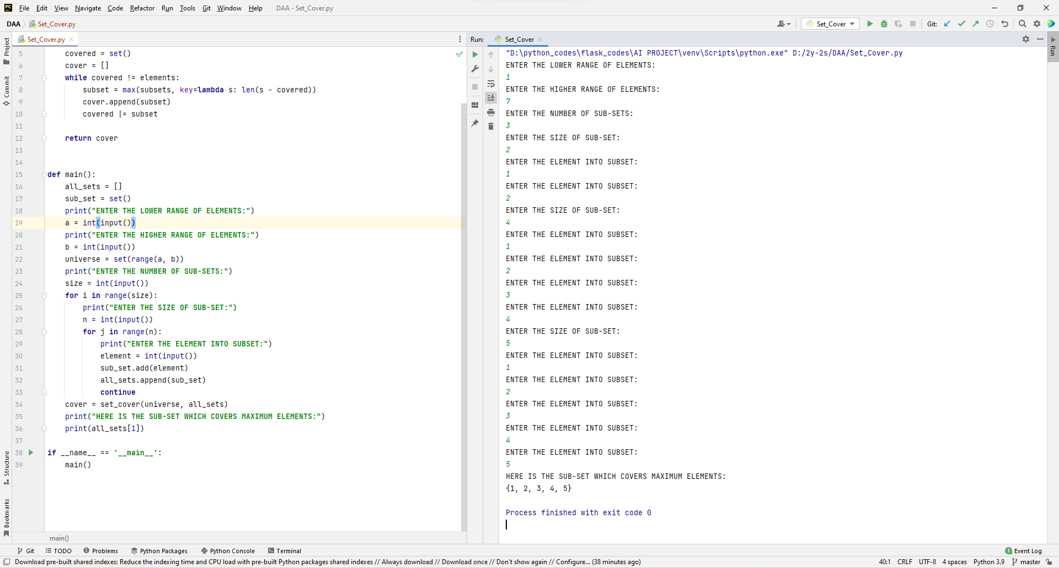
RESULTS

Slide 16
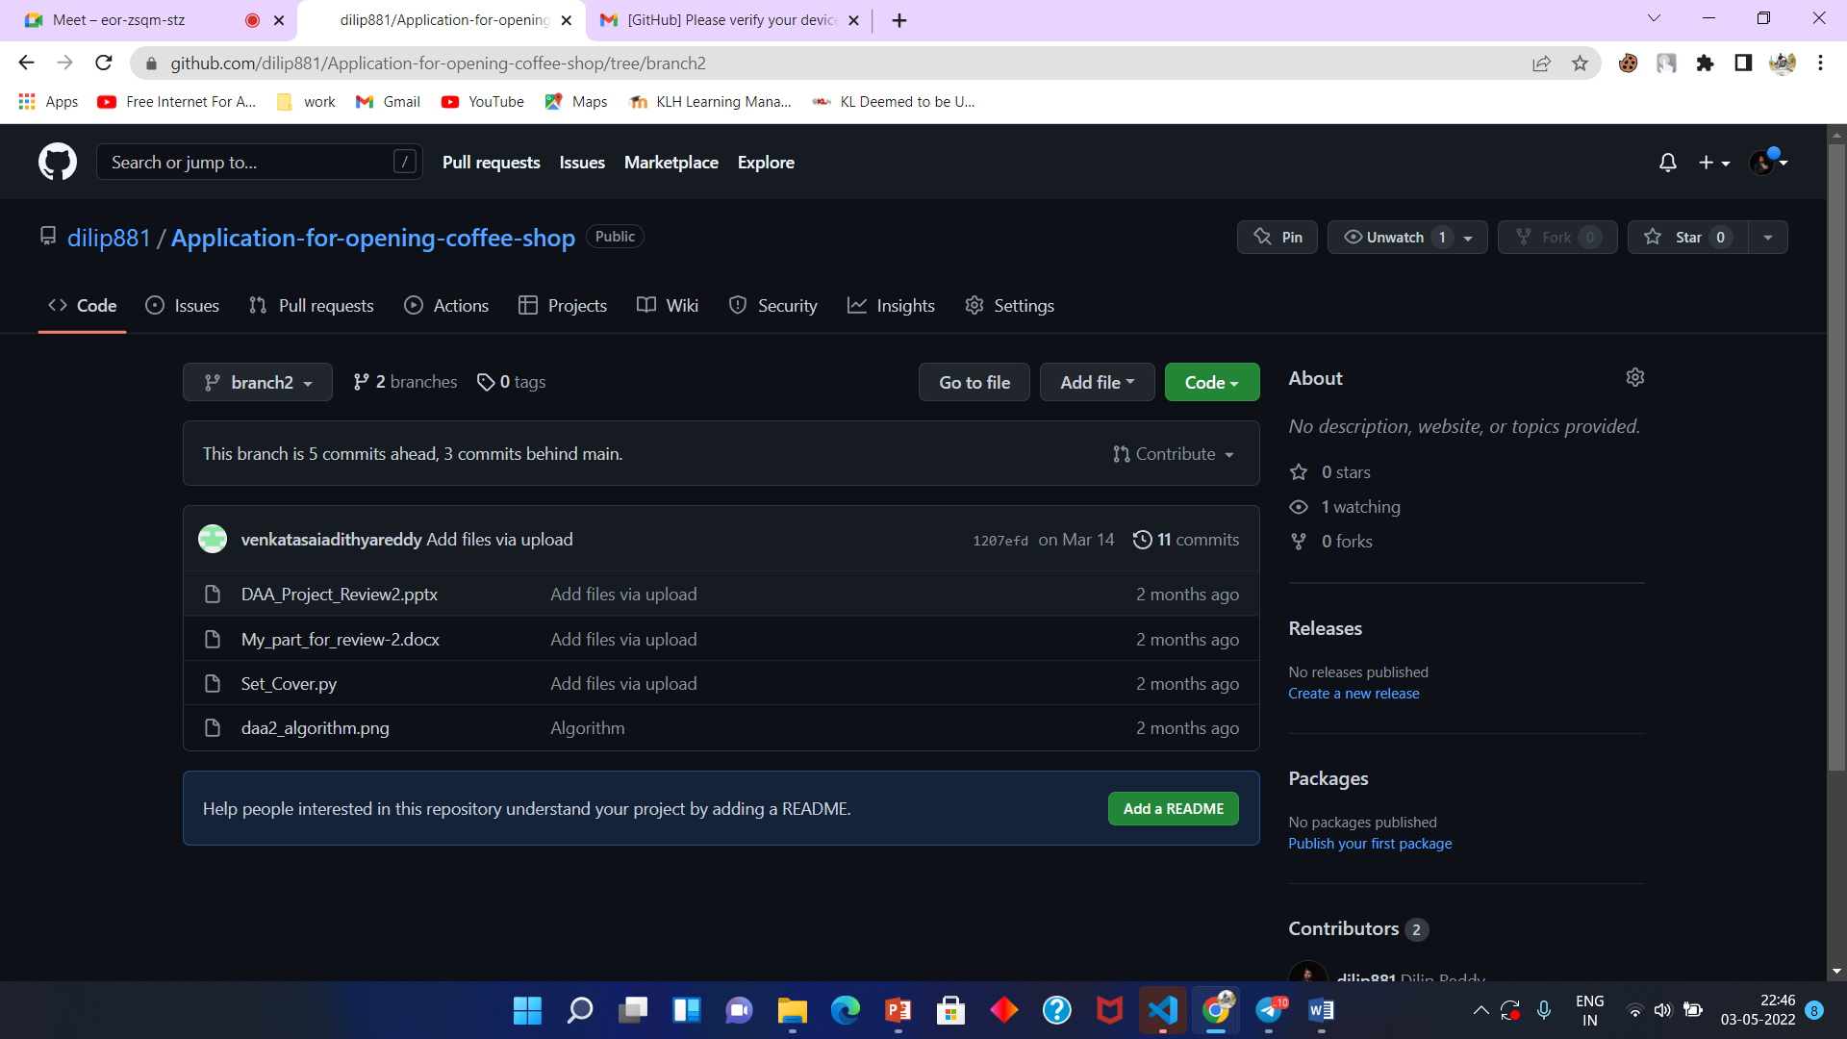
GITHUB SETUP

Slide 17
APPLICATIONS OF SET COVER PROBLEM IN REAL LIFE
The Optimal Location Problem :
-> Finding the Optimal location to locate Cell towers
-> Fire stations to serve the towns of some city.
The Optimal Route Selection Problem: -> Greedy approximation algorithm to solve an optimal selection problem including 213 bus routes in Hyderabad.
The airline crew scheduling problem :
->Personnel shift planning mainly in large airline companies. There, elements to be covered are the single shifts (or single flights), and sets are legal combinations of work/no work schedules

Slide 18
CONCLUSION
By our system we proposed, an optimal location to open any kind of business can be obtained. Especially in the case of a coffee shop. Not only providing the user with the optimal location but also enhanced user interface to make things easier. This optimal location is provided after verifying all the surrounding areas and extent of people that business could cover. Therefore, we conclude that an optimal point can be obtained with the help of Set Cover Problem.

Slide 19
FUTURE SCOPE
For further part we would like to use google API’s and help the user to locate a place where it covers all the subset places so that when a coffee shop is opened maximum profit can be obtained at that optimal location on maps. This also enhances the user interface

Slide 20
REFERENCES
[1] Sheng, Haiyun, Donglei Du, Yuefang Sun, Jian Sun, and Xiaoyan Zhang.
"Approximation Algorithm for Stochastic Set Cover Problem." In International
Conference on Algorithmic Applications in
Management, pp. 37-48. Springer, Cham, 2020.
[2] Chen, Wenbin, Fufang Li, Ke Qi, Miao Liu, and Maobin Tang. "A Primal-Dual
Randomized Algorithm for the Online Weighted Set Multi-Cover Problem."
In International Conference on Theory and Applications of Models of Computation,
pp. 60-68. Springer, Cham, 2020.
[3] Mitrović, Slobodan, and Ronitt Rubinfeld. "Improved local computation algorithm for
set cover via sparsification." (2020).

Slide 21
DIVISION OF WORK AMONG THE GROUP MEMBERS
S.No | Team member | Work allocated
1) | G . Dilip Reddy(2010030041) | Requirements gathering
2) | K . Vamshi(2010030326) | Implementation
3) | M . Ruchitha(2010030480) | Implementation
4) | P . Venkata Sai Adithya Reddy(2010030434) | Documentation

Slide 22
Thank You

