Slide 1

Design And Analysis of Algorithms
An application for
opening coffee shops
Team Members :
G . Dilip Reddy – 2010030041
K . Vamshi – 2010030326
M . Ruchitha – 2010030480
P . Venkata Sai Aditya – 2010030434
Under the guidance of
P. Sree Lakshmi Mam
Notes:
2. Algorithm used- its description
3. Flow chart of the proposed solution
4. Numeric example of the algorithm (Sample input - expected output)
5. Coding status and testing
6. Work division
7. GitHub commits

Slide 2
Problem statement and domain
If we look around, we find many problems and they might have an optimal solution but we may or may not deploy it . We aim to implement the minimum number of sets that cover all of the elements of the universal set. Consider the problem of opening coffee shops to gain maximum profit from adjacent public places. We can formulate a set covering problem where each subset consists of a set of adjacent places. The problem is then solved to maximize the profit gained by deploying a coffee shop.

Slide 3
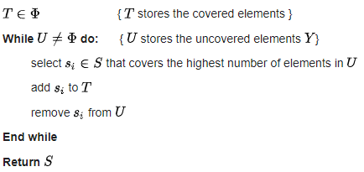
Proposed Algorithm Design Technique

Slide 4
DESCRIPTION
Greedy Approximation Algorithm is being used in the project to solve an optimal selection problem because the greedy algorithm is known as the best possible polynomial time algorithm for maximum coverage problem and works by iteratively selecting a set that contains the largest number of elements and then removing selected elements from all the remaining sets in the collection.

Slide 5

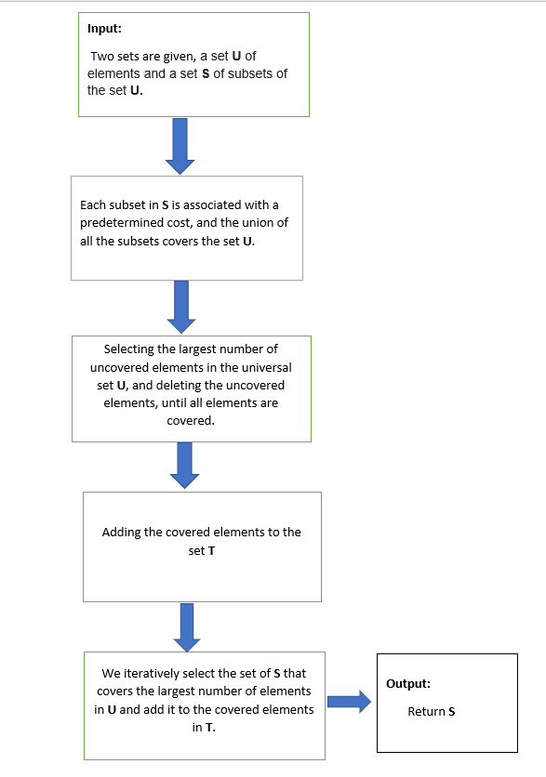
FLOW CHART OF THE PROPOSED SOLUTION

Slide 6

Example
We have a set U (University areas) that needs to be covered with C (camera locations).
U={1,2,3,4,5,6,7,8,9,10,11,12,13,14,15}
C = {C1,C2,C3,C4,C5,C6,C7,C8}
C1={1,3,4,6,7} C2={4,7,8,12}
C3={2,5,9,11,13} C4={1,2,14,15}
C5={3,6,10,12,14} C6={8,14,15}
C7={1,2,6,11} C8={1,2,4,6,8,12}
The cost of each Camera Location is the same in this case, we just hope to minimize the total number of cameras used, so we can assume the cost of each C to be 1.
Let I represents set of elements included so far. Initialize I to be empty.

Slide 7

First Iteration:
The new element cost for C1=1/5,for C2=1/4,for C3=1/5,for C4=1/4,for C5=1/5,for C6=1/3,for C7=1/4,for C8=1/6
Since,C8 has minimum value,C8 is added, and I becomes {1,2,4,6,8,12}
Second Iteration:
I = {1,2,4,6,8,12}
The new element cost for C1=1/2,for C2=1/1,for C3=1/4,for C4=1/2,for C5=1/3,for C6=1/2,for C7=1/1
Since,C3 has minimum value,C3 is added, and I becomes {1,2,4,5,6,8,9,11,12,13}
Third Iteration:
I = {1,2,4,5,6,8,9,11,12,13}
The new element cost for C1=1/2,for C2 = 1/1,for C4=1/2,for C5=1/3,for C6=1/2,for C7=1/1
Since C5 as minimum value,C5 is added, and I becomes {1,2,3,4,5,6,8,9,10,11,12,13,14}

Slide 8
Fourth iteration:
I = {1,2,3,4,5,6,8,9,10,11,12,13,14}
The new element cost for C1=1/1,for C2=1/1,for C4=1/0,for C6=1/1,for C7=1/0
Since C1,C2,C6 all have meaningful and same values, we can choose either both C1 and C6 or both C2 and C6.As C1 or C2 add 7 to I, and C6 add 15 to I.
I becomes {1,2,4,5,6,7,8,9,10,11,12,13,14,15}
Now,
The solution obtained is:
Option 1: C8 + C3 + C5 + C6 + C1
Option 2: C8 + C3 + C5 + C6 + C2
The greedy algorithm does not provide the optimal solution in this case.
The usual elimination algorithm would give us the minimum number of cameras that we need to install to be4, but the greedy algorithm gives us the minimum number of cameras that we need to install is 5.

Slide 9
Implementation
def main():
all_sets = []
sub_set = set()
print("ENTER THE LOWER RANGE OF ELEMENTS:")
a = int(input())
print("ENTER THE HIGHER RANGE OF ELEMENTS:")
b = int(input())
universe = set(range(a, b))
print("ENTER THE NUMBER OF SUB-SETS:")
size = int(input())
for i in range(size):
print("ENTER THE NUMBER OF SUB-SET ELEMENTS:")
n = int(input())
for j in range(n):
print("ENTER THE ELEMENT INTO SUBSET:")
element = int(input())
sub_set.add(element)
all_sets.append(sub_set)
continue
cover = set_cover(universe, all_sets)
print(all_sets[1])
if __name__ == '__main__':
main()
def set_cover(universe, subsets):
elements = set(e for s in subsets for e in s)
if elements != universe:
return None
covered = set()
cover = []
while covered != elements:
subset = max(subsets, key=lambda s: len(s - covered))
cover.append(subset)
covered |= subset
return cover

Slide 10
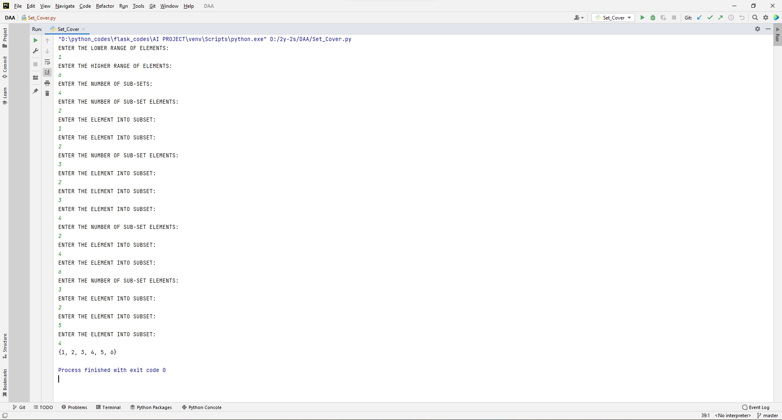
Results

Slide 11
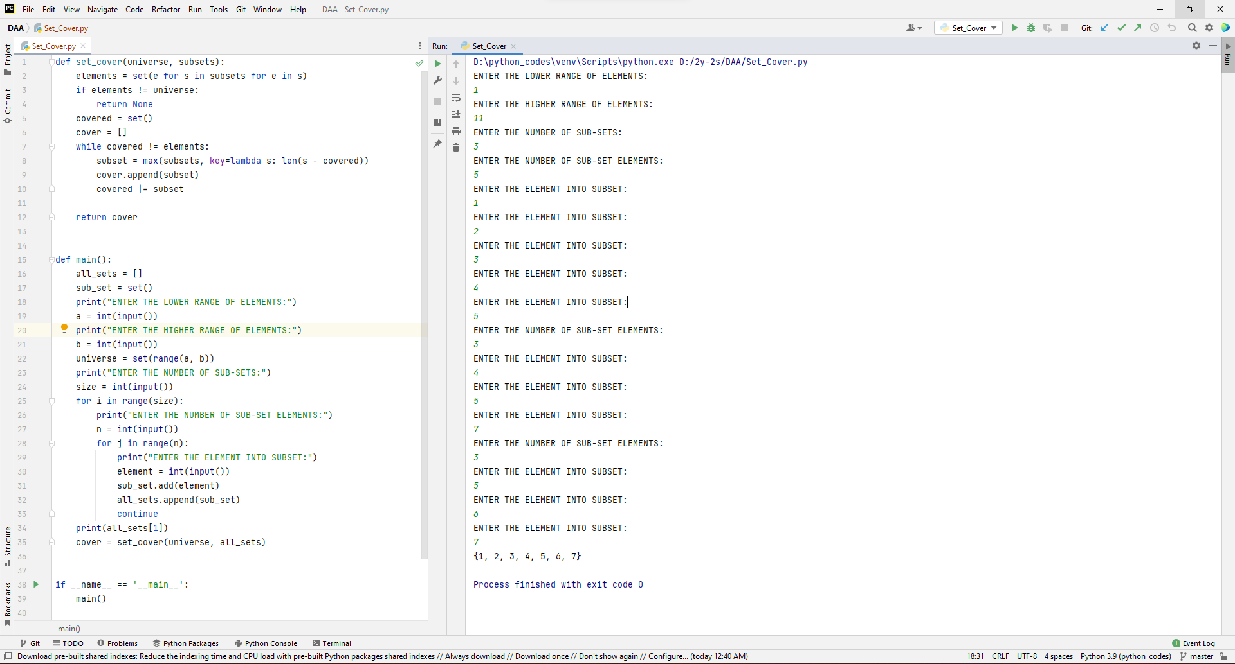
Coding status and Testing

Slide 12
Future scope of improvement
For further part we want to use google API’s and help the user to locate a place where it covers all the subset places so that when a coffee shop is opened maximum profit can be obtained at that optimal location on maps.

Slide 13
Division of work among the group members
S.No | Team member | Work allocated
1) | G . Dilip Reddy(2010030041) | Requirements gathering
2) | K . Vamshi(2010030326) | Implementation
3) | M . Ruchitha(2010030480) | Implementation
4) | P . Venkata Sai Adithya Reddy(2010030434) | Documentation

Slide 14
Thank You

