Slide 1

Design And Analysis of Algorithms
Computing Approximate
Minimum Set Cover
Team Members :
G . Dilip Reddy – 2010030041
K . Vamshi – 2010030326
M . Ruchitha – 2010030480
P . Venkata Sai Aditya – 2010030434
Under the guidance of
P. Sree Lakshmi Mam
Computing Approximate Minimum Set Cover

Slide 2
Problem statement and domain
If we look around, we find many problems and they might have an optimal solution but we may or may not deploy it . We aim to implement the minimum number of sets that cover all of the elements of the input set. Picking the optimal location for a cell tower so that it covers the maximum number of customers is a clear example which states the necessity of our project.
Computing Approximate Minimum Set Cover

Slide 3
Existing solutions/ Naïve solutions
There are two way approaches for the problem,
1.Greedy Method – or “brute force” method:
The classical greedy algorithm for set covering problem in each step selects a set that contains greatest number of uncovered elements of a finite set. This method is explained with help of a small collection of and The same collection of sets used.
2. Linear Programming :
In this The objective function is defined to minimize the number of subset that cover all elements in the universal by minimizing their total cost. The first constraint implies that every element in the universal set must be covered and the second constraint indicates that the decision variables are binary which means that every set is either in the set cover or not.
Computing Approximate Minimum Set Cover
Notes:
In this The objective function is defined to minimize the number of subset that cover all elements in the universal by minimizing their total cost. The first constraint implies that every element in the universal set must be covered and the second constraint indicates that the decision variables are binary which means that every set is either in the set cover or not.

Slide 4
Proposed Algorithm Design Technique
We use Greedy Approximation Algorithm in this project to solve an optimal selection problem because the greedy algorithm is known as the best possible polynomial time algorithm for maximum coverage problem and works by iteratively selecting a set that contains the largest number of elements and then removing selected elements from all the remaining sets in the collection.
Computing Approximate Minimum Set Cover

Slide 5
Proposed Algorithm Design Technique
Algorithm Greedy (a, n)
{
Solution : = 0;
for i = 0 to n do
{
x: = select(a);
if feasible(solution, x)
{
Solution: = union(solution , x)
}
return solution;
} }
Computing Approximate Minimum Set Cover

Slide 6
Data Structures needed
Bipartite graph :
A set of graph vertices decomposed into two disjoint sets such that no two graph vertices within the same set are adjacent.
The set cover can be seen by observing that an instance of set covering can be viewed as an arbitrary bipartite graph, with sets represented by vertices on the left, the universe represented by vertices on the right, and edges representing the inclusion of elements in sets.
Computing Approximate Minimum Set Cover

Slide 7
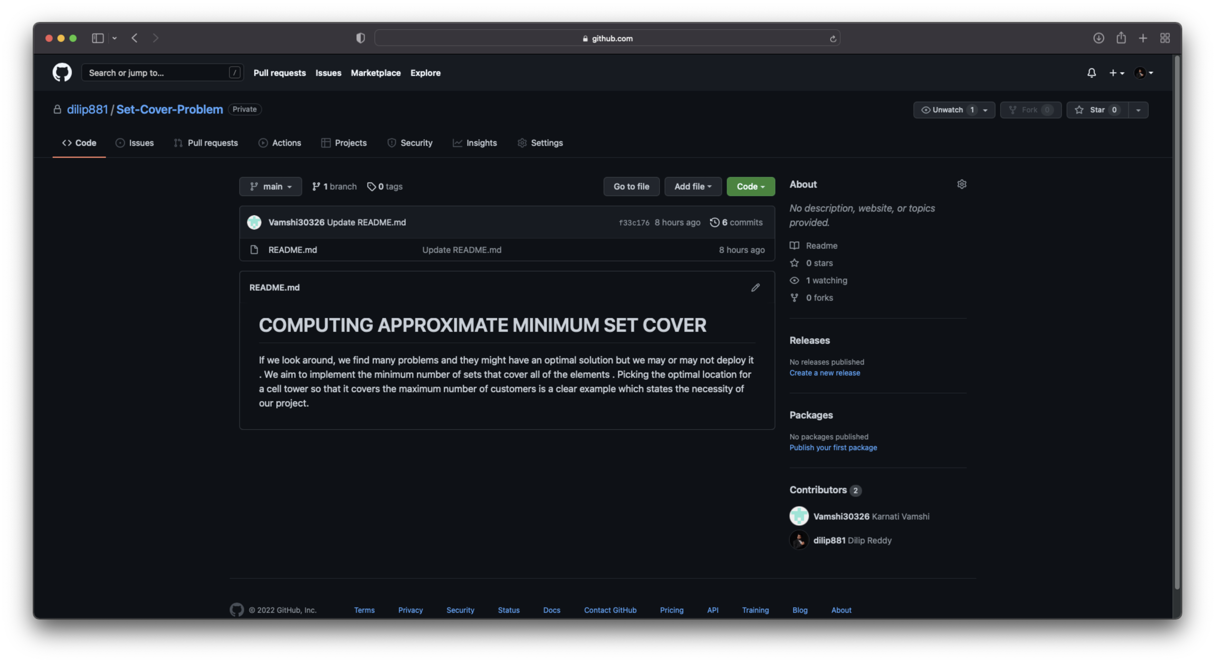
GitHub setup
Computing Approximate Minimum Set Cover

Slide 8

GitHub setup
Computing Approximate Minimum Set Cover

Slide 9
Conclusion
The set covering problem, which aims to find the least number of subsets that cover some universal set, is a widely known NP-hard combinatorial problem. Due to its applicability several methods have been proposed to solve it. Its straightforward formulation allows for the use of off-the-shelf optimizers to solve it. Moreover greedy algorithms can be used to solve large-scale set covering problems for industrial applications.
Computing Approximate Minimum Set Cover

Slide 10
Division of work among the group members
S.No | Team member | Work allocated
1) | G . Dilip Reddy(2010030041) | Requirements for the algorithm
2) | K . Vamshi(2010030326) | Algorithm design
3) | M . Ruchitha(2010030480) | Analyzing the algorithm
4) | P . Venkata Sai Adithya Reddy(2010030434) | Conclusion + Documentation
Computing Approximate Minimum Set Cover

Slide 11
Thank You
Computing Approximate Minimum Set Cover

