Slide 1
DATA 608 Knowledge and Visual Analytics
Final Project Presentation.

Slide 2
Project Proposal
Gun Violence and Mass Shootings. I live in the suburbs of DC, I had the opportunity to experience #MarchForOurLives happening in the streets of DC. Off late gun violence has penetrated in to our temples of learning, yes, I am talking about school shooting and other mass shootings. From Parkland in Florida to Great Mills in Maryland there has been rampant news of shooting taking place in high schools. These heart wrenching events made me to look at why these shootings are taking place, where all they are taking place and are there any ways to mitigate these.
Data Source: On researching for gun violence, I stumbled upon the following site. http://www.gunviolencearchive.org/. This site has the entire dataset needed for this project. They are a not for profit corporation which provides public access to accurate information about gun related violence in United States.
Project Proposal: This site provides access to their database with search options to filter the data that we need. I am thinking of analyzing the dataset with last three years of data to do an exploratory analysis on the dataset.
Some of the things I would like execute as part of this project.
Present a Visualization of Shootings in United States for the last three years.
Present a visualization of shootings in United States where kids were involved.
Final Project Output: I would like to build a shiny app or a dash app for this project.

Slide 3
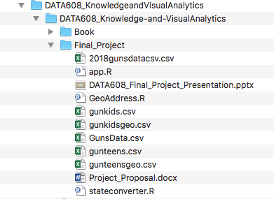
Data Source
Data Source:
We got the following data source from the website listed in the project proposal.
2018 Gun Violence Data
2014 -2017 Gun Violence Data
2018 Kids Gun Violence Data
2018 Teens Gun Violence Data

Slide 4
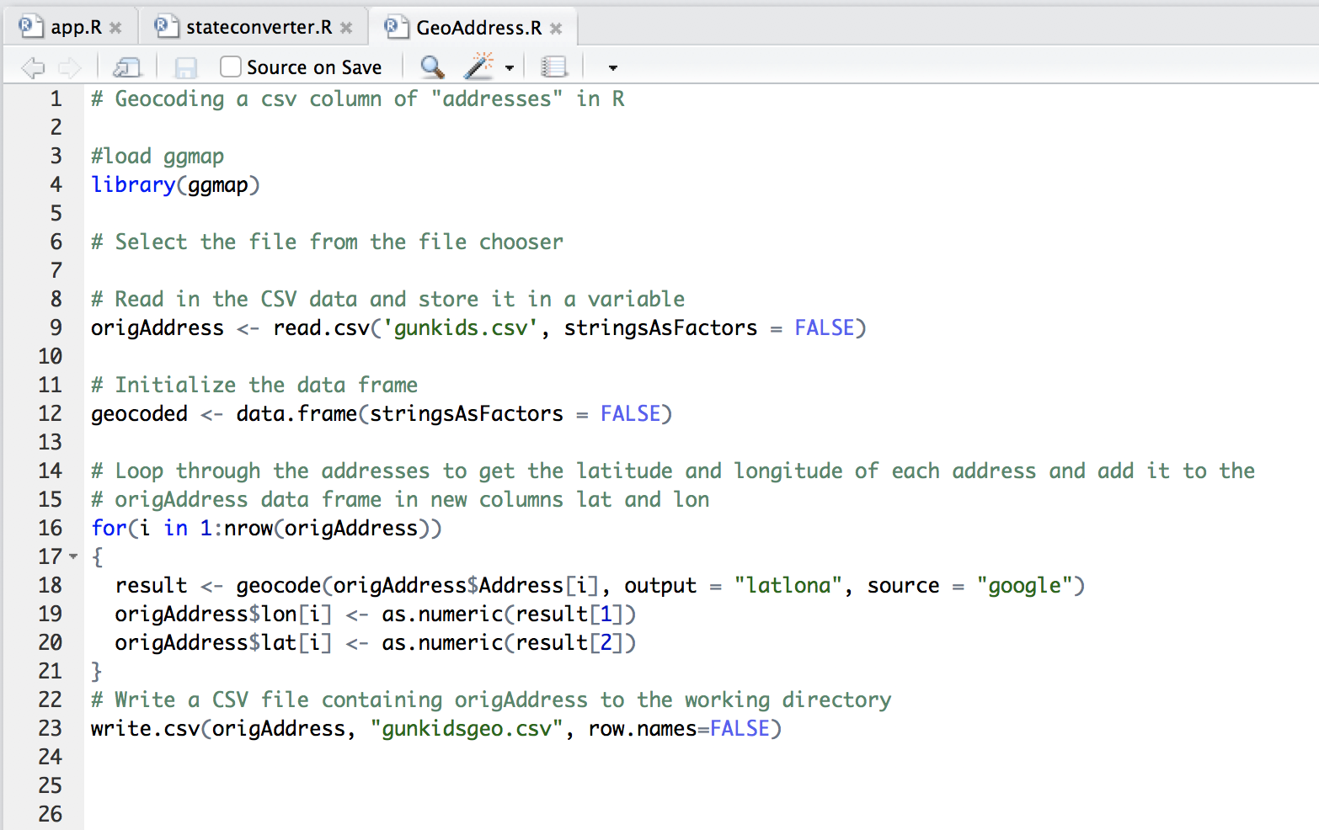
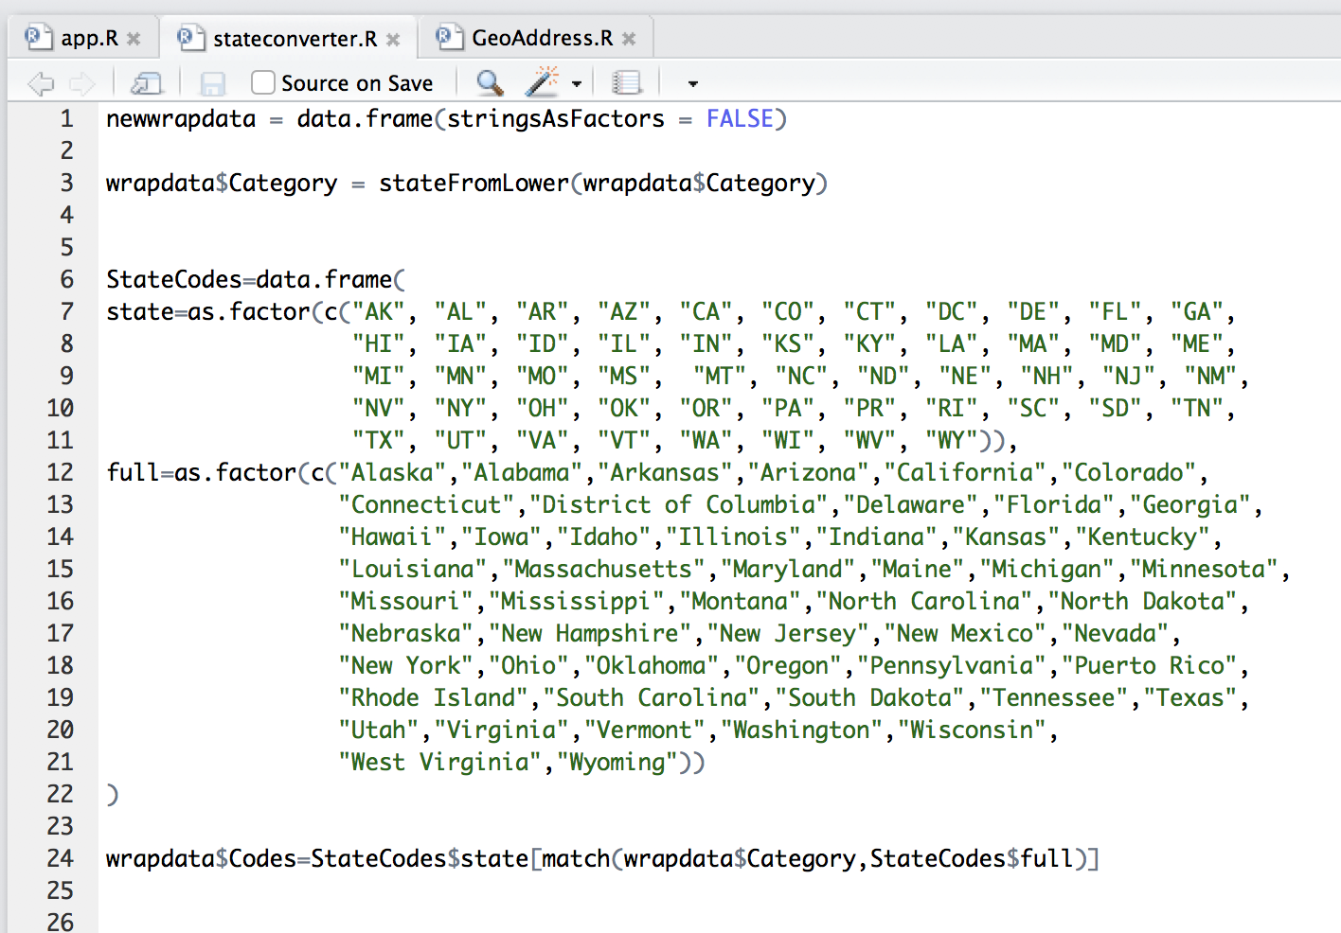
Data Munging
Data we got from the data sets, did not contain the requisite information and formats.
Like the latitude and longitudes were missing
State codes were not in the correct format.

Slide 5
Gun Violence Application
Decided to use the following for the Gun Violence application.
Shiny App.
Plotly.js
Plotly Choropleth.

Slide 6
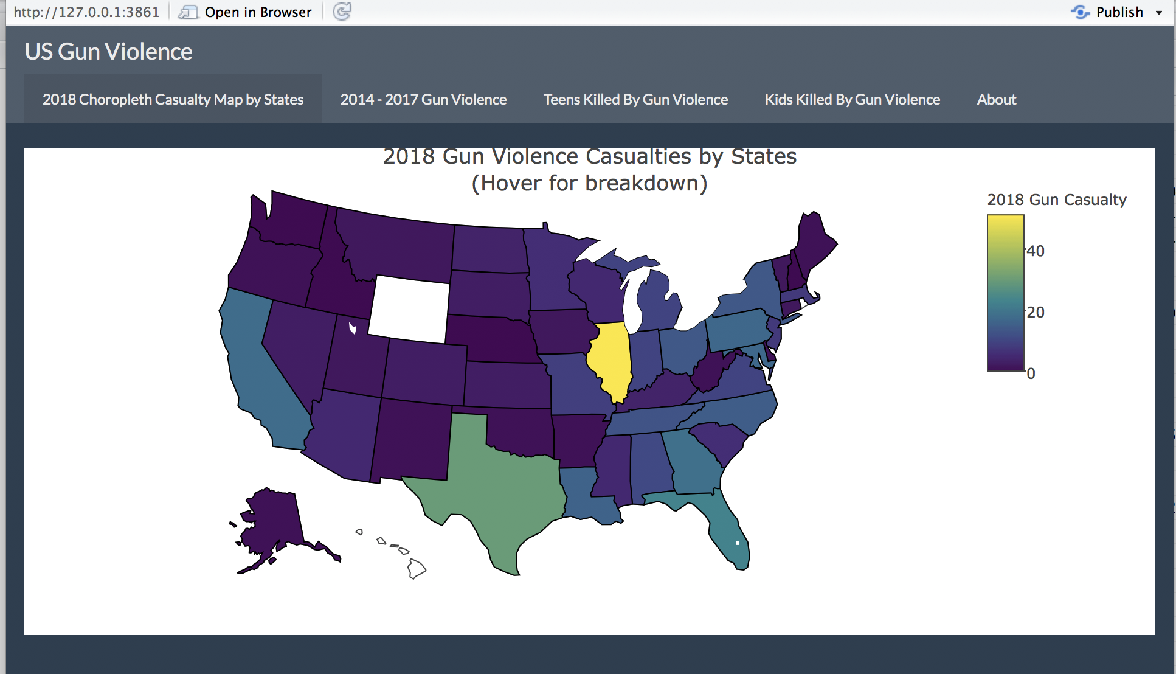
Application Demo.

Slide 7
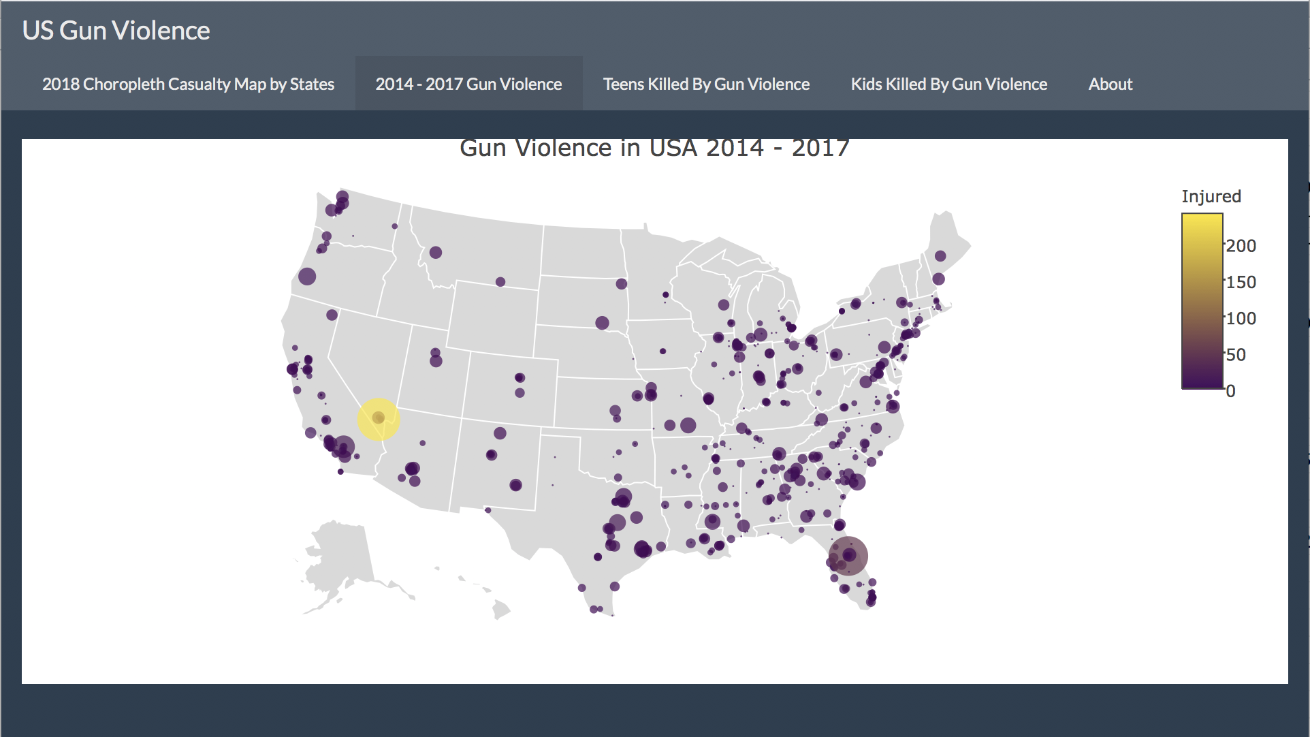
Application Demo.

Slide 8
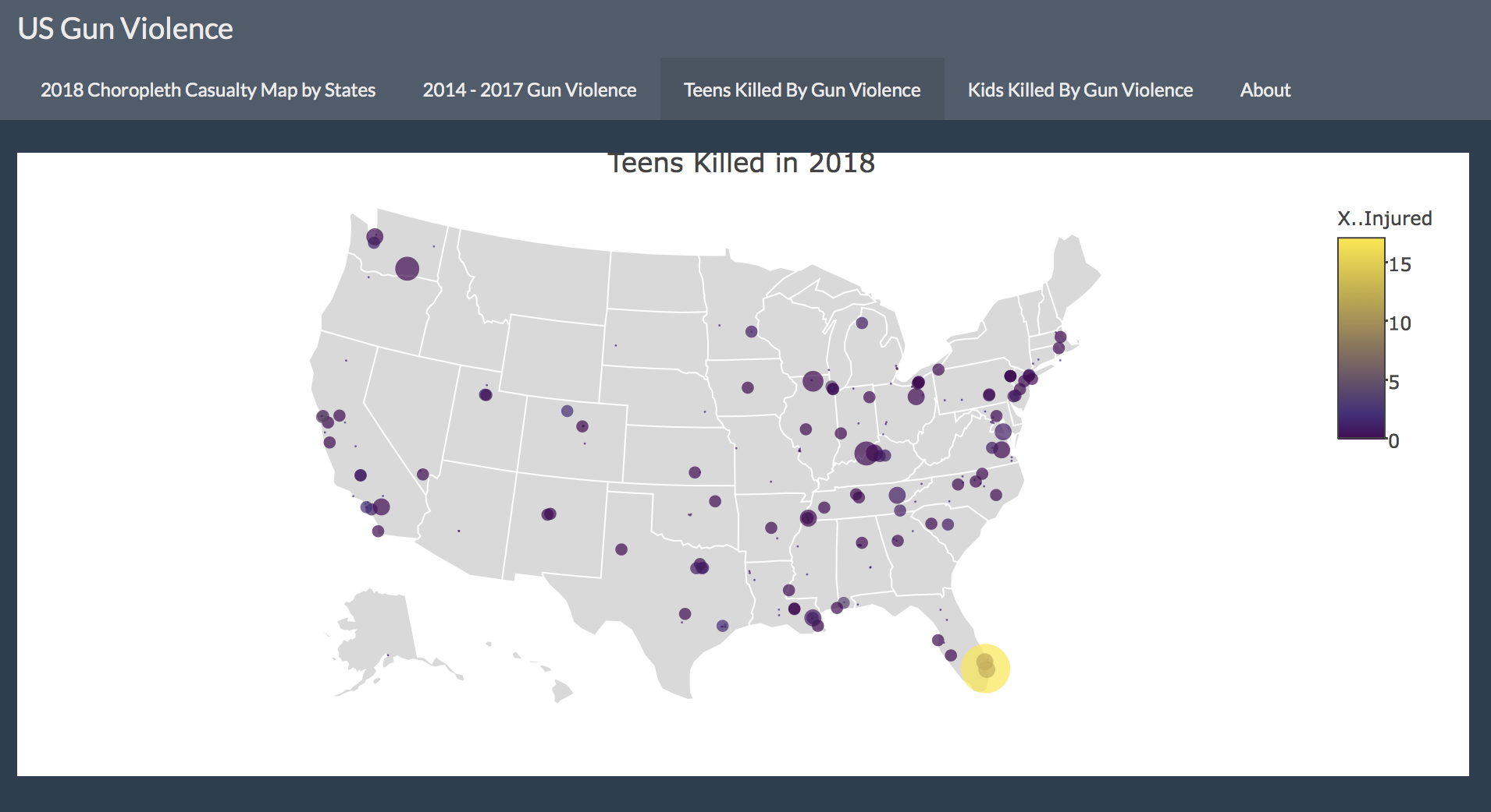
Application Demo.

Slide 9
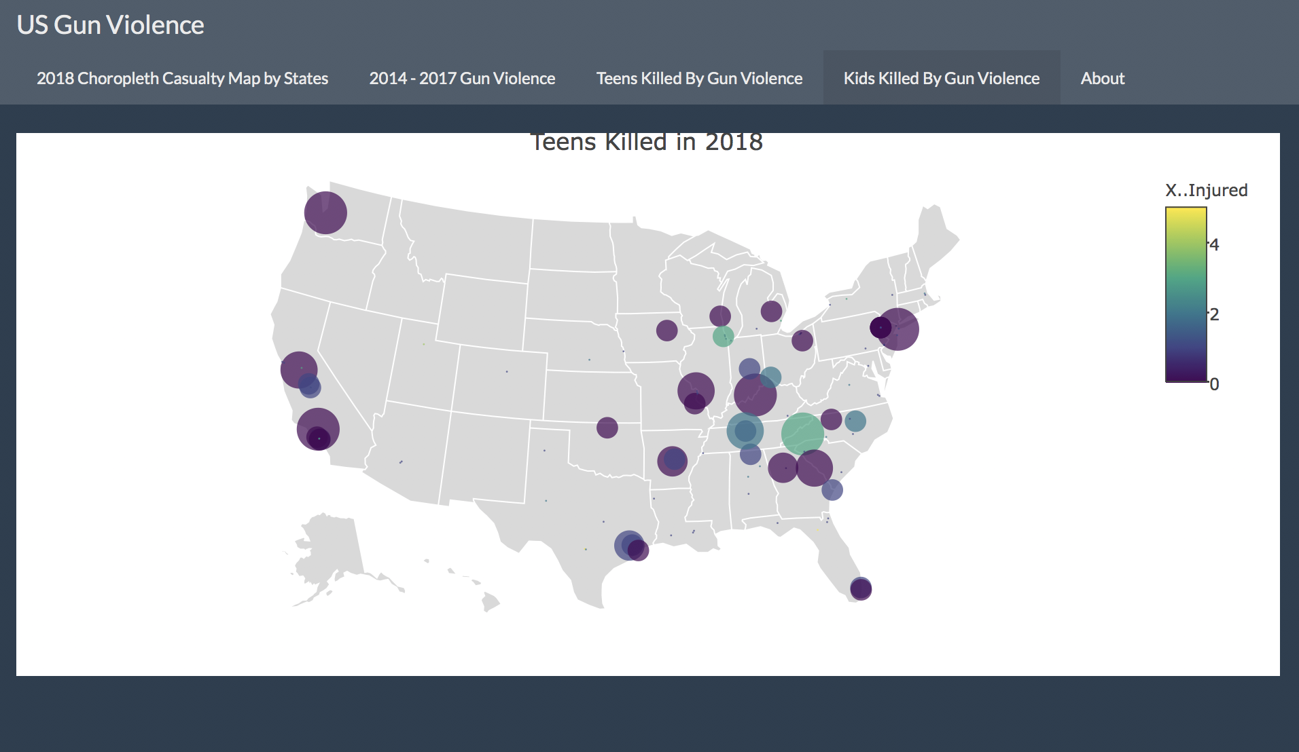
Application Demo.

Slide 10
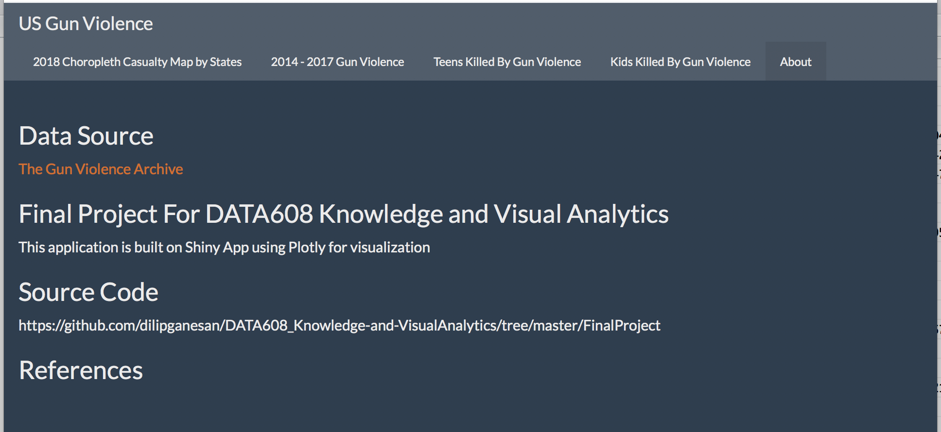
Thank You

