Slide 1
Predict hospital Readmission in diabetes patients
By Ali Harb, dilip ganesan & raghunathan ramnath

Slide 2
Agenda
Research Problem Statement
Literature Review
Data Gathering
Methodology
Data Exploration and Preparation
Regression
Ensemble and Neural Networks
Conclusion

Slide 3
Research problem statement
Problem Statement:
Predict whether a patient diagnosed with diabetes will be readmitted to hospital within 30 days of discharge.
Research Question:
The focus of this research is to answer the following questions:
Is DRG (Diagnosis Related Group) as parameter a positive predictor for hospital readmission in diabetes mellitus patients?
What are the strongest predictors that lead to hospital readmission in diabetes mellitus patients?

Slide 4
Literature review
Patient Demographics
Age
Race
Sex
Payment Methodologies
Diagnosis Related Group (DRG)
Medical Condition and Medications
HbA1C
Insulin and Sulfonylurea .et.al.
Modeling

Slide 5
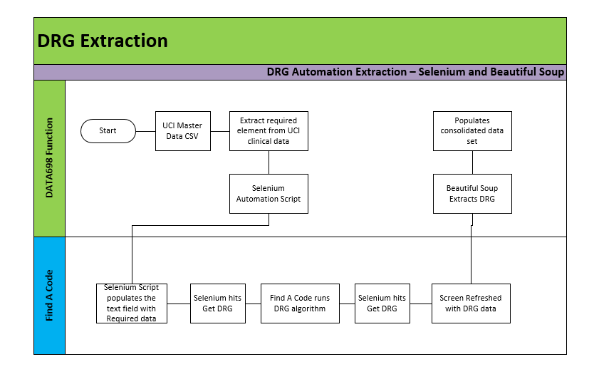
Data gathering

Slide 6
methodology
Data Exploration
Data Preparation and Preprocessing
Logistic Regression
Ensemble Methods and Neural Networks

Slide 7
Data exploration and preparation
Selecting important variables for our modeling
Clinical significant variables for our modeling
Skewness and Correlation of variables
Training and Test Data preparation

Slide 8
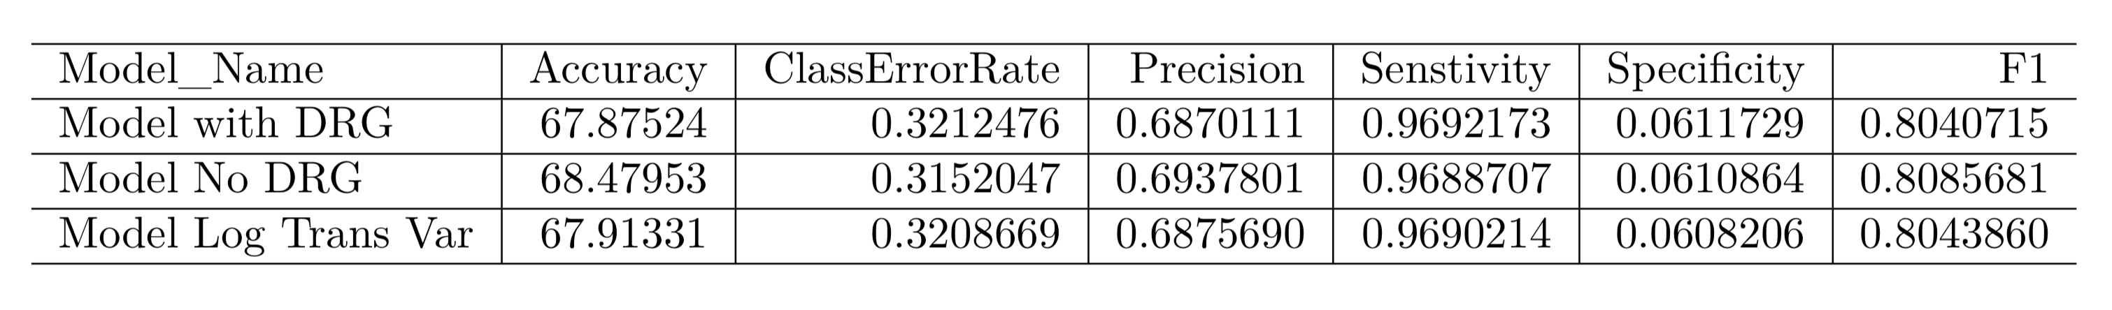
Binary Logistic regression

Slide 9
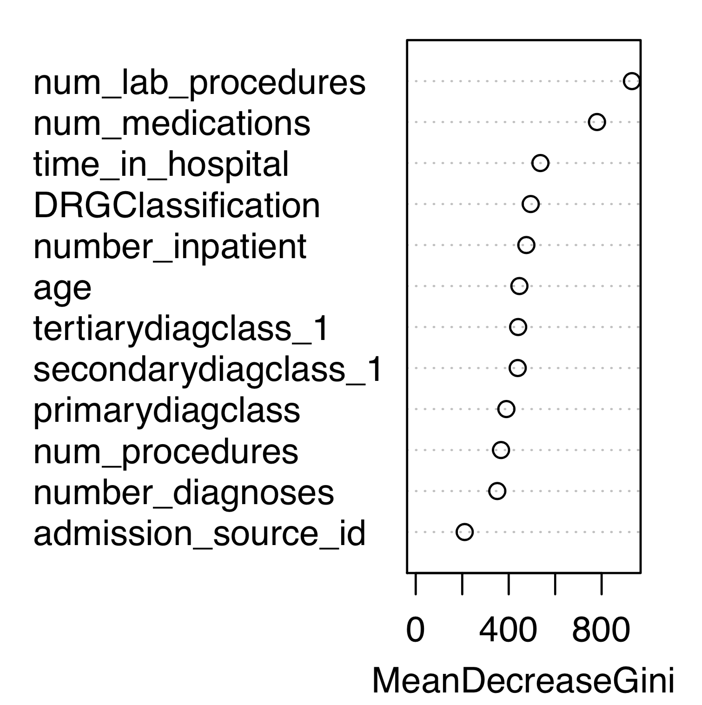
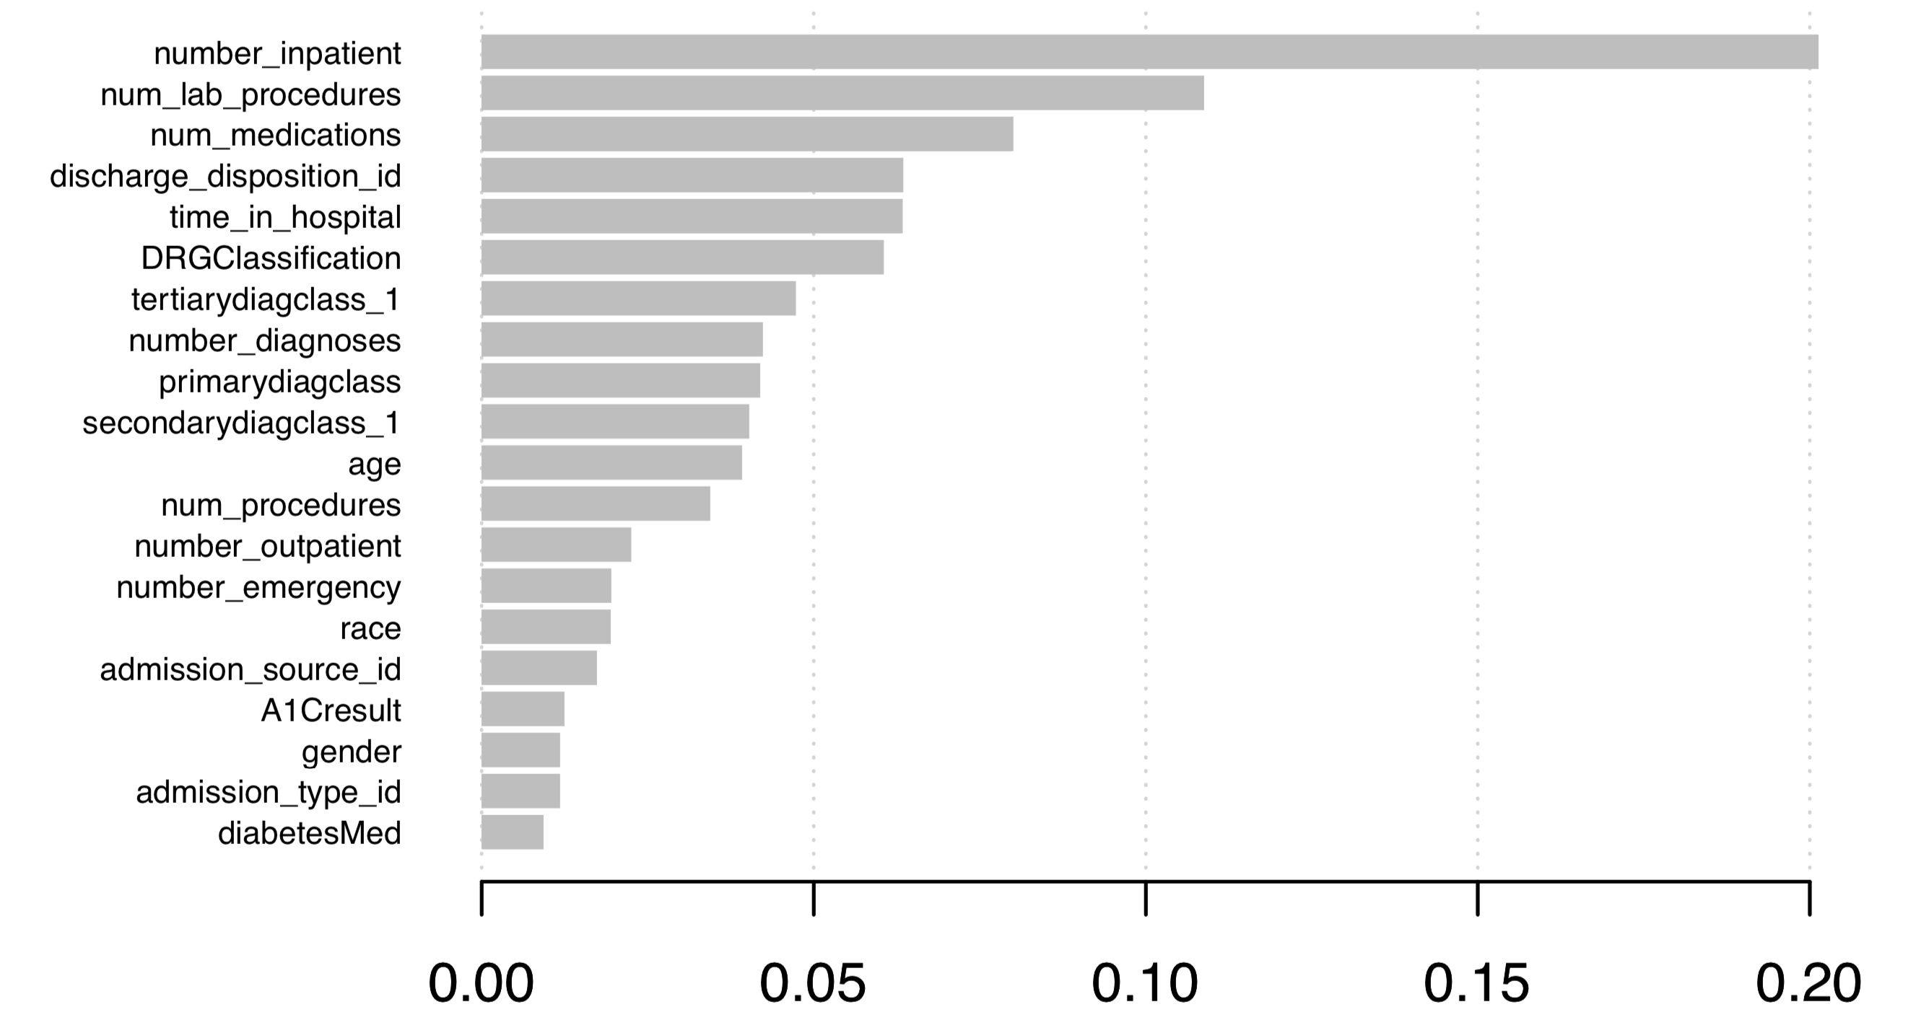
Ensemble models and neural network Importance Variable Plot

Slide 10
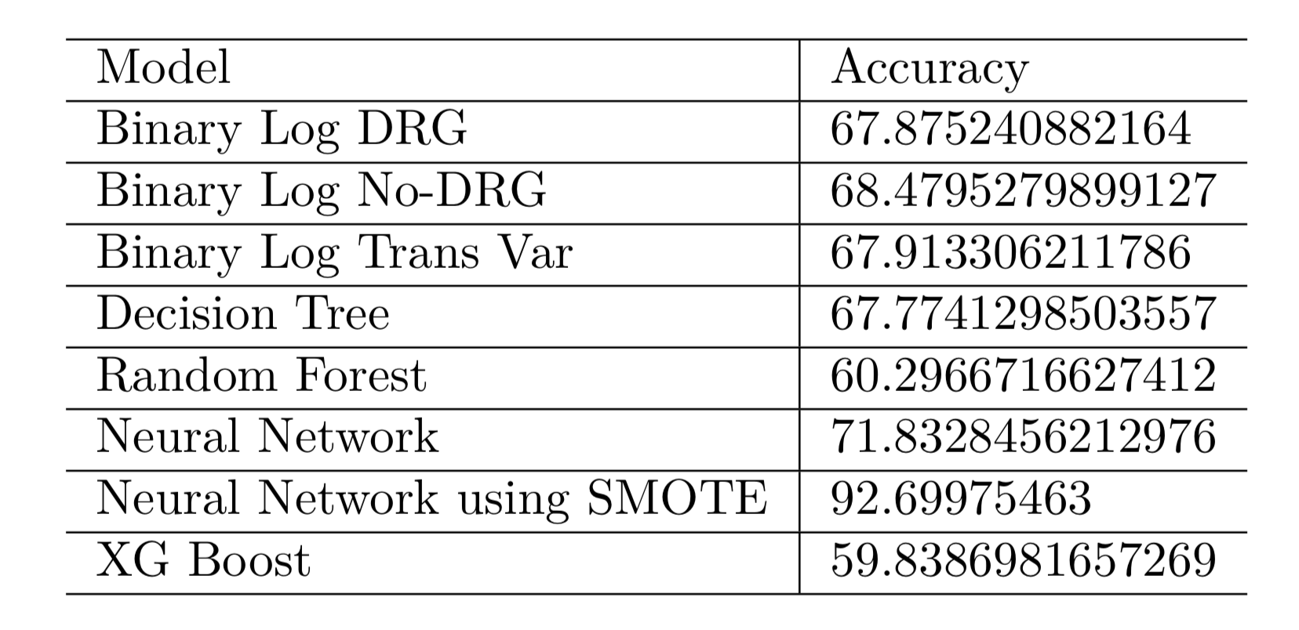
Conclusion

