Slide 1
PANDAA Localization Using Ambient Sound
Team Google

Slide 2
Team Google
Client
Trevor Pering, contact (grafnu@gmail.com)
Pei Zhang, advisor (peizhang@cmu.edu)
Team
Dilip Gudlur (dgudlur@cmu.edu)
Divya Vavili (divya.vavili@west.cmu.edu)
Fabian Popa (fabian.popa@west.cmu.edu)
Qi Zheng (qi.zheng@west.cmu.edu)

Slide 3
Agenda
Project Overview
Related Work
Project Architecture
Implementation
Measuring Outcome
Project Management
Demo

Slide 4
Project Overview
PANDAA - novel localization technique that uses ambient sounds to localize a network of static sensors
PANDAA isolates mixed ambient sounds that already exist in the environment (claps, speech, cough, walking sounds, etc.) to localize the devices

Slide 5
Technical Problem
How to determine the relative physical arrangements of networked devices?
Requirements
Accurate (sub-meter)
Work on off-the-self devices, minimal requirement of specialized hardware
Non-intrusive, automated operation and maintenance

Slide 6
Related Work (Indoor Localization)
 | Desired Accuracy | No Specialized Hardware | Non-intrusiveness
WiFi signal strength range/fingerprint | X | ✓ | ✓
Ultrasound-RF (Cricket) | ✓ | X | ✓
Audible chirp ranging (BeepBeep) | ✓ | ✓ | X
Ambient sound ranging (PANDAA) | ✓ | ✓ | ✓
Borrowed from Zheng's slides under his acknowledgement
Notes:
add one more column - autonomous setup

Slide 7
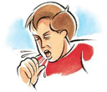
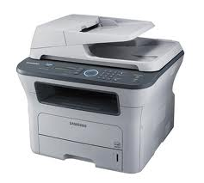
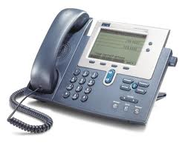


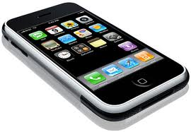

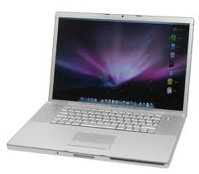
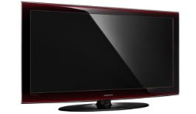

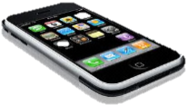
PANDAA (in simple terms)
(x3, y3)
(x1, y1)
(x2, y2)
(0, 0)
(x4, y4)
(x5, y5)
Borrowed from Zheng's slides under his acknowledgement

Slide 8





Project Architecture
Ambient Sound (Input)
2. Pairwise Distance Estimation
1. Pre-processing
TDoA Estimation
Microphone
Two-tier TDoA Aggregation
Framing
3. Arrangement Detection
reduce 80%~99.9% raw data
Compensation of Pairwise TDoA Errors
Impulsive Sound Extraction
Arrangement Detection
Relative Device Locations (Output)
Borrowed from Zheng's slides under his acknowledgement
Notes:
arrows
lines
mention some will not be addressed
mention Two-tier will handle ambient noise

Slide 9
Implementation

Slide 10

Demonstration Setup

Slide 11
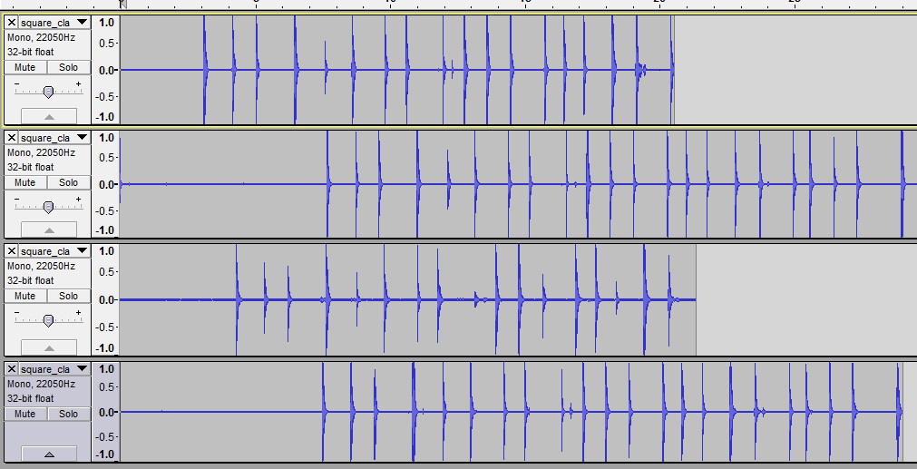
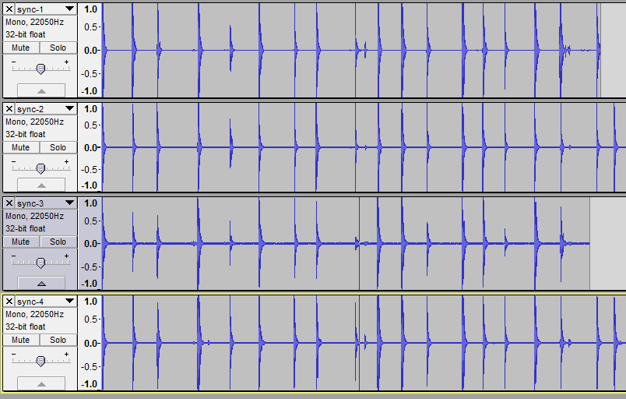
Raw Audio Synchronization
Audio after synchronization
Unsynchronized audio from devices

Slide 12
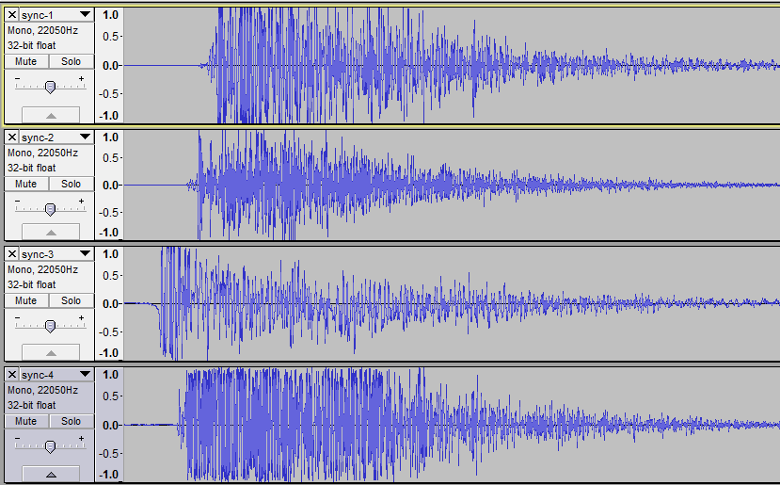
Raw Audio Synchronization
Audio after synchronization
(Magnified view)

Slide 13
Peak Detection
What is peak?
Audio -> frames
100ms, 22,050Hz -> 2205 samples in one frame
Rules
Detect impulsive sounds: short duration + higher amplitude (e.g. claps)
One frame contains at most one clap
The first peak represents the clap

Slide 14
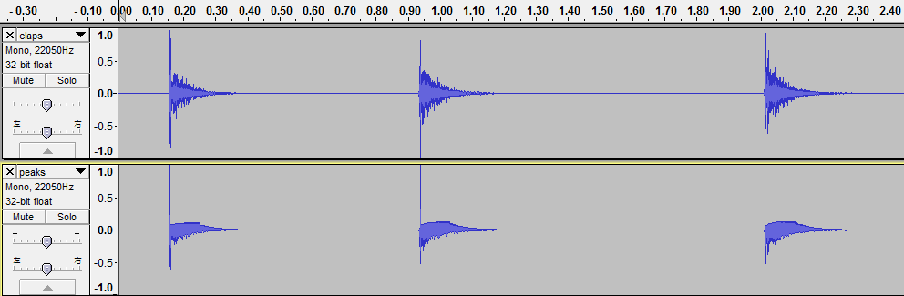
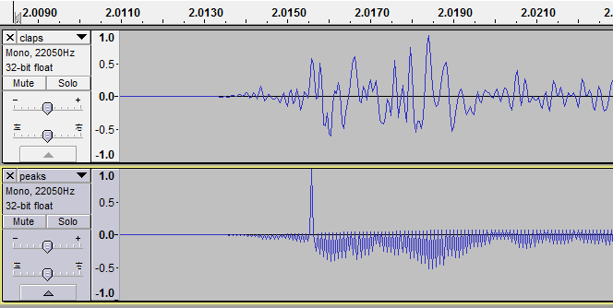
Peak Detection
A

Slide 15
Implementation
RMS: Root Mean Square
The power of the sound
Slow-window RMS
1000 samples
Noise floor
Fast-window RMS
50 samples
Appearance of a peak

Slide 16
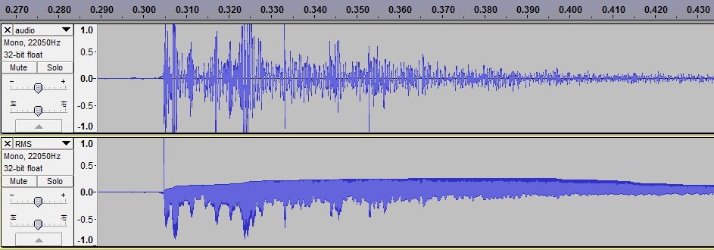
Implementation
Slow-window RMS
Fast-window RMS

Slide 17
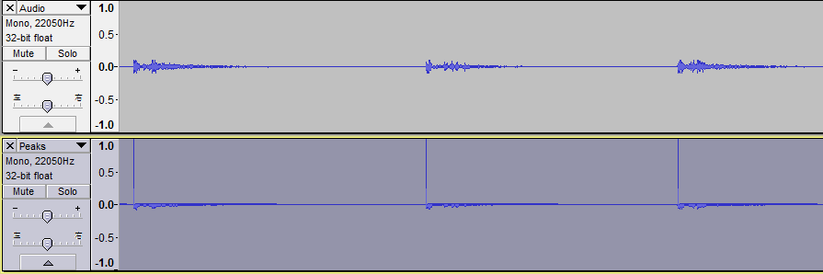
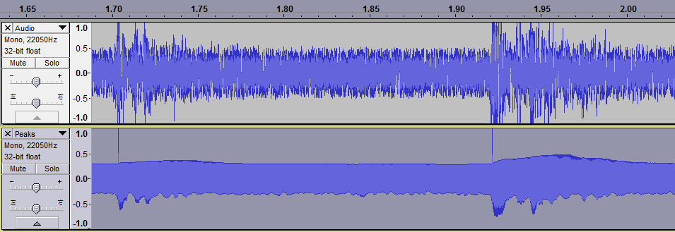
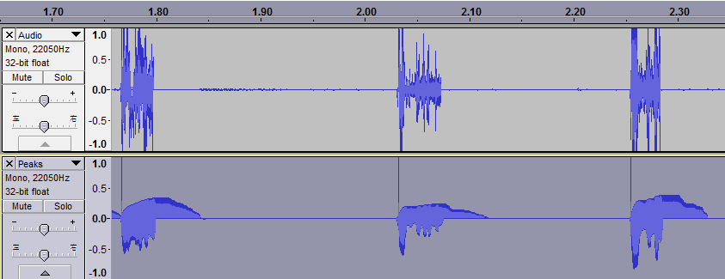
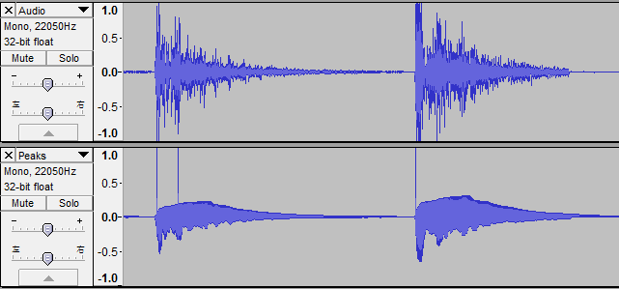
Results
Quiet Ambient Noisy Ambient Normal Ambient

Slide 18
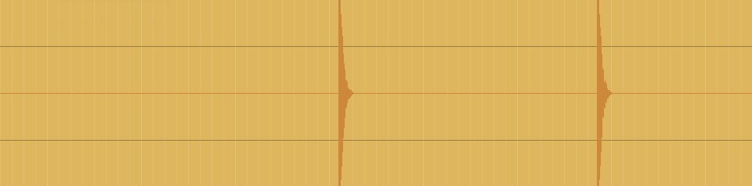
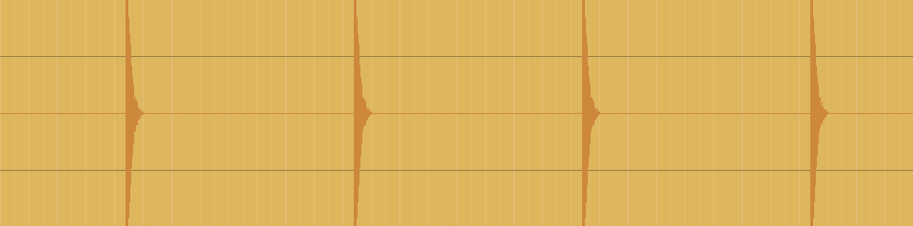
TDOA (Time Difference of Arrival)
Objective: match impulses in two synchronized intervals
Frame 1
Frame 2

Slide 19
TDOA (Time Difference of Arrival)
Algorithm: look at all plausible pairs of impulses
d
Frame 1
Frame 2

Slide 20
TDOA (Time Difference of Arrival)
Algorithm: get the closest pairs time-wise
d
Frame 1
Frame 2

Slide 21
TDOA (Time Difference of Arrival)
Algorithm: remember pair and distance, then advance
d
Frame 1
Frame 2

Slide 22
TDOA (Time Difference of Arrival)
Algorithm: remember pair and distance, then advance
d
Frame 1
Frame 2

Slide 23
TDOA (Time Difference of Arrival)
Algorithm: remember pair and distance, then advance
d
Frame 1
Frame 2

Slide 24
TDOA (Time Difference of Arrival)
Algorithm: remember pair and distance, then advance
d
Frame 1
Frame 2

Slide 25
TDOA (Time Difference of Arrival)
Algorithm: sort potential matches by distance
Frame 1
Frame 2
1
3
4
2

Slide 26
TDOA (Time Difference of Arrival)
Algorithm: accept in decreasing order of distance
Frame 1
Frame 2
1
3
4
2

Slide 27
TDOA (Time Difference of Arrival)
Algorithm: every impulse can only be matched once
Frame 1
Frame 2
1
3
4
2

Slide 28
TDOA (Time Difference of Arrival)
Algorithm: final list of matches is a subset
Frame 1
Frame 2

Slide 29
Arrangement Detection
Geometry Detection
pairwise distances “comprehensive” distance matrix
distance matrix coordinate matrix (using MDS)
MDS (Multi Dimensional Scaling) – key component
similarity of data objects geometric positions
Java library for MDS

Slide 30
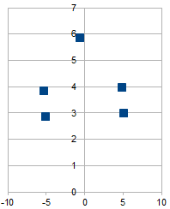
Pairwise Distances
Device | A | B | C | D | E
A | 0 | 0 | 10 | 10 | 5
B | 0 | 0 | 10 | 10 | 5
C | -10 | -10 | 0 | 0 | -5
D | -10 | -10 | 0 | 0 | -5
E | -5 | -5 | 5 | 5 | 0
Coordinate Matrix
X | Y
5.16263035 | 2.97380274
4.95503652 | 3.95185523
-5.03470857 | 2.84630802
-5.24230241 | 3.8243605
-0.55882061 | 5.84421285
Geometry of Devices
MDS in Action

Slide 31
Measuring Outcome
Root Mean Square for an estimate of error
Variation of the actual and estimated locations of the vertices
Observation1: Single sound source nearer to the devices
produce better impulses and thereby better localization
Observation2: RMS error varies with the number of impulses processed
Observation3: Triangle of devices with music as sound source produces 600mm error when 15 impulses are processed and reduces to 300 mm when 35 impulses are processed.

Slide 32
Project Management
Weekly meetings with Client every Friday via video chat
Face to face meetings to resolve complex issues
Google applications (Hangout and Docs) used
efficiently for task management and meetings
Extensive use of Github for maintenance of code repository
Maintenance of Engineering Notebook to track our progress/failures

Slide 33
Project Management
Task identification and division among the four team members
High involvement of client in architecture design and implementation details
Client addressed individual team member queries via email threads
Extensive code reviews to identify issues at the early stages
Emphasis on correct and good quality of source code

Slide 34
Acknowledgements
Dr. Trevor Pering – For such a good learning experience
Dr. Pei Zhang – For guidance throughout the project
Zheng Sun – For technical expertise in the project

Slide 35

Thanks!!
Open to Questions…
And demo time…. See it in Action

