Slide 1
Biosynthesis and Antimicrobial Activity of Silver Nanoparticles Using a Flower Extract Of Calotropis procera
Presented By : Thakor Dilip k
Exam No : 389
M.Sc Sem - 4 Microbiology
Department Of Life Sciences
H.N.G.University, Patan
Guided By : Dr. S.A. Bhatt
Professor and Head,
Department Of Life Sciences
H.N.G.University, Patan

Slide 2
CONTENT
Introduction
Aim and Objective
Material and Method
Results and discussion
Conclusion
References

Slide 3
INTRODUCTION
The nanoparticles is an important Branch in the field of biology, chemistry, physics and material science. Nanotechnology deals with the study of material which are small in size (nanometer.) (Prasad et al.,2010 ,Singh at el., 2009 )
Nano is a Greek word synonymous to dwarf means extremely small.(Feynman 1959) There was numbers of different types of Nanoparticles was synthesis includes copper, zink, titanium, magnesium, gold , alginate and silver nanoparticles.(Schabe et al.2006) (Tong at el.,2003,Ahmed et al.,2005)
There was different method such as physical, chemical, irradiation and biological method used to synthesis for nanoparticles. Various plant material was used to synthesis of nanoparticles are called the green technology.
The Calotropis procera is medicinal plant which is used for the synthesis of nanoparticle. Calotropis is genus having two species Calotropis gigantea and Calotropis procera.

Slide 4
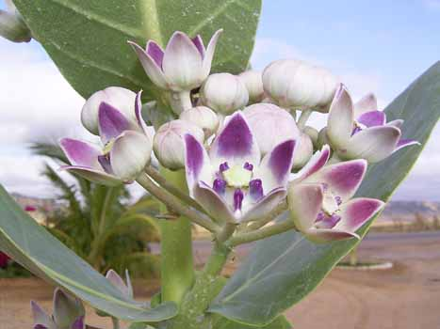
SCIENTIFIC CLASSIFICATION CALOTROPIS PROCERA
Image of Calotropis procera
Kingdom : Plantae-Plant
Subkingdom : Tricheobionta Vascular
plant
Division : Spermatophyta, Seedplants
Class : Magnoliphyta flowering plant
Subclass : Asteridae
Order : Gentianales
Family : Apocynaceae
Subfamily : Asclepiadoideae
Genus : Calotropis
Species : C. procera

Slide 5
MATERIAL AND METHOD
Collection of fresh flower of Calotropis procera
Take 20 g of flower. Wash with deionized water and boil in 100 ml of deionized water for 15 min in boiling water bath.
Allow to cool and filter with whatman filter no.1.Prepare silver nitrate solution.
Mix the flower extract and silver nitrate solution in definite ratio. Incubate it for for 8 hours on magnetic stirrer.
Observe color. Brown color indicate formation of silver nanoparticles. Allow it to further analysis.
UV Visible Spectra Analysis
X-ray Differaction (XRD) Analysis
Scanning Electron Microscope ( SEM) Analysis
Fourier Transform Infrared Spectroscopy (FTIR) Analysis

Slide 6
Aim and Objective
To synthesize silver nanoparticles by green method using a flower extract of Calotropis procera and Evaluate antimicrobial activity against bacteria.
Characterization of the biosynthesized silver nanoparticles by UV-Vis spectrophotometer, XRD , FTIR , SEM and TEM analysis.
Study of antioxidant, antifungal, wound healing, anti-cancer and larvicidal activities of synthesized silver nanoparticles.

Slide 7
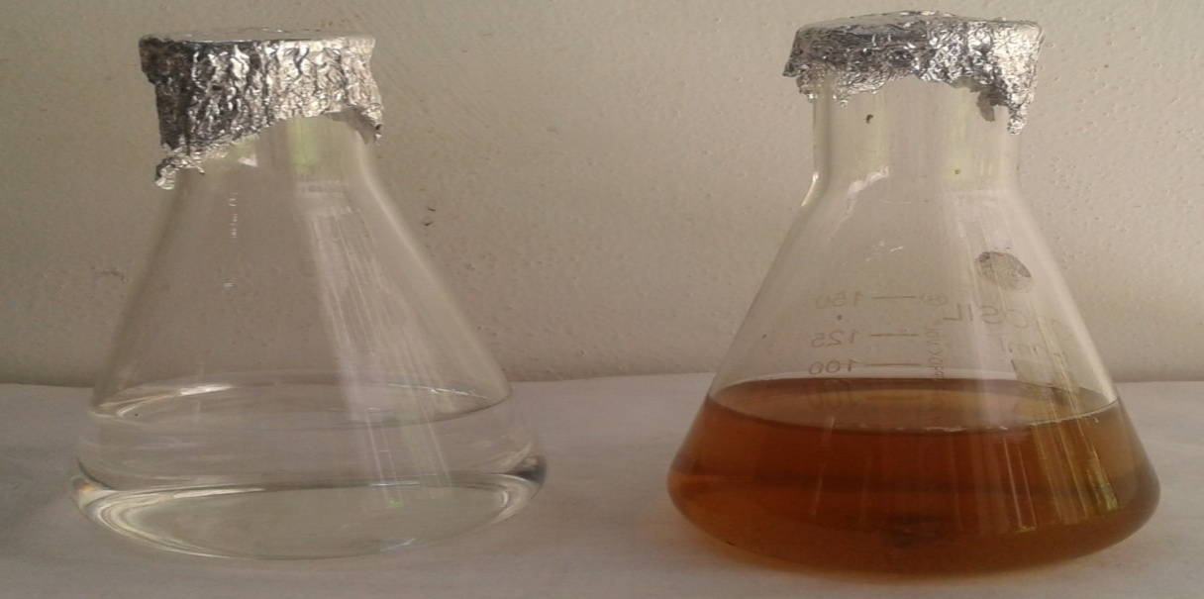
RESULT AND DISCUSSION
The reduction of silver ion in the aqueous solution of silver solution during the reaction with a flower extract of Calotropis procera was observed by the UV Visible Spectroscopy.
Aqueous solution of AgNO3 With C. procera flower extract (left) before adding the leaf extract and (right) after addition of leaf extract after 8 hours

Slide 8
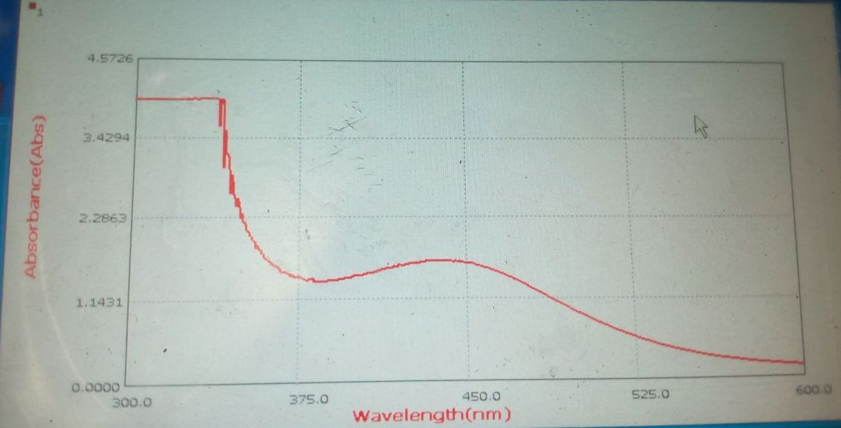
UV Visible Spectrum Analysis
The silver nanoparticles were characterized by UV-VIS spectroscopy, one of the most widely used techniques for structural characterization of silver nanoparticles. The nanoparticles synthesized by the process were confirmed through measurement of UV-VIS spectroscopy of the reaction mixture.
Image (a) : UV Visible spectrum at ratio 8:2

Slide 9
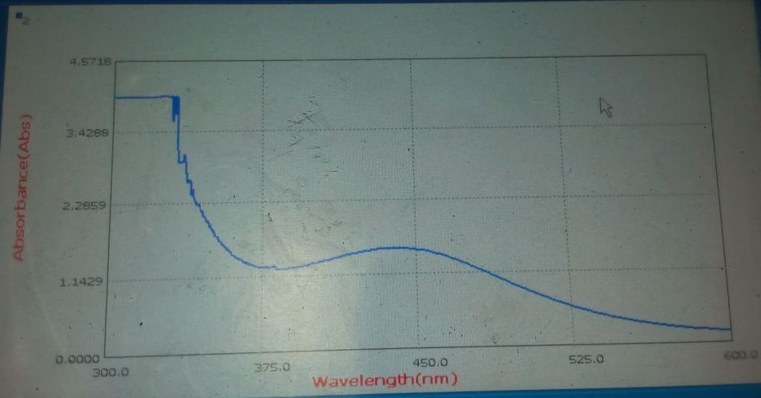
Image (b) : UV Visible spectrum at ratio 10:1

Slide 10
Fourier Transform Infrared Spectroscopy (FTIR) Analysis
Range | Obtain Frequency | Possible Group
3400 -3550 | 3420 | N-H (Primary amine group)
2850- 3000 | 2935 | CH3 (Alkane group)
2100-2250 | 2097 | C-H (Stretching N-H bending)
1630-1680 | 1638 | N-H Bending
1350-1380 | 1384 | CH3 Bending
1100-1200 | 1141 | C-O Group (ether group)
1000-1050 | 1050 | C-N Stretching
600-700 | 653 | C-H Deformation

Slide 12
Scanning Electron Microscopy (SEM) Analysis
Scanning electron microscope used to visualize the morphology of the silver nanoparticles. SEM analyses of the synthesized AgNPs showed in clustered and irregular in shape.

Slide 13
X-ray Differaction (XRD) Analysis
X ray differaction analysis were carried to confirm the crystalline nature of the synthesized silver nanoparticles.
The XRD peak were identified as (100,200,202,222,311) . A number of Bragg reflection with 2θ value of 27.35, 32.11, 46.06, 57.37, 77.35 are shown in figure.
The size of silver nanoparticles was obtain by Debye Scherrer formula given the equation;
D = 0.9 λ /ß COSθ
The average size of silver nanoparticles were calculated is 48.00nm.

Slide 14
Table :Theta value of nanoparticles by XRD analysis
No. | 2-theta(deg) | d(ang.) | Height(counts) | FWHM(deg) | Int. I(counts deg) | Int. W(deg) | Size(ang.)
1 | 27.666(11) | 3.2217(13) | 110(11) | 0.375(16) | 66.0(19) | 0.60(7) | 228(9)
2 | 32.110(11) | 2.7853(10) | 239(15) | 0.358(10) | 121.1(17) | 0.51(4) | 241(7)
3 | 37.98(2) | 2.3671(12) | 137(12) | 0.62(2) | 125(2) | 0.91(9) | 142(5)
4 | 44.14(5) | 2.050(2) | 36(6) | 1.08(6) | 53(2) | 1.5(3) | 83(5)
5 | 46.067(17) | 1.9687(7) | 121(11) | 0.381(17) | 62.6(15) | 0.52(6) | 237(10)
6 | 54.611(10) | 1.6792(3) | 39(6) | 0.24(4) | 16.9(8) | 0.43(9) | 390(63)
7 | 57.373(17) | 1.6047(4) | 34(6) | 0.34(3) | 14.3(8) | 0.42(10) | 275(23)
8 | 64.352(19) | 1.4465(4) | 30(5) | 0.63(9) | 30.7(14) | 1.0(2) | 155(22)
9 | 76.64(3) | 1.2424(4) | 29(5) | 0.43(7) | 21(4) | 0.7(3) | 243(41)
10 | 77.35(3) | 1.2327(4) | 32(6) | 0.47(11) | 25(5) | 0.8(3) | 227(53)
11 | 81.39(5) | 1.1814(5) | 9(3) | 0.54(12) | 7.3(9) | 0.8(4) | 201(44)
12 | 85.42(4) | 1.1356(4) | 18(4) | 0.34(5) | 6.7(7) | 0.38(13) | 331(46)

Slide 16
Antimicrobial Activity
Sr. No | Test Organism | Zone of inhibition North to South(mm) | Zone of inhibition East to West(mm)
1. a) | Proteus vulgaris | 16 | 15.5
b) | Proteus vulgaris | 14 | 13
2. a) | Staphylococcus aureus | 15.5 | 16
b) | Staphylococcus aureus | 15.5 | 16
3. a) | E.coli | 16 | 15.5
b) | E.coli | 16 | 17
4 a) | Bacillus subtilis | 14 | 14.5
b) | Bacillus subtilis | 15 | 15
Table : Antimicrobial activity of AgNPs of C. procera by Agar well method

Slide 17
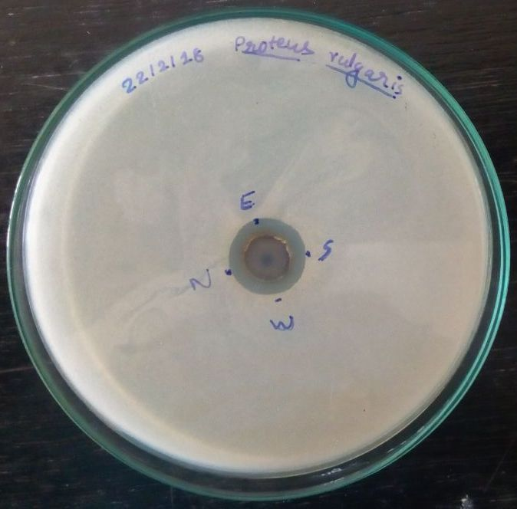
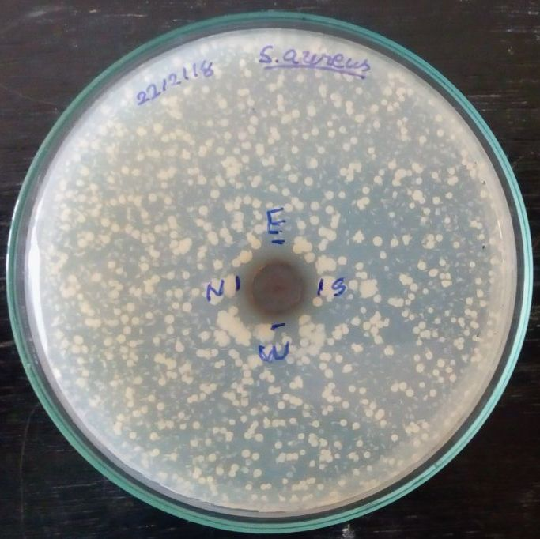
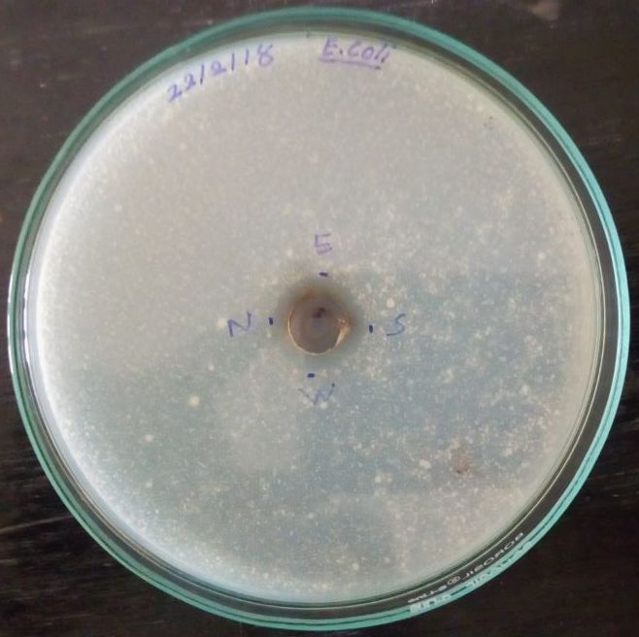
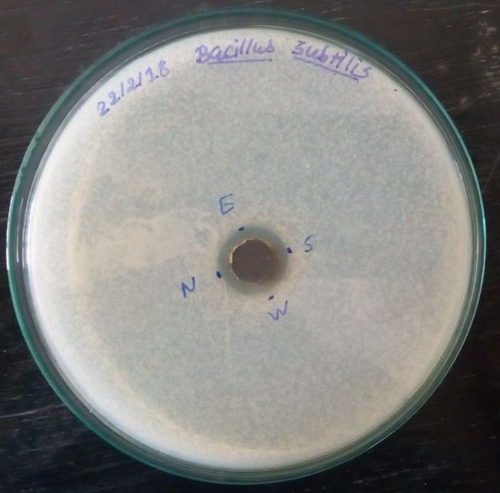
a) Proteuse vulgaris a) S.aureus
a) E.coli a) Bacillus subtilis

Slide 18
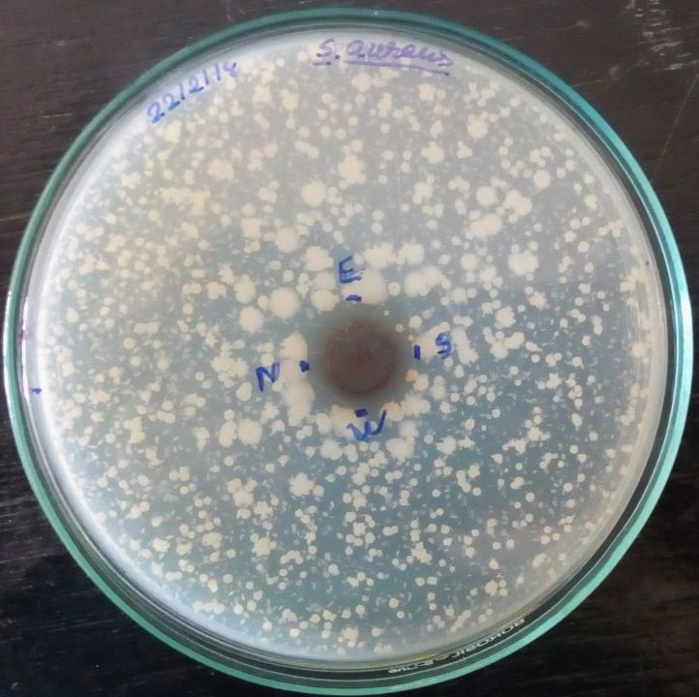
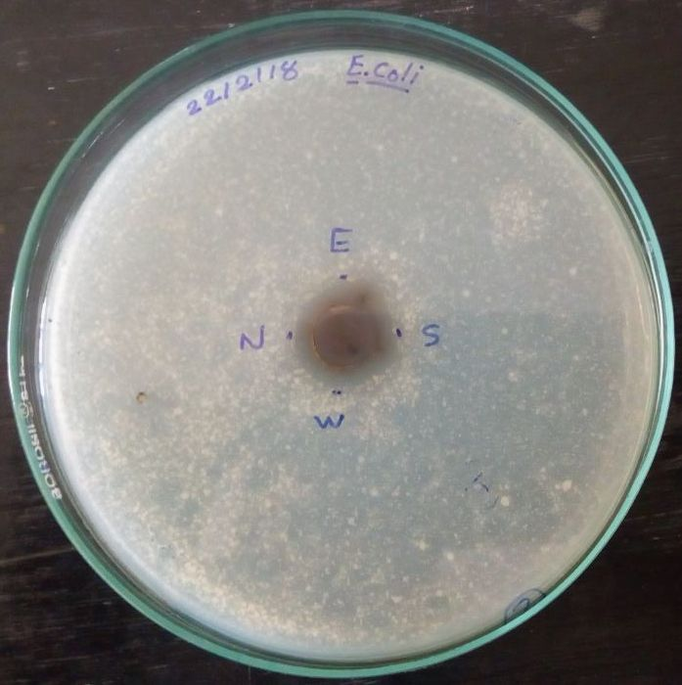
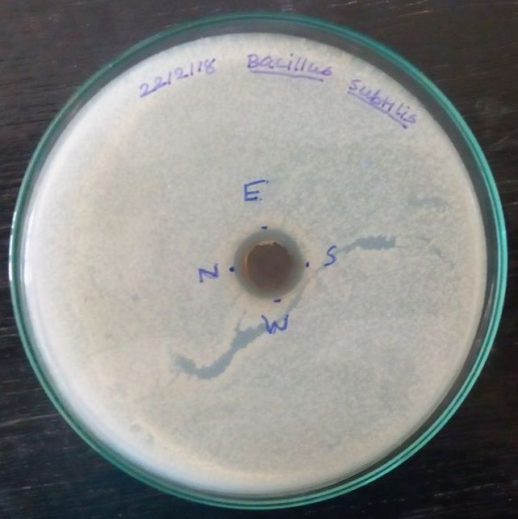
b) Proteuse vulgaris b) S.aureus
b) E.coli b ) Bacillus subtilis

Slide 19
Conclusion
The biosynthesis of silver nanoparticles using the flower extract of Calotropis procera has been demonstrated. It is known that green synthesis of silver nanoparticles is much safer and environmentally friendly as compared to chemical method. The characterization of silver nanoparticles were carried out by UV Visible absorption spectroscopy, Fourier transform infrared spectroscopy (FTIR), X-ray diffraction (XRD) ,Scanning electron microscopy (SEM). The average size of silver nanoparticle in the range of 48 nm. The silver nanoparticles synthesized Calotropis procera show antimicrobial activity against E.coli, S.aureus, Bacillus subtilis, and Proteus vulgaris .

Slide 20
References
Singh V, Patil R, Kasture MB, Gade WNand Prasad BLV, Synthesis of Ag-Pt alloy nanoparticles in aqueous bovine serum albumin foam and their cyto compatibility against human gingival fibroblasts. Colloids and Surfaces B, 69 (2): 239-245,(2009).
Feynman, R., 1959. Lecture at the California Institute of Technol., December 29.
Ahmad, Z., R. Pandey , S. Sharma and G.K. Khuller,2005. Alginate nanoparticles as antituberculosis drug carriers: formulation development, pharmacokinetics and therapeutic potential. IndJChestDis.AlliedSci.,48: 171-6
Sivakumar J, Premkumar C, Santhanam P, Saraswathi N.Biosynthesis of silver nanoparticles using Calotropis gigantean leaf. Afr J Basic Appl Sci 2011; 3(6): 265-270.
Pavani. K . V., and Gayathramma. K.., 2015. Synthesis of silver nanoparticles using extracts of Calotropis gigantea flowers. International journal of research in pharmaceutical and Nano Science. 4(4): 263-240.
Priyanka Subhash Joshi, Gowthami Ramesh, Jenitta Emima Packiyam, and Shobha K Jayanna, Green synthesis and evaluation of silver nanoparticles using leaf extract from Calotropis gigantea, Int.J.Curr.Biotechnol., 2017, 5(3):1-5.

Slide 21
Thank You……!

