Slide 1

SMART INDIA HACKATHON 2026
Problem Statement ID -- SIH26127
Problem Statement Title -- City-Wide AI Engine for Multi-Camera ANPR Trajectory Tracking and Urban Traffic Analysis
Theme-Transportation & Logistics
PS Category- Software
Team ID- SIH26-A0H-T046
Team Name - CODENOVA

Slide 2

CityTrace AI
AI-Powered Multi-Camera Vehicle Trajectory & Traffic Analytics Platform
Proposed Solution:
>>Centralized AI platform integrating multiple CCTV/ANPR camera feeds.
>>Detects vehicles and recognizes registration plates.
>>Links vehicle observations across different cameras and timestamps.
>>Generates city-wide vehicle trajectories and traffic insights.
How it addresses the problem:
*Eliminates isolated camera-wise monitoring.
*Enables cross-camera vehicle tracking.
*Provides a unified view of vehicle movement.
*Converts camera data into actionable urban traffic analytics.
Innovation and uniqueness of the solution:
^Combines ANPR + vehicle tracking + cross-camera correlation + trajectory analytics in one platform.
^Spatio-temporal matching connects observations from different locations.
^Interactive city-level visualization of vehicle movement and traffic patterns.

Slide 3
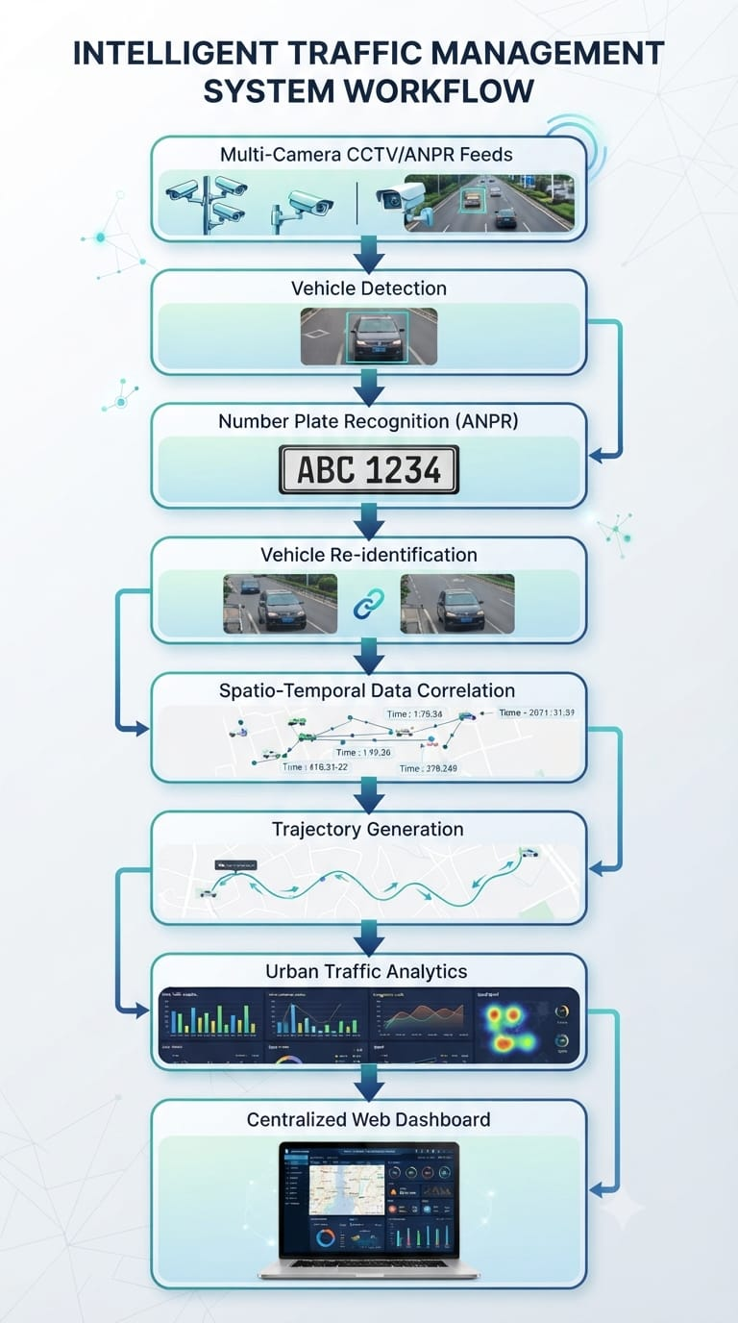
TECHNICAL APPROACH
Technology Stack
Python – AI & backend development
YOLO – Vehicle detection
OpenCV – Video/image processing
OCR – Number plate recognition
FastAPI – Backend APIs
React – Web dashboard
PostgreSQL – Vehicle & event data storage
_Process vehicle detections from multiple cameras.
_Associate the same vehicle across different locations using plate and visual features.
_Store vehicle ID + camera location + timestamp for every detection.
_Reconstruct vehicle movement paths across the monitored city.
_Generate traffic-flow and journey analytics on a unified dashboard.

Slide 4
FEASIBILITY AND VIABILITY
Feasibility
>Uses existing CCTV/ANPR camera infrastructure.
>AI models can process vehicle and number-plate data from multiple camera feeds.
>Centralized architecture enables integration of cameras across different locations.
>Prototype can be developed and tested using recorded/simulated camera feeds.
Key Challenges / Risks
-Low-quality or partially visible number plates.
-Different camera angles, lighting and weather conditions.
-Matching the same vehicle across multiple cameras.
-High processing and storage requirements for large camera networks.
Mitigation Strategies
*Use image preprocessing and robust OCR for difficult plates.
*Combine number-plate information + vehicle visual features + timestamp/location for re-identification.
*Use confidence scores and temporal/spatial constraints for reliable matching.
*Design the system with scalable processing and database architecture.
Viability
^Software-first solution → no specialized hardware required for the prototype.
^Can start with a small number of cameras and scale to larger networks.
^Existing city CCTV infrastructure can potentially be integrated through standard video/ANPR feeds.
^Provides a foundation for city-wide traffic monitoring and analytics.

Slide 5
IMPACT AND BENEFITS
Target Users
>Traffic Management
>Authorities
>Urban Planners
>Law Enforcement & Authorized Agencies
>Emergency Response Teams
>Smart City Operations Centers
Key Benefits
City-Wide Vehicle Visibility:
Connects vehicle observations across multiple cameras
Faster Traffic Analysis:
Provides real-time and historical vehicle movement insights.
Reduced Manual Monitoring:
Automates cross-camera vehicle tracking and trajectory generation.
Improved Traffic Management:
Identifies traffic flow patterns, congestion-prone zones and travel trends.
Scalable Infrastructure:
Can integrate additional cameras and monitoring zones as the network grows.
Overall Impact
Transforms isolated CCTV/ANPR feeds into a unified city-wide traffic intelligence system.

Slide 6
RESEARCH AND REFERENCES
Problem Statement Reference
-SIH26127
-City-Wide AI Engine for Multi-Camera ANPR Trajectory Tracking and Urban Traffic Analytics
-Organization: Bharat Electronics Limited (BEL)
2. Research Areas
*Automatic Number Plate Recognition (ANPR)
*Multi-Camera Vehicle Tracking
*Vehicle Re-Identification
*Spatio-Temporal Trajectory Tracking Urban Traffic Analytics
3. Dataset / Data Resources
>Public vehicle/traffic datasets
>Public number-plate datasets
>Recorded/simulated multi-camera traffic videos for prototype testing
6. Technical Documentation Used
^Python — Backend & AI development
^OpenCV — Image/video processing
^YOLO — Vehicle detection
^FastAPI — Backend API development
^PostgreSQL — Data management
6. Reference Sources
_Smart India Hackathon 2026 — Official Problem Statement
_Research literature on ANPR and OCR
_Research literature on multi-camera vehicle tracking and re-identification
7. Official SIH LinkSmart India Hackathon 2026 — SIH26127https://sih.gov.in/sih2026PS#ViewProblemStatement26127

