Slide 1
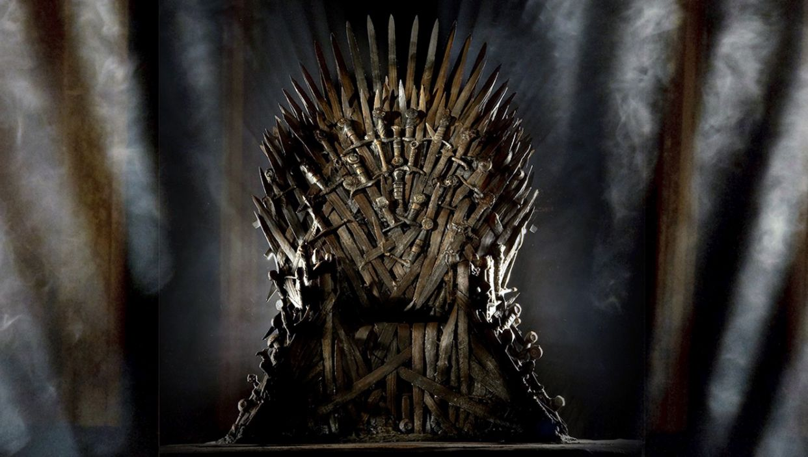
Game of Thrones
Most Dangerous Destinations of Westeros

Slide 2
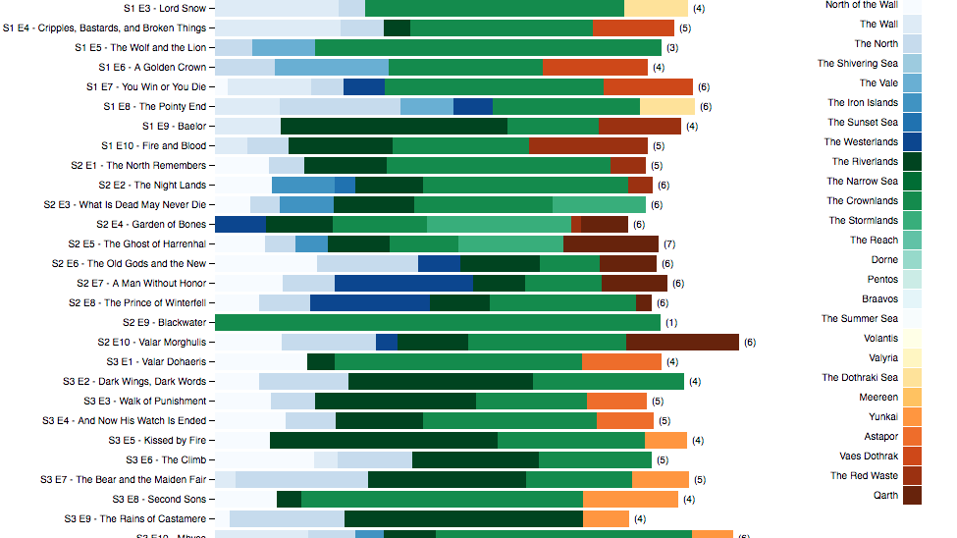

Slide 3
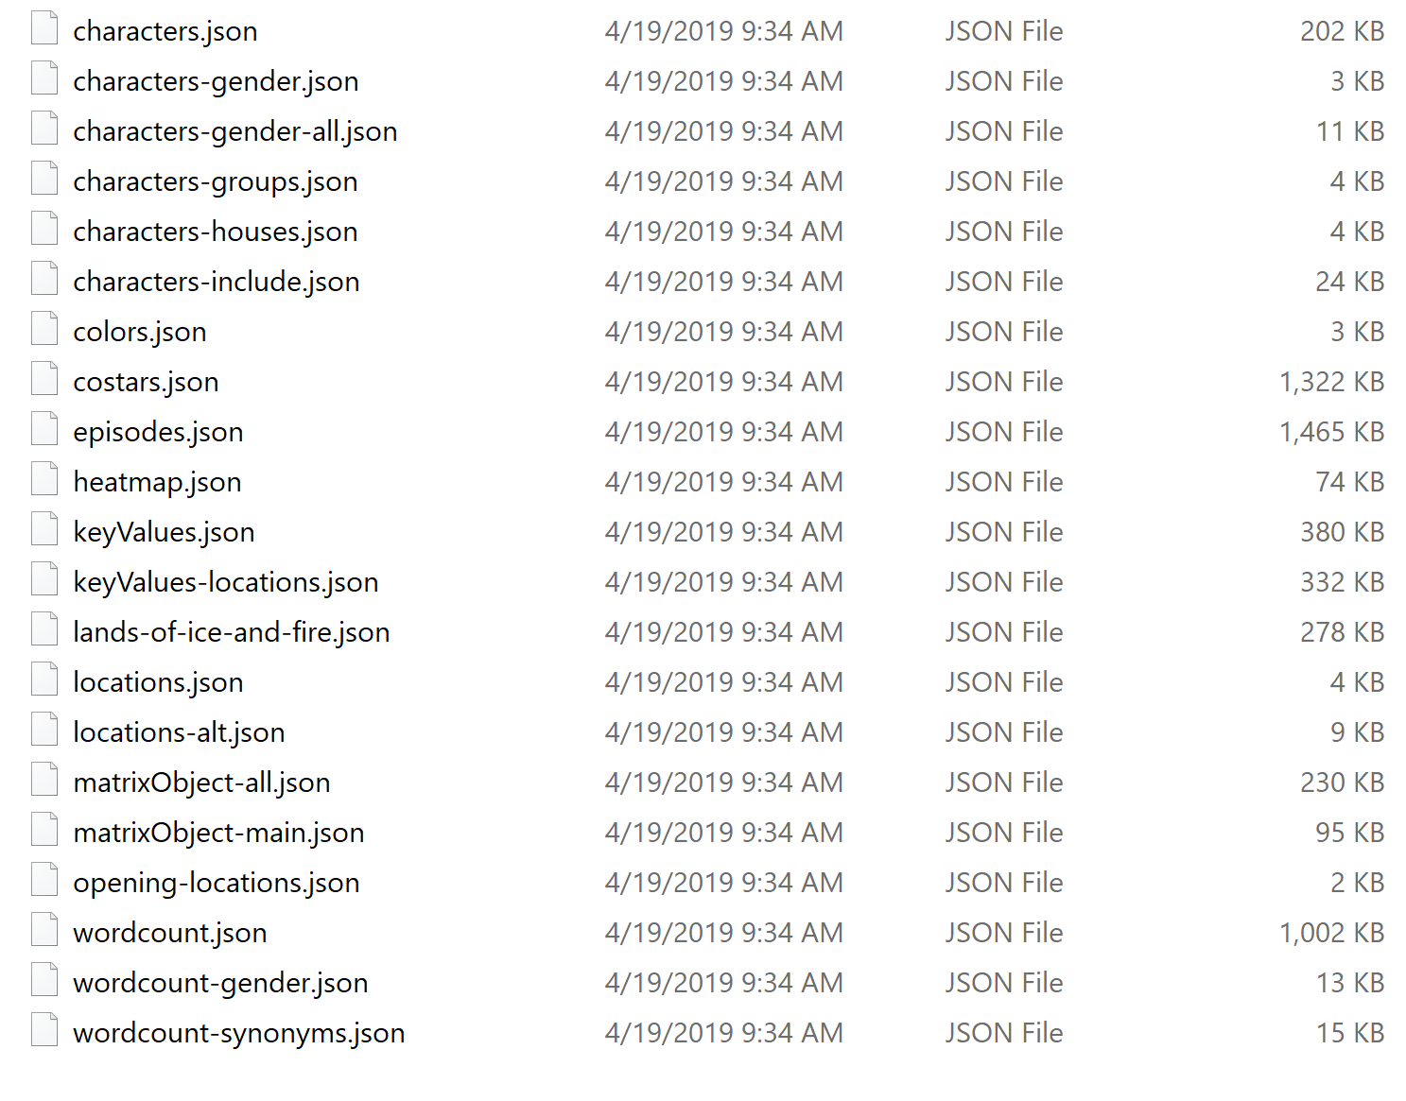
Available Data

Slide 4
The Chosen Ones
Characters - Killed By
Episodes – Death
Location – Region, Sub-regio

Slide 5
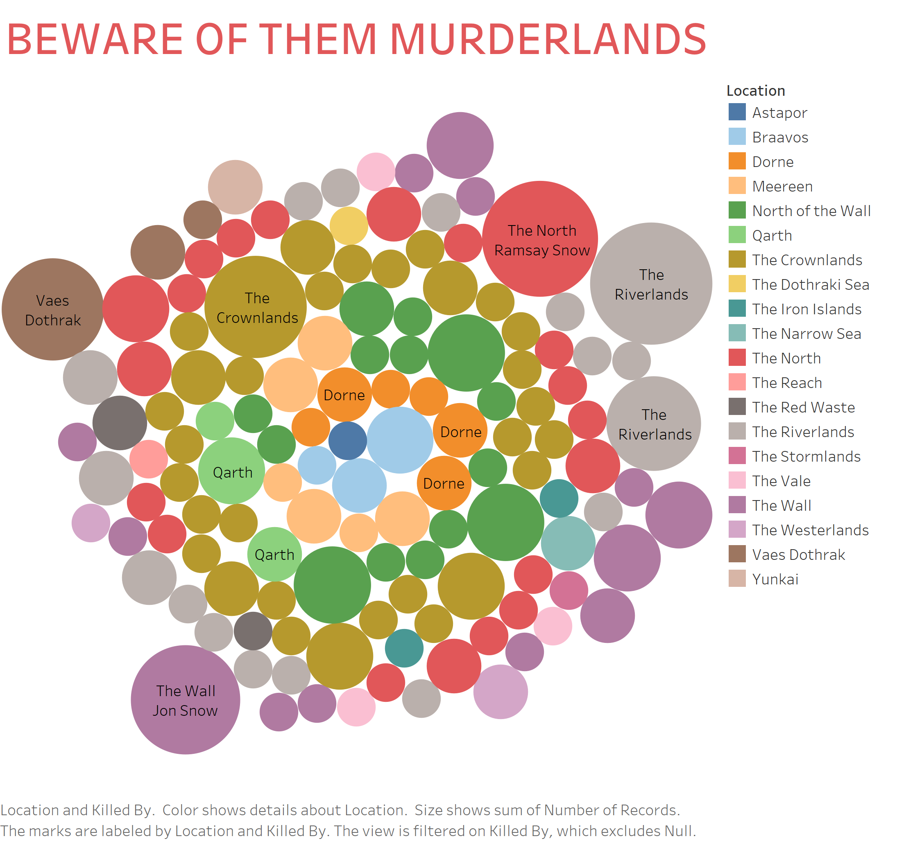

Slide 6
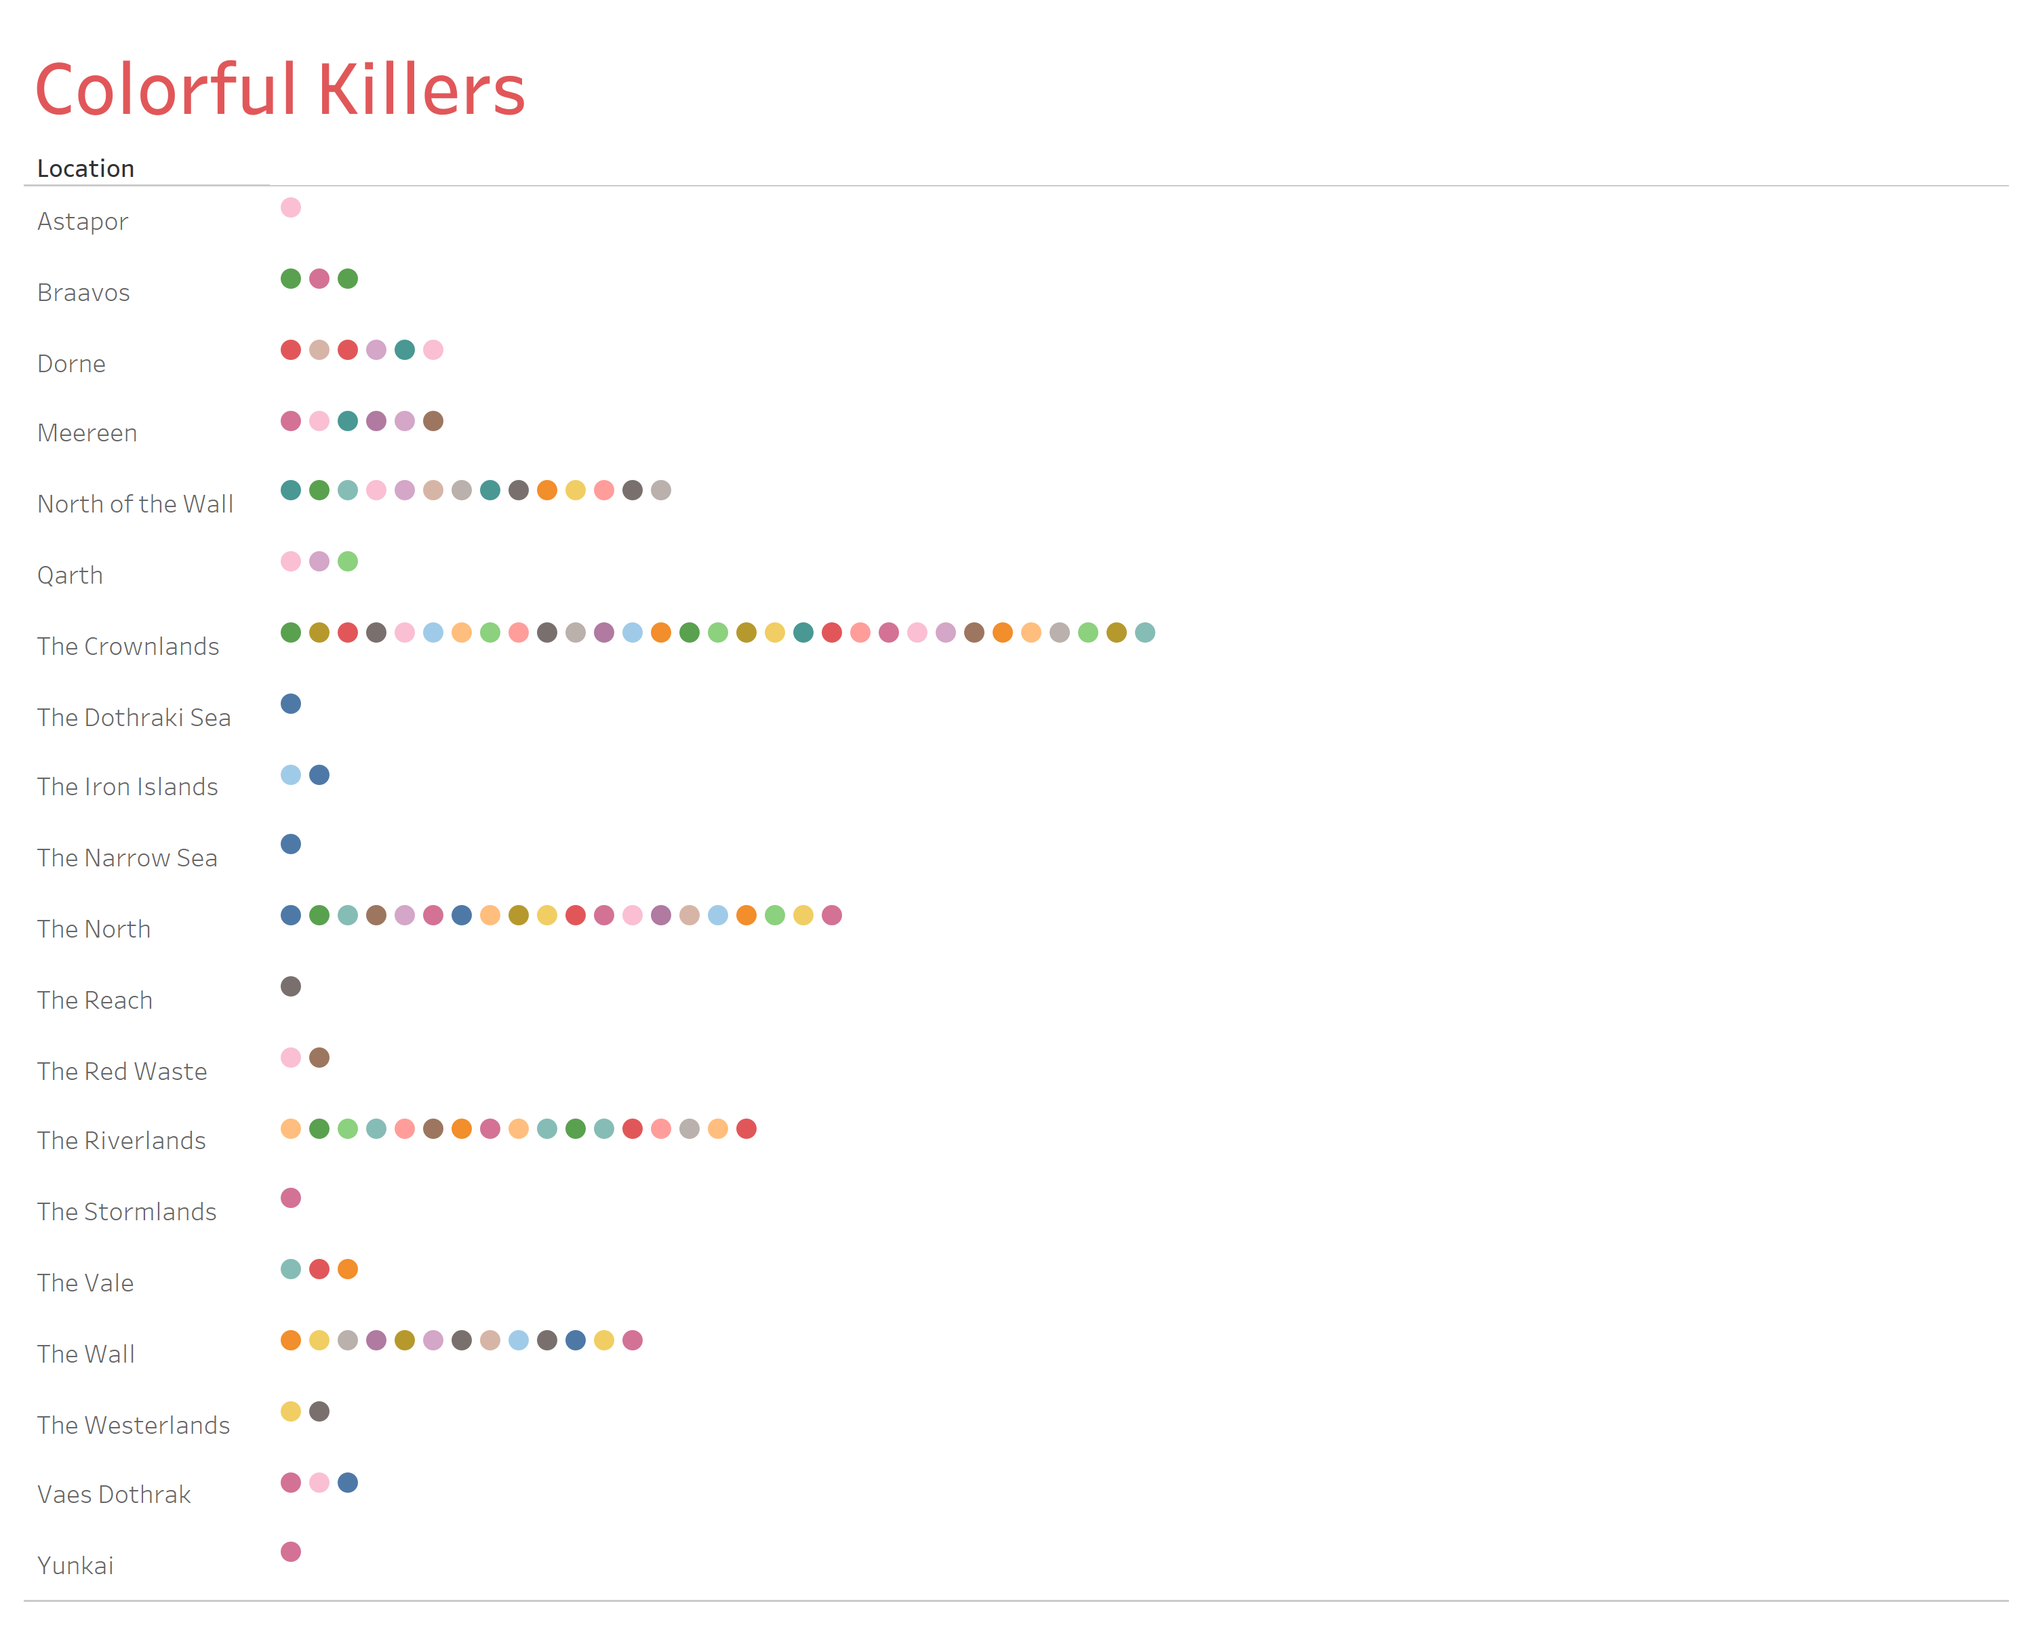

Slide 7
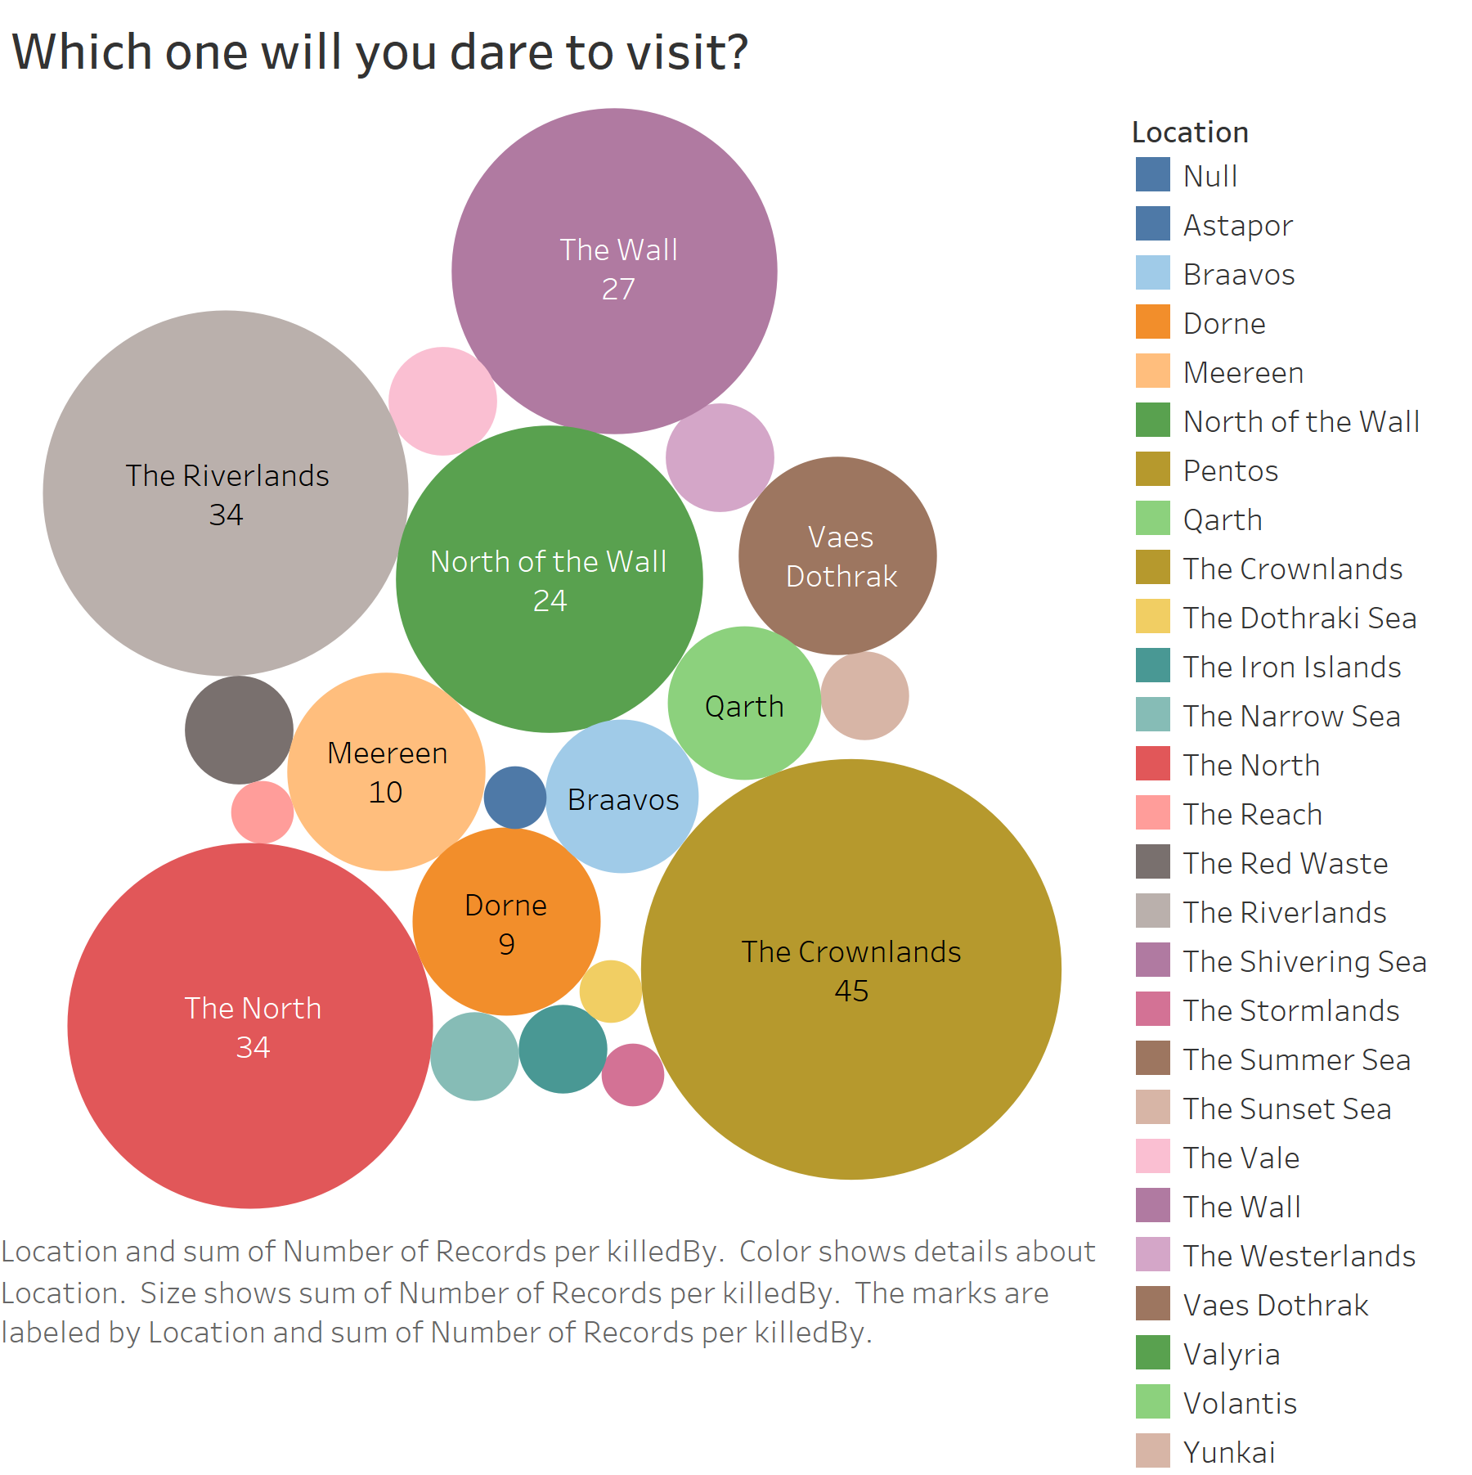

Slide 8

Reference
Special thanks to Jeffrey Lancaster and his amazing dataset:
https://jeffreylancaster.github.io/game-of-thrones/
This Photo by Unknown Author is licensed under CC BY-NC

