Slide 1
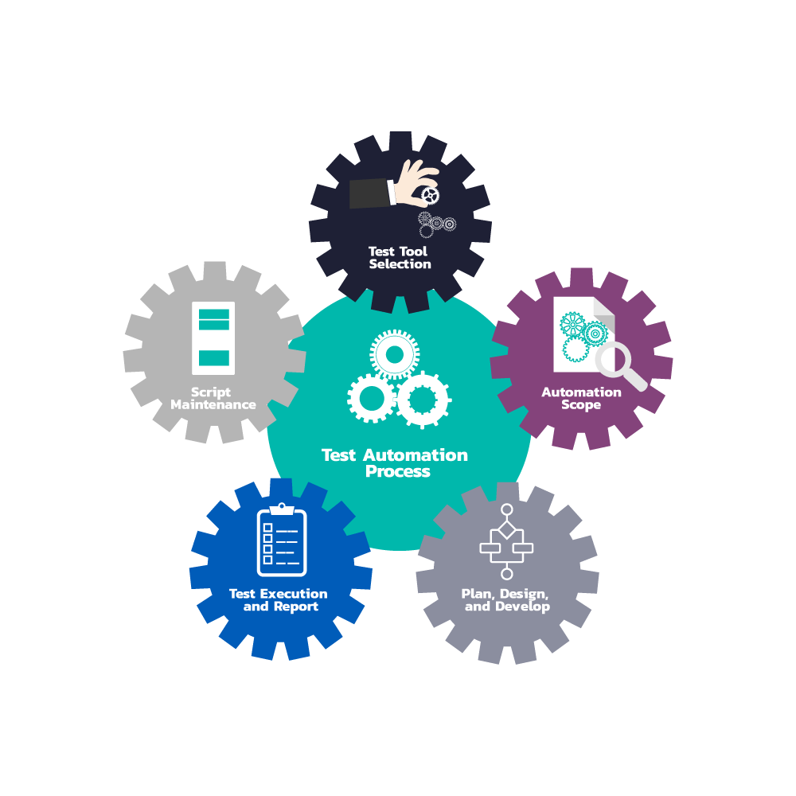
FUNCTIONAL TESTING TOOL DETAILS

Slide 2
FUNCTIONAL TESTING TYPES
TYPES OF FUNCTIONAL TESTING
UNIT TESTING
SANITY TESTING
SMOKE TESTING
SYSTEM TESTING
INTERFACE TESTING
REGRESSION TESTING
COMPONENT TESTING
USER ACCEPTANCE TESTING

Slide 3
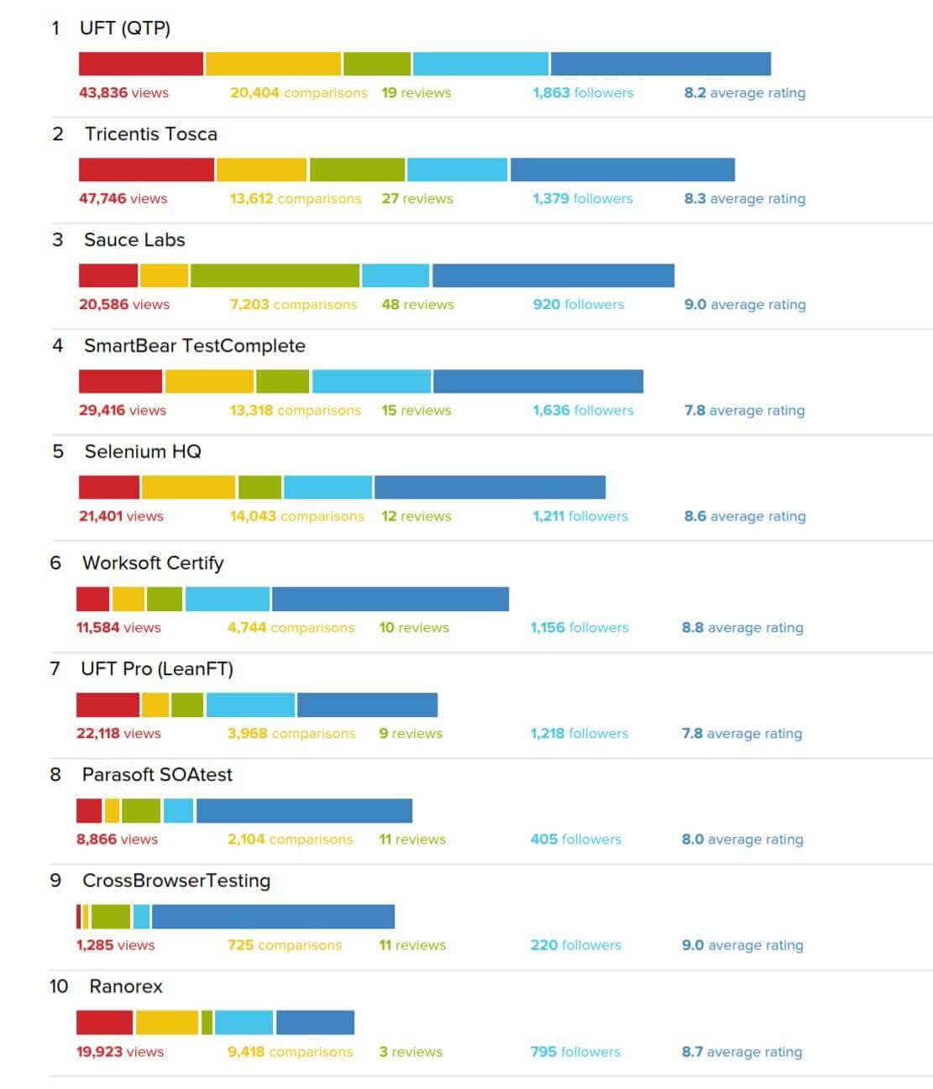
FUNCTIONAL TESTING TOOLS- Market Share and Trends

Slide 4
TYPES OF APPLICATIONS
DESKTOP
MIDDLEWARE
WEB APPLICATION
TECHNOLOGY USED
Java (Swing, AWT, SWT, JavaFX)
.NET (UWP, WPF, WinForms, VB.NET)
Windows API (win32), GDI, MFC, Visual Basic, Visual C++, PowerBuilder, SAPGUI, Oracle Forms, Telerik, DevExpress, Infragistics, Xlib Cocoa
TECHNOLOGY USED
Web Services, REST, JSON, MQ, JMS, TIBCO, HTTP, XML technologies
TECHNOLOGY USED
HTML, CSS, JavaScript, AJAX, ASP.NET, PHP, ColdFusion, Ruby on rails, Python

Slide 5
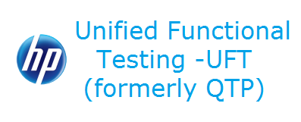


FUNCTIONAL TESTING TOOLS FOR DESKTOP APPLICATIONS – TOP 3
UFT
TOSCA
TEST COMPLETE
PARENT : MICROFOCUS
PRICING : LICENSED
PARENT : TRICENTIS
PRICING : LICENSED
PARENT : SMARTBEAR
PRICING : LICENSED

Slide 6
FUNCTIONAL TESTING TOOLS FOR DESKTOP APPLICATIONS - POPULAR
RANOREX
TELERIK TEST STUDIO
WINAPPDRIVER
AUTOIT
WINIUM

Slide 7



FUNCTIONAL TESTING TOOLS FOR MIDDLEWARE TESTING – TOP 3
REST ASSURED
SOAP UI
POSTMAN
PARENT : OPEN SOURCE
PRICING : FREE
PARENT : SMART BEAR
PRICING : LICENSED
PARENT : POSTMAN
PRICING : LICENSED

Slide 8
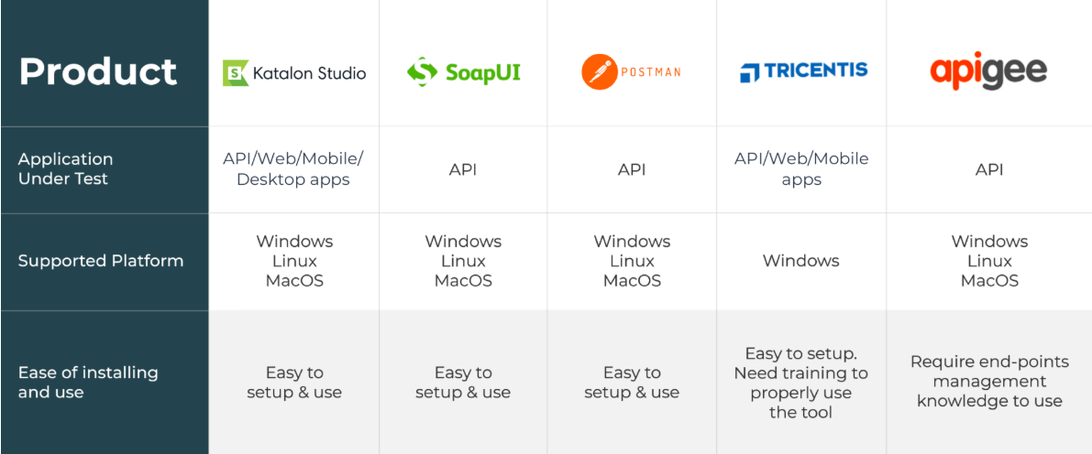
FUNCTIONAL TESTING TOOLS FOR MIDDLEWARE TESTING - POPULAR

Slide 9


FUNCTIONAL TESTING TOOLS FOR WEB APPLICATIONS – TOP 3
SELENIUM
UFT
IBM RFT
PARENT : OPEN SOURCE
PRICING : FREE
PARENT : MICROFOCUS
PRICING : LICENSED
PARENT : IBM
PRICING : LICENSED

Slide 10
FUNCTIONAL TESTING TOOLS FOR WEB APPLICATIONS - POPULAR
TESTINGWHIZ
SAHI
TOSCA
KATALON STUDIO
WATIR

Slide 11
FUNCTIONAL TESTING TOOLS FOR MOBILE APPLICATIONS - POPULAR
APPIUM
ROBOTIUM
SEETEST
TESTANDROID
PERFECTO

Slide 12
NON- FUNCTIONAL (Performance) TESTING TOOLS - POPULAR
LOADRUNNER
JMETER
GATLING
SILKPERFORMER
NEOLOAD

Slide 13
Bibliography
Google.com
softwaretestinghelp.com

