Slide 1
ML BASED SOLICITATION IN FEDERAL TRANSCRIPTS
DILIP PRASAD 2020MT12208

Slide 2
PROJECT DETAILS
For the given German government federal archive written in Germany, implement NLP based search engine.
This search performed should be more than a simple Regex based or word to word match.
So, it has to be a semantic based search understanding the meaning and also get results based on synonyms

Slide 3
Problem statement
There are multiple web pages in the German federal archive website, written in German language.
Implementing a search based on word/ sentence could be done with a Regex based match, However, this in turn results only with exact match.
Fetching details based on synonyms or on the basis of context is lacking

Slide 4
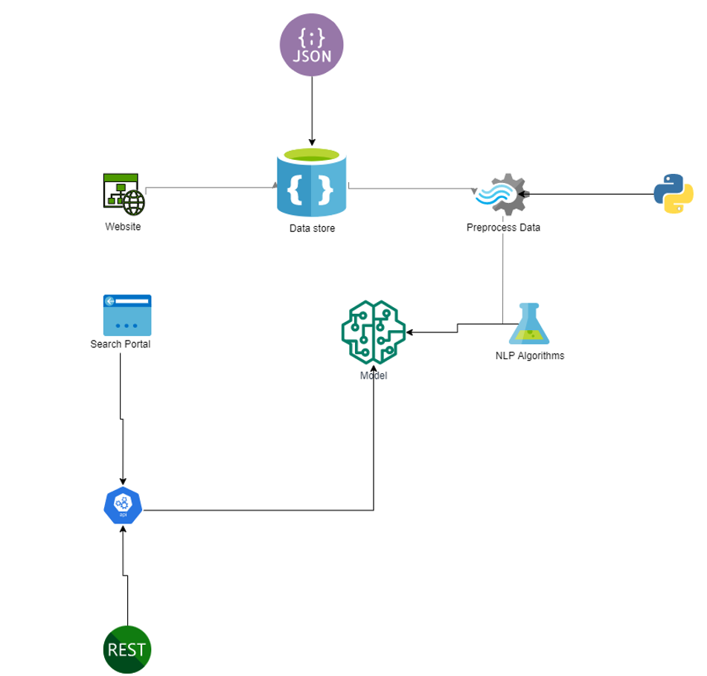
Architecture Diagram

Slide 5
Architecture Explained
The web crawler module, crawls and finds all the given set of possible links in the entire website.
Azure Queue functionality is used to maintain the crawled URL temporarily
Later, the URL Validator module dequeues each of the links validates the same.
Post that, the same module extracts web text without HTML or Rich media and queues to another queue hosted in azure
Finally, the NLP modules performs data cleanup and pre-processing techniques to build a model

Slide 6
Architecture Explained Cont.
After creating a module, we make use of it by consuming from an API
This API is created as a RESTful service to perform READ operations mostly or CRUD in general.
To facilitate the search operation, we will be creating a web application in Dot Net core with Docker container.
Upon performing search, it invokes the API and the API fetches the relevant text from the NLP Model

Slide 7
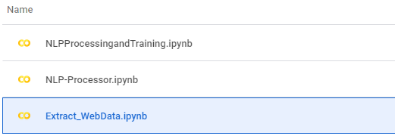
3 Python files for Core NLP

Slide 8
Data extraction

Slide 9
Web scraping
Load the page
Extract Html
Extract Plain Text

Slide 10
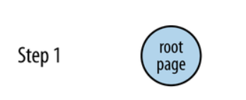
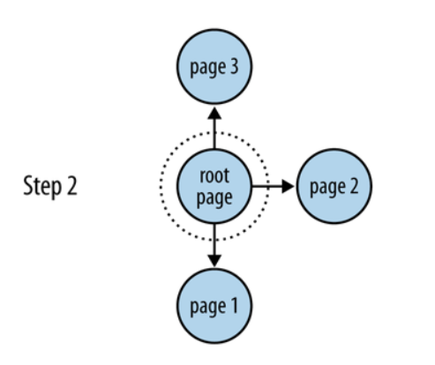
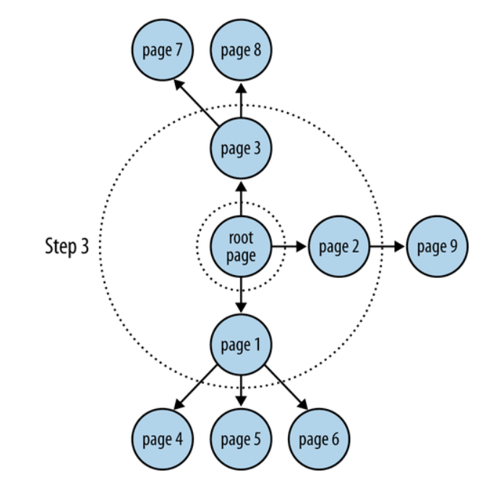
Web crawling steps

Slide 11
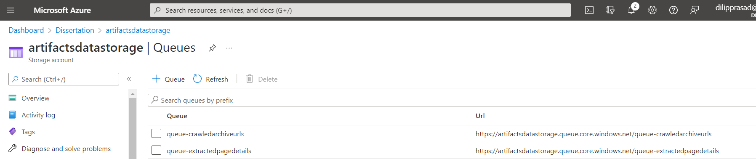
Azure Queues
Azure storage – queues to maintain data

Slide 12
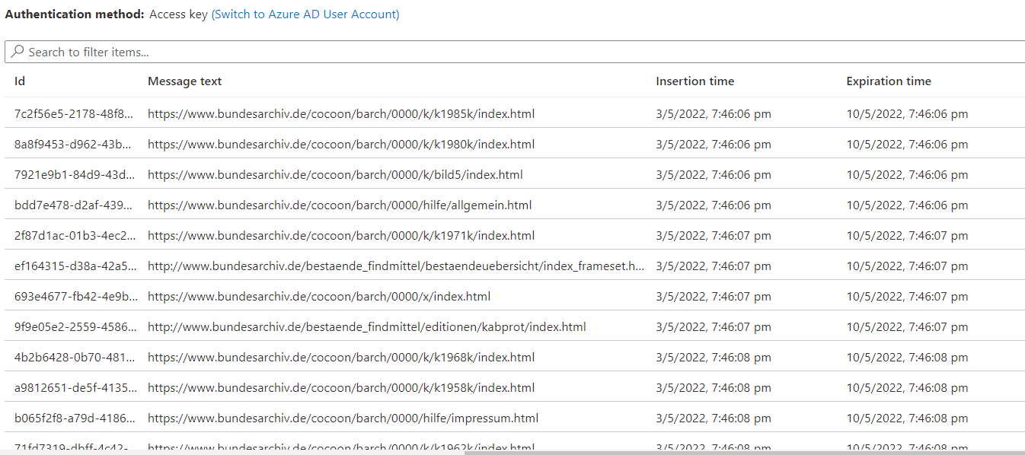
Queue#1 queue-crawledarchiveurls
Maintains URLs

Slide 13
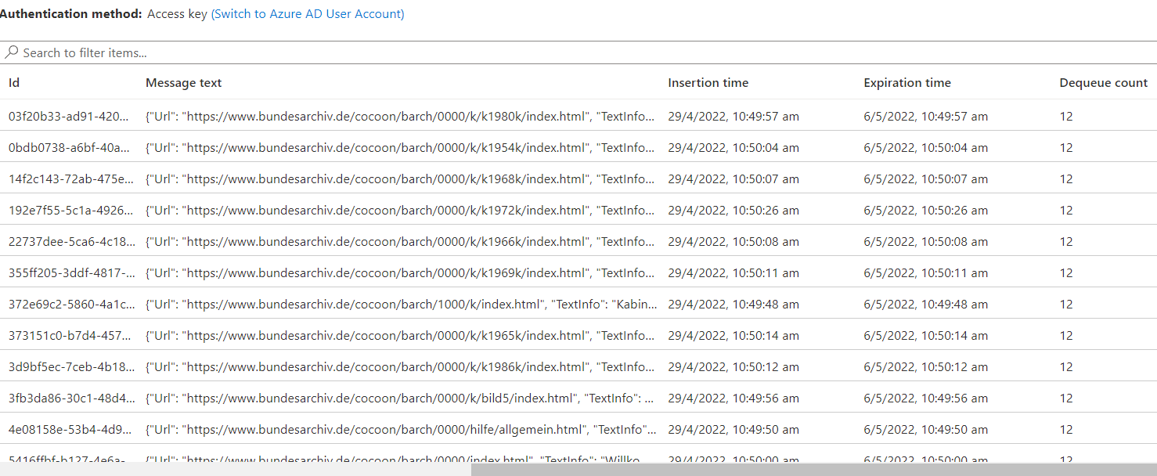
Queue#2 queue-extractedpagedetails
Maintains extracted Text from web page

Slide 14
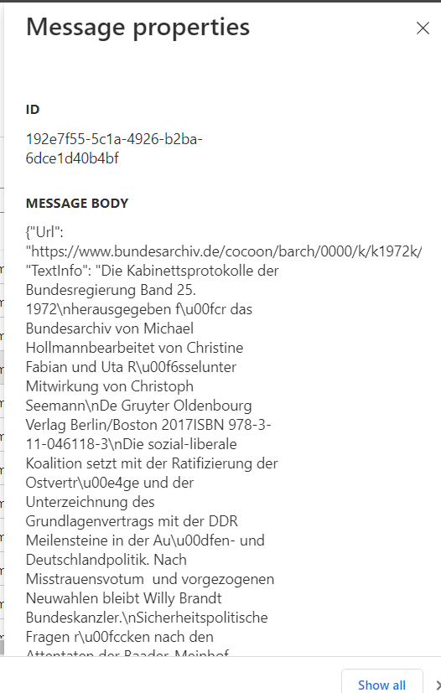
Sample Queue message

Slide 15
NLP Phases
There are 5 phases on any given NLP projects and the same will be performed here
Lexical & Morphological analysis
Syntactic analysis (parsing)
Semantic analysis
Discourse integration
Pragmatic analysis

Slide 16
Data cleanup
Below are the common steps performed to clean or normalize the data
Tokenizing the string
Lowercasing
Removing stop words and punctuation
Stemming / lemmatization

Slide 17
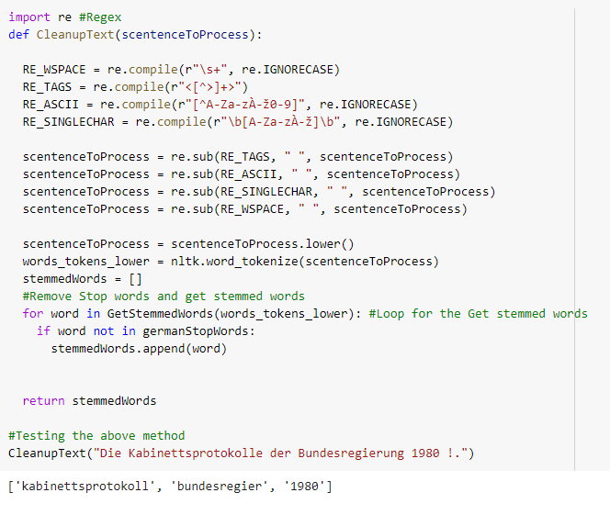
Data cleanup source

Slide 18
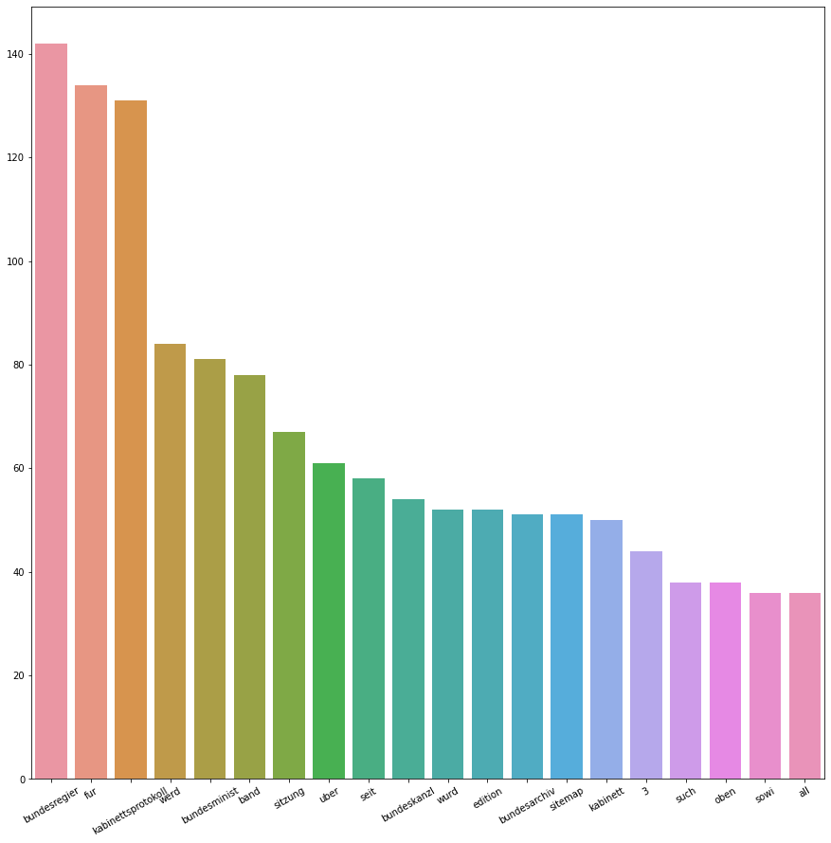
Frequency Distribution

Slide 19
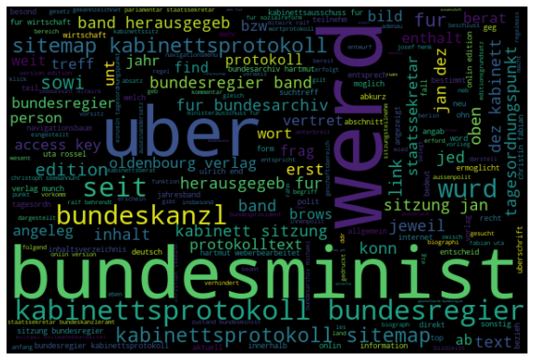
Word Cloud

Slide 20

NLP Tasks
Overview of the tasks performed
Using a language library
Building pipeline object
Using token
Part of speech tagging
Understanding token attributes

Slide 21
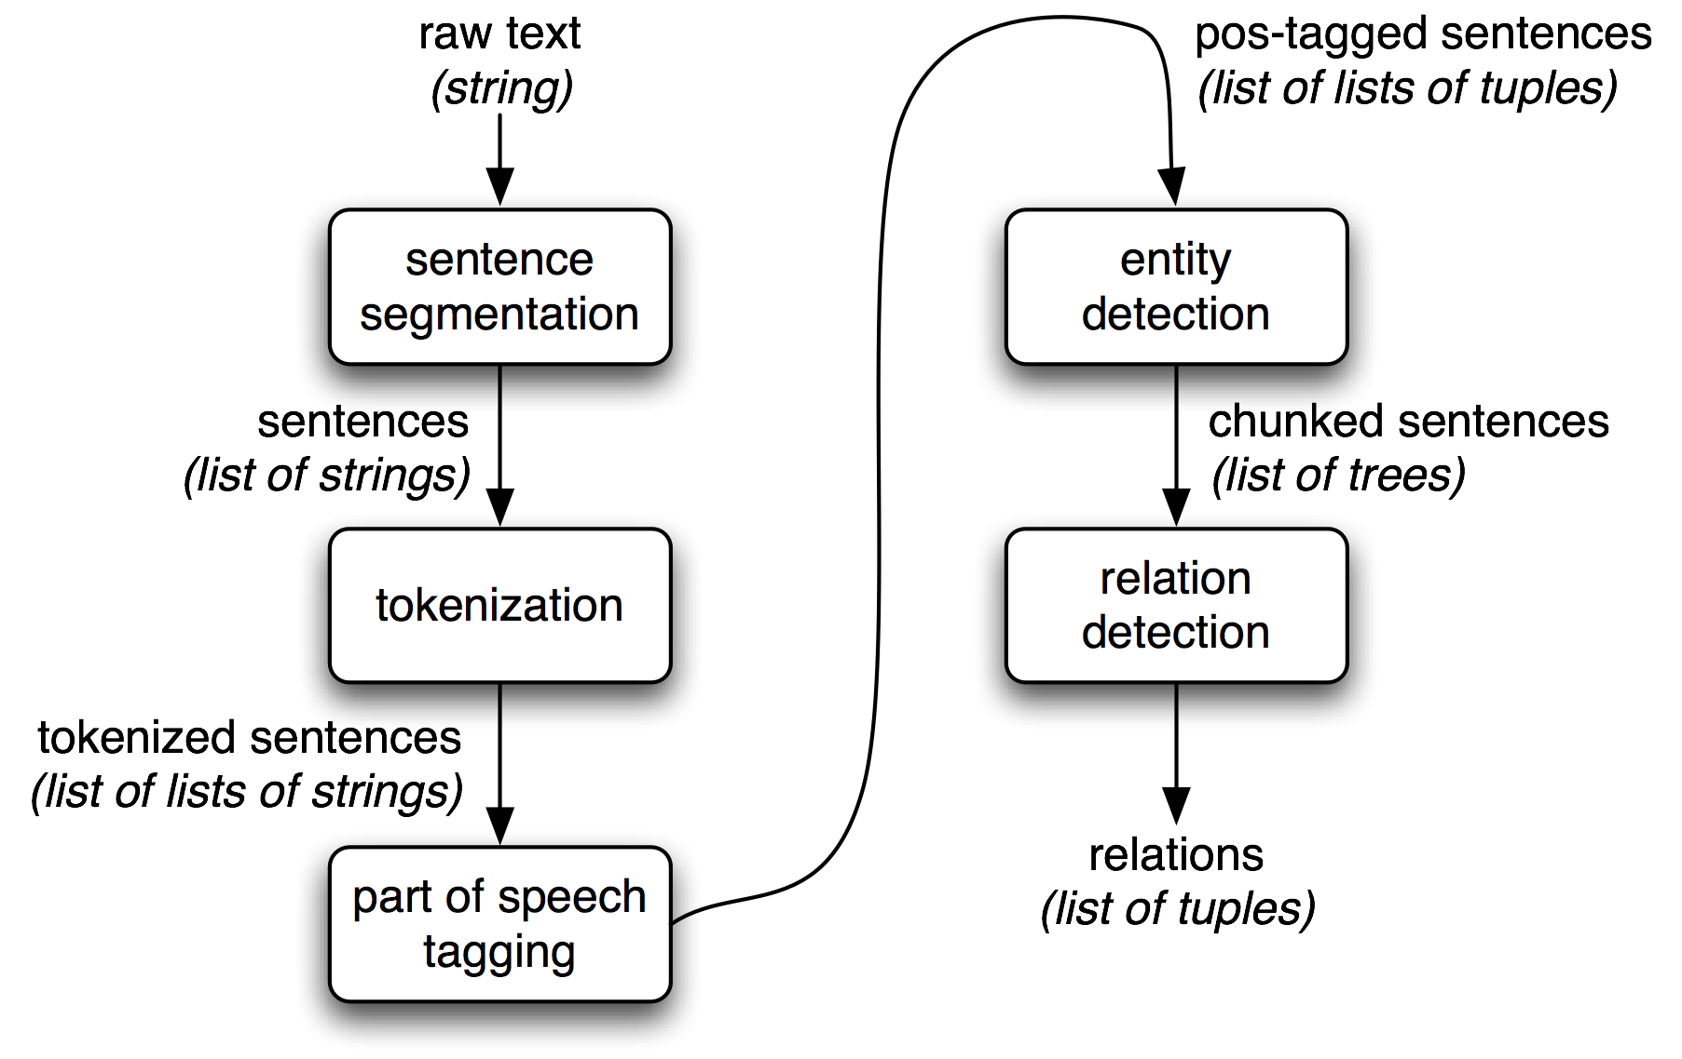
Info extraction architecture

Slide 22
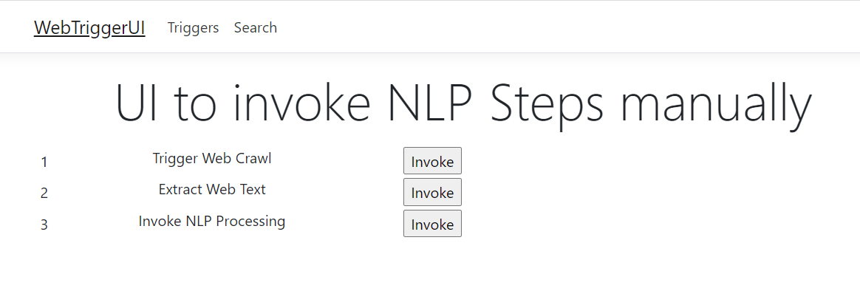
Manual trigger
Below UI helps us to trigger the various steps in this NLP Project

Slide 23
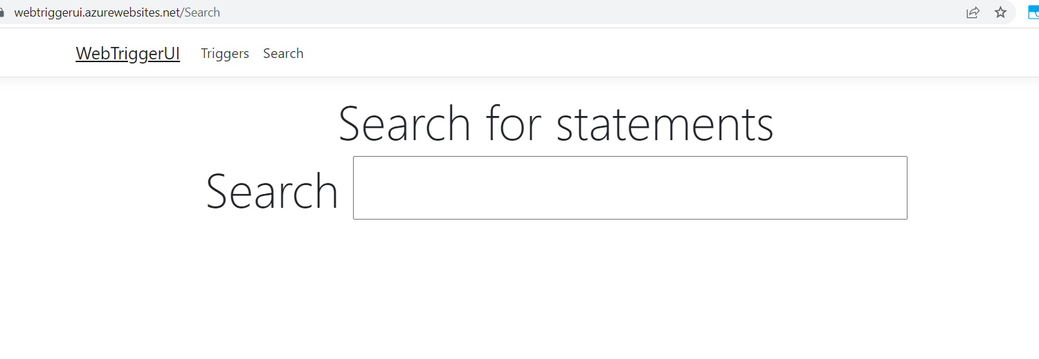
Search Screen
Below UI helps us to perform search on our model

Slide 24
Scope for improvement
Use no server methodologies by making use of azure on demand or AWS functionless offerings
Communicate between serverless functions to create a cascading experience
Create a MLOPS pipeline to continuously train and deploy model for enhancements

Slide 25
Conclusion
Though there are multiple algorithms to handle these scenarios, we have used a simple one available in the market.
Going forward these algorithms will be replaced with a proprietary algorithm developed in house.

Slide 26
Thank You

