Slide 1
Block cipher modes of operation [Slide courtesy: Cryptography and network security by Behrouz Fourozan]
t

Slide 2
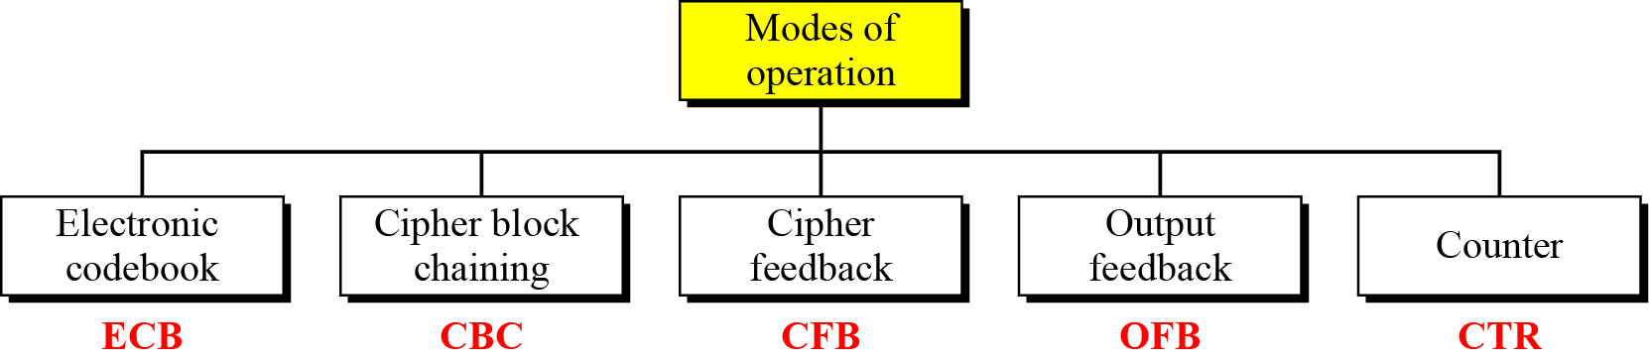
Modes of operation
Modes of operation have been devised to encipher text of any size employing either DES or AES.

Slide 3
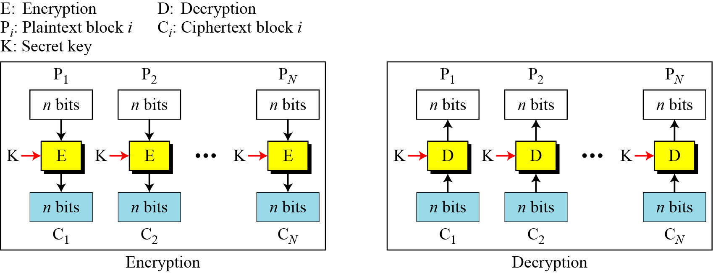
Electronic Codebook (ECB) Mode

Slide 4
Electronic Codebook (ECB) Mode…
It can be proved that each plaintext block at Alice’s site is exactly recovered at Bob’s site.
Because encryption and decryption are inverses of each other,
Called electronic codebook
because one can precompile 2^{K} codebooks (one for each key) in which each codebook has 2^{n} entries in two columns.
Each entry can list the plaintext and the corresponding ciphertext blocks.

Slide 5
Electronic Codebook (ECB) Mode…
Assume that Eve works in a company a few hours per month (her monthly payment is very low). She knows that the company uses several blocks of information for each employee in which the seventh block is the amount of money to be deposited in the employee’s account. Eve can intercept the ciphertext sent to the bank at the end of the month, replace the block with the information about her payment with a copy of the block with the information about the payment of a full-time colleague. Each month Eve can receive more money than she deserves.

Slide 6
Electronic Codebook (ECB) Mode…
Error Propagation
A single bit error in transmission can create errors in several in the corresponding block.
However, the error does not have any effect on the other blocks.

Slide 7
Electronic Codebook (ECB) Mode…
What if one does not want to use padding?or the plaintext is fixed and stored somewhere?
A technique called ciphertext stealing (CTS) can make it possible to use ECB mode without padding.
In this technique the last two plaintext blocks, P_{N−1} and P_{N} , are encrypted differently and out of order, as shown below, assuming that P_{N−1} has n bits and P_{N} has m bits, where m ≤ n

Slide 8
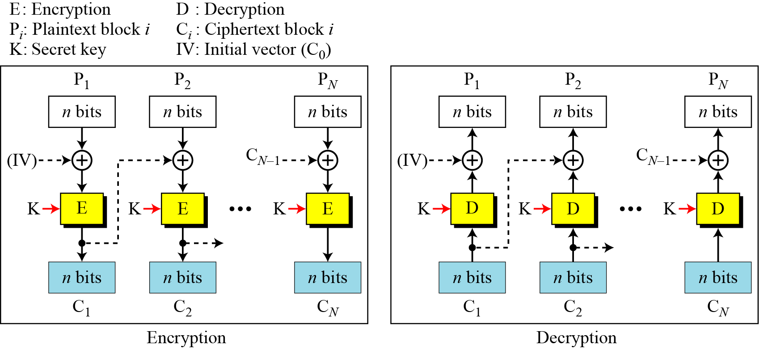
Cipher Block Chaining (CBC) Mode
Each plaintext block is exclusive-ored with the previous ciphertext block before being encrypted.

Slide 9
Cipher Block Chaining (CBC) Mode
Prove that each plaintext block at Alice’s site is recovered exactly at Bob’s site.

Slide 10
Cipher Block Chaining (CBC) Mode
Prove that each plaintext block at Alice’s site is recovered exactly at Bob’s site.
Because encryption and decryption are inverses of each other,
Initialization Vector (IV)
The initialization vector (IV) should be known by the sender and the receiver.

Slide 11
Cipher Block Chaining (CBC) Mode
Error Propagation
a single bit error in ciphertext block C_{j} during transmission may create error in most bits in plaintext block P_{j} during decryption.
What about plaintext block P_{j+1} ???

Slide 12
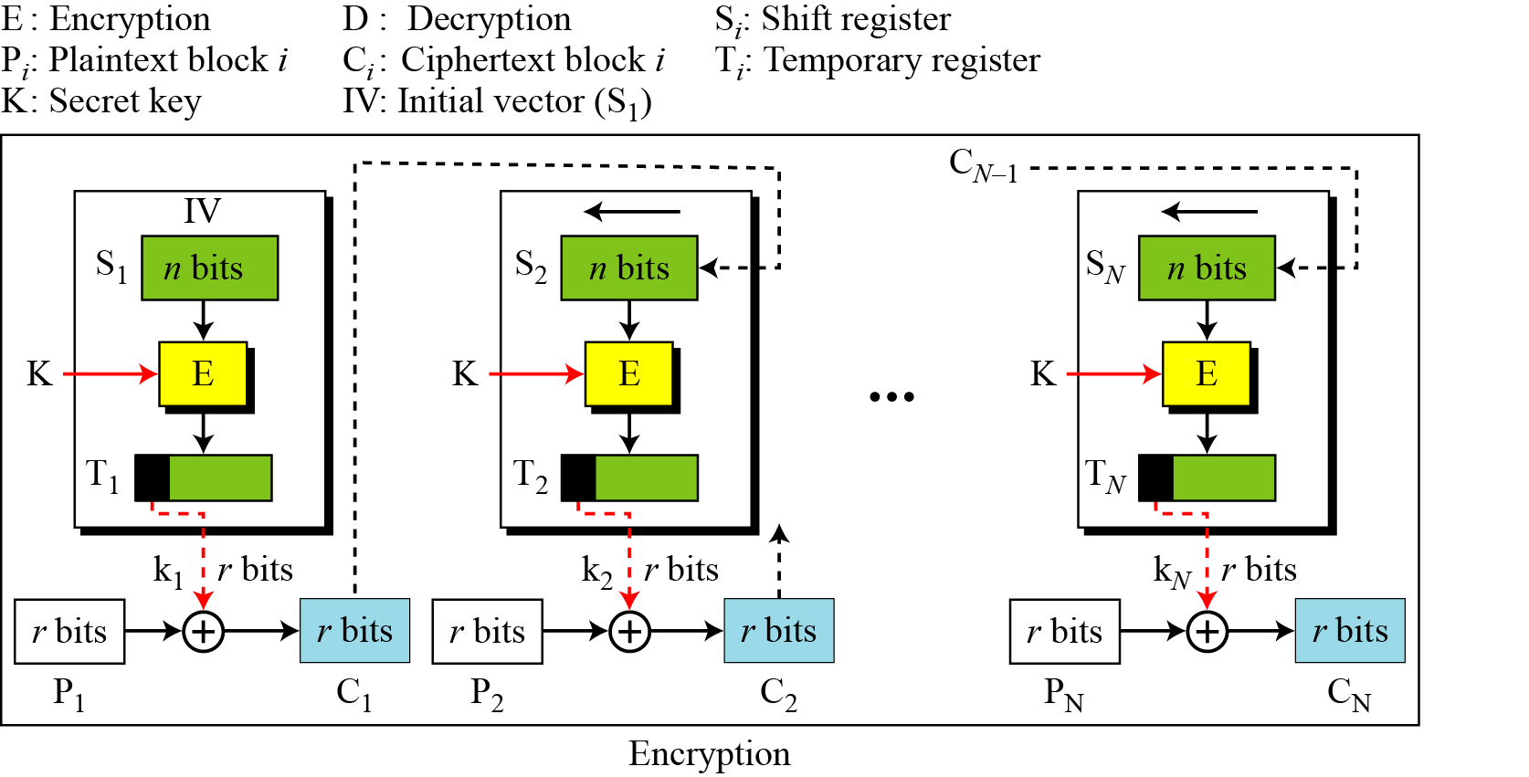
Cipher Feedback (CFB) Mode
In situations where,
we need to use DES or AES as secure ciphers,
but the plaintext or ciphertext block sizes are to be smaller.

Slide 13
Cipher Feedback (CFB) Mode…
The relation between plaintext and ciphertext blocks is shown below:

Slide 14
Cipher Feedback (CFB) Mode…
Security analysis
No padding is required
System does not have to wait until it has received a large block of data before starting encryption
Less efficient than CBC or ECB
Why???

Slide 15
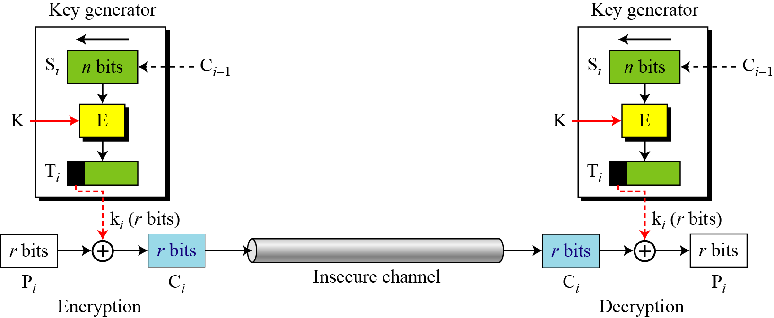
Cipher Feedback (CFB) Mode
CFB as a Stream Cipher

Slide 16
Cipher Feedback (CFB) Mode
Error Propogation
What if a single bit of C_{i} is changed?
What will be the effect on P_{i} ?
What will be the effect on subsequent blocks?

Slide 17
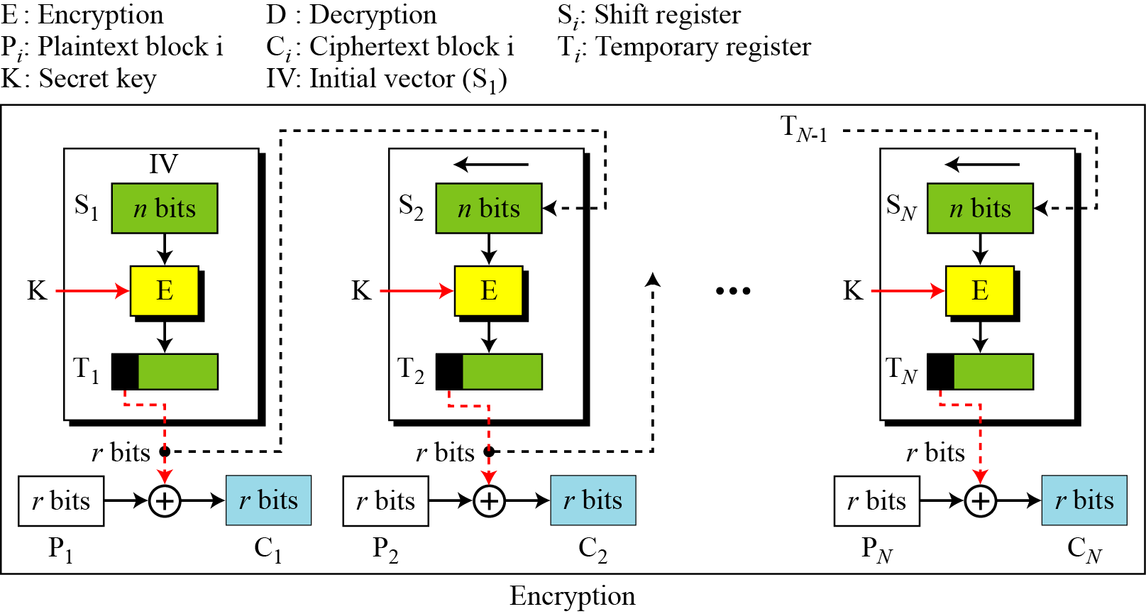
Output Feedback (OFB) Mode
In this mode each bit in the ciphertext is independent of the previous bit or bits.
This avoids error propagation.

Slide 18
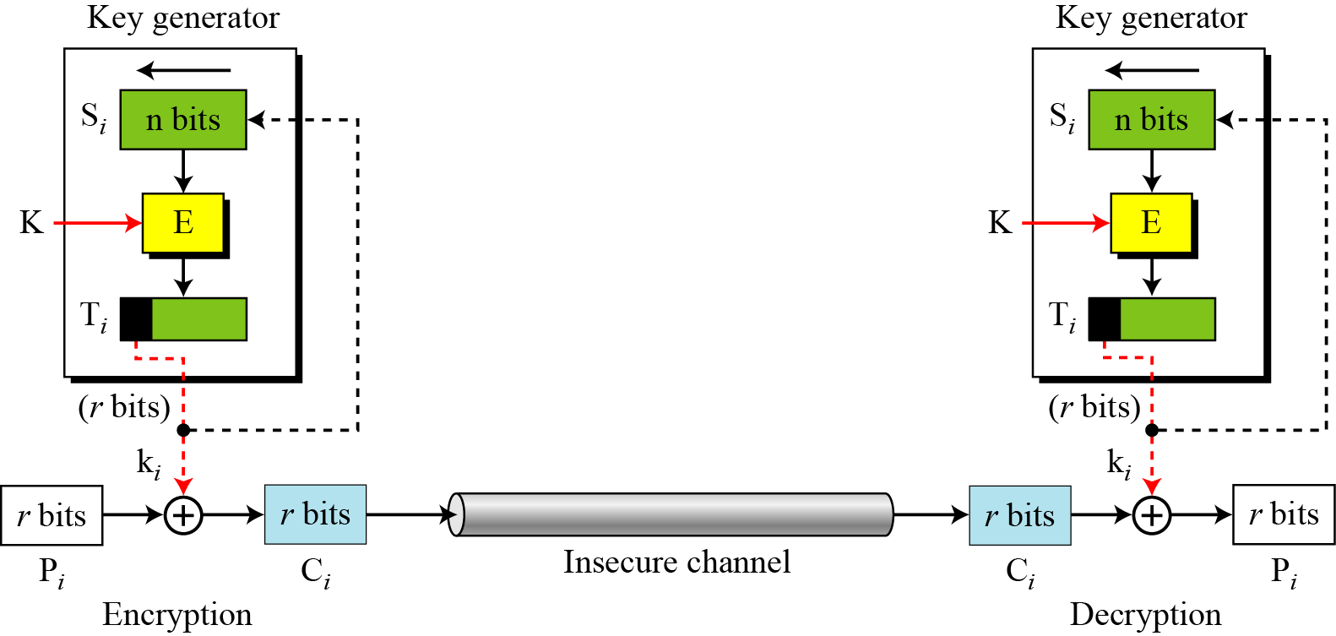
Output Feedback (OFB) Mode…
OFB as a Stream Cipher

Slide 19
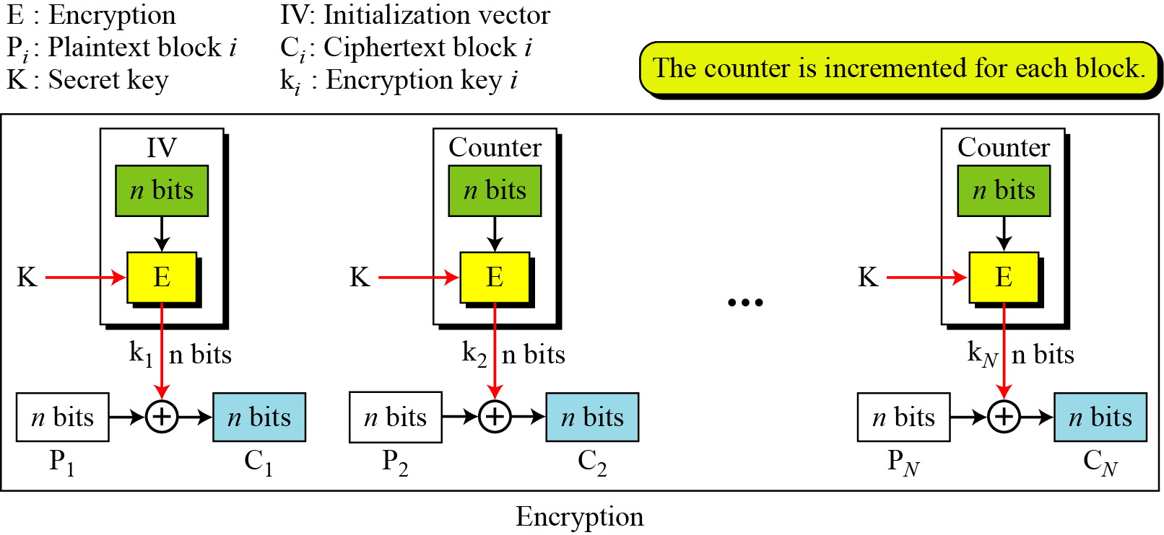
Counter (CTR) Mode
In the counter (CTR) mode, there is no feedback.
The pseudorandomness in the key stream is achieved using a counter.

Slide 20
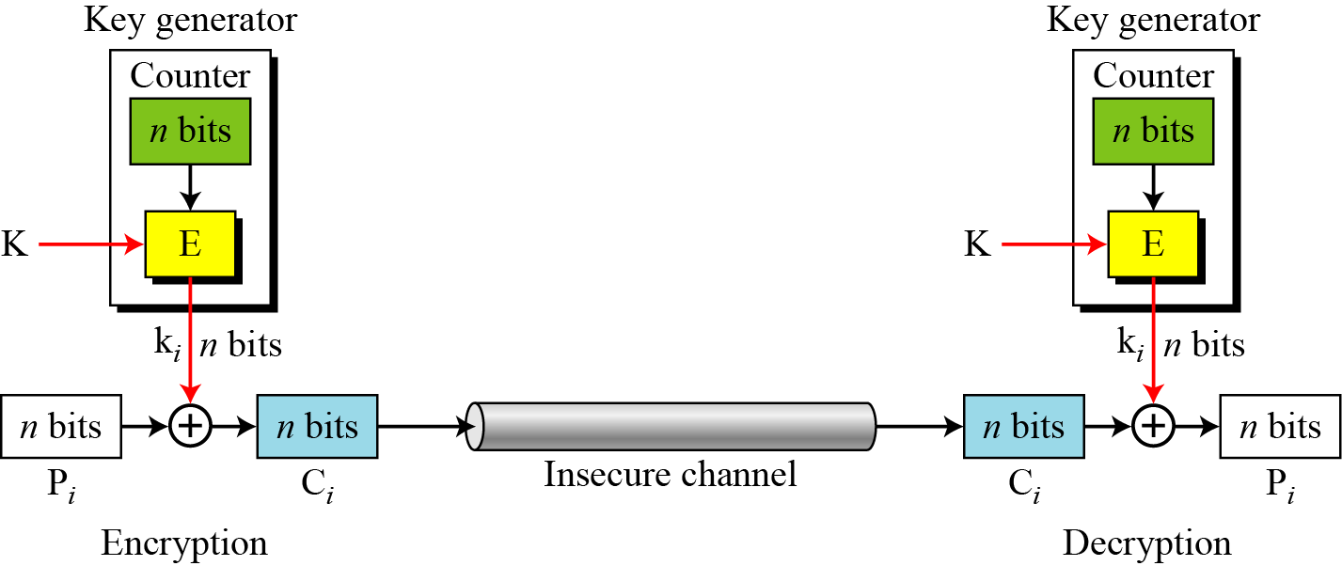
Counter (CTR) Mode
CTR mode as a stream cipher

Slide 21
Comparison of Different Modes

