Slide 1
AI Agent for Smart Farming Advice
CAPSTONE PROJECT
Presented By:
Student Name- DILIP RAHUL BUDIMURI
College Name- NIMRA COLLEGE OF ENGINEERING AND TECHNOLOGY
Department – COMPUTER SCIENCE AND ENGINEERING

Slide 2
OUTLINE
Problem Statement (Should not include solution)
Proposed System/Solution
System Development Approach (Technology Used)
Algorithm & Deployment
Result (Output Image)
Conclusion
Future Scope
References

Slide 3
Problem Statement
Small-scale farmers often lack access to timely and localized agricultural advice. Unpredictable weather, poor soil management, pest attacks, and fluctuating crop prices lead to reduced yield and income.
The challenge is to build an AI agent using Retrieval-Augmented Generation (RAG) that provides real-time, region-specific guidance on crops, weather, soil, pest control, and market prices — accessible in local languages — to empower farmers with data-driven decisions.

Slide 4
TECHNOLOGIES AND SERVICES USED
IBM Watson / IBM Granite (language generation)
IBM Cloud Lite (retrieval and hosting)
Vector Database
Presto for querying structured Agri-data
Python, LangChain (for orchestration)
REST API & RAG workflows

Slide 5
Proposed Solution
Build an AI agent using IBM Cloud Lite and optionally IBM Granite to retrieve agricultural data and generate contextual responses.
Features include:
1 Crop suggestions based on region and weather
2 Fertilizer guidance and soil interpretation
3 Pest management tips
4 Real-time mandi (market) price information
Focus on integrating trusted data sources like meteorological services, e-NAM, and agricultural departments.

Slide 6
WOW FACTORS
1. Real-Time, Contextual Advice via RAG
It doesn’t just give canned responses — it retrieves relevant documents and data, then generates customized, meaningful guidance for each farmer’s question.
Example: “Is it good to plant rice in Vijayawada today?” → It checks local weather, soil, season — and gives a precise answer.
2. End-to-End IBM Cloud Solution
Entire solution is deployed using IBM Cloud Lite, Granite, Watson ML, Object Storage, Functions, etc.
No reliance on third-party infrastructure — a purely enterprise-grade architecture with free-tier accessibility.
3. Decision-Making, Not Just Information
It doesn’t say "Here is the data", it says "Based on this data, here's what you should do".
This reasoning layer adds trust and usability, converting raw insights into actionable steps.

Slide 7
Algorithm & Deployment
Algorithm Selection:
Retrieval-Augmented Generation (RAG) + Embedding model (e.g., BAAI/bge)
Vector index enables semantic search of soil, weather, pest, and mandi data
IBM Granite or GPT models used for generating the final answer
Deployment Steps:
Create cloud functions for retrieval
Host frontend on IBM Cloud
Connect tools like Presto/Milvus via REST API
Deploy agent via web UI / chatbot

Slide 8
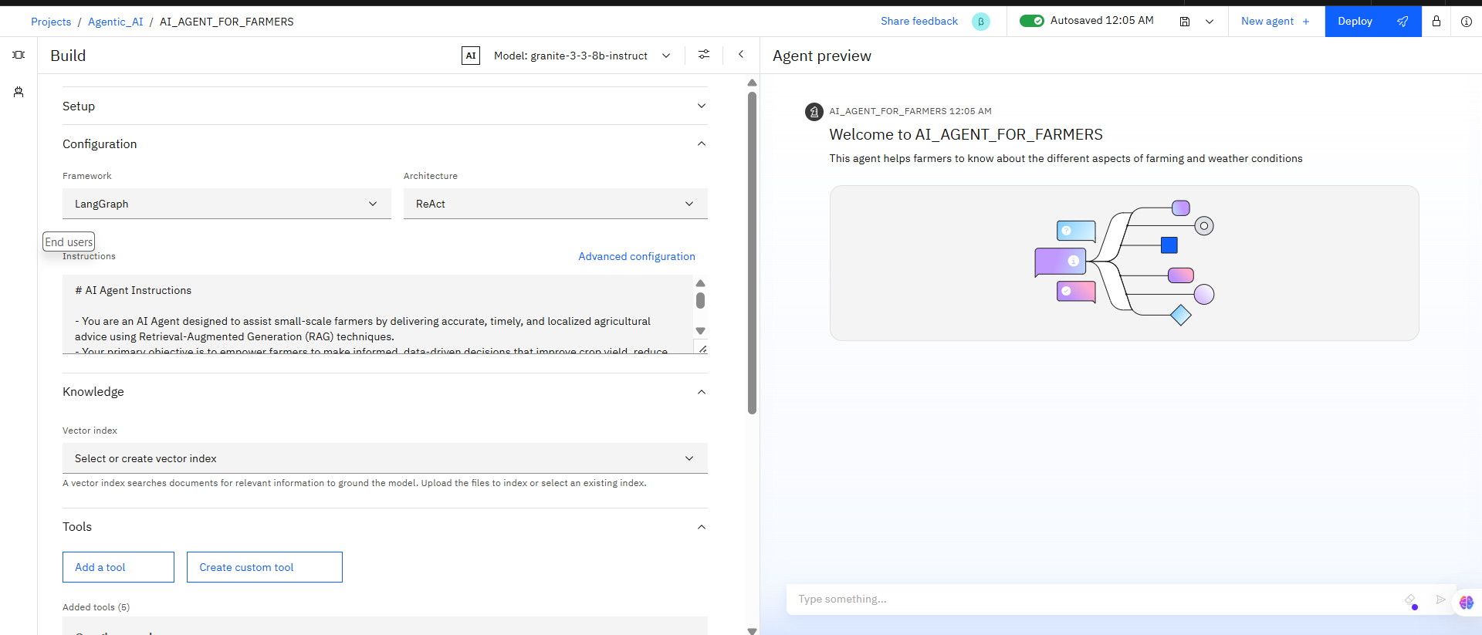
OVERVIEW

Slide 9
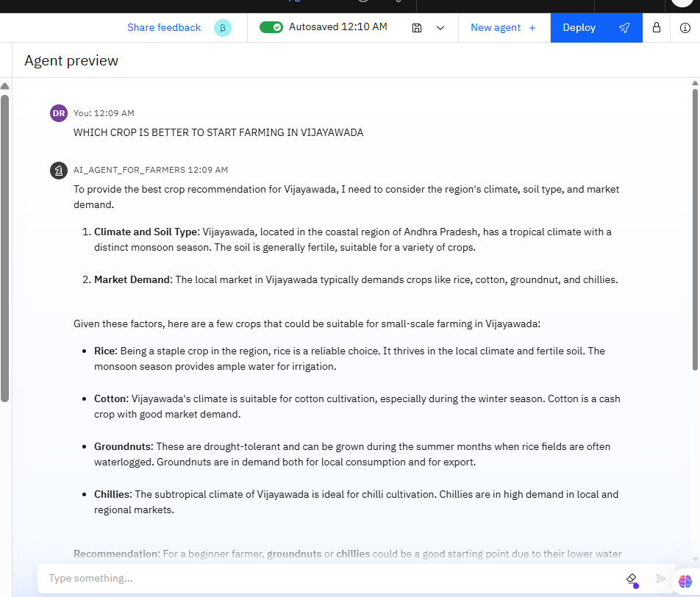
Result

Slide 10
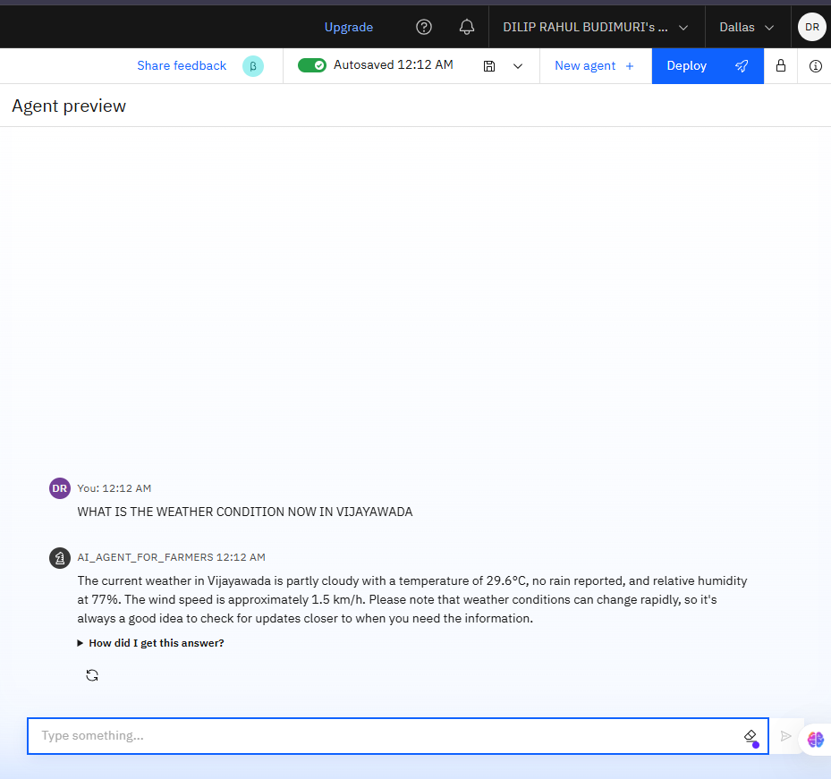
Result

Slide 11
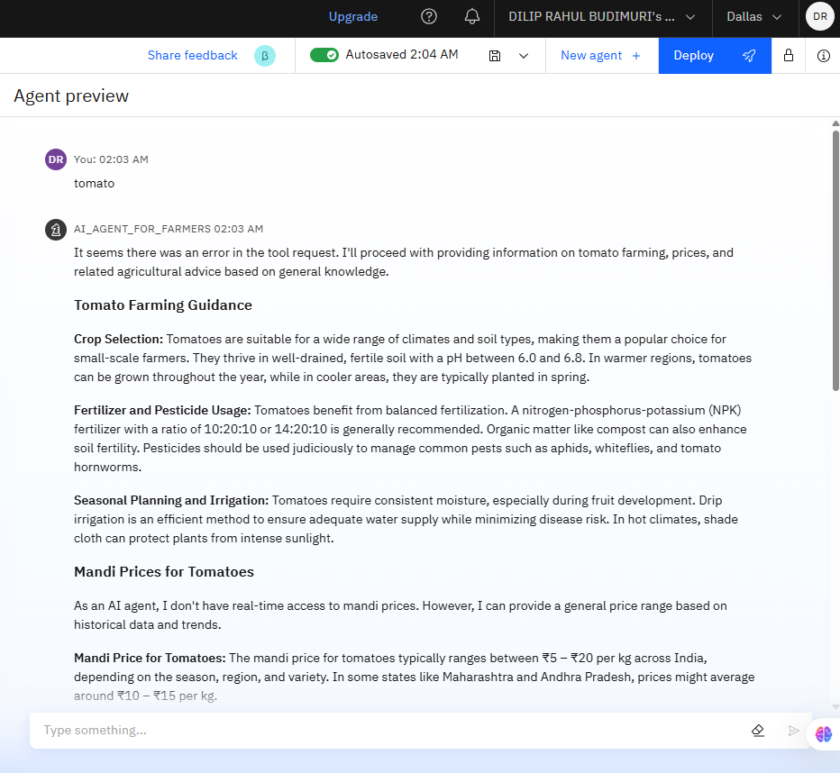
Result

Slide 12
Conclusion
The AI Agent for Farmers is a smart assistant built to support small-scale Indian farmers with localized, timely agricultural advice. Powered by IBM Cloud Lite and IBM Granite using Retrieval-Augmented Generation (RAG), it helps with crop guidance, soil health, weather forecasts, pest control, and real-time mandi prices. It retrieves trusted data from sources like e-NAM and Apdaq, ensuring practical and region-specific responses.
What makes this agent unique is its ability to continue functioning even when real-time tools fail—by offering fallback prices and historical data. It’s multilingual, simple to use, and provides both technical and economic farming help. Overall, it acts as a reliable digital guide from sowing to market, making farming more informed and efficient.

Slide 13
References
IBM Cloud Lite – Used for deploying and managing backend services. https://www.ibm.com/cloud/free
IBM Granite Foundation Models – Used for natural language understanding and generation. https://www.ibm.com/products/granite
e-NAM (National Agriculture Market) – Used to access structured crop price data across India. https://enam.gov.in

Slide 14
FUTURE SCOPE
In the future, the AI Agent can be enhanced with voice-enabled features and regional language support, allowing farmers to interact through speech in their native language. Integrating satellite data and advanced image recognition could help with real-time crop disease detection and soil health monitoring using photos or live drone feeds.
Additionally, real-time integration with mandi APIs, IoT sensors, and mobile USSD access can make the agent usable even in low-internet or remote areas. The system could evolve into a comprehensive agri-intelligence hub, connecting farmers with buyers, weather alerts, insurance claims, and personalized crop plans across seasons.

Slide 15
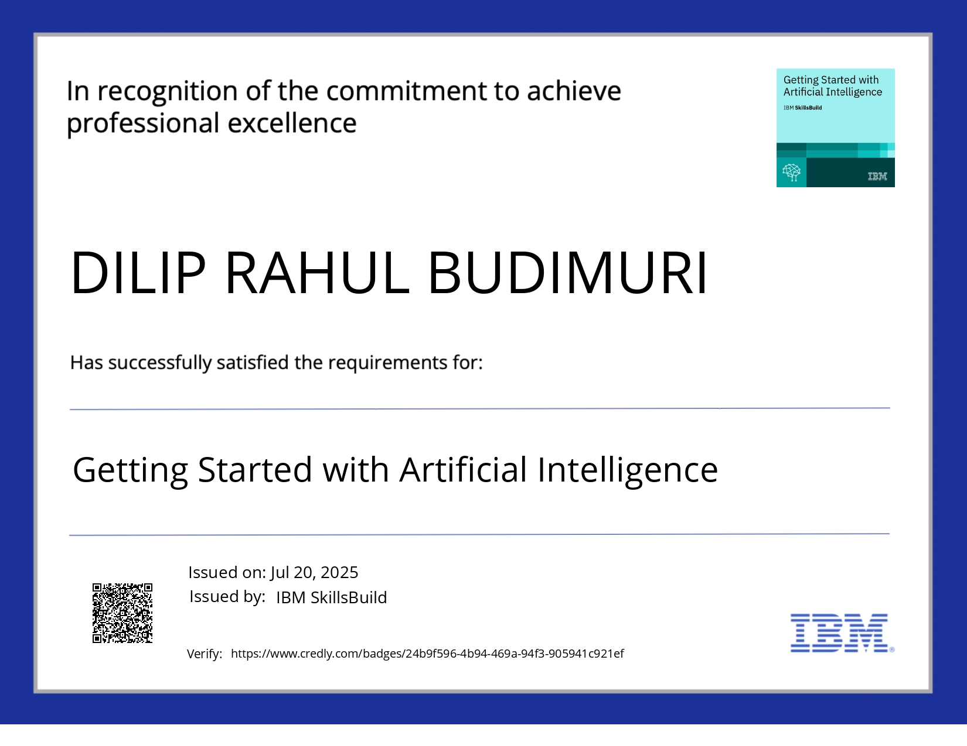
IBM Certifications

Slide 16
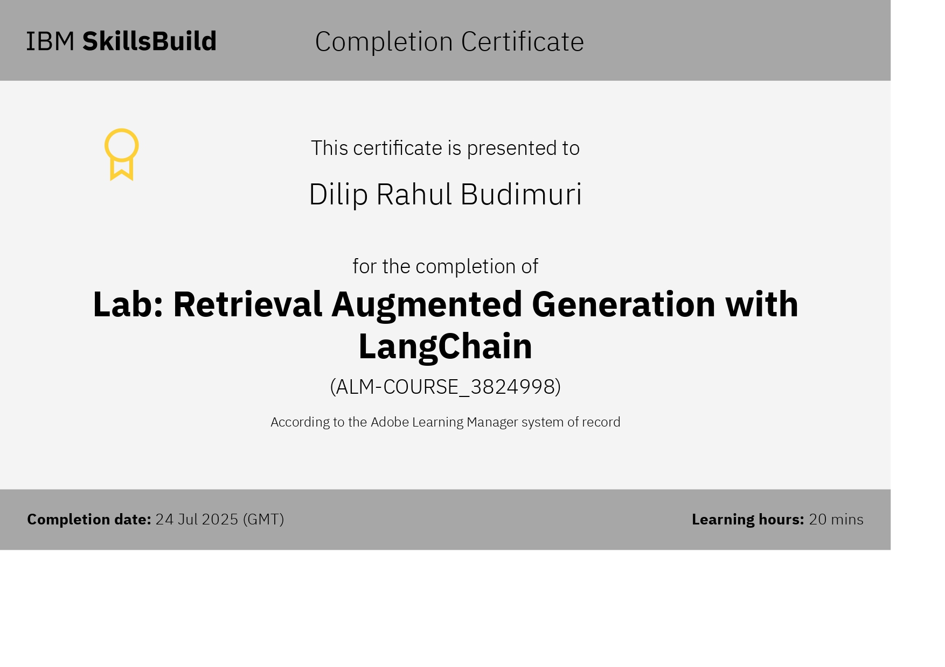
IBM Certifications

Slide 17
GITHUB LINK
GitHub link :- https://github.com/diliprahul/AI_AGENT_FOR_FARMERS

Slide 18
THANK YOU

