Slide 1
AI Agent for Smart Farming Advice
CAPSTONE PROJECT
Presented By:
Student Name- DILIP RAHUL BUDIMURI
College Name- NIMRA COLLEGE OF ENGINEERING AND TECHNOLOGY
Department- COMPUTER SCIENCE AND ENGINEERING

Slide 2
OUTLINE
Problem Statement
Technologies and Services used
Proposed Solution
WOW Factor
Algorithm & Deployment
Overview & Result
Conclusion
References
Future Scope
IBM Certifications
GitHub Link

Slide 3
Problem Statement
Small-scale farmers often lack access to timely and localized agricultural advice. Unpredictable weather, poor soil management, pest attacks, and fluctuating crop prices lead to reduced yield and income.
The challenge is to build an AI agent using Retrieval-Augmented Generation (RAG) that provides real-time, region-specific guidance on crops, weather, soil, pest control, and market prices — accessible in local languages — to empower farmers with data-driven decisions.

Slide 4
TECHNOLOGIES AND SERVICES USED
IBM Granite (language generation)
IBM Cloud Lite (retrieval and hosting)
Vector Database
Presto for querying structured Agri-data
Python, LangChain (for orchestration)
REST API & RAG workflows

Slide 5
Proposed Solution
Overview of the solution: An AI agent built on IBM Cloud Lite and Granite, using retrieval and language generation to answer farming queries. Key features:
Crop suggestions adapted to weather and region
Fertilizer advice and soil analysis
Pest management tips
Real-time market price info Emphasizes integration of trusted sources, ensuring reliable and practical advice.

Slide 6
WOW FACTORS
1. Real-Time, Contextual Advice via RAG
Retrieves latest, region-specific data for each query
Generates advice that adapts to weather, soil, & local trends
2. End-to-End IBM Cloud Solution
Fully hosted on IBM Cloud Lite, no third-party tools needed
Seamlessly connects storage, functions, and AI services in one platform
3. Decision-Making, Not Just Information
Converts raw data into clear, actionable recommendations
Provides step-by-step guidance, boosting farmer confidence

Slide 7
Algorithm & Deployment
Algorithm Selection:
Retrieval-Augmented Generation (RAG) + Embedding model (e.g., BAAI/bge)
Vector index enables semantic search of soil, weather, pest, and mandi data
IBM Granite model is used for generating the final answer
Deployment Steps:
Create cloud functions for retrieval
Hosted frontend on Gradio
Deploy agent via web UI / chatbot

Slide 8
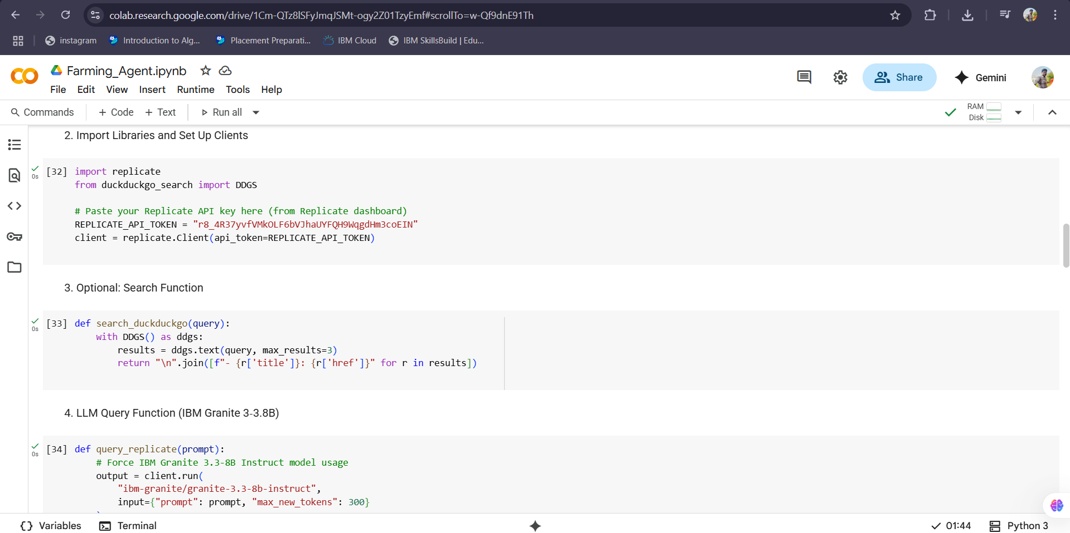
OVERVIEW

Slide 9
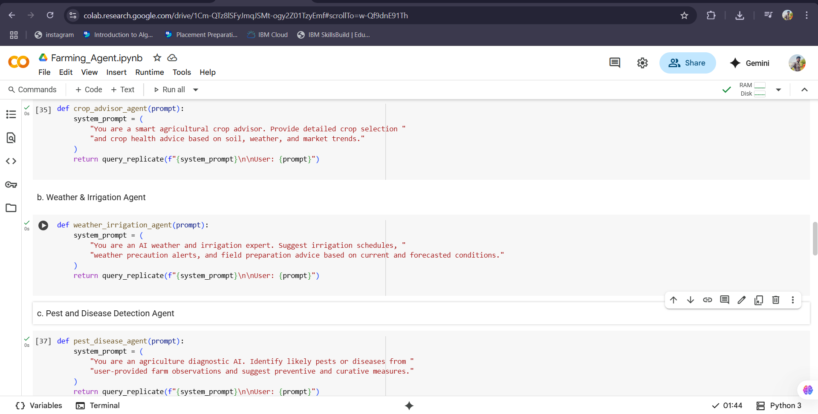
OVERVIEW

Slide 10
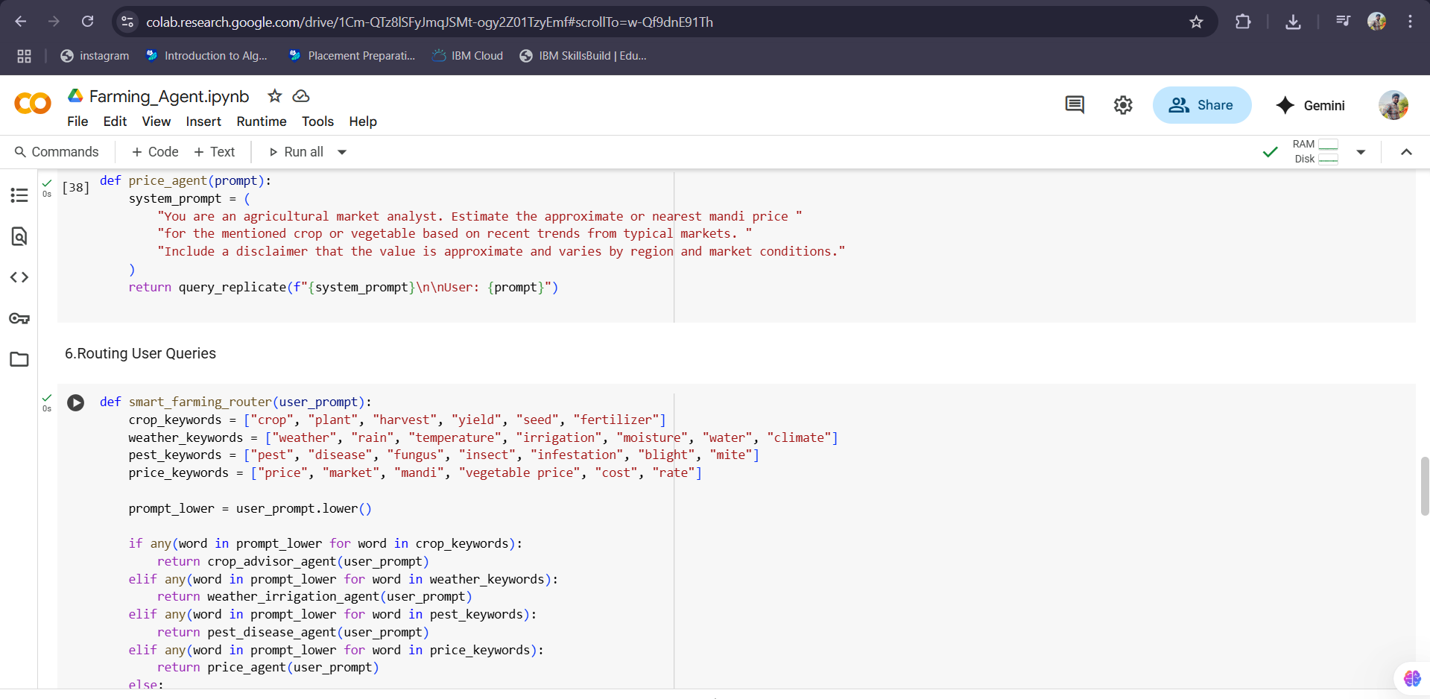
OVERVIEW

Slide 11
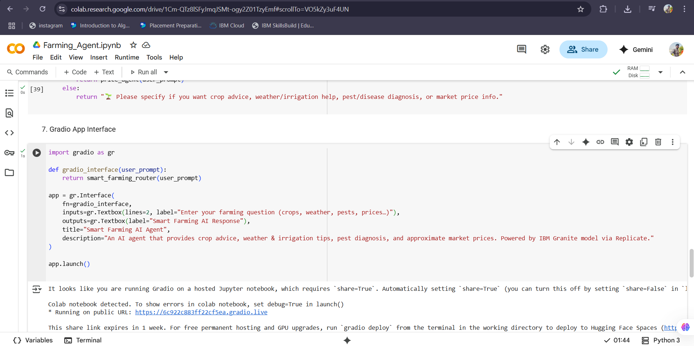
OVERVIEW

Slide 12
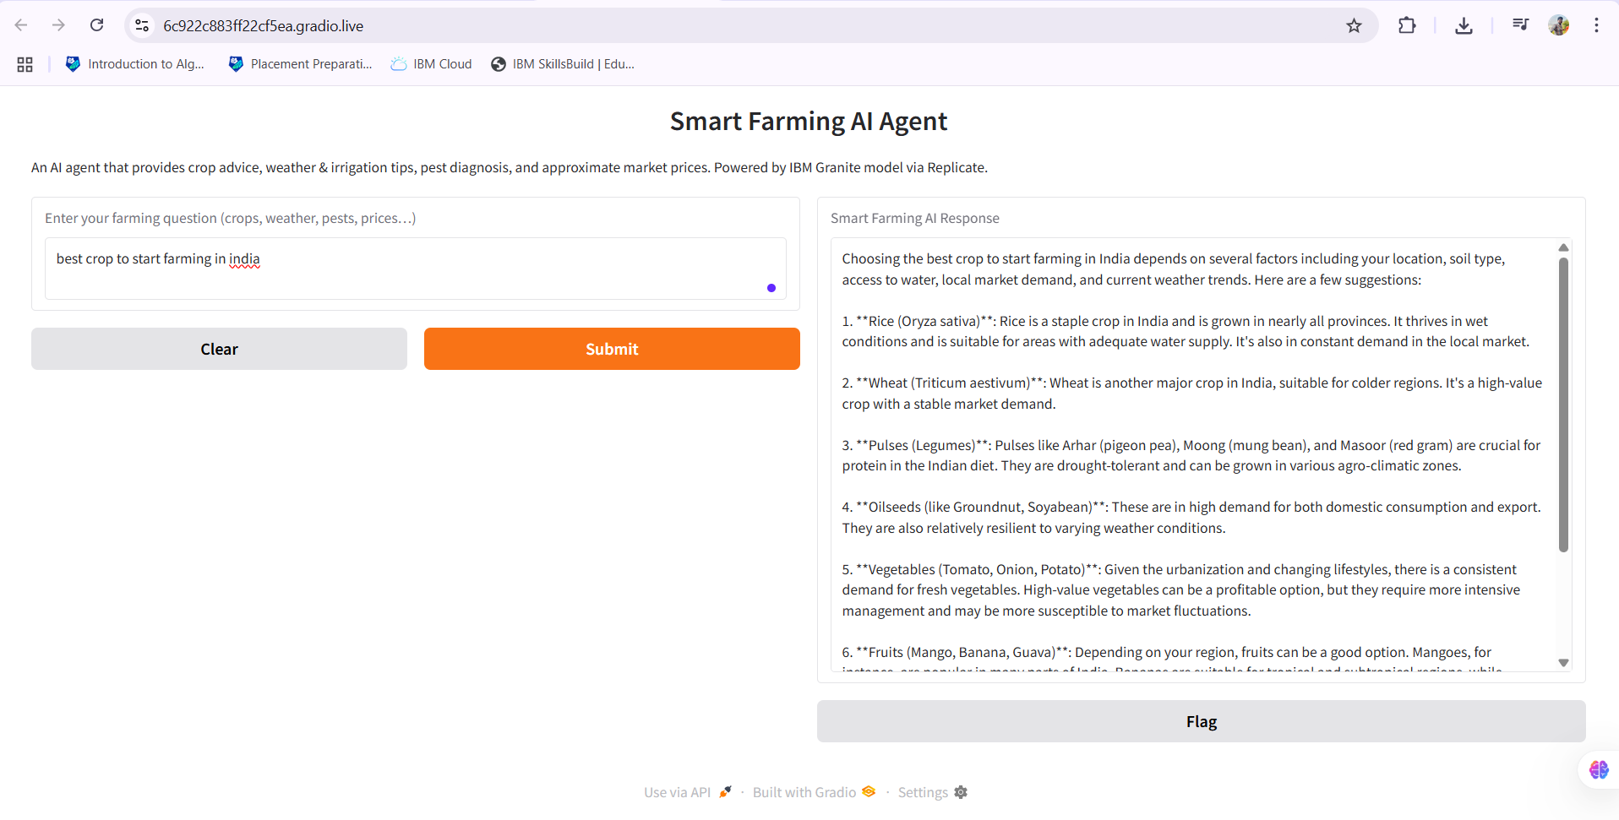
Result

Slide 13
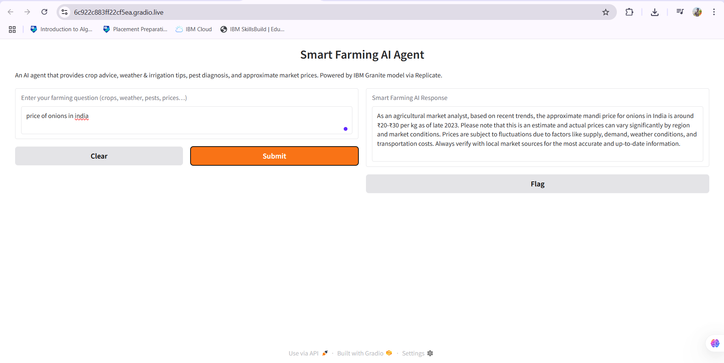
Result

Slide 14
Conclusion
The AI Agent for Farmers is a smart assistant built to support small-scale Indian farmers with localized, timely agricultural advice. Powered by IBM Cloud Lite and IBM Granite using Retrieval-Augmented Generation (RAG), it helps with crop guidance, soil health, weather forecasts, pest control, and real-time mandi prices. It retrieves trusted data from sources like ensuring practical and region-specific responses.
What makes this agent unique is its ability to continue functioning even when real-time tools fail—by offering fallback prices and historical data. It’s multilingual, simple to use, and provides both technical and economic farming help. Overall, it acts as a reliable digital guide from sowing to market, making farming more informed and efficient.

Slide 15
References
IBM Cloud Lite – Used for deploying and managing backend services. https://www.ibm.com/cloud/free
IBM Granite Foundation Models – Used for natural language understanding and generation. https://www.ibm.com/products/granite

Slide 16
FUTURE SCOPE
In the future, the AI Agent can be enhanced with voice-enabled features and regional language support, allowing farmers to interact through speech in their native language. Integrating satellite data and advanced image recognition could help with real-time crop disease detection and soil health monitoring using photos or live drone feeds.
Additionally, real-time integration with mandi APIs, IoT sensors, and mobile USSD access can make the agent usable even in low-internet or remote areas. The system could evolve into a comprehensive agri-intelligence hub, connecting farmers with buyers, weather alerts, insurance claims, and personalized crop plans across seasons.

Slide 17
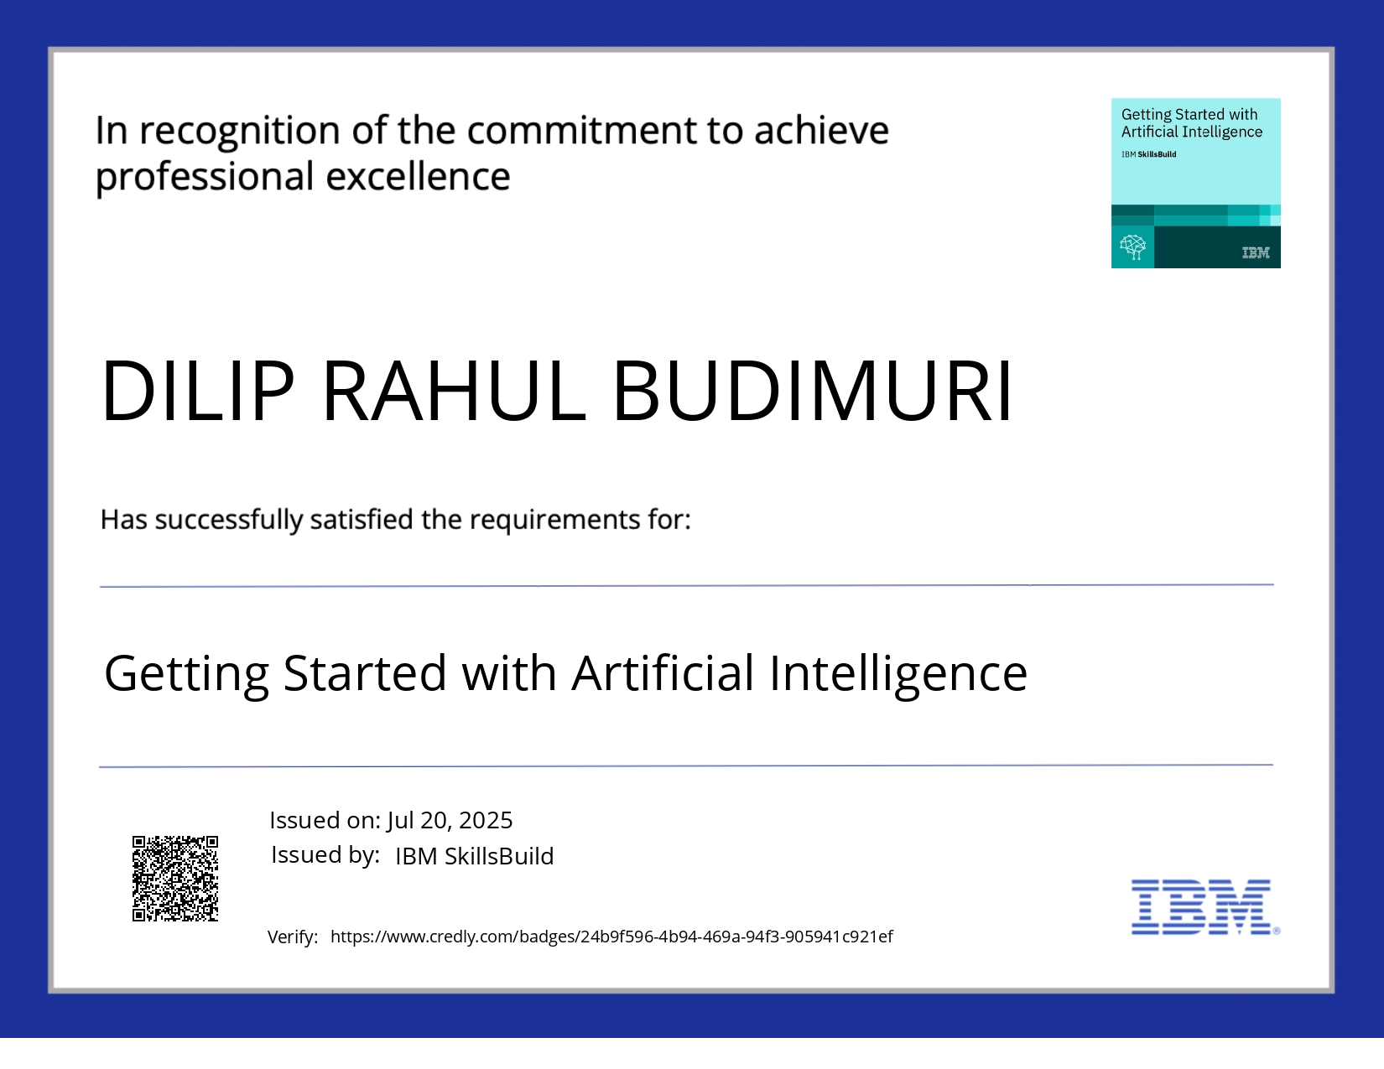
IBM Certifications

Slide 18
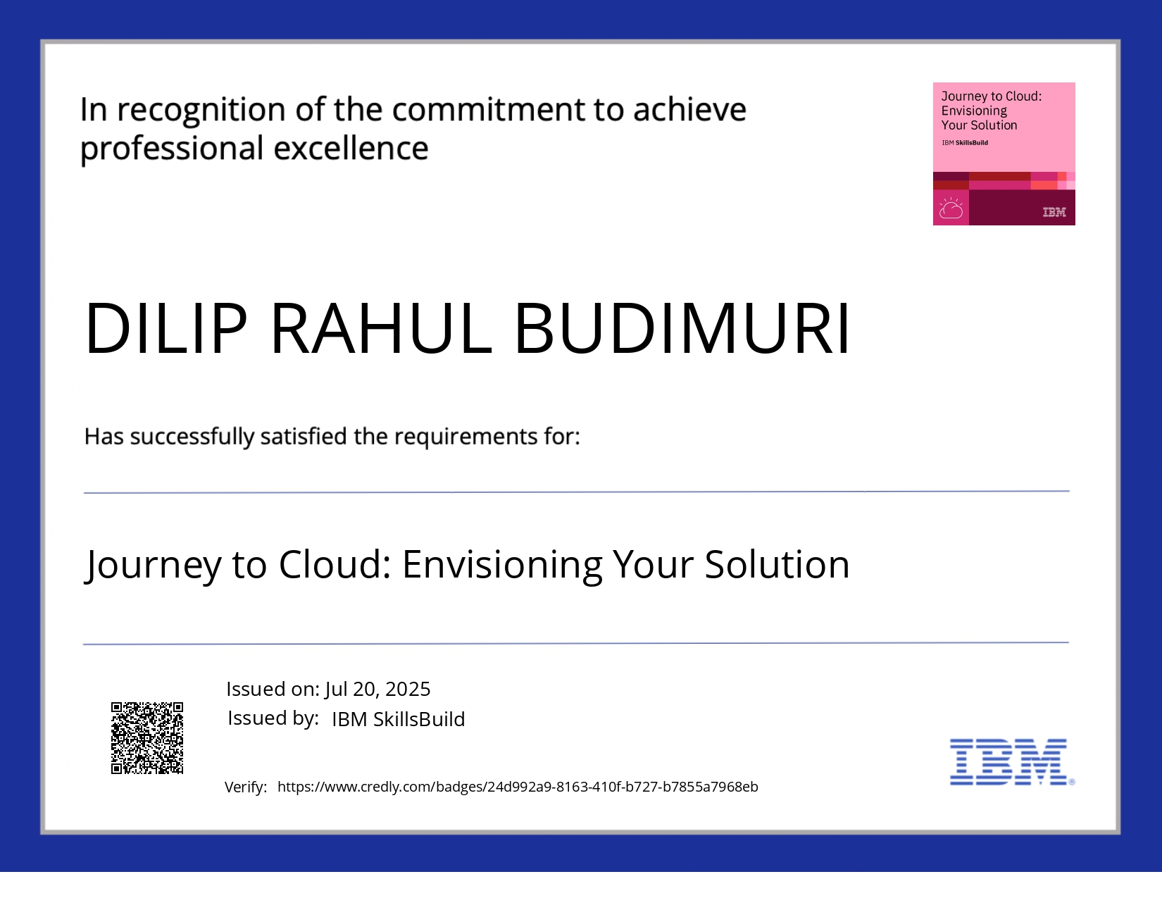
IBM Certifications

Slide 19
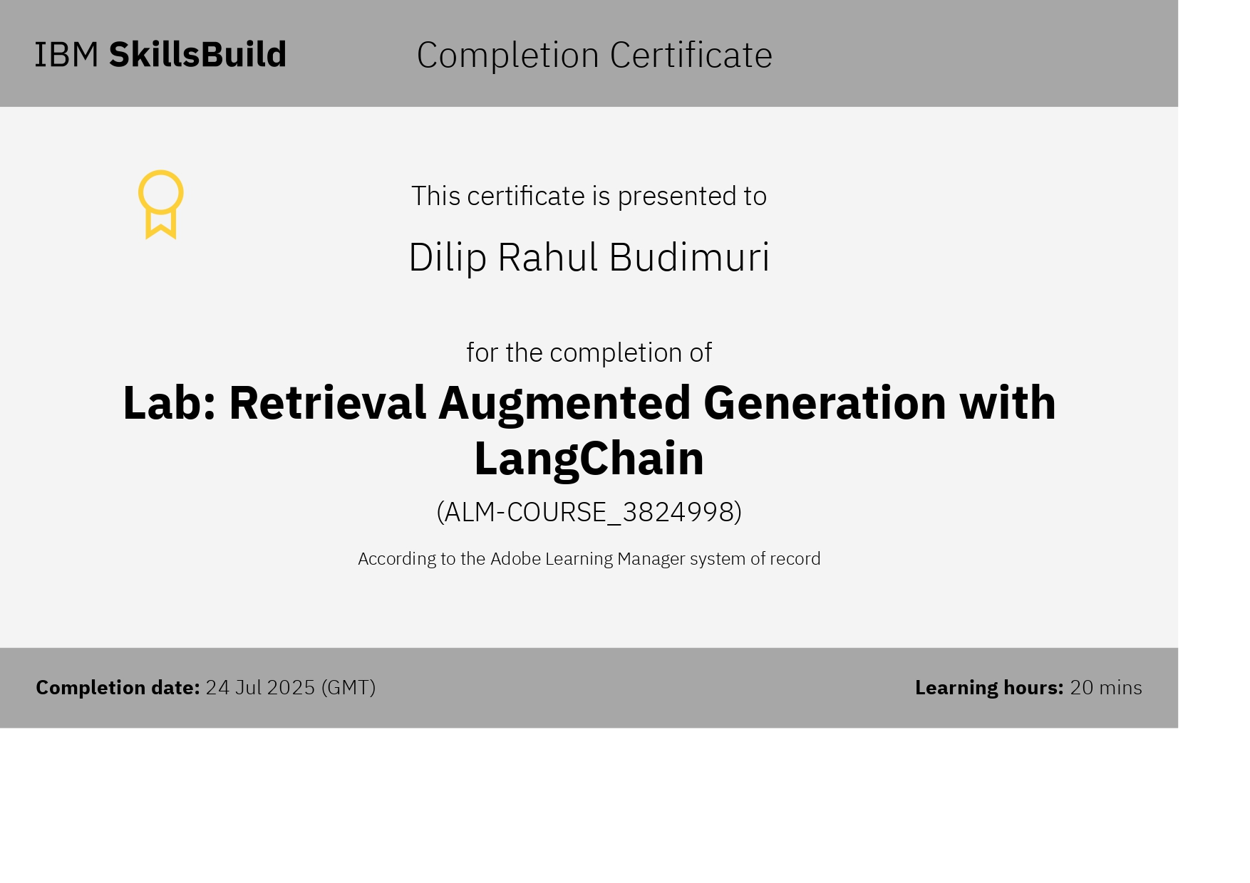
IBM Certifications

Slide 20
GITHUB LINK
GitHub link :- https://github.com/diliprahul/AI_AGENT_FOR_FARMERS

Slide 21
THANK YOU

