Slide 1

PhonePe Transaction Insights Dashboard
Data-Driven Strategy in India's Digital Payment Ecosystem
Project Domain
Developed by: Your Name (B.E. CSE Student)
Finance / Payment Systems Analytics
Mentor/Guide: (If Applicable)
Key Technologies
Python | SQL | Streamlit | Plotly | Pandas | MySQL

Slide 2


Project Overview: Decoding Digital India
The PhonePe Transaction Insights Dashboard is a comprehensive data analytics project designed to explore and visualize the vast landscape of India's digital payment ecosystem.
Interactive Dashboard
Regional Insights
Strategic Decision Support
Built using Streamlit to provide dynamic, accessible, and interactive data visualization for stakeholders.
Analyzes and displays transaction data broken down across India’s states and specific districts.
Converts raw data into actionable business intelligence for market understanding and strategic planning.

Slide 3
The Analytical Engine: Technology Stack
A robust, full-stack architecture was implemented to handle data extraction, processing, storage, and dynamic visualization.
Frontend
Streamlit
Dashboard UI & Interactivity
Backend
MySQL
Centralized Data Storage & Querying
Data Processing
Python, Pandas
Data Cleaning, Normalization & Transformation
Visualization
Plotly
Advanced Charts & Interactive Geo Maps
Mapping
GeoJSON
Enabling State-Level Choropleth Maps

Slide 4
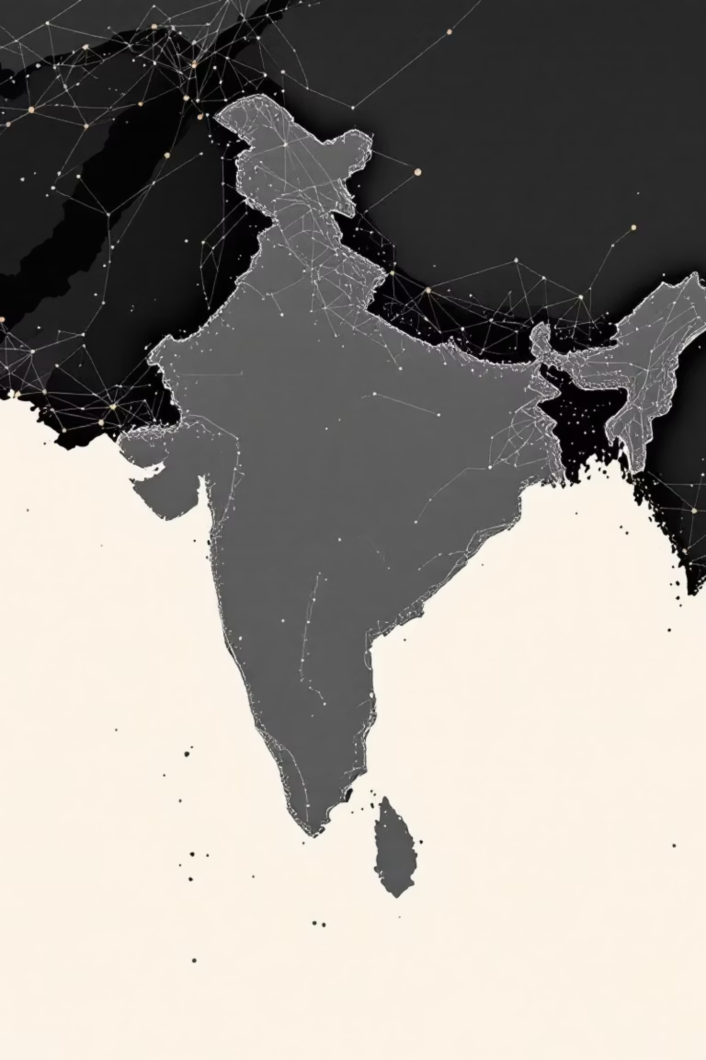
Defining the Challenge: Problem Statement
The rapid mass adoption of digital payments generates massive amounts of data. This project’s objective is to systematically analyze this data to extract valuable trends, user behavior patterns, and deep regional insights.
Transaction Patterns
Understand key trends in transaction value, volume, and distribution across all Indian states and regions.
User & Device Analysis
Analyze user engagement, registration growth, and the prevalence of different mobile device brands.
Insurance Market Potential
Study the penetration and growth of the digital insurance category on the platform.
Data-Driven Strategy
Provide objective insights that support informed business strategy and resource allocation.

Slide 5





Project Methodology: From Raw Data to Insight
Our structured approach followed a classic ETL (Extract, Transform, Load) pipeline, culminating in a dynamic visualization layer.
Data Extraction
Sourcing raw JSON data files from the official PhonePe Pulse GitHub repository.
Data Transformation
Utilizing Python (Pandas) for data cleaning, normalization, structuring, and error resolution (pysql.ipynb).
Data Loading
Loading the clean, structured data into MySQL tables using a SQLAlchemy connector for persistent storage.
Dashboard Development
Creation of the interactive Streamlit dashboard (app1.py) for visualization and analysis.
Insight Generation
Implementing five distinct business case studies within the dashboard for deep analytics and reporting.

Slide 6
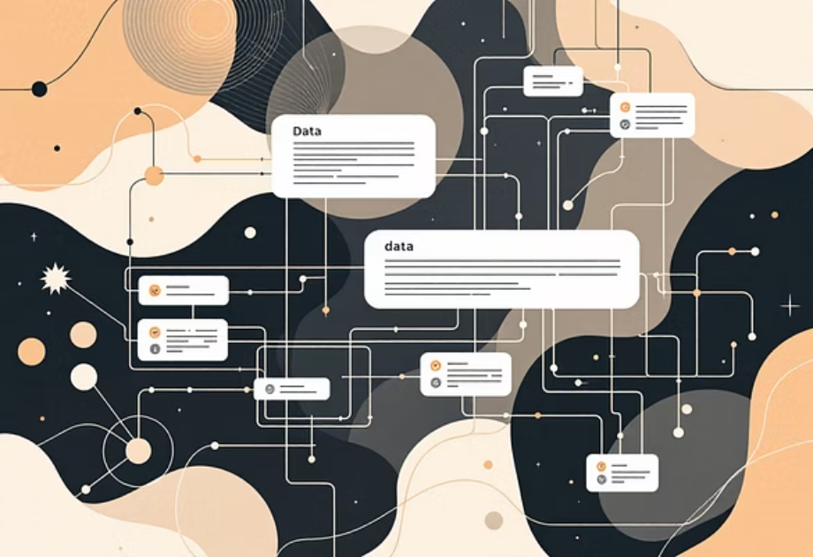
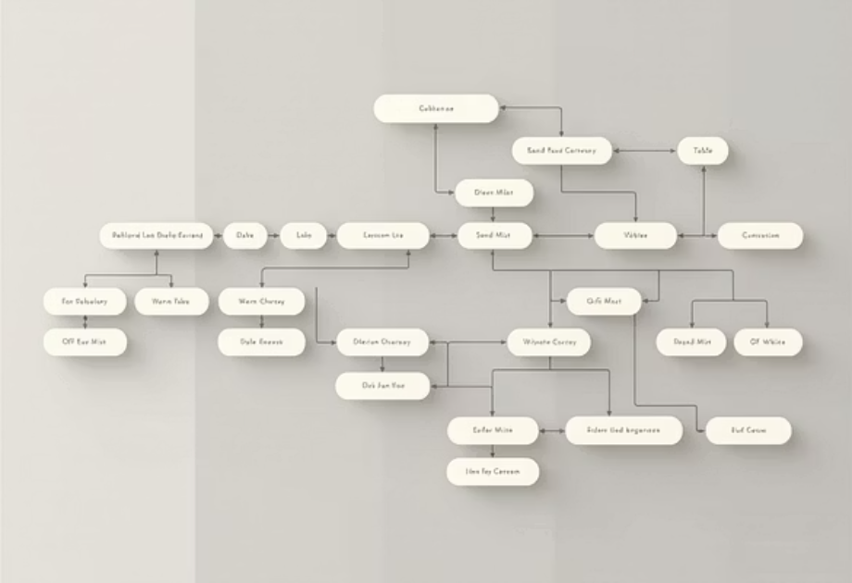
Database Design: Organizing Transactional Data
The data model comprises nine structured tables, logically categorized to support different levels of analytical depth.
Aggregated
aggregated\_transaction, aggregated\_user, aggregated\_insurance
Summary-level data aggregated quarterly and annually.
Map
map\_transaction, map\_user, map\_insurance
Detailed district and state-level geographical data for mapping.
Top
top\_transaction, top\_user, top\_insurance
Rankings for top-performing states, districts, and pincodes.

Slide 7
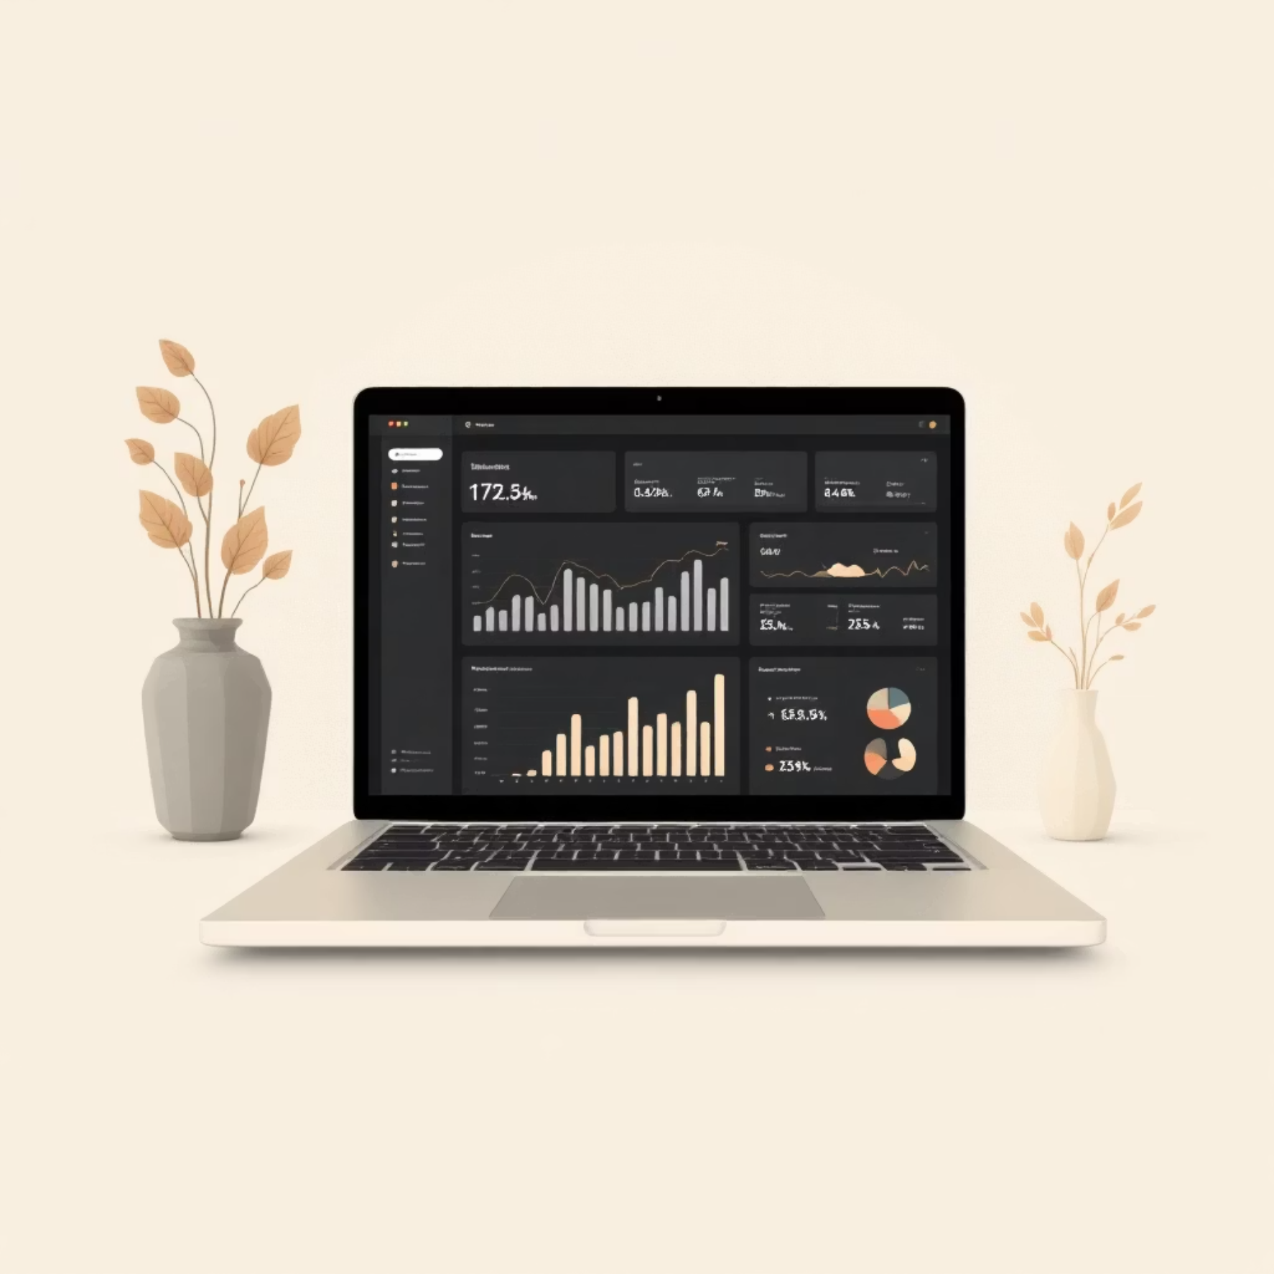
Dashboard Overview: Features and Functionality
The main dashboard serves as the user's primary interface, integrating real-time data fetching and advanced visualization capabilities for seamless analysis.
Core Visual Elements
Technical Integration
Interactive state-wise choropleth maps (heatmaps).
The dashboard is powered by the synergistic combination of Streamlit, Plotly, and direct MySQL database integration, ensuring data integrity and responsiveness.
Real-time filters for flexible analysis by year and quarter.
Prominent display of Key Performance Indicators (KPIs): Total Transactions, Users, Insurance, and Amount.
Trend Analysis: Line charts showcasing growth metrics over historical timeframes.
The core visualization script used is app1.py, which handles the front-end logic and data calls.

Slide 8
Deep Dive Analytics: Business Case Studies
Five critical business questions were addressed through dedicated analytical views within the dashboard, translating data into strategic directives.
Transaction Dynamics
Analyzing state-wise trends, payment type distribution, and identifying regional preferences.
Device Usage & Engagement
Insights into the most popular device brands and district-level application utilization rates.
Insurance Market Analysis
Tracking the growth trajectory and geographical coverage of the digital insurance sector.
Market Expansion Strategy
Pinpointing high-potential states based on low penetration and high growth metrics for future expansion.
User Growth Analysis
Detailed tracking of new user registration rates and long-term user retention metrics.

Slide 9
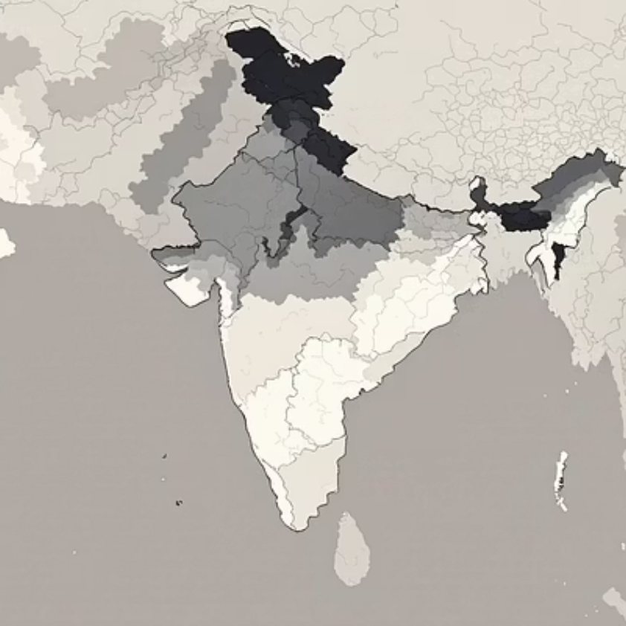
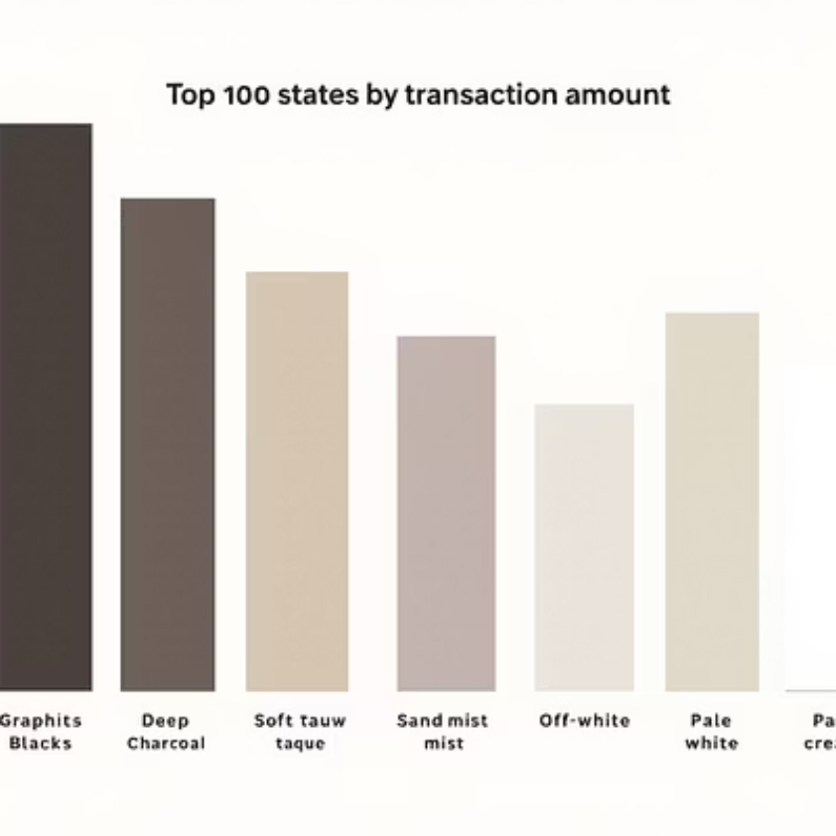
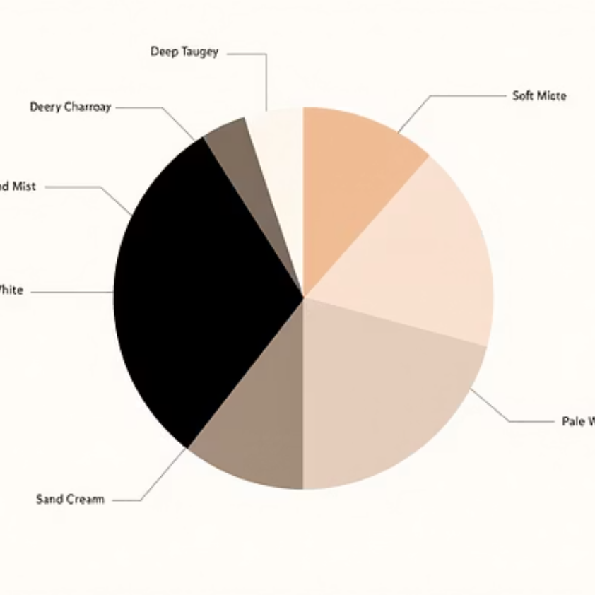
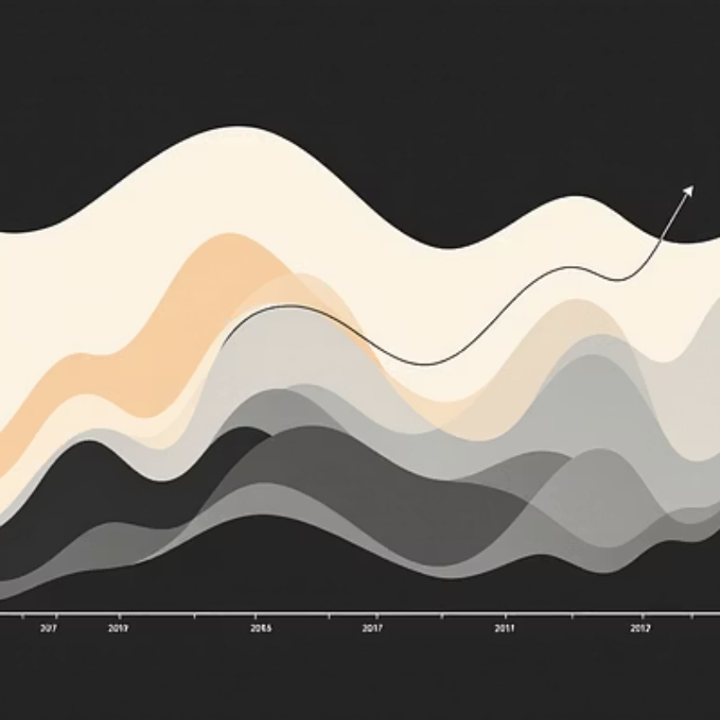
Sample Visualizations: Data Made Visible
These visualization examples demonstrate how complex transactional data is rendered into clear, compelling, and interactive charts for immediate comprehension.
Choropleth Map
Trend & Distribution
Visualizing state-wise transaction density to instantly highlight high-activity zones.
Using bar and line charts to rank performance and track quarterly growth curves.

Slide 10

Conclusion: Optimized Data Analysis Pipeline
The project established a stable and optimized pipeline from data source to final dashboard, ensuring high performance and data reliability.
ETL Workflow Overview
Extract
Load
Load JSON data from GitHub using Python scripts (phonepe_analysis.ipynb).
Insert processed data efficiently into the MySQL database (pysql.ipynb).
Transform
Visualize
Clean and standardize data formats, including consistent state name mapping (e.g., handling the 'Odisha' fix).
Real-time data fetching and analysis via the Streamlit dashboard (app1.py).
Key Optimizations
Implemented @st.cache_data to significantly speed up SQL query execution on the dashboard.
Robust error handling mechanisms for both GeoJSON files and database connection stability.
Ensuring data quality through rigorous standardization and mapping protocols.

