Slide 1

NYT Data Analysis Using HIVE
Guided By: Prof. Houwei cao | Submitted By: Harshada phadol Dilip verma

Slide 2
Abstract
In this project, we will analyze “New York Times Comments,”, a data set having information about the comments made on the articles published in New York Times.
It demonstrates the usage of HDFS, MapReduce, Google Cloud and Hive on big data.
The dataset files for comments comprise of over 2 million (Approx.) comments in total.
This data will help the purpose of understanding and analyzing the public reading interests, analyzing behaviors.

Slide 3
Goals
Analyzing most used Document Type and Type of Material.
Analyzing most Popular Author for the Articles.
Analyzing sentiments of people based on positive negative comments
Analyzing the recommendation's, reply, document type counts
Analyzing the highest reply count based on user location.

Slide 4

FLOW CHART

Slide 5

DATASET SOURCE
NEWYORK TIMES
DOWNLOAD CSV FILES
VISUALIZE
DATA CLEANING
STORE AND PROCESS DATA
QUERY

Slide 6
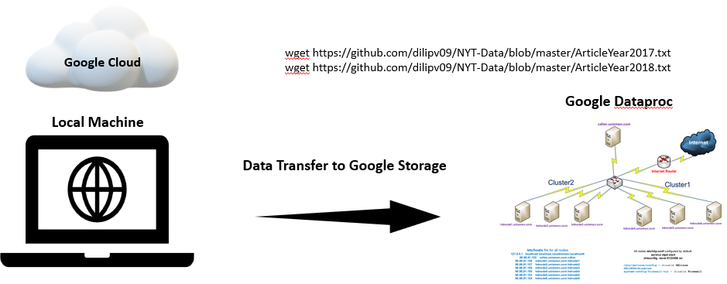
ARCHITECTURE

Slide 7
DataSet Details
Dataset & Dictionary URL: https://www.kaggle.com/
Dictionary, Comments, Articles | 2017, 2018 | Jan-May
Columns: Reply count, Comments, Month, User location, Article Word Count
Dataset Size: 1.5 GB

Slide 8
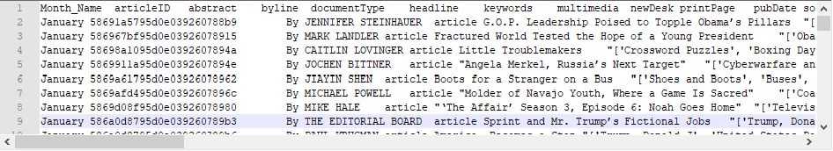
Sample Data

Slide 9
Details
Instead of storing all articles and content. We used articleId, keywords, word count of article for all the mappings and analysis.
It would be helpful to avoid unnecessary storage of data.
Columns are Month_Name, articleID, abstract, byline, documentType, headline, keywords, multimedia, newDesk, printPage, pubDate, source, typeOfMaterial, webURL, articleWordCount
Planning to use all columns for different analysis. Example – Month and Date for monthly popular articles, byline to get most popular author.

Slide 10

Data Visualization
For data visualization we are using PowerBI & Excel 3D Maps

Slide 11
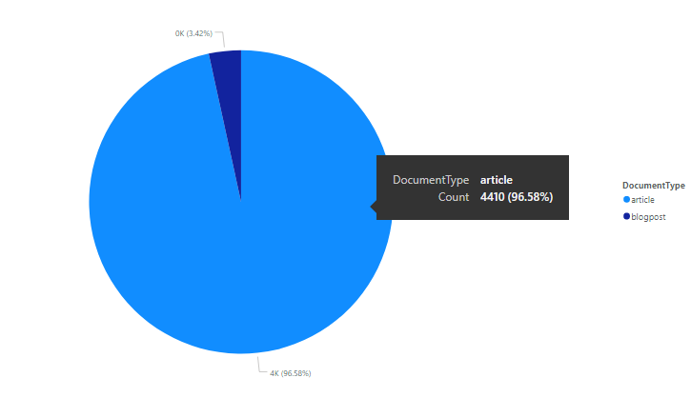
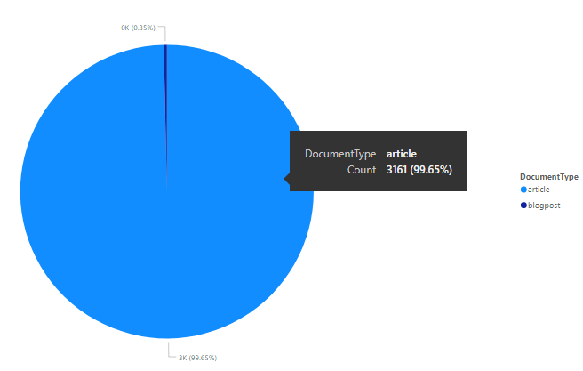
COUNT OF DOCUMENT TYPE/ TYPE OF MATERIAL
Maximum: Article: 4410, 3161
Minimum: Blogpost: 156, 11
2017
2018

Slide 12
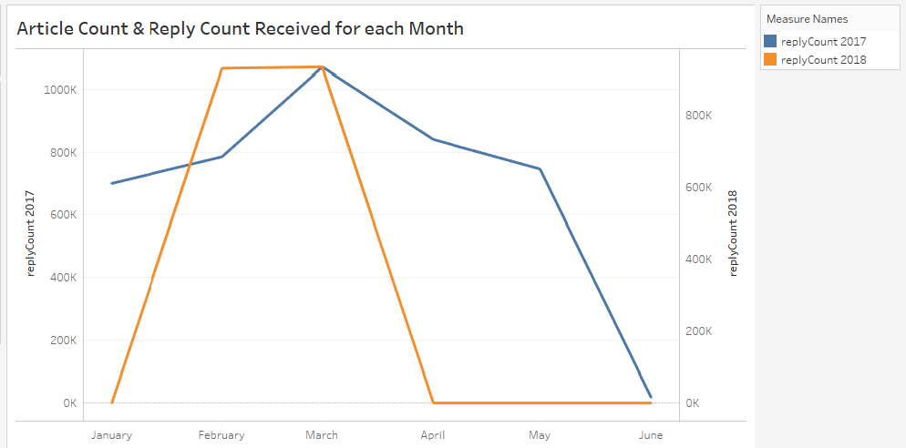
REPLY COUNT FOR ARTICLE MONTH WISE

Slide 13
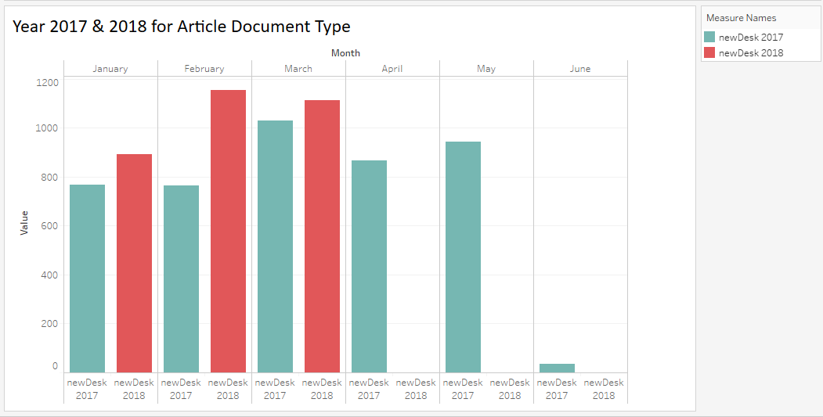
COUNT OF NEW DESK MONTH WISE

Slide 14
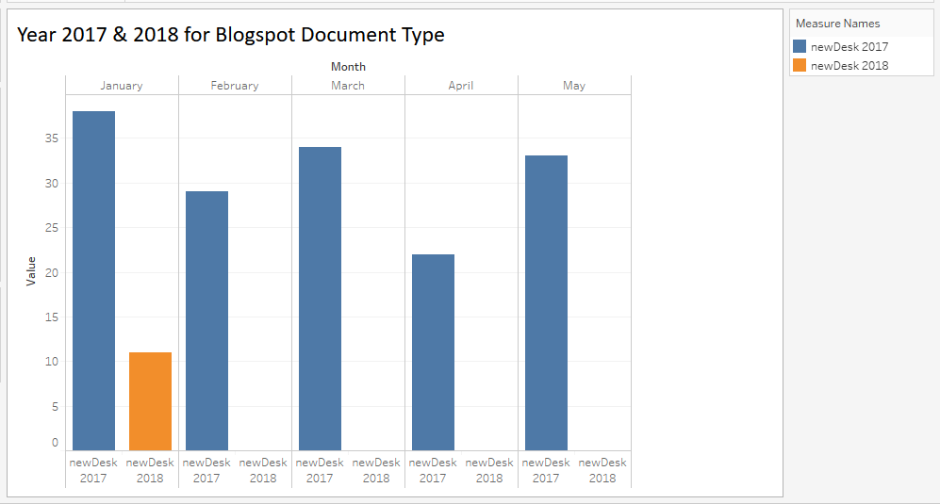
COUNT OF NEW DESK MONTH WISE

Slide 15
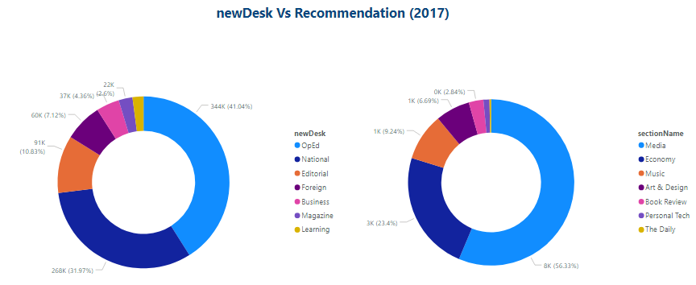
NEW DESK BASED ON RECOMMENDATIONS
Highest: OpEd

Slide 16
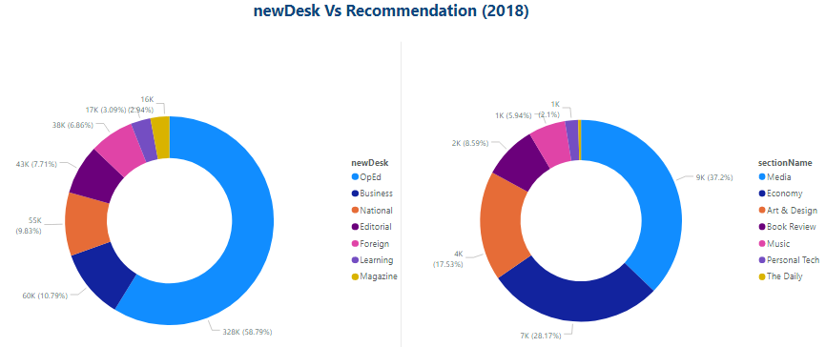
NEW DESK BASED ON RECOMMENDATIONS
Highest: OpEd

Slide 17
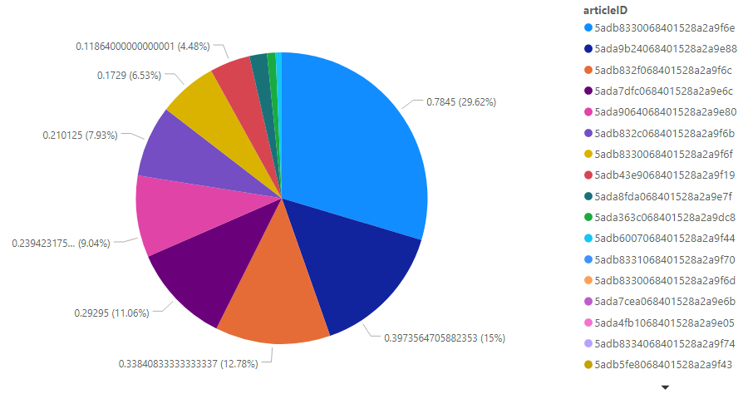
Degree of polarity for each article by comments : 2017

Slide 18
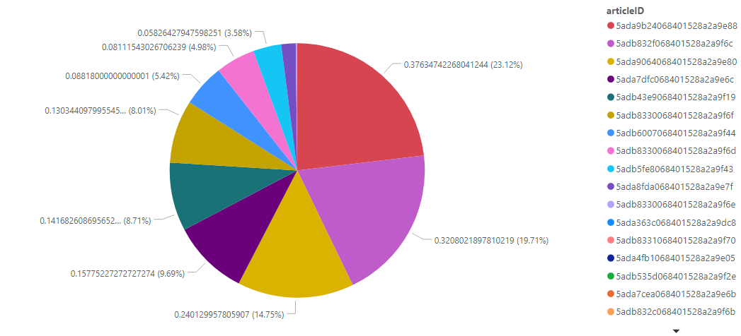
Degree of polarity for each article by comments : 2018

Slide 19
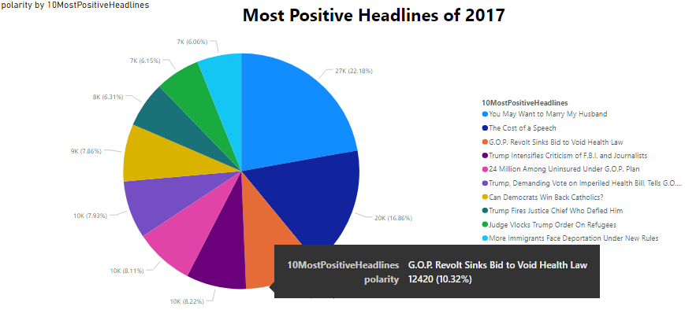
DEGREE OF POLARITY BY MOST POSITIVE HEADLINES
Polarity calculated on positive words in comments

Slide 20
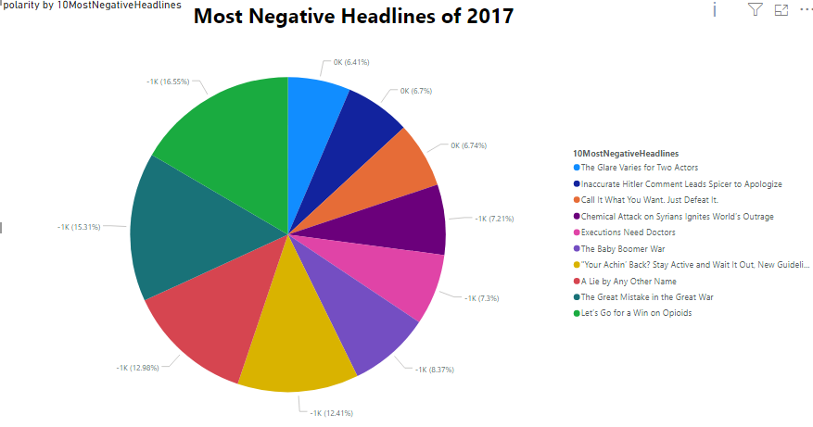
DEGREE OF POLARITY BY MOST NEGATIVE HEADLINES
Polarity calculated on negative words in comments

Slide 21
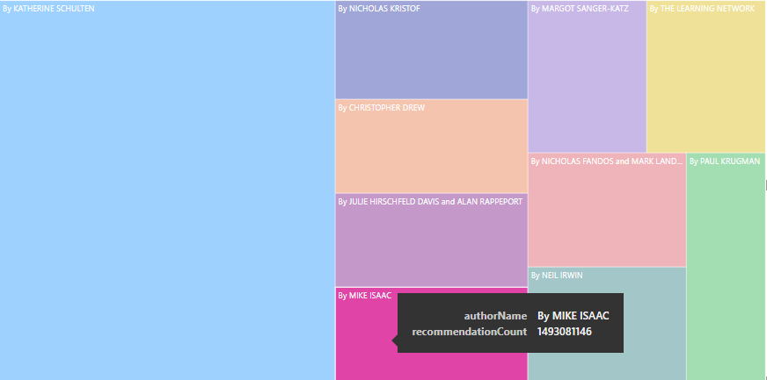
Most Popular Author (2017)

Slide 22
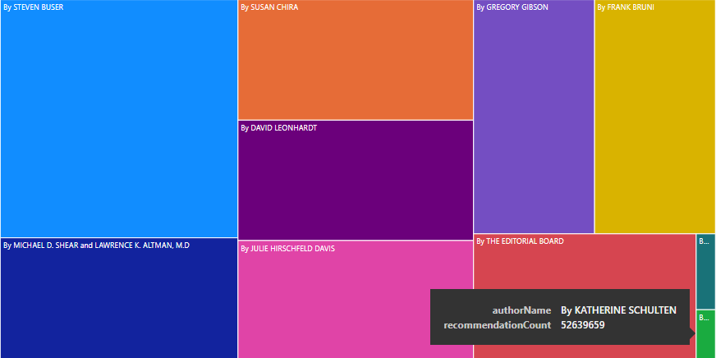
Most Popular Author (2018)

Slide 23
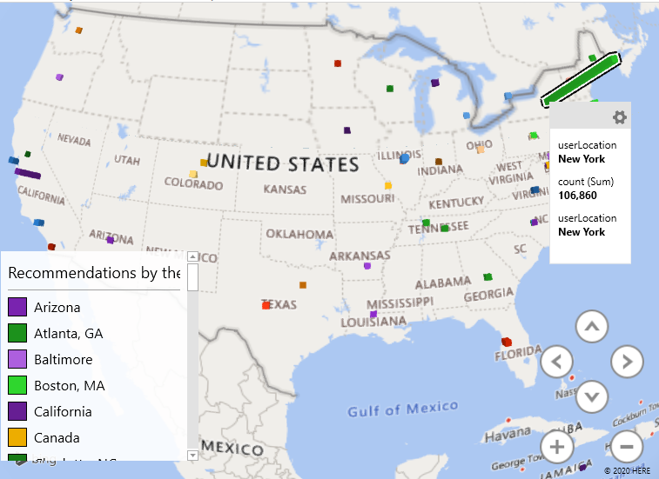
REPLY COUNT BY USER LOCATION FOR 2017

Slide 24
CONCLUSION
High article Count
In Articles Highest count is for News
Highest Active Reply Count: New York
Most popular author: (in 2017) KATHERINE SCHULTEN , STEVEN BUSER (2018)

Slide 25

Thank You

