Slide 1
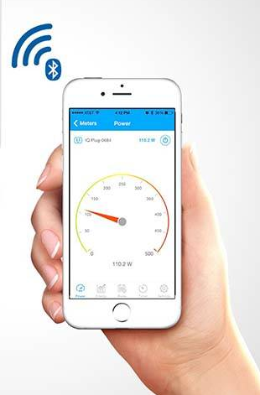



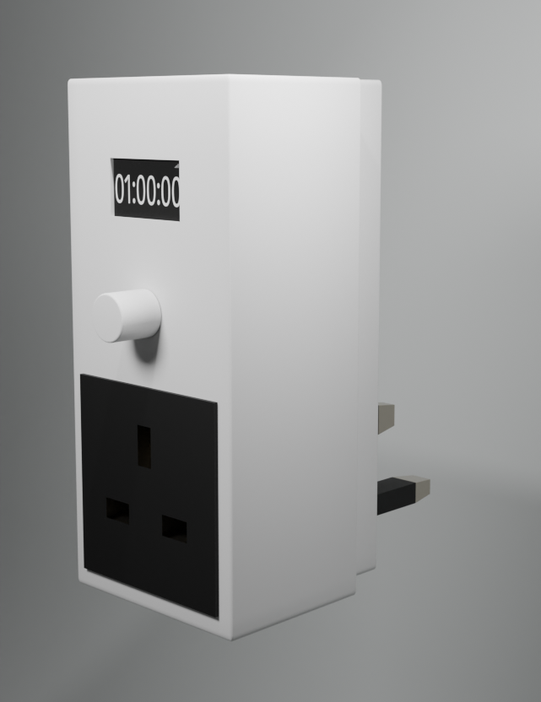
HYBRID TIMER plug: Control Power Smarter – Anywhere, Anytime
👉Most smart plugs rely entirely on internet. Many users need offline + online control with flexible options.
👉 Our solution is a hybrid smart multiplug that allows individual socket control with both app-based and manual control, supported by a built-in timer and display.
Smart Flexible Affordable
Technologies Used
ESP32
OLED Display
Google Firebase
Custom PCB
Custom Enclosure
Key Features :
✅ Dual control (Manual + App)
⏱️ Countdown timer with OLED display
📶 Control from anywhere in the world
🔌 Independent sockets control

