Slide 1
FRAUD DETECTION IN BLOCKCHAIN TRANSACTIONS
PRESENTED BY:
DILJOT KAUR(2210990285)
GARIMA(2201990313)
GOPIKA ASHUTOSH GOYAL(2210990328)
UNDER SUPERVISION OF
DR. JATIN ARORA
DEPARTMENT OF COMPUTER SCIENCE AND ENGINEERING

Slide 2
INDEX
Introduction
Problem Statement
Technologies/Methods Used
Code Snapshots
Results
Conclusion
Questions
References

Slide 3
INTRODUCTION
In today's digital era, the rise of cryptocurrencies has brought about significant advancements in financial transactions. However, along with these advancements comes the challenge of ensuring the security and integrity of transactions within blockchain ecosystems like Ethereum.
Our project focuses on leveraging machine learning techniques to address this challenge by detecting and preventing fraudulent activities within blockchain transactions. By employing algorithms such as logistic regression, random forest, and decision trees, we aim to enhance transaction security and protect against fraudulent behaviour.

Slide 4
PROBLEM STATEMENT
.
The rise of blockchain technology has brought about significant benefits, but it has also introduced new challenges, particularly in the area of fraud detection.
As transactions on the Ethereum blockchain increase, so do the opportunities for fraudulent activities.
Detecting and preventing these fraudulent transactions is crucial for maintaining the integrity and security of the blockchain ecosystem.

Slide 5
TECHNOLOGIES/METHODS USED
Python: The project was developed using Python, a versatile programming language known for its readability and extensive libraries.
Libraries:
NumPy: Utilized for efficient numerical operations and array manipulation.
Matplotlib: Employed for creating visualisations and graphs to analyse data.
Seaborn: Used to enhance the aesthetics of visualisations and statistical data exploration.
Pandas: Utilized for data manipulation and analysis, offering powerful data structures and functions.
Scikit-learn (sklearn): Utilized for implementing machine learning algorithms, model evaluation, and preprocessing.
Imbalanced-learn (imblearn): Used for handling imbalanced datasets, a common challenge in fraud detection.
Machine Learning Models:
Logistic Regression: Applied for binary classification tasks, effectively identifying patterns in categorical data.
Decision Tree: Employed for both classification and regression tasks, partitioning data into subsets based on feature values.
Random Forest: Utilized as an ensemble learning method, constructing multiple decision trees to improve accuracy and robustness.

Slide 6
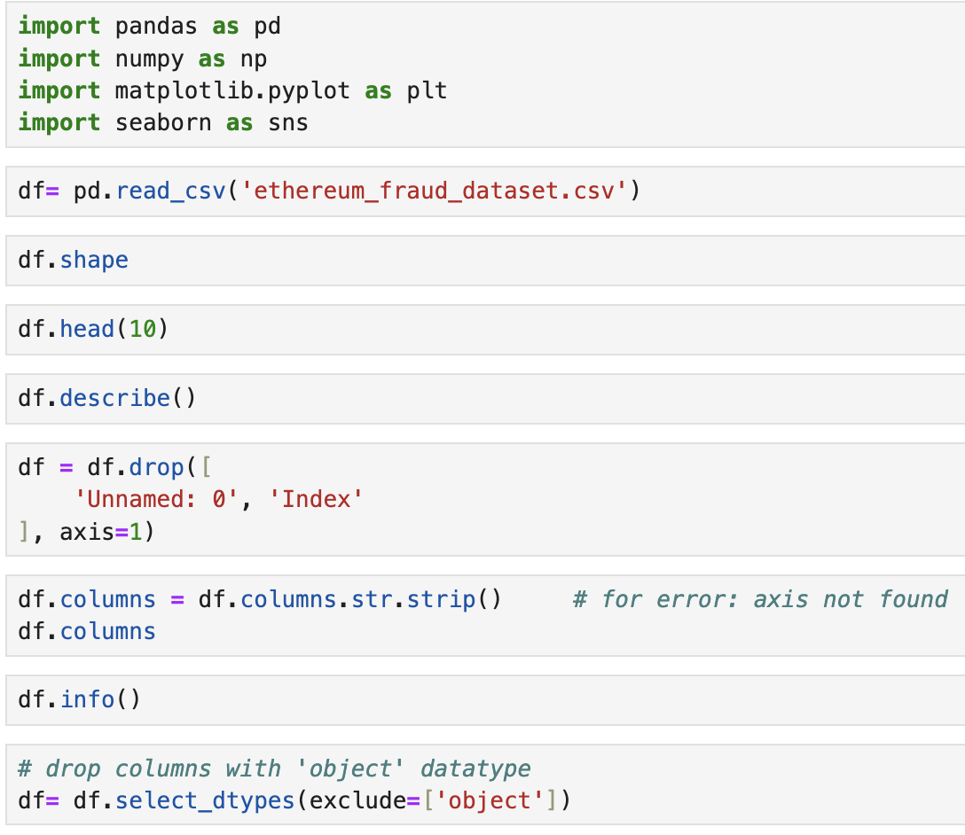
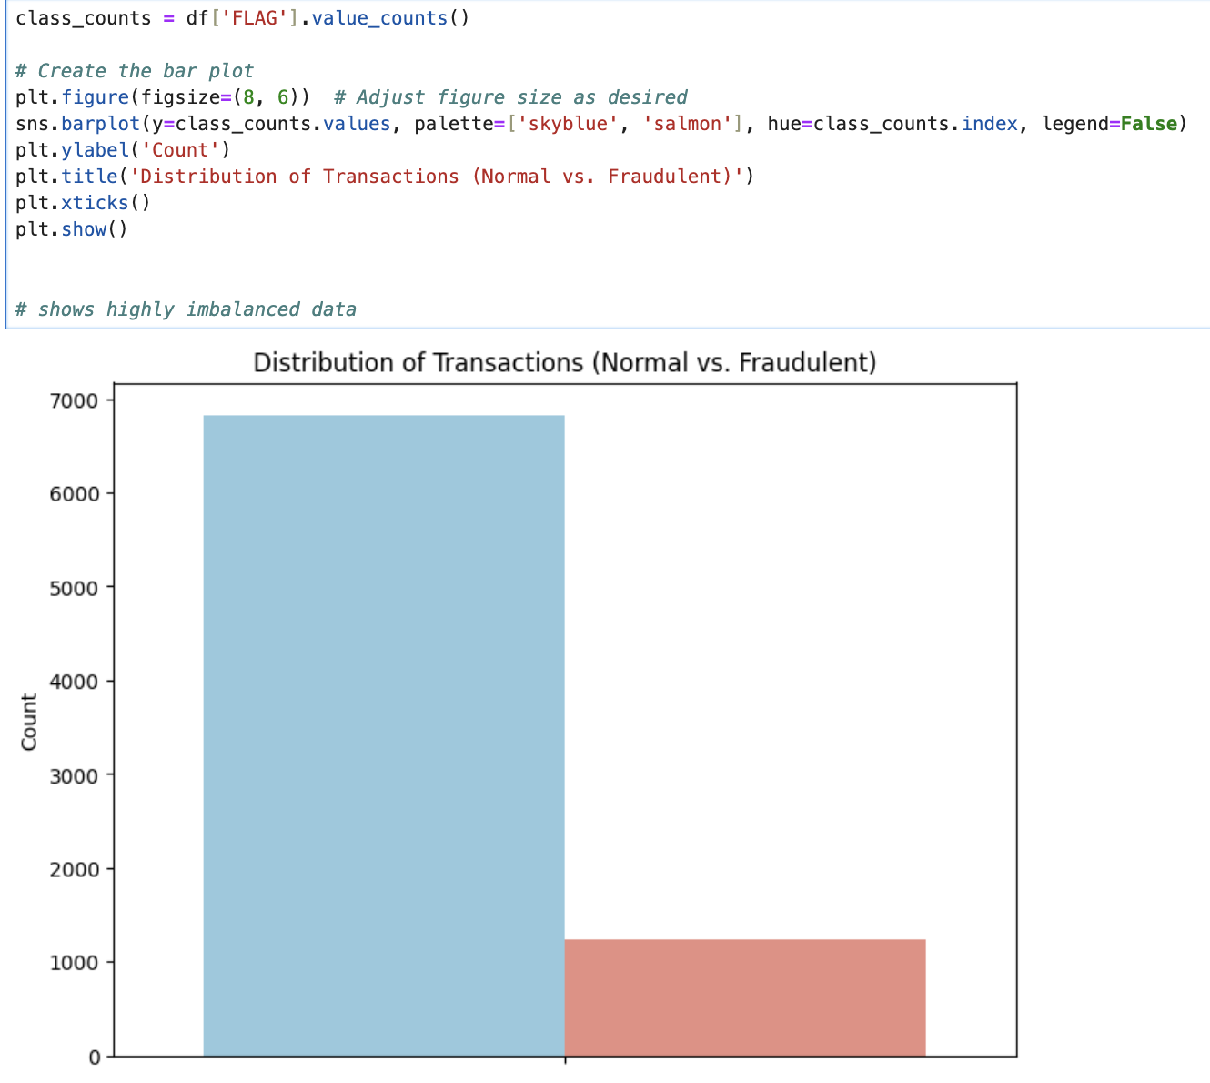
CODE SNAPSHOTS
Fig 1. Basic data preprocessing
Fig 2. Barplot showing class imbalance

Slide 7
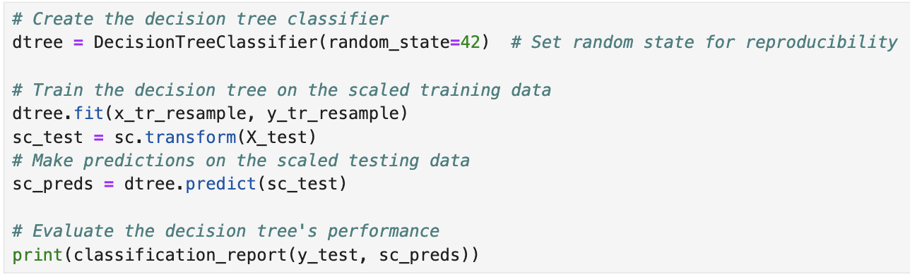
Code snapshot of Decision Tree Classifier on oversampled train data.
Fig 3.

Slide 8
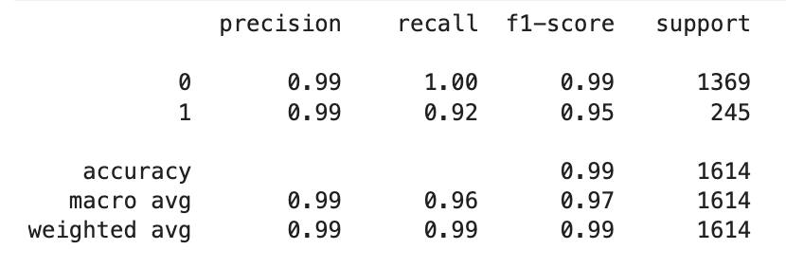
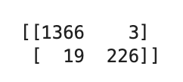
RESULT
Each model—logistic regression, random forest, and decision tree—demonstrated strong performance in detecting fraudulent transactions within the Ethereum blockchain. Key performance metrics such as accuracy, precision, recall, and F1-score were evaluated to assess the effectiveness of each model.
After all the preprocessing, feature selection, data balancing (using class weights) and complete analysis of data, we analysed that the random forest model , was the best out of all the three that we applied.
Fig 4.

Slide 9
CONCLUSION
To conclude, our project emphasises the significance of using machine learning to tackle fraud in blockchain transactions.
We've shown how techniques like logistic regression, random forest, and decision trees can help identify and stop fraudulent activities in the Ethereum blockchain.
By analyzing transaction data with these methods, we've demonstrated that it's possible to detect and prevent fraudulent behaviour, thus enhancing the security and trustworthiness of blockchain transactions.

Slide 10

QUESTIONS

Slide 11
REFERENCES
https://www.kaggle.com/datasets/vagifa/ethereum-frauddetection-dataset
https://www.mdpi.com/1424-8220/22/19/7162
https://www.researchgate.net/publication/378145255_Advanced_Fraud_Detection_in_Blockchain_Transactions_An_Ensemble_Learning_and_Explainable_AI_Approach
https://medium.com/@nusfintech.ml/crypto-fraud-detection-3d99b3298815

Slide 12

THANK YOU!

