Slide 1
MOVIE MENTOR
PRESENTED BY:
GEETIKA MEHTA(2201990325)
GOPIKA ASHUTOSH GOYAL(2210990328)
DILJOT KAUR(2210990285)
UNDER SUPERVISION OF
MR.VIKAS PATEL
MS. PARUL
DEPARTMENT OF COMPUTER SCIENCE AND ENGINEERING

Slide 2
INTRODUCTION
Our Movie Database Website Project aims to create a user-friendly online platform where movie lovers can search, browse, and discover a vast collection of films from various genres, eras, and cultures.
By leveraging the power of technology, we aspire to revolutionize the way people interact with movies and enhance their cinematic experience.

Slide 3
PROBLEM STATEMENT
.
Our research has identified several key pain points experienced by movie enthusiasts, including difficulty finding specific films and limited access to comprehensive movie information.
By addressing these challenges head-on, our website aims to provide a seamless and enjoyable movie-watching experience for users of all backgrounds.

Slide 4
MOTIVATION BEHIND WORK
The main reason for creating a movie recommendation system is to make users happier, keep them interested, and help the business by suggesting movies that they're likely to enjoy.
It's like having a friend who knows your tastes and suggests great movies just for you!

Slide 5
TOOLS AND TECHNOLOGIES
HTML:HYPERTEXT MARKUP LANGUAGE(BASE)
CSS:CASCADING STYLING SHEETS(STYLING)
JAVASCRIPT: FUNCTIONALITY
OMDB API : FOR API ‘S.
PINTEREST: FOR IMAGES OR MOVIES.
JSON: FOR CREATING JAVASCRIPT OBJECTS.(Javascript Object Notation).
ALPHA CODERS: FOR IMAGES.

Slide 6
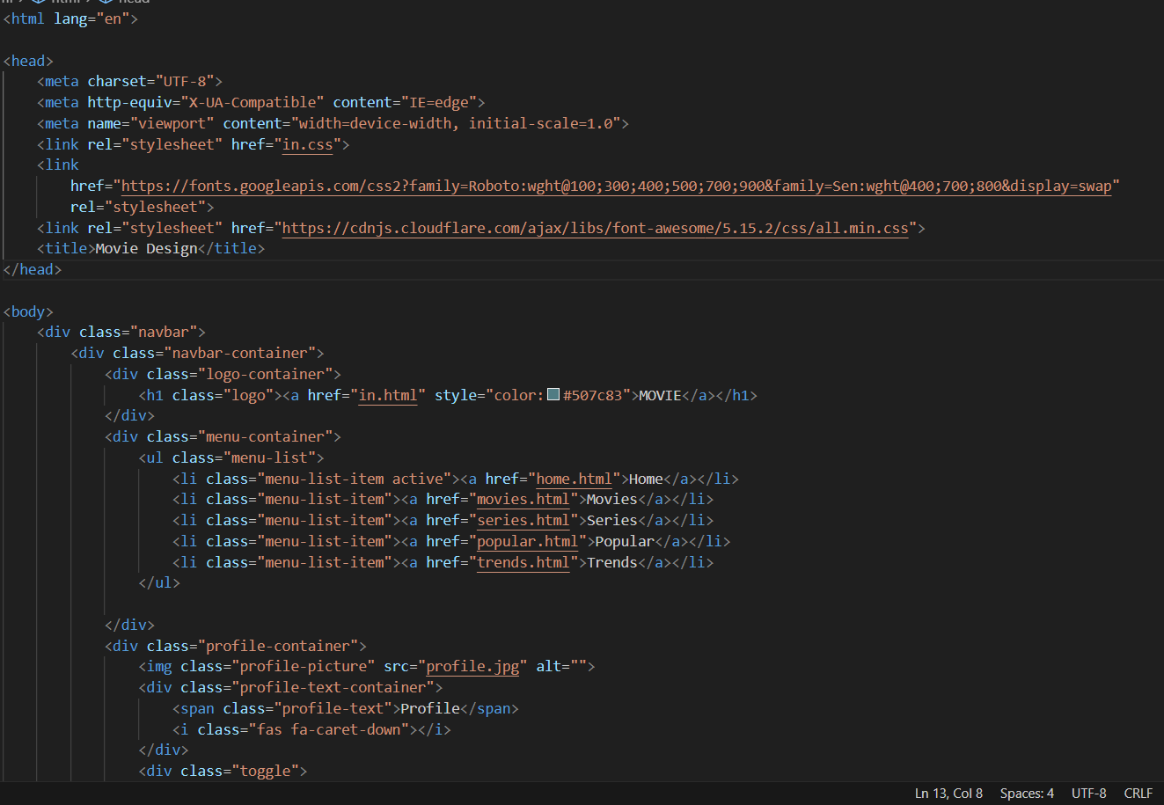
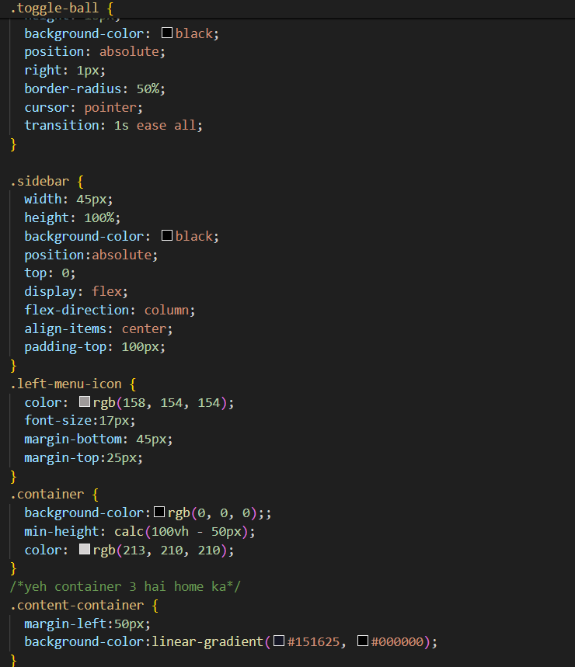
CODE SNAPSHOTS

Slide 7
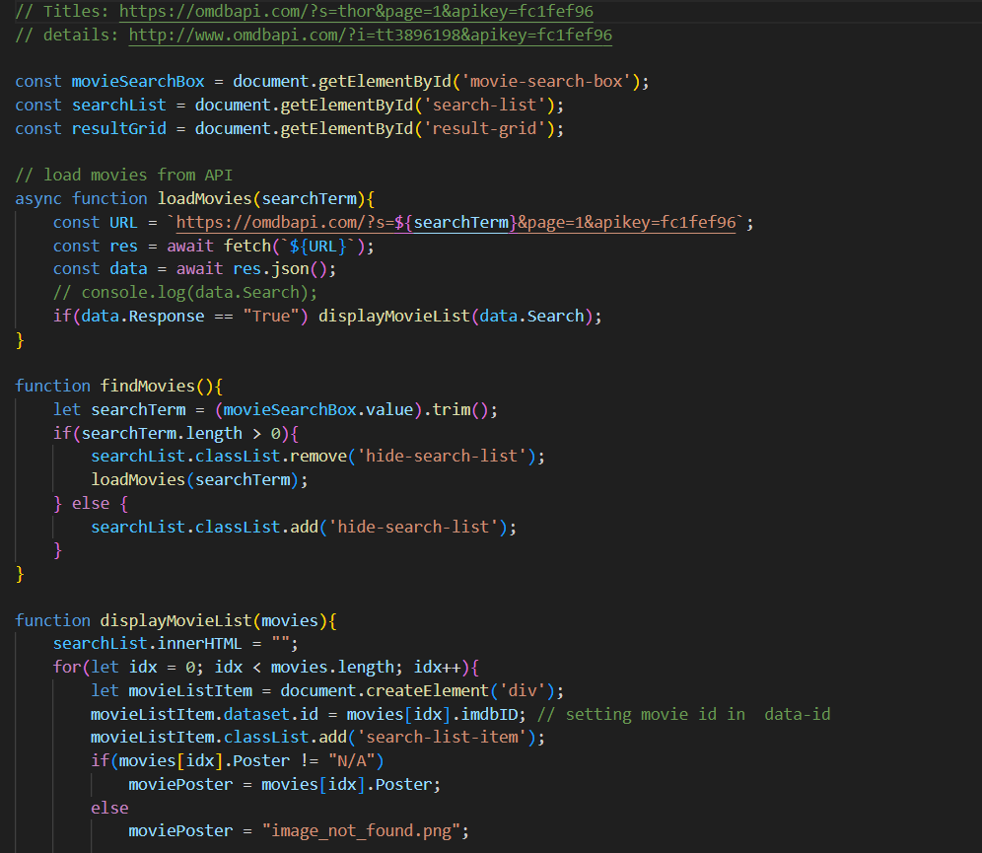
CONTINUED.

Slide 8
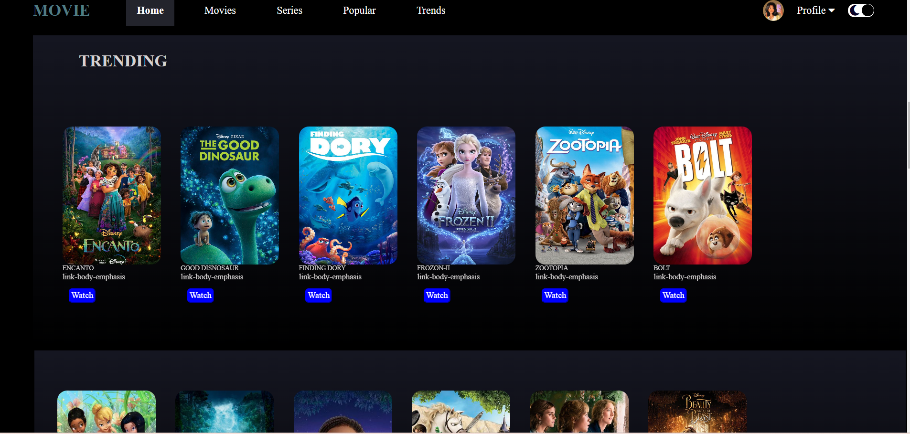
RESULT

Slide 9
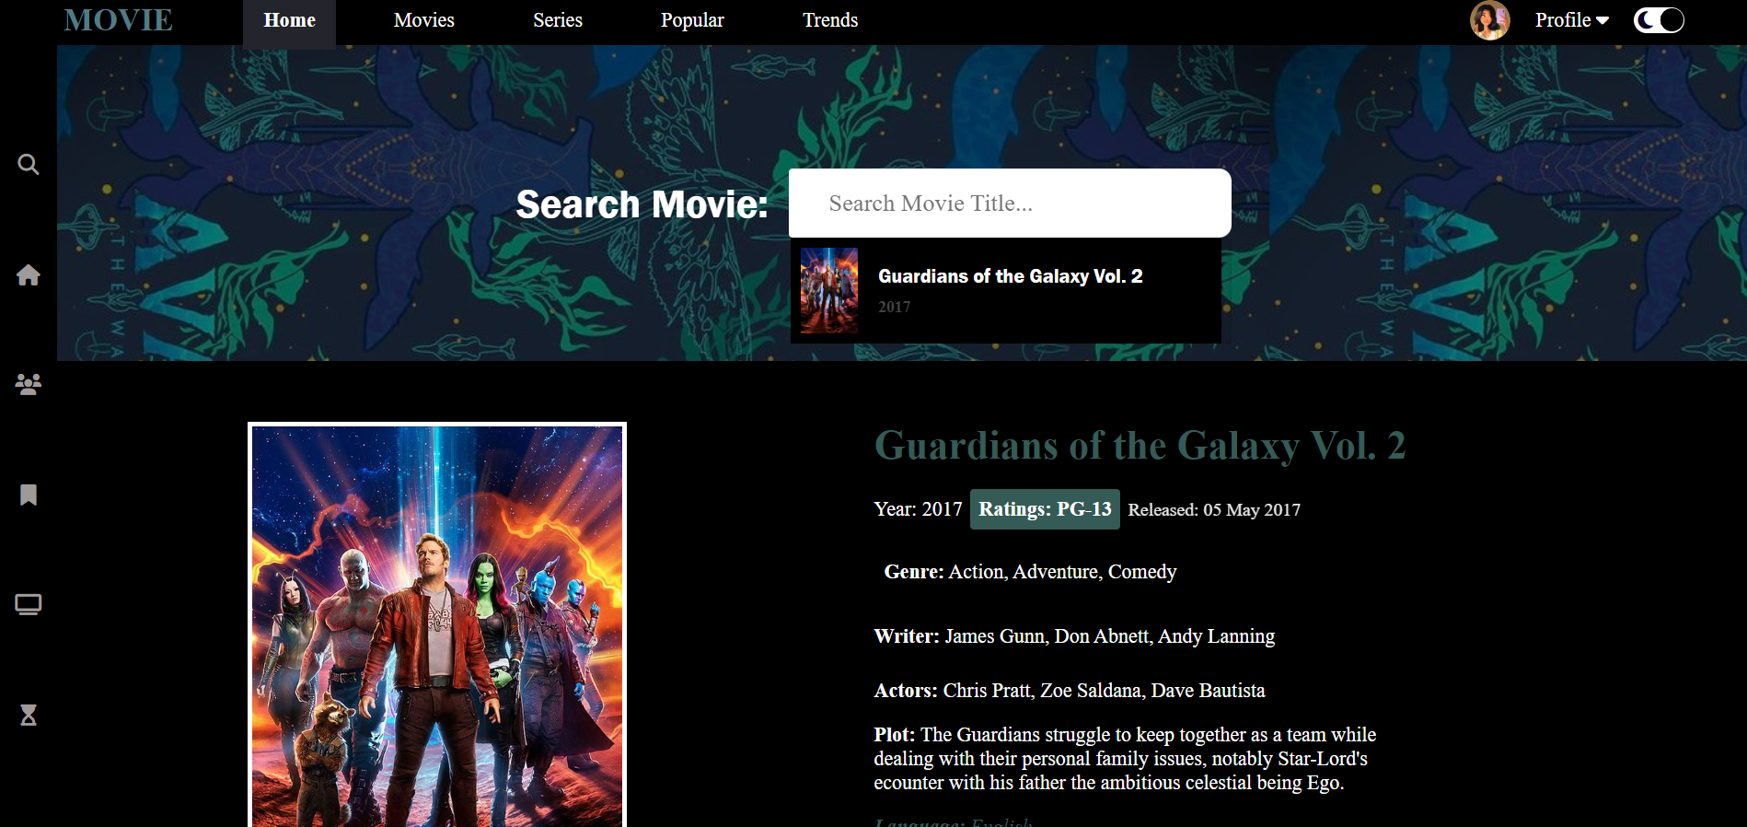
RESULT

Slide 10
CONCLUSION
They increase user engagement and retention by offering relevant content, leading to higher satisfaction levels.
These systems drive business value by increasing user interaction, which can lead to higher customer loyalty and retention rates.
Movie DataBase systems contribute to revenue growth by promoting content consumption and potentially increasing sales or subscriptions.

Slide 11
REFERENCES
https://in.pinterest.com/search/pins/?q=movie%20wallpaper&rs=typed
https://unsplash.com/s/photos/cinema
https://www.omdbapi.com/
https://alphacoders.com/movie-wallpapers

Slide 12

THANK YOU!

