Slide 1
indiereads
A goodreads alternative for indie bookstores

Slide 2
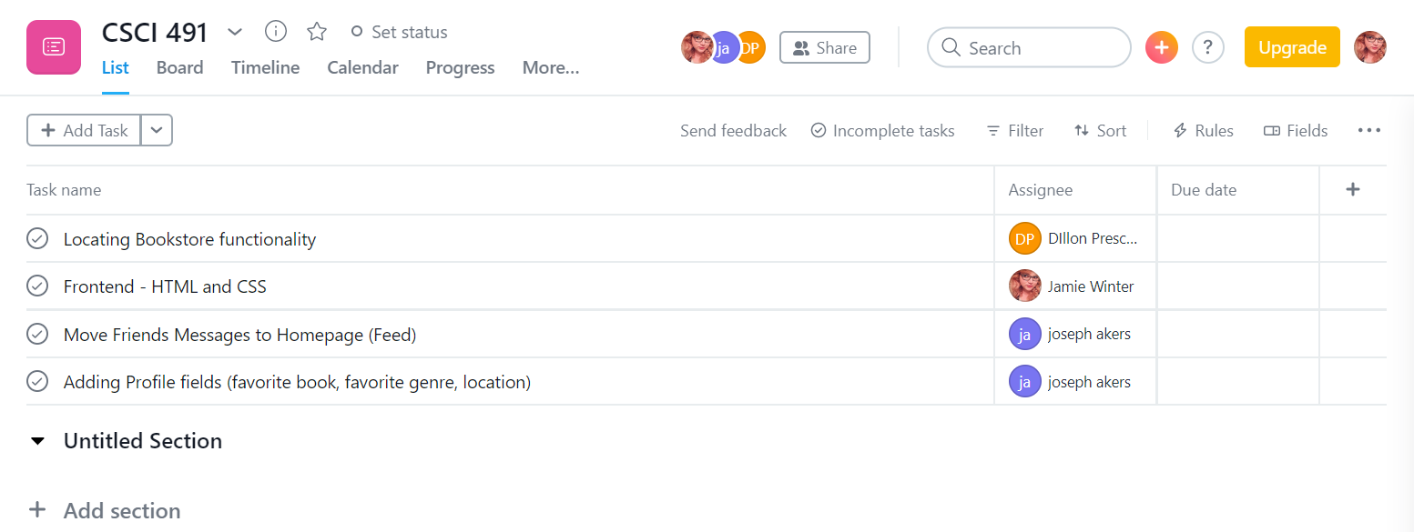
First Meeting
Group Met
Don’t worry, we found Dillon
Researched Tools
React.js
Location functionality
LAAMP
Team Member Roles
Jamie - Design
Joe - Messages feed, profile fields
Dillon - location functionality

Slide 3
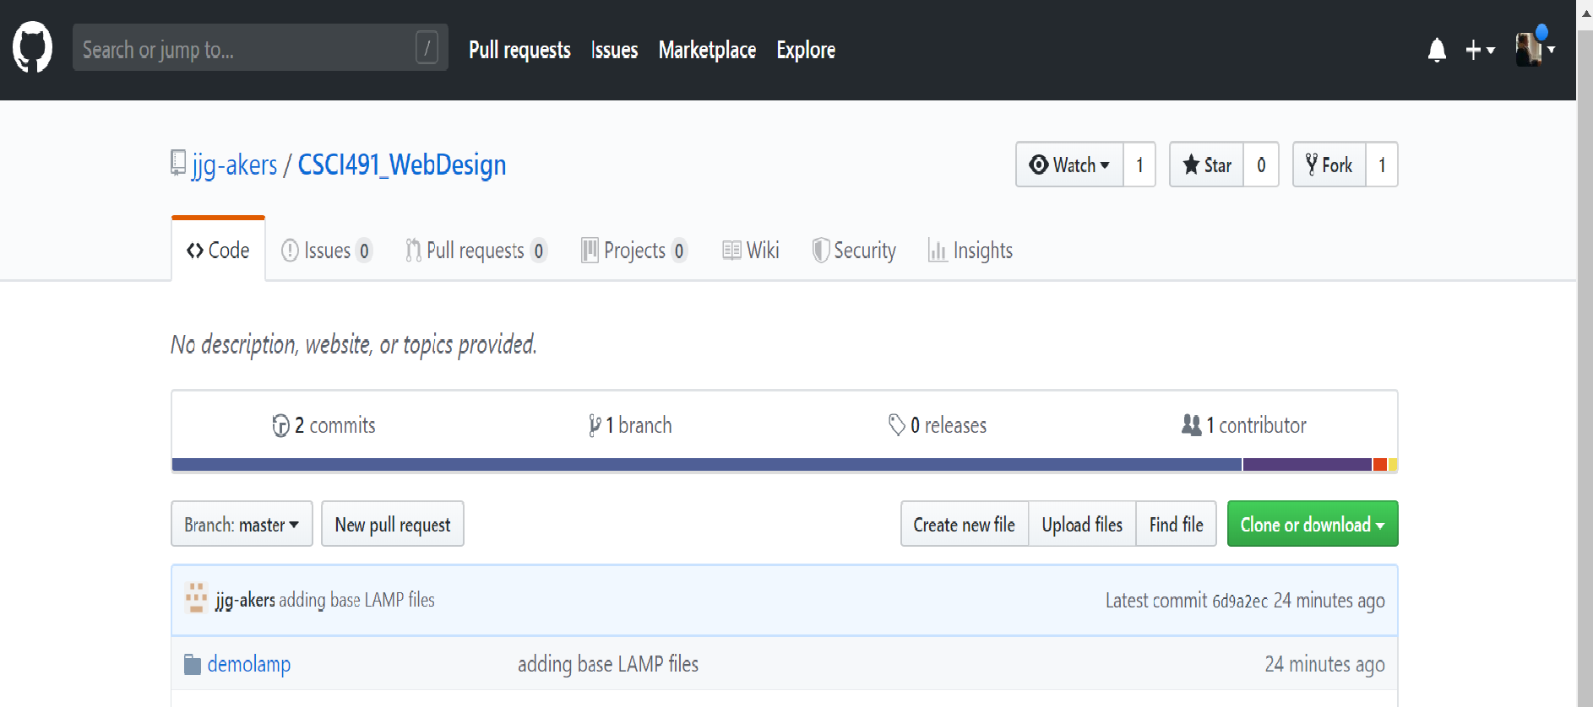
First Meeting
Git Repo Set Up
(https://github.com/jjg-akers/CSCI491_WebDesign)
Risks Identified
React.js
Scope Creep

