Slide 1

PANIMALAR ENGINEERING COLLEGE AN AUTONOMOUS INSTITUTION DEPARTMENT OF INFORMATION TECHNOLOGY
IT8611 - Mini Project Review
III year/VI sem
A SAFE AND RELIABLE IDENTITY BASED HEALTHCARE SYSTEM
TEAM MEMBERS
K.SOWNDARYA (2020PECIT165)
R.THARANI (2020PECIT171)
R.C.YOGITAA DEVI (2020PECIT177)

Slide 2
ABSTRACT
To design an identity based, integrated multi-user system to store massive medical records in a secure cloud database & retrieving the medical records by Quick Response code which will be quick and widely acceptable.
To provide physicians with fast and more comprehensive access to patients’ medical info in times of crisis. This in turn reduce administrative burden.
To implement patient data sharing in a healthcare system, patient may grant rights to users based on a role or attributes held by the respective user to share specific healthcare data with that user.
To develop a cost effective approach to assist doctors in a effective drug prescription and which maintains integrity of data

Slide 3
LITERATURE SURVEY
H. Deng et al., "Identity-Based Encryption Transformation for Flexible Sharing of Encrypted Data in Public Cloud," in IEEE Transactions on Information Forensics and Security, vol. 15, pp. 3168-3180, 2020, doi: 10.1109/TIFS.2020.2985532.
This paper defines a serious problem when the encrypted data needs to be shared to more people beyond those initially designated by the data owner. To handle this, data users are identified and authorized for data access based on their recognizable identities and IBE is utilised, which proved its security against powerful attacks.
(Ermatita et al., 2020)Diffie-Hellman Algorithm for Securing Medical Record Data Encryption Keys
This work analyses the use of AES and Diffie-Hellman algorithms to encrypt and decrypt the medical images and analyses approaches to avoid data leakage to irresponsible parties.

Slide 4
LITERATURE SURVEY
An Enhanced Cryptographic Algorithm in Securing Healthcare Medical Records (Jessie R. Paragas et al., 2020)
This paper presents idea of securing e-health records with modified Hill Cipher which analyses the unpredictability of the ciphertext as the known plaintext attack is handled with proposed methodology.
Secure Distributed Medical Record Storage using Blockchain
(Sudarshan Parthasarathy et al., 2020)
This work proposes the functionality of system to store Electronic records and techniques in smart contracts and encryption using random key.
Applying QR Code to Secure Medical Management
(Xuehu Yan et al., 2018)
This work depicts possibilities of using secure QR code access to the patient’s medical records to improve medical management across organisations.

Slide 5
EXISTING SYSTEM
The public key encryption process works only if the recipient has already decided to use it and has made a key available. And most system find it cost effective to establish key management systems.
Utilisation of Private Key Generator encounters trust issues on the end-user sides.
Approach to computational security through Bilinear Pairings. Here we take upon an approach to Quadratic residuosity problem to achieve Identity Based Cryptography.
An efficient approach for establishing trust on employing an Hierarchical Trust model will ensure liabilities of PKG in Identity Based Encryption.

Slide 6
PROPOSED SYSTEM
In this approach, we are providing a secure cloud-based application for Health care sector to manage the medical records and perform functionalities with it.
The storage and sharing of medical records will employ Identity based encryption on the records using the Blowfish algorithm and hashing will be involved to alter plaintext and improve resistance against attacks.
The cryptographic algorithms will allow the system to function efficiently and makes the approach cost effective, also scalability of the application will make it preferable for legacy systems.
The confidentiality of reports will be taken care and memory efficiency and time for execution will play a major factor in deciding a strong cryptographic algorithm for larger resources.
Cascading of algorithm will make the approach efficient against hackers and universal patient id will be useful for Quick Access of records.

Slide 7
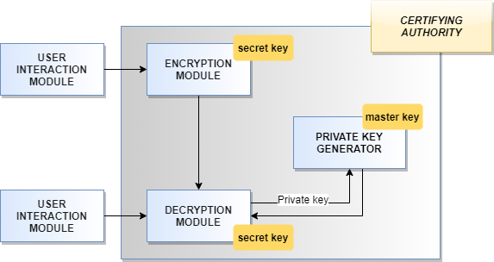
PROPOSED ARCHITECTURE

Slide 8
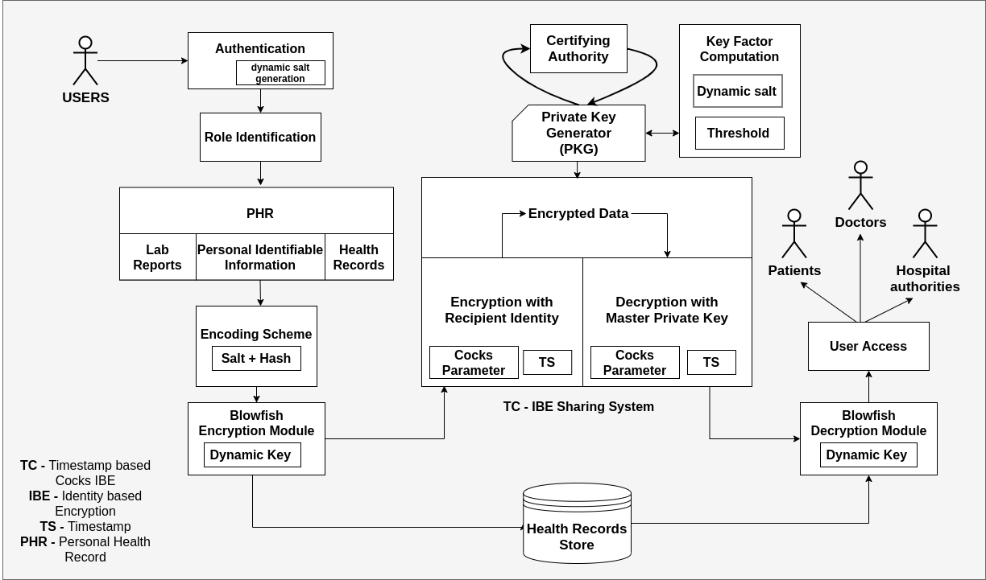
DETAILED ARCHITECTURE
Server Side
Client Side
Client Side

Slide 9


HARDWARE & SOFTWARE REQUIREMENTS
HARDWARE
Intel i3 processor
4 GB RAM
100 GB ROM
SOFTWARE
Python Pymongo MongoDB
Flask OpenCV AWS EC2 Instance

Slide 10
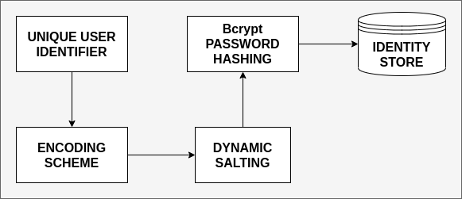
PROPOSED MODULES
IDENTITY GENERATOR

Slide 11
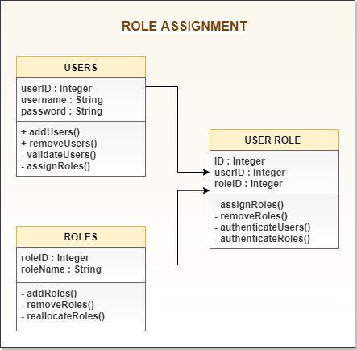
PROPOSED MODULES
ROLE BASED ACCESS CONTROL

Slide 12


HOME PAGE

Slide 13
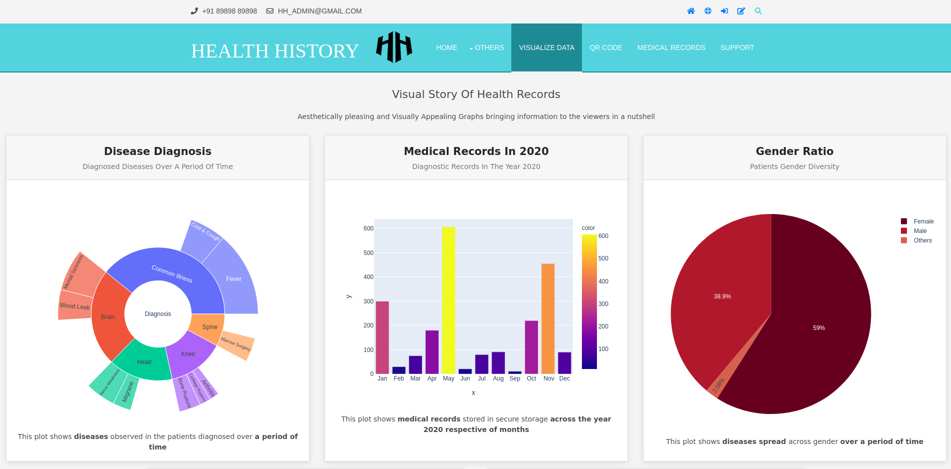
VISUAL DATA (TOP VIEW)

Slide 14
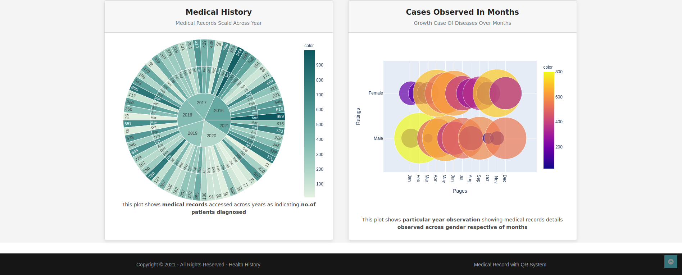
VISUAL DATA(BOTTOM VIEW)

Slide 15
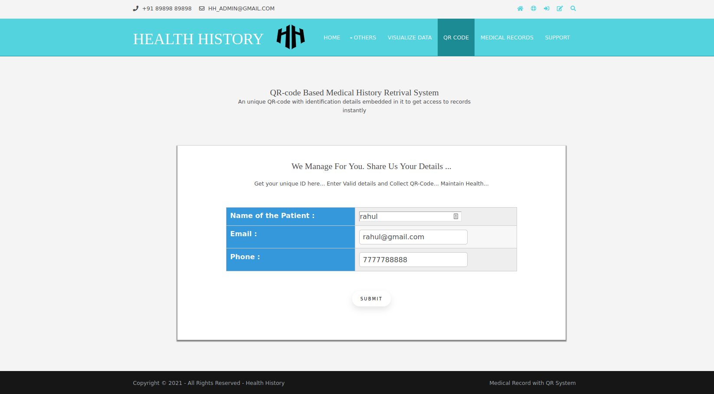
PATIENT LOGIN PAGE

Slide 16
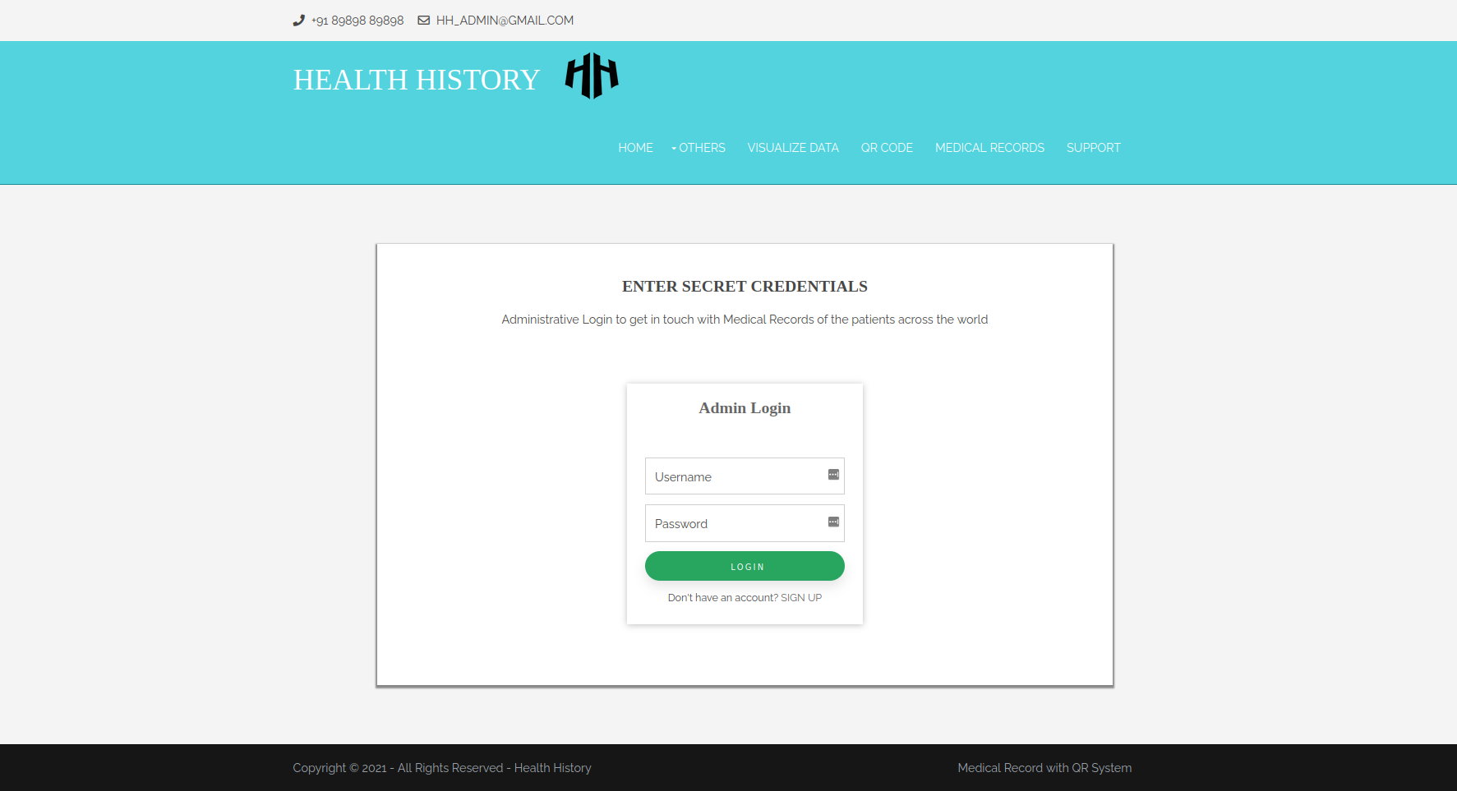
ADMIN ACCESS PAGE

Slide 17
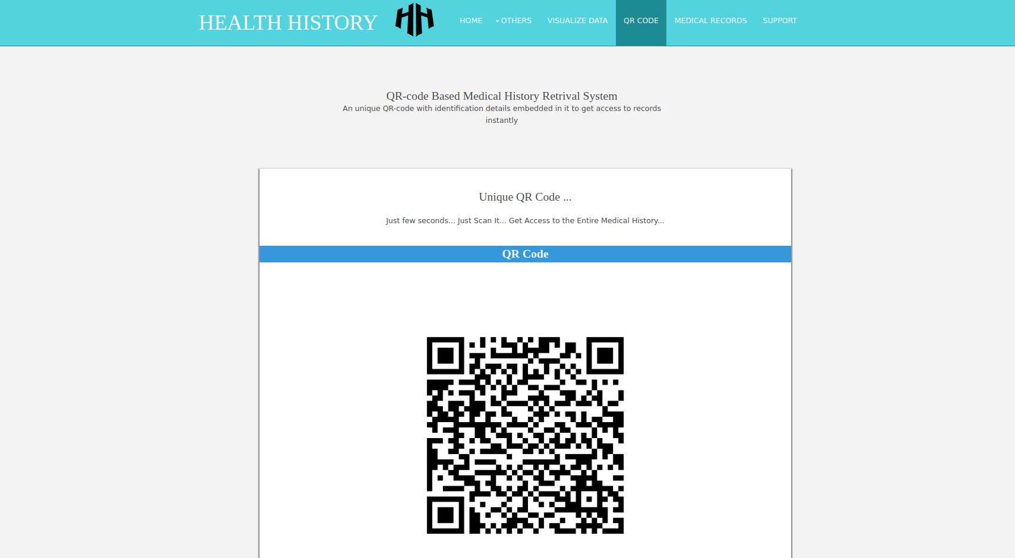
QRCODE GENERATING PAGE

Slide 18
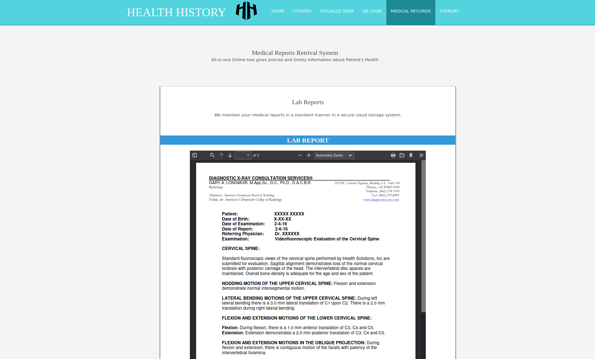
OUTPUT DEMO

Slide 19
REFERENCES
1. A. chouhan, A. kumari and M. Saiyad (2019), "Secure Multiparty Computation and Privacy Preserving scheme using Homomorphic Elliptic Curve Cryptography," 2019 International Conference on Intelligent Computing and Control Systems (ICCS), pp. 776-780, doi: 10.1109/ICCS45141.2019.9065645.
2. Al-Issa, Yazan and Ottom, Mohammad Ashraf and Tamrawi, Ahmed (2019),“eHealth Cloud Security Challenges: A Survey” in Journal of Healthcare Engineering, vol. 2019, pp. 7516035, doi: 10.1155/2019/7516035.
3. Amiri R and O. Elkeelany (2021), "FPGA Design of Elliptic Curve Cryptosystem (ECC) for Isomorphic Transformation and EC ElGamal Encryption," in IEEE Embedded Systems Letters, vol. 13, no. 2, pp. 65-68, doi:10.1109/LES.2020.3003978.
4. D. Boneh and M. Franklin (2003), “Identity-based encryption from the Weilpairing,” SIAM J. Computing., vol. 32, no. 3, pp. 586–615.
5. Deng H(2020), "Identity-Based Encryption Transformation for Flexible Sharing of Encrypted Data in Public Cloud," in IEEE Transactions on Information Forensics and Security, vol. 15, pp. 3168-3180, doi: 10.1109/TIFS.2020.2985532.

Slide 20
REFERENCES
6. Ermatita, Ermatita & Prastyo, Yugo & Pradnyana, I & Adrezo, Muhammad (2020), Diffie-Hellman Algorithm for Securing Medical Record Data Encryption keys. 296-300. doi: 10.1109/ICIMCIS51567.2020.9354297.
7. J. Wei, W. Liu, and X. Hu (2018), “Secure data sharing in cloud computing using revocable-storage identity-based encryption,” IEEE Trans. Cloud Computing., vol. 6, no. 4, pp. 1136–1148.
8. J. Lai, Y. Mu, F. Guo, W. Susilo, and R. Chen (2017), “Fully privacy preserving and revocable ID-based broadcast encryption for data access control in smart city,” Pers. Ubiquitous Computing, vol. 21, no. 5, pp. 855–868.
9. Kashfia Sailunaz and Musaed Alhussein and Md. Shahiduzzaman and Farzana Anowar and Khondaker Abdullah Al Mamun (2016), “CMED: Cloud based medical system framework for rural health monitoring in developing countries”, in Journal of Computers & Electrical Engineering, vol. 53, pp: 469- 481, doi: 10.1016/j.compeleceng.2016.02.005.
10. K. Li, W. Zhang, C. Yang, and N. Yu (2015), “Security analysis on One-to Many order preserving encryption-based cloud data search,” IEEE Trans. Inf. Forensics Security, vol. 10, no. 9.

Slide 21
REFERENCES
11. K. Lee (2020), "Comments on “Secure Data Sharing in Cloud Computing Using Revocable-Storage Identity-Based Encryption”," in IEEE Transactions on Cloud Computing, vol. 8, no. 4, pp. 1299-1300, doi:
10.1109/TCC.2020.2973623.
12. Mayank Kumar Kundalwal and Kakali Chatterjee and Ashish Singh (2019), “An improved privacy preservation technique in health-cloud”, in ICT Express, vol. 5, pp - 167-172, doi: 10.1016/j.icte.2018.10.002.
13. M. Keshk, B. Turnbull, E. Sitnikova, D. Vatsalan and N. Moustafa (2021), "Privacy-Preserving Schemes for Safeguarding Heterogeneous Data Sources in Cyber-Physical Systems," in IEEE Access, vol. 9, pp. 55077-55097, doi: 10.1109/ACCESS.2021.3069737.
14. Maiti S and Misra S (2020), "P2B: Privacy Preserving Identity-Based Broadcast Proxy Re-Encryption," in IEEE Transactions on Vehicular Technology, vol. 69, no. 5, pp. 5610-5617, doi: 10.1109/TVT.2020.2982422.
15. Paragas, Jessie. (2020), An Enhanced Cryptographic Algorithm in Securing Healthcare Medical Records. 1-6, doi: 10.1109/ICVEE50212.2020.9243228.

Slide 22
THANK YOU

