Slide 1
Crop recommendation with fertilizer suggestion and plant disease detection
Manikandan R(211420205086) Dr.M.Sumithra
Madhu sudharshanan K(211420205083)
Karthik Padmaraj R(211420205074)

Slide 2
Abstract
In modern agriculture, three key technologies are revolutionizing farming practices: crop recommendation, fertilizer suggestion, and plant disease detection.
Crop recommendation uses data on environmental factors like temperature and rainfall to suggest the best crops for farmers' fields, optimizing yield and profit.

Slide 3
Fertilizer suggestion recommends the right fertilizers based on soil nutrient levels and crop requirements, ensuring healthy plant growth while minimizing environmental impact.
Plant disease detection employs advanced imaging technology to identify diseases early, allowing farmers to take timely action and protect their crops.
Together, these technologies form a powerful toolkit for sustainable and efficient agriculture, helping farmers make informed decisions and safeguard their livelihoods."

Slide 4
Literature Survey
S. No | Name of the paper with year | Objective | Pros | Cons
1 | Gopi, P. S. S., & Karthikeyan, M. (2023). Multimodal Machine Learning Based Crop Recommendation and Yield Prediction Model. | Develop a crop recommendation and yield prediction model using multimodal machine learning | Incorporates multiple data sources | Complexity in integrating different modalities
2 | Kumar, P., Bhagat, K., Lata, K., & Jhingran, S. (2023, May). Crop recommendation using machine learning algorithms. | Utilize machine learning algorithms for crop recommendation | Wide range of algorithms considered | May lack specific focus on certain crops
3 | Nehra, V., Anand, A., & Kumari, N. (2023, January). Fertilizer and Crop Recommendation using IoUT and Machine Learning. | Propose IoUT and machine learning for fertilizer and crop recommendation | Potential for precision agriculture | Requires robust data infrastructure

Slide 5
S. No | Name of the paper with year | Objective | Pros | Cons
4 | Sivanandam, K., Prasanth, M., Naveen, B., & Saran, S. (2023, March). An Efficient Machine Learning Approaches for Crop Recommendation based on Soil Characteristics. | Develop efficient machine learning approaches for crop recommendation based on soil characteristics | Focus on soil characteristics | May require extensive data collection
5 | Kuradusenge, M., Hitimana, E., Hanyurwimfura, D., Rukundo, P., Mtonga, K., Mukasine, A., ... & Uwamahoro, A. (2023). Crop yield prediction using machine learning models: case of Irish potato and maize. | Predict crop yields using machine learning models | Specific focus on crop yield prediction | Limited to specific crops
6 | Rani, G. E., Venkatesh, E., Balaji, K., Yugandher, B., Kumar, A. N., & SakthiMohan, M. (2022, April). An automated prediction of crop and fertilizer disease using Convolutional Neural Networks (CNN). | Develop an automated system for predicting crop and fertilizer diseases using CNN | Utilizes advanced deep learning techniques | May require extensive training data

Slide 6
S. No | Name of the paper with year | Objective | Pros | Cons
7 | Swaminathan, B., Palani, S., Vairavasundaram, S., Kotecha, K., & Kumar, V. (2022). IoT-driven artificial intelligence technique for fertilizer recommendation model. | Propose an IoT-driven AI technique for fertilizer recommendation | Incorporates IoT data for precise recommendations | Dependence on IoT infrastructure may be a limitation
8 | Siddiqua, A., Kabir, M. A., Ferdous, T., Ali, I. B., & Weston, L. A. (2022). Evaluating plant disease detection mobile applications: Quality and limitations. | Evaluate the quality and limitations of plant disease detection mobile applications | Provides insights into the effectiveness of apps | Limited to evaluation, does not propose new methods
9 | Meenakshi, M., & Naresh, R. (2022). Soil health analysis and fertilizer prediction for crop image identification by Inception-V3 and random forest. | Analyze soil health and predict fertilizers for crop image identification using Inception-V3 and random forest | Utilizes machine learning for soil analysis | May require expertise in machine learning
10 | Radha, N., & Swathika, R. (2021, March). A polyhouse: plant monitoring and diseases detection using CNN. | Develop a system for plant monitoring and disease detection using CNN | Utilizes CNN for disease detection | Limited information on effectiveness of the system

Slide 7
Existing System
Traditional farming relies on manual decision-making processes, where farmers make choices based on experience, local knowledge, and general agricultural practices.
Limited use of data analytics and technology, leading to suboptimal crop choices, fertilizer usage, and delayed disease detection.
Lack of precision in crop recommendations, often resulting in reduced yields and inefficient resource utilization.
Manual monitoring makes it challenging to identify and address plant diseases in the early stages, leading to increased crop losses.

Slide 8
Proposed System
Data-Driven Decision Making:
Introducing a cutting-edge precision agriculture system leveraging data analytics for precise crop recommendations, optimized fertilizer suggestions, and early plant disease detection.
Harnessing comprehensive data, including soil health, climate patterns, and historical crop performance, for informed decision-making.
Technology Integration:
Utilizing advanced technologies such as machine learning and image recognition for accurate crop and disease identification.
Real-time data analysis ensures up-to-date insights, enabling farmers to make timely and informed decisions.

Slide 9
Smart Crop Recommendations:
Tailored suggestions based on factors like soil composition, moisture levels, and temperature, optimizing crop choices for specific geographical regions.
Enhanced resource management to maximize yields and promote sustainable agricultural practices.

Slide 10
Software & hardware Requirements
Hardware specifications:
• Microsoft Server enabled computers, preferably workstations
• Higher RAM, of about 4GB or above
• Processor of frequency 1.5GHz or above
Software specifications:
• Python 3.6 and higher
• Anaconda software

Slide 11
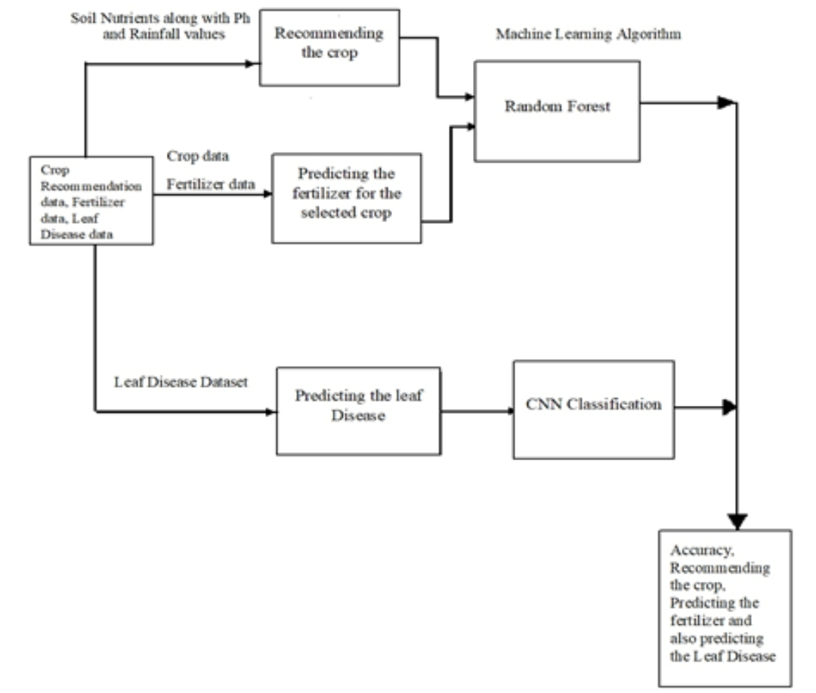
Architecture diagram

Slide 12
Algorithm/Methodology
Develop an intelligent precision agriculture system using a data-driven approach for crop recommendations, fertilizer optimization, and disease detection. The proposed algorithm integrates data analytics, machine learning, and image recognition for comprehensive decision-making in agriculture.
Random Forest
Crop Recommendation: Random Forest can analyze historical crop performance and environmental factors to predict suitable crops for specific conditions.
Fertilizer Suggestion: Random Forest can correlate soil nutrient levels with crop requirements to suggest appropriate fertilizers.
Plant Disease Detection: Random Forest can classify plant disease images based on extracted features, aiding in disease identification.

Slide 13
Decision Trees:
Crop Recommendation: Decision Trees can make decisions based on environmental factors to recommend crops with high predictive accuracy.
Fertilizer Suggestion: Decision Trees can determine the relationship between soil nutrient levels and crop requirements to suggest suitable fertilizers.
Plant Disease Detection: Decision Trees can classify plant disease images based on visual features, aiding in disease detection.
Support Vector Machine (SVM)
Crop Recommendation: SVM can classify environmental data to recommend crops based on similar conditions.
Fertilizer Suggestion: SVM can learn the relationship between soil nutrient levels and crop requirements to suggest fertilizers.
Plant Disease Detection: SVM can classify plant disease images based on extracted features, aiding in disease identification.

Slide 14
Naive Bayes
Crop Recommendation: Naive Bayes can calculate probabilities of crop suitability based on environmental factors and recommend crops with the highest likelihood.
Fertilizer Suggestion: Naive Bayes can estimate the probability of fertilizer effectiveness based on soil nutrient levels and crop requirements.
Plant Disease Detection: Naive Bayes can classify plant disease images based on feature probabilities, aiding in disease classification.
ResNet (Convolutional Neural Network)
Plant Disease Detection: ResNet is specifically designed for image classification tasks like plant disease detection. It can extract hierarchical features from plant images, enabling accurate disease classification and detection.

Slide 15
Novelty
Combining crop recommendation with fertilizer suggestion and plant disease detection is indeed a novel and valuable idea in the field of agriculture. This integrated system can greatly benefit farmers by providing comprehensive support throughout the farming process, from selecting the appropriate crops for their specific conditions to managing fertilizer application and identifying potential diseases early on. Here's how such a system could work:
Crop Recommendation:
The system would analyze various factors such as soil type, climate conditions, available resources (water, sunlight), and historical crop performance data.
Machine learning algorithms could be employed to process this data and suggest the most suitable crops for a particular area or farm.

Slide 16
2. Fertilizer Suggestion:
Once the crop is selected, the system could recommend the optimal fertilizer composition and application schedule based on soil nutrient analysis and crop nutrient requirements.
It could consider factors like soil pH, nutrient deficiencies, and previous fertilizer usage to provide tailored recommendations.
3.Plant Disease Detection:
The tool can identify sick plants. If a farmer takes a picture of a plant, the tool can look at it and tell if the plant has a disease by comparing it to pictures of other plants. This helps farmers spot and treat diseases early, which can help save their crops.
4. Smart Device Integration:
The tool can connect to smart devices that keep track of soil moisture, weather conditions, and other important information in real time. This can help farmers make quick decisions base

Slide 17
Modules Split up Crop Recommendation
Data Collection: Gather environmental data (temperature, humidity, rainfall), soil characteristics, historical crop performance data.
Data Preprocessing: Clean data, handle missing values, normalize numerical data, perform feature engineering.
Model Training: Train machine learning models (e.g., Decision Trees, Random Forest, XGBoost) on historical crop performance and environmental factors.
Evaluation: Evaluate model performance using metrics such as accuracy, precision, recall.
Recommendation: Use the trained model to recommend crops based on environmental conditions and predicted crop performance.

Slide 18
Fertilizer Suggestion
Data Collection: Gather soil nutrient data, crop requirements, fertilizer characteristics.
Data Preprocessing: Clean soil nutrient data, preprocess crop requirements.
Model Training: Train machine learning models (e.g., Decision Trees, Random Forest, XGBoost) on soil nutrient levels and crop characteristics.
Evaluation: Evaluate model performance using metrics such as accuracy and mean squared error.
Suggestion: Utilize the trained model to suggest appropriate fertilizers based on soil nutrient levels and crop requirements.

Slide 19
Plant Disease Detection
Data Collection: Gather plant disease images, environmental data, and soil characteristics.
Data Preprocessing: Preprocess plant disease images, and clean environmental data.
Model Development: Build a convolutional neural network (CNN) architecture (e.g., ResNet) for plant disease detection.
Model Training: Train the CNN model on labelled images to learn features indicative of different plant diseases.
Evaluation: Validate the model using testing data, and evaluate performance using metrics such as accuracy, precision, and recall.
Deployment: Deploy the trained model for real-time disease detection using images captured from fields.

Slide 20
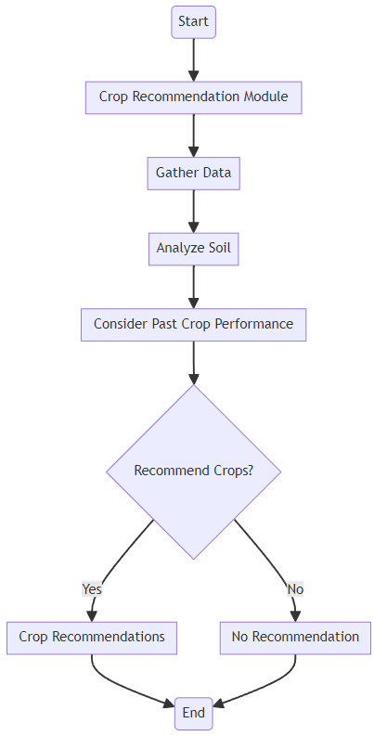
Flow Diagram for Crop Recommendation

Slide 21
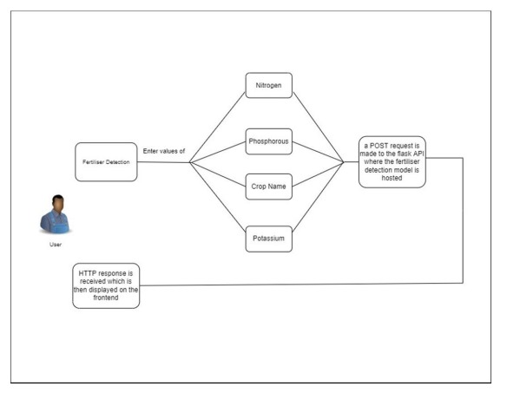
Flow Diagram for Fertilizer Suggestion

Slide 22
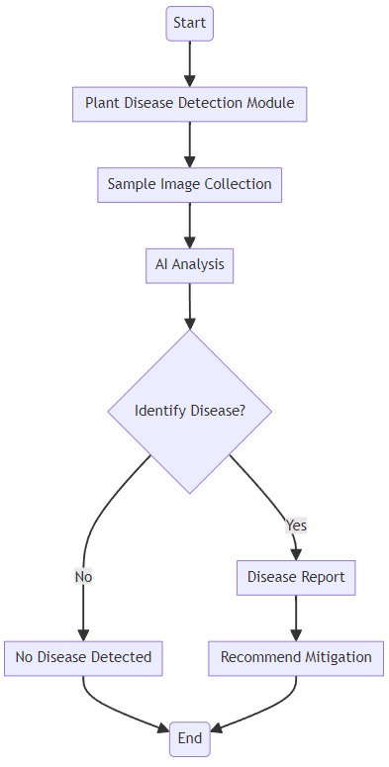
Flow Diagram for Plant Disease Detection

Slide 23
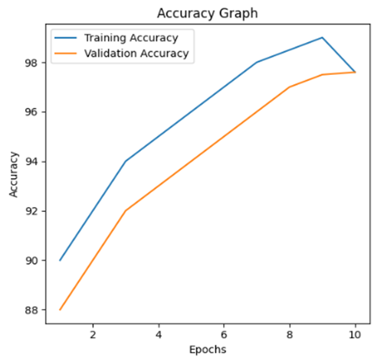
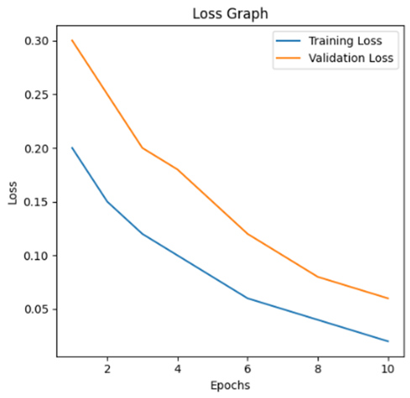
Performance measures of Proposed System
Accuracy | Precision | Recall | F1 score
97.6 | 97.4 | 96.3 | 96.7

Slide 24
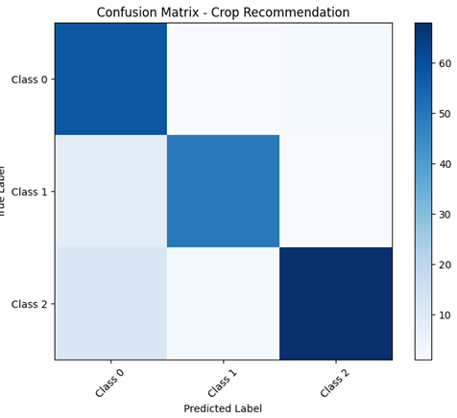
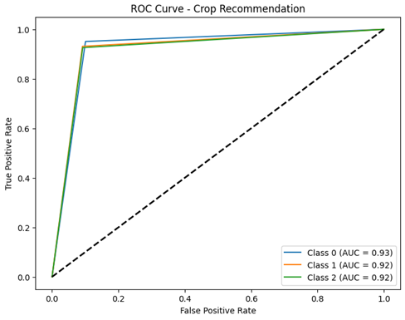

Slide 25
Project work flow
TASK | TIMELINE
Literature survey | February
Backend development | February
Integration of frontend | March
Documentation | April

Slide 26
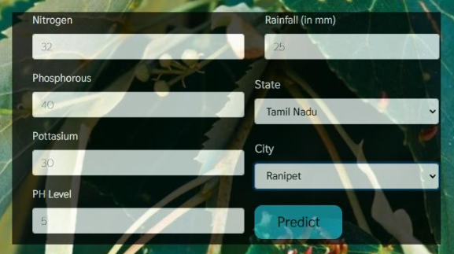
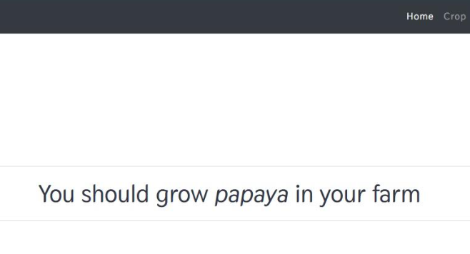
Sample Input and Output

Slide 27
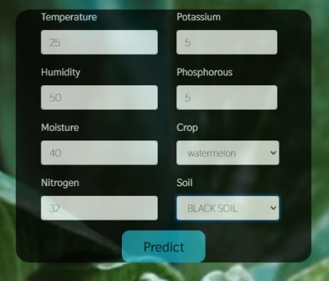
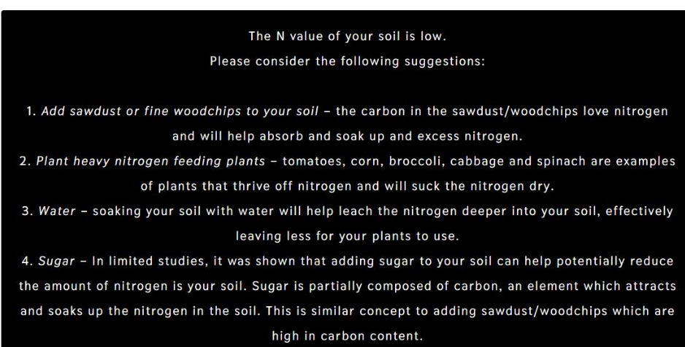

Slide 28
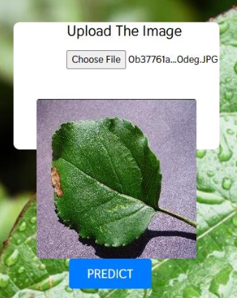
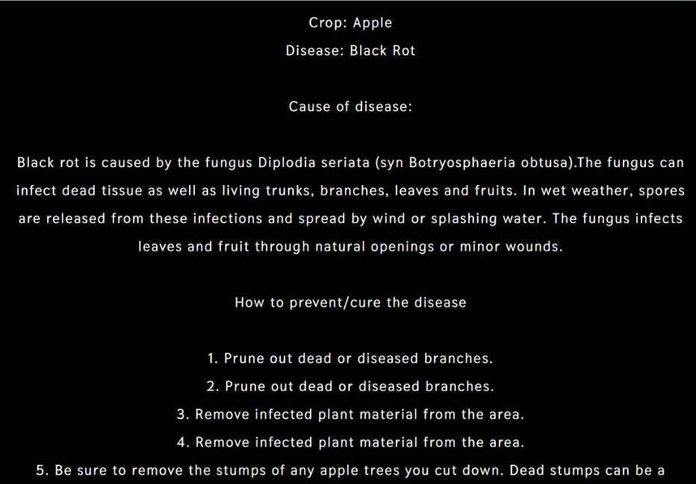

Slide 29
Project work flow
TASK | TIMELINE
Literature survey | February
Backend development | February
Integration of frontend | March
Documentation | March

Slide 30
References
Gopi, P. S. S., & Karthikeyan, M. (2023). Multimodal Machine Learning Based Crop Recommendation and Yield Prediction Model. Intell. Autom. Soft Comput, 36, 313-326.
Kumar, P., Bhagat, K., Lata, K., & Jhingran, S. (2023, May). Crop recommendation using machine learning algorithms. In 2023 International Conference on Disruptive Technologies (ICDT) (pp. 100-103). IEEE.
Nehra, V., Anand, A., & Kumari, N. (2023, January). Fertilizer and Crop Recommendation using IoUT and Machine Learning. In 2023 13th International Conference on Cloud Computing, Data Science & Engineering (Confluence) (pp. 629-634). IEEE.

Slide 31
References
Rani, G. E., Venkatesh, E., Balaji, K., Yugandher, B., Kumar, A. N., & SakthiMohan, M. (2022, April). An automated prediction of crop and fertilizer disease using Convolutional Neural Networks (CNN). In 2022 2nd International Conference on Advance Computing and Innovative Technologies in Engineering (ICACITE) (pp. 1990-1993). IEEE.
Swaminathan, B., Palani, S., Vairavasundaram, S., Kotecha, K., & Kumar, V. (2022). IoT-driven artificial intelligence technique for fertilizer recommendation model. IEEE Consumer Electronics Magazine, 12(2), 109-117.

Slide 32
References
Vaishnavi, S., Shobana, M., Sabitha, R., & Karthik, S. (2021, March). Agricultural crop recommendations based on productivity and season. In 2021 7th international conference on advanced computing and communication systems (ICACCS) (Vol. 1, pp. 883-886). IEEE.
Dharani, M. K., Thamilselvan, R., Natesan, P., Kalaivaani, P. C. D., & Santhoshkumar, S. (2021, February). Review on crop prediction using deep learning techniques. In Journal of Physics: Conference Series (Vol. 1767, No. 1, p. 012026). IOP Publishing.

Slide 33
THANK YOU

