Slide 1
Decentralized Application using Blockchain
Managing government corruption using Distributed Ledger
Team members:
Prakash Kumar M(211414205071)
Prasanna M(211414205072)
Aslam S M(211414205093)
Shijil R(211414205096)
Project Guide
Mr. S Gopi M.Tech
(Assistant Professor)

Slide 2
Abstract
A Blockchain is a continuously growing records, called blocks, which are linked and secured using cryptography such as hashing.
Each block contains a hash pointer as a link to the previous block, a timestamp and transaction data.
By design, blockchains are inherently resistant to modification of the data. It is similar to a ledger, but in this case it is a decentralized ledger which can record transactions between two different parties efficiently in a verifiable and permanent way.
The data stored in the block is permanently stored and it cannot be modified or deleted.
In this project using the blockchain technology a decentralized application or a database can be implemented to record the transactions taking place between the government so that corruption can be stopped.

Slide 3
Literature Survey
S.no | Name of the paper with year | Objective
1 | Blockchain Technology as an enabler of service (Aug 2017) - Stefen Seebacher | Research on blockchain technology
2 | A review of blockchain (Nov 2016) – George Pirlea | Research on Bitcoin and Ethereum
3 | A comprehensive Literature review on Blockchain (January 2018) – Stefen K. Johansen | Complete analysis of Blockchain technology in Information system
4 | A framework for Blockchain based application (Mar 2018) – Ephraim Feig | Providing framework for how to implement blockchain technology in industries
5 | Using Blockchain Technology to Validate the Integrity and Confidentiality of Backups Versions on the Cloud (Feb 2018) – Badr Aleidi, Abdulaziz Albesher | Storage of backups of sensitive data in cloud to maintain its integrity

Slide 4
S.no | Name of the paper with year | Objective
6 | Blockchain platform with proof-of-work based on analog Hamiltonian optimizers (Feb 2018) – K. P. Kalinin | Use of blockchain technology to store confidential data securely in decentralized system.
7 | A Blockchain based Privacy-Preserving Incentive Mechanism in Crowd sensing Applications (Mar 2018) – Jingzhong Wang | Use of crypto currency built on blockchains is used as a secure incentive way.
8 | Efficient Distributed Admission and Revocation using Blockchain for Cooperative ITS (Feb 2018) – Noureddine Lasla | Use of Blockchain to keep track of the certificate of each vehicle
9 | Blockchain Technology for Providing an Architecture Model of Decentralized Personal Health Information (Jan 2018) – Sandi Rahmadika | Management of Personal Health Information (PHI)
10 | Blockchain and Smart Contracts for Insurance (Feb 2018) – Valentina Gatteschi | Analysis of usage of blockchain in insurance companies

Slide 5
Existing System
Government data or transactions are handled by government organization centrally by each states and Central government. Fund allocation is done by central government using the taxes collected and is distributed as per the Finance commission recommendation.
Most of the files and transaction related to government are handled by government members.
These data and files are modified to the own will of government members to meet their needs which thus leads to corruption.
Issues in Existing system
Since data or files or transactions associated with government are modified, there is no proper way to manage this activity and there is no proof that the file or data or a transaction is original or modified, thus leading to corruption.

Slide 6
Proposed System
Instead of handling all the files, data or transactions related to government by each government member separately, we can use blockchain technology to handle how the data, file or log of the transaction is stored and used.
We can build a decentralized database using blockchain, to handle all the files, data and transaction.
All the members involved in this process have a copy of the database and and any update to the database is reflected to all the copies of the database.
Anything stored in the database is subjected to hashing and each block is linked to each other using the block hash as a pointer to previous block, thus forming a blockchain.
When ever the blockchain is updated, it is reflected to all the copies of the blockchain.
Since hashing is used, any modification to the data stored in block can affect the other block and the copies of it in the blockchain as it contradict with the computed hash value. Thus we can know that the block has been modified without the consensus between all the members involved.

Slide 7
Software and hardware requirement
Software requirement:
Eclipse IDE
Programming language used:
JAVA
Hardware requirements:
Operating system – Windows 7 and above (or) Linux (or) Mac OS
Processor – Intel i3 processor (min)
RAM – 4GB (min)
Storage – 500GB(min)

Slide 8
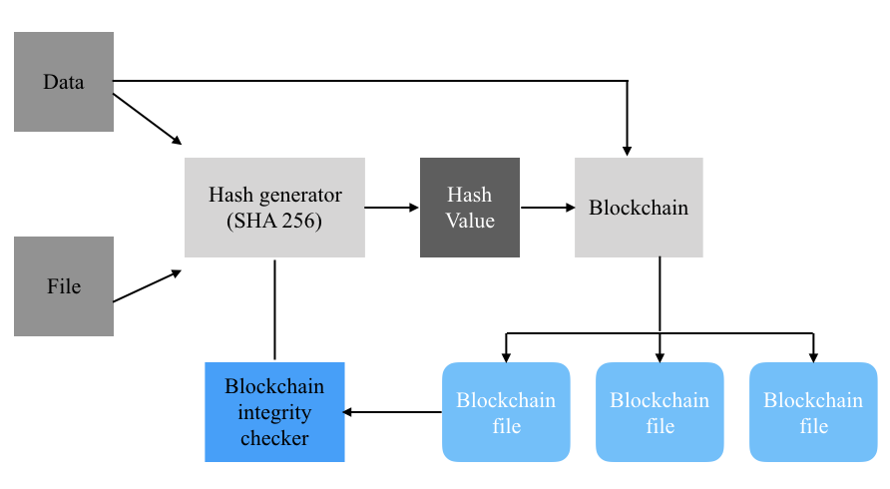
Architecture Diagram

Slide 9
Algorithm & Methodology
Proof of Work (PoF) Algorithm:
A proof of work is a piece of data which is difficult (costly, time-consuming) to produce but easy for others to verify and which satisfies certain requirements. Producing a proof of work can be a random process with low probability so that a lot of trial and error is required on average before a valid proof of work is generated.

Slide 10
For Example:
Let's say the base string that we are going to do work on is "Hello, world!". Our target is to find a variation of it that SHA-256 hashes to a value beginning with '000'. We vary the string by adding an integer value to the end called a nonce and incrementing it each time.
"Hello, world!4250" => 0000c3af42fc31103f1fdc0151fa747ff87349a4714df7cc52ea464e12dcd4e9

Slide 11
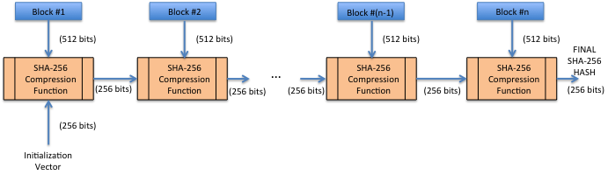
SHA – 256 Algorithm
SHA-256 is a member of the SHA-2 cryptographic hash functions designed by the NSA. SHA stands for Secure Hash Algorithm. Cryptographic hash functions are mathematical operations run on digital data; by comparing the computed "hash" (the output from execution of the algorithm) to a known and expected hash value, a person can determine the data's integrity. A one-way hash can be generated from any piece of data, but the data cannot be generated from the hash.

Slide 12
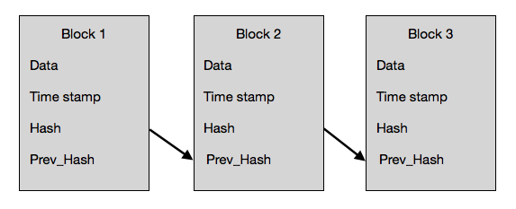
Representation of blockchain

Slide 13
Novelty
The novelty of this project is instead of generating a specific hash value which is a time consuming task, we can generate a hash value for the given data and a separate hash value for the file in which the data and its hash value is stored. Only this hash value is to check the integrity of the entire blockchain instead of calculating the hash value for each and every data . This reduced the computational resource required for generating hash value and also reduces the time required for checking the integrity of the blockchain.

Slide 14
Modules
MainBLock – creation of blockchain, insertion of block, checking blockchain integrity and writing blockchain to file
Block – Used for creating a block with data and hash value
FileHasher – Used for generating hash value for the given file
BlockchainIntegrity – Used for checking the integrity of the blockchain
SHA-256 – Used for generating hash value for the given data

Slide 15
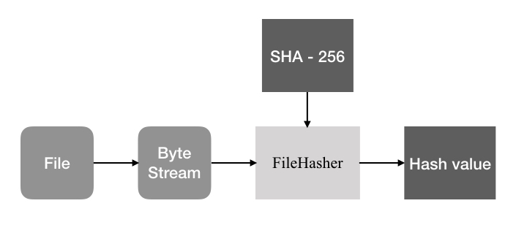
File Hasher

Slide 16

SHA - 256

Slide 17
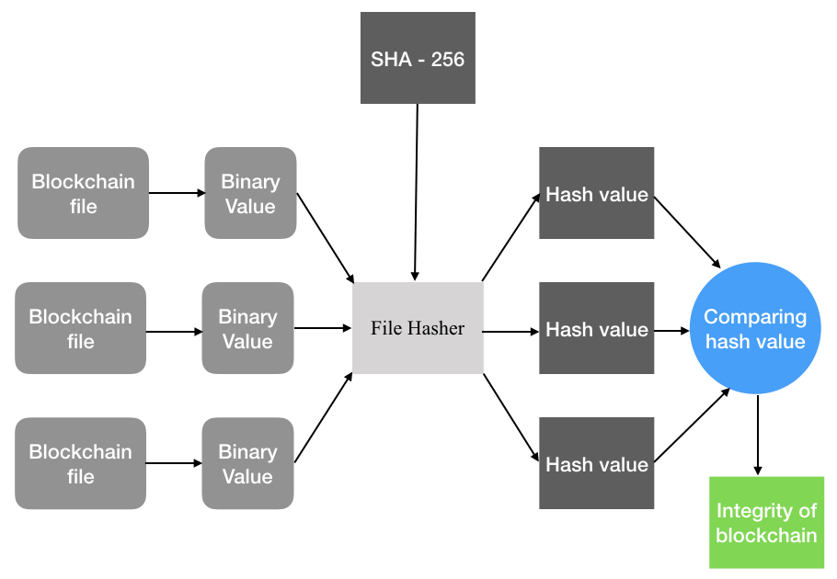
Blockchain Integrity

Slide 18
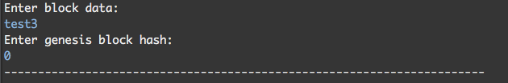
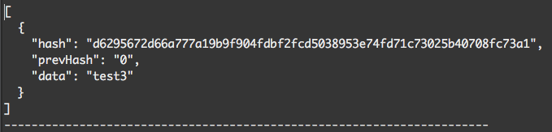
MainBlock
Creation of block
Input
Output

Slide 19

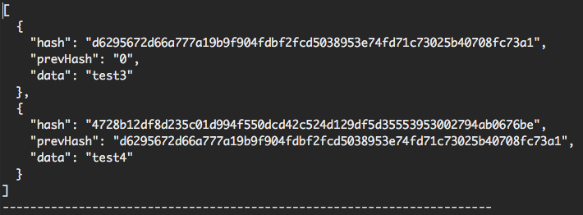
Insertion of block
Input
Output

Slide 20
Block
Input :
Data
PrevHash
Output :

Slide 21
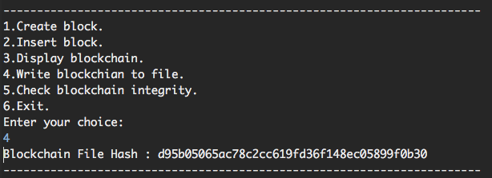
FileHasher
Input :
/… /Eclipse workspace/File_hasher/src/File_hasher/blockchain1.txt

Slide 22
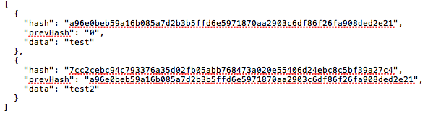

BlockchainIntegrity
Input
File 1
File 2
Output

Slide 23
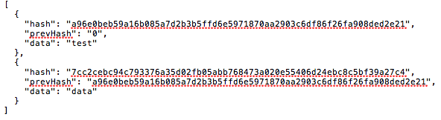

Input
File 1
File 2
Output

Slide 24
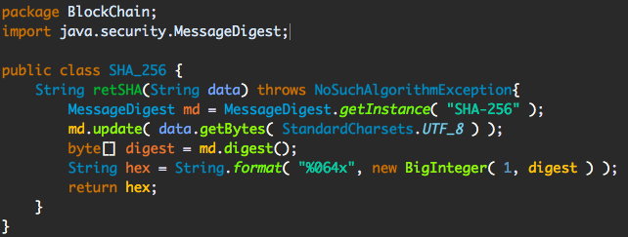
SHA - 256
Input :
Data – test
Prevhash - a96e0beb59a16b085a7d2b3b5ffd6e5971870aa2903c6df86f26fa908ded2e21
Output :
Hash - 7cc2cebc94c793376a35d02fb05abb768473a020e55406d24ebc8c5bf39a27c4

Slide 25
Sample Code
package BlockChain;
import java.security.NoSuchAlgorithmException;
public class Block {
public String hash;
public String prevHash;
private String data;
public Block(String data, String prevHash) throws NoSuchAlgorithmException{
this.data = data;
this.prevHash = prevHash;
this.hash = blockHASH();
}
String blockHASH() throws NoSuchAlgorithmException{
String calculatedBlockHash;
SHA_256 sh = new SHA_256();
calculatedBlockHash = sh.retSHA(prevHash+data);
return calculatedBlockHash;
}
public void displayBlockHash()
{
System.out.println("Block Data :"+data);
System.out.println("Block HASH:"+hash);
System.out.println("Block PREV_HASH:"+prevHash);
}
}

Slide 26
Future enhancement
Enhance the security of the system
Support for storing multiple types of data and files
Support for multiple storage technology
Further improve the resources and time required for computing hash value

Slide 27
References
http://searchcio.techtarget.com/definition/blockchain
https://blockgeeks.com/guides/what-is-blockchain-technology
https://en.wikipedia.org/wiki/Blockchain
https://medium.com/programmers-blockchain/

Slide 28
Thanking you

