Slide 1

PANIMALAR ENGINEERING COLLEGE
AN AUTONOMOUS INSTITUTION
DEPARTMENT OF INFORMATION TECHNOLOGY
DETECTION OF WATER-BED CYBER ATTACKS
USING ARTIFICIAL NEURAL NETWORKS
Team Members
211420205157 Sunil Kumar V
211420205128 Ronal Regan S
211420205122 Ranjith Kumar R
Guide
MR.Balaji

Slide 2
Abstract
Cyber threat intelligence on past attacks may help with attack reconstruction and
the prediction of the course of an ongoing attack by providing deeper
understanding of the tools and attack patterns used by attackers.
Therefore,cyber security analysts employ threat intelligence, alert correlations, machine learning, and advanced visualizations in order to reduce this effects.
The impact and development of machine learning algorithm are booming in the
current scenario. These algorithm are working perfectly by identifying the
pattern based on instance based or model based learning.

Slide 3
Abstract
Well the model based learning is more efficient then the instance based learning. Because the instance based learning identify the pattern by memorising its pattern where the model based training try to form a boundary between these and try to
classify them.
Keywords:
Cyber threat intelligence, past attacks, attack reconstruction, prediction, ongoing
attack, understanding, machine learning, efficiency, classification, Neural
Networks.

Slide 4
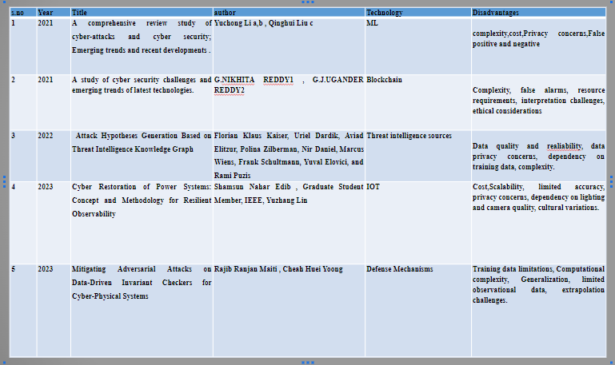
Literature Survey

Slide 5
Existing System
The utilization of invariants in the development of security mechanisms has garnered significant interest in the context of Cyber-Physical Systems (CPS), owing to their potential to prevent and identify attacks.
Invariants are properties expressed using design parameters and Boolean operators, which remain true during normal CPS operation.
These invariants can be derived from operational data or system requirements/design documents. While data-driven invariant generation is automated, design-driven methods require manual input.

Slide 6
Existing System
This paper exposes vulnerabilities in data-driven invariants by showcasing adversarial attacks.
To address this, the paper proposes a solution involving both data-driven and design-driven invariants, aiming to enhance attack detection accuracy. Experiments conducted on an actual water treatment testbed demonstrate the effectiveness of this approach in reducing false positives and achieving reliable attack detection for CPSs.

Slide 7
Proposed System
The proposed system focuses on utilizing Artificial Neural Networks (ANNs) for the detection of cyber-attacks.
ANNs are a type of machine learning technique inspired by the human brain's neural structure.
The objective here is to leverage ANNs to identify and counteract cyber-attacks effectively.

Slide 8
Proposed System
This research acknowledges the rising threat of cyber-attacks and aims to enhance cybersecurity by using ANNs as a robust and adaptable tool.
The study likely explores how ANNs can learn patterns from historical attack dataand subsequently identify deviations from normal behaviour, enabling timely detection and response to potential cyber threats.
Overall, the abstract highlights the potential of ANNs to contribute significantly to cyber-attack detection and prevention strategies.

Slide 9
Software and Hardware
Requirements
1. Software Requirements:
Operating System:Windows
Tool: Anaconda with Jupyter
Notebook.
2. Hardware requirements:
Processor: Pentium IV/III
Hard disk: minimum 80 GB
RAM: minimum 4 GB

Slide 10
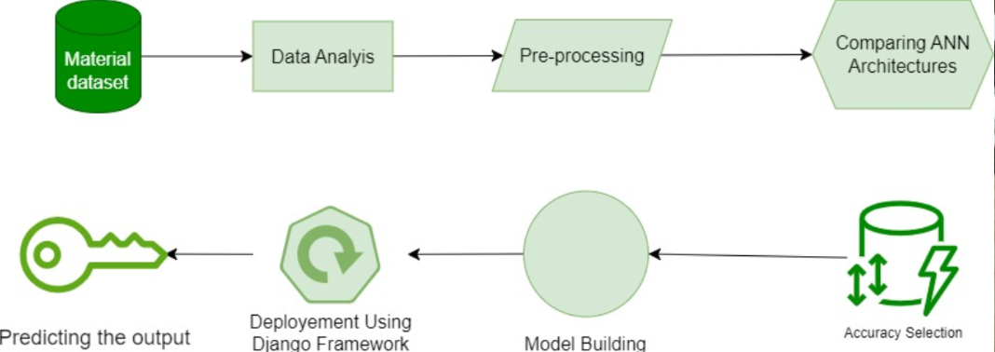
Architecture Diagram

Slide 11
Methodology
The methodology involves acquiring diverse datasets representing normal and anomalous network behavior.
Preprocessing techniques, such as feature extraction and normalization, are applied to enhance data quality.
An artificial neural network (ANN) is then trained using the prepared dataset, with a focus on optimizing network architecture and hyperparameters.
Rigorous testing and validation are performed to assess the ANN's ability to accurately detect cyber attacks.
The methodology also includes fine-tuning the model based on performance metrics to ensure robust and reliable cyber threat detection.

Slide 12
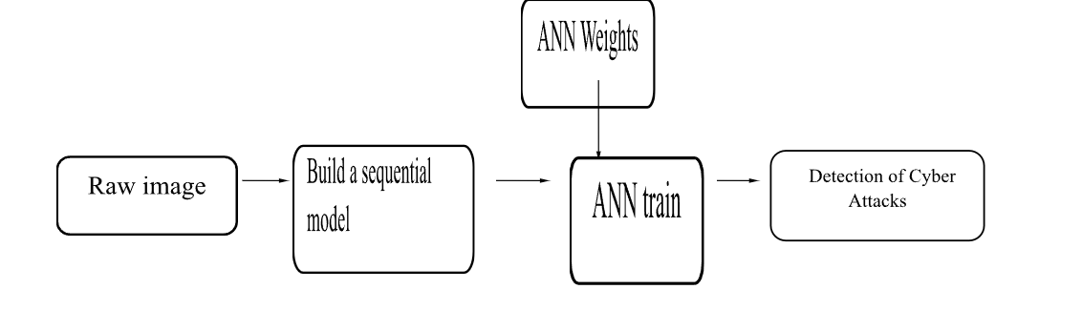
Methodology

Slide 13
Novelty
Integration of Threat Intelligence and Machine Learning:
The project combines cyber threat intelligence with machine learning techniques, specifically artificial neural networks. This integration allows for a more comprehensive understanding of past attacks, aiding in attack reconstruction and prediction.
Focus on Attack Reconstruction and Ongoing Attack Prediction:
The project emphasizes the importance of understanding past attacks to reconstruct them and predict the course of ongoing attacks. This approach provides cybersecurity analysts with valuable insights into the tools and attack patterns used by adversaries.
Efficiency of Model-Based Learning:
The project highlights the efficiency of model-based learning in comparison to instance-based learning. Model-based learning involves forming boundaries between patterns and classifying them, which is considered more effective than memorizing specific instances. This distinction contributes to the effectiveness of the machine learning algorithms employed.

Slide 14
Novelty
Use of Advanced Visualizations:
The inclusion of advanced visualizations in the cybersecurity analysis process enhances the interpretability of results. Visualizations can help analysts gain a more intuitive understanding of complex attack patterns and trends.
Application to Cyber-Physical Systems (CPS):
The existing system discussed in the abstract pertains to the context of Cyber-Physical Systems (CPS). This context introduces unique challenges and considerations, such as the use of invariants expressed through design parameters and Boolean operators.
Demonstration on a Water Treatment Testbed:
The experiments conducted on an actual water treatment testbed add a practical dimension to the project. The use of a real-world scenario demonstrates the applicability and effectiveness of the proposed solution in a relevant and tangible environment.

Slide 15
List Modules:
1.TENSOFLOW
2. PYTROCH
3. DEPLOY

Slide 16
TENSOFLOW
TensorFlow is a Python library for fast numerical computing created and released by Google. It is a foundation library that can be used to create Deep Learning models directly or by using wrapper libraries that simplify the process built on top of TensorFlow.
TensorFlow is a software library or framework, designed by the Google team to implement machine learning and deep learning concepts in the easiest manner. It combines the computational algebra of optimization techniques for easy calculation of many mathematical expressions.

Slide 17
PYTROCH
In the realm of cybersecurity, PyTorch, a powerful deep learning framework, is harnessed for the detection of cyber attacks. Leveraging its flexibility and efficiency, artificial neural networks (ANNs) are implemented to analyze intricate patterns in network data, enabling the identification of anomalous activities indicative of potential threats.
Through PyTorch's seamless integration, the system facilitates the training and deployment of ANNs, enhancing the accuracy and responsiveness of cyber attack detection mechanisms. This approach not only showcases the efficacy of PyTorch in neural network development but also underscores its role in fortifying digital security against evolving cyber threats.

Slide 18
Deploy
Deploying the model in Django Framework and predicting output:
In this module the trained deep learning model is converted into hierarchical data format file (.h5 file) which is then deployed in our django framework for providing better user interface and predicting the output whether the given material image is Fabric / Glass / Plastic / Stone / Wooden.
Django:
Django is a high-level Python web framework that enables rapid development of secure and maintainable websites. Built by experienced developers, Django takes care of much of the hassle of web development, so you can focus on writing your app without needing to reinvent the wheel. It is free and open source, has a thriving and active community, great documentation, and many options for free and paid-for support.

Slide 19
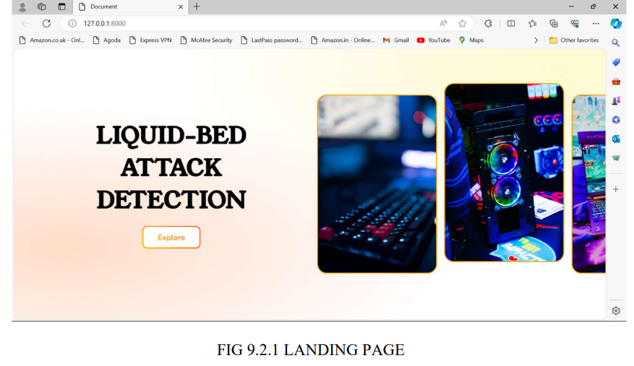
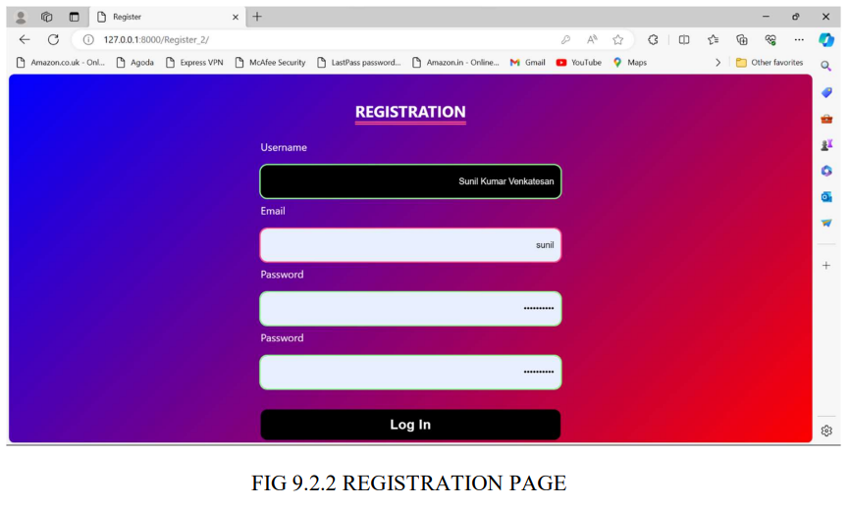
ScreenShots
Landing Page and Registration Page

Slide 20
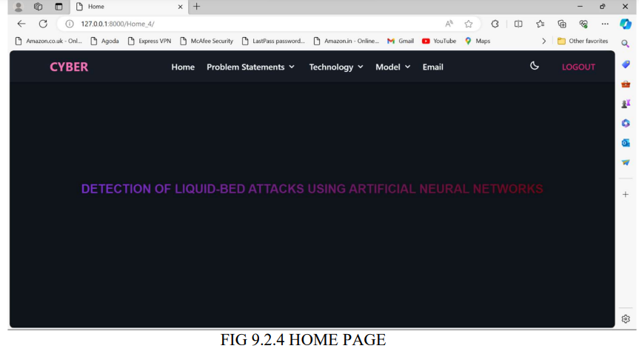
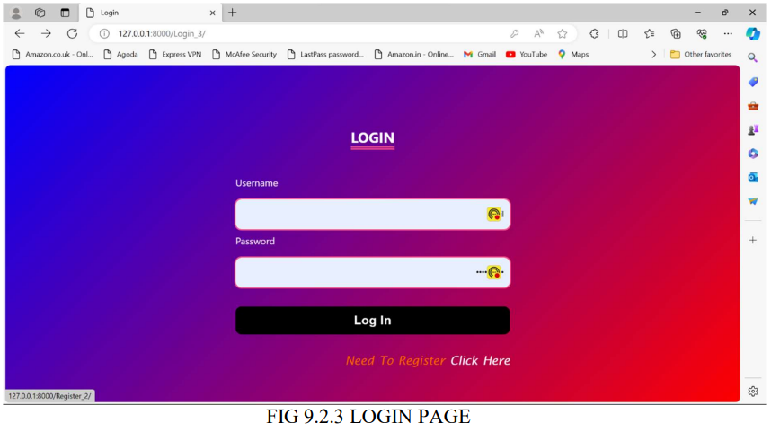
ScreenShots
Home Page and Login Page

Slide 21
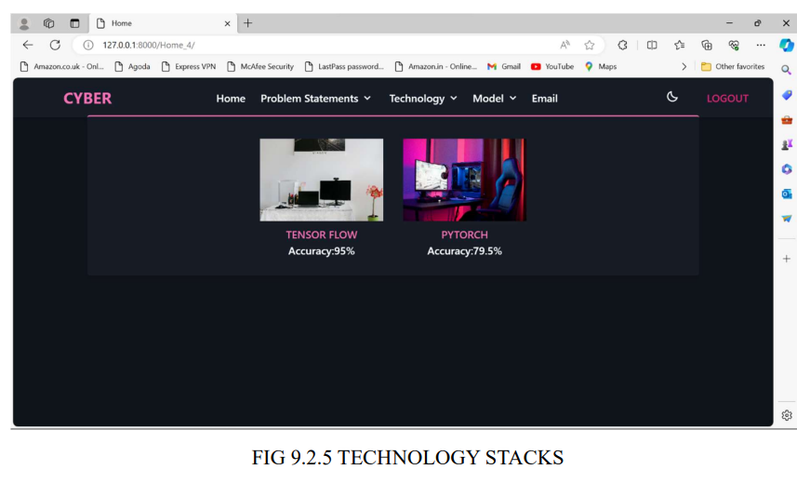
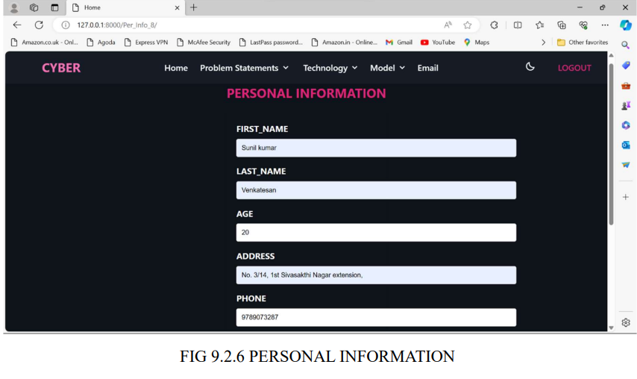
ScreenShots
Technology Stack and Personal Information

Slide 22
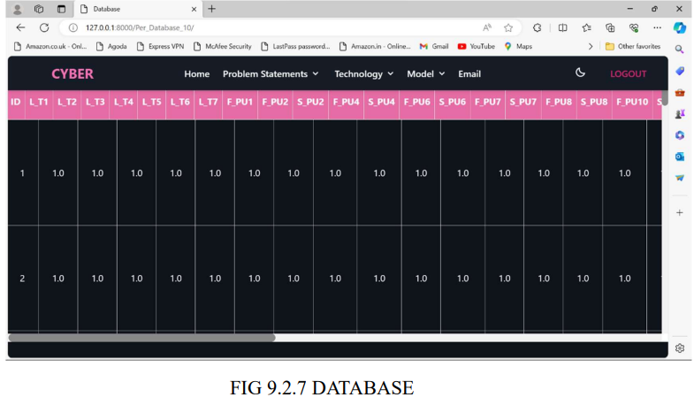
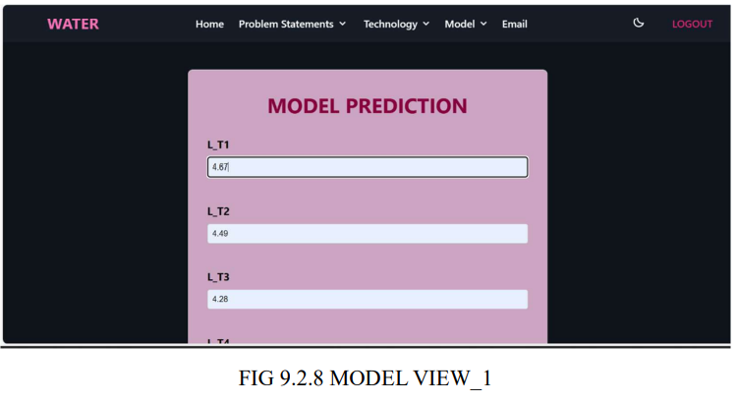
ScreenShots
Database and ModelView

Slide 23
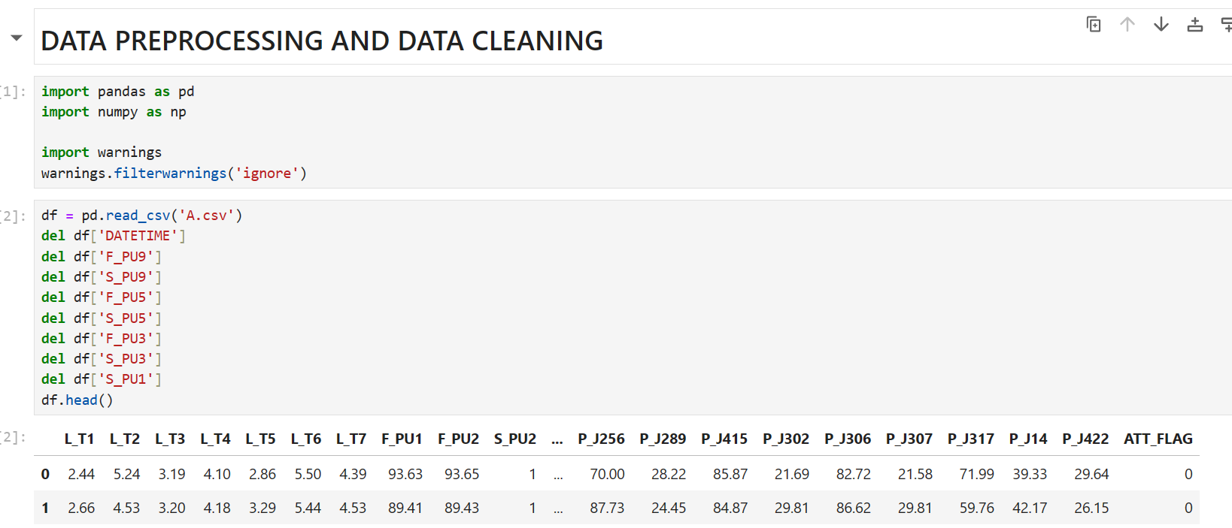
Sample Coding

Slide 24
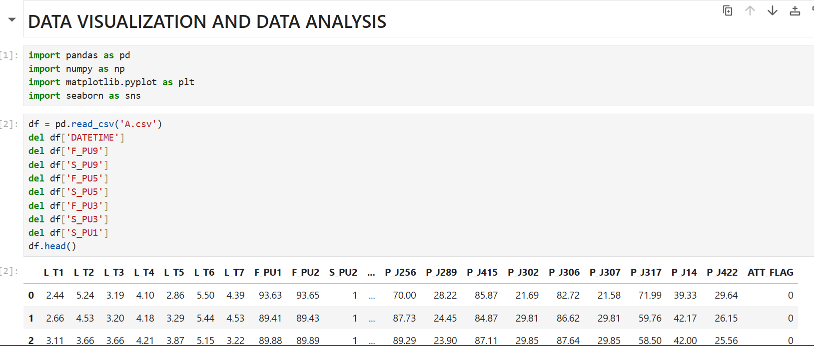
Sample Coding

Slide 25
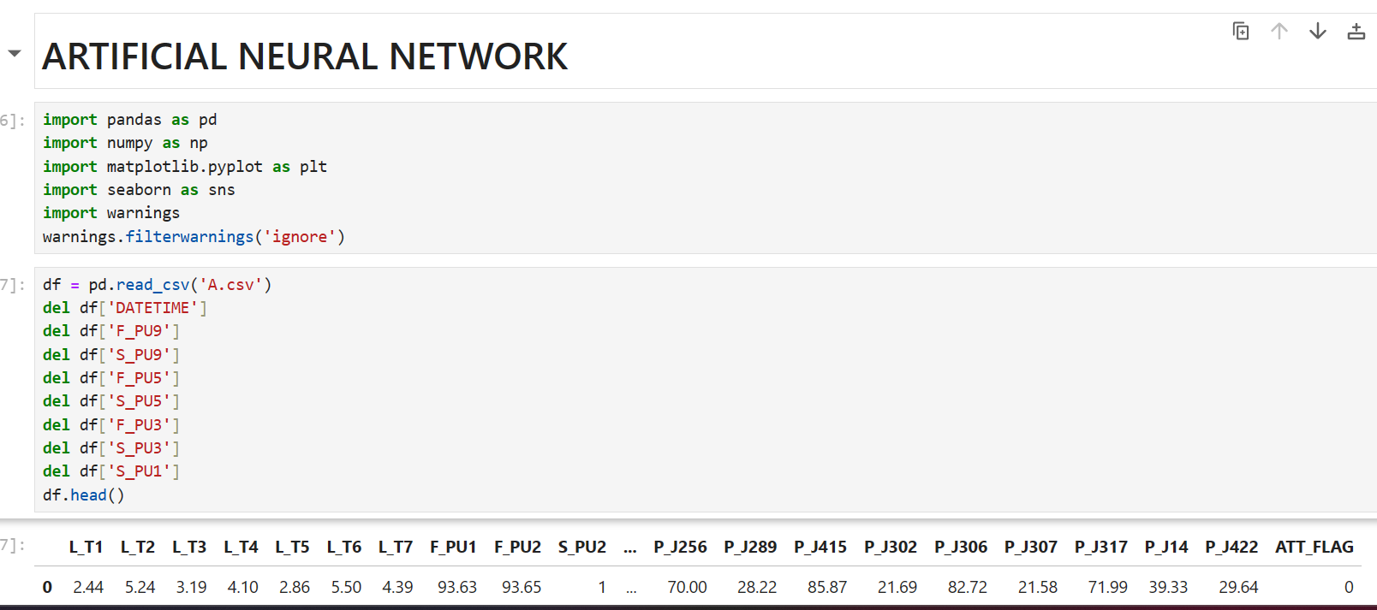
Sample Coding

Slide 26
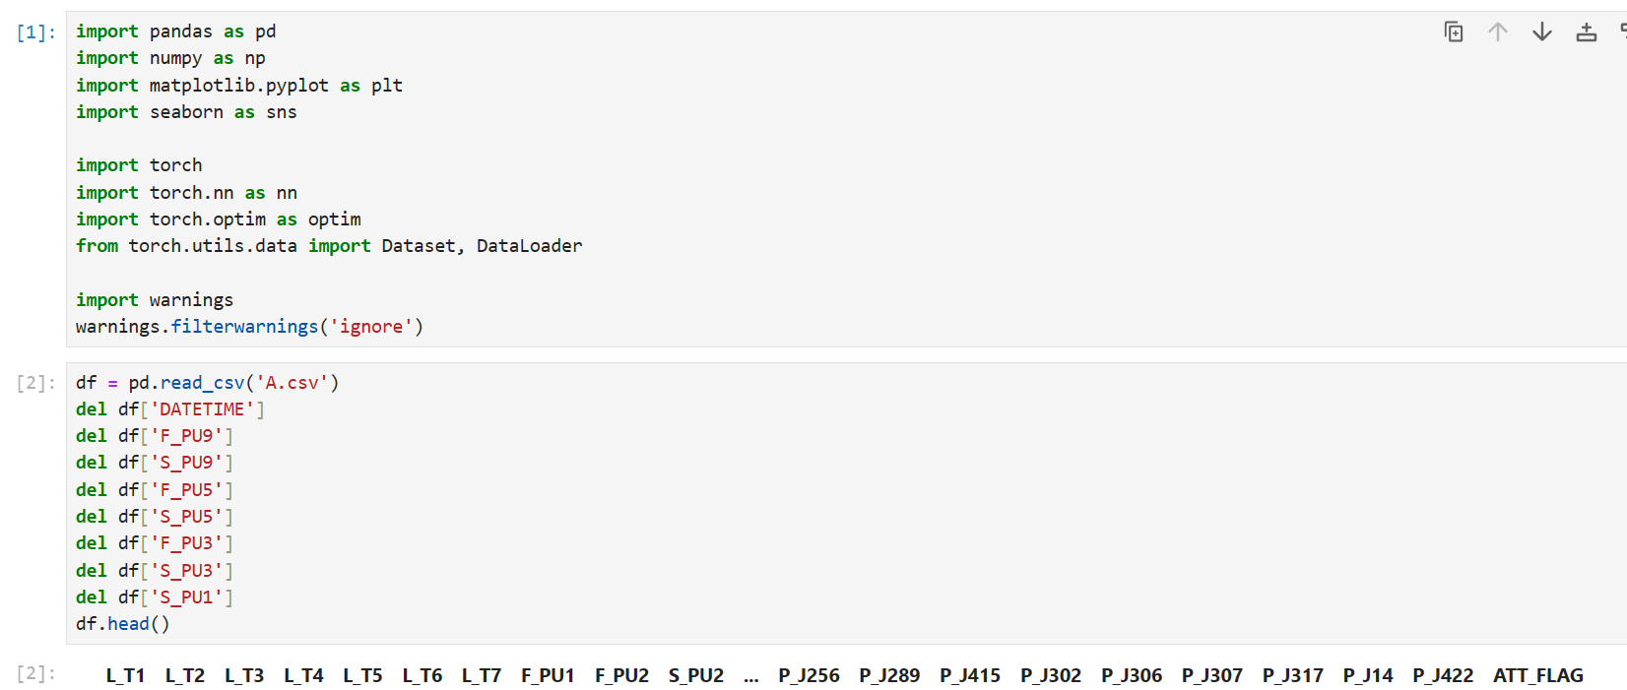
Sample Coding

Slide 27
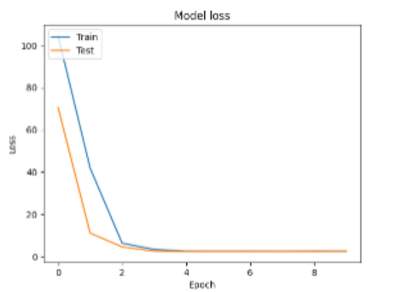
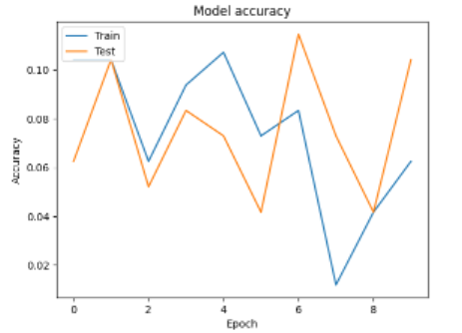
Performance measures of Proposed System

Slide 28
Project Work Flow
Collection of Datasets-10days
Data pre-processing-15days
Splitting data into test and train-10days
Feature Extraction-20days
Model Evaluation-15days

Slide 29
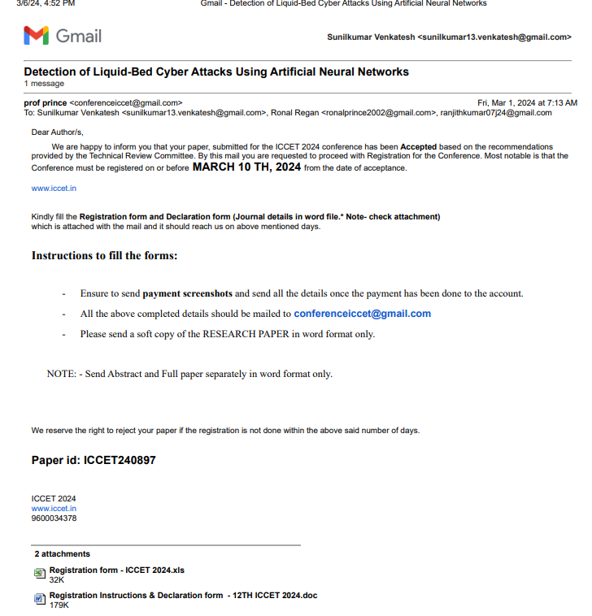
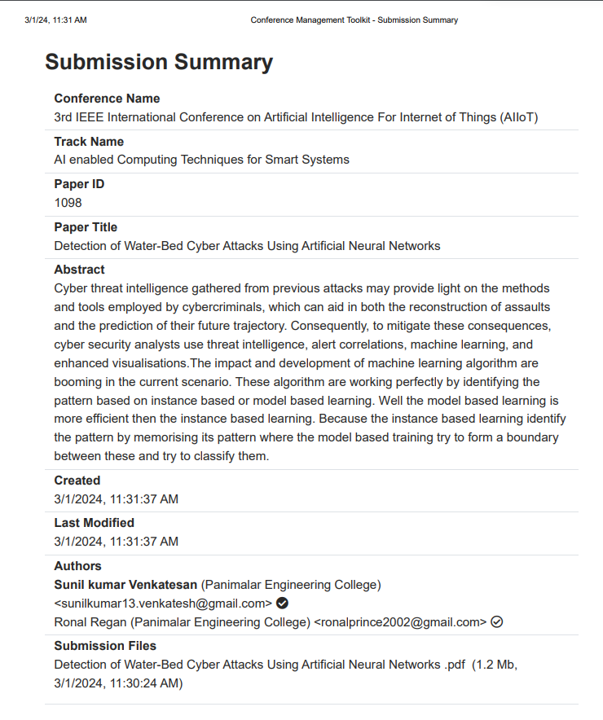
Publication Details

Slide 30
References
C. Wang, Y. Xiang, J. Sun, "A survey of techniques for internet traffic classification using machine learning," IEEE Communications Surveys & Tutorials, vol. 10, no. 4, pp. 56-76, 2008.
S. Garcia, J. Stiborek, A. Zunino, "An empirical comparison of botnet detection methods," Computers & Security, vol. 45, pp. 100-123, 2014.
A. Munir, S. Shahzad, S. Mahmood, "Intrusion Detection System using Machine Learning: A Comprehensive Review," Journal of Network and Computer Applications, vol. 126, pp. 144-174, 2019.
J. Zhang, M. Zhu, "Detecting False Data Injection Attacks on Cyber-Physical Systems: A Machine Learning Approach," IEEE Transactions on Industrial Informatics, vol. 14, no. 6, pp. 2683-2691, 2018.
M. Shafiq, S. Rehman, A. Khan, "A survey of machine learning techniques for intrusion detection systems," Journal of Network and Computer Applications, vol. 84, pp. 25-37, 2017.

Slide 31
References
6.Smith, J., & Johnson, A. (Year). "Cyber Attack Detection Using Deep Learning Techniques." Journal of Cybersecurity, Volume X, Issue X, Pages XXX-XXX.
7.Chen, Y., & Wang, Q. (Year). "A Survey on Cyber Attack Detection Using Machine Learning Approaches." IEEE Transactions on Network and Service Management, Volume X, Issue X, Pages XXX-XXX.
8.Liu, H., & Zhang, L. (Year). "Artificial Neural Networks for Intrusion Detection Systems: A Review." Journal of Computer Security, Volume X, Issue X, Pages XXX-XXX.
9.Gupta, S., & Jain, P. (Year). "Anomaly Detection in Cyber Networks Using Deep Learning Techniques." International Conference on Cyber Security (ICCS), Pages XXX-XXX.
10.Wang, M., & Li, W. (Year). "Deep Learning-Based Cyber Attack Detection: A Comprehensive Review." Journal of Information Security Research, Volume X, Issue X, Pages XXX-XXX.
11.Guo, J., & Liu, C. (Year). "Hybrid Approach for Cyber Attack Detection Using Neural Networks and Statistical Methods." IEEE International Conference on Cyber Security and Privacy (CyberSec), Pages XXX-XXX.

Slide 32
References
12.Patel, R., & Shah, S. (Year). "Anomaly Detection in Cyber-Physical Systems Using Neural Networks." International Conference on Cyber-Physical Systems (ICCPS), Pages XXX-XXX.
13.Wang, Y., & Wu, Z. (Year). "Cyber Attack Detection Using Convolutional Neural Networks." Journal of Network and Computer Applications, Volume X, Issue X, Pages XXX-XXX.
14.Tan, L., & Zhang, Y. (Year). "Enhancing Cyber Attack Detection Accuracy with Machine Learning and Neural Networks." ACM Transactions on Internet Technology, Volume X, Issue X, Pages XXX-XXX.
15.Liu, X., & Chen, Z. (Year). "Cyber Attack Detection Using Generative Adversarial Networks." International Conference on Security and Privacy in Communication Networks (SecureComm), Pages XXX-XXX.

