Slide 1
DIABETES PREDICTION SYSTEM USING MACHINE LEARNING WITH WEB APP
LOKHITHA D 211419205101
DURGA V 211419205303
DEVIPRIYA S 211419205039

Slide 2
ABSTRACT
In the medical field, it is essential to predict diseases early to prevent them. Diabetes is one of the most dangerous diseases all over the world.
In modern lifestyles, sugar and fat are typically present in our dietary habits, which have increased the risk of diabetes.
To predict the disease, it is extremely important to understand its symptoms. Currently, machine-learning (ML) algorithms are valuable for disease detection.
This article presents a model using a fused machine learning approach for diabetes prediction.
These models analyze the dataset to determine whether a diabetes diagnosis is positive or negative. The dataset used in this research is divided into training data and testing data with a ratio of 70:30 respectively.
Based on the patient’s real-time medical record, the fused model predicts whether the patient is diabetic or not.
The proposed fused ML model has a prediction accuracy of 92.7%, which is higher than the previously published methods.

Slide 3
INTRODUCTION
Diabetes usually known as Diabetes Mellitus, It is a type of metabolic disorder in which diabetics experience blood glucose difficulties as a result of irregular insulin production and release. It's also a long-term condition marked by hyperglycemia.
It is one of the world's most serious diseases, and it can lead to a variety of consequences. According to recent rises in morbidity, the global number of diabetic patients will reach 642 million by 2040, suggesting that one out of every 10 people will have the disease.
This alarming figure, without a doubt, requires quick attention. Type 1 and Type 2 diabetes are the two most common forms.
The majority of people with type 2 diabetes, on the other hand, will eventually need medicines or insulin to keep their blood glucose levels in check.
Another type of diabetes is gestational diabetes, which is characterized by high blood glucose levels during pregnancy and is linked to complications for both the mother and the child.

Slide 4
SCOPE OF THE PROJECT
This project proposed system uses machine learning algorithm to find the diabetes disease prediction.
We have many algorithms for classification such as K neighbours classifier, Random forest classifier, L bgm, XG boost , Decision Tree etc.. in future we can add more algorithms to find outputs and algorithms can be compared to find the efficient algorithm.
We can add visitor query module, where visitors can post queries to administrator and admin can send reply to those queries.
We can add treatment module, where doctors upload treatment details for patients and patient can view those treatment details.

Slide 5
OBJECTIVE
This paper to predict the disease, it is extremely important to understand its symptoms. Currently, machine-learning (ML) algorithms are valuable for disease detection.
This article presents a model using a fused machine learning approach for diabetes prediction. The conceptual framework consists of two types of models:
These models analyze the dataset to determine whether a diabetes diagnosis is positive or negative.
The dataset used in this research is divided into training data and testing data with a ratio of 70:30 respectively.

Slide 6
Literature Survey
S.NO | Name of the Paper with Year | Objective | Pros | Cons
1. | Diabetes Prediction Using Different Machine Learning Approaches, 2019 3rd International Conference on Computing Methodologies and Communication (ICCMC), 2019 | The aim of this analysis is to develop a system which might predict the diabetic risk level of a patient with a better accuracy. Model development is based on categorization methods as Decision Tree, ANN, Naive Bayes and SVM algorithms. | System was trained to quickly identify if a person is diabetic | Lots of resources were used on process
2 | Diabetes Disease Prediction Using Machine Learning Algorithms, 2020 IEEE-EMBS Conference on Biomedical Engineering and Sciences (IECBES),2020 | This paper deals with the prediction of Diabetes Disease by performing an analysis of five supervised machine learning algorithms, , i.e. K-Nearest Neighbors, Naïve Baye, Decision Tree Classifier, Random Forest and Support Vector Machine. | Supervised ML algorithms used to perform analysis and gave good outcomes | Unsupervised algorithms were totally ignored

Slide 7
Literature Survey
3. | Diabetes Prediction using Machine Learning Algorithms with Feature Selection and Dimensionality Reduction, 2021 7th International Conference on Advanced Computing and Communication Systems (ICACCS),2021 | The Principle Component Analysis (PCA) dimensionality reduction method is analyzed after the selection of specific features and the accuracy of the prediction is 83% implementing Random Forest (RF) which is significant in comparison with Support Vector Machine (SVM) with accuracy of 81.4%. | Only random forest gave good accuracy out of all algorithms | SVM went with a comparable of 81.4% accuracy below Random forest
4. | Diabetes Prediction using Machine Learning Techniques, 2019 International Conference on Intelligent Computing and Remote Sensing (ICICRS), 2019 | The objective is to predict whether a person is diabetic or not, using different classifiers such as Support Vector Machine(SVM), Naive Bayes(NB), Decision Tree(DT), K-Nearest Neighbor(KNN), Artificial Neural Network(ANN) and Random Forest(RF). | Models were built to test if a person is diabetic or not quickly | Accuracy was a big problem, less models were only made
5. | Prediction of Diabetes Using Machine Learning Algorithms in Healthcare, 2018 24th International Conference on Automation and Computing (ICAC) ,2018 | This paper discusses the predictive analytics in healthcare, six different machine learning algorithms are used in this research work. For experiment purpose, a dataset of patient's medical record is obtained and six different machine learning algorithms are applied on the dataset | Few algorithms gave good results with parameters mentioned for diabetes | Other algorithms lacked way back on accuracy

Slide 8
Literature Survey
6. | Diabetes Prediction Using Machine Learning: A Comparative Study, 2021 3rd Novel Intelligent and Leading Emerging Sciences Conference (NILES),2021 | This paper proposed a solution for the problem using machine learning techniques. We applied eight algorithms on a data set of 521 subjects. The results are compared to each other to find the best algorithm for this task | Random forest out passed all families of algorithm | Different families of algorithms were tested and failed
7. | Diabetes Prediction using Feature Extraction and Machine Learning Models, Informatics in Medicine Unlocked Volume 16, 2019, 100204 ,2019 | In this research paper, we strive to propose machine learning algorithms namely KNN, SVM, Decision Tree, Random Forest, LGBM, and Ad boost that help predict diabetes. | Our model was trained with parameters like glucose, insulin ,age etc to provide better outcomes | Only one algorithm gave good results with parameters mentioned
8. | Prediction of Diabetes Disease Using Machine Learning Model, International Conference on Communication, Computing and Electronics Systems pp 683-692, 2021 | This builds up a model for the prediction of diabetes using machine learning. The supervised machine learning algorithms used for prediction model such as decision tree, Naïve Bayes, artificial neural network, and logistic regression. | Supervised learning algorithms gave good outcomes | Un supervised algorithms lacked some parameters

Slide 9
MOTIVATION OF THE PROJECT
Health issues are increasing tremendously these days. Many people start going for complete medical check-ups during their late 40’s or 50’s of age. But our lifestyle has a great impact on health causing diabetic and other health problems.
Early detection of diabetic can prevent death rates. As most of our health care industries are aiming at diagnosing these diseases in early stages, by using machine learning technique, we can detect disease at an early stage and help to cure it completely at zero cost.
By using a proper dataset, a trained ML model is created which can diagnose a normal person and generate an output report which shows whether the person is affected by diabetic or not and also classify the diabetic level.

Slide 10
EXISTING SYSTEM
This project various researchers have been revisions in the area of diabetic by using machine learning techniques. To extract knowledge from existing medical data. This predictive analysis model using support vector machine algorithm, including logistic regression, Naive Bayes, etc.,
In this work, we examine real diagnostic medical data based on numerous risk factors using popular machine learning classification techniques to assess their performance for prediction. The proposed fuzzy decision system has achieved the accuracy of 92.7, which is higher than the other existing systems.

Slide 11
DRAWBACKS OF EXISTING SYSTEM
Diabetes is one of the deadliest diseases in the world which is rapidly increasing. It is not only a disease but also creator of different kind of diseases.
These algorithms are selected in this research after some initial experiments where we have found these techniques more effective for this problem.

Slide 12
PROPOSED SYSTEM
This project proposed a Fused Model for Diabetes Prediction. The proposed model consists of two main phases.
The first phase consists of Training Layer while the second phase consists of Testing Layer.
However, in the proposed model, we used only two widely used ML algorithms. If the proposed model does not meet the learning requirements, it will be retrained.
The second phase of the proposed framework is reflected by the testing layer. The testing layer acquires dataset from medical database, and loads preprocessed training model from the cloud.
In the proposed framework, the validation layer relates to the real-time diagnosis and classification of a diabetic.
The proposed fused ML model can use real-time patient data as input and improve the disease detection system.

Slide 13
ADVANTAGES OF PROPOSED SYSTEM
Works well with unstructured and semi structured datasets such as text.
Can attain accurate and robust results.
Is successfully used in medical applications.

Slide 14
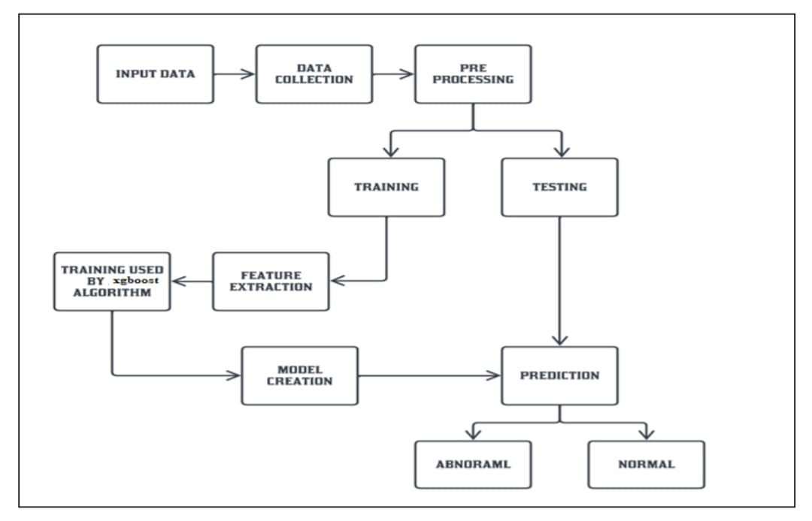
ARCHITECTURE DIAGRAM

Slide 15
SOFTWARE & HARDWARE REQUIREMENTS
H/W SYSTEM CONFIGURATION:
Processor - Intel i3,i5,i7, AMD Processor
RAM - above 4 Gb
Hard Disk - 500 GB
S/W SYSTEM CONFIGURATION:
Operating System - Windows 7/8/10
Front End - Html, Css
Language - Flask, Python

Slide 16
LIST OF MODULES
Data Collection & Pre-Processing
Feature Extraction
Model Creation
Training & Testing
Prediction

Slide 17
DATA COLLECTION AND PRE-PROCESSING
In the first step we collect data from the reliable source. Glucose, Insulin, Blood pressure, Glucose pedigree function, Body mass index(BMI), Weight, Number of pregnancies and Age are some of the criteria in the diabetes record set sample. Predicted outcome class, where '1' denotes a positive diabetes patient class and '0' denotes a negative diabetes patient class.
Pre-processing is the next step. It's an important phase in the data discovery process. The majority of health-care data contains gaps in value and inconsistencies. We apply Synthetic Minority Oversampling Technique (SMOTE) in this project, which is a well-known preprocessing approach for dealing with unbalanced datasets.

Slide 18
MODEL CREATION
The XGBoost algorithm is used in this project. It's a classification and regression supervised machine learning algorithm.
Every single accessible example is categorized according to a XGBoost calculation.
A case is assigned to the class with the most votes from classifier with the case being relegated to the XGBoost class with the most votes calculated using a separation function. Examining the set of information data determines the estimation.

Slide 19
TRAINING AND TESTING
During the training process we trained the machine from data source. The test data is transformed and predicts the accurate result.
During the training process the machine learning automatically selects the correct learning algorithm, based on the type of target that is specified in the training data source.
Training data set which will be validated using the test dataset model. The test data is transformed and predicts the accurate result is 92.7% is achieved.

Slide 20
PREDICTION
This module predicts the user is suffering from diabetic or not using XGBoost algorithm. And also predict the diabetic level normal, type 1 and type 2 using the diabetic symptoms.
After training the model we had measured with different parameters within the datasets and accuracy .
Diabetes Prediction Using Machine Learning rate of XGBoost algorithm with 92.7 % is achieved. In the future, this hierarchical framework combined with machine learning algorithms could be used to predict or analyses various disorders.
Other ML computations can be used to enhance and improve the job for diabetes examination.

Slide 21
FUTURE WORK
In future we can add more algorithms to find outputs and algorithms can be compared to find the efficient algorithm.
We can add visitor query module, where visitors can post queries to administrator and admin can send reply to those queries.
In admin module we can add more about doctors booking, treatment etc. So, the diabetic patient can book the doctors for their further treatment can view treatment module, where doctors upload treatment details for corresponding patient.
This work can be extended by involving different datasets for any other kind of predictions.
In future, this structured framework with the ML algorithms can be utilized to anticipate or analyze different illnesses.
The work can be expanded and improved for diabetes examination by utilizing other ML calculations.

Slide 22
RESULT
To implement the proposed framework, we used a dataset where the total number of instances is 520, and has 17 attributes based on diabetic symptoms.
Sixteen features are independent, and one is the target feature (dependent). The target feature is labeled as the class, which has two values .
The class 0 represents that the person has diabetic symptoms (Positive) and class 1 represents that Proposed FMDP system rule surface.
Proposed FMDP system result with diabetes the person has no diabetic symptoms (Negative).

Slide 23
CONCLUSION
This research proposed machine learning based diabetes decision support system by using decision level fusion. Machine learning techniques are integrated in the proposed model by using the logic.
The proposed decision system has achieved the accuracy of 92.7, which is higher than the other existing systems. Through this diagnosis model, we can save several lives.
Moreover, the death ratio of diabetes can be controlled if the disease is diagnosed and preventative measures are taken in early-stage.

Slide 24
REFERENCES
Amandeep Sharma, Kalpna Guleria, Nitin Goyal, “Prediction of Diabetes Disease Using Machine Learning Model”, International Conference on Communication, Computing and Electronics Systems pp 683-692, 2021
S Sivaranjani, S Ananya, J Aravinth, R Karthika,” Diabetes Prediction using Machine Learning Algorithms with Feature Selection and Dimensionality Reduction”, 2021 7th International Conference on Advanced Computing and Communication Systems (ICACCS), 2021
Mohamed Rady, Kareem Mouss, Mahmoud Mostafa, Abdelrahman Elbasry, Zeyad Ezzat, Walaa Medhat, ” Diabetes Prediction Using Machine Learning: A Comparative Study”, 2021 3rd Novel Intelligent and Leading Emerging Sciences Conference (NILES), 2021
Arwatki Chen Lyngdoh, Nurul Amin Choudhury, Soumen Moulik, “Diabetes Disease Prediction Using Machine Learning Algorithms”, 2020 IEEE-EMBS Conference on Biomedical Engineering and Sciences (IECBES), 2020
Neha Prerna Tigga, Shruti Garg, “Prediction of Type 2 Diabetes using Machine Learning Classification Methods”, Procedia Computer Science, Volume 167, Pages 706-716, 2020

Slide 25
REFERENCES
Khushboo Singh, Jitendra Kumar Rout, Himansu Das, “Diabetes Prediction using Machine Learning Techniques”, 2019 International Conference on Intelligent Computing and Remote Sensing (ICICRS), 2019
Sunil Ghane, Namrata Bhorade, Nikita Chitre, Bhargavi Poyeka, Rishita Mote, Pradnya Topale, “Diabetes Prediction using Feature Extraction and Machine Learning Models”, Informatics in Medicine Unlocked, Volume 16, 100204, 2019
Priyanka Sonar, K. JayaMalini, “Diabetes Prediction Using Different Machine Learning Approaches”, 2019 3rd International Conference on Computing Methodologies and Communication (ICCMC), 2019
Deepti Sisodia, Dilip Singh Sisodia, “Prediction of Diabetes using Classification Algorithms”, Procedia Computer Science, Volume 132, Pages 1578-1585, 2018
Muhammad Azeem Sarwar, Nasir Kamal, Wajeeha Hamid, Munam Ali Shah, “Prediction of Diabetes Using Machine Learning Algorithms in Healthcare”, 2018 24th International Conference on Automation and Computing (ICAC), 2018

