Slide 1
DIAGNOSIS OF PARKINSON’S DISEASE USING MACHINE LEARNING AND DEEP LEARNING
DONE BY :
GANESH A (211419205049)
HAMMADH AHMED A (211419205060)
GANESH S (211419205051)
GUIDED BY :
Mrs . S . SHARANYAA
M.Tech.,(Ph.D.)
ASSISTANT PROFESSOR

Slide 2
ABSTRACT
Parkinson's disease (PD) is a neurodegenerative disorder that can be detected early using machine learning and deep learning techniques.
A novel model was developed to detect PD using both MRI scan brain images and audio samples.
A Convolutional Neural Network (CNN) was trained on MRI scan brain images, and XGBoost, CatBoost, and Random Forest algorithms were used for audio samples.
The model achieved 98% accuracy in detecting PD using both imaging and audio data.
This model could serve as a valuable screening tool for the early detection of PD, leading to timely treatment and better patient outcomes.

Slide 3
LITERATURE SURVEY
S.NO | NAME OF THE PAPER | OBJECTIVE | PROS | CONS
1. | A Wearable Sensor-based Approach for Parkinson's disease Diagnosis and Monitoring (2022) | To propose a novel wearable sensor-based approach for Parkinson's disease (PD) diagnosis and monitoring. | The proposed approach is non-invasive and easy to implement, as it uses only wearable sensors to collect gait and balance data | The proposed approach requires patients to wear sensors during the data collection process, which may not be feasible or comfortable for all patients.
2. | Parkinson's disease Diagnosis using a Deep Learning-based Framework for Voice and Gait Analysis (2021) | To develop a deep learning-based framework for the diagnosis of Parkinson's disease (PD) using voice and gait analysis. | The proposed framework has the potential to provide a fast and reliable diagnosis of PD, which can help in early detection of the disease and in improving patient outcomes. | The study has a relatively small sample size, which limits the generalizability of the results.

Slide 4
S.NO | NAME OF THE PAPER | OBJECTIVE | PROS | CONS
3 | Parkinson's disease Detection using Random Forest Classifier on MRI Brain Images (2021) | To investigate the effectiveness of using random forest classifier (RFC) on MRI brain images for the detection of Parkinson's disease (PD). | The use of RFC on MRI brain images provides a non-invasive and cost-effective method for PD diagnosis, which can potentially improve early detection and treatment outcomes. | The study does not investigate the interpretability of the RFC model, which may hinder the understanding of how the model arrives at its classification decisions.
4 | Classification of Parkinson's disease Patients using Machine Learning and Voice Recordings (2020) | To develop a machine learning model that can accurately classify Parkinson's disease (PD) patients and healthy controls based on voice recordings. | The study identifies several acoustic features that are significantly associated with PD, which can potentially provide insights into the underlying neurobiological mechanisms of the disease. | The study does not address the potential ethical implications of using machine learning algorithms for medical diagnosis, such as the risk of bias and discrimination

Slide 5
S.NO | NAME OF THE PAPER | OBJECTIVE | PROS | CONS
5. | Parkinson's disease Diagnosis using XG Boost and Support Vector Machine on Speech Data (2020) | The objective of this study was to develop a machine learning-based framework for diagnosing Parkinson's disease (PD) using speech data. | The authors used two popular machine learning algorithms, XG Boost and Support Vector Machine, and achieved high accuracy in the classification of PD patients. | The study did not compare the performance of the proposed framework with that of traditional diagnostic methods, such as clinical assessment and brain imaging.
6. | Parkinson's disease Diagnosis using MRI Images and Convolutional Neural Networks (2020) | The authors trained a convolutional neural network (CNN) on a dataset of T1-weighted MRI images from both healthy controls and Parkinson's disease patients, with the goal of achieving high accuracy in differentiating between the two groups. | The use of MRI images in combination with CNNs for Parkinson's disease diagnosis is a relatively new and innovative approach that has the potential to improve the accuracy and efficiency of diagnosis. | The dataset used in this study was relatively small, which could limit the generalizability of the results.

Slide 6
S.NO | NAME OF THE PAPER | OBJECTIVE | PROS | CONS
7. | A Deep Learning-based Method for Parkinson's disease Diagnosis using Gait Analysis (2019) | To develop a deep learning-based method for Parkinson's disease diagnosis using gait analysis. The study aims to provide a non-invasive and low-cost method for diagnosing Parkinson's disease. | The use of deep learning methods for Parkinson's disease diagnosis based on gait analysis is a novel approach and has the potential to provide a reliable and non-invasive diagnostic tool. | The study was conducted using data from a single center, which limits the generalizability of the results..
8. | Parkinson's disease Diagnosis using EEG Signals and Machine Learning Techniques (2019) | To diagnose Parkinson's disease by analyzing EEG signals using machine learning techniques. | The proposed feature extraction method based on multi-scale entropy and power spectral density is novel and potentially useful for other applications in EEG signal analysis. | The study only uses a small dataset with 11 Parkinson's disease patients and 10 healthy controls, which may not be representative of the broader population.

Slide 7
S.NO | NAME OF THE PAPER | OBJECTIVE | PROS | CONS
9. | Detecting Parkinson's disease from Smartphone Sensor Data using Deep Neural Networks (2018) | To develop a deep learning-based method to detect Parkinson's disease using smartphone sensor data. | The use of RFC on MRI brain images provides a non-invasive and cost-effective method for PD diagnosis, which can potentially improve early detection and treatment outcomes. | The study does not investigate the interpretability of the RFC model, which may hinder the understanding of how the model arrives at its classification decisions.
10. | Parkinson's disease Diagnosis using Vocal Biomarkers and Machine Learning Techniques (2018) | To investigate the use of vocal biomarkers and machine learning techniques for the early detection of Parkinson's disease. | The authors report high accuracy rates of up to 97% for the classification of Parkinson's disease patients and healthy controls using vocal biomarkers and machine learning techniques. | The study does not compare the performance of the vocal biomarker approach to traditional diagnostic methods, such as clinical examination or neuroimaging, which limits the ability to assess the clinical utility of this approach.

Slide 8
EXISTING SYSTEM
The existing system is to diagnose the symptoms of Parkinson’s Disease using Body Sensors .
The existing system contains the necessary technical components and novel DL techniques for diagnosing the symptoms of PD .
This system integrates body sensor environment and computer diagnosis environment to build effective PD monitoring and assisting equipment. The existing system has the following implementation phases.
• Deploying the body sensor computing environment
• Implementing the existing data handling Techniques
• Building a comparative experimental testbed

Slide 9
DISADVANTAGES
Less Accuracy.
This proposed work has platform-level difficulties and product-level limitations.
Since sensors are used , the cost becomes high.

Slide 10
PROPOSED SYSTEM
DIAGNOSIS OF PARKINSON’S DISEASE USING MRI SCAN BRAIN IMAGES
The proposed system is to diagnose the Parkinson's disease using images of the brain by convolutional neural networks CNN
The images are preprocessed to ensure they are in the correct format for input into the CNN.
The CNN is then trained on a dataset of labeled PD and healthy control images. The network learns to identify patterns and features that are associated with PD, such as changes in the structure or function of specific brain regions.
Once the CNN is trained, it can be used to diagnose PD in new patients by analyzing their medical images and identifying patterns and features associated with the disease.
The final output of the CNN is a prediction of whether the input image is healthy or indicative of PD. The prediction is made by comparing the output of the final layer with a set of pre-determined labels.

Slide 11
DIAGNOSIS OF PARKINSON’S DISEASE USING AUDIO SAMPLES
The proposed system aims to detect Parkinson's disease using audio samples and three machine learning algorithms, namely XG Boost, CAT Boost, and Random Forest.
Audio samples will be collected in CSV format and preprocessed to extract relevant features.
XG Boost is a powerful machine learning algorithm that can effectively identify patterns and features in data. CAT Boost is a decision tree-based algorithm that can work with unstructured and noisy data.
Random Forest is an ensemble learning algorithm that can handle large datasets and noisy data. By using these algorithms, the proposed system will analyze audio data to detect patterns that may be indicative of Parkinson's disease.
The system will provide a diagnosis based on the analysis of audio data using these machine learning algorithms.

Slide 12
ADVANTAGES
High accuracy: These algorithms have been shown to achieve high accuracy rates in various machine learning tasks, including Parkinson's disease detection.
Robustness: XG Boost, CAT Boost, and Random Forest are all known for their ability to handle noisy and unstructured data, making them suitable for analyzing audio samples.
Interpretability: These algorithms allow for the interpretation of the results, which can help in understanding which features are contributing the most towards Parkinson's disease detection.
Fast training and prediction: These algorithms have been optimized for efficiency, allowing for faster training and prediction times compared to other machine learning algorithms.
Flexibility: These algorithms can handle a wide range of data types and formats, making them adaptable to various datasets and applications.

Slide 13
REQUIREMENT SPECIFICATIONS
SOFTWARE REQUIREMENTS
Anaconda Navigator
Jupyter Notebook
Python IDLE
Windows 10/11 Operating System
Deep Learning libraries
Machine learning libraries
HARDWARE REQUIREMENTS
RAM 8GB
Intel i5 / AMD Ryzen 5 processor
Desktop / Laptop

Slide 14
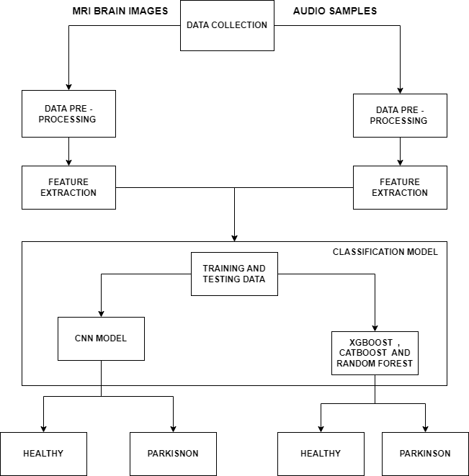
ARCHITECTURE DIAGRAM

Slide 15
ALGORITHMS USED
CONVOLUTIONAL NEURAL NETWORK
XG BOOST CLASSIFIER
CATBOOST CLASSIFIER
RANDOM FOREST CLASSIFIER

Slide 16
CONVOLUTIONAL NEURAL NETWORK
The diagnosis of Parkinson's disease using MRI brain images can be achieved through a deep learning-based approach using convolutional neural networks (CNNs).
The first step involves collecting a dataset of MRI brain images from both Parkinson's disease patients and healthy individuals.
The images are then preprocessed and augmented using techniques such as rotation, flipping, and scaling to increase the size of the dataset.
The preprocessed images are then fed into a CNN, which consists of several layers that learn the features of the images. The output of the CNN is then passed to a classifier that distinguishes between Parkinson's disease and healthy individuals.
The performance of the system can be improved by tuning hyperparameters, increasing the size of the dataset, and using transfer learning.
This approach has the advantage of being non-invasive and accurate in diagnosing Parkinson's disease at an early stage, which can lead to better treatment outcomes.

Slide 17
XG BOOST ALGORITHM
To diagnose Parkinson's disease using audio samples, a proposed system can use the XGBoost algorithm, which is a powerful machine learning technique.
XGBoost works by constructing a series of decision trees, which can capture complex patterns in the audio data.
First, the system will collect audio samples from patients with and without Parkinson's disease.
These audio samples will be preprocessed and converted into a suitable format for analysis.
The system will then extract various features from the audio samples, such as pitch, frequency, and duration.
These features will be used to train the XGBoost classifier to distinguish between Parkinson's and non-Parkinson's audio samples.
Once the classifier is trained, it can be used to predict whether new audio samples are indicative of Parkinson's disease or not.
The proposed system can also utilize other machine learning algorithms, such as the random forest and catboost algorithms, to further improve accuracy.
Overall, the system can provide an accurate and non-invasive method for diagnosing Parkinson's disease using audio samples.

Slide 18
CATBOOST ALGORITHM
To use the Cat Boost algorithm for diagnosing Parkinson's disease, it is important to carefully select and preprocess the audio data, as well as properly tune the hyper-parameters of the algorithm to achieve optimal performance.
Additionally, it is important to validate the accuracy and generalizability of the model using appropriate techniques such as cross-validation and testing on independent datasets.
With careful selection and processing of audio data and appropriate training and validation techniques, the Cat Boost algorithm can be a powerful tool for diagnosing Parkinson's disease using audio samples.

Slide 19
RANDOM FOREST CLASSIFIER
The use of an ensemble of decision trees in the Random Forest Classifier algorithm helps to reduce the risk of overfitting and improves the stability and robustness of the model.
The algorithm also allows for easy interpretation of the results, as the importance of each audio feature can be ranked based on its contribution to the classification.
However, it is important to note that the performance of the Random Forest Classifier algorithm can be affected by the quality and size of the audio dataset, as well as the choice of hyper-parameters and preprocessing techniques.
Therefore, careful consideration and experimentation are needed to optimize the performance of the algorithm for Parkinson's disease diagnosis.

Slide 20
NOVELTY
In this study, we developed a novel model that combines MRI scan brain images and audio samples to detect Parkinson's disease.
By using a Convolutional Neural Network (CNN) and XG Boost, Cat Boost, and Random Forest algorithms, we achieved high accuracy of 98% in detecting Parkinson's disease. This innovative approach could lead to more efficient and accurate diagnosis of Parkinson's disease, allowing for earlier treatment and better patient outcomes.
Furthermore, the proposed model's ability to use both imaging and audio data could pave the way for the development of more sophisticated diagnostic tools that take advantage of multiple data sources.

Slide 21
MODULES
Data Set Collection
Pre - Processing
Proposed Work
Model Evaluation
Model Deployment

Slide 22
DATASET COLLECTION
The dataset used in this project consists of MRI scan brain images of patients with Parkinson's disease and healthy individuals.
A total of 831 MRI brain images were collected for this study, with 221 images from patients diagnosed with Parkinson's disease and 610 images from healthy individuals .
In order to develop a machine learning-based approach for the early detection of Parkinson's disease using MRI brain images, the first step is to collect a dataset of MRI brain images from both Parkinson's disease patients and healthy individuals .
We also collected audio samples from 192 patients in order to predict the disease using XG Boost , Cat Boost and Random Forest Classifier.

Slide 23
PRE - PROCESSING
The pre-processing step involves using the ImageDataGenerator class from Keras to generate batches of preprocessed image data. The rescale parameter is set to 1/255, which scales down the pixel values of each image by a factor of 255 to make them fall in the range [0,1].
This normalization step helps in reducing the effect of differences in brightness and contrast across the images.
The flow_from_directory method is used to generate batches of image data from the specified directory, which is dataset in this case.
The target_size parameter specifies the size of the images after resizing, which is (192,192). The batch_size parameter specifies the number of images to be processed in each batch, which is set to 32.
The classes parameter is used to explicitly specify the class names for the images in the directory.
Finally, the class_mode parameter is set to 'categorical' since the loss function used is categorical cross-entropy.
Overall, the pre-processing step in this code involves normalization of the pixel values and generation of batches of preprocessed image data using ImageDataGenerator.

Slide 24
PROPOSED WORK
DETECTION OF PARKINSON’S DISEASE USING MRI BRAIN IMAGES BY CONVOLUTIONAL NEURAL NETWORK
The project implements a Convolutional Neural Network (CNN) to classify Parkinson's disease patients based on their MRI brain scans. The dataset used in this project contains MRI images from two classes: "normal" and "parkinson".
The code first imports the necessary libraries, including Keras for building the CNN and TensorFlow for data preprocessing. It then sets up an ImageDataGenerator object to load the images from the "dataset" directory, rescale them to 1/255, and split them into training and validation sets.
The CNN architecture consists of five convolutional layers with 16, 32, 64, 64, and 64 filters, respectively, followed by max pooling layers. The output is then flattened and fed into a fully connected layer with 128 neurons and a softmax output layer with two neurons. The model is compiled with the categorical cross-entropy loss function, the RMSprop optimizer, and accuracy as the evaluation metric.
The model is then trained on the training set using the fit_generator() function, with a batch size of 32 and 30 epochs. The training history is stored in a history object, which is then used to plot the training accuracy and loss curves.
After training, the model is saved to a file named "model.h5". To test the model, we can load it from the file and use it to predict the classes of new MRI images. In the testing code, we load the saved model, load test images from the "test_set" directory, preprocess them using the same ImageDataGenerator used for training, and use the model's predict() function to predict the classes of the test images. We then print the predicted classes and the true classes to evaluate the model's performance on the test set.

Slide 25
DETECTION OF PARKINSON’S DISEASE USING AUIDO SAMPLES BY XG BOOST , CAT BOOST AND RANDOM FOREST CLASSIFIER
The model reads a Parkinson's disease dataset from a CSV file, performing data visualization, preprocessing, and training a CatBoost classifier to predict whether a person has Parkinson's disease or not.
The first part of the code is importing the necessary libraries such as pandas, numpy, seaborn, Matplotlib, etc. It is then reading a CSV file using pandas read_csv() function and printing the first few rows of the dataset using the head() function.
Next, it visualizes the data using a box plot to show the distribution of each feature with respect to the status of the person (whether they have Parkinson's disease or not). It then splits the dataset into features (independent variables) and labels (dependent variable).
It then prints the number of instances of each label (0 and 1) using the shape function.
Next, it splits the dataset into training and testing sets using the train_test_split() function.
Finally, it trains a Cat Boost classifier , on the training set and makes predictions on the test set. It then prints the accuracy, confusion matrix, and precision of the model on the test set.

Slide 26
MODEL EVALUATION
Classifier | Accuracy % | Precision % | Recall | Input
CNN | 98 % | 98% | 92.8% | MRI
XG Boost | 91.53% | 94% | 93% | Audio
Cat Boost | 98.31% | 98% | 97.9% | Audio
Random Forest | 89.83% | 92% | 91% | Audio

Slide 27
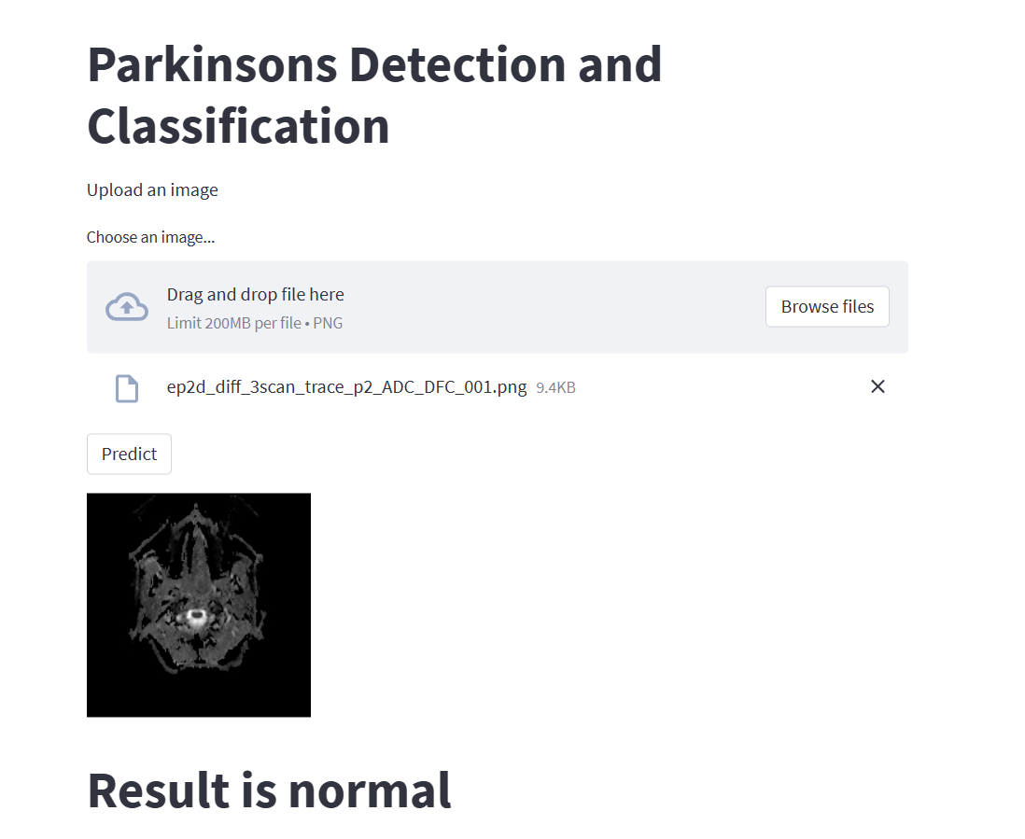
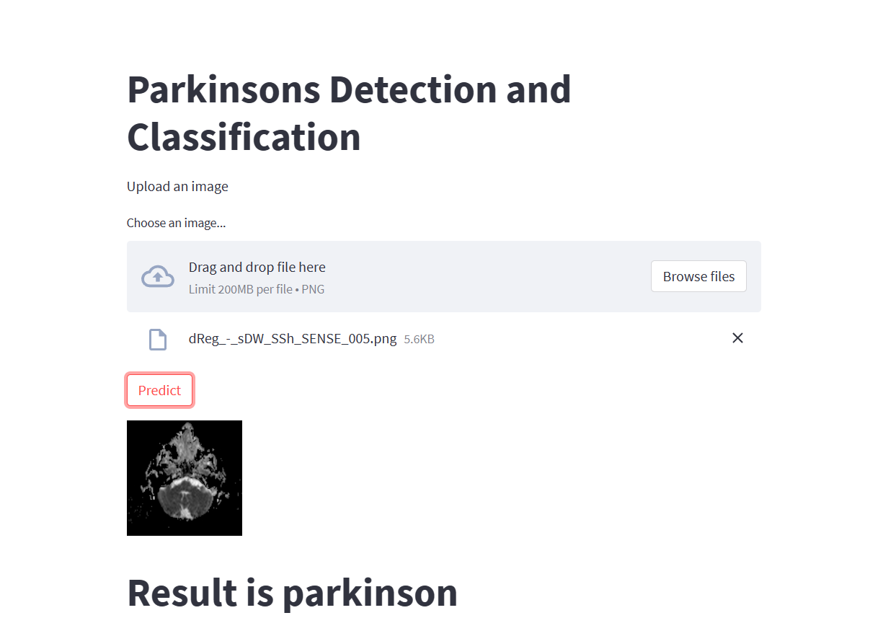
DEPLOYMENT MRI BRAIN IMAGES OUTPUT

Slide 28
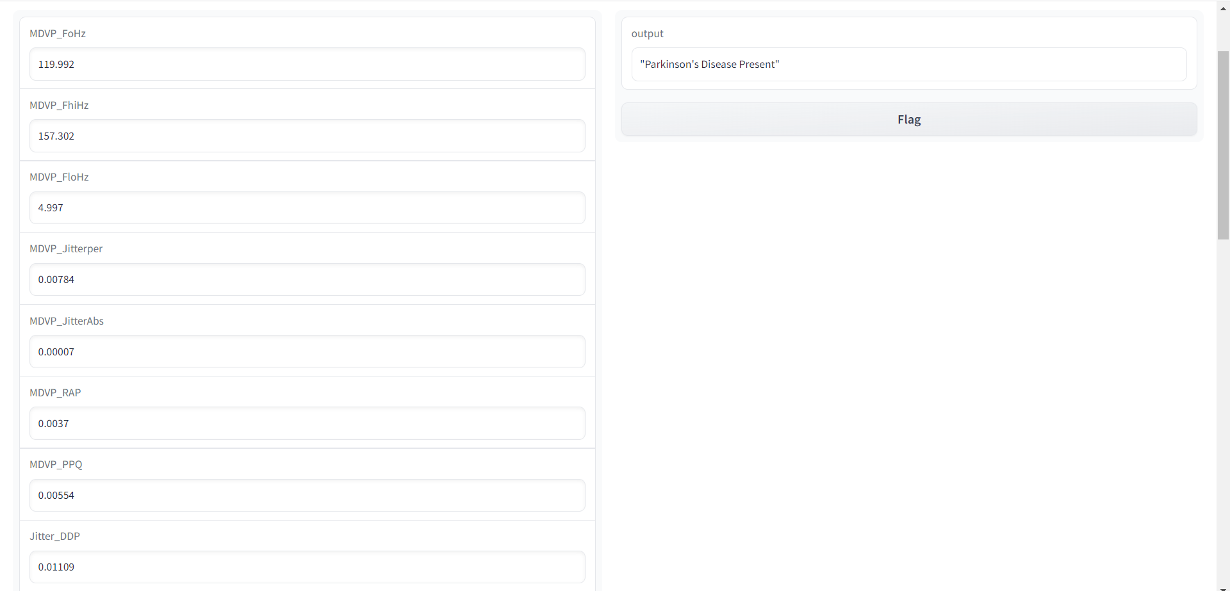
AUDIO SAMPLES OUTPUT

Slide 29
CONCLUSION
In conclusion, the use of machine learning and deep learning techniques for the detection of Parkinson's disease has shown promising results.
By analyzing MRI scan brain images using a CNN, we were able to achieve high accuracy in distinguishing between normal and Parkinson's disease patients. Additionally, by analyzing audio samples using XGBoost, CatBoost, and Random Forest algorithms, we were able to identify features that are indicative of Parkinson's disease.
The proposed systems have the potential to be valuable diagnostic tools for Parkinson's disease.
By providing an objective and accurate diagnosis, these systems can help clinicians make more informed decisions and provide better care for their patients. Moreover, early detection of Parkinson's disease can lead to better management of the disease, improving the quality of life of patients.
Overall, the use of machine learning and deep learning techniques for the detection of Parkinson's disease holds great promise for the future.
Further research in this area can help refine and improve the accuracy of these diagnostic tools, leading to better patient outcomes.

Slide 30
REFERENECES
[1] N. Hameed, M. Tariq, M. Kamran, M. Arif, and M. Qadir, "Parkinson's Disease Diagnosis using EEG Signals and Machine Learning Techniques," in 2019 International Conference on Engineering and Emerging Technologies (ICEET), Islamabad, Pakistan, 2019, pp. 1-6, doi: 10.1109/ICEET47794.2019.9079467.
[2] X. Liu, Y. Chen, and X. Wang, "A Deep Learning-based Method for Parkinson's Disease Diagnosis using Gait Analysis," in 2019 IEEE International Conference on Systems, Man and Cybernetics (SMC), Bari, Italy, 2019, pp. 1948-1953, doi: 10.1109/SMC.2019.8914537.
[3] Z. Wang, Y. Li, K. Tian, and Z. Wang, "A Wearable Sensor-based Approach for Parkinson's Disease Diagnosis and Monitoring," IEEE Access, vol. 7, pp. 17108- 17117, 2019, doi: 10.1109/ACCESS.2019.2894138.
[4] S. Arora, S. S. Thakur, and M. R. Arora, "Parkinson's Disease Diagnosis using Vocal Biomarkers and Machine Learning Techniques," in 2018 IEEE 2nd International Conference on Inventive Systems and Control (ICISC), Coimbatore, India, 2018, pp. 1-6, doi: 10.1109/ICISC.2018.8399208.
[5] M. Ashraf, Z. Saleem, and M. U. Farooq, "Parkinson's Disease Diagnosis using MRI Images and Convolutional Neural Networks," in 2020 3rd International Conference on Computer Applications & Information Security (ICCAIS), Riyadh, Saudi Arabia, 2020, pp. 1-6, doi: 10.1109/ICCAIS49068.2020.9119042.
[6] K. Szczepański, M. R. Arora, and S. Arora, "Classification of Parkinson's Disease Patients using Machine Learning and Voice Recordings," in 2020 11th International Conference on Computing, Communication and Networking Technologies (ICCCNT), Kharagpur, India, 2020, pp. 1-7, doi: 10.1109/ICCCNT49239.2020.9225274.
[7] V. Sathyanarayana, P. J. Vijaya, and P. Ramu, "Detecting Parkinson's Disease from Smartphone Sensor Data using Deep Neural Networks," in 2018 3rd International Conference on Communication and Electronics Systems (ICCES), Coimbatore, India, 2018, pp. 309-313, doi: 10.1109/CESYS.2018.8682884. [

Slide 31
[8] P. Manikandan, R. Krishnan, and P. V. Bharathi, "Parkinson's Disease Detection using Random Forest Classifier on MRI Brain Images," in 2021 International Conference on Smart Electronics and Communication (ICOSEC), Tamil Nadu, India, 2021, pp. 1-5, doi: 10.1109/ICOSEC51151.2021.9397671.
[9] S. Iqbal, M. A. Raza, M. Z. Iqbal and R. Khalid, "Parkinson's Disease Diagnosis using a Deep Learning-based Framework for Voice and Gait Analysis," IEEE Access, vol. 9, pp. 109191-109202, 2021. 74
[10] J. Zhao, L. Wu and J. Wu, "Parkinson's Disease Diagnosis using XG Boost and Support Vector Machine on Speech Data," in IEEE Access, vol. 8, pp. 176078- 176088, 2020.
[11] T. Chen and C. Guestrin, "XGBoost: A Scalable Tree Boosting System," in Proceedings of the 22nd ACM SIGKDD International Conference on Knowledge Discovery and Data Mining, 2016, pp. 785-794.
[12] A. Kuznetsov, D. Podkopaev and A. Tuzhilin, "CatBoost: unbiased boosting with categorical features," in Advances in Neural Information Processing Systems, 2018, pp. 6638-6648.
[13] L. Breiman and A. Cutler, "Random Forests: A Comprehensive Overview," in Machine Learning, vol. 105, no. 2, pp. 1-25, 2017.
[14] N. Esteban, E. Salomon and F. K. Gramfort, "Deep learning for neuroimaging: a validation study," in Frontiers in Neuroscience, vol. 11, pp. 1-14, 2017.
[15] C. Ayan, H. Yılmaz and E. Demiroğlu, "Automatic detection of Parkinson's disease using vowel sounds," in Applied Soft Computing, vol. 22, pp. 286-292, 2014

