Slide 1
disabled PATIENT MANAGEMENT SYSTEM
RESHMA.B[211414205084]
SIRISHA.A[211414205101]
SUNANTHA.K[211414205110]
PROJECT GUIDE:
Dr .M. HELDA MERCY

Slide 2
ABSTRACT
This application is mainly designed for hospitals, which treats both the hearing and speech problem patient.
Hospitals currently use a manual system for the management and maintenance of critical information.
The current system requires numerous paper forms, with data stores spread throughout the hospital management standards.
This system helps to control the patient’s demographic details , case history and the examination results.

Slide 3
These services are to be provided in an efficient, cost effective manner, with the goal of reducing the time and resources currently required for such tasks.
This system will automate the management of the patient details making it more efficient and error free.

Slide 4
EXSISTING SYSTEM
The existing system provides the basic functionalities needed to be handled in a hospital management environment.
There is no intelligence of the software in such cases. In the existing system all the patients details, case history and regarding the tests done to the patients prescribed by the doctor is maintained manually by the receptionist.
And there is no proper search technique to check the patient information. It is a very difficult task to maintain all the records in the hospital by using this existing system.
.

Slide 5
DISADVANTAGES
Loss of information.
Database is not maintained efficiently.
Redundancy of data.
Usage cost is high.
Possibility of human error.

Slide 6
PROPOSED SYSTEM
In the proposed system, we are going to provide solutions to all the problems faced in the existing system by automating the whole management system in the hospital by using the integrated software that handles the whole system.
This application would accept details from the patients case history like ENT surgery, Ear discharge, medical history and proforma details like voice evaluation, fluency disorder assessment for deaf and dumb patients.
The proposed system provides one integrated view to patient demographic details, case history and examination results.
Effective search facility to search any type of information related to patient history.
.

Slide 7
ADVANTAGES
No redundancy of data.
Database is maintained efficiently.
Error free software.
Cost efficient.

Slide 8
SOFTWARE REQUIREMENTS
Operating system : Windows XP, 7 and more.
Coding Language : PHP
Tools used : Xampp , Notepad++
Database : My Sql.
Front End Tool : HTML , CSS , Bootstrap.
Back End Tool : Php , My Sql.

Slide 9
HARDWARE REQUIREMENTS
RAM : Min 512 MB.
Processor : Pentium IV 2.4 GHz.
Hard Disk : min 40 GB.
Motherboard : Genuine Intel.

Slide 10
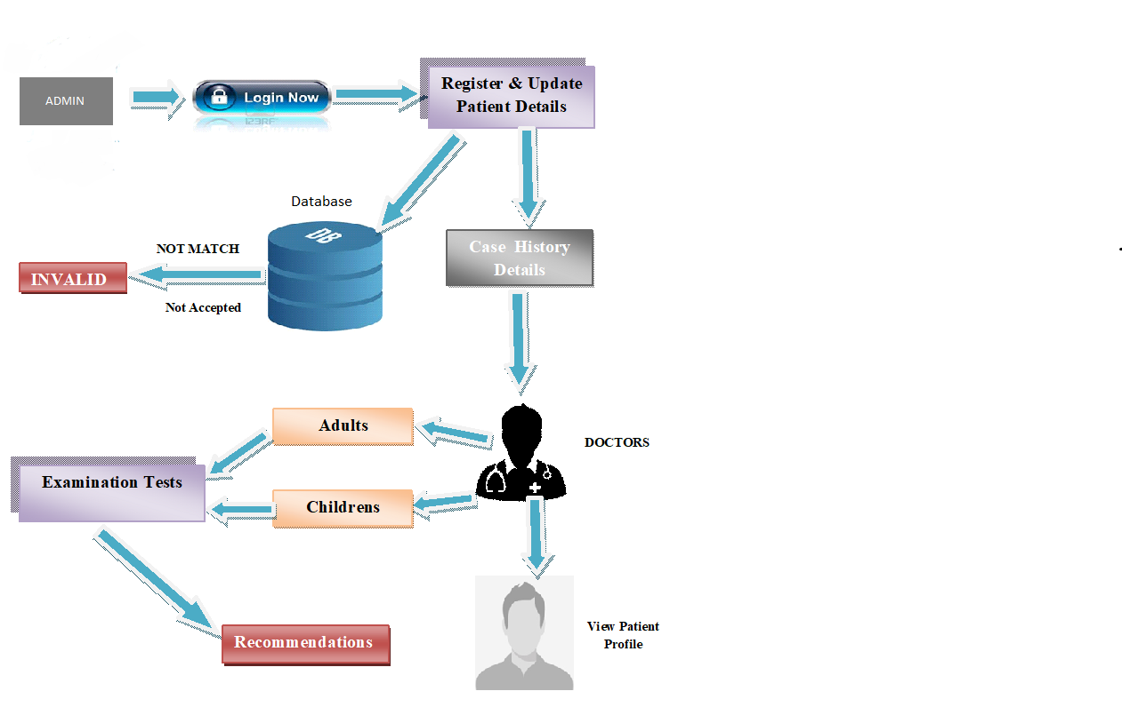
ARCHITECTURE DIAGRAM

Slide 11
NOVELTY
At present in the MERF hospital all the patient details are written manually ,as the management of the data is difficult this software will be helpful to store the data in digital format.

Slide 12
LIST OF MODULES
Login
Data Collection/Entry
Evaluation phase
Recommendation

Slide 13
MODULE DESCRIPTION
Login:
Login provides access only to the authenticated users through a login id and password.
After the user logs in ,he/she can get an access to the database and also can enter new data.

Slide 14
Data Collection/Entry:
In the data collection module, patient registers details based on general and demographic information.
Patients are allocated a Unique Identification Number (UID) which helps in implementing patient relationship with management and also maintain the medical history such as hypertension, diabetes , renal disorder, carcinoma and otologic history of the patient.

Slide 15
Evaluation Phase:
After obtaining the patient details based on the analysis, the patient is sent to the corresponding examiner.
Then the examiner conducts the required special tests like pure tone audiometry, fluency disorder ,voice evaluation etc.. to the deaf and dumb patients.
The acquired test results will be stored in this phase.

Slide 16
Recommendation:
Recommendation, after the patient diagnosis the consulting date and the final observations is entered in the provided text space for further references.

Slide 17
OUTPUT SNAPSHOT

Slide 18
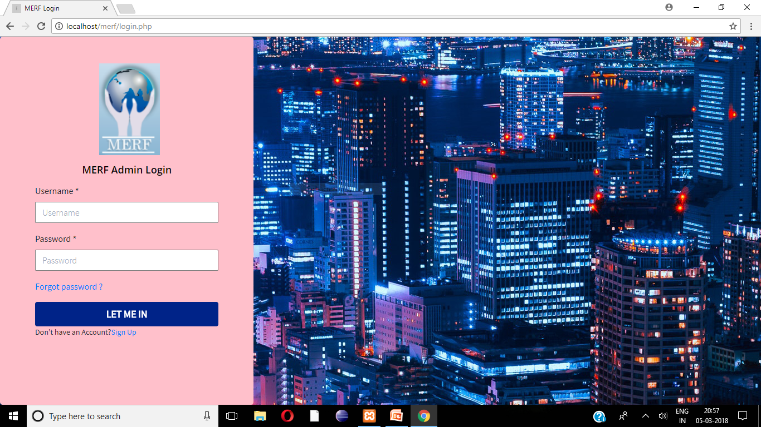

Slide 19
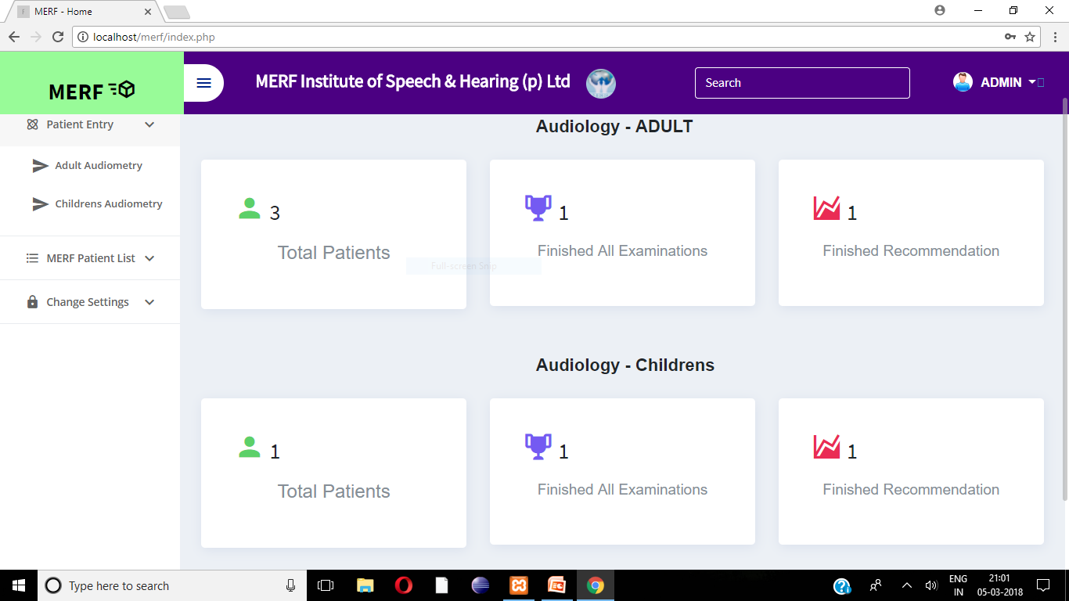

Slide 20
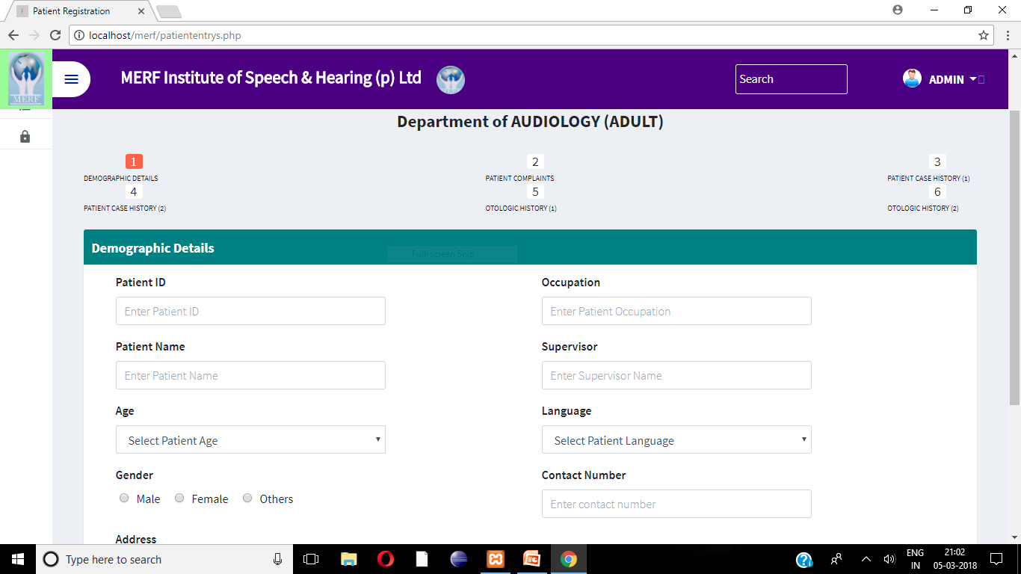

Slide 21
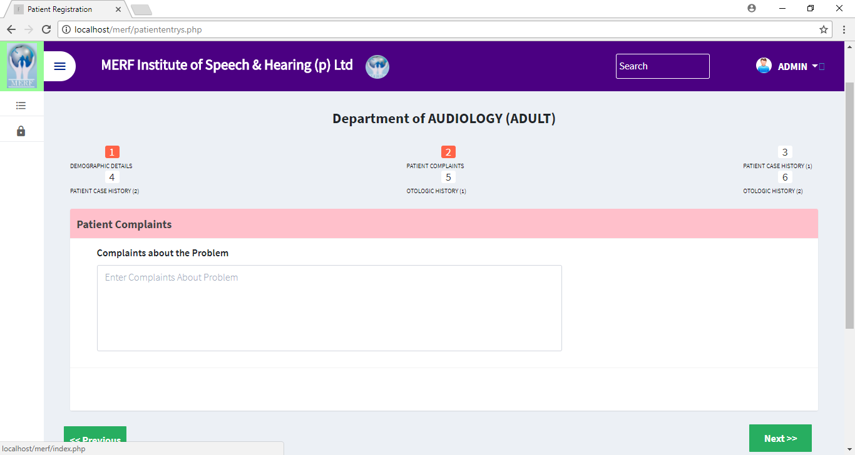

Slide 22
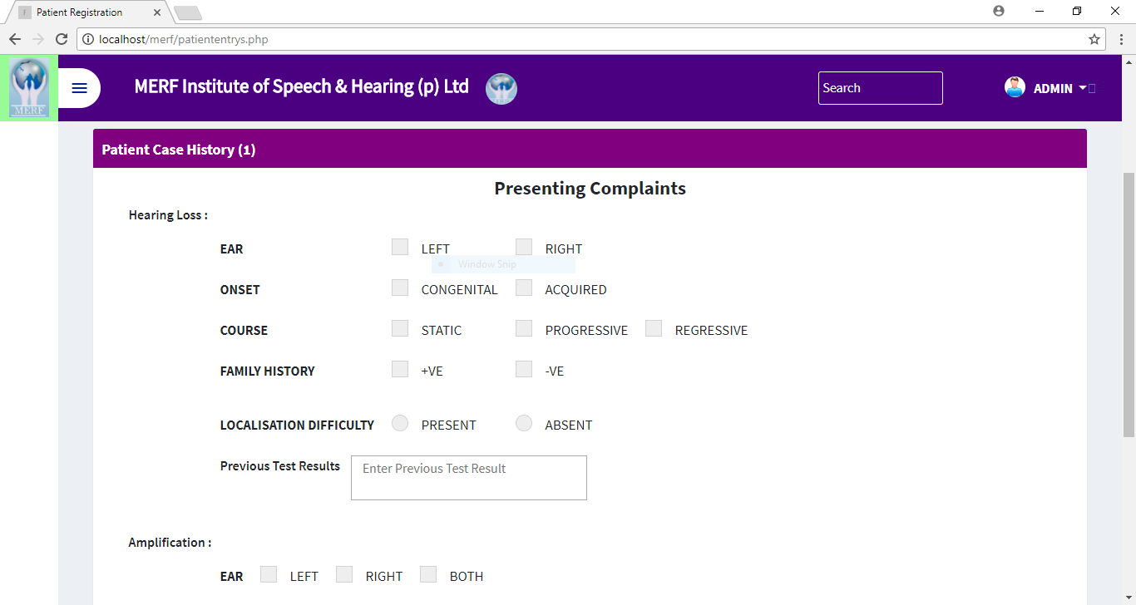

Slide 23
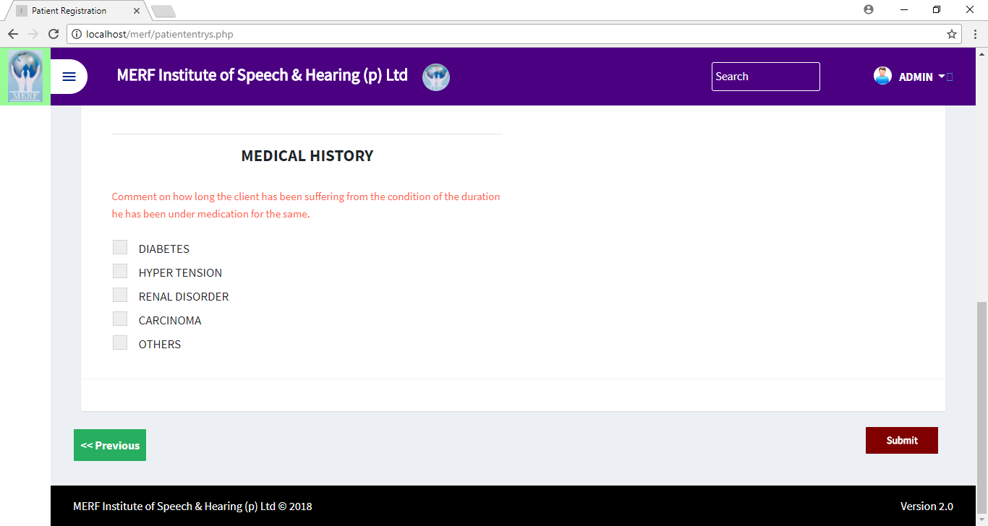

Slide 24
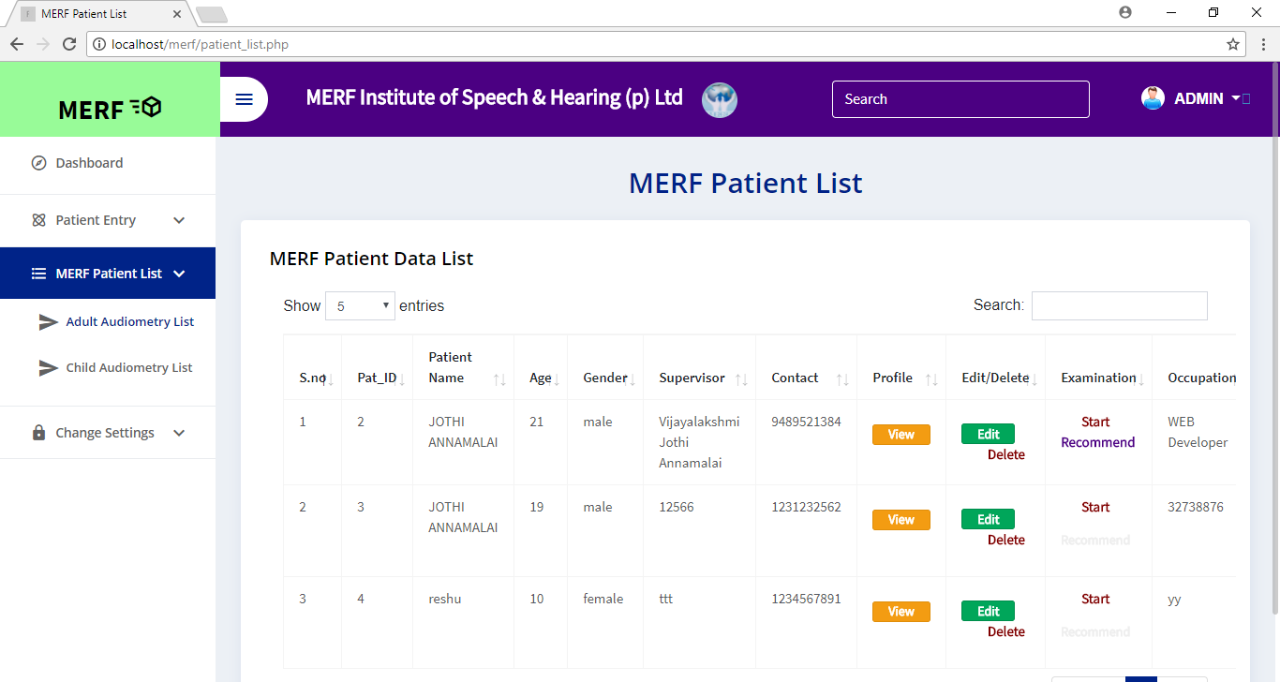

Slide 25
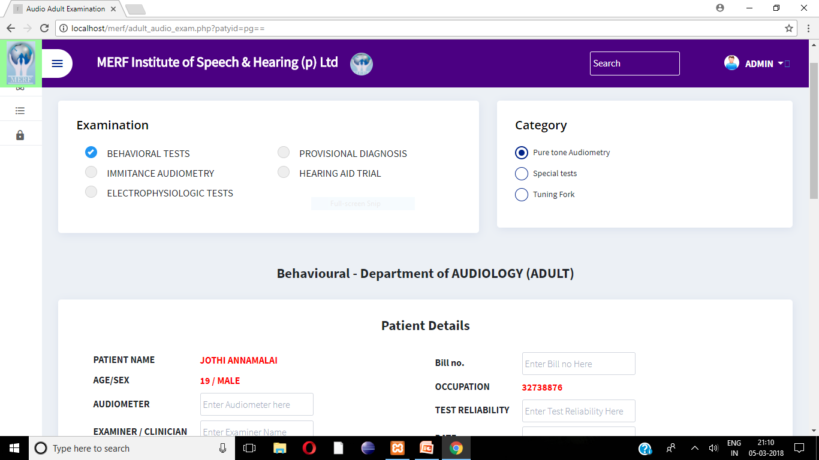

Slide 26
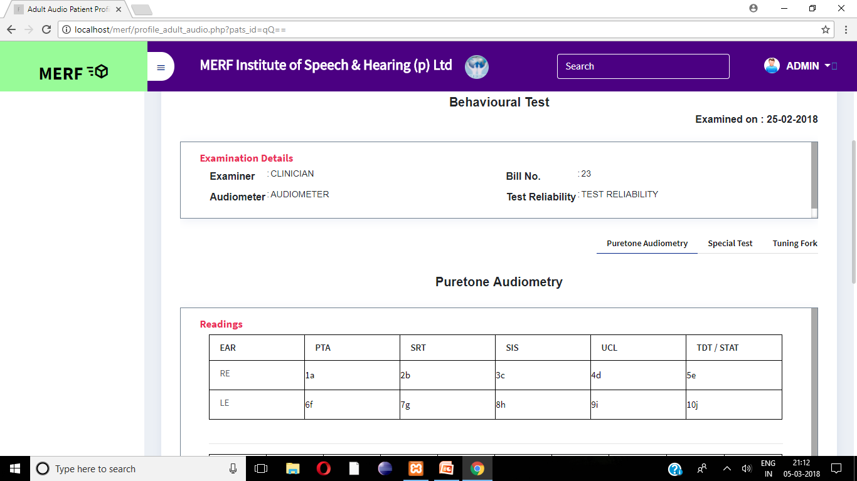

Slide 27
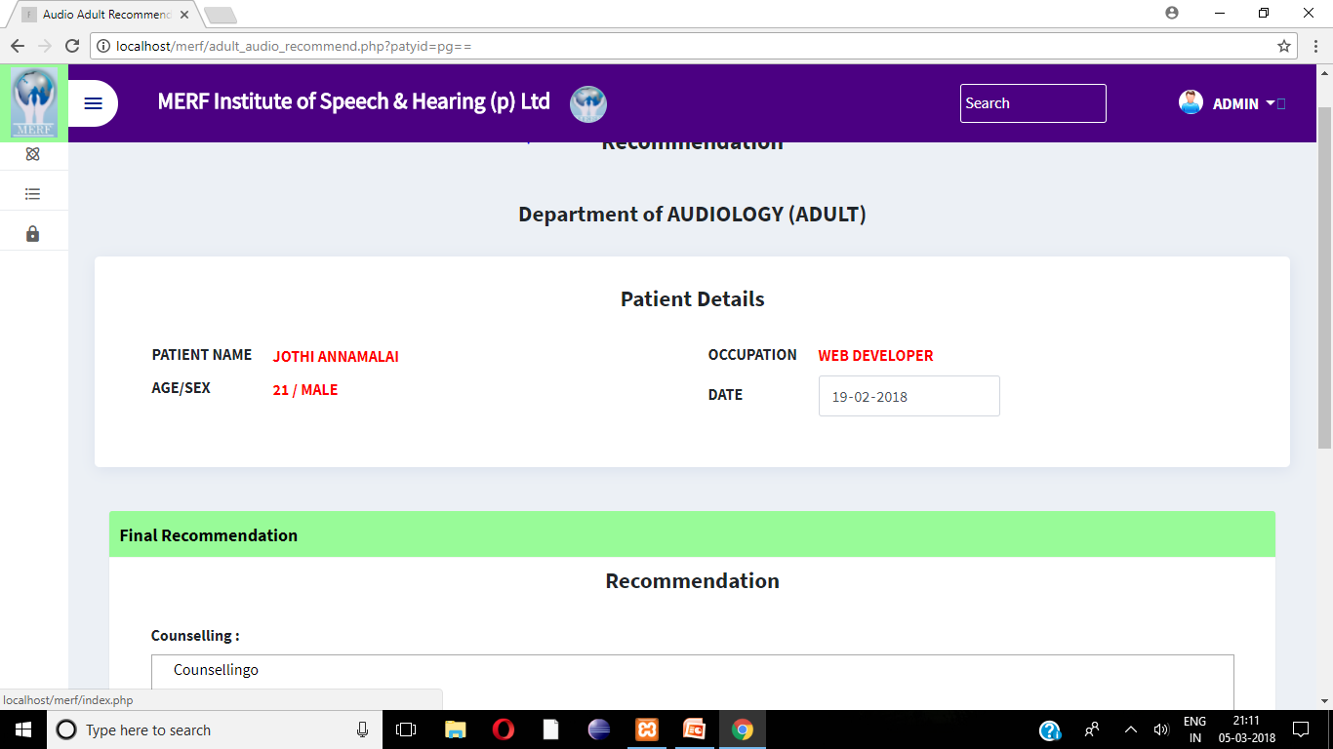

Slide 28
