Slide 1

PANIMALAR ENGINEERING COLLEGE AN AUTONOMOUS INSTITUTION DEPARTMENT OF INFORMATION TECHNOLOGY
IT8611 Mini Project Project Review
III year/VI sem
DROWSINESS DETECTION WITH EMERGENCY ALERT SYSTEM
Team Members
VARSHAA.A.S(211420205174)
VEDHASHINI.K(211420205175)
VIGNESHWARI.G(211420205179)

Slide 2
Abstract
Most of the road accidents are caused because of drowsiness and also working environments, reduced sleep and time factor. Driver drowsiness and fatigue driving reduces the driver decision making capability and perception level.
These two situations affect the ability to control the vehicle. There are some techniques which are used to detect drowsiness in drivers like by sensing of driver operation or physiological characteristics of driver like or vehicle movement etc.

Slide 3
Literature Survey
AUTHOR | TITLE | YEAR
M.S. Satyanarayana et. al | Continuous Monitoring and Identification of Driver Drowsiness Alert System | 2021
C.Jacobe de Naurois et.al | Detection and prediction of driver drowsiness using artificial neural network models | 2017
H.Iwamoto et.al | Real-driving-implementable drowsy driving detection method using heart rate variability based on long short-term memory and autoencoder | 2021

Slide 4
Literature Survey
AUTHOR | TITLE | YEAR
Uche M. Chikezie et. al | Drowsiness detection system using computer vision and IoT | 2021
A.K. Biswal et.al | IoT-Based Smart Alert System for Drowsy Driver Detection | 2021
Chaitanya V Shembekar | IoT based Alcohol and Driver Drowsiness Detection and Prevention System | 2020

Slide 5
Existing System
Several methods to provide safety while driving like collision avoidance using ir sensors fuel detection systems lane change assistance and adaptive light control system
The primary downside is that their sensors are used to find out the presence of other vehicles pedestrians and some other objects to avoid crashes and accidents
In case of consistent transceivers are better than sensors and the maximum range of transceivers is about 20 metres it is not cost-effective and battery friendly

Slide 6
PROPOSED SYSTEM
In our method eye is the decision parameter for finding the state of the driver. Though detection of the eye may be easier to locate, it’s really quite complicated.
At this point, it performs the detection of the eye in the required particular region with the use of the detection of several features. It is a time taking process.
When eye detection is done then the result is matched with the reference or threshold value for deciding the state of the driver.
If the Drowsiness state is detected this system will automatically alert the driver, if it continues it’ll slow down the vehicle and stop it as a proof of concept.

Slide 7








Architecture Diagram

Slide 8
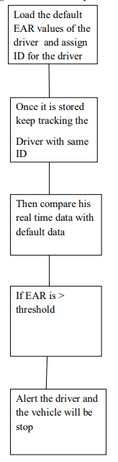
EAR COMPARISON FLOW

Slide 9
HARDWARE AND SOFTWARE REQUIREMENTS
Hardware Requirements
ATMEGA328 Microcontroller
Liquid Crystal Display
Motor Driver L298N
12v DC Gear Motor
12V/1A transformer
Data Transferring Cable
Software Requirements
Arduino IDE
Python
OpenCV

Slide 10
METHODOLOGY
The main aim is to detect the drowsiness of the driver, it can be done in different ways like detecting the facial expression of the driver and measuring the Eye Aspect Ratio (EAR).
Haar Cascade Classifiers
Shape predictor

Slide 11
Haar Casacade Classifiers
Haar cascades are one of many algorithms that are currently being used for object detection. One thing to note about Haar cascades is that it is very important to reduce the false negative rate, so make sure to tune hyperparameters accordingly when training your model.

Slide 12
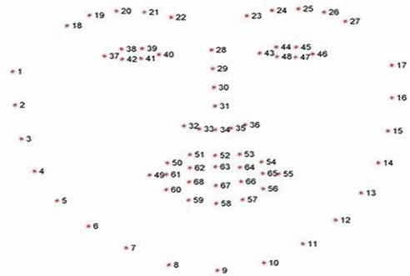
Shape predictor
In order to predict the face and eye region in the live video stream, shape predictor is used. It shows the sleepiness which is measured by calculating the eye aspect ratio (Euclidean distance between the eyes are calculated), the arguments are passed to the predefined dataset and facial landmark detection is carried out. For every video sequence, the eye landmarks are located. The aspect ratio between width and height of the eye is calibrated.

Slide 13
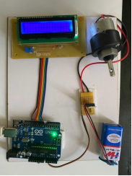
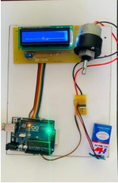
RESULT
a) Circuit b) Output message on LCD display

Slide 14
References
[1] M.S. Satyanarayana, P. Aruna, P. Guruprasad, Continuous Monitoring and Identification of Driver Drowsiness Alert System, Glob. Transitions Proc. 2 (2021). https://doi.org/10.1016/j.gltp.2021.01.017.
[2] C. Jacobé de Naurois, C. Bourdin, A. Stratulat, E. Diaz, J.-L. Vercher, Detection and prediction of driver drowsiness using artificial neural network models, Accid. Anal. Prev. 126 (2017). https://doi.org/10.1016/j.aap.2017.11.038.
[3] H. Iwamoto, K. Hori, K. Fujiwara, M. Kano, Real-driving-implementable drowsy driving detection method using heart rate variability based on long short-term memory and autoencoder, IFAC-PapersOnLine. 54 (2021) 526–531. https://doi.org/10.1016/j.ifacol.2021.10.310.
[4] A.K. Biswal, D. Singh, B. Pattanayak, D. Samanta, M.-H. Yang, IoT-Based Smart Alert System for Drowsy Driver Detection, Wirel. Commun. Mob. Comput. 2021 (2021) 1–13. https://doi.org/10.1155/2021/6627217.
[5] D. Borikar, Accident Detection and Emergency Alerting System for Road Safety, Biosci. Biotechnol. Res. Commun. 13 (2020) 256–259. https://doi.org/10.21786/bbrc/13.14/60.
[6] S. S, J. E, S. N, V. R, Drowsiness Detection using CNN, in: 2021. https://doi.org/10.3233/APC210105.

Slide 15
Reference
[7] U. Chikezie, N. Nwazor, A DROWSINESS DETECTION SYSTEM USING COMPUTER VISION AND IoT, IARJSET. 8 (2021). https://doi.org/10.17148/IARJSET.2021.81201.
[8] R. Mathavan, V. Rohitram, C. Ashhwath, S. Periyasamy, Drowsiness Detection and Rest Stop Suggestion, J. Phys. Conf. Ser. 2115 (2021) 12028. https://doi.org/10.1088/1742-6596/2115/1/012028.
[9] C. Shembekar, IoT based Alcohol and Driver Drowsiness Detection and Prevention System, Int. J. Eng. Res. V9 (2020). https://doi.org/10.17577/IJERTV9IS090375.
[10] R. Jabbar, M. Shinoy, M. Kharbeche, K. Al-Khalifa, M. Krichen, K. Barkaoui, Driver Drowsiness Detection Model Using Convolutional Neural Networks Techniques for Android Application, 2020. https://doi.org/10.1109/ICIoT48696.2020.9089484.
[11] G. Federico, G. Petrelli, In-Vehicle Drowsiness Detection, (2022).
[12] M. Wankhede, Vehicle Accident Detection and Emergency Alert System, Int. J. Res. Appl. Sci. Eng. Technol. 7 (2019) 2617–2619. https://doi.org/10.22214/ijraset.2019.5432.
[13] R. Kepner, EFFICIENCY OF THE EMERGENCY ALERT SYSTEM, (2022).
[14] U. Chikezie, N. Nwazor, A DROWSINESS DETECTION SYSTEM USING COMPUTER VISION AND IoT, IARJSET. 8 (2021). https://doi.org/10.17148/IARJSET.2021.81201.
[15] D. M., IOT based Drowsiness Detection System for Road Safety, Int. J. Psychosoc. Rehabil. 24 (2020) 7290–7296. https://doi.org/10.37200/IJPR/V24I5/PR2020761.
[16] C. Shembekar, IoT based Alcohol and Driver Drowsiness Detection and Prevention System, Int. J. Eng. Res. V9 (2020). https://doi.org/10.17577/IJERTV9IS090375.

