Slide 1

PANIMALAR ENGINEERING COLLEGE AN AUTONOMOUS INSTITUTION DEPARTMENT OF INFORMATION TECHNOLOGY
IT8611 Mini Project Project Review
III year/VI sem
Detection Of Violence In Videos
Team mates
SANDHYA B (211420205130)
SONAL K (211420205148)
SOWMIYA K P (211420205150)

Slide 2
ABSTRACT
Detecting the violence in the video automatically is already implemented in video surveillance and movie grading.
The audio-visual input in a violent video may not be semantically consistent, yet most methods for recognizing violent videos neglect this problem.
If we mindlessly fusing the differences in the characteristics will not be beneficial it may tied to cause harm to the models.
The next stage is to combine these multimodal characteristics utilising a feature-level fusion technique and shared subspace learning.
To test out our model we carry out the test in various video sources available. The result of our model had high success rate.

Slide 3
LITERATURE SURVEY
Sno | Paper Name &year | Author Name | Problem defined | Methodology | Solution | Drawback
01 | Multi -Scale Spatio-Temporal Network for Violence Behavior Detection (2015) | wei zhou | Providing a measure of efficacy and superiority of the suggested strategy in terms of calculation speed | STM module,double pooling layer,STB,LTB,Trans. | a multi-scalespatio temporal network termed as MSTN is proposed to detect violence from video | Due to the complex scene in real life, some non-violence actions have large variation.
02 | Violence detection | XIAOYU WU | On the basis of spatial coherence, violent video detection, the traditional methods with Deep Learning and feature fusion baseline. | MULTIMODAL FEATURE EXTRACTION,FEATURE FUSION BASELINE,semantic correspondance | feature-levelfusion strategy to fuse these multimodal features via shared subspace learning. | semantic correspondence information in feature fusion stage to eliminate interference of non-corresponding data is complex and not available for certain frames

Slide 4
 | Paper Name &year | Author Name | Problem defined | Methodology | Solution | Drawback
03 | An Infrastrucre for Recognizing Aggression in Video Monitoring Systems ViFand LBP | Piyush Vashistha | To detect abnormal activities in the videos with help of motion magnitude andoptical flow. | This is done by using reading the facial expressions in the video. | It is proposed to identify violence in video surveillance system using ViF and LBP . | The detection were detected in certain set of quantities only
04 | Detection of Violent Behavior Using Neural Networks and Pose Estimation(2022) | JOSÉ C. ORTÍZ-BAYLISS | solutions for pedestrian safety are guards, police car patrolling, sensors, and security cameras | 3D convolutional neural networks (3D-CNNs), spatio-temporal models, long short-term memory networks, pose estimation. | uses a time window frame to extract joint angles, given by the pose estimation algorithm, as features for classifying behavior. | tracking method is somewhat limited.testing with other modern approaches like DeepSort, but it also had issues with people crossing paths.it required lots of computational power.

Slide 5
EXISTING SYSTEM
About Previous Methods
We provide a method for identifying violent videos based on the audio-visual data. The characteristics of three separate modalities appearance, motion, and audio are extracted using deep neural networks. The next stage is to combine these multimodal characteristics utilising a feature-level fusion technique and shared subspace learning. To test out our model we carry out the test in various video sources available.

Slide 6
PROPOSED SYSTEM
Varied behaviour in crowds.
Distinction between violent and non-violent behaviour.
Creating a system to detect this by means of machine learning.
Video Surveillance on the rise all over the world.

Slide 7
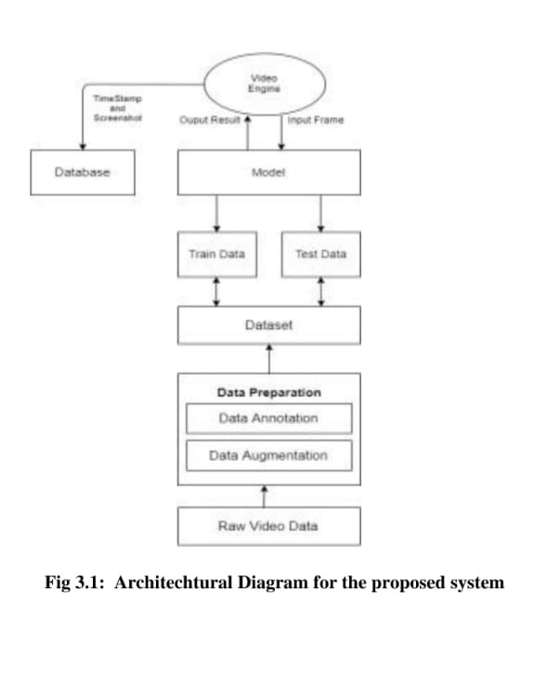
ARCHITECTURE DIAGRAM

Slide 8
REQUIREMENTS OF THE PROJECT
Hardware Requirement : 5gb RAM
Software Requirement : PYTHON IDLE
OPEN CV2
PIP

Slide 9
MODULES OF THE PROJECT
Frame by Frame:
We first have to insert the video and load the videos.
Create a Haar cascade classifier for detecting faces.
Initialize frame count.
Loop through each frame of the video.
Read a frame from the video. If there are no more frames, break out of the loop.

Slide 10
MODULES OF THE PROJECT
2. Grayscale :
Convert the frame to grayscale.
Detect faces in the grayscale frame.
Loop through each face.
Every time a new frame is read from the camera(frame_count+=1).

Slide 11
MODULES OF THE PROJECT
3. Threshold :
After incrementing the frame count.
We have to check whether the frame count exceeds and if it exceeds set the violence detection flag.
Display the frame.
4.Quitting :
If the 'q' key is pressed, break out of the loop.
If violence is detected, print a message and break out of the loop.
Release the video and close by destroying all the windows.

Slide 12
RESULT DISCUSSION
In conclusion, a classification model is achieved that classifies frames of video files of crowd into acts of violence or non-violence using computer vision and machine learning.
The model works fairly well, and the next step is to convert the system to be able to work with real time surveillance data.
By using a larger and more varied data set the results achieved can be improved drastically.
Also, can be used to generate a desktop application for monitoring and security purposes at law enforcement locations.
This model can be extended to detect more crowd based behavior beyond violent and non-violent actions.

Slide 13
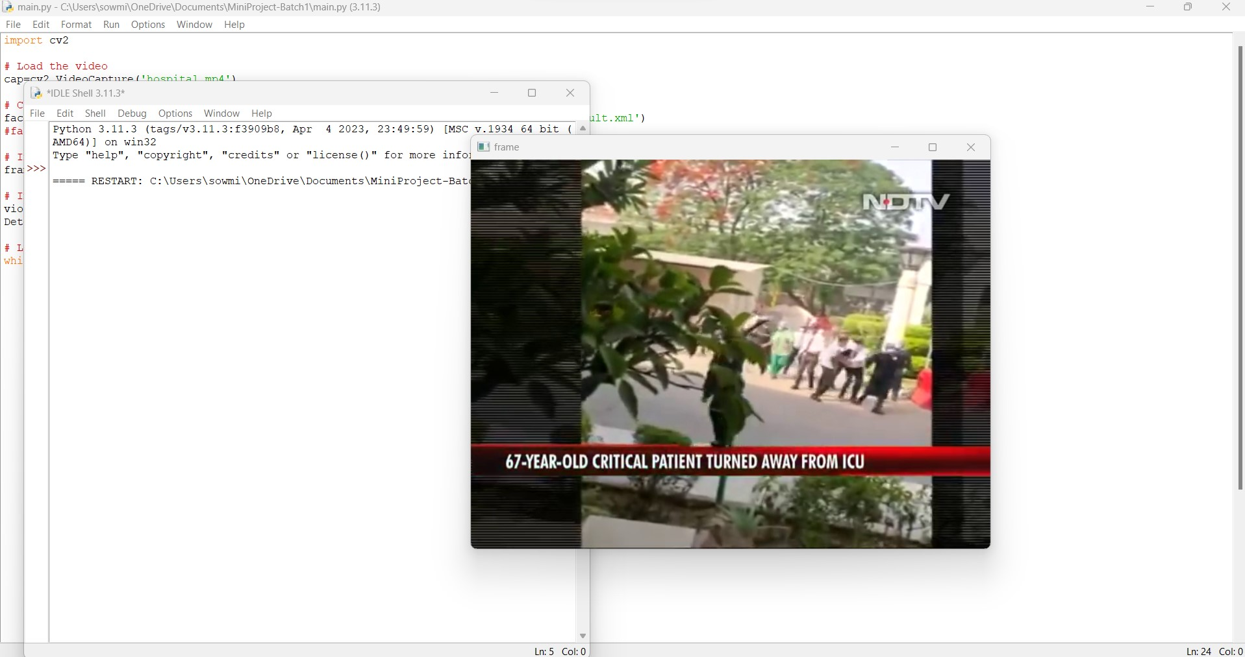
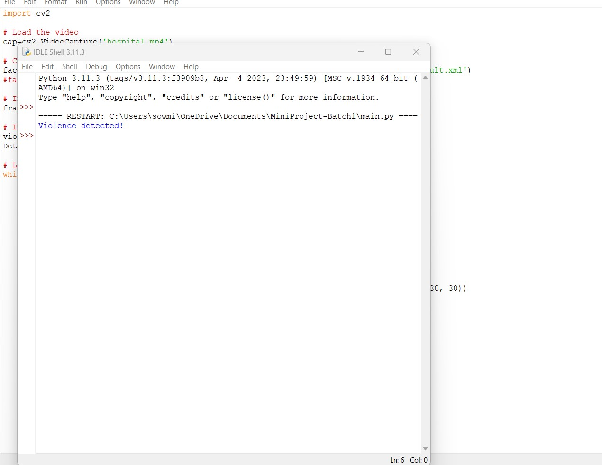
INPUT AND OUTPUT (VIOLENCE)

Slide 14
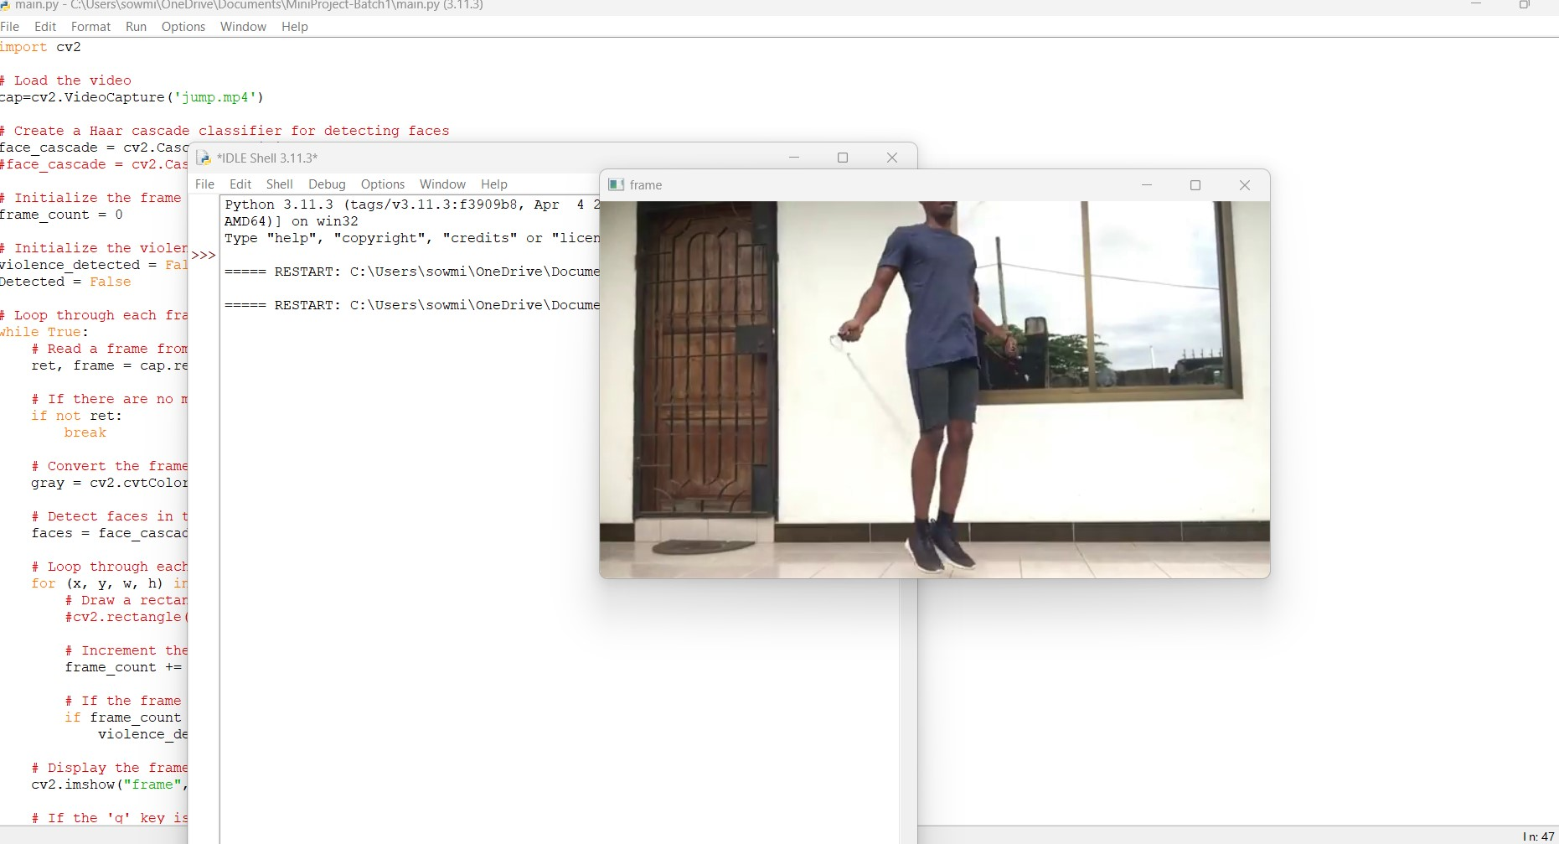
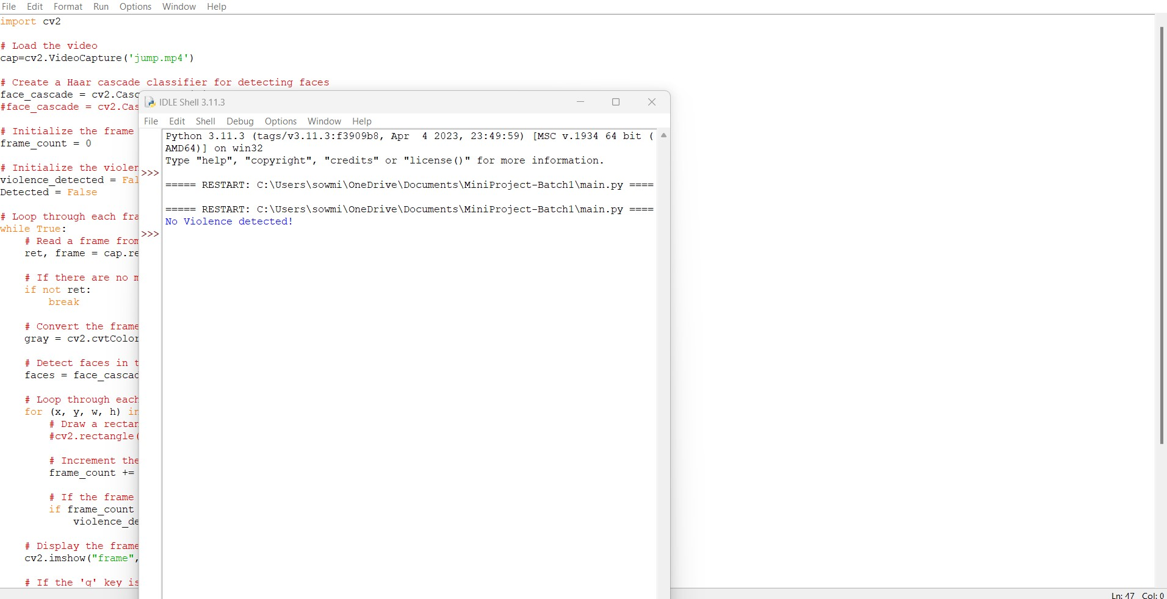
INPUT AND OUTPUT(NON-VIOLENCE)

Slide 15
REFERENCES
O. Boiman and M. Irani. Detecting irregularities in images and in video. In Tenth IEEE International Conference on Computer Vision
(ICCV’05) Volume 1, volume 1, pages 462–469 Vol. 1, Oct 2005. doi: 10.1109/ICCV.2005.70.
P.A. Crook, V. Kellokumpu, G. Zhao, and M. Pietikainen. Human activity recognition using a dynamic texture based method. In
Proceedings of the British Machine Vision Conference, pages 88.1–88.10. BMVA Press, 2008. ISBN 1-901725-36-7. doi:10.5244/C.22.88
P. Dollar, V. Rabaud, G. Cottrell, and S. Belongie. Behavior recognition via sparse spatio-temporal features. In 2005 IEEE International
Workshop on Visual Surveillance and Performance Evaluation of Tracking and Surveillance, pages 65–72, Oct 2005. doi:
10.1109/VSPETS.2005.1570899.
.Avishai Hendel, Daphna Weinshall, and Shmuel Peleg. Identifying Surprising Events in Videos Using Bayesian Topic Models, pages
448–459. Springer Berlin Heidelberg, Berlin, Heidelberg, 2011. ISBN 978-3-642-19318- 7. doi: 10.1007/978-3-642-19318-7_35. URL
https://doi.org/10.1007/978-3-642-19318-7_35.
J. Liu, Jiebo Luo, and M. Shah. Recognizing realistic actions from videos ’in the wild’;. In 2009 IEEE Conference on Computer Vision and
Pattern Recognition, pages 1996–2003, June 2009. doi: 10.1109/CVPR. 2009.5206744.
Y. Itcher T. Hassner and O. Kliper-Gross. Violent flows: Real-time detection of violent crowd behavior. In 3rd IEEE International
Workshop on Socially Intelligent Surveillance and Monitoring (SISM) at the IEEE Conf. on Computer Vision and Pattern Recognition
(CVPR), June 2012. URL www.openu.ac.il/home/ hassner/data/violentflows/.
G. Zhao and M. Pietikainen. Dynamic texture recognition using local binary patterns with an application to facial expressions. IEEE
Transactions on Pattern Analysis and Machine Intelligence, 29(6):915–928, June 2007. ISSN 0162-8828. doi: 10.1109/TPAMI.2007.1110.

