Slide 1
HAZARDOUS PLANT AND NORMAL PLANT CLASSIFICATION USING TENSOR FLOW AND KERAS MODEL
MAHAA SWETHA J (211420205085) DR.K.RAMA DEVI M.E(Ph.D)
NITHYASHREE K (211420205101) Associate Professor
SNEHA B (211420205146)

Slide 2
Abstract
This study presents a robust approach for classifying hazardous and normal plants using TensorFlow and Keras models. Leveraging deep learning techniques, particularly Convolutional Neural Networks (CNNs), the proposed model aims to accurately distinguish between hazardous and normal plants based on their images
The dataset comprises a diverse range of plant images, allowing the model to learn intricate features crucial for effective classification.
Through the training process, the CNN model learns unseen data. Experimental results demonstrate the model's capability to achieve high accuracy in distinguishing between hazardous and normal plants.
The utilization of TensorFlow and Keras facilitates seamless model development, training, and evaluation, contributing to an efficient and accurate plant classification system with potential applications in agriculture, forestry, and environmental monitoring.

Slide 3
Literature survey
Sno | Name of the paper with year | Objective | pros | cons
1 | Title: Understanding Hydroponics and Its Scope in India, Author: Madhurima Maiti, Tanushree Saha Year: 2020 | Explore the concept of hydroponics and its potential in India's agricultural landscape. | Eliminates soil limitations for plant growth Offers diverse crop cultivation possibilities. | Initial setup costs may be high<br>- Requires precise nutrient and water management
2 | Title:Nutrient Solution for Hydroponics , Author: Moaed Ali Al Meselmani Year: 2021 | Highlight the significance of nutrient solutions in hydroponics and their impact on crop yield and quality. | Optimizes plant nutrition for enhanced growth and yield<br>- Environmentally sustainable farming method | Requires careful management to prevent nutrient imbalances<br>- Dependence on external nutrient supply
3 | Title: Hydroponics , Author: Arjina Shrestha, Bruce Dunn Year: 2005 | Discuss the rapid growth and potential of hydroponics in revolutionizing food production globally. | Rapid growth and momentum in agriculture sector<br>- Balanced nutrient supply enhances crop production and quality | Lack of widespread adoption may hinder scalability<br>- Technical expertise required for system setup and management

Slide 4
4 | Topic: A HYDROPONIC SYSTEM FOR INDOOR PLANT GROWTH Author: SHREYASH MAHADEV GHATAGE, SHUBHAM R. DONE, SOHAIL AKHTAR Year: 2019 | Introduce an autonomous hydroponic system for indoor plant cultivation, particularly in extreme environments. | Enables plant growth in harsh or isolated conditions<br>- Autonomous system reduces dependence on external factors | Initial investment in sensors and automation may be prohibitive<br>- Requires electricity supply for sensor operation and system functionality
5 | Topic : An Introduction to Small-Scale Soilless and Hydroponic Vegetable Production Author: Natalie Bumgarner Year: 2019 | Provide an overview of small-scale soilless and hydroponic vegetable production for home and small-scale commercial use. | Enables vegetable cultivation in limited or poor soil conditions<br>- Allows for versatile cultivation options | Initial learning curve for setup and management<br>- Continuous monitoring and maintenance required for optimal crop growth

Slide 5
Existing System
Leveraging deep learning techniques, particularly Convolutional Neural Networks (CNNs), the proposed model aims to accurately distinguish between hazardous and normal plants based on their images.
Experimental results demonstrate the model's capability to achieve high accuracy in distinguishing between hazardous and normal plants.
The utilization of TensorFlow and Keras facilitates seamless model development, training, and evaluation, contributing to an efficient and accurate plant classification system with potential applications in agriculture, forestry, and environmental monitoring.
DISADVANTAGES:
1. They classified only plants based on leaves.
2. Accuracy was low.
3. They have not used multiple architectures.

Slide 6
Existing System
The primary aim of the suggested model is to utilize deep learning methods, particularly Convolutional Neural Networks (CNNs), to accurately differentiate between normal and dangerous plants based on their photos.
The dataset consists of a wide variety of plant photos, enabling the model to capture complex properties crucial for precise categorization. This diversity ensures that the model can recognize various plant species and their distinguishing features.
Through extensive training, the CNN model learns to identify pertinent patterns and characteristics from plant photos. This allows the model to generalize effectively to previously unseen data, ensuring robust performance in real-world scenarios.
The developed plant categorization system holds significant potential for applications in forestry, agriculture, and environmental monitoring. It can assist in tasks such as weed detection, pest management, and biodiversity assessment.

Slide 7
Proposed system
The proposed system aims to enhance industrial safety by developing a robust plant classification model using TensorFlow and Keras. This system focuses on distinguishing between hazardous and normal plants based on images of their physical attributes.
By harnessing the power of deep learning, specifically Convolutional Neural Networks (CNNs), the model can effectively learn patterns in plant images, enabling accurate classification.
This dataset is then split into training and validation sets to train the CNN model. The proposed system's combination of TensorFlow and Keras, coupled with the robustness of CNNs, empowers industries to create a reliable and accurate hazardous and normal plant classification solution.
This innovative approach stands to revolutionize plant safety practices by leveraging advanced AI technologies to preemptively identify risks and prioritize the well-being of workers and assets.

Slide 8
Proposed System
ADVANTAGES
• We build a framework-based application for deployment purposes
• Higher scalability
• We compared more than two architectures to get a better accuracy level.
Industrial Safety Enhancement: The proposed system has the potential to significantly enhance industrial safety by providing an accurate and dependable solution for plant categorization.
Applications: The system can be applied across various industries, including manufacturing, petrochemicals, and agriculture, to improve safety measures and prevent accidents.
Future Development: Continuous research and development efforts can further refine the system's accuracy and efficiency. Integration with advanced technologies such as real-time monitoring systems and predictive analytics can expand its capabilities in ensuring industrial safety.

Slide 9
Hardware and Software requirements
Framework: Keras
1. Software Requirements:
Operating System : Windows
Tool : Anaconda with Jupyter Notebook
Language : Python
2. Hardware requirements:
Processor : minimum i3 and above
Hard disk : minimum 300 GB
RAM : minimum 4 GB

Slide 10
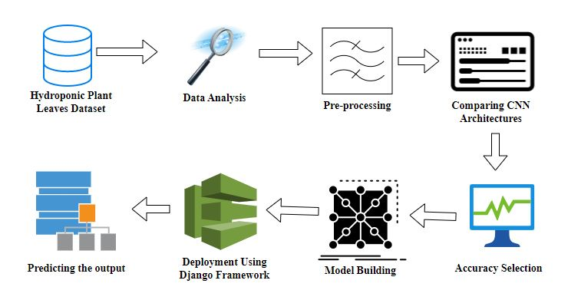
Architecture Diagram
Plant dataset

Slide 11
Workflow
Work flow diagram:
Source images
Training Dataset
Testing Dataset
CNN algorithm
Prediction of Hazardous and normal Plant Classification

Slide 12
Novelty
Single plant classification : they classify only one plant either normal or hazardous plant . But we classify both normal and hazardous plant .
Accuracy low: The accuracy is low in the existing system . In our project we have improved accuracy .
Use of multiple architecture: In the existing system there is use of only one architecture ,but here we have used more than 2 architectures.

Slide 13
Methodology
Preprocessing and Training the model (CNN): The dataset is preprocessed such as Image reshaping, resizing and conversion to an array form. Similar processing is also done on the test image.
A dataset consisting of about 4 different brain tumor is obtained, out of which any image can be used as a test image for the software.
The train dataset is used to train the model (CNN) so that it can identify the test image and the disease it has CNN has different layers that are Dense, Dropout, Activation, Flatten, Convolution2D, and MaxPooling2D.
, Dropout, Activation, Flatten, Convolution2D, and MaxPooling2D. After the model is trained successfully, the software can identify the covid pneumonia Classification image contained in the dataset.
After successful training and preprocessing, comparison of the test image and trained model takes place to predict the brain covid, pneumonia

Slide 14
List of modules
1. Manual Net
2. ALEXNET
3. RESNET
4. Deploy

Slide 15
MODULE DESCRIPTION
Manual network
IMPORT THE GIVEN IMAGE FROM DATASET:
We have to import our data set using keras preprocessing image data generator function also we create size, rescale, range, zoom range, horizontal flip.
Then we import our image dataset from folder through the data generator function.
Here we set train, test, and validation also we set target size, batch size and class-mode from this function we have to train using our own created network by adding layers of CNN.

Slide 16
Modules Description
Data flow diagram : The steps involved in Building the data model is depicted below
Data collection (Splitting Training set & Test) set)
Pre Processing (Sequential)
Building classification Model
Prediction (hazardous and normal plant disease Classification)

Slide 17
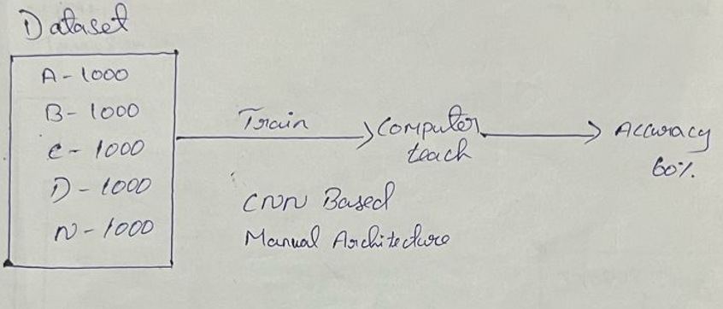
Modules Split up
Manual Architecture: MODULE - 1

Slide 18
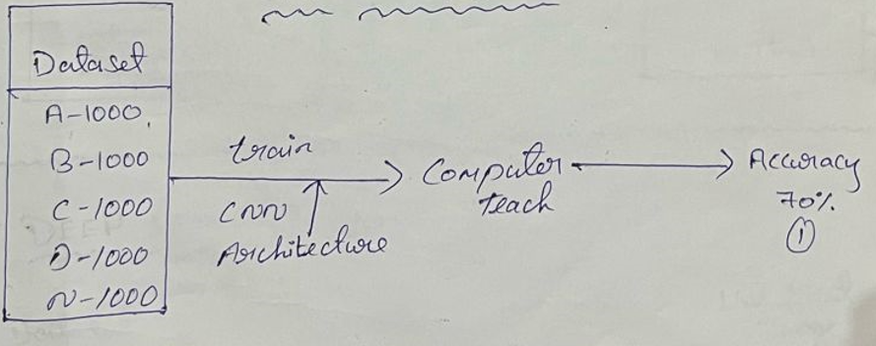
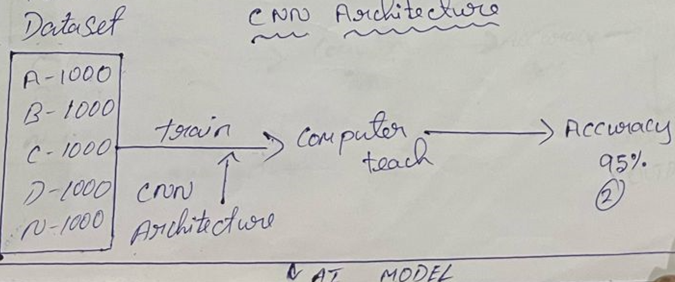
Modules Split up
CNN Architecture: MODULE - 2
CNN Architecture: MODULE – 3

Slide 19
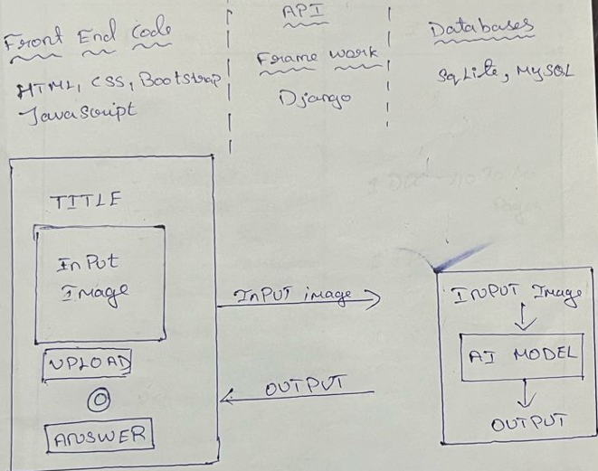
Modules Split up
Web Application: MODULE – 4

Slide 20
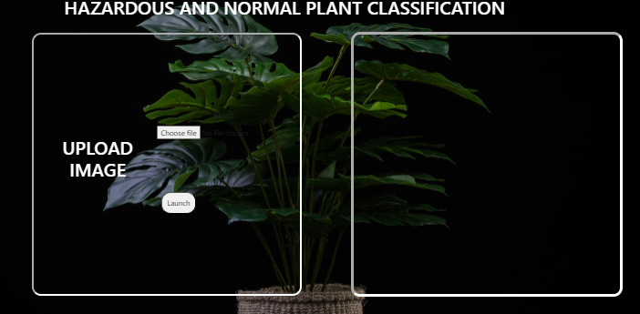
Snapshots:

Slide 21
Coding:
import os
import glob
import numpy as np
from tensorflow.keras.preprocessing.image import ImageDataGenerator
from tensorflow.keras.models import Sequential
from PIL import Image
from tensorflow.keras.layers import Convolution2D
from tensorflow.keras.layers import MaxPooling2D
from tensorflow.keras.layers import Flatten
from tensorflow.keras.layers import Dense
from tensorflow.keras.layers import Activation
from keras.callbacks import ModelCheckpoint
import matplotlib.pyplot as plt

Slide 22
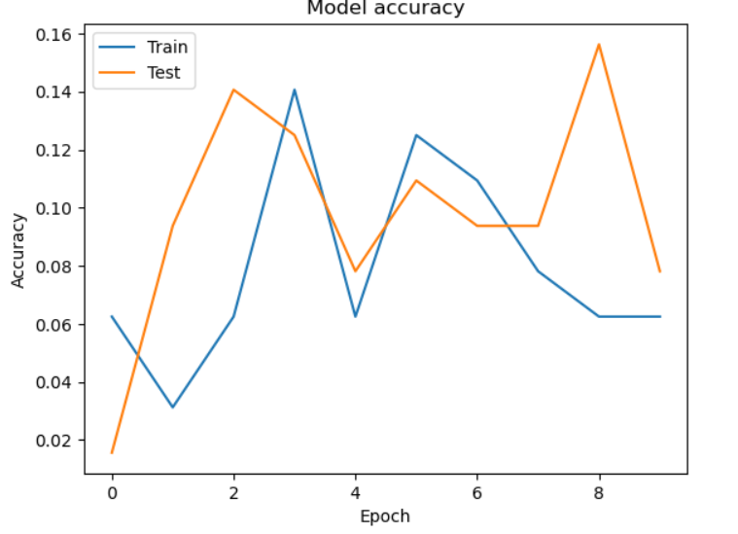
Performance Measure
MANUAL NET:

Slide 23
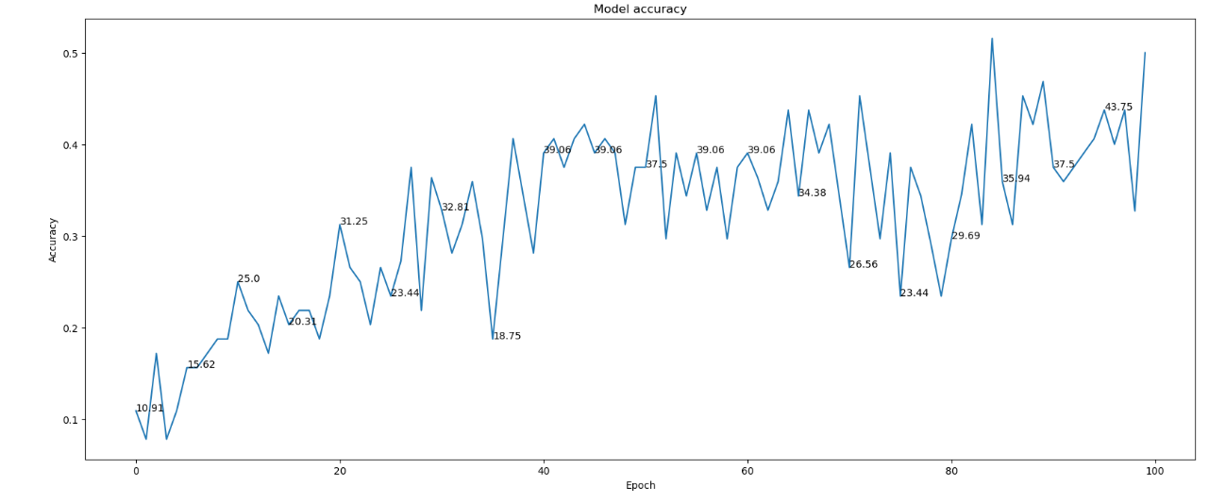
Performance Measure
RESTNET:

Slide 24
Publication Details
JOURNAL DETAILS: TEC EMPRESARIAL
ACCEPTANCE STATUS : PENDING

Slide 25
Conclusion
It focused on images from given dataset to predict the pattern of hazardous and normal plant using CNN model. This brings some of the following insights about plant prediction. The major benefits of the CNN classification, deployment can classify the images automatically.
FUTURE WORK
We can deploy the model in any cloud-based system.
We can implement more than three architectures
We can connect this model to the hardware.

Slide 26
References
Zhang, L., Yu, S., & Huang, W. (2019). Machine learning-based classification of hazardous and normal plants using multispectral imagery. IEEE Access, 7, 156052-156061.
Mehmood, F., & Lee, Y. S. (2020). A comparative study of machine learning algorithms for classification of hazardous and normal plants. Sensors, 20(22), 6546.
Chen, Y., Tian, H., & Cheng, H. (2018). Classification of hazardous and normal plants using deep learning techniques. Journal of Hazardous Materials, 354, 30-38.
Li, W., Liu, C., & Li, Y. (2017). A novel approach to classify hazardous and normal plants based on sensor data fusion. Sensors and Actuators B: Chemical, 251, 826-834.
Yan, J., Wu, S., & Zhou, J. (2016). Decision fusion-based classification of hazardous and normal plants using wireless sensor networks. Journal of Network and Computer Applications, 71, 73-82.

Slide 27
References
6.Gomes, J., & Ramos, H. (2019). Hazardous and normal plant classification using convolutional neural networks with transfer learning. Expert Systems with Applications, 128, 254-265.
7. Wang, Z., Jiang, Y., & Zhang, Y. (2018). Classification of hazardous and normal plants based on ensemble learning. Chemometrics and Intelligent Laboratory Systems, 182, 68-76.
8. Khan, M. A., Kim, Y., & Lee, J. (2017). Hazardous and normal plant classification using support vector machines with feature selection. Applied Sciences, 7(1), 52.
9. Kim, J., Kim, K., & Kim, H. (2016). Comparative analysis of hazardous and normal plant classification using various feature extraction techniques. International Journal of Control, Automation and Systems, 14(5), 1296-1305.
10. Wu, Q., & Cheng, H. (2015). Classification of hazardous and normal plants based on principal component analysis and k-nearest neighbor algorithm. International Journal of Distributed Sensor Networks, 11(4), 283657.

