Slide 1

PANIMALAR ENGINEERING COLLEGE
IMPLEMENTATION OF HYBRID SECURITY LAYER OF
STEGANOGRAPHY & VISUAL CRYPTOGRAPHY FOR
SECURED ONLINE
PURCHASE
by
Praveen M(211411205066)
Under the guidance of
Dr. M. HELDA MERCY M.E.,Ph.D.,
HEAD OF THE DEPARTMENT
Department of Information Technology

Slide 2
ABSTRACT:
The Secret Text is Converted to ASCII & then to 8 bit Binary Format.
A Duplicate Sentence is formed and that sentence is hidden in a Image which is called Steganography.
This Image is Splitted into Two Halves called Visual Cryptography (VC).
First half is stored in Server and 2nd Half is stored in the User End.
Destegano is achieved to retrieve the User Identification secret Text.
User is authenticated using User name, Password, Image, half of the OTP & finally the 2nd part of the Image obtained using VC.
Anti Phishing Concept is Implement to eliminate Duplicate Sites

Slide 3
EXISTING SYSTEM:
In the EXISTING SYSTEM, Rapid Growth of E Commerce market leads to lots of Credit / Debit Card Frauds happening via Internet.
Visual Cryptography is used to encrypt and decrypt the images but it is a costlier technique
There is no Security in Cyber Space.

Slide 4
DISADVANTAGE:
1. No security in online shopping while using Debit and Credit Card.
2. Shoulder suffering attack.
3. Revealing the personal details.

Slide 5
LITERATURE SURVEY
Reference | Author Name | Year | Description | Disadvantage
Lossless Tagged Visual Cryptography Scheme -2014 | Xiang Wang, Qingqi pei | 2014 | Secret text is convert to ASCII Increasing the security level. | No Security In Online Shopping. Shoulder Suffering Attack.
Tagged Visual Cryptography | R-Z Wang and S-F.hsu | 2011 | The tagging property can be easily applied to any report. | Knowledge of less than t shares. T shares gets no secret information
Visual multiple secret sharing based upon turning and flipping | S-Z. Shyu and K. Chen, | 2011 | We explore the possibilities of visual secret sharing. | Two square shares secrets cannot be obtained from single share.

Slide 6
PROPOSED SYSTEM:
Steganography and visual Cryptography technique are used.
User Provides Account Number along with the Secret Text. This Secret Text is Converted to ASCII & then to 8 bit Binary Format.
Destegano is achieved to Retrieve the User Identification secret Text.
This Image is Splitted into Two Halves called Visual Cryptography.

Slide 7
ADVANTAGE:
1. secret text is convert to ASCII .
2. Increasing the security level.
3. Image Based Steganography And Visual Cryptography Authentication System.

Slide 8
SYSTEM SPECIFICATION:
HARDWARE REQUIREMENTS:
Processor:Pentium IV
RAM:512 MB
HDD:80 GB
SOFTWARE REQUIREMENTS:
Platform:Windows Xp
Front End: JAVA
Back End :MS SQL server

Slide 9
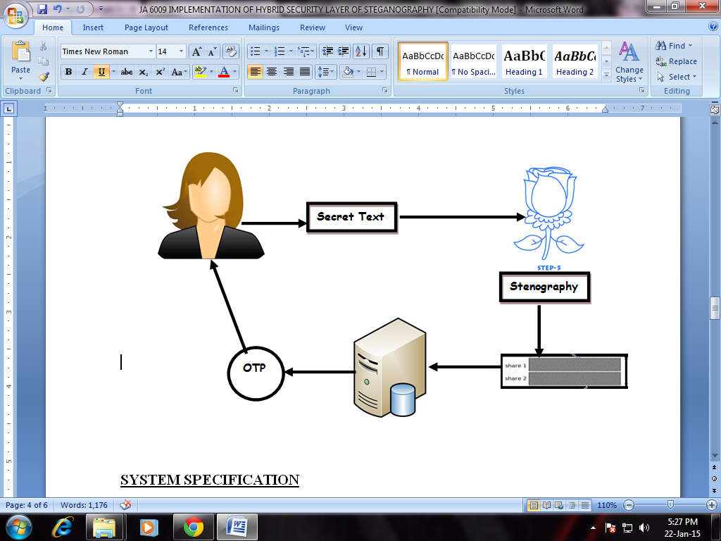
ARCHITECTURE DIAGRAM

Slide 10
MODULES:
1. User registration
2. Server
3. Password Ascii Conversion
4. Steganography
5. Visual Cryptography
6. Destagno & Rejoining of Images
7. OTP Authentication & User Purchase

Slide 11
USER REGISTRATION:
In this module we are going to create an User application by which the User is allowed to access the data from the Server.
Once the User create an account, they are allowed to login into their account to access the application.
Based on the User’s request, the Server will respond to the User. All the User details will be stored in the Database of the Server
User Interface Frame to Communicate with the Server through Network Coding using the programming Languages like Java/ .Net.

Slide 12
SERVER:
The Server will monitor the entire User’s information in their database and verify them if required.
Also the Server will store the entire User’s information in their database. Also the Server has to establish the connection to communicate with the Users.
The Server will update the each User’s activities in its database.
The Server will authenticate each user before they access the Application. So that the Server will prevent the Unauthorized User from accessing the Application.
USER
Registration Information
Bank Server

Slide 13
PASSWORD ASCII CONVERSION
In this module we implement the Representation of each letter in password by its equivalent ASCII code.
Conversion of ASCII code to equivalent 8 bit binary number.
Division of 8 bit binary number into two 4 bit parts choosing suitable letters from table
PASS WORD
CONVERT TO ASCII
CONVERT 8BITASCII TO
Convert 8Bit to 4Bit
TEXT

Slide 14
STEGANOGRAPHY:
Steganography is the art of hiding of a message within another so that hidden message is indistinguishable.
The key concept behind steganography is that message to be transmitted is not detectable to casual eye.
Text is used as a cover media for hiding data in steganography.
4BIT TO
STEGANOGRAPHY

Slide 15
VISUAL CRYPTOGRAPHY
Visual Cryptography (VC) is a cryptographic technique based on visual secret sharing used for image encryption.
Using k out of n (k, n) visual secret sharing scheme a secret image is encrypted in shares which are meaningless images that can be transmitted or distributed over an un trusted communication channel.
Only combining the k shares or more give the original secret image
Steganography
VISUAL CRYTOGRAPHY
2 HALVES OF IMAGE
PXEL SELECTION

Slide 16
DESTAGNO & REJOINING OF IMAGES:
Steganography is the art of hiding of a message within another so that hidden message is indistinguishable.
The key concept behind steganography is that message to be transmitted is not detectable to casual eye.
The splited image are rejoined and password is destagnoed and compared to the server if it is validated
2 halves of image
Joining of image
destagno
password

Slide 17
OTP AUTHENTICATION & USER PURCHASE
In this when the password is validated by the server and then an OTP is generated by the server and send to user it will be 8 bit OTP.
Then 4 bit is send to the user and rest of the 4 bit will be stored in the server.
User has to give the 4 bit OTP it will be validate and then go for online bank transfer the fund
2 halves of image
Joining of image
destagno
password
User mobile
Otp generation
Bank server
Otp validation

Slide 18
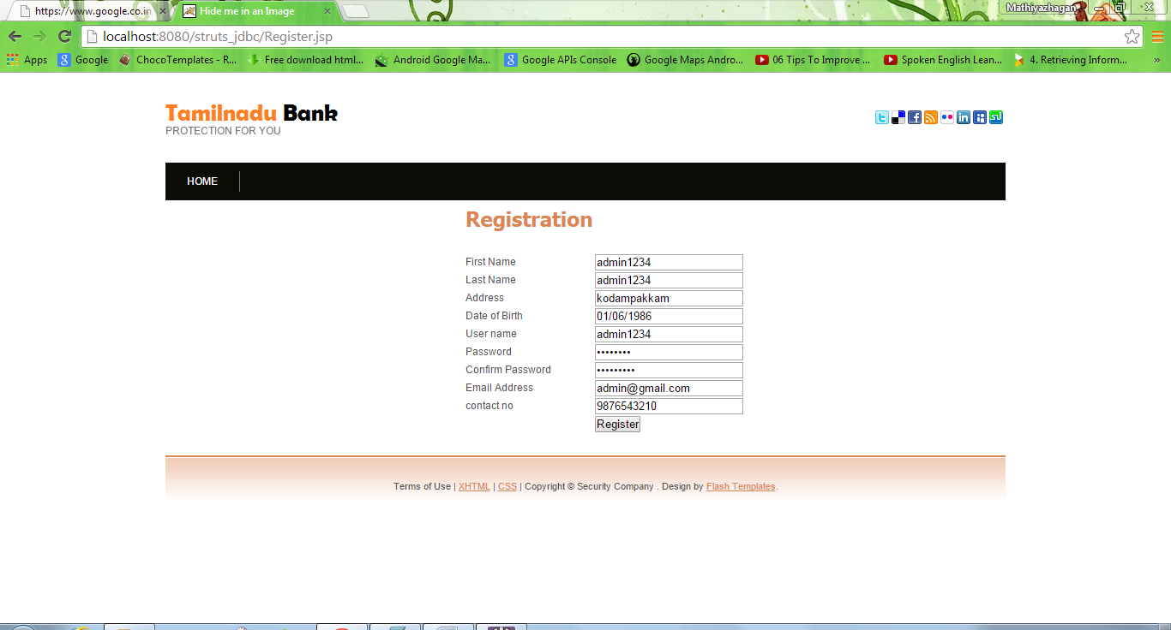
SCREEN SHOT USER REGISTRATION:

Slide 19
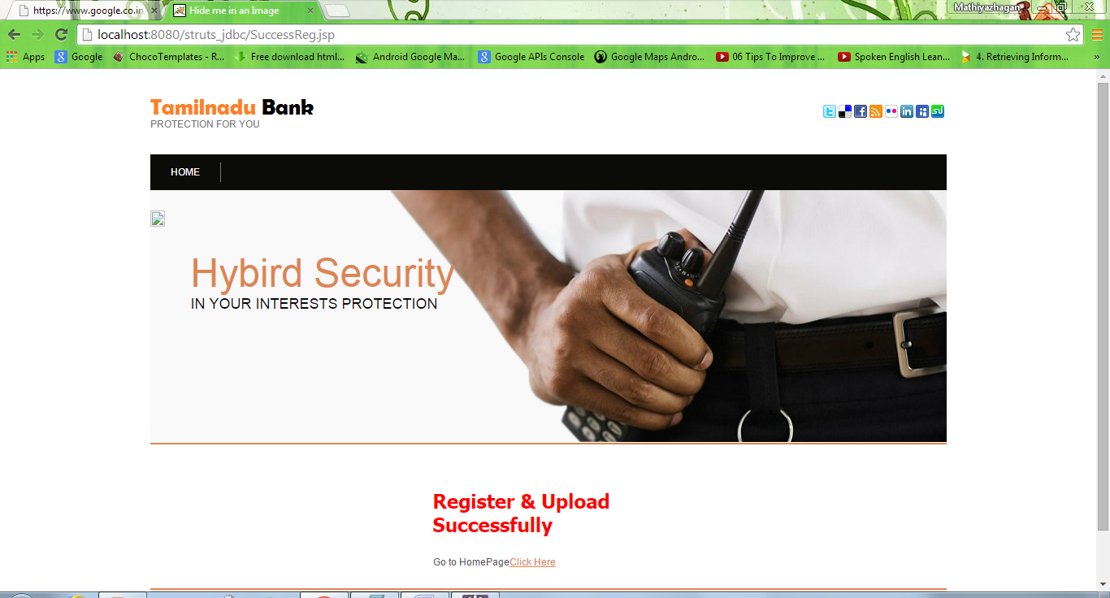
SERVER:

Slide 20
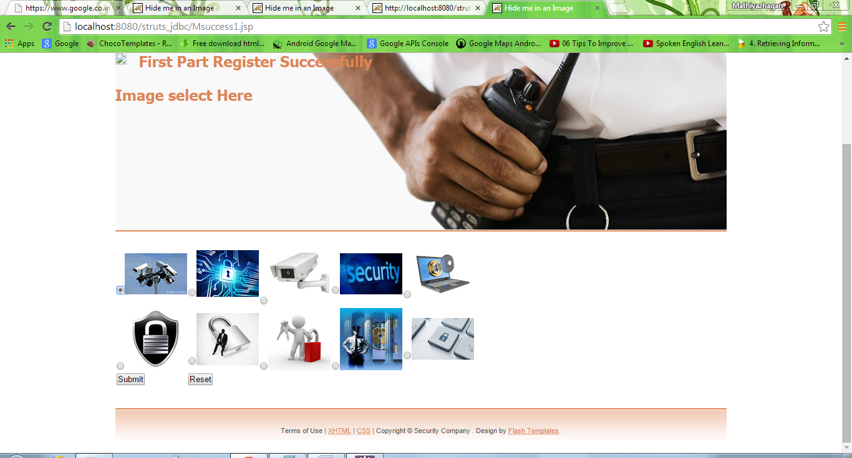
STEGANOGRAPHY

Slide 21
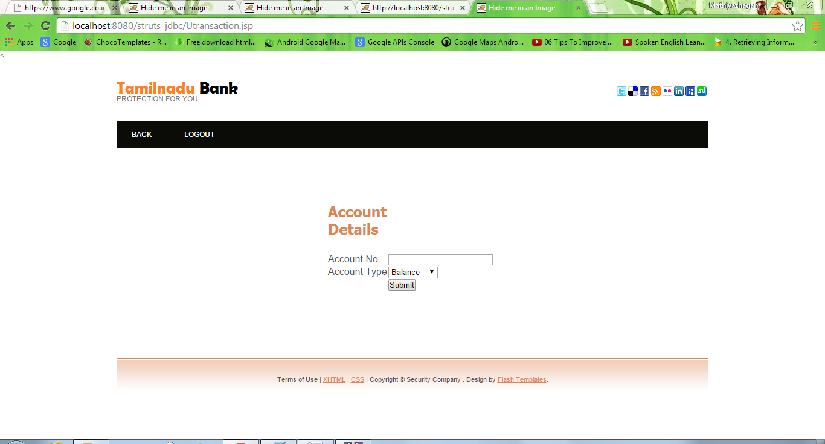
OTP AUTHENTICATION & USER PURCHASE

Slide 22
CONCLUSION:
In this project, a payment system for online shopping is proposed by combining text based steganography and visual cryptography that provides customer data privacy and prevents misuse of data at merchant’s side.
The method is concerned only with prevention of identify theft and customer data security.
In comparison to other banking application which uses steganography and visual cryptography, are basically applied for physical banking, the proposed method can be applied for E-Commerce with focus area on payment during online shopping as well as physical banking.

