Slide 1



INNOVATIVE RESSISTANCE:
Cloud based Portal for Flat and Land Booking
TEAM - C13
NAJUMUDDIN HUSSAIN Z(2114520205093)
ASHWIN S (2114520205022)
GUIDED BY,
DR. KALADEVI
HARISH RAJ (2114520205060)

Slide 2
OBJECTIVES AND SCOPE
Efficiency and Transparency: The system aims to streamline land transactions by allowing users to register, verify, and complete transactions directly on the portal, reducing the need for intermediaries. This promotes efficiency and transparency in the buying and selling process.
Accessibility and Convenience: By providing a digital platform for land transactions, the system enhances accessibility for users, allowing them to participate in buying and selling activities from anywhere with internet access. This increases convenience and reduces geographical barriers, making the process more inclusive and efficient.
Scope: Create an online platform enabling direct land transactions, ensuring increased trust and security through smart contracts, enhancing efficiency and transparency.

Slide 3
ABSTRACT
Traditional land registration in India involves intermediaries like brokers, leading to potential document loss and tampering.
Proposed system eliminates intermediaries, utilizing smart contracts fOR SECURE, TRANSPARENT, AND DECENTRALIZED TRANSACTIONS.
BENEFITS INCLUDE INCREASED INTEGRITY, TRANSPARENCY, AND EFFICIENCY IN LAND TRANSACTIONS.
INNOVATION RESISTANCE-BASED LAND REGISTRATION SYSTEM ENSURES TRUST AND SECURITY WITHOUT RELIANCE ON INTERMEDIARIES.

Slide 4
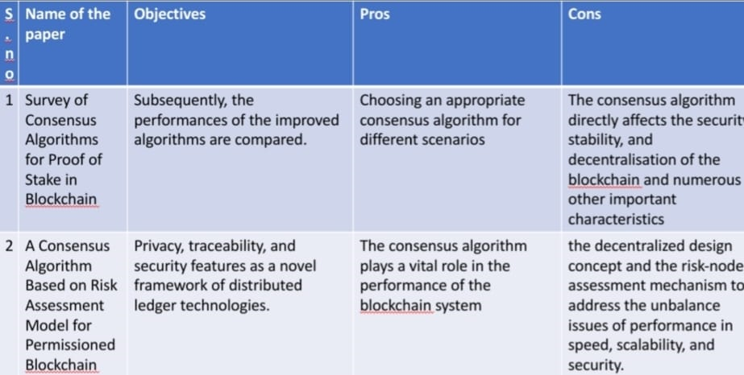
LITRATUE SURVEY

Slide 5
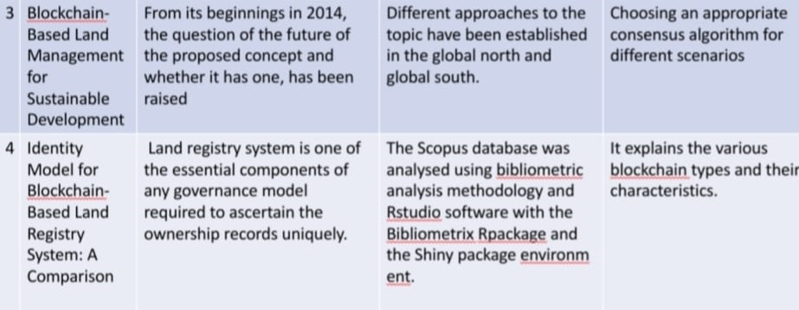
LITRATUE SURVEY

Slide 6
LITRATUE SURVEY

Slide 7
EXISTING SYSTEM
DIGITalization's Impact: Technology revolutionizes societal norms, particularly in land ownership where lost or altered physical documents pose significant challenges.
Manual Verification Delays: Traditional processes entail time-consuming manual verificatiON, HINDERING SWIFT AND LEGITIMATE TRANSACTIONS.
SECURITY CONCERNS: MIDDLE AGENTS' INVOLVEMENT RAISES SECURITY RISKS LIKE FRAUD, BRIBERY, AND FORGERY, HIGHLIGHTING THE NEED FOR MODERNIZED, SECURE SYSTEMS.

Slide 8
PROPOSED SYSTEM
PROPOSED SOLUTION: INTRODUCE A PRIVATE AND PERMISSIONED INNOVATIVE RESISTANCE SYSTEM FOR LAND REGISTRATION IN MAHARASHTRA, RESTRICTING PARTICIPANT ACCESS FOR ENHANCED SECURITY AND CONSENSUS.
ENABLING SELLER VERIFICATION THROUGH ADMIN CONCENTRATION AND PREVENTING FRAUDS AND POTENTIAL RISKS
ENABLING BOOKING TIMEPERIOD FOR FOCUSED TRANSACTIONS BY SLOT METHOD

Slide 9
PROPOSED SYSTEM
INTRODUCING SELLER BLOCKING, BUYER’S POWER TO KEEP SELLERS WITH SUSPICIOUS ACTIVITIES
GEO-LOCATION VERIFICATION FOR ENHANCED TRUSTABILITY TOWARDS CUSTOMERS FOR FLAT/LAND REGISTRATION
INTRODUCING ENCRYPTED BUYER’S LOCKER FOR ENHANCED PRIVACY TOWARDS WISHLISTING
USER DETAIL ENCRYPTION USING ADVANCED ENCRYPTION STANDARD(AES) AND HASHING ALGORITHMS.

Slide 10
SOFTWARE & HARDWARE REQUIREMENTS
H/W SYSTEM CONFIGURATION:
•Processor - Intel Pentium
•RAM - 4 Gb
•Hard Disk - 260 GB
S/W SYSTEM CONFIGURATION:
•Operating System - Windows 7/8/10
•Front End - JAVA
•Back End - MySQL
•Tools - NetBeans 7.3.1

Slide 11
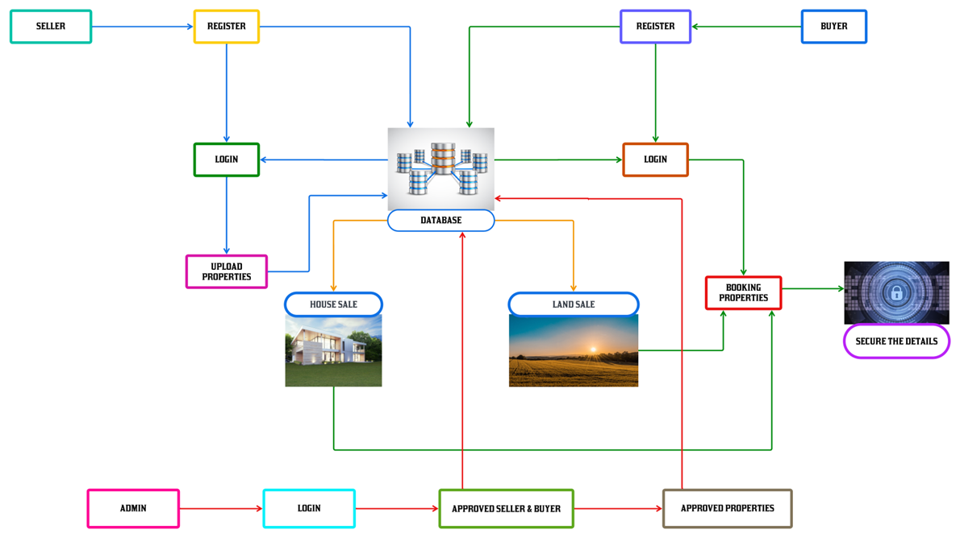
ARCHITECTURE DIAGRAM

Slide 12
NOVELTY
1. RESTRICTIVE ACCESS MODEL : THE SYSTEM INTRODUCES A NOVEL APPROACH BY IMPLEMENTING A PRIVATE AND PERMISSIONED INNOVATIVE RESISTANCE SYSTEM, WHICH LIMITS PARTICIPANT ACCESS, ENSURING ENHANCED SECURITY AND CONSENSUS WHILE DEVIATING FROM CONVENTIONAL OPEN-ACCESS MODELS.
2. Advanced Security Measures: Through the utilization of asymmetric cryptography and distributed consensus algorithms, the system innovates in securing user data and ensuring transaction integrity, offering a level of security beyond traditional land registration methods.

Slide 13
NOVELTY
3. COST-EFFECTIVE EFFICIENCY ENHANCEMENTS: BY EMPHASIZING FEATURES LIKE PERSISTENCE, ANONYMITY, AND AUDITABILITY, THE SYSTEM INTRODUCES NOVEL WAYS TO REDUCE COSTS AND ENHANCE OPERATIONAL EFFICIENCY IN LAND REGISTRATION PROCESSES, PROVIDING A FRESH AND EFFECTIVE SOLUTION TO EXISTING CHALLENGES.

Slide 14
MODULE SPLITUPS
LOGIN AND REGISTER:
BUYER, SELLER, ADMIN
UPLOAD PROPERTY DETAILS
HOUSE / LAND SALES PAGE
BOOKING PROPERTIES
BUYER’S LOCKER ACCESSING
DETAIL ENCRYPTION:
BUYER, SELLER, ADMIN
GEOLOCATION VERIFICATION
SELLER VERIFICATION

Slide 15
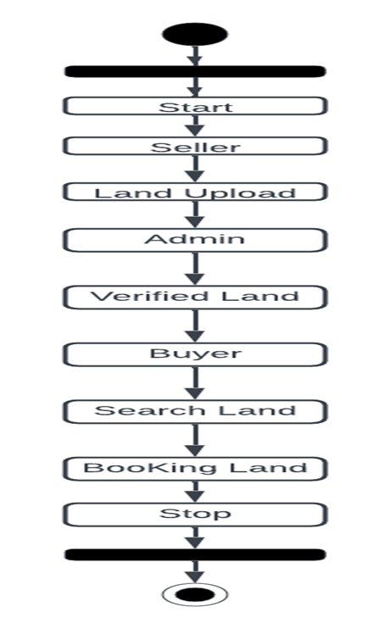
PROJECT WORK FLOW

Slide 16
REFERENCES
[1] N.S.TINU(2018), A SURVEY ON INNOVATIVE RESISTANCE TECHNOLOGY TAXONOMY, CONSENSUS ALGORITHMS AND APPLICATIONS.
[2] J. Michael Graglia, Christopher Mellon, Innovative Resistance and Property in 2018 : At end of the Beginning.
[3] Raquel Benbunan-Fich, Arturo Castellanos(2018) Digitalization of Land Records: From Paper to Innovative Resistance.
[4] IBM, State Street Corp. Hyper ledger Fabric: A Distributed Operating System for Permissioned Innovative Resistance.
[5] MiroslavStefanovic, DordePrzulj, DarkoStefanovic(2018) Blockchain and Land Administration : Possible applications and limitation.

Slide 17
REFERENCES
[6] TSUNG-TING KUO, HUGO ZAVALETA ROJAS AND LUCILAOHNOMACHADO(2019) COMPARISON OF BLOCKCHAIN PLATFORMS: A SYSTEMATIC REVIE AND HEALTHCARE EXAMPLES.
[7] YacovManevich, Artem Barger, and Yoav Toc, Service Discovery for Hyperledger Fabric .
[8] YashwanthMadaka, Building a blockchain application using Hyperledger Fabric with Angular Frontend: Part-2 https://medium.com/coinmonks/building-a-blockchain-applicationusing-hyperledger-fabric-with-angular-frontend-part-2-22ef7c77f53

Slide 18
REFERENCES
[9] M.-H. GUO, Z.-N. LIU, T.-J. MU, AND S.-M. HU, ‘‘BEYOND SELF-ATTENTION: EXTERNAL ATTENTION USING TWO LINEAR LAYERS FOR VISUAL TASKS,’’ 2023, ARXIV:2105.02358.
[10] Madakam, S., & Kollu, S. Blockchain Technologies FundamentalsaPerceptions, Principles, Procedures and Practices. Journal of ˆ Social and Management Sciences, 34.

Slide 19
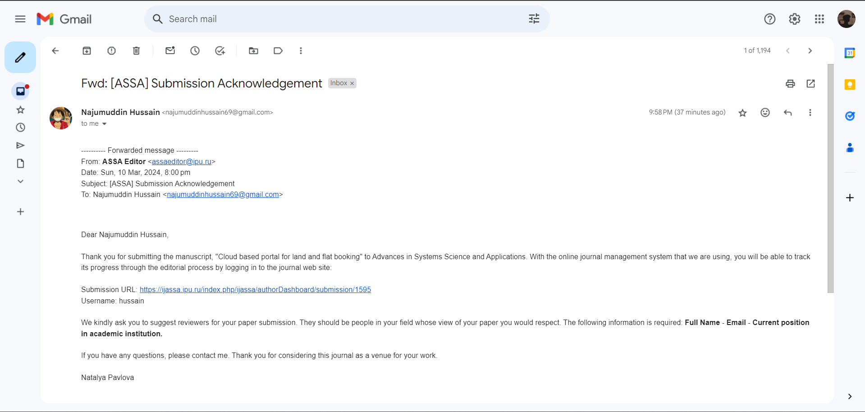
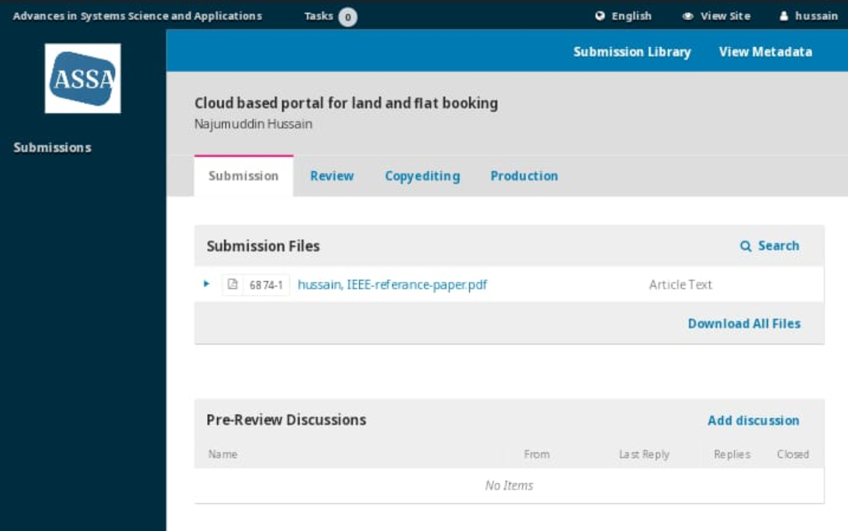
SUBMISSION DETAILS

Slide 20
THANK YOU

