Slide 1

PANIMALAR ENGINEERING COLLEGE AN AUTONOMOUS INSTITUTION
IT8611 Mini Project Review
III Year/VI semester
ONLINE GROCERY SHOPPING MANAGEMENT
TEAM MEMBERS:
1. SATHISH.A & 211420205136
2. SURENTHAR.J & 211420205159
3. THIRUNAVAKARASU.S 211420205170

Slide 2
TABLE OF CONTENTS :
Page
I ABSTRACT 3
II LITERATURE SURVEY 4
III EXISTING SYSTEM 7
IV PROPOSED OF THE SYSTEM 8
V REQUIREMENTS OF THE SYSTEM 9
VI REFERENCES 10

Slide 3
Abstract
Online grocery shopping management is a web based application designed for purchasing grocery items online.
The Project is built using PHP(Hyper Text preprocessor),front end is designed by html,CSS,javascript.
The Primary goal of the system is to provide a easy way of purchasing the grocery products.
The system involves various aspects which includes inventory management,delivery fee management etc.
Now a days digital marketings improved.Many people buys the products through online which saves people time and their travel expense.

Slide 4
EXISTING SYSTEM
In the existing system people travel from their place to the grocery shop, which has a lot of problems like
NOT COST EFFICIENT
WASTE OF TIME
ADVANTAGES OF THE PROJECT:
Convenience
Time-saving
Efficiency
Flexibility
Contactless Shopping

Slide 5
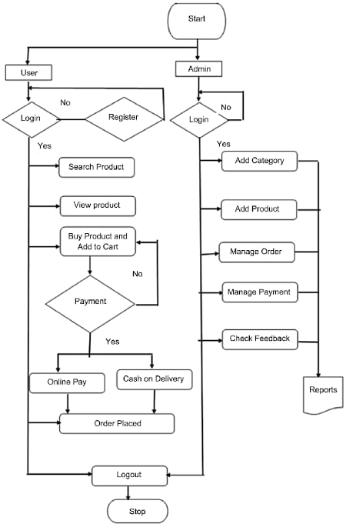
PROPOSED SYSTEM AND ARCHITECTURE:

Slide 6
MODULES:
ADMIN SIDE LOGIN
USER SIDE LOGIN

Slide 7
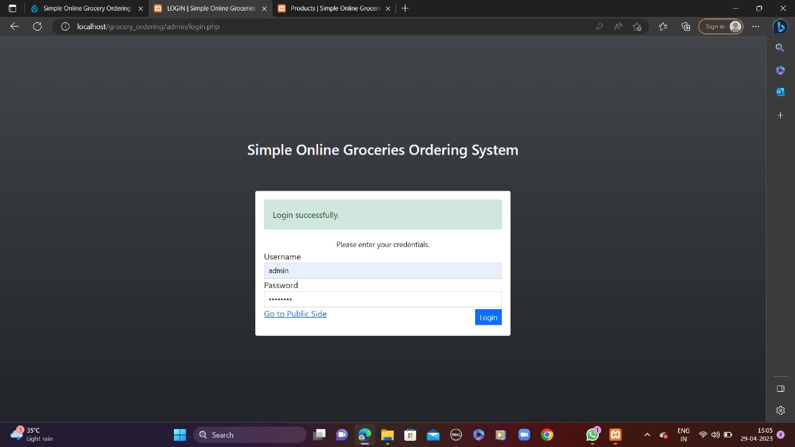
ADMIN SIDE:
The admin of the system can be log in to system through the admin login

Slide 8
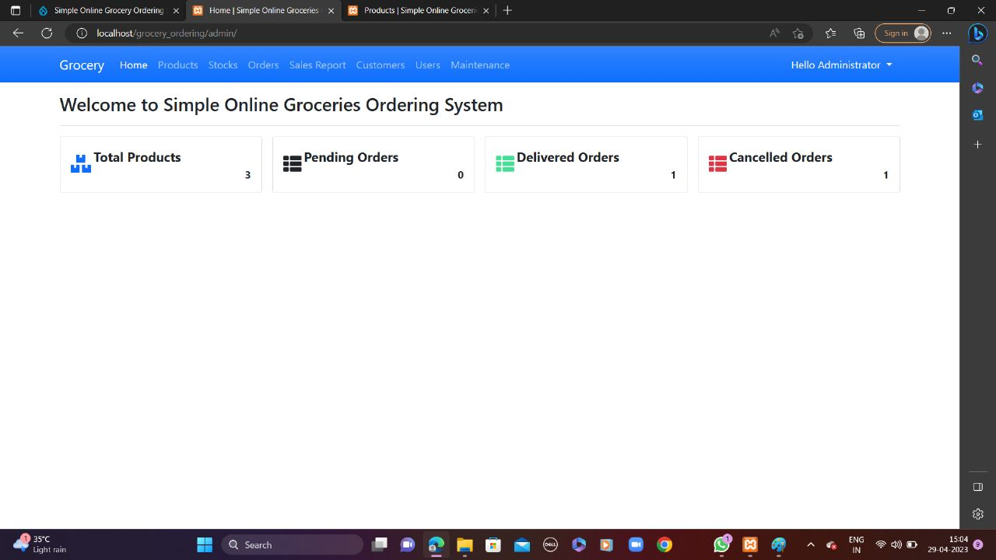
Welcome page of the admin

Slide 9
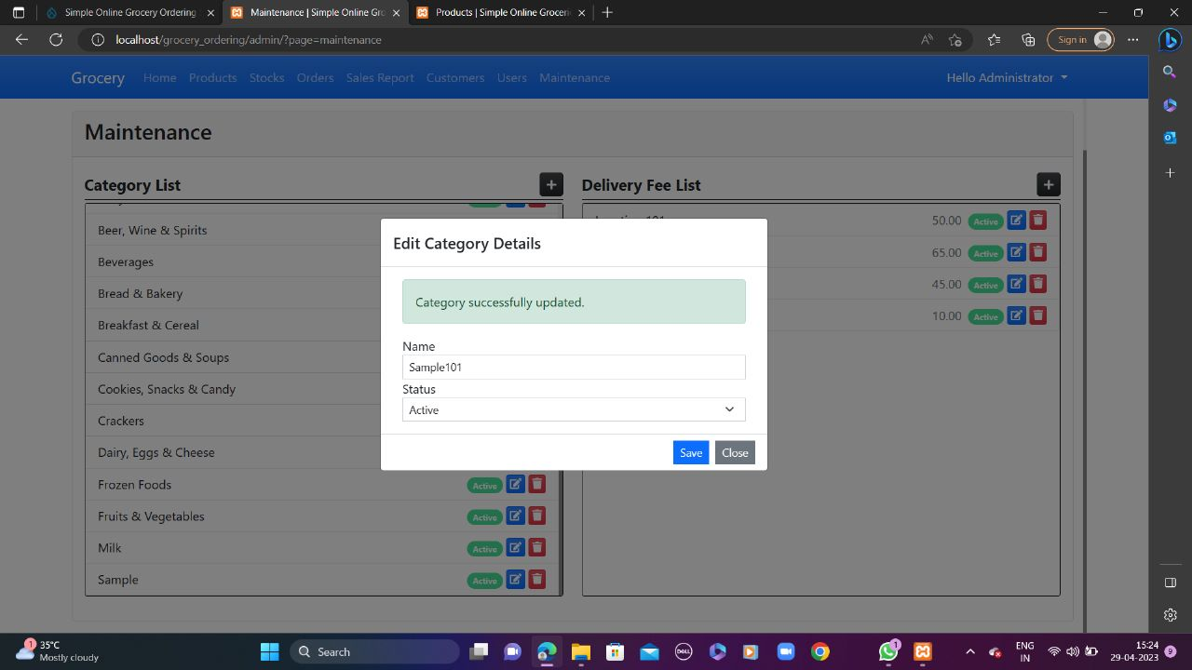
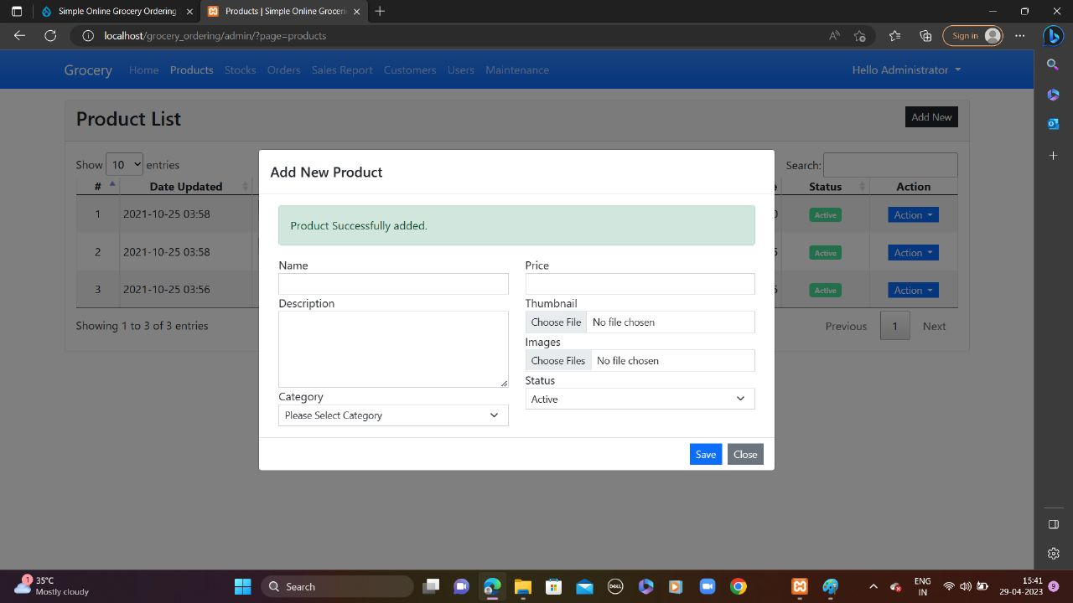
Adding new category Adding products in category

Slide 10
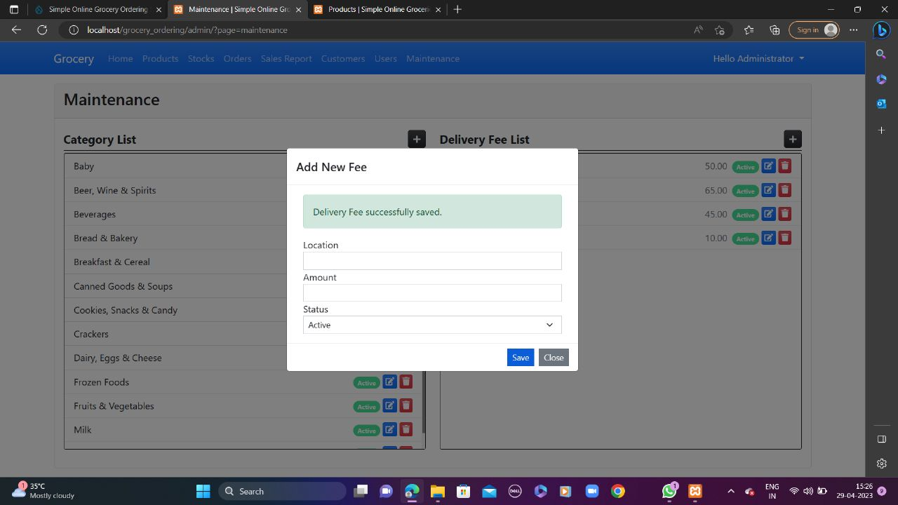
Setting delivery fee

Slide 11
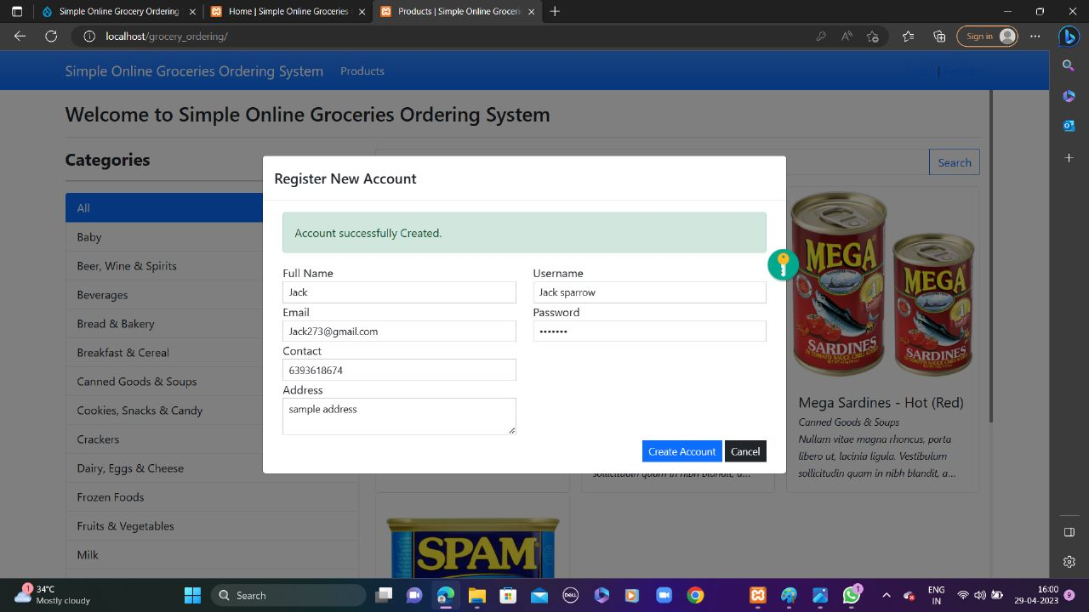
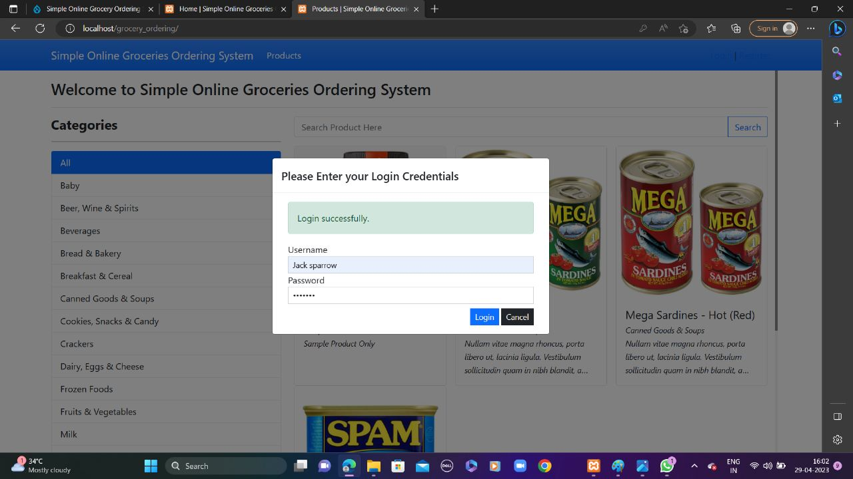
NEW USER REGISTRATION USER LOGIN

Slide 12
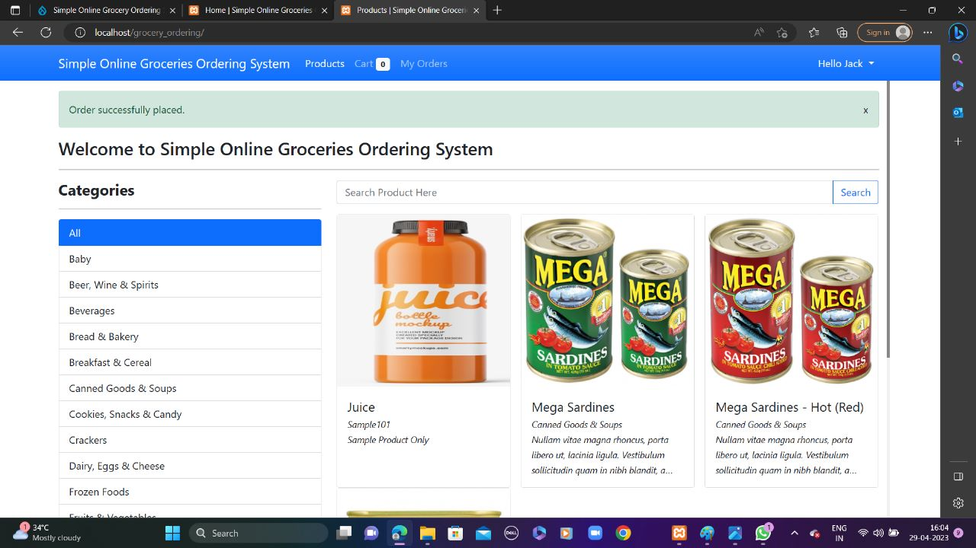
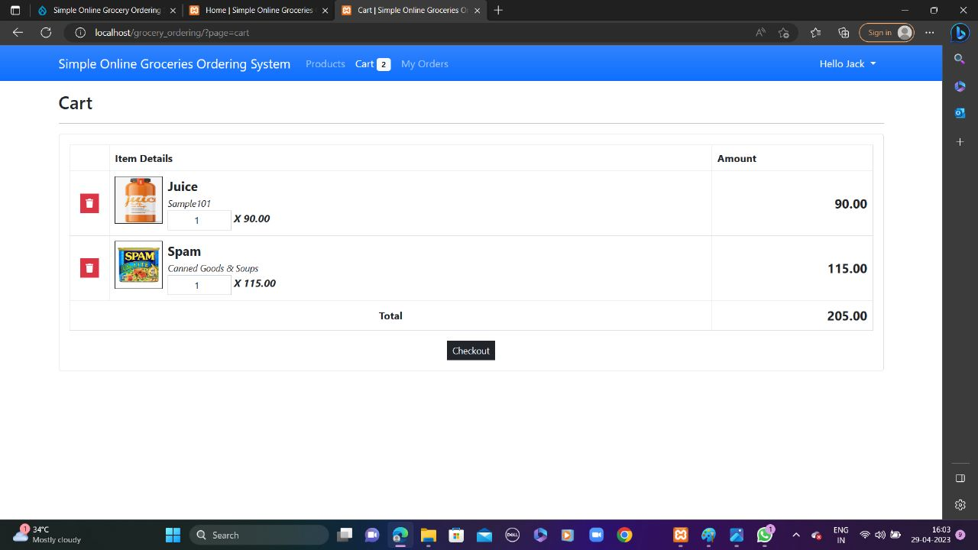
USER SEARCH PRODUCT CART

Slide 13
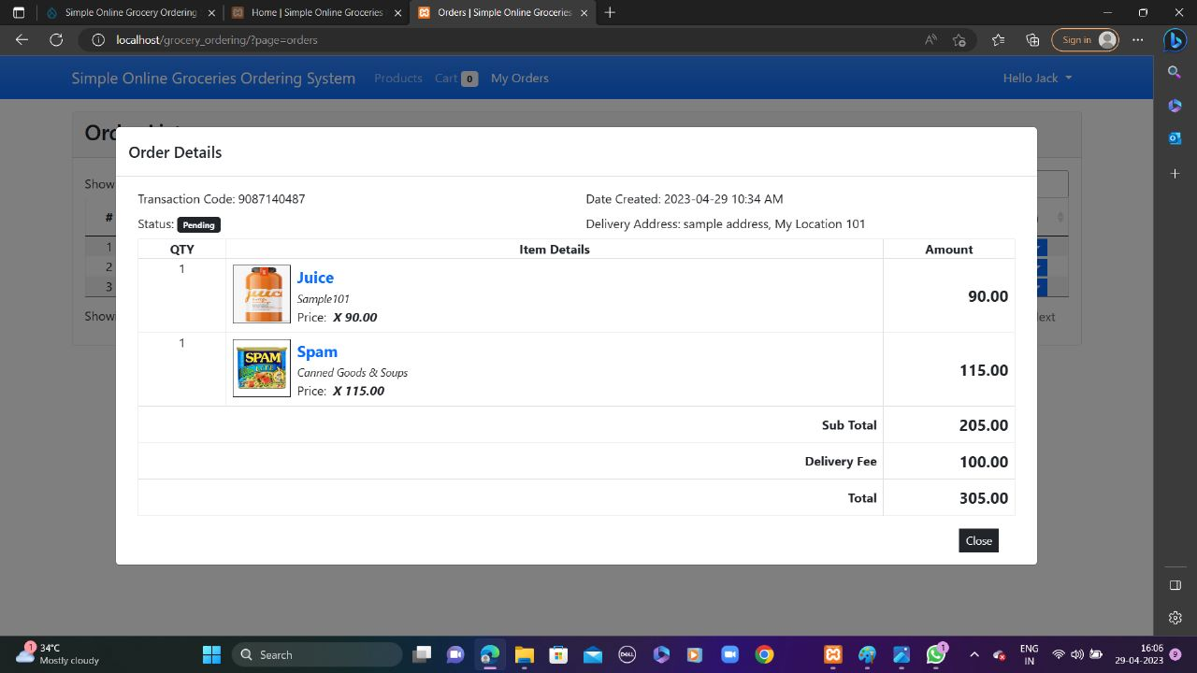
Checkout:

Slide 14
REFERENCES
1. Amite Sharma et al. / International Journal of Engineering Science and Technology (IJEST)
2. ://www.wikipedia.com/online-event-management- https system
3. Ramsborg, G.C.; B Miller, D Breiter, BJ Reed & A Rushing (eds), Professional meeting management: Comprehensive strategies for meetings, conventions and events, 2008, 5th ed, Kendall/Hunt Publishing, Dubuque, Iowa. ISBN 0-75755212-9
4. Bowdin, Glenn; Johnny Allen, William O'Toole, Rob Harris, Ian McDonnell, 2010. Events Management (Events Management S.) ISBN 0-7506-6533-5
5. http://www.wikipedia.com/event+management+officail+version.pdf
6. https ://www.financesonline.com/top- 10-event-management-software
7. Ramsborg, G.C.; B Miller, D Breiter, BJ Reed & A Rushing (eds), Professional meeting management: Comprehensive strategies for meetings, conventions and events, 2008, 5th ed, Kendall/Hunt Publishing, Dubuque, Iowa. ISBN 0-75755212-9

