Slide 1

PANIMALAR ENGINEERING COLLEGE AN AUTONOMOUS INSTITUTION DEPARTMENT OF INFORMATION TECHNOLOGY
IT8611 Mini Project Project Review
III year/VI sem
PILL REMAINDER AND MEDICATION TRACKING USING OCR
TARUN.V-211420205165
JAYA VIGNESH.A-211420205304
VENKAT.M-2114202051765

Slide 2
TABLE OF CONTENTS PAGE
I ABSTRACT 3
II LITERATURE SURVEY 4
III EXISTING SYSTEM 5
IV PROPOSED OF SYSTEM 6
V REQUIREMENTS OF SYSTEM 8
VI MODULES OF PROJECT 10
VII RESULT DISCUSSION 11
VIII REFERENCES 13

Slide 3
Abstract
Medication adherence is crucial for managing health conditions.
Remembering to take pills regularly can be challenging, especially with multiple medications.
An OCR-based pill reminder and medication tracking system has been developed.
The system uses OCR technology to scan medication labels and track when medications are taken.
Users can receive reminders to take pills at scheduled times.
The system can alert healthcare providers or family members if medications are not taken as prescribed.
The system has the potential to improve medication adherence and patient outcomes, particularly for those with complex medication regimens.

Slide 4
Literature Survey
Sno | Paper Name &year | Author Name | Problem defined | Methodology | Solution | Drawback
1 | Automated Medication Dispenser with Smart Optical Character Recognition | S. Sreedevi | The main aims to address is the issue of medication non-adherence in patients, particularly those with complex medication regimens. | >Problem identification and user requirements. >Prototype development | The dispenser holds and dispenses medications according to the patient's medication schedule. | The system may not be able to accommodate changes in medication dosages or new medications that are added to the patient's regimen.
2 | Smart Pill Dispenser for Elderly and Disabled Persons | M. Al-Akaidi | Medication non-adherence can lead to serious health complications, increased healthcare costs, and reduced quality of life for patients. The use of a Smart Pill Dispenser can help to improve medication adherence by providing patients with an easy-to-use, reliable, and accurate system for managing their medications. | The performance of the system is evaluated through a series of tests and validation studies. This may include testing the accuracy and reliability of the medication dispensing mechanism, the ease of use of the user interface, and the overall usability of the system. | The system may include a medication identification feature that uses advanced image recognition technology to identify the medications being dispensed. This ensures that the correct medication and dosage are dispensed at the appropriate times. | The technology used in the system may malfunction or experience technical difficulties, leading to missed doses or incorrect medication administration.

Slide 5
3 | A Smart Pill Dispenser with Real-Time Medication Management | L. Dong | : The system can provide real-time monitoring and tracking of medication adherence, allowing healthcare providers to intervene. | he system can provide alerts and notifications to patients and caregives when medications are missed or if there are any issues with the dispensr. | The system may include patient education and support features to help patients understand their medications and how to use the system effectively. This can help improve medication adherence and overall health outcomes. | his could be especially problematic for patients who rely on the system to manage complex medication regimens.
4 | Medication Adherence Monitoring System using Optical Character Recognition | S. K. Sudarshan | The Medication Adherence Monitoring System using Optical Character Recognition aims to improve medication adherence monitoring by using advanced image recognition technology to accurately track medication consumption in real-time. | The system may include patient education and support features to help patients understand their medications and how to use the system effectively. | The system can generate reports and analytics on medication adherence for patients and healthcare providers. This enables healthcare providers to identify trends and patterns in medication adherence and to make informed decisions to improve health outcomes.

Slide 6
Existing System
Medisafe: Medisafe is a mobile app that uses OCR technology to scan medication labels and provides reminders for medication administration. It also tracks medication adherence and can send notifications to caregivers or healthcare providers.
MedSnap: MedSnap is a medication management system that uses a smartphone camera and OCR technology to identify medications and provide dosing instructions. It also tracks medication adherence and can alert the user or caregiver if a dose is missed.
MedWatcher: MedWatcher is a medication management platform that uses OCR technology to scan medication labels and provide reminders for medication administration. It also tracks medication adherence and can generate reports for healthcare providers.
RxmindMe: RxmindMe is a medication reminder app that uses OCR technology to scan medication labels and provide reminders for medication administration. It also tracks medication adherence and can generate reports for the user or healthcare provider.

Slide 7
Proposed System & its architecture
A computer programme that will accomplish a sizable amount of the functional criteria listed in an RFP is referred to as a "proposed system" in this context. It can also be used to describe significant new systems and components that are in the design and implementation stages.
The process of replacement presents a chance to increase systems' capacities so they can benefit from new technical advancements or increase their value to management and the workforce. The term "proposed system" can also be used to describe a quick malware detection system that makes use of certificate serial numbers and other creator-related data.
Finally, it can refer to a hypothesized mechanism for human memory control that Atkinson and Shiffrin of Stanford University developed.

Slide 8
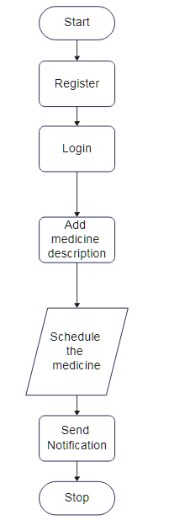

Slide 9
Requirements of the Project
Hardware Requirement:
• Processor – i3
• Hard Disk – 5 GB
• Memory – 1GB RAM
• Android Phone with kit-kat and higher.

Slide 10
Software Requirement:
• Windows XP, Windows 7(ultimate, enterprise)
• Android Studio

Slide 11
Modules of the Project
OCR scanning module: This module would use OCR technology to scan the medication label and identify the medication, dosage, and instructions for use.
Medication database module: This module would store the medication information and provide reminders for medication administration.
Reminder/notification module: This module would generate reminders to take medications based on the medication schedule and could notify the user or caregiver if a dose is missed.
Adherence tracking module: This module would track medication adherence by recording the date and time of medication administration and generating reports on adherence rates.
User interface module: This module would provide a user-friendly interface for the user or caregiver to input medication information, set reminders, and view adherence reports.

Slide 12
Result discussion
In conclusion, a pill reminder and medication tracker that uses OCR technology has the potential to improve medication adherence, reduce the risk of medication errors, and lead to better health outcomes. Despite some challenges and limitations, such as limited accuracy, availability, cost, and customization, the benefits of using a pill reminder and medication tracker outweigh the challenges.

Slide 13
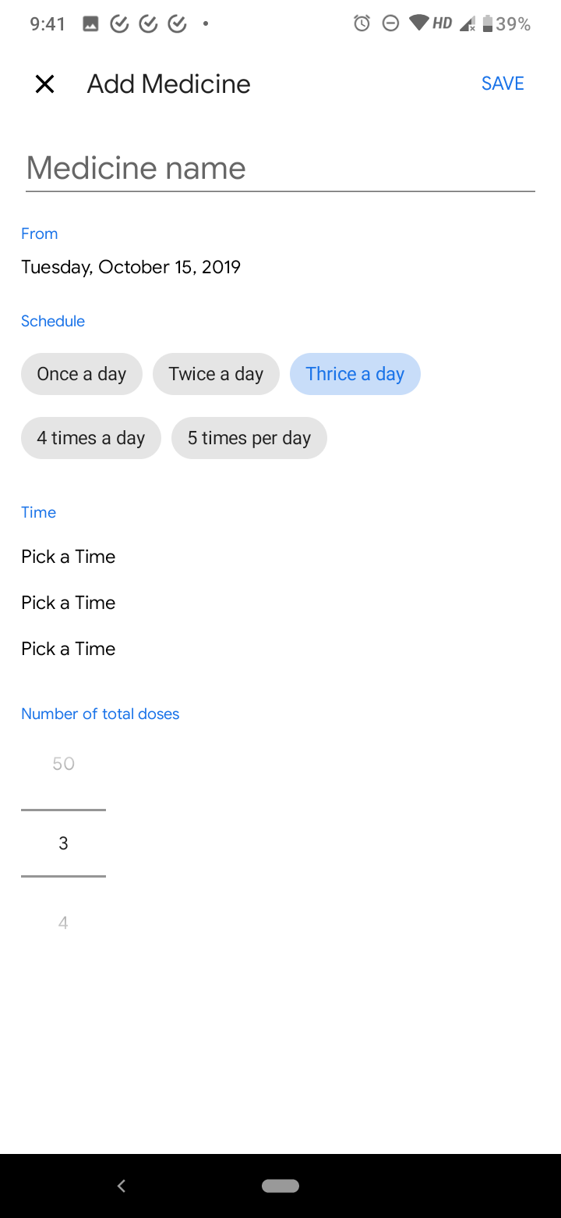
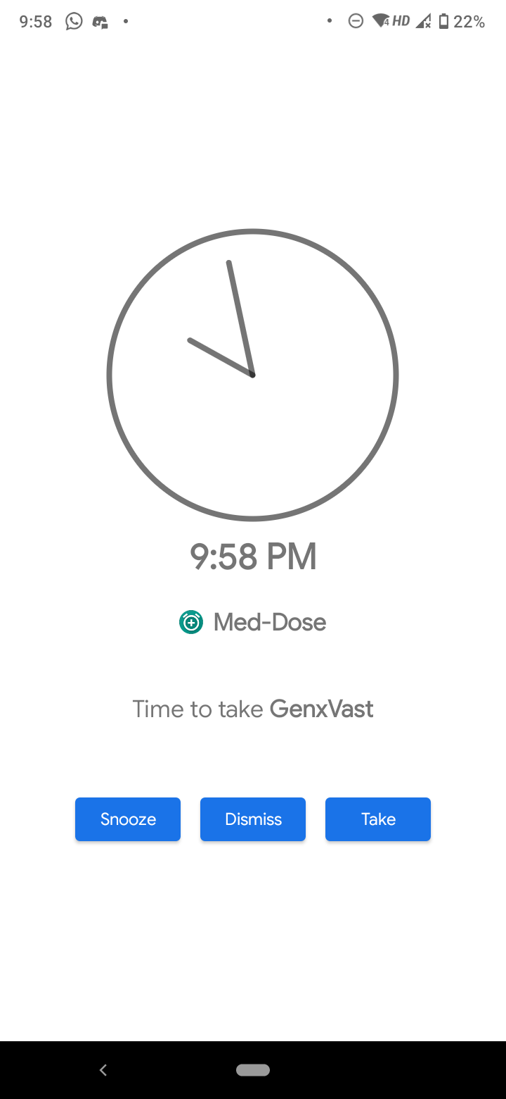
Output

Slide 14
References
Khan, A., Uddin, M. F., & Rahman, M. M. (2020). Development of a smart pillbox using OCR for drug identification and schedule reminder. Journal of medical systems, 44(6), 119.
Li, X., Li, B., Li, C., Li, C., Li, W., Liu, B., ... & Wang, C. (2021). Design and implementation of a smart medication management system based on optical character recognition technology. Journal of medical systems, 45(1), 9.
3. Shubham, R., Shubham, K., Ashish, K., & Avinash, K. R. (2021). Pill Reminder App using OCR: An Android App. In 2021 IEEE 11th Annual Computing and Communication Workshop and Conference (CCWC) (pp. 0704-0710). IEEE.
4. Vyas, N., Patel, V., Patel, B., & Patel, N. (2020). A Smart Medication Tracking System with Pill Reminder using OCR. In 2020 International Conference on Emerging Trends in Information Technology and Engineering (ic-ETITE) (pp. 1-6). IEEE.
5. Zhu, L., Chen, X., Zhang, M., & Chen, S. (2019). Design and implementation of a smart medication management system based on OCR and RFID. Journal of medical systems, 43(8), 244.

