Slide 1
RIDER SURVEILLANCE TO ENSURE WEARING OF HELMET AND TO ASSIST PATROL FOR SAFETY DRIVE USING DEEP LEARNING APPROACHES BY GUIDE BY CHARAN M GOPI S (M.Tech) GOKUL P ASSOCIATE PROFESSOR LINGESAN R

Slide 2
ABSTRACT
We develop an helmet detection method combining classification and cluster.
Our proposed method work is as follows, Pre-processing, Feature Extraction and classification.
We demonstrate our proposed work by using surveillance traffic cameras.
Our method will classify whether the person is wearing helmet or not.
As far as the robustness and effectiveness are concerned, our method is better than the existing algorithms

Slide 3
LITERATURE SURVEY
S.NO | NAME OF THE PAPER WITH YEAR | OBJECTIVE | PROS | CONS
1. | Automatic Helmet Detection and Identification Using Deep Learning," by Xiaohui Zhang, Xiangyang Ji, and Wei Wu (2019). | This paper proposes an automatic helmet detection and identification system using a deep convolutional neural network (CNN). The system achieves high accuracy and can be used in real-world scenarios. | This high accuracy is crucial in real-world scenarios where the safety of riders is at stake. | The authors used a dataset consisting of only 1,000 images for training their model
2. | Automatic Number Plate Recognition Using Deep Learning Techniques," by K. N. Krishna and M. Chaitanya Kumar (2018). | This paper presents an automatic number plate recognition system based on deep learning techniques. The system uses a combination of convolutional neural networks and recurrent neural networks to achieve high accuracy. | The pros of this approach include its high accuracy and robustness. | the cons include the need for a large amount of training data and computational resources.

Slide 4
LITERATURE SURVEY
3. | Automatic Helmet Detection and Recognition System Using YOLOv3," by Syed Ali Abbas, Adil Amin, and Tariq Rahim Soomro (2020) | This paper proposes an automatic helmet detection and recognition system using the YOLOv3 algorithm. The system achieves high accuracy and can be used in real-world scenarios. | The pros of this approach include its high accuracy and real-world applicability. | The cons include the need for a large amount of training data and computational resources.
4. | Automatic Number Plate Recognition System using Deep Learning," by Ashwini A. Bahirat and Dr. S. V. Dudul (2020). | This paper proposes an automatic number plate recognition system based on deep learning techniques. The system uses a combination of convolutional neural networks and long short-term memory networks to achieve high accuracy. | The system uses a combination of convol -utional neural networks and long short-term memory networks to achieve high accuracy in number plate recognition. | The paper does not provide a detailed discussion on the training data used for the proposed approach
5. | Automatic Number Plate Recognition System Using Deep Learning," by A. Thangamani and S. Jayaraj (2021). | This paper proposes an automatic number plate recognition system based on deep learning techniques. The system uses a combination of convolutional neural networks and support vector machines to achieve high accuracy. | The system is designed to operate in real-time, making it suitable for applications such as toll booths and parking lots. | The paper provides limited evaluation results, with only a small number of test images used to evaluate the proposed system.

Slide 5
EXISTING SYSTEM
Mask R-CNN for Helmet Detection and Counting: This system uses the Mask R-CNN object detection model to detect and count helmets in images captured by a camera. It uses a custom dataset of helmet images for training the model.
YOLO-based Helmet Detection System: This system uses the YOLO object detection model to detect helmets in images captured by a camera. It also includes a feature for detecting whether the helmet is being worn or not.
Automatic Number Plate Recognition (ANPR) System: This system uses deep learning models to detect and recognize license plates in images captured by a camera. It can be used to identify vehicles violating traffic rules.

Slide 6
EXISTING SYSTEM
CNN-based License Plate Detection and Recognition: This system uses a Convolutional Neural Network (CNN) to detect and recognize license plates in images captured by a camera.
Helmet Detection and Recognition System: This system uses deep learning models to detect and recognize helmets in images captured by a camera. It can be used for safety monitoring in industries such as construction and mining.

Slide 7
DRAWBACKS
Exact Features is not extracted
High complexity
Low performance in restoration of image/video quality
Time consuming

Slide 8
PROPOSE SYSTEM
The helmet detection model is based on a deep learning architecture, such as YOLOV3, which can detect helmets in real-time with high accuracy.
The model is trained on a large dataset of images of motorcyclists wearing helmets, as well as images of motorcyclists without helmets, to ensure that it can distinguish between the two categories effectively.
The number plate detection model is also based on a deep learning architecture, such as OCR, which can detect number plates in real-time with high accuracy.

Slide 9
PROPOSED SYSTEM
The model is trained on a large dataset of images of vehicles with number plates, as well as images of vehicles without number plates, to ensure that it can distinguish between the two categories effectively.
The model can also be trained to handle scenarios where number plates are obscured by objects or environmental factors, such as dirt or rain.

Slide 10
HARDWARE REQUIREMENTS
Processor - Intel i7
RAM - 8 GB RAM
SSD - 100 GB Drive
Operating System - Windows 7 and above

Slide 11
SOFTWARE REQUIREMENTS
Python 3.11
Tool - Anaconda navigator

Slide 12
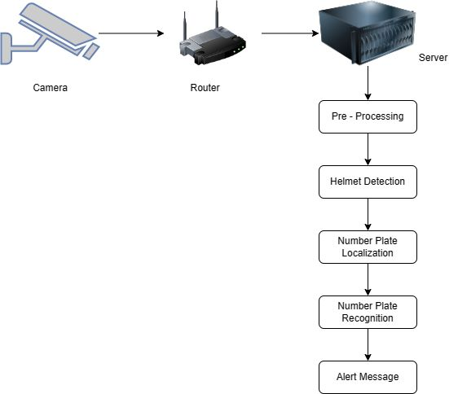
SYSTEM ARCHITECTURE

Slide 13
ALGORITHM / METHODOLOGY
YOLO v3 – Used to detect the helment,the confidence value is compared to the robo flow training data ouput.The ROBO flow output will be in the format of ‘.weights’ which can be able to read by the yolo model.
OCR – It is used to identify the text in the number plate for the further proceedings.

Slide 14
ALGORITHM / METHODOLOGY
Dataset Collection
Annotation
Labelling
Training & Testing split
Augmentation
Training & Validation

Slide 15
NOVELTY
REAL-TIME DETECTION: Many existing systems require a significant amount of time to process the images and detect the helmets or number plates..
ROBUSTNESS TO LIGHTING AND WEATHER CONDITIONS: Existing systems may have difficulty detecting helmets or number plates under challenging lighting or weather conditions, such as low light or rain.
MULTI-OBJECT DETECTION: Existing systems typically detect only one object at a time, either helmets or number plates. Developing deep learning models that can detect multiple objects simultaneously.
IMPROVED ACCURACY: While existing systems demonstrate good accuracy in many cases, there is still room for improvement.
INTEGRATION WITH OTHER SYSTEMS: Developing a system that can integrate with other systems, such as traffic management systems or safety monitoring systems, would be a significant innovation.

Slide 16
MODULES
HELMET DETECTION
NUMBER PLATE IDENTIFICATION

Slide 17
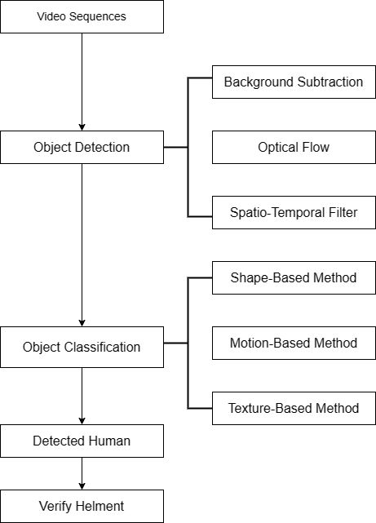
DATA FLOW DIAGRAM-HELMET DETECTION

Slide 18
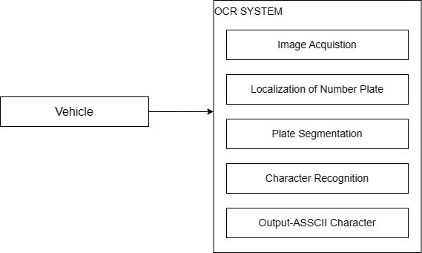
DATA FLOW DIAGRAM-NUMBER PLATE IDENTIFICATION

Slide 19
MODULE 1 – HELMET DETECTION
DATA COLLECTION MODULE: This module is responsible for collecting data for training the deep learning models. The data can include images and annotations of helmets and number plates.
DATA PREPROCESSING MODULE: This module is responsible for preparing the data for training the deep learning models. This may involve tasks such as data cleaning, data augmentation, and data normalization.
OBJECT DETECTION MODULE: This module is responsible for detecting helmets and number plates in images using deep learning models such as YOLO, Faster R-CNN, or RetinaNet.
HELMET RECOGNITION MODULE: This module is responsible for recognizing whether a helmet is being worn or not using deep learning models such as CNNs.

Slide 20
MODULE 1 –HELMET DETECTION
LICENSE PLATE RECOGNITION MODULE: This module is responsible for recognizing the characters on a license plate using deep learning models such as CNNs and character segmentation algorithms.
USER INTERFACE MODULE: This module is responsible for providing a user interface for the system. This may involve displaying the images and the detections, providing controls for configuring the system, and enabling interaction with other systems.
INTEGRATION MODULE: This module is responsible for integrating the system with other systems, such as traffic management systems or safety monitoring systems.
PERFORMANCE EVALUATION MODULE: This module is responsible for evaluating the performance of the system using metrics such as accuracy, precision, and recall.

Slide 21
MODULE 2 –NUMBER PLATE IDENTIFICATION
IMAGE PREPROCESSING: The module begins with the preprocessing of the input image to improve the quality and prepare it for processing by the deep learning model.
OBJECT DETECTION: The module uses deep learning models for object detection, such as YOLO or Faster R-CNN, to locate the license plate region in the input image
IMAGE SEGMENTATION: The module then segments the license plate region into individual characters. This may involve techniques such as morphology, edge detection, or clustering.
CHARACTER RECOGNITION: The module uses deep learning models for character recognition, such as CNNs or LSTM networks, to recognize the individual characters in the license plate region.
POST-PROCESSING: Finally, the module performs post-processing to improve the accuracy of the recognition results. This may involve techniques such as character verification, template matching, or language modeling.

Slide 22
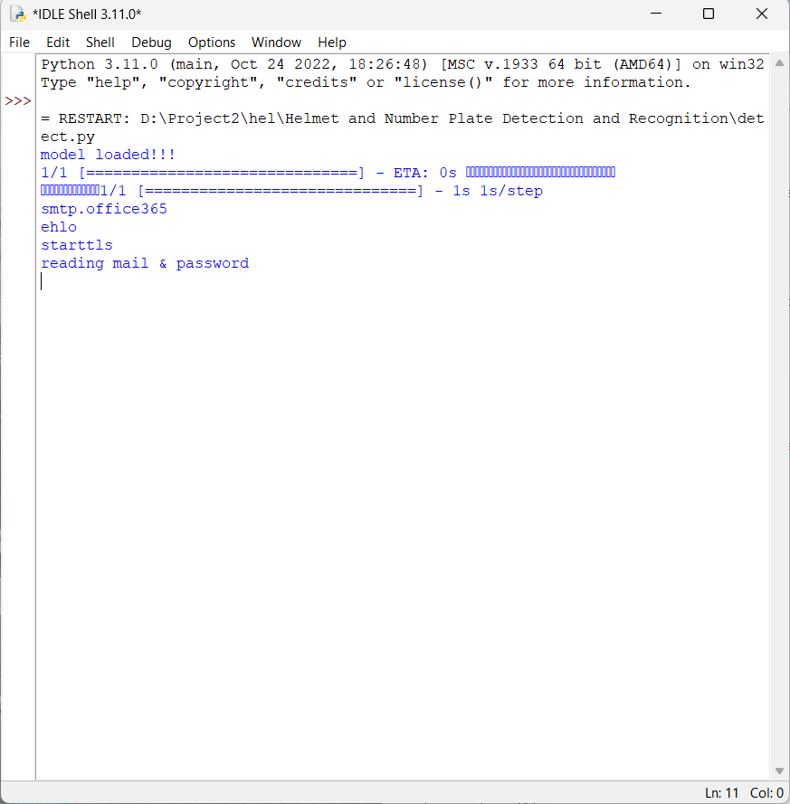
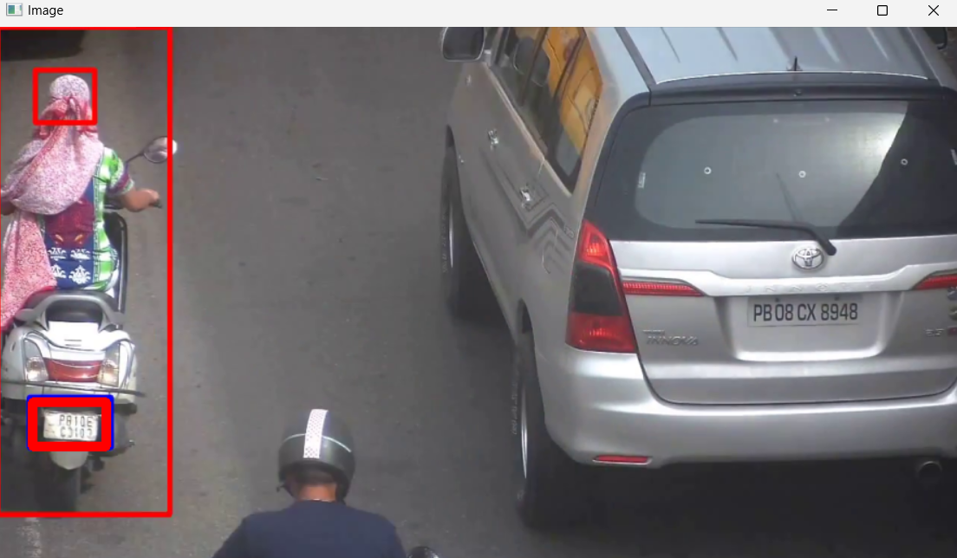
OUTPUT

Slide 23
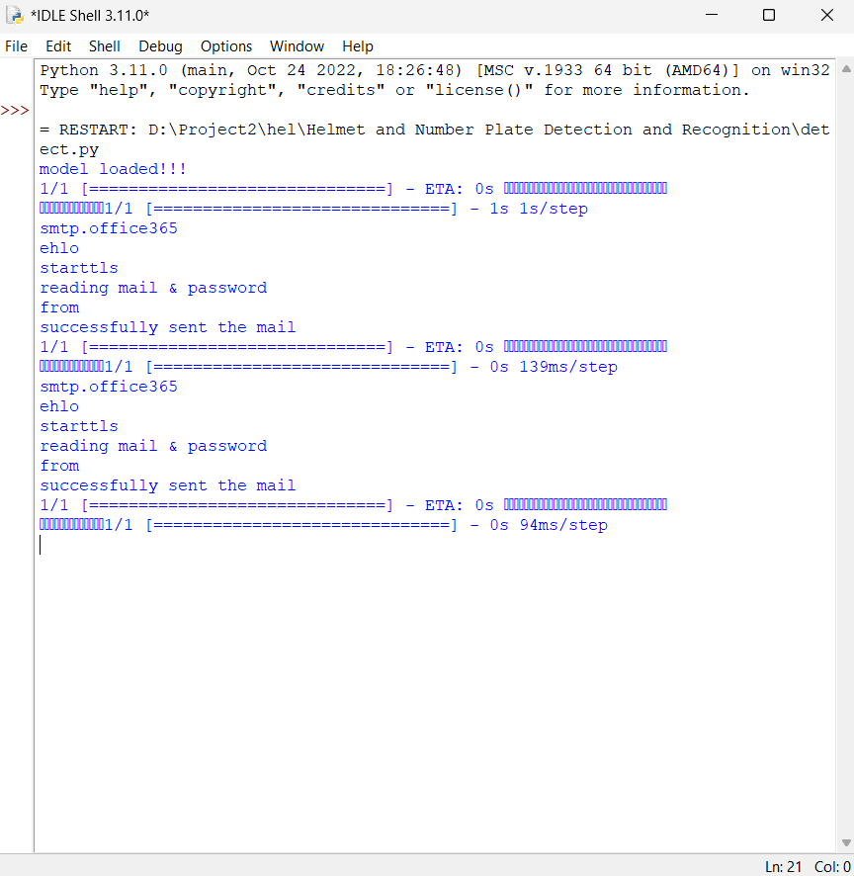

OUTPUT

Slide 24
REFERENCE
Alarifi, A., & Al-Salman, A. (2022). Automatic license plate recognition using deep learning: A review. IEEE Access, 10, 46331-46353.
Aras, S., & Kiliç, E. (2021). Automatic license plate recognition with deep learning techniques. In 2021 International Artificial Intelligence and Data Processing Symposium (IDAP) (pp. 1-4). IEEE.
Balaji, R., & Kottaimuthu, R. (2022). A deep learning-based number plate recognition system for vehicle identification. Journal of Ambient Intelligence and Humanized Computing, 13(2), 2051-2064.
Dnyaneshwar Kokare, Aaditi Ujwankar, Alisha Mulla, Mrunal Kshirsagar, Apurva Ratnaparkhi “Helmet Detection and Number Plate Recognition using Machine Learning” International Journal of Research in Engineering, Science and Management, June 2022.
Li, Y., Li, J., & Zhang, B. (2021). Deep learning based detection and recognition of vehicle license plates: A review. IET Intelligent Transport Systems, 15(8), 1086-1094.

Slide 25
REFERENCE
Lokesh Allamki, Manjunath Panchakshari, Ashish Sateesha, K S Pratheek proposed Helmet Detection using Machine Learning and Automatic License Plate Recognition International Research Journal of Engineering and Technology (IRJET), Dec 2019.
Mr. Thirunavukkarasu.M ; Bugade Amoolya ; Bulusu Vyagari Vaishnavi “Helmet Detection and Licence Plate Recognition” Thirunavukkarasu.M et al, International Journal of Computer Science and Mobile Computing, April- 2021.
Piliouras, K., & Siganos, D. (2020). An end-to-end deep learning approach for license plate recognition. In 2020 IEEE 23rd International Conference on Intelligent Transportation Systems (ITSC) (pp. 3468-3473). IEEE.
Sakhare, N. A., & Bhangale, M. D. (2021). Automatic vehicle number plate recognition system using deep learning. In 2021 International Conference on Sustainable Computing and Intelligent Systems (ICSCIS) (pp. 1-5). IEEE.
S. B. Akintoye, O. E. Famoroti, and B. A. Adejuyigbe, "Helmet detection and number plate recognition system for law enforcement agencies," Journal of Physics: Conference Series, vol. 1529, no. 1, p. 012049, 2020

Slide 26
THANK YOU

